Slide 1

CBP Climate Resiliency Management Strategy: From Development to Implementation
Zoë P. Johnson, NOAA Chesapeake Bay Office
Mark Bennett, USGS
November 16, 2016
Citizen’s Advisory Committee

Slide 2
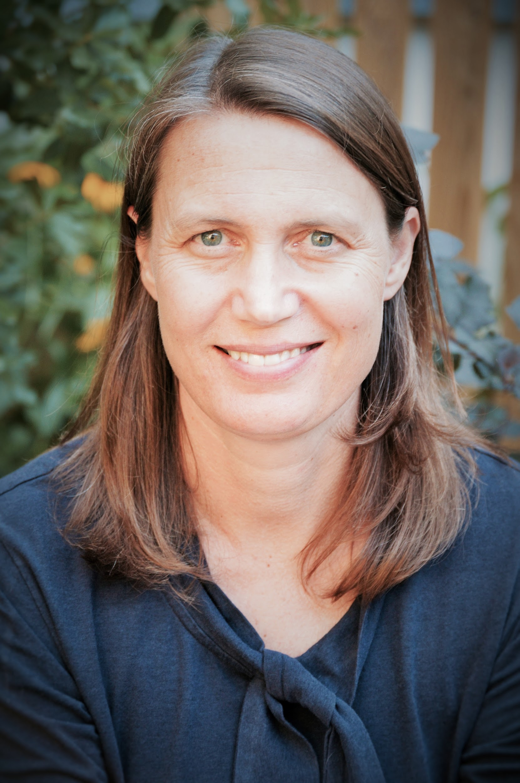

Today’s Speakers
Zoë Johnson
National Oceanic and Atmospheric Administration
CBP Climate Change Coordinator
Mark Bennett
U.S. Geological Survey
CBP Climate Resiliency Workgroup Co-Chair

Slide 3
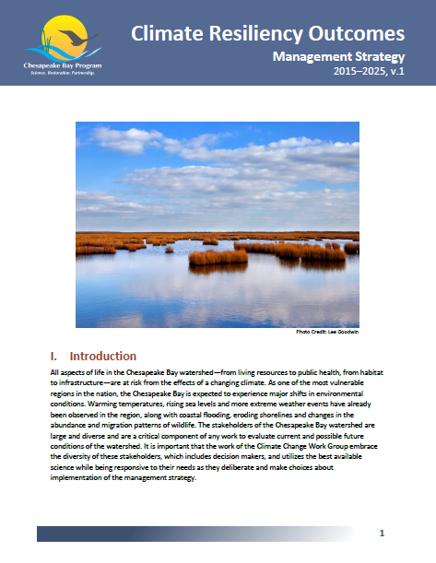
Key Partnership Climate Change-Related Commitments and Recommendations
2009 Presidential Executive Order 13508
2010 Chesapeake Bay TMDL
2010 Executive Order 13058: Strategy for Protecting and Restoring the Chesapeake Bay Watershed
2014 Chesapeake Bay Watershed Agreement

Slide 4
2014 Chesapeake Bay Agreement
CLIMATE RESILIENCY
GOAL: Increase the resiliency of the Chesapeake Bay watershed, including its living resources, habitats, public infrastructure and communities, to withstand adverse impacts from changing environmental and climate conditions.
  Monitoring and Assessment Outcome: Continually monitor and assess the trends and likely impacts of changing climatic and sea level conditions on the Chesapeake Bay ecosystem, including the effectiveness of restoration and protection policies, programs and projects.
  Adaptation Outcome: Continually pursue, design and construct restoration and protection projects to enhance the resiliency of Bay and aquatic ecosystems from the impacts of coastal erosion, coastal flooding, more intense and more frequent storms and sea level rise.

Slide 5
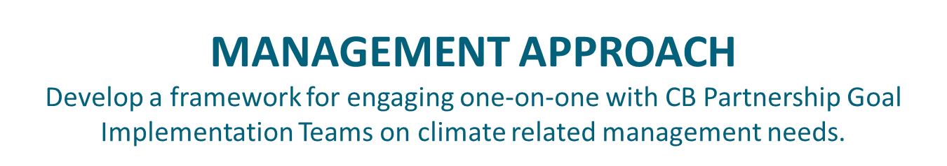
Management Strategy | Baseline | Factor Influencing Success | Current Efforts & Gaps | Management Approach | Cross-Outcome Collaboration and Mutual Benefit | Adaptive Mgmt. & Monitoring Progress | No Mention | Rating
Water Quality |  | x |  | x | x | x |  | 4
Black Duck |  | x | x | x |  | x |  | 4
Brook Trout |  | x | x | x |  | x |  | 4
Wetlands |  | x | x | x |  |  |  | 3
Protected Lands |  | x | x | x |  |  |  | 3
Public Access |  | x |  | x |  |  |  | 2
Healthy Watersheds |  | x |  | x |  |  |  | 2
Urban Tree Canopy |  |  | x | x |  |  |  | 2
Blue Crab |  | x |  |  | x |  |  | 2
Oyster Restoration |  | x |  |  | x |  |  | 2
Fish Habitat |  | x |  |  | x |  |  | 2
SAV |  | x |  |  |  |  |  | 1
Diversity |  |  |  | x |  |  |  | 1
Local Leadership |  | x |  |  |  |  |  | 1
Fish Passage |  | x |  |  |  |  |  | 1
Forage Fish |  | x |  |  |  |  |  | 1
Toxics Research | x |  |  |  |  |  |  | 1
Stream Health |  |  |  |  |  |  | x | 0
Land Use Methods and Metrics |  |  |  |  |  |  | x | 0
Land Use Options Evalations |  |  |  |  |  |  | x | 0
Citizen Stewardship |  |  |  |  |  |  | x | 0
Environmental Literacy |  |  |  |  |  |  | x | 0
Toxics Prevention and Policy |  |  |  |  |  |  | x | 0
Forest Buffer |  |  |  |  |  |  | x | 0
x = climate change related element

Slide 6
Climate Resiliency Management Strategy
“In a Nutshell”
Unlike many other Bay Agreement Goals and Outcomes; it is very broad, with no numerical goals and outcomes and no established indicators.
It’s different in that it touches on both regulatory aspects of water quality and watershed restoration, as well as the need for the integration of climate considerations into many other CB Agreement goals and outcomes.
Implementation is complicated by the fact that goal attainment requires research, monitoring, modeling, assessment, on-the-ground projects, policy and regulatory mechanisms, performance measurement, and adaptive management.
Implementation priorities needed to be established due to the breadth of the issue; recognizing new priorities will evolve over time.
Work Plan contains 108 actions divided between “individual signatory and partner” actions and a small set of of “collective” actions .

Slide 7
Key Management Actions
Monitoring & Assessment
Define goals and establish baselines
Prioritize climate impacts (those most critical to goal attainment)
Design monitoring and modeling plans
Develop a research agenda
Assess trends and conduct assessments
  Select appropriate climate scenarios, forecasts and projections
Undertake public, stakeholder and local engagement
Review progress and reassess implementation priorities

Slide 8
Key Management Actions
Adaptation
Review and revise conservation, restoration and protection goals and objectives
Increase the institutional capacity to prepare for and respond to climate change
Implement priority adaptation actions
  On-the-ground projects, including pilot projects
Increase local engagement and targeted education and outreach
Foster larger discussion on linkage between climate impacts and diversity
Track adaptation action effectiveness and ecological response
  Programmatic progress
  Develop suite of climate indicators

Slide 9
What are Our Options for Factoring in Consideration of Climate Change into the Phase III WIPs

Slide 10
Climate Change & the TMDL
Mid-Point Assessment
Assess how climate change may affect current water quality standards (i.e., nutrient and sediment source loads over time )
  Precipitation change (increased volume and intensity)
  Temperature increase (air and water)
  Sea level rise (hydrodynamics and impacts to beneficial resources (i.e., wetlands)
Evaluate climate impacts on the effectiveness of existing water quality BMPs over time
Explore policy response options to address projected climate-related changes in water quality standards
Seek opportunities to prioritize BMP’s with ancillary “climate resilience” benefits

Slide 11
STAC Workshop: The Development of Climate Projections for Use in CBP Assessments
Take Home Messages
The Northeast US has gotten warmer and wetter
Precipitation has become more intense
Trends will continue in the coming decades
There is a large sensitivity to emissions scenarios, but not until mid-century
Natural variability is important, particularly for precipitation
Sea levels are rising faster than the global average and rates are increasing
Build the capacity within the Partnership to ensure ready access to data, scenario outputs, indicators and to be able to continue to evaluate, learn, and adapt.
STAC Workshop (March, 2016)

Slide 12
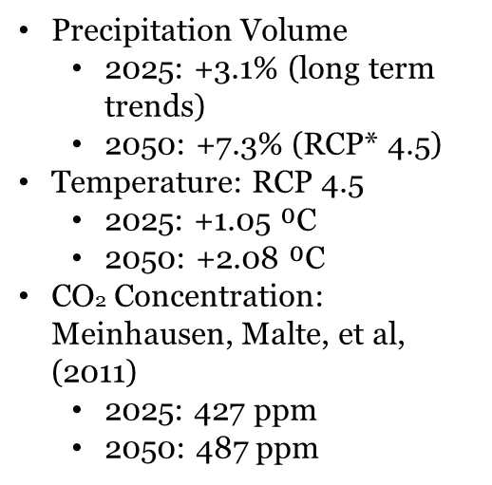
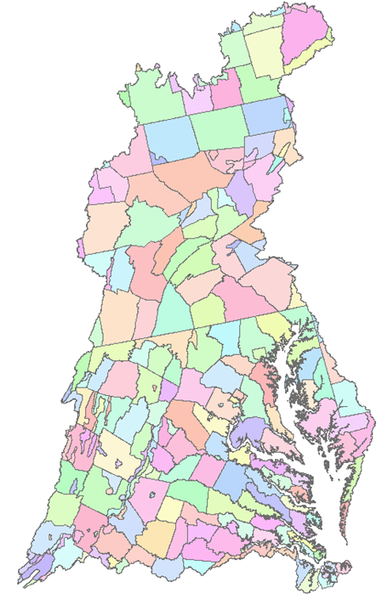
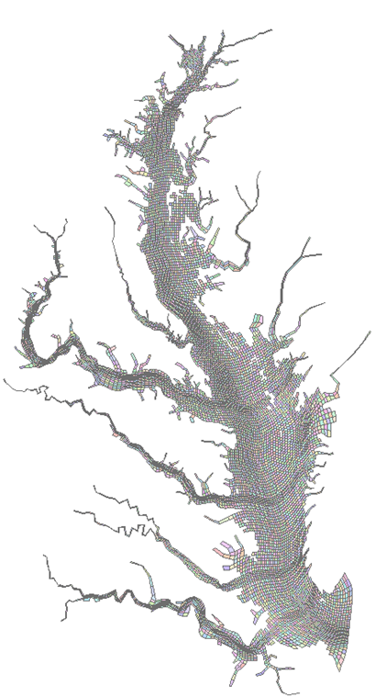
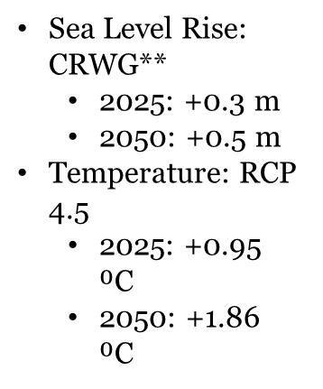


Model Climate Inputs – Initial Scenario Runs

Slide 13
Modeling Summary
Estimated influence of changes in tidal wetland attenuation is small in 2025 and 2050 because of little change in overall tidal wetland area, but wetland type changes and tidal wetland loss is estimated to increase beyond 2050.
The range of the influence of estimated watershed loads in future climate change conditions using observed (87 year) increase of precipitation volume (Karen Rice) and precipitation intensity (Karl and Knight) depends on the evapotranspiration method chosen.
The estimated 2025 range of nutrient (nitrogen & phosphorus) and sediment loads are 0% to 2% and 0% to 5%, respectively.

Slide 14
Modeling Summary
Scientific peer reviews of the representation of climate change by the CBP models will be conducted by the CBP Scientific and Technical Advisory Committee (STAC).
This is a work in progress. Still to come are 13 other Phase 6 Watershed Model climate change scenarios that are in the queue.
Likewise, the hydrodynamic simulation of the 2025 sea level rise is still underway.

Slide 15
Modeling Summary
Scientific peer reviews of the representation of climate change by the CBP models will be conducted by the CBP Scientific and Technical Advisory Committee (STAC).
This is a work in progress. Still to come are 13 other Phase 6 Watershed Model climate change scenarios that are in the queue.
Likewise, the hydrodynamic simulation of the 2025 sea level rise is still underway.

Slide 16
Key Messages
Assessment approach informed by sound science.
  Next Steps: Scientific peer reviews of the representation of climate change by the CBP models will be conducted by the CBP Scientific and Technical Advisory Committee (STAC).
Current efforts are to frame initial future climate change scenarios based on estimated 2025 (potential TMDL application) and 2050 conditions (future condition scoping scenario application).
  Next Steps: 1) Seek input and approval on the climate assessment approach; 2) decisions on using a 2025 and/or 2050 climate change analysis; and, 3) if additional scenarios should be run.
The CBP Models are under development, with the current (Beta 3) version to be replaced by Beta 4 in December 2016 (Beta 4) and a final version in March 2017.
  Next Steps: The preliminary results are being refined going forward with additional 2025 estuarine model hydrodynamics and 2050 Watershed Model Scenarios., as proposed.
Range of options have been developed for how and when climate considerations could be addressed within Phase III WIPs.
  Next Steps: Consideration of full range of options and partnership decision for how and when to factor climate considerations into the Phase III WIPs

Slide 17
Guiding Principles
WIP Development:
Capitalize on “Co-Benefits”
Account for and integrate planning and consideration of existing stressors
Align with existing climate resiliency plans and strategies
Manage for risk and plan for uncertainty
Engage local agencies and leaders
WIP Implementation:
Reduce vulnerability
Build in flexibility and adaptability
Adaptively manage

Slide 18
Range of Climate Change Policy Options
Draft Options | Description
#1: Factor Climate Change into the Bay’s Assimilative Capacity (2025/2050). | The annual total nutrient and sediment pollutant loads that the CB ecosystem can assimilate and still meet the four Bay jurisdictions’ CB water quality standards will be revised based on 2025 or 2050 climate change projections (i.e., CBWQSTM climate model results) that result in a direct affect the Bay’s ecosystem and internal processes.
#2: Factor Climate Change into Phase III WIP’ Base Conditions (2025/2050) | Use either the 2025 or 2050 climate projection scenarios as base conditions (informed by CBWM climate modeling results) in the establishment of the jurisdictions’ Phase III WIPs. The climate change projection would be an added load that the jurisdictions would need to address in addition to their Phase III WIP planning targets.
#3: Commit to Factor Climate Change into the Bay’s Assimilative Capacity (Option 1) and/or into Phase III WIP Base Conditions (Option 2) with Deferred Implementation until 2025 or beyond. | The projected impacts of climate change in 2025 and 2050 will be assessed and relayed to the jurisdictions, but they will not be explicitly factored into the Bay’s Assimilative Capacity or incorporated into the Phase III WIP Base Conditions. However, the partnership would establish a timeframe (e.g., 2025, 2030, 2035, etc.) for when climate considerations would be factored into the TMDL and/or Base Conditions.
#4: Factor Climate Change into a Bay TMDL Margin of Safety. | Allocate a specific pollutant load reduction as “explicit” margin of safety to account for any lack of knowledge concerning the relationship between load and waste-load allocations and achieving the four Bay jurisdictions’ CB water quality standards.

Slide 19
Range of Climate Change Policy Options
Draft Options | Description
#5: Factor Climate Change into Phase III WIP BMP Optimization. | During the development of Phase III WIPs, jurisdictions’ would prioritize the selection of BMPs that will better mitigate the anticipated increased nitrogen, phosphorus and sediment loads due to the projected effects of climate change through 2025 or 2050.
#6: Adaptively Manage Phase III WIP BMP Implementation (Post Phase III WIP development). | During each two-year milestone development period, jurisdictions would evaluate the performance of existing BMPs, assessing and documenting BMP performance, including identifying the contribution of seasonal, inter-annual climate variability and weather extremes on BMP performance.
#7: Factor Climate Change into Programmatic Commitments with Set Expectations. | The projected impacts of climate change in 2025 and 2050 will be assessed and relayed to the jurisdictions. Jurisdictions would provide a narrative that describes their programmatic commitments to address climate change in their Phase III WIPs. Jurisdictions are expected to consult the Guiding Principles when developing their narratives. Narratives may vary among jurisdictions, but would include a description of their method (s) for gathering and assessing scientific data and information, their conclusions based on that information, and how those conclusions guide their programmatic commitments.
#8: Factor Climate Change into Programmatic Commitments with No-Set Expectations. | The projected impacts of climate change in 2025 and 2050 will be assessed and relayed to the jurisdictions. Jurisdictions would narratively demonstrate how they are addressing climate change in their Phase III WIPs. No prescriptive guidance or specific expectations would be established.

Slide 20
Packages and Alternatives
Quantitative/Most Comprehensive | Qualitative/ Comprehensive
Quantitative/ Comprehensive | Qualitative/ Least Comprehensive
Option 1:
Assimilative Capacity
Option 2:
Base Conditions
Option 5:
BMP Optimization
Option 6:
Adaptively Manage
Option 3:
Commit with Deferred Imp.
Option 4:
Margin of Safety
Option 7: Programmatic with Set Expectations
Option 8: Programmatic with No Set Expectations

Slide 21
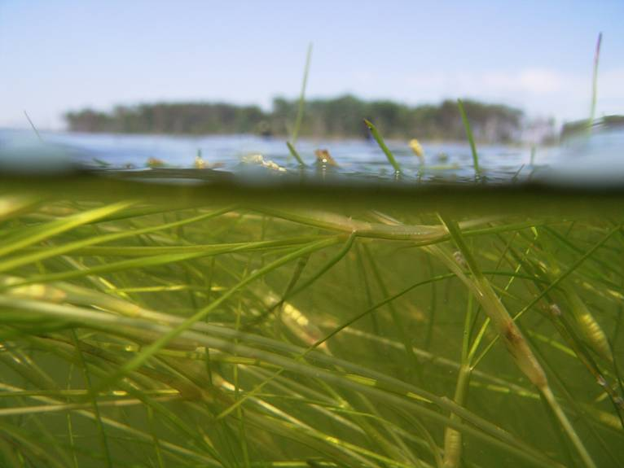
2017 Mid Point Assessment
Timeline
Climate Considerations
December 2016: Proposed climate change assessment procedures.
December 2016: Proposed ranges of options for when and how to factor climate change considerations into the jurisdictions Phase III WIPs with decisions in spring 2017 informed by the outcomes of the proposed climate change assessment procedures.
May 2017: When and how to incorporate climate change considerations into the Phase III WIPs as the partners work on the draft Phase III WIP planning targets due in June 2017.
December 2017: Final Phase III WIP planning targets fully reflect partnership decision regarding how and when to incorporate climate change considerations.

Slide 22
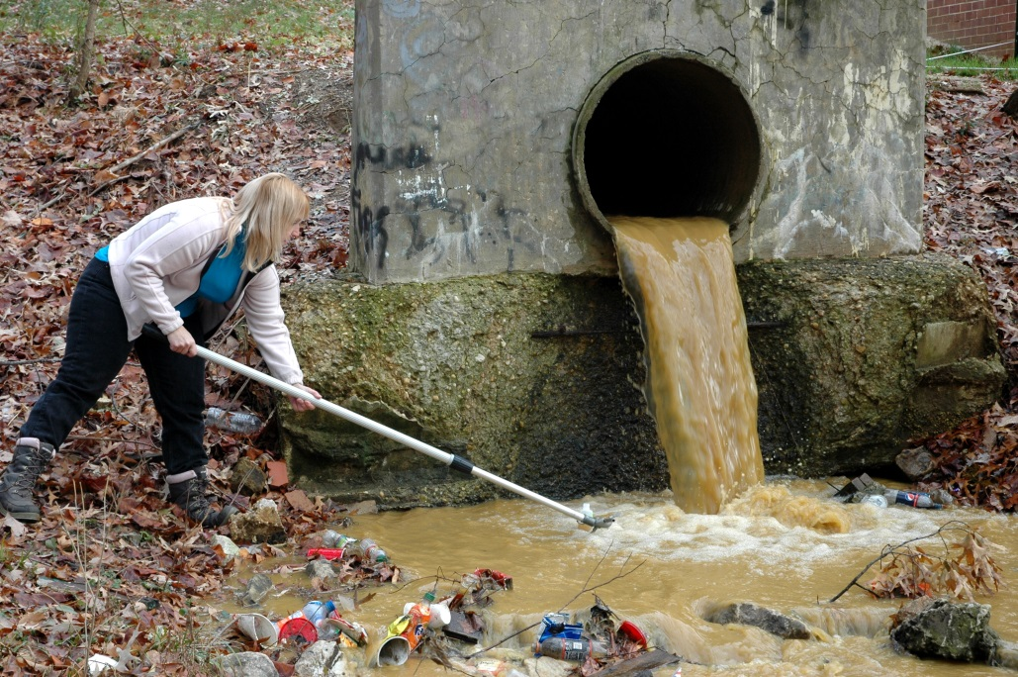
Citizen Advisory Committee
Areas for Future Engagement
Participation, Input, and Ideas
Feedback on the programmatic approach to climate resiliency
Guidance on future implementation priorities
Thoughts on appropriate forums and opportunities to advance policy dialog related to the Mid-Point Assessment, Phase III WIPS, and beyond .

Slide 23
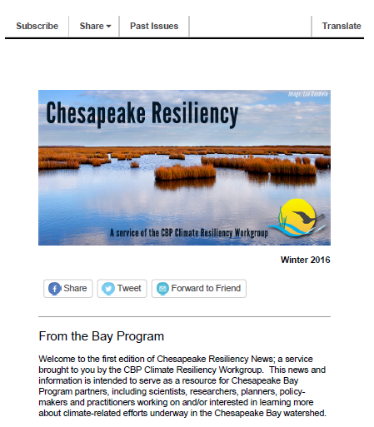
Subscribe: http://www.chesapeakebay.net/groups/group/climate_change_workgroup

Slide 24
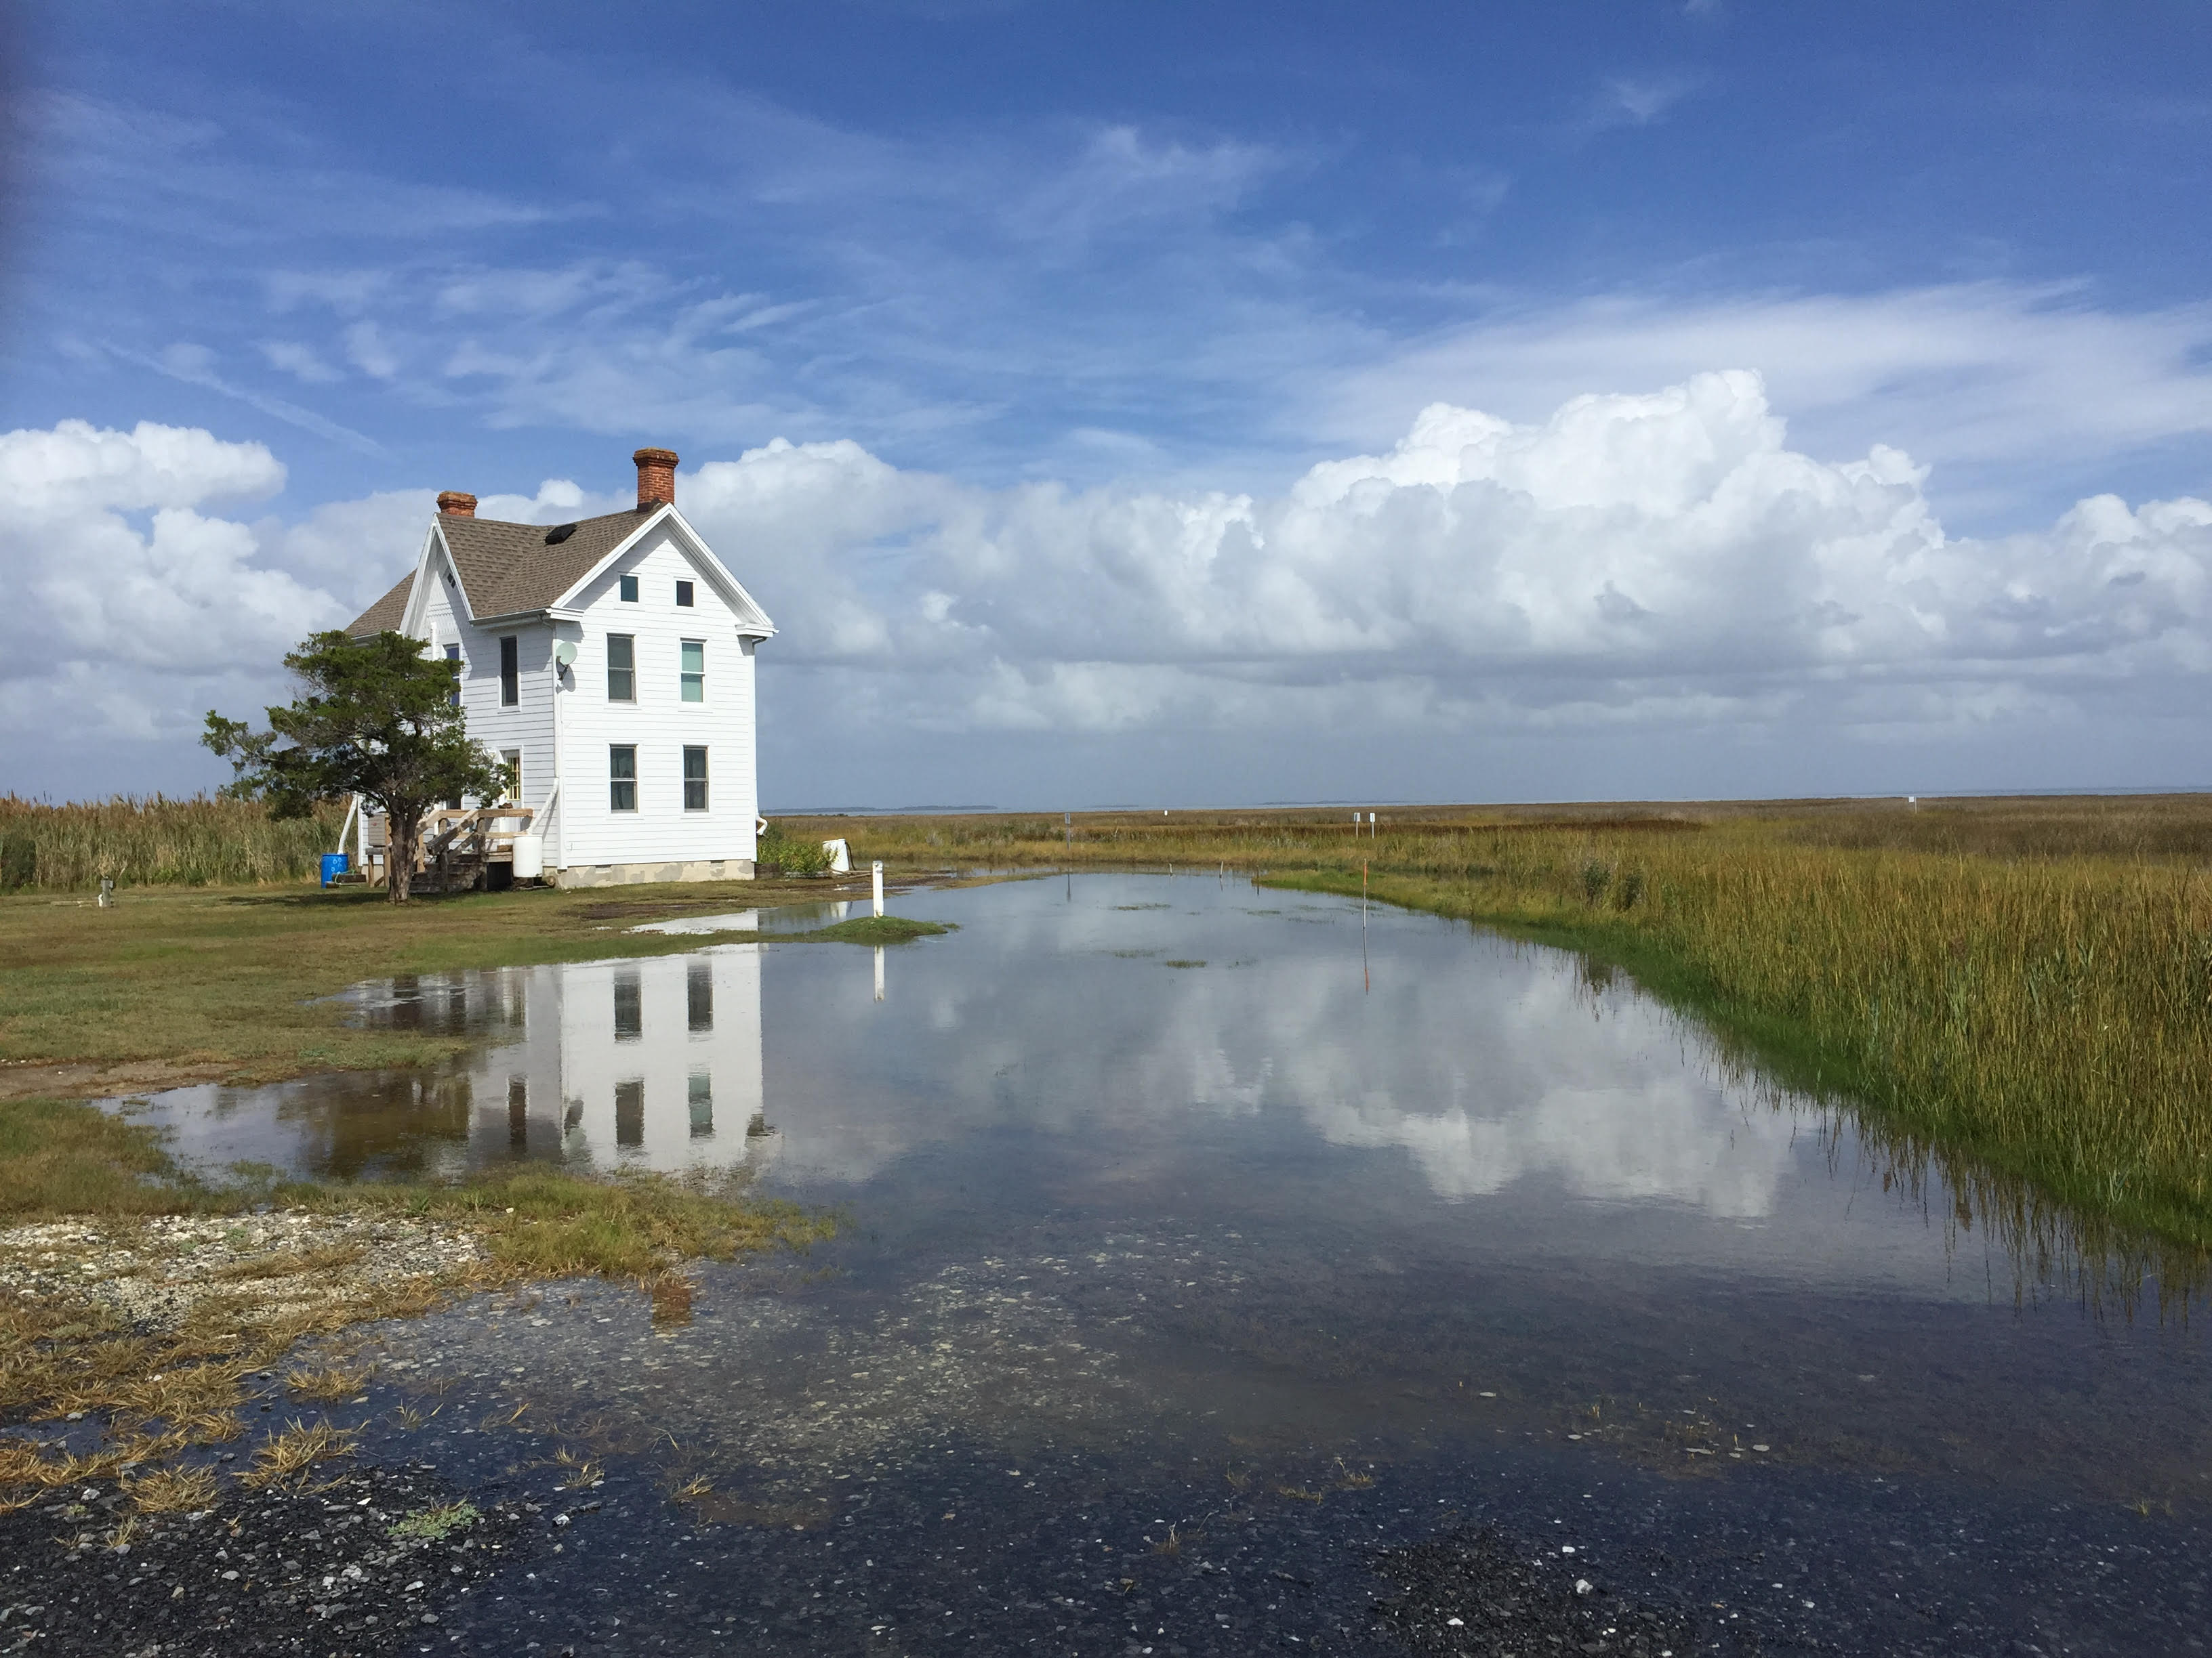
Thank you.

