Slide 1



Climate Change and the Chesapeake Bay TMDL
Zoë P. Johnson, NOAA Chesapeake Bay Office
December 1, 2016
Local Government Advisory Committee

Slide 2
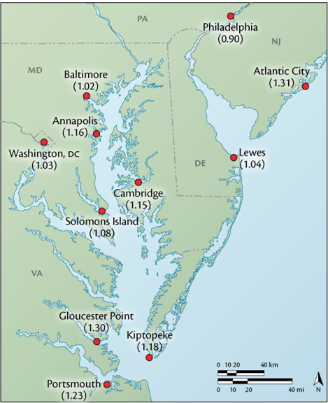
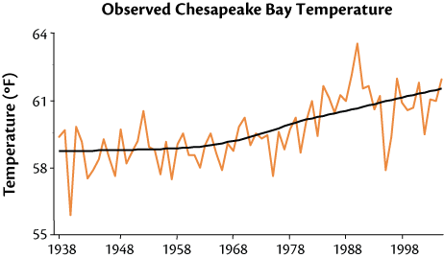
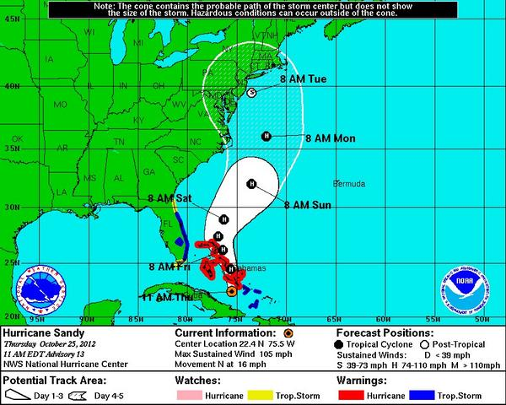
Climate Change: A Shifting Backdrop
Chesapeake Bay has warmed by more than 2°F.
Extreme Events, such as Hurricane Sandy in 2012, foreshadow the Watersheds vulnerability to climate change impacts.
Sea level has risen approximately one-foot in the last century.
Source: www.umces.edu/climateimpacts/
Notes:
The USDA Plant Hardiness Zone map (2012) is based on the average annual minimum winter temperature, divided into 10-degree F zones.

Slide 3
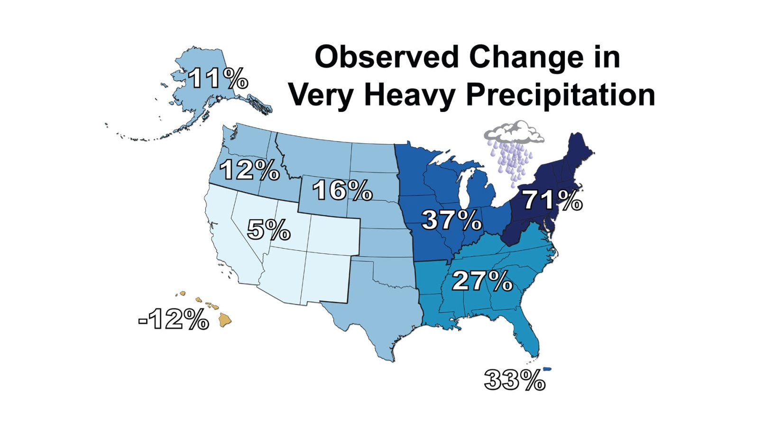
Increased Precipitation & Extreme Rainfall Events
There is a clear national trend toward a greater amount of precipitation being concentrated in very heavy events, particularly in the Northeast and Midwest.
Percent changes in the amount of precipitation falling in very heavy events (the heaviest 1%) from 1958 to 2012 for each region.
Source: National Climate Assessment (2014)

Slide 4
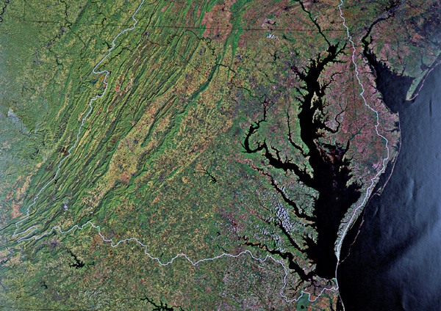
Climate Change & the Chesapeake Watershed
Source: Wikipedia

Slide 5
STAC Workshop: The Development of Climate Projections for Use in CBP Assessments
Take Home Messages
The Northeast US has gotten warmer and wetter
Precipitation has become more intense
Trends will continue in the coming decades
There is a large sensitivity to emissions scenarios, but not until mid-century
Natural variability is important, particularly for precipitation
Sea levels are rising faster than the global average and rates are increasing
Build the capacity within the Partnership to ensure ready access to data, scenario outputs, indicators and to be able to continue to evaluate, learn, and adapt.
STAC Workshop (March, 2016)

Slide 6
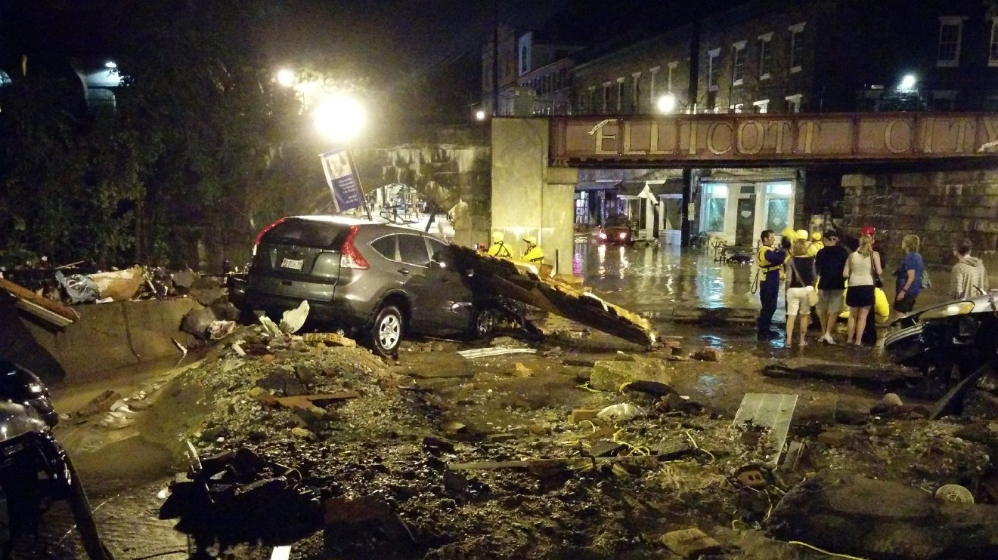
Copyright: Circa News 2016.

Slide 7
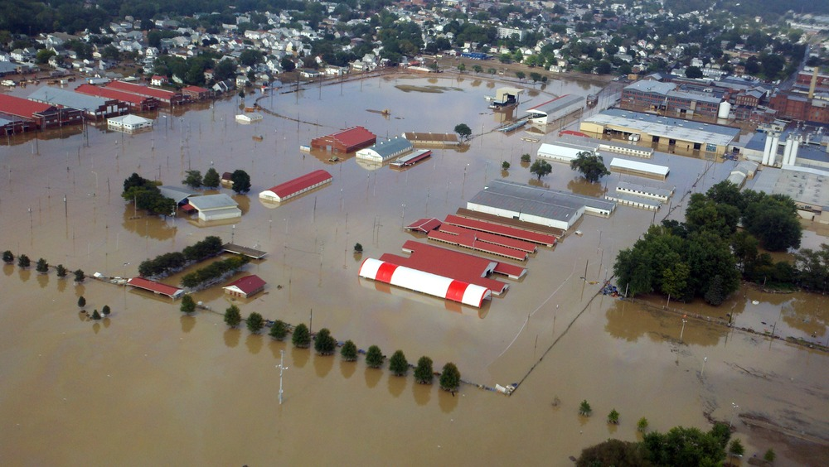
Copyright: NBC News 2011.

Slide 8
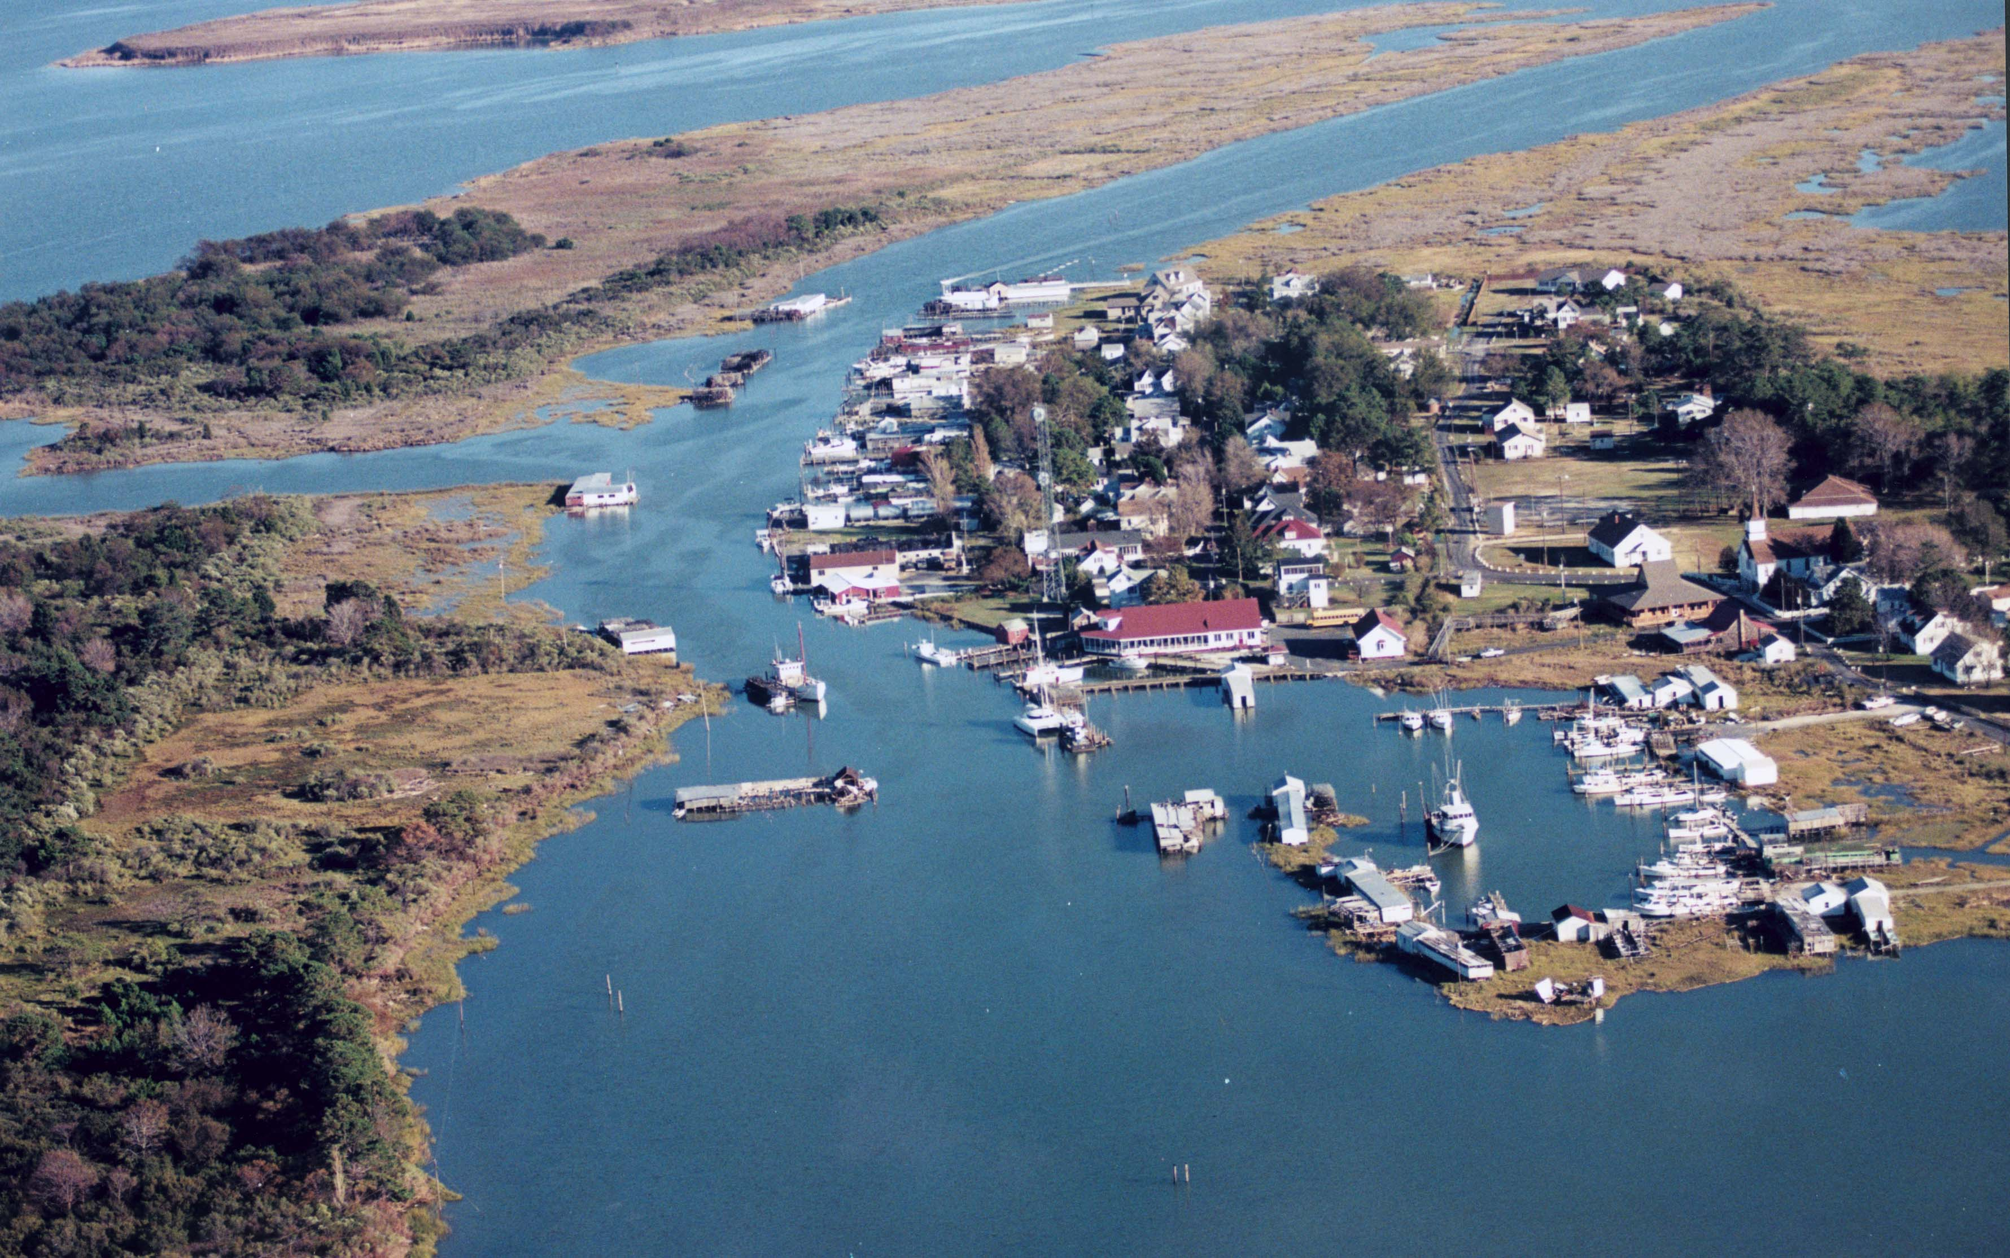
Photo Credit: UMCES, IAN

Slide 9
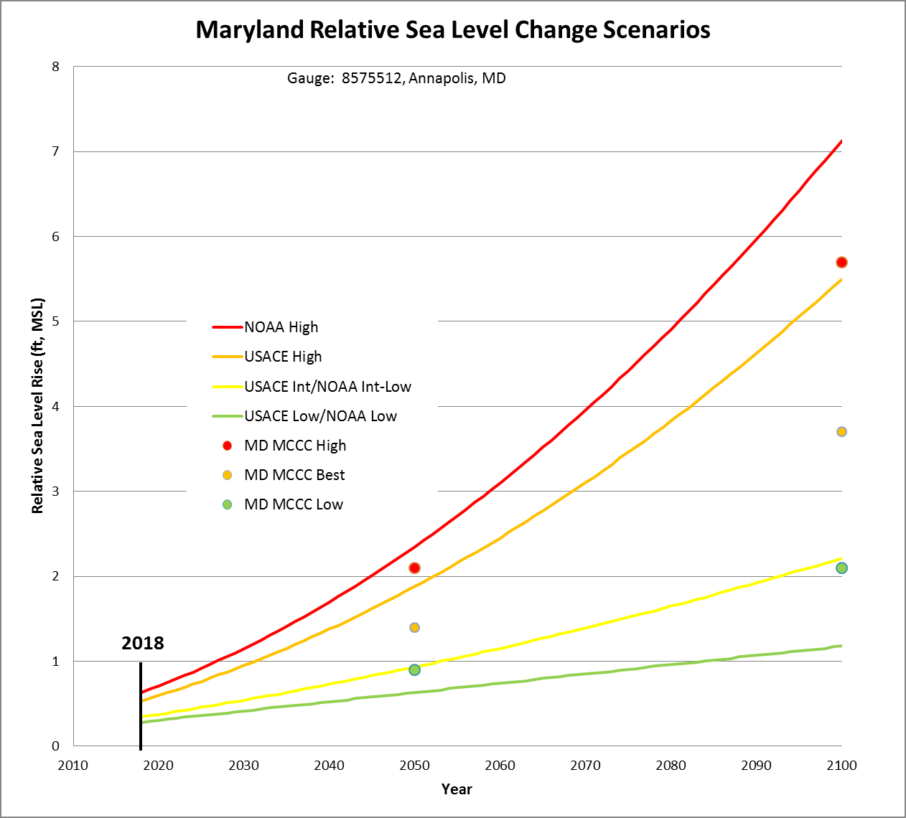
Relative Sea Level Rise Projections for the Chesapeake Bay
Source: USACE. 2015. NACCS Study. Appendix D. USACE, Baltimore, MD.

Slide 10
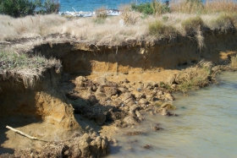
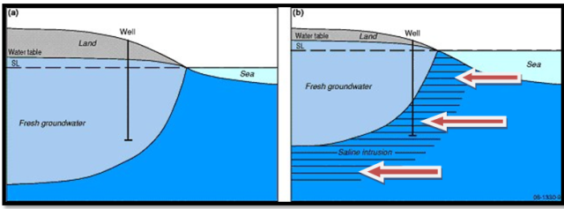
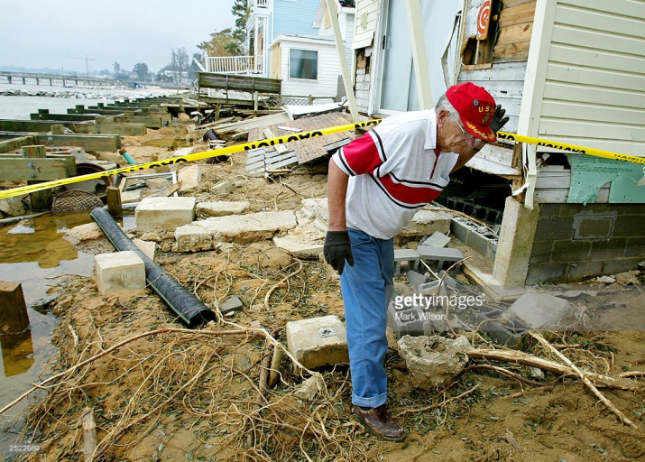
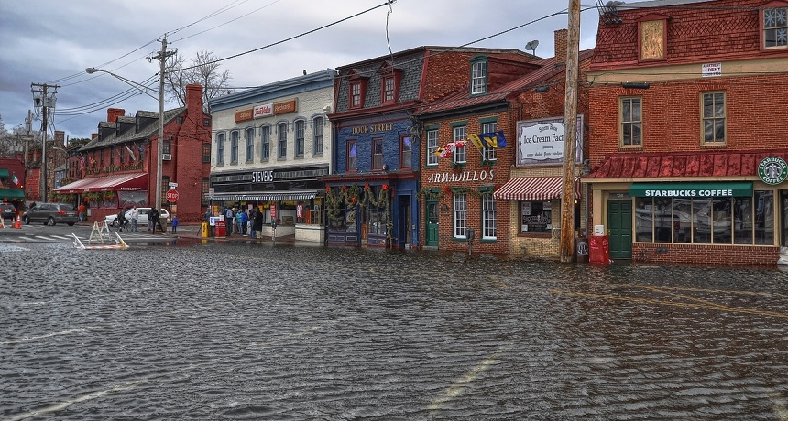
How does local sea level rise impact the coast?
Increased coastal erosion
Increased saltwater intrusion
Increased damage from storm surges
Increased frequency of tidal flooding

Slide 11
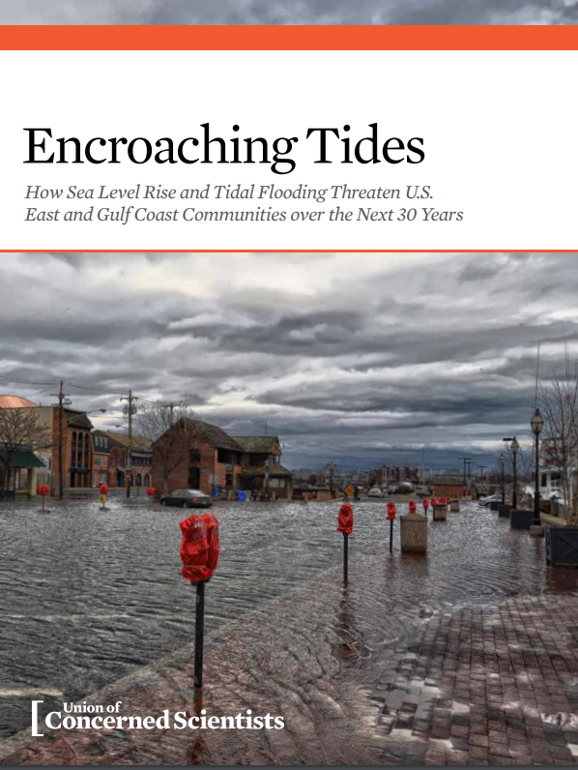
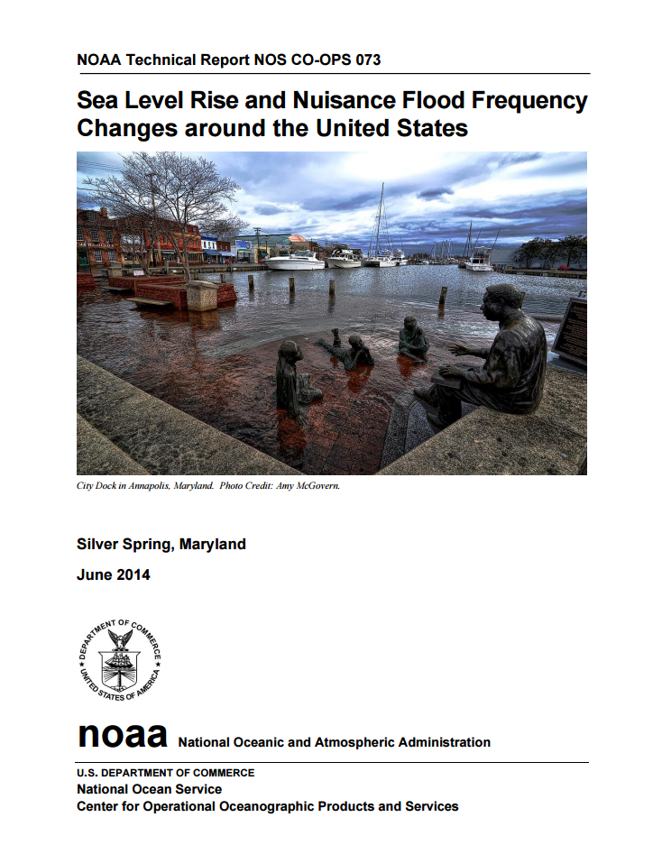
Increased nuisance flooding
Since 1990, sea level has risen by three inches in Annapolis and the number of minor floods has more than doubled (NOAA, 2014)
Today, Annapolis experiences nuisance flooding ~50 days/year (UCS, 2014)
By 2030(5.5 inches SLR), Annapolis would experience 180 flood events per year (UCS , 2014)

Slide 12
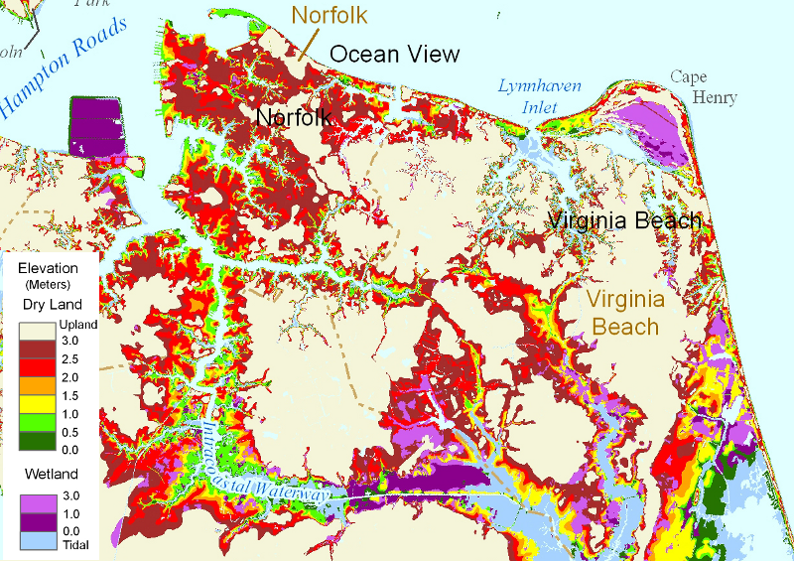
Coastal Community Impacts
Source: virginaplaces.org
Potential Inundation – 3.7 feet of SLR

Slide 13
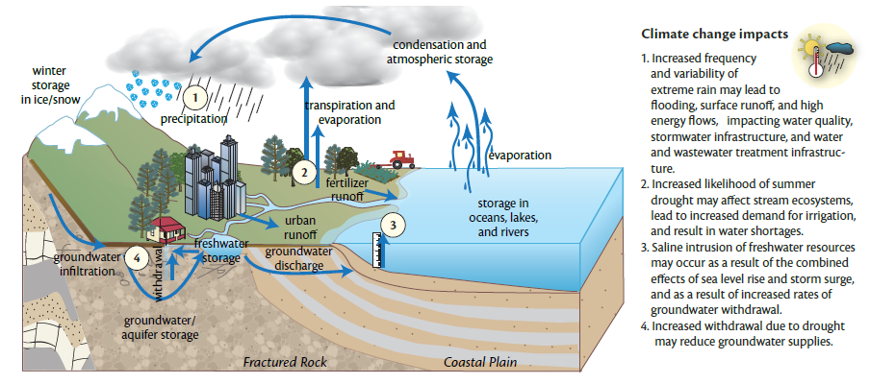
Changes to Water Supply
Source: www.umces.edu/climateimpacts/

Slide 14
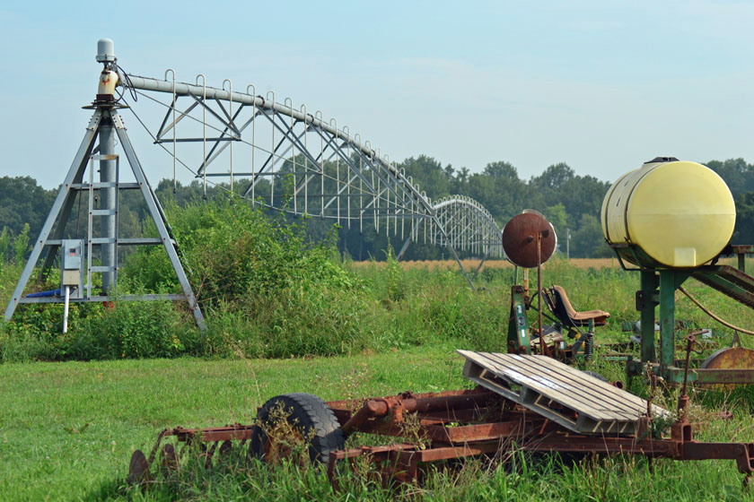
Drought Risk

Slide 15
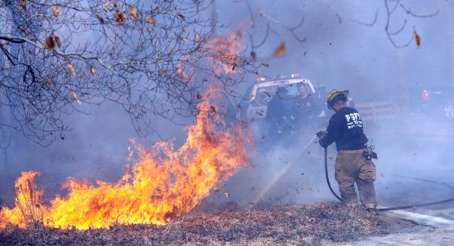

Slide 16
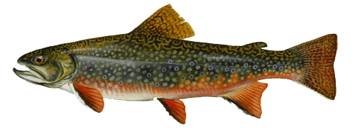
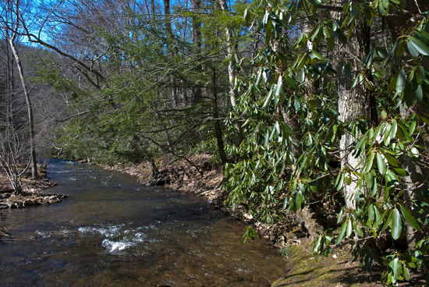
Impacts to Cold Water Resource Areas
Brook Trout, Salvelinus fontinalis
Source: Chesapeake Bay Program

Slide 17
Adaptation Planning 101
Notes:
The goal of the resources, tools, and trainings provided or house by CoastSmart is to help communities take a more holistic perspective of hazards planning. A community’s hazards mitigation plan is not the only place to address this…we promote the collaboration among all sectors so that when an event hits, the planning department is fully aware of the steps emergency management will be taking, or that transportation planning is completely aware of policies in community planning around shoreline and buffer management, floodplain ordinance and zoning.

Slide 18
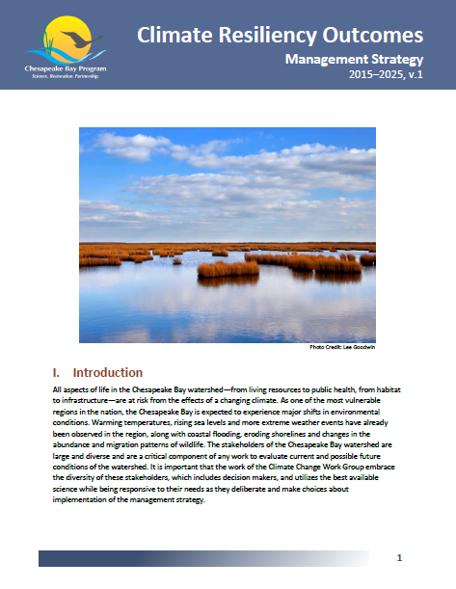
Key Partnership Climate Change-Related Commitments and Recommendations
2009 Presidential Executive Order 13508
2010 Chesapeake Bay TMDL
2010 Executive Order 13058: Strategy for Protecting and Restoring the Chesapeake Bay Watershed
2014 Chesapeake Bay Watershed Agreement

Slide 19
2014 Chesapeake Bay Agreement
CLIMATE RESILIENCY
GOAL: Increase the resiliency of the Chesapeake Bay watershed, including its living resources, habitats, public infrastructure and communities, to withstand adverse impacts from changing environmental and climate conditions.
Monitoring and Assessment Outcome: Continually monitor and assess the trends and likely impacts of changing climatic and sea level conditions on the Chesapeake Bay ecosystem, including the effectiveness of restoration and protection policies, programs and projects.
Adaptation Outcome: Continually pursue, design and construct restoration and protection projects to enhance the resiliency of Bay and aquatic ecosystems from the impacts of coastal erosion, coastal flooding, more intense and more frequent storms and sea level rise.

Slide 20
Chesapeake Bay 2017 Mid-Point Assessment
2010 TMDL
2025 All Practices Implemented
Goal: Determine whether the implementation the CBP Partnership’s restoration strategies by 2025 will achieve water quality standards in the Bay.
Objective: Make this determination based on the best available science data, tools, BMPs, and lessons-learned.
Commitment: Conduct a more complete analysis of climate change effects on nitrogen, phosphorus, and sediment loads and allocations in time for the mid-course assessment of Chesapeake Bay TMDL progress in 2017 (EO 13508)

Slide 21
Climate Change & the TMDL Mid-Point Assessment
Assess how climate change may affect current water quality standards (i.e., nutrient and sediment source loads over time and attainment )
Precipitation change (increased volume and intensity)
Temperature increase (air and water)
Sea level rise (hydrodynamics and impacts to beneficial resources (i.e., wetlands)
Evaluate climate impacts on the effectiveness of existing water quality BMPs over time
Seek opportunities to prioritize BMP’s with ancillary “climate resilience” benefits
Explore policy response options to address projected climate-related changes in water quality standards

Slide 22
What are Our Options for Factoring in Consideration of Climate Change into the Phase III WIPs
Quantitative/Most Comprehensive | Qualitative/ Comprehensive
Quantitative/ Comprehensive | Qualitative/ Least Comprehensive
Option 1:
Assimilative Capacity
Option 2:
Base Conditions
Option 5:
BMP Optimization
Option 6:
Adaptively Manage
Option 3:
Commit with Deferred Imp.
Option 4:
Margin of Safety
Option 7: Programmatic with Set Expectations

Slide 23
Guiding Principles WIP Development
Capitalize on “Co-Benefits” – maximize BMP selection to increase climate or coastal resiliency, soil health, flood attenuation, habitat restoration, carbon sequestration, or socio-economic and quality of life benefits.
Align with existing climate resiliency plans and strategies – align with implementation of existing greenhouse gas reduction strategies; coastal/climate adaptation strategies; hazard mitigation plans; floodplain management programs; fisheries/habitat restoration programs, etc.
Account for and integrate planning and consideration of existing stressors – consider existing stressors such as future increase in the amount of paved or impervious area, future population growth, and land-use change in establishing reduction targets or selection/prioritizing BMPs.
Manage for risk and plan for uncertainty – employ iterative risk management and develop robust and flexible implementation plans to achieve and maintain the established water quality standards in changing, often difficult-to-predict conditions.

Slide 24
Guiding Principles WIP Implementation
Reduce vulnerability - use “Climate-Smart” principles to site and design BMP’s to reduce future impact of sea level rise, coastal storms, increased temperature, and extreme events on BMP performance over time. Vulnerability should be evaluated based on the factor of risk (i.e. consequence x probability) in combination with determined levels of risk tolerance, over the intended design-life of the proposed practice.
Build in flexibility and adaptability - allow for adjustments in BMP implementation in order to consider a wider range of potential uncertainties and a richer set of response options (load allocations, BMP selections, BMP redesign). Use existing WIP development, implementation and reporting procedures, as well as monitoring results and local feedback on performance, to guide this process.
Engage Local Agencies and Leaders – work cooperatively with agencies, elected officials, and staff at the local level to provide the best available data on local impacts from climate change and facilitate the modification of existing WIPs to account for these impacts.

Slide 25
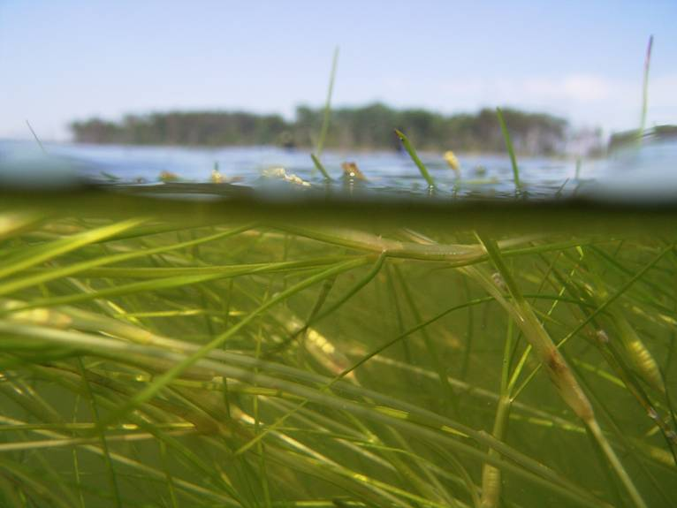
2017 Mid Point Assessment Timeline
Climate Considerations
Key Decision Dates:
On December 13, 2016, the PSC to consider:
Proposed climate change assessment procedures.
Proposed range of options for when and how to factor climate change considerations into the jurisdictions Phase III WIPs

Slide 26
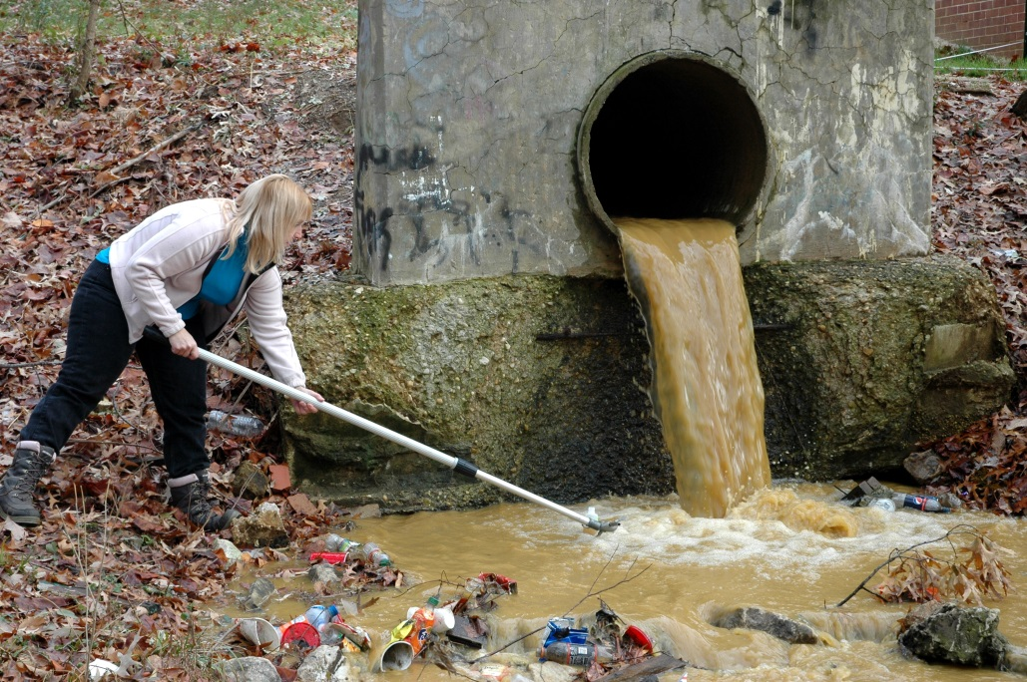
Local Government Advisory Committee Areas for Future Engagement
Participation, Input, and Ideas
Guidance on implementation priorities
Engage in the policy dialog related to integrating climate change into the Mid-Point Assessment, Phase III WIPS, and beyond
Identify Local Government Technical assistance needs

Slide 27
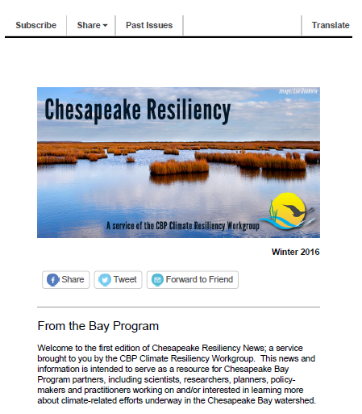
Subscribe: http://www.chesapeakebay.net/groups/group/climate_change_workgroup

Slide 28
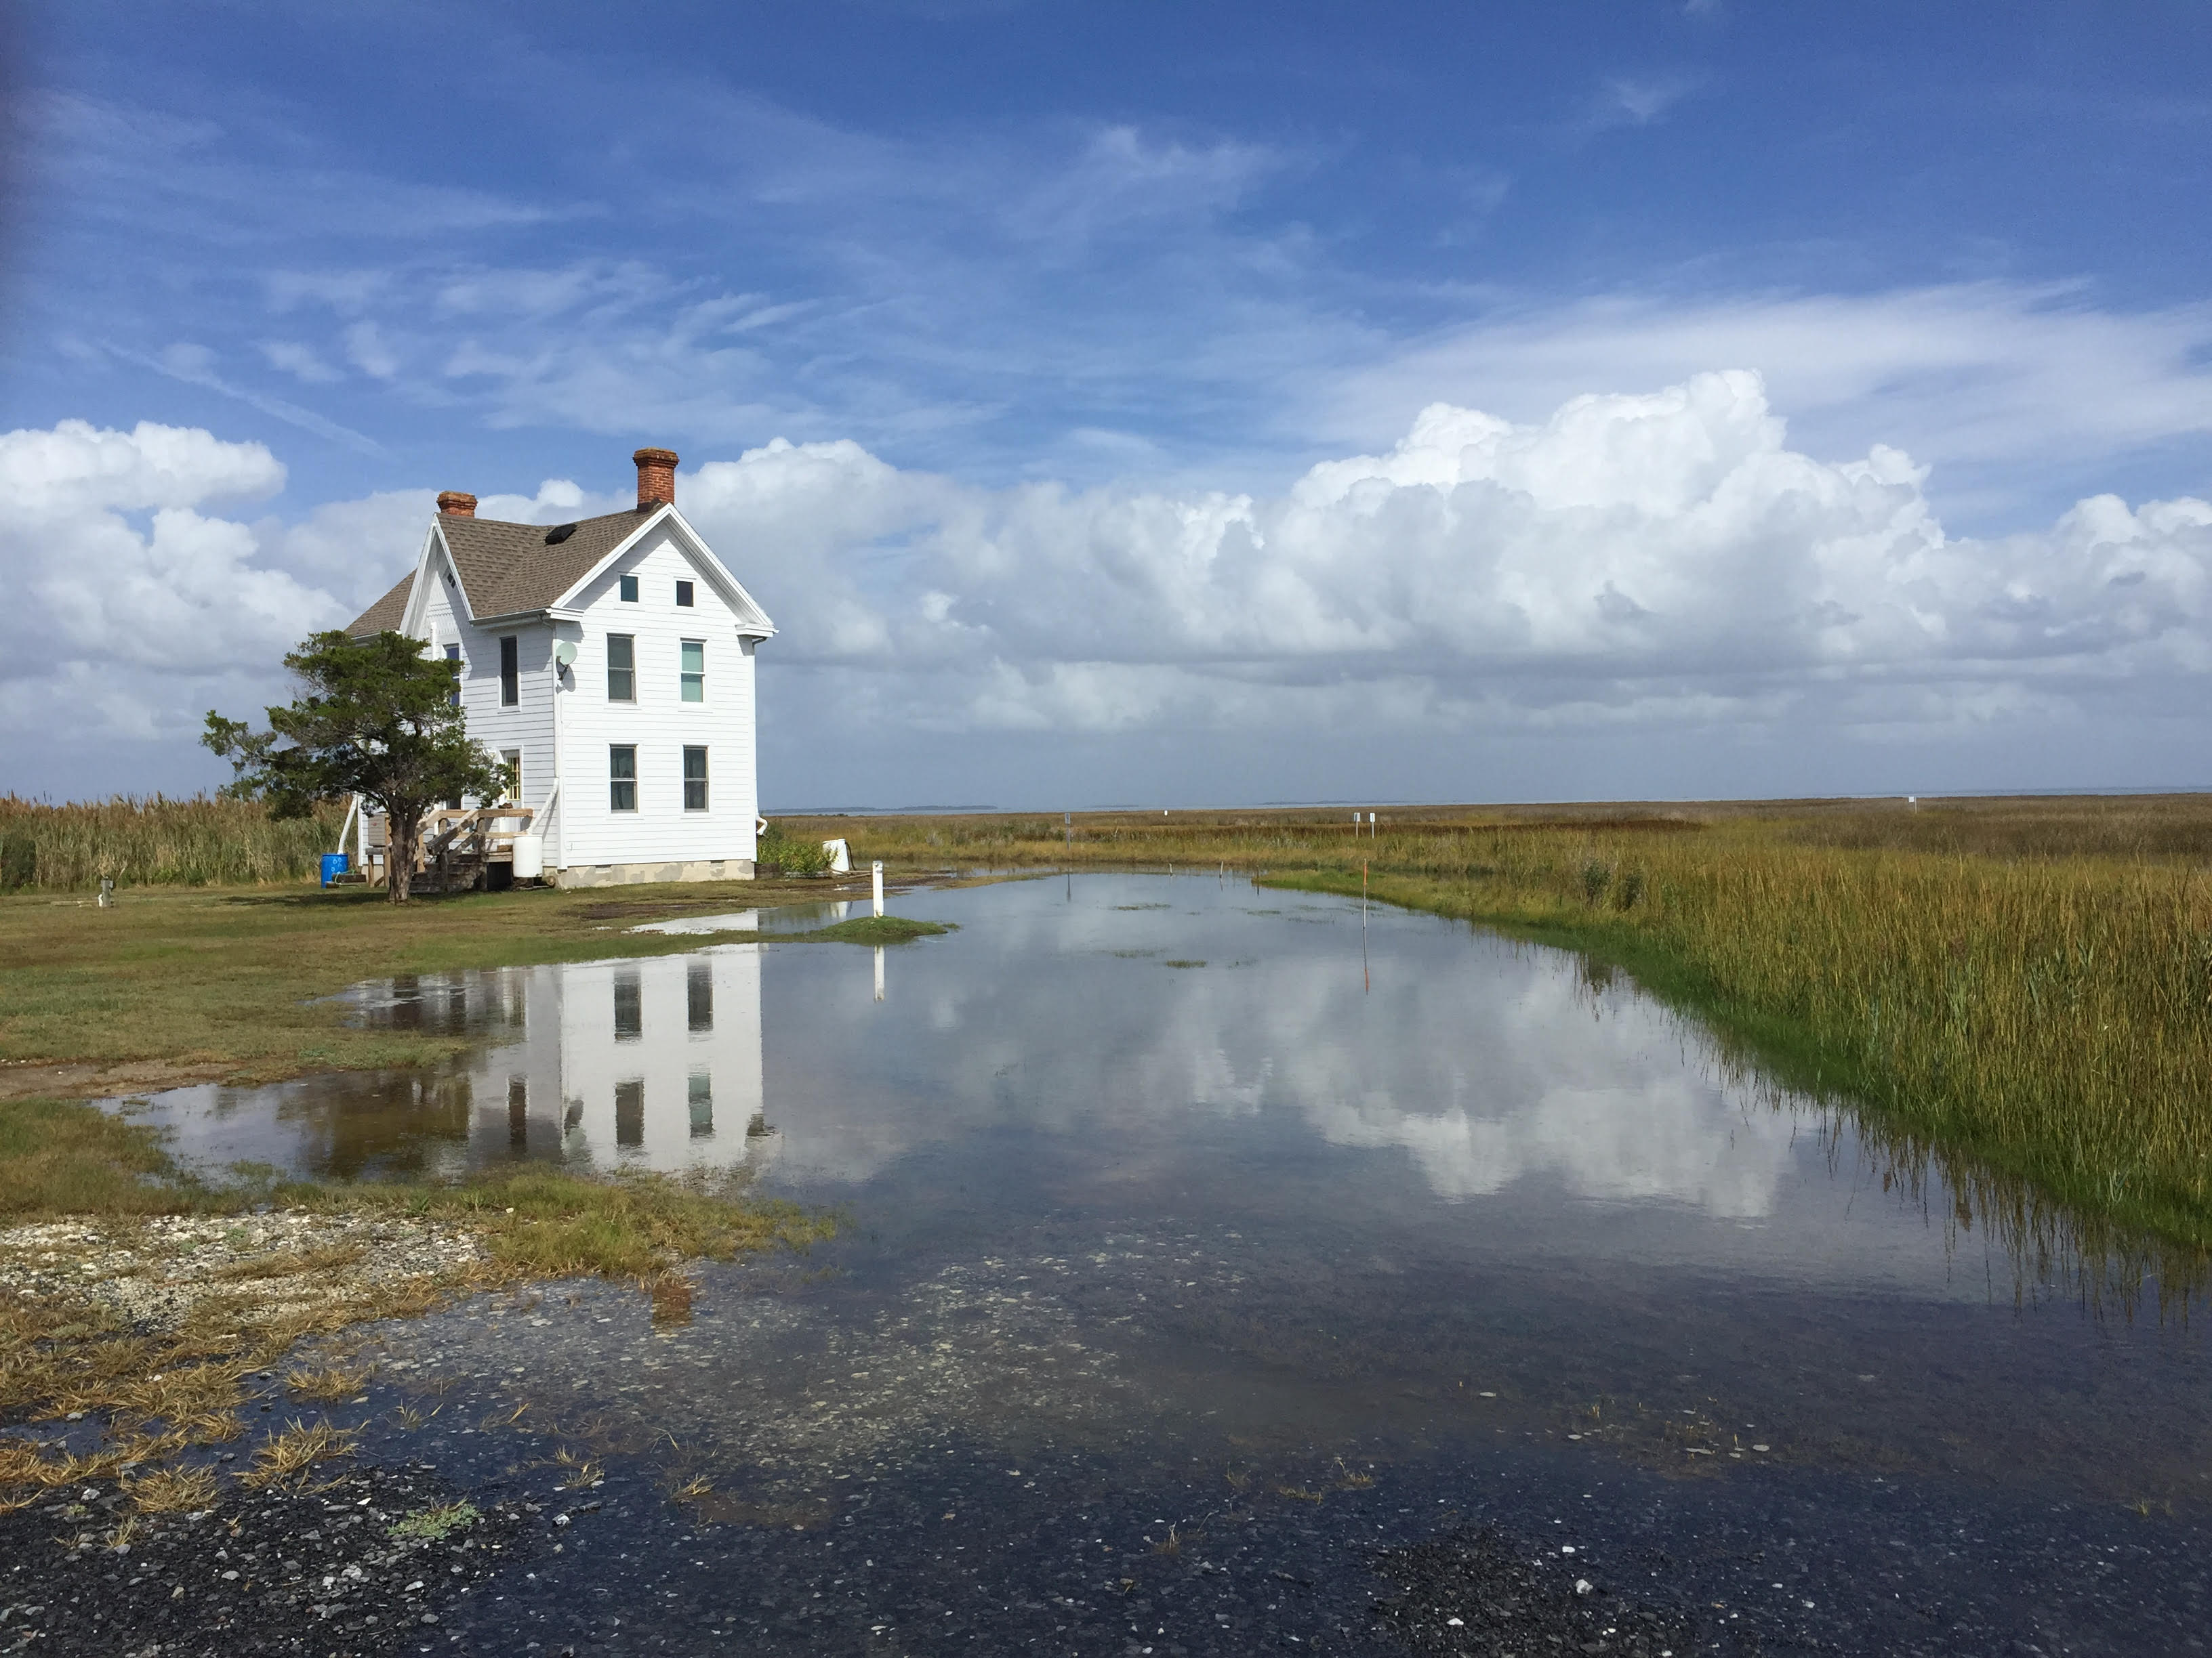
Thank you.

