Slide 1
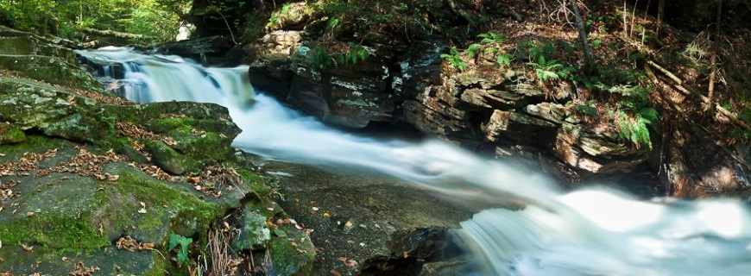
Healthy Watersheds Consortium
Research & Tools
Demonstrating Stream Health Improvement from
Healthy Watershed Actions in Maryland
Mark Southerland
Carlos Lozano
Andrea Fortman
April 17, 2018

Slide 2
Outline
Research Question
Methods
Results
Conclusions

Slide 3
Research Question
General question:
What is the effect of healthy watershed actions on stream condition?
Specific question:
What is the condition of Maryland streams in protected vs. non-protected areas from 1995-2016?
Notes:
Site condition = condition of stream network that site is in

Slide 4
Methods
Stream Data
Maryland Biological Stream Survey
Protected Lands
MD iMAP
Chesapeake Bay Program
Statistical Analysis
Logistic Regression Mixed Model
Generalized Linear Mixed Model

Slide 5
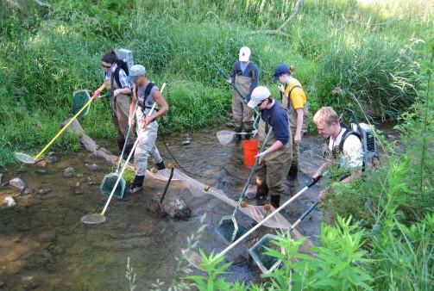
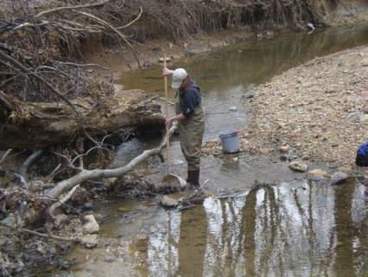
Stream Data
Maryland Biological Stream Survey
5,000 sites sampled over 20 years
Fish IBI and Benthic invertebrate IBI as indicators of stream condition
IBI ≥ 3 is healthy (non-impaired) on scale 1-5

Slide 6
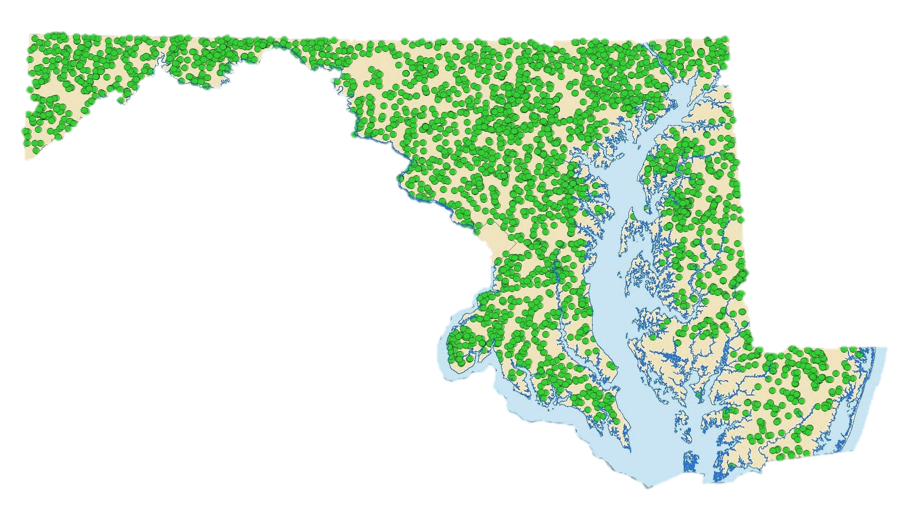
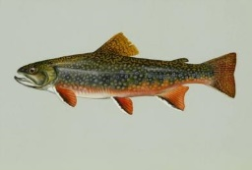
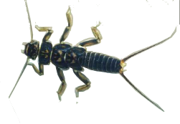
MBSS Sites

Slide 7
Protected Lands

Slide 8
Protected Lands
Types of protected areas
Coastal and Estuarine Land Conservation Program
DNR Owned Properties and Conservation Easements
Forest Conservation Act Easements
Protected Federal Lands
Local Protected Lands
Private Conservation Lands
Maryland Environmental Trust Easements
Maryland Agricultural Land Preservation Foundation Easements
Rural Legacy Properties
Transfer Development and Purchase Development Rights

Slide 9
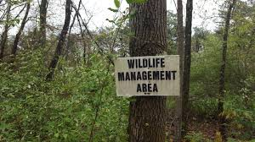
Protected Land Types
Consolidated categories of protected areas
All protected areas
DNR-owned lands and easements
100-acre minimum areas
100-acre minimum DNR areas

Slide 10
DNR Lands
State Parks
Natural Resources Management Areas
Natural Environmental Areas
State Battlefields
Rail Trails
State Forests
Demonstration Forests
John S. Ayton Tree Nursery
Chesapeake Forest Lands
Forest Fire Tower sites
Wildlife Management Areas
Fishery Management Propagation Areas
Fishery Management Public Fishing Areas
State Wildlands
Heritage Conservation Sites
Marine/Communication Facilities
Undesignated lands

Slide 11
Statistical Analyses
Logistic Regression Mixed Model
Binomial distribution: Probability of IBI ≥ 3
IBI = 3 is the threshold for “healthy” condition
Random slope and MDE8 watershed factor
Generalized Linear Mixed Model
Gaussian distribution: IBIs as response
Random slope and MDE8 watershed factor

Slide 12
Logistic Regression Mixed Model

Slide 13
Generalized Linear Mixed Model

Slide 14
Sample Size (all sites)

Slide 15
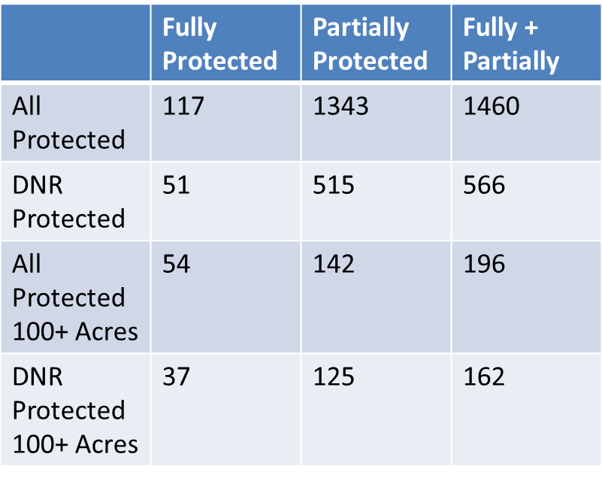
Sample Size (tested classes)

Slide 16
Sites on Protected Lands

Slide 17
Sites on Unprotected Lands

Slide 18
Hypotheses
Are protected areas always healthy?
Is stream condition better with type of protection?
Size
Management
Length of time protected
Is more protected land in a watershed better?
Especially well-managed lands

Slide 19
Protected areas are not always better

Slide 20
Protected areas are not always better

Slide 21
Protected areas are not always better

Slide 22
Protected areas are not always better

Slide 23
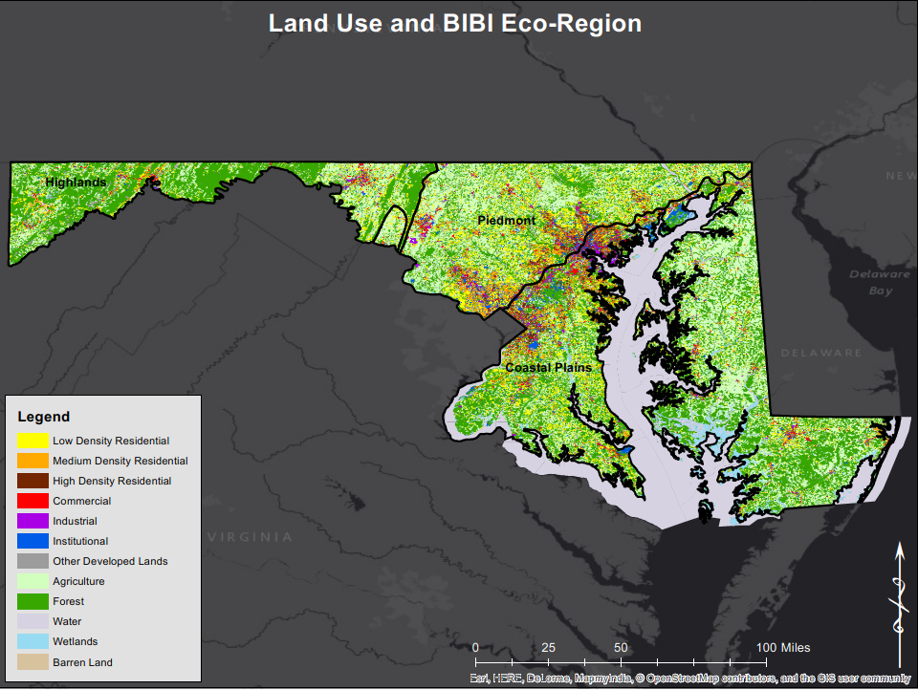
Land use

Slide 24
Land use matters

Slide 25
DNR sites

Slide 26
DNR sites are better

Slide 27
DNR sites are better

Slide 28
DNR sites are better

Slide 29
DNR sites are better

Slide 30
Large sites

Slide 31
Large sites are better

Slide 32
Large DNR Sites

Slide 33
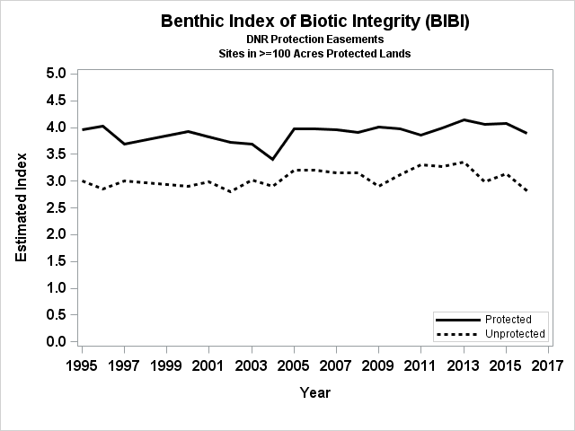
Large DNR sites are better

Slide 34
Protecting Watersheds
MD8
average
90 mi²

Slide 35
Percent of watershed protected

Slide 36
Percent of watershed protected

Slide 37
Percent of watershed protected

Slide 38
Percent of watershed protected

Slide 39
Protecting Watersheds

Slide 40
Percent of watershed DNR protected

Slide 41
Percent of watershed DNR protected

Slide 42
Percent of watershed DNR protected

Slide 43
Percent of watershed DNR protected

Slide 44
Conclusions
Not all protected areas are created equal
Management, size, and time protected matter
Truly protected streams and watersheds are in better condition
Preserving healthy watersheds and “green infrastructure networks” provide ecosystem benefits over time

