Slide 1
ELIT Data Collection
August 1, 2019

Slide 2
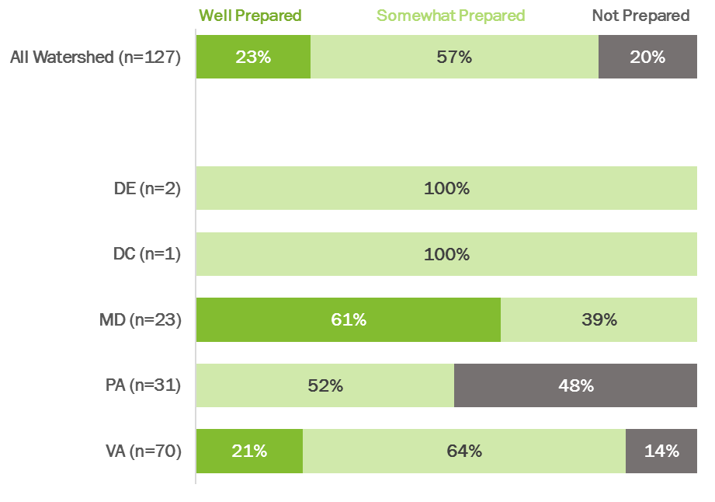
School District Preparedness

Slide 3
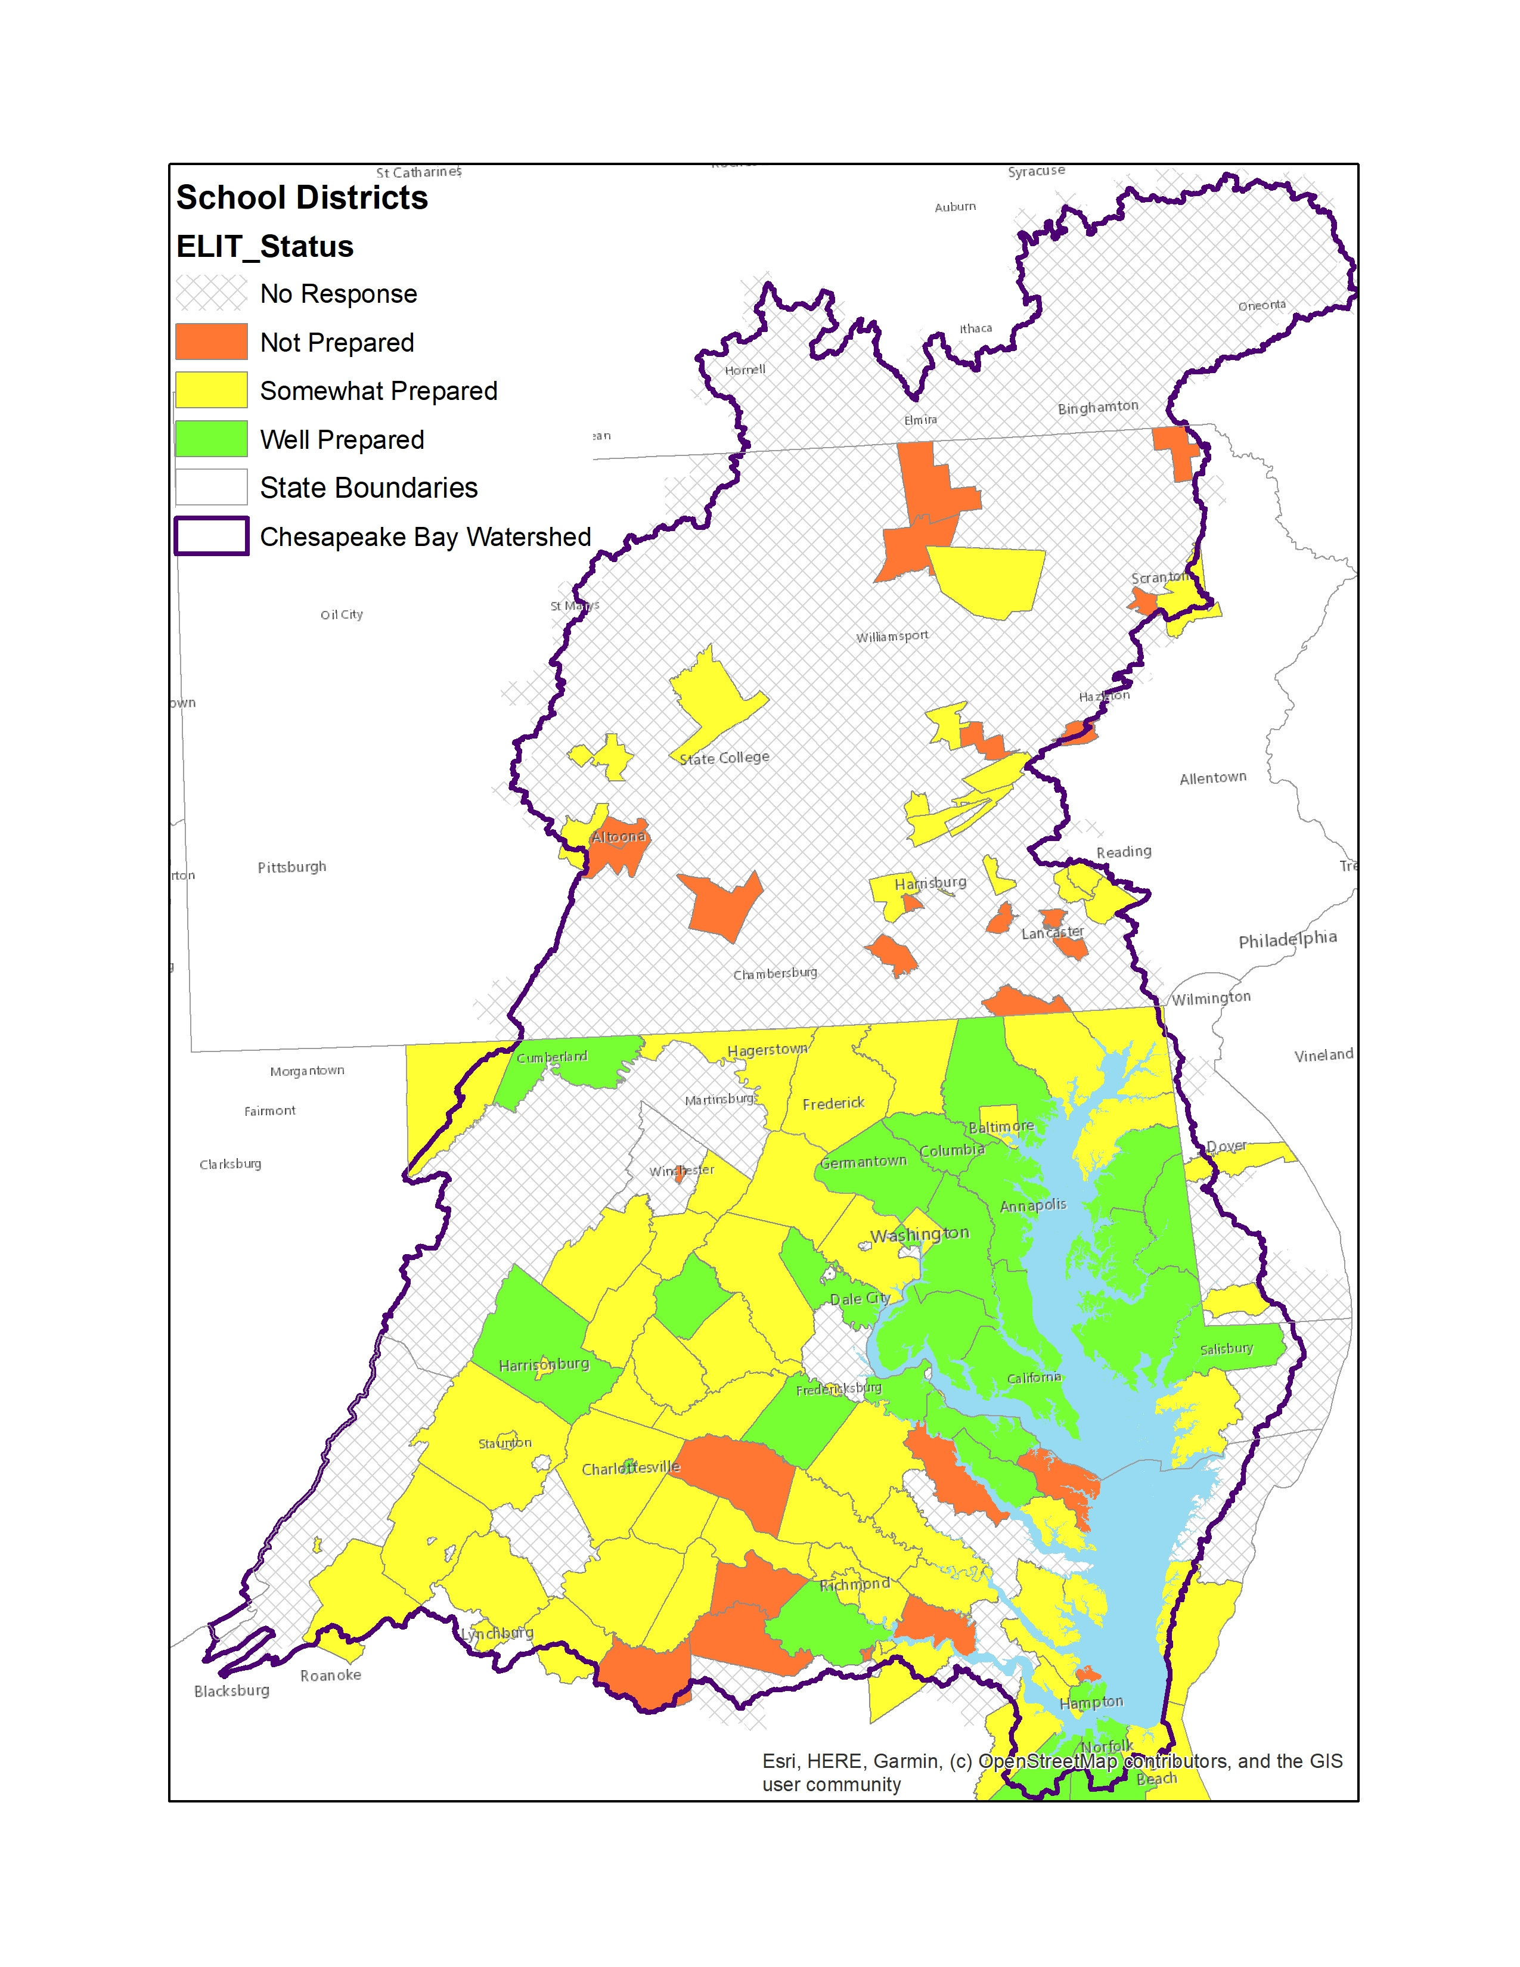

Slide 4
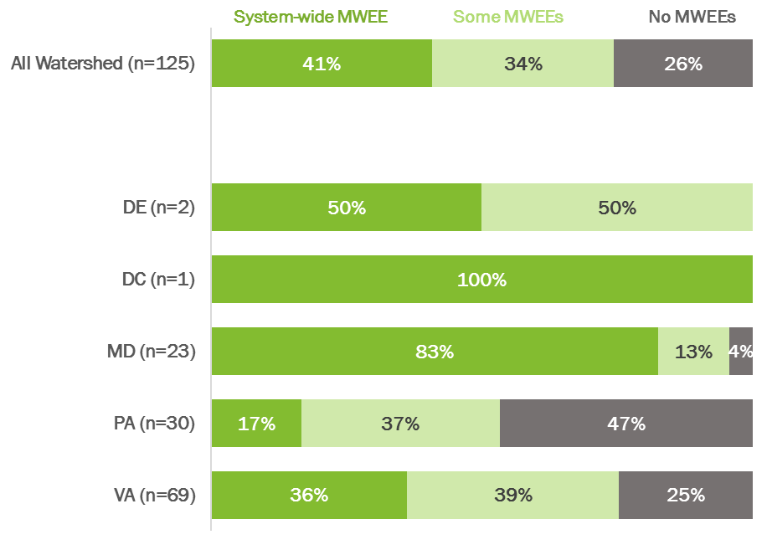
MWEE Implementation (Elementary)

Slide 5
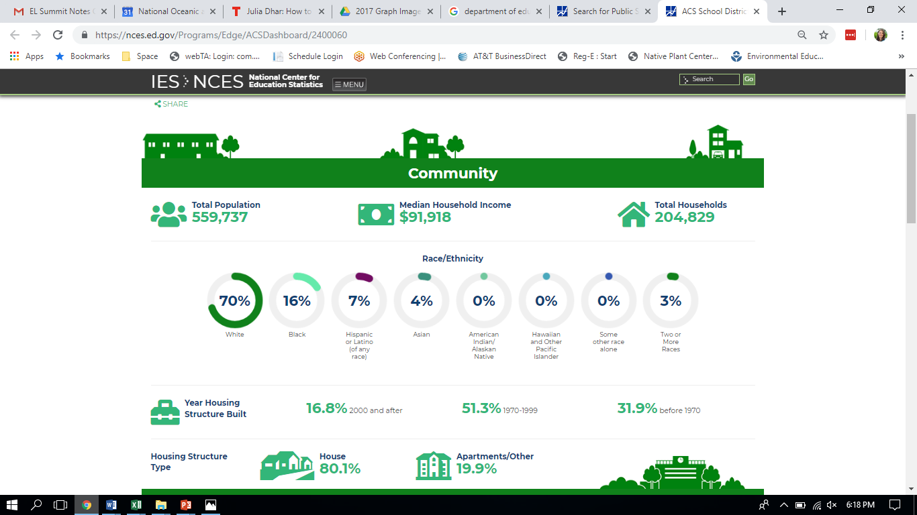

Slide 6
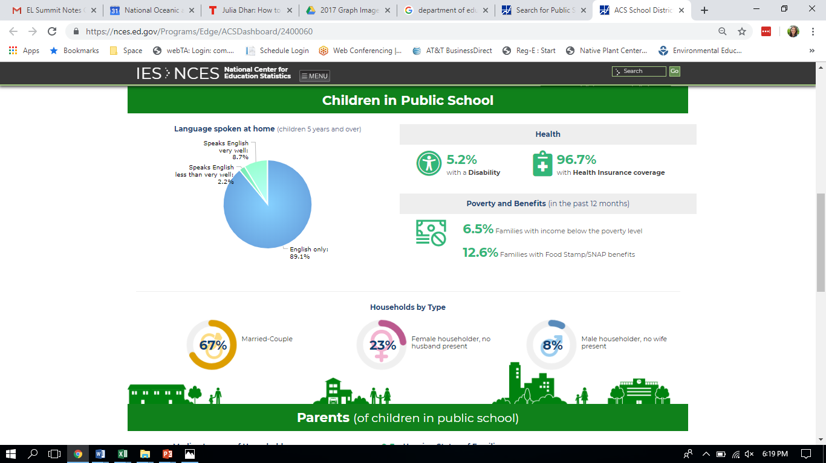

Slide 7
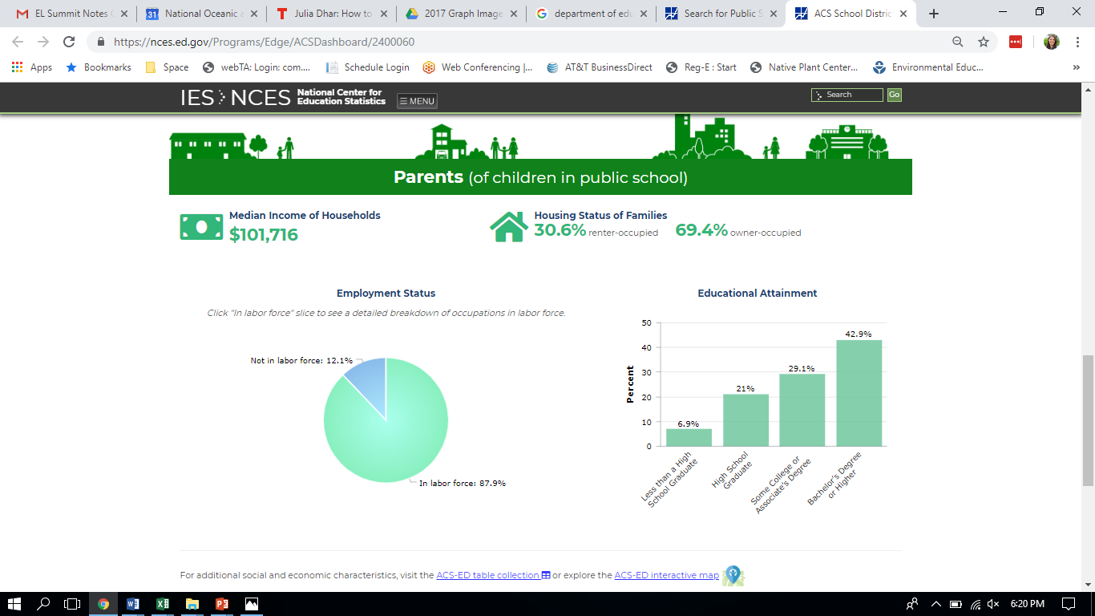

Slide 8
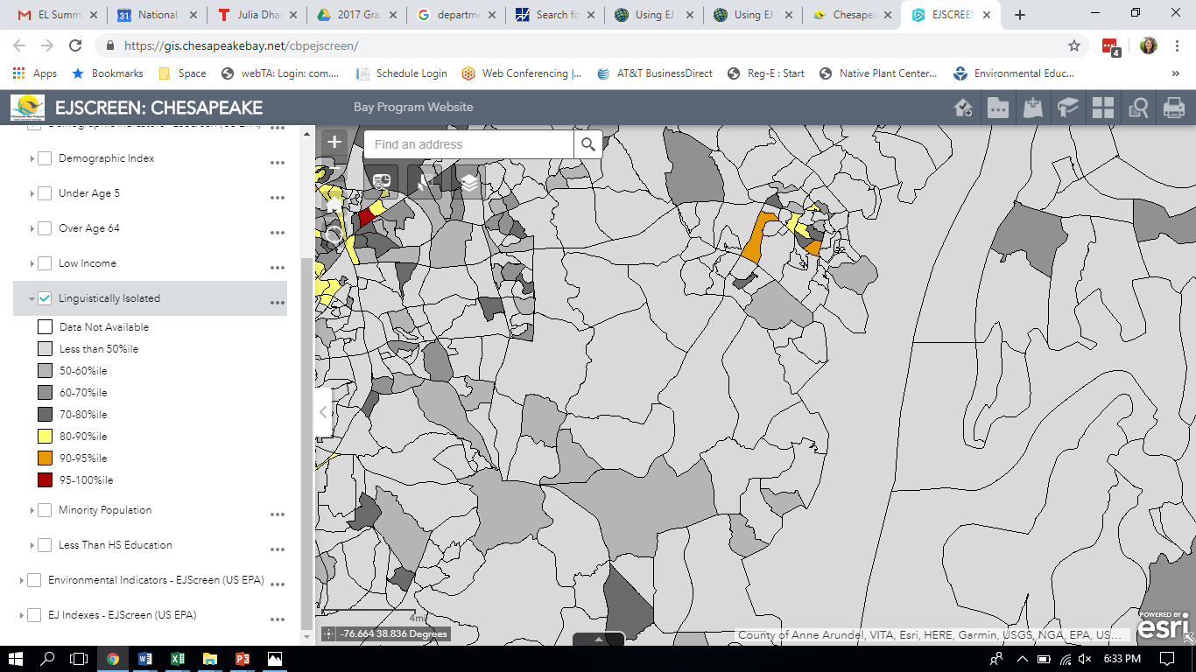

Slide 9
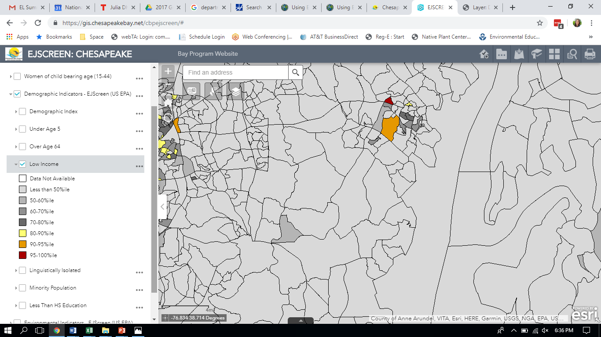

Slide 10
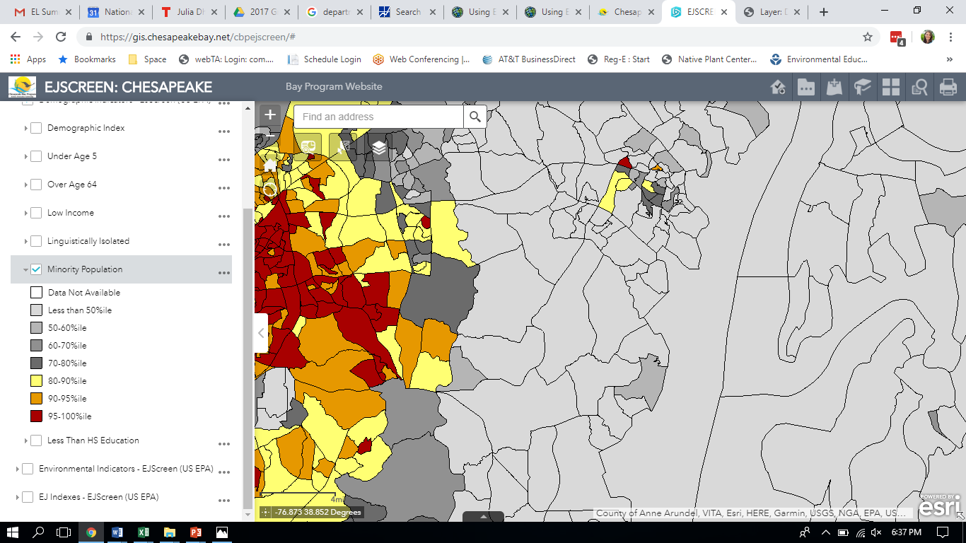

Slide 11
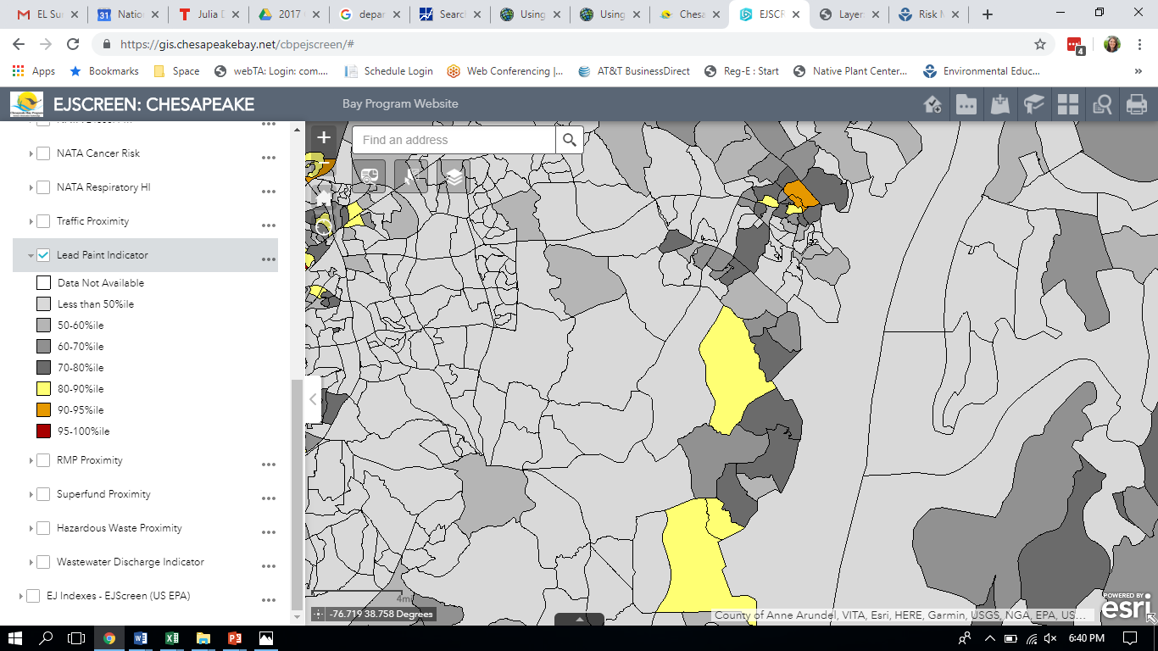

Slide 12
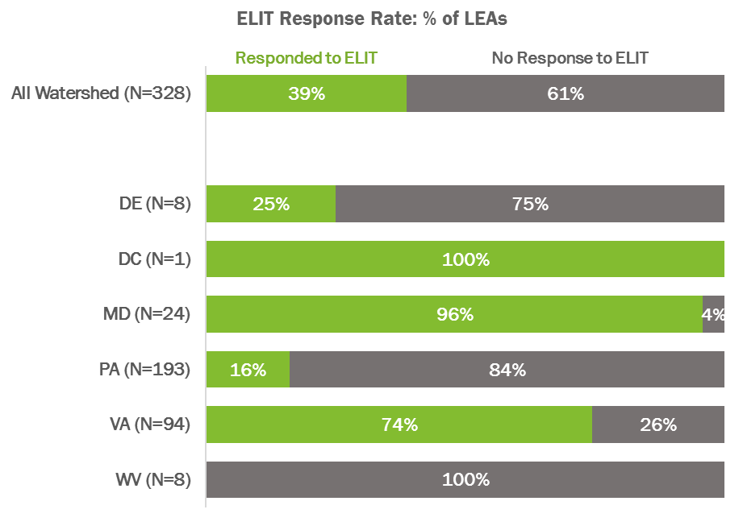

Slide 13
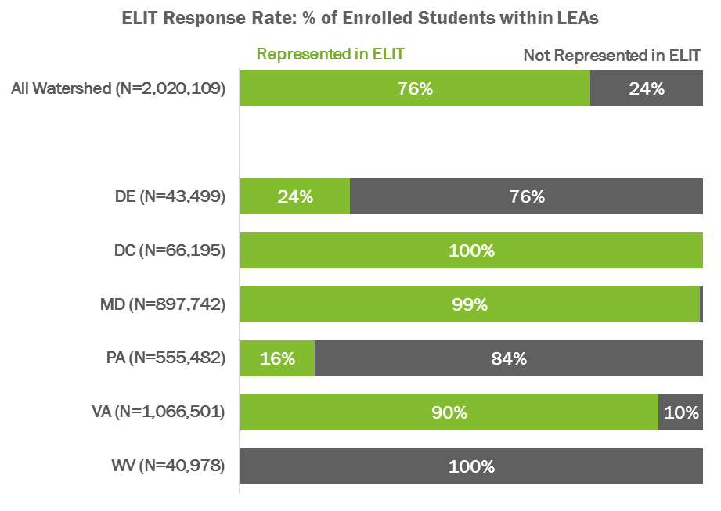

Slide 14
2019 Data Collection
18 surveys completed so far (4 in MD; 14 in VA)
June 2019: Initial emails sent by DOE reps
October 15, 2019: Data collection closes
November/December 2019: Data processing and GIS analysis
January/February 2020: Findings presented to Education Workgroup leadership team
February 2020: Findings presented to CBP Mgmt Board as part of biennial review
UPDATES ON DATA SUBMISSIONS WILL BE SENT TO DOE REPS MONTHLY

Slide 15
QUESTIONS
What data sets should we use to better understand equity issues related to environmental education?
How can we ensure a good response rate in 2019?

Slide 16
LEADERSHIP SUMMIT TAKE AWAYS
The Green Ceiling is real and there is an underrepresentation of people of color in environmental groups. Organizations—especially high level staff, who are more likely to report strong DEIJ practices—need to reflect on how DEIJ connects to their mission and how to implement it. The DEIJ in Action guide provides a good starting point for a continuing and individualized process.
It is vitally important that you meet people where they are, in their communities. Involving local school district administrators is very important to ensure support at the school building level for programs and policies. Beyond the school, it is important to think collaboratively and “outside the box” to involve non-formal educators and other partners. Doing environmental education is good for students and good for their academic performance.
There are many benefits to student-centered sustainable schools. State agencies can help by encouraging coordination, providing technical assistance, and administering open-ended funding. Currently, teachers are spending huge amounts of time applying for grants because sustainable school programs are not funded in district budgets—there need to be creative ways to include funding for sustainable schools in budget planning

Slide 17
LEADERSHIP SUMMIT TAKE AWAYS (cont)
It is important to involve administrators and frame MWEEs and field trips as ways to support learning and enhance academic performance. Seek out partnerships to be able to provide MWEEs to students. MWEEs do not have to be off-site—find creative ways to do them at school.
Partnerships are vital to providing equitable environmental education. There are lots of pots of money, but they are spread out—it is important to know which is the best fit for which program or school, and funders can help by making access easier for schools. We need to continue expanding the concept of environmental education out of the sciences and across subject areas, as well as continue to include new partners.
Keep the focus on the students—not only is this for them, but they can be some of our biggest advocates. Also, be sure to think broadly and across disciplines. Think about innovative ways to get funding and to frame the conversation about funding environmental education.

Slide 18
What are you inspired to do differently, or what is your big takeaway?
Secretary Qarni: Virginia has a problem with aging school buildings—use upgrades as an opportunity not only to upgrade sustainably but to involve students with that process.
Dr. Salmon: There is a big focus on school safety with school construction, but sustainability should be in that conversation as well.
Ms. Brumsted: This is a great opportunity to leverage communication channels developed during behavioral health expansion
Mr. Pittman: Control the narrative and call out successful schools, call out EE as part of STEM, and make sure that all students means all students.

Slide 19
Closing Remarks from DOE leadership
Dr. Salmon: Her husband is a commercial fisherman, so the Bay has always been important. Environmental literacy is and has been key, and now equity needs to be the overarching goal. It is important that all students have these opportunities and we need to be proactive about preserving the world around us. Governor Hogan is very committed to environmental literacy, and nearly 90% of Maryland schools offer MWEEs at all levels. We need to find a meaningful way to integrate it into curriculum and into student life. In Maryland, education is working with the Department of Transportation to identify accessible green spaces. The goal is to empower students to be stewards of the future.
Secretary Qarni: He experienced an International Baccalaureate school connect all of the content areas related to the Chesapeake Bay, but this was only done after SOLs. High stakes testing threatens this kind of deeper learning and forces us to have conversations about learning in silos. We should be in harmony, incorporating local officials, involving the PTA, and making sure the actual decision makers on the ground have buy in.
Ms. Brumsted: The District of Columbia has 67 independent school districts with over 200 schools, so it is hard to adopt a uniform policy. A focus has been to think about health and school climate in addition to pure academics, and push that they are the foundation of educational success. Use the whole school, whole community, whole child model, which includes leveraging partnerships—the schools cannot do it themselves. There are waitlists of people who are interested but there is not enough funding. Technical assistance should be targeted where it is needed most by looking at school metrics like successful implementation or grant applications. At the end of the day, this will never work under a compliance model—we need to involve stakeholders and do this together.
Mr. Pittman: It took Pennsylvania years to get a point person to represent several different agencies on EE issues, but it has been valuable. Do not underestimate the power of the student voice—involve them and they will become our best advocates. Focus on early education and out-of-school-time education—the risks and accountability are lower. Tailor conversations around issues that matter to the community you are addressing and remember to incorporate workforce and skills development into the rationale for EE adoption

