Slide 1

Social Science in Action: Informing Conservation Genevieve LaRouche U.S. Fish and Wildlife Service Field Supervisor Chesapeake Bay Field Office
Notes:
The work of the summit focused on describing a vision for integrating social science and human dimensions into our work; identifying major needs and opportunities; brainstorming actions and strategies in support of agency-wide integration; and demonstrating successful application of social science through case studies. Specific goals discussed include:
· Increasing conservation social science literacy and understanding in the Service
· Developing applied practices for social science integration customized to the needs of our organization
· Formalizing policy and procedures to leverage and support capacity for this effort
· Spurring innovation in applied conservation social science by Service practitioners
· Engaging partners to increase the effectiveness of social science integration

Slide 2
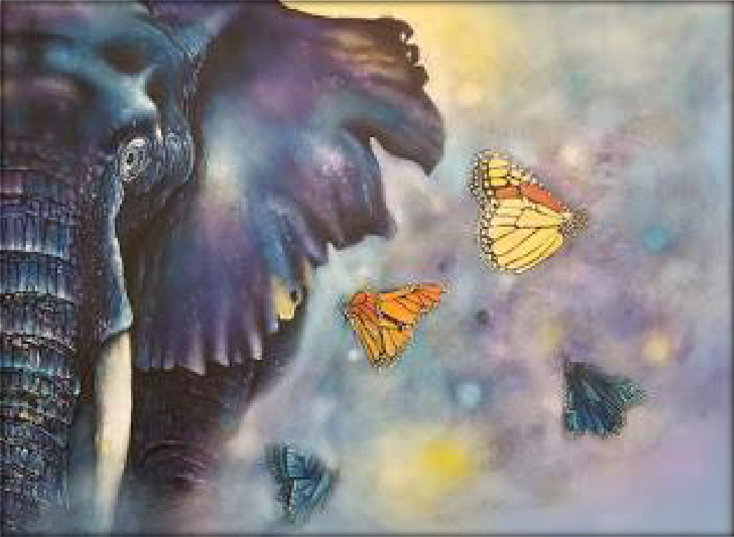

What Do Elephants and Butterflies Have in Common?

Slide 3
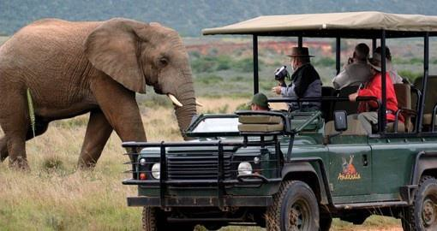

Slide 4
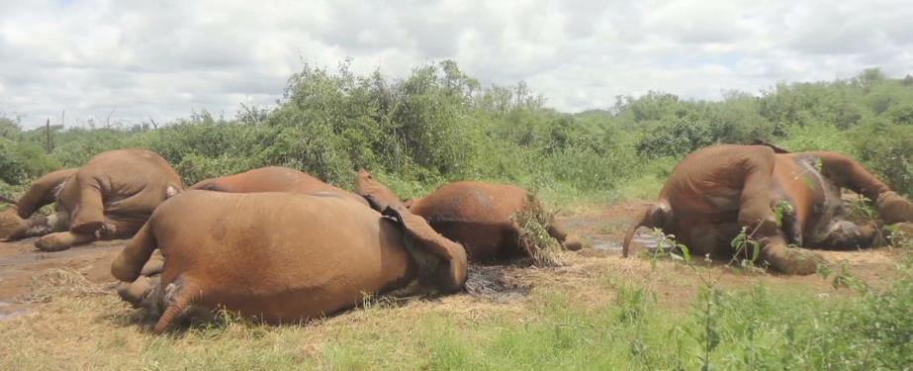

Slide 5
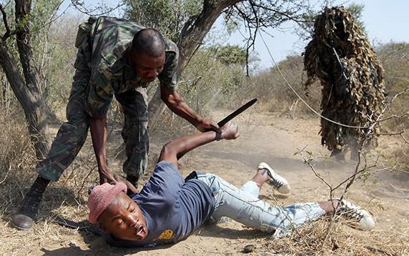

Slide 6
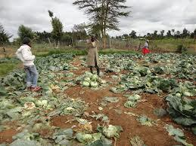
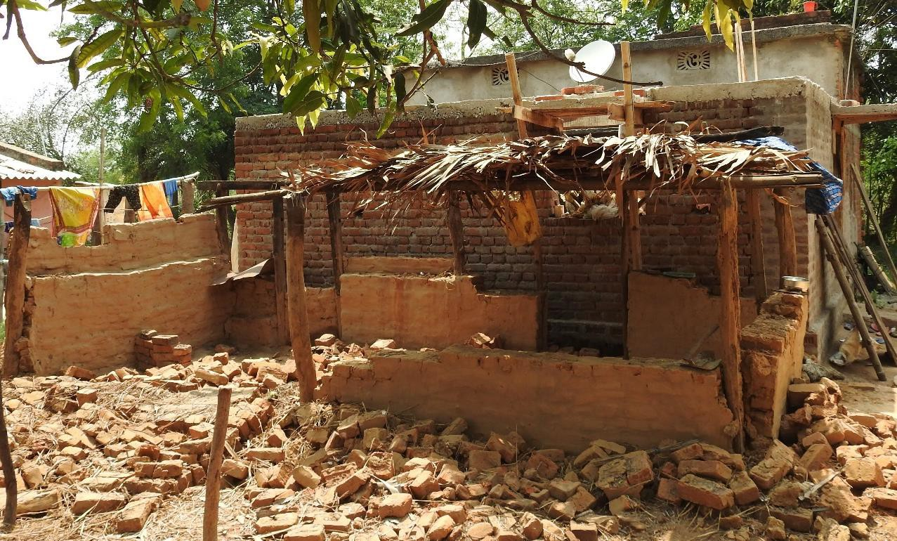

Slide 7
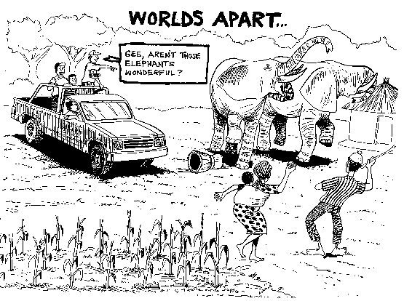

Slide 8
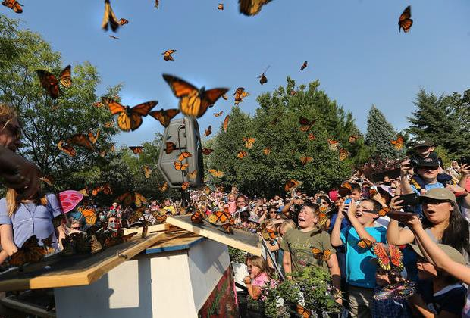

Slide 9
What should our social objectives/desired social outcomes be?
How do we determine impacts of our strategies/activities?

Slide 10
Common Approach to Conservation
Conservation Target

Slide 11
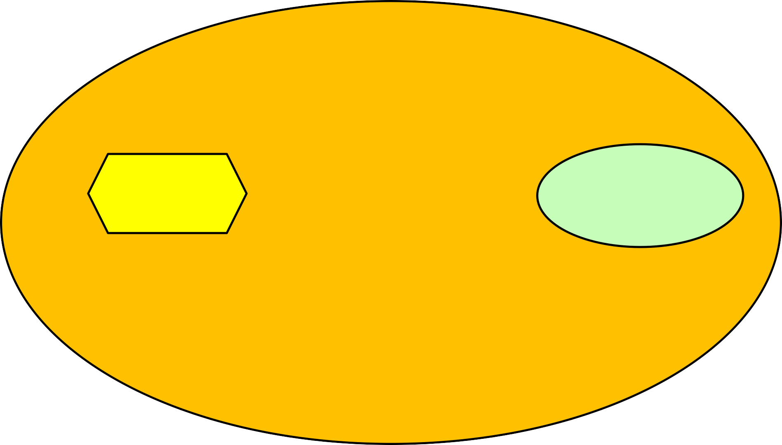
Common Approach to Conservation
CONSERVATION
Strategy
Conservation Target
CONTEXT

Slide 12
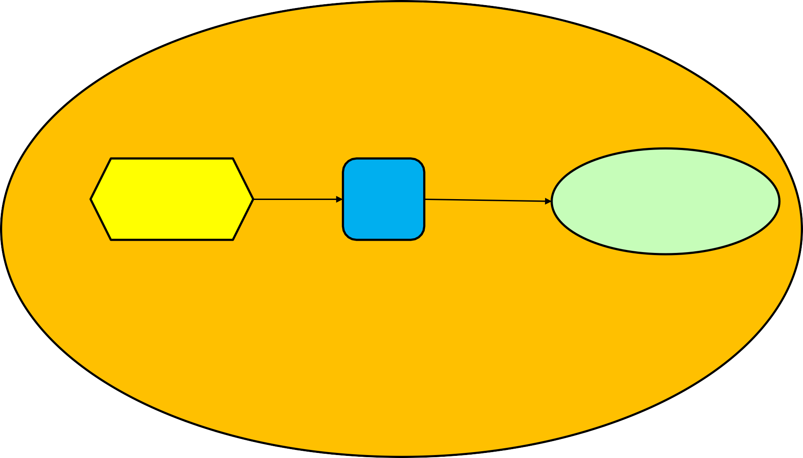
Common Approach to Conservation
CONSERVATION
Strategy
?
Conservation Target
CONTEXT

Slide 13
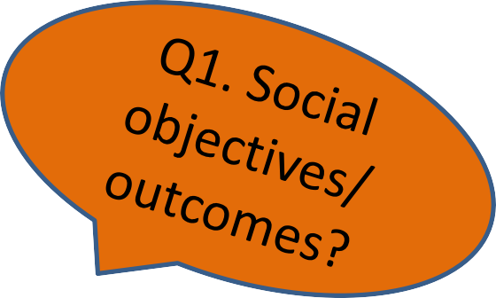
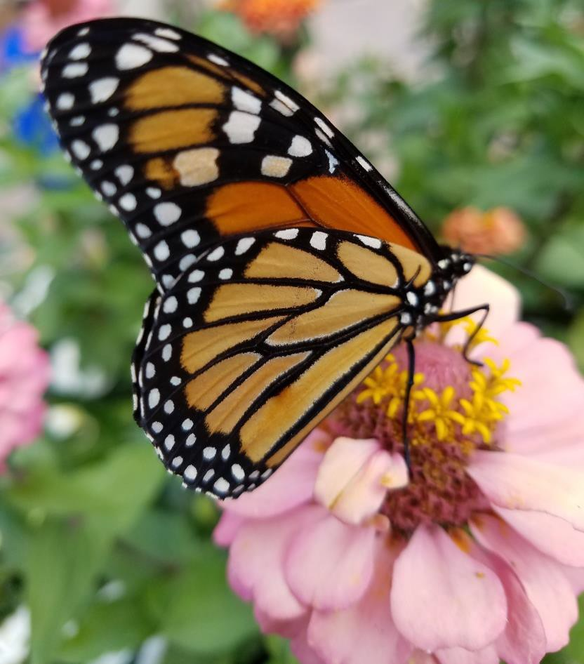
HD and Planning Monarch Conservation
What are the social drivers within the socio- ecological context of monarch conservation?
Who are the related stakeholders?
How are they affected/do they affect the issue?
What is their current knowledge, attitude, behavior?
What are the desired social outcomes?
Are social interventions having the desired impacts?

Slide 14
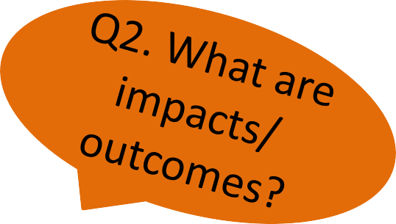

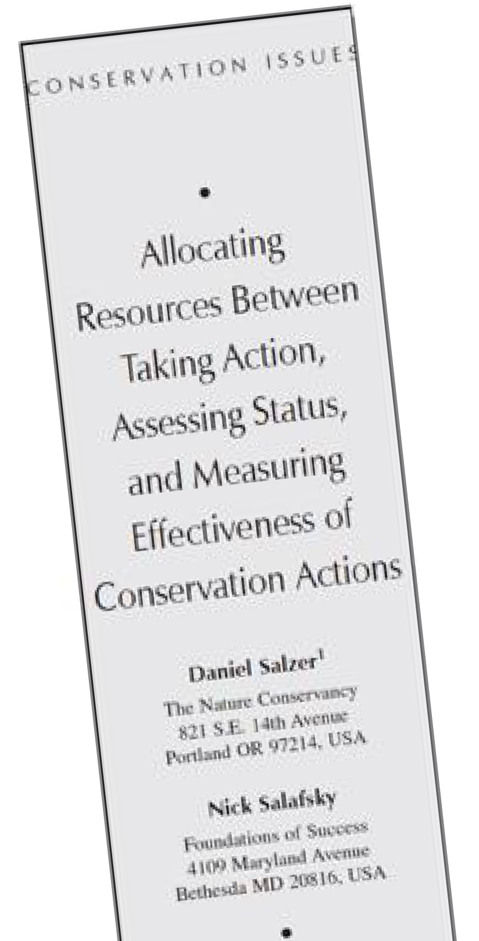
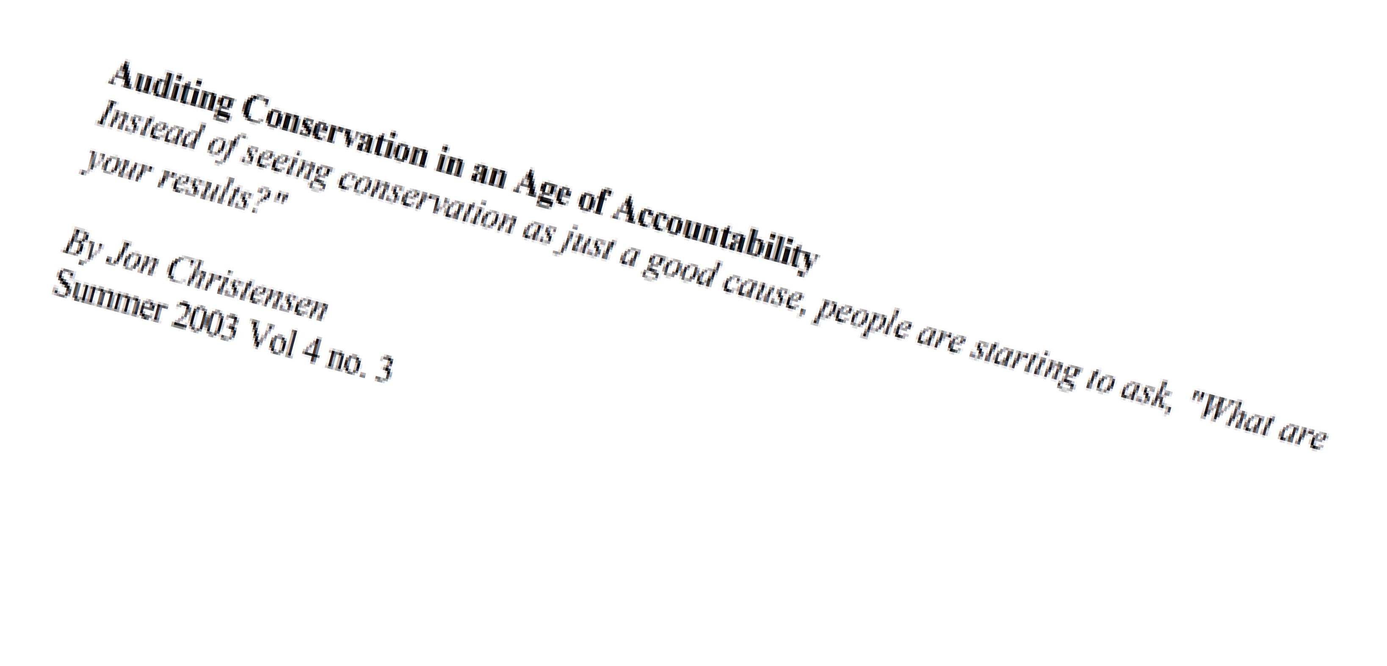
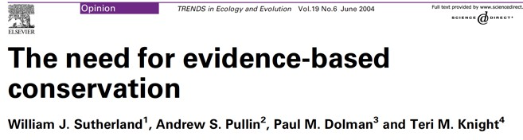
Accountability & Transparency

Slide 15
Where is HD?
Assess Problem
Adjust
Design
Evaluate
Implement
Monitor

Slide 16
Adaptive Management
Assess
Problem
Adjust
Design
Evaluate
Implement
Monitor

Slide 17
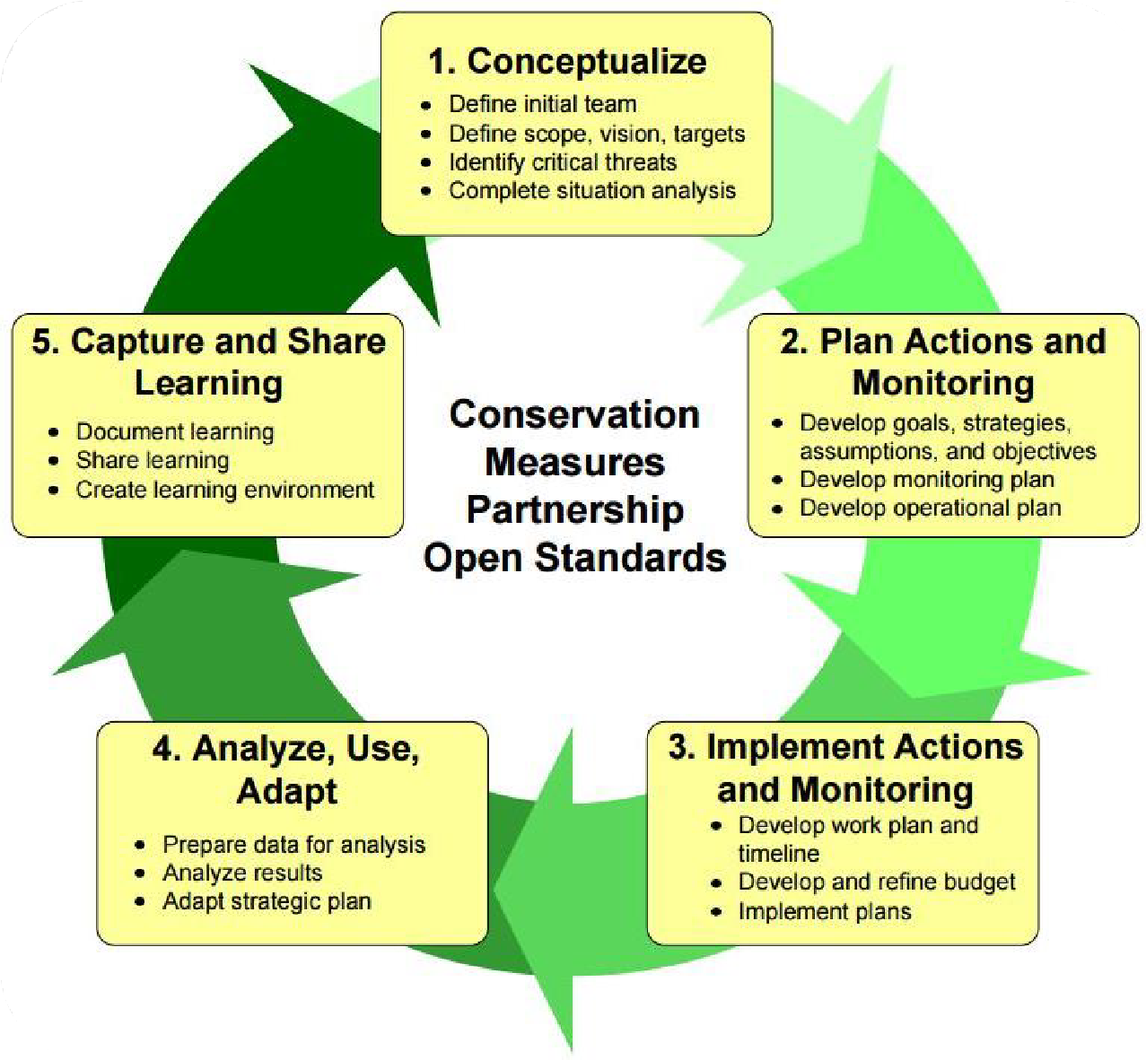
Open Standards for the Practice of Conservation

Slide 18
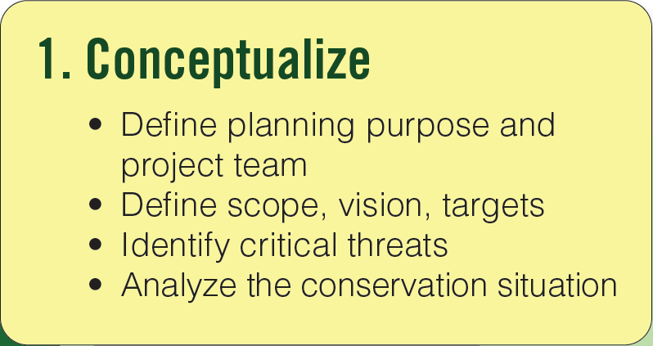
Open Standards for the Practice of Conservation

Slide 19
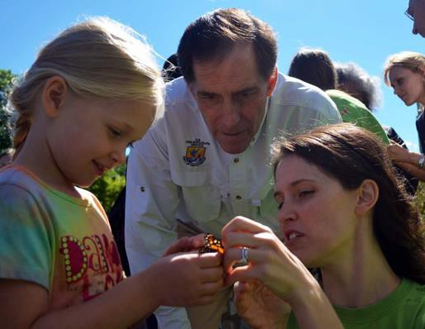
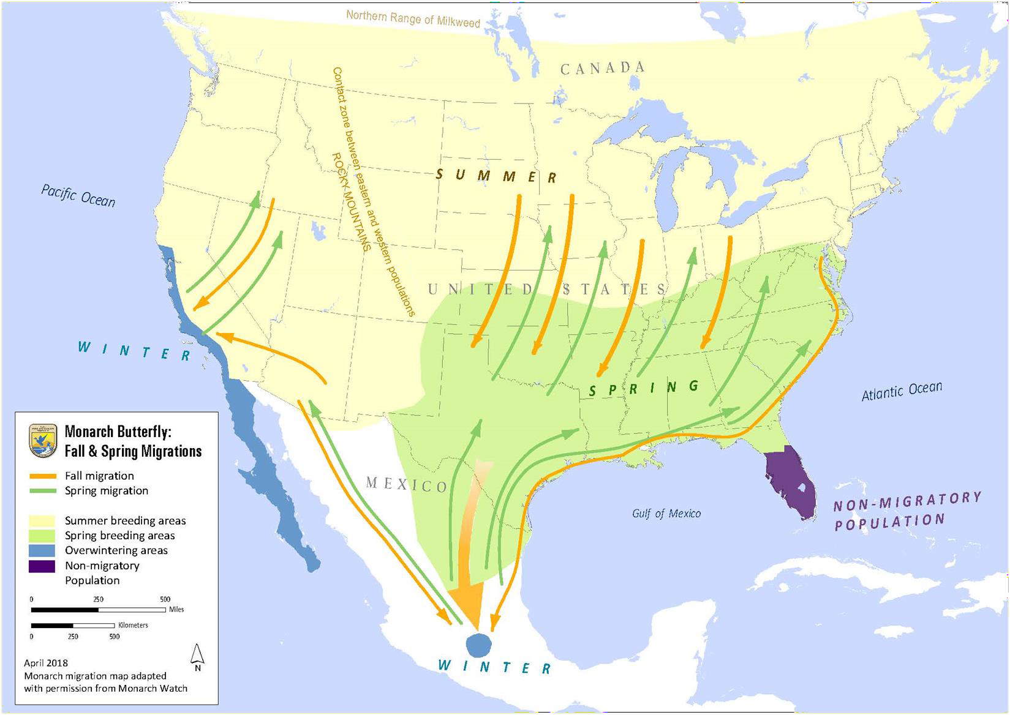
What’s the Scope?

Slide 20
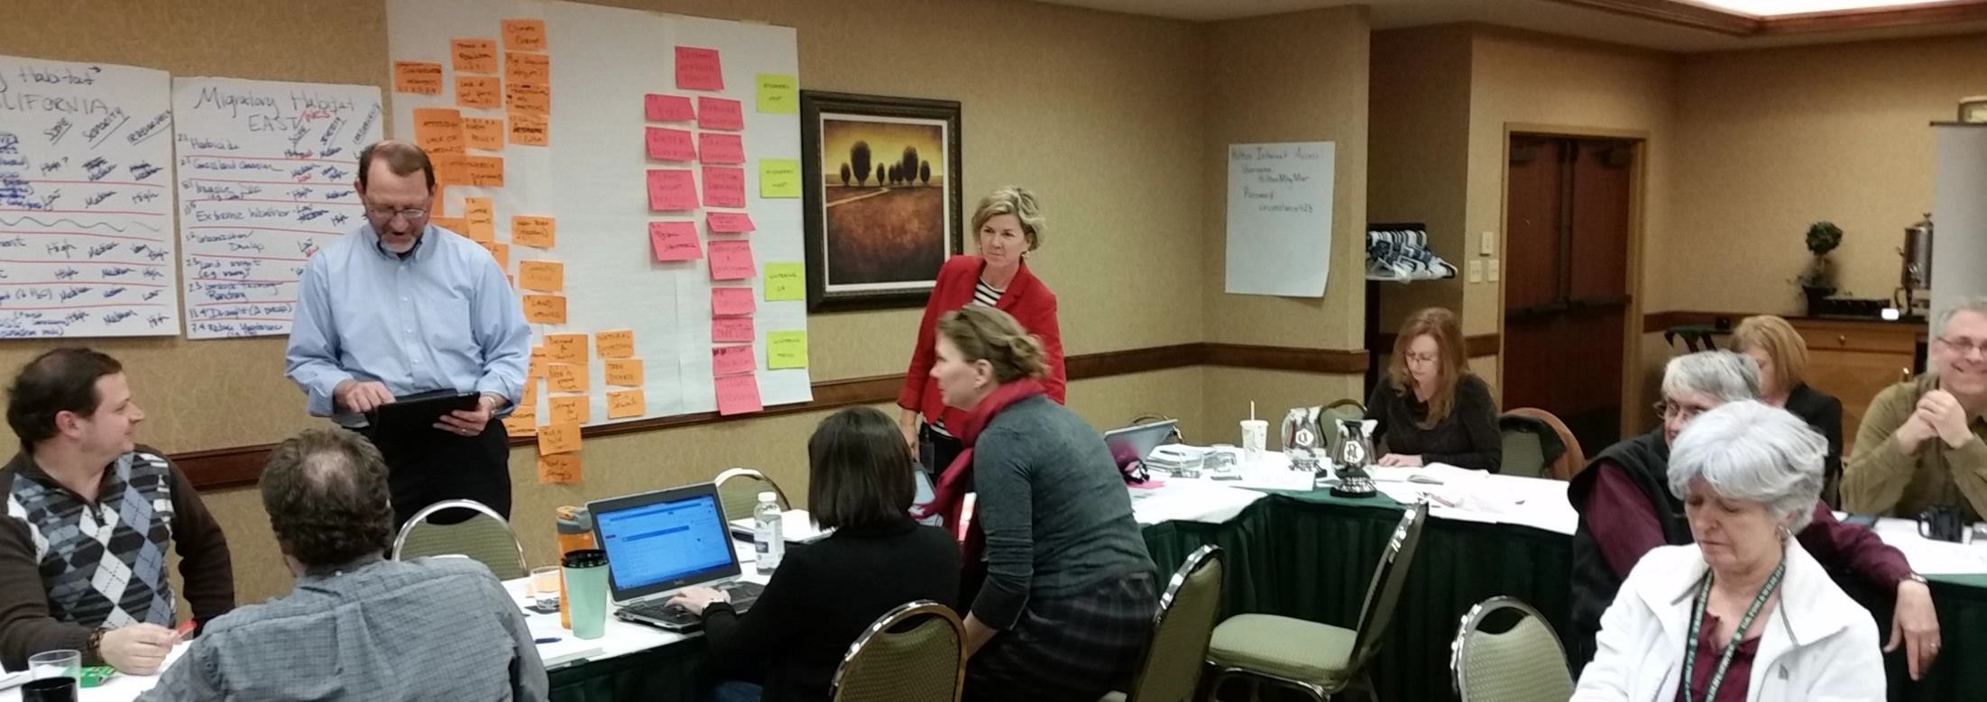
USFWS Monarch Planning Workshop

Slide 21

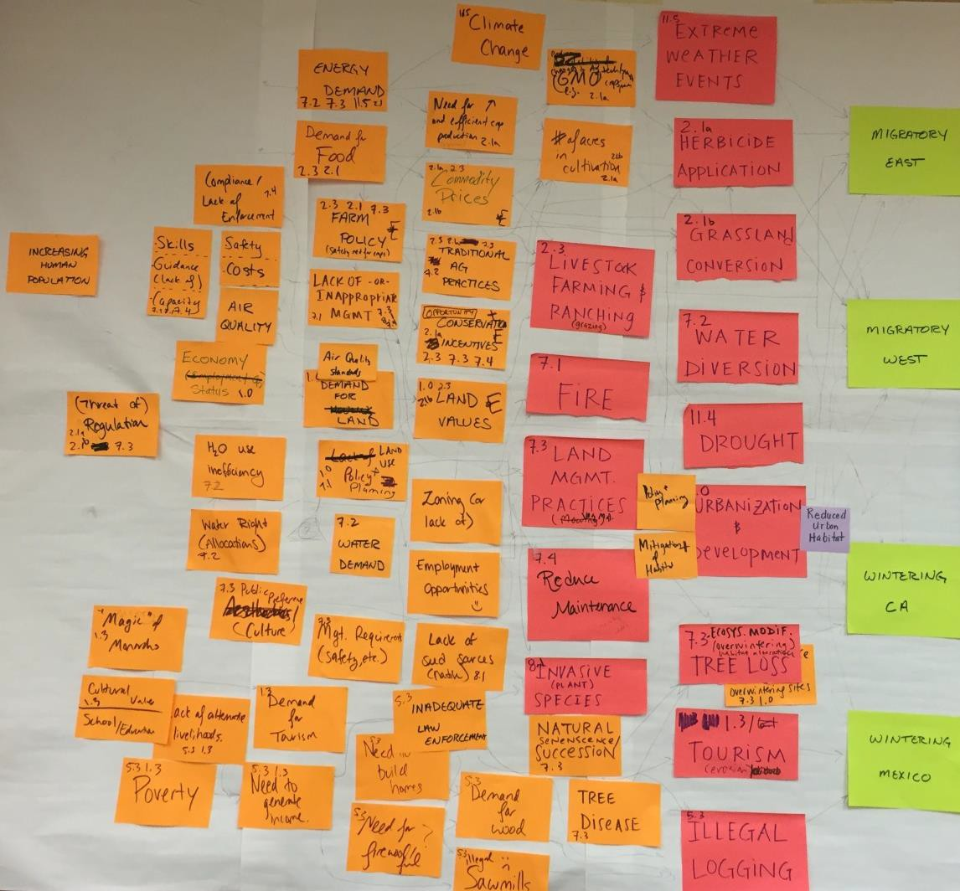
Monarch Conceptual Model
Defined:
Conservation targets
Direct threats (& rated)
Indirect threats/ contributing factors

Slide 22
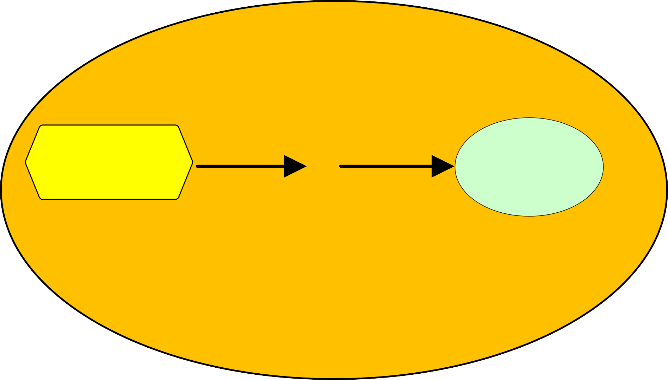
?
CONSERVATION
Strategy
Conservation target improved
CONTEXT

Slide 23
Results Chain: Theory of Change
Outcome
(Direct Threat)
Impact on Conservation Target
Strategy
Outcome
Outcome
Objective
Objective
Objective
Goal
Results chains show the anticipated results
-- the “desired state of the world”

Slide 24

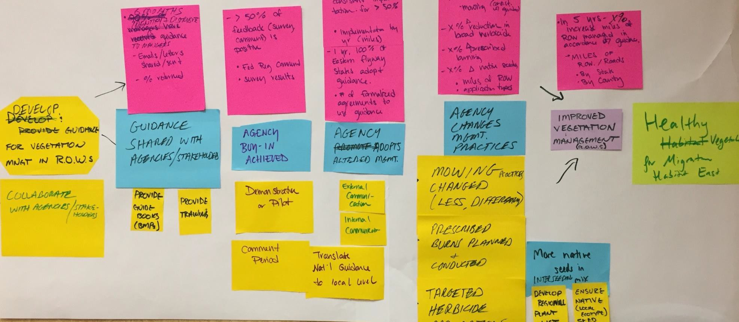
Monarch Results Chain

Slide 25
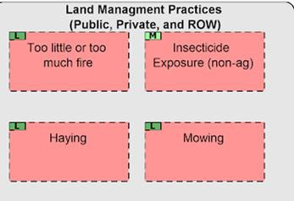
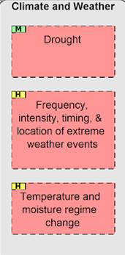
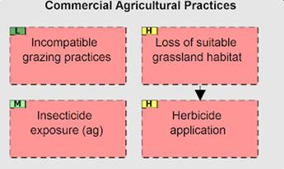
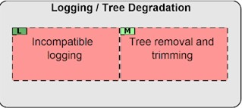
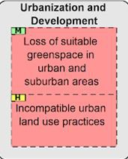

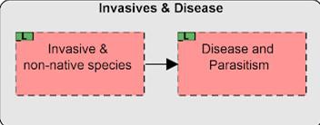
Indirect threat
Direct threat
Conservation
Target
Direct Threats

Slide 26
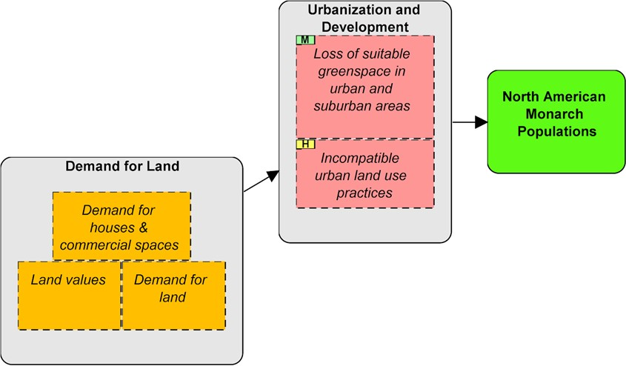
Indirect threat
Direct threat
Conservation
Target
Urbanization and Development

Slide 27
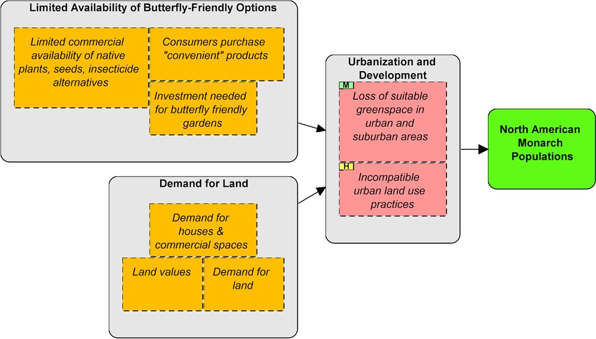
Indirect threat
Direct threat
Conservation
Target
Urbanization and Development

Slide 28
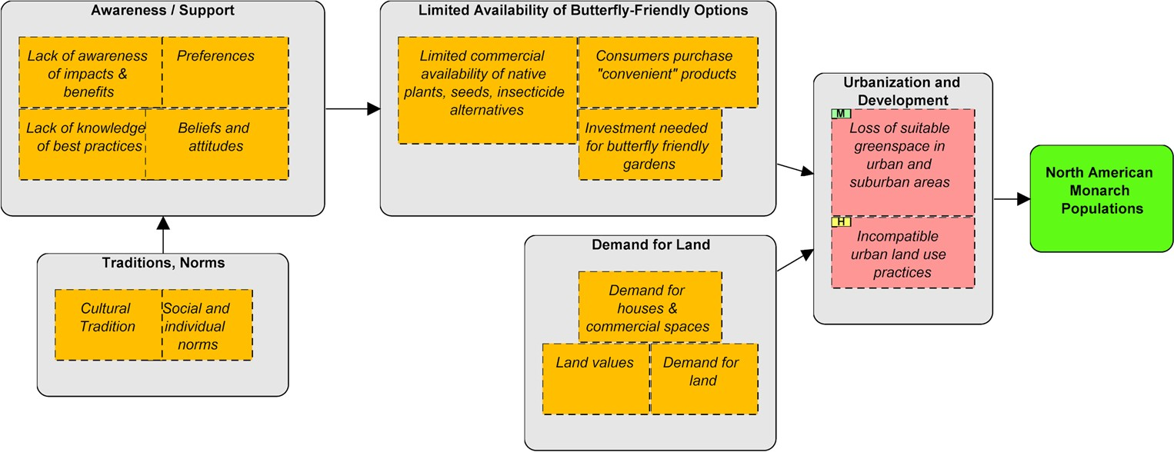
Indirect threat
Direct threat
Conservation
Target
Urbanization and Development

Slide 29
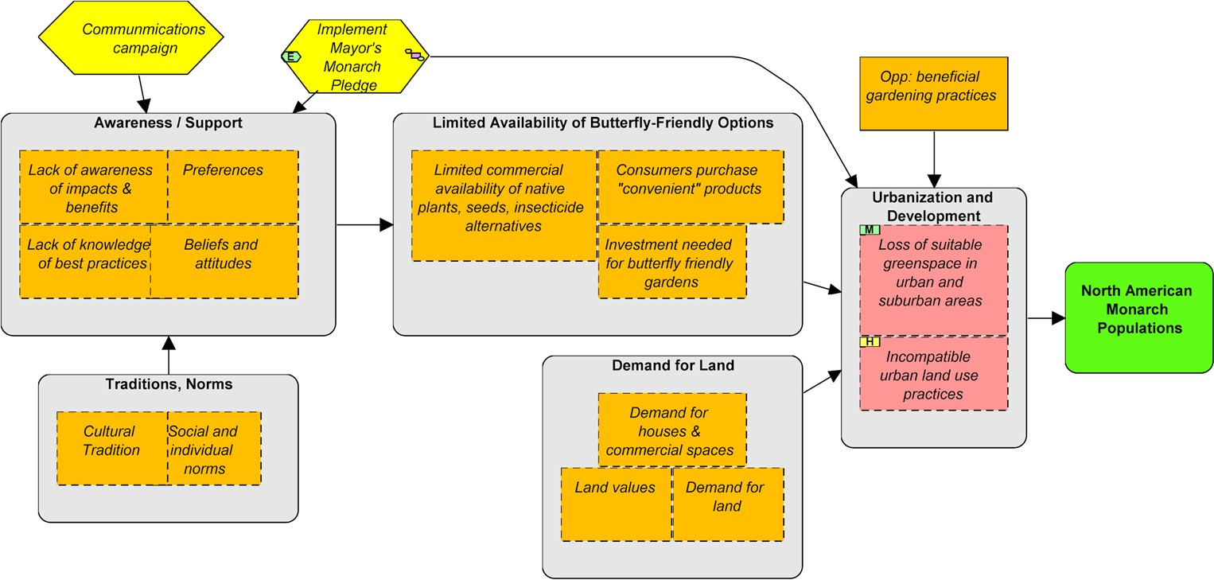
Indirect threat
Direct threat
Conservation
Target
Urbanization and Development

Slide 30
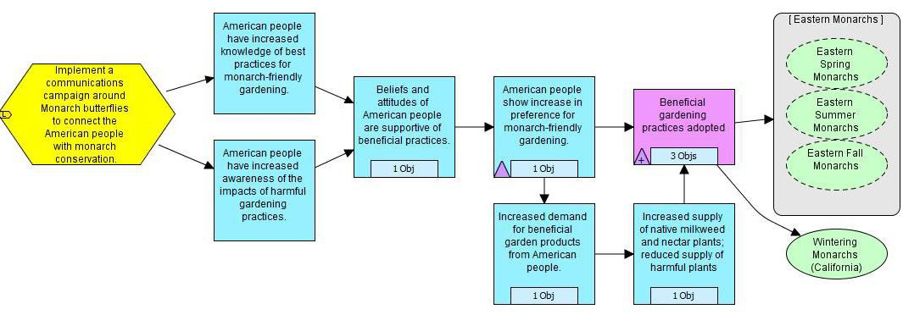
Beneficial Gardening Practices Results Chain

Slide 31
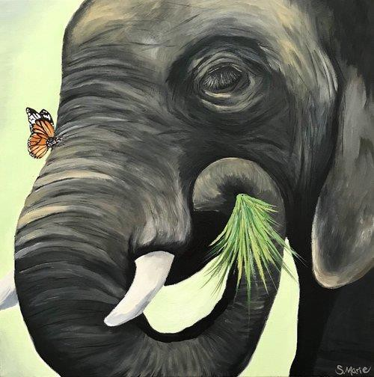
What do elephants and butterflies have in common?
It’s complex!

Slide 32
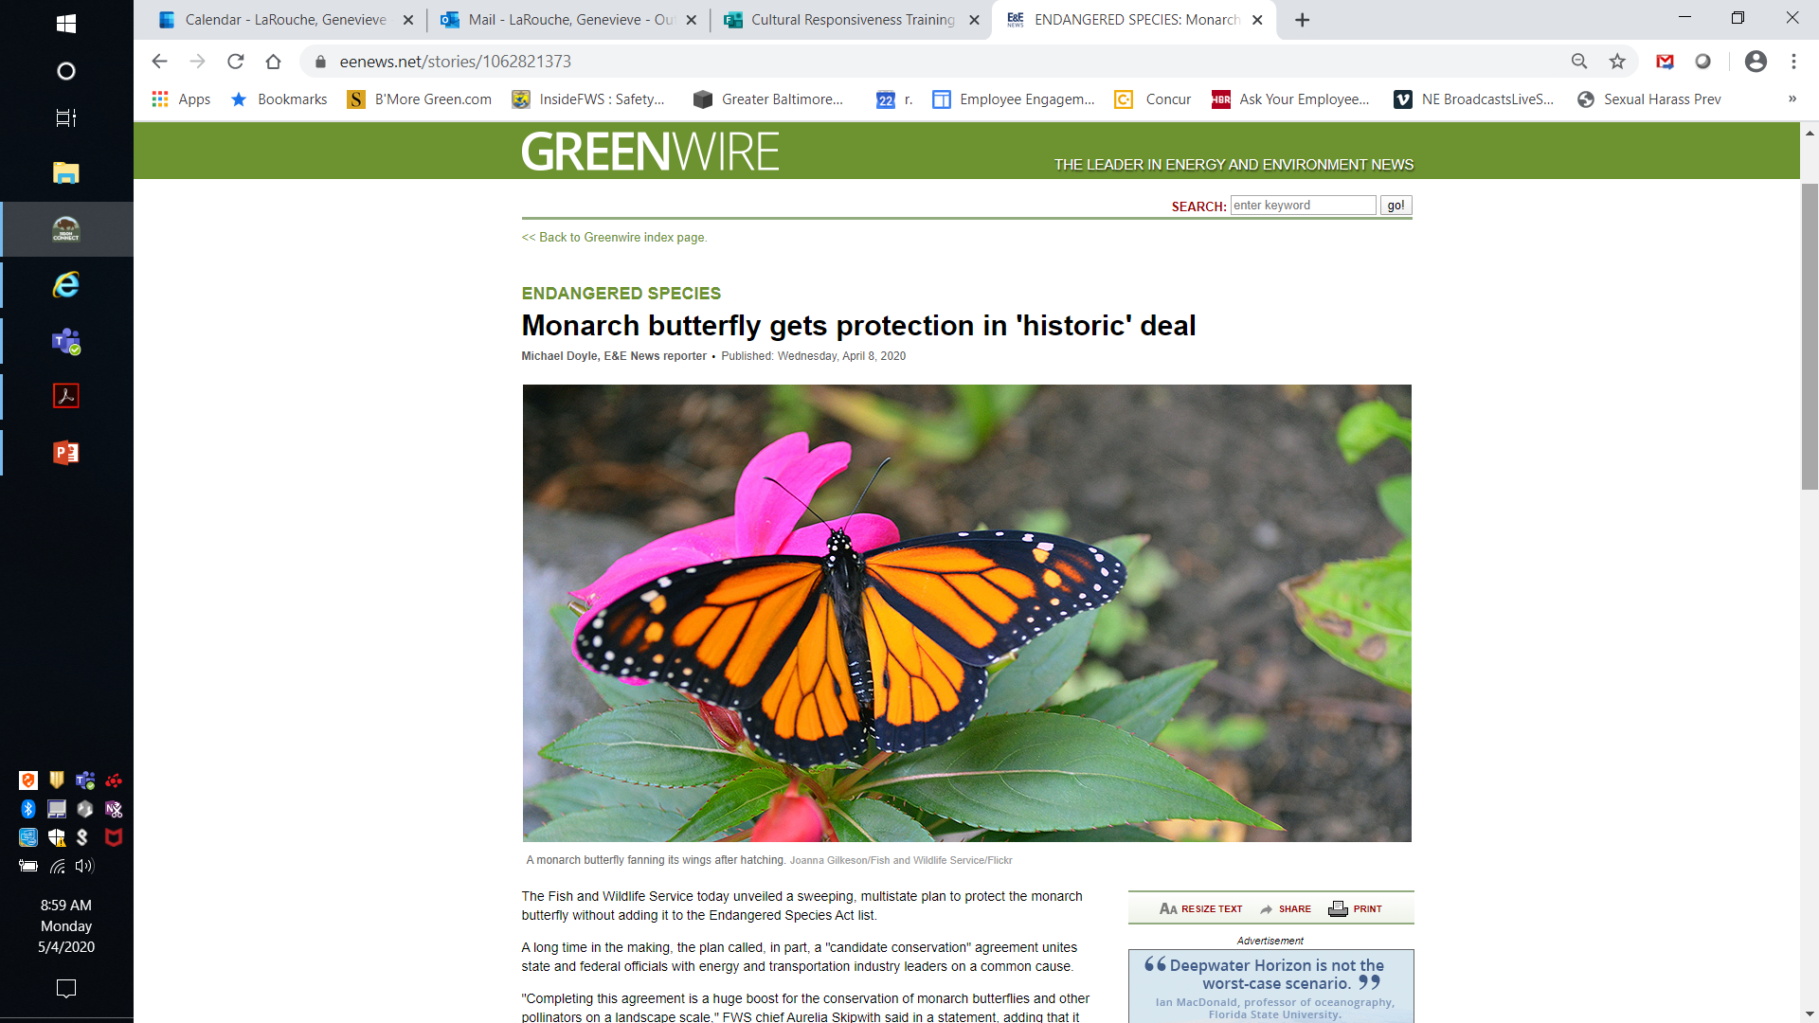

Slide 34
Standards of Excellence
1.Know and Relate to the Community
2.Connect People with Nature via Stepping Stones of Engagement
3.Build Partnerships
4.Be a Community Asset
5.Ensure Long-Term Resources
6.Provide Equitable Access
7.Ensure Visitors Feel Safe and Welcome
8.Model Sustainability

Slide 35
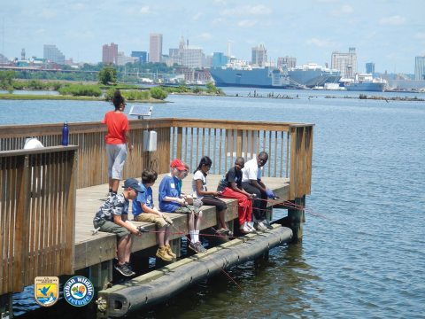
Baltimore Rivers to Harbor Urban Refuge Partnership
Notes:
Finally we get to Baltimore. This is Masonville Cove, one of our jewels of the partnership. Baltimore skyline in background and Port. We started working here through our relationship with the Corp and the MD Port Administration, a state agency needed our help with a mitigation project. The Port needed a place to put their dredged material and was doing community based outreach that identified non-motorized water access as a priority. They called us up and asked for help, with a black rail they spotted and knew was a rare bird. We brought refuges to help with the community-visitor piece and we helped with their wildlife
Why should an ES office do work in Baltimore? 80% of Americans now live in cities. If we want FWS to stay relevant – if we want wildlife conservation to stay relevant, we need to reach people where they are.
Why should people care? Aren’t they all on their phones anyway? Recent studies have found that connection with nature is fundamental to people’s health and well-being.

Slide 36
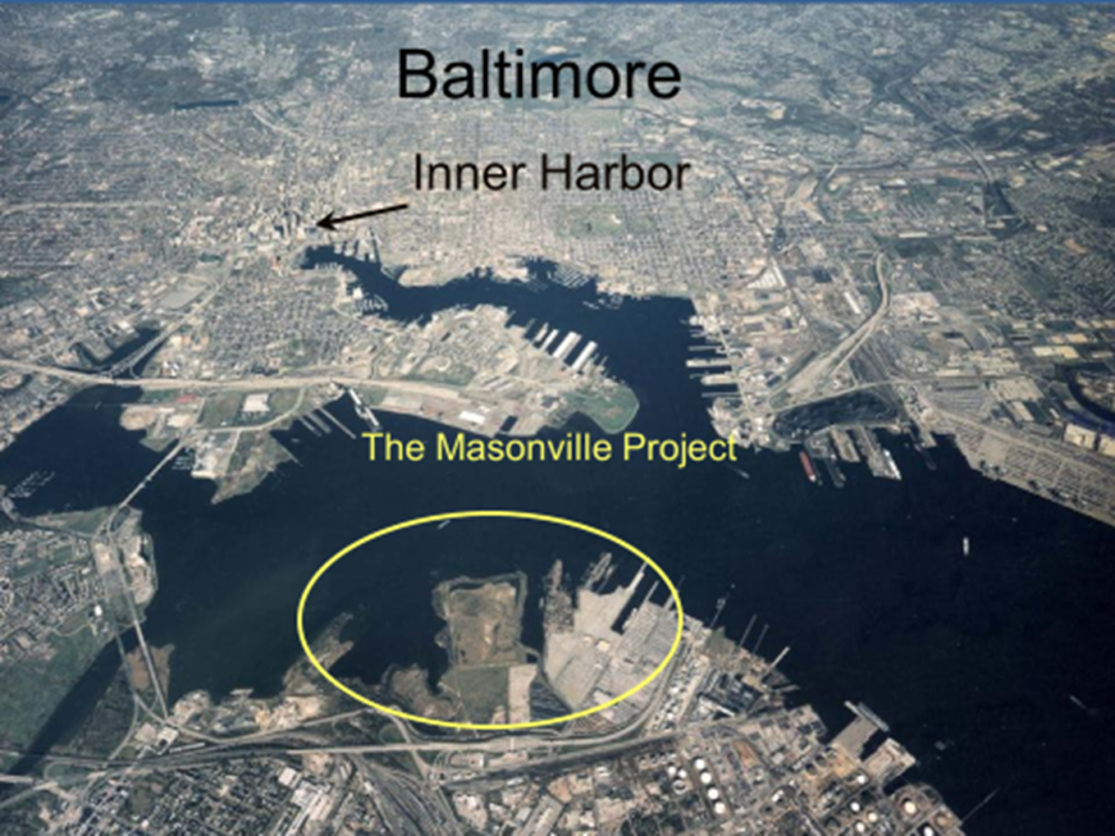
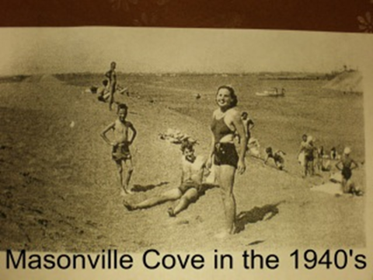
Masonville Cove and its Neighborhoods
Notes:
MC people were cut off from access to the Harbor and the Ches Bay in the 1950s. The people wanted to connect with nature again.
I’m not going to be talking about MC much but the work that the partners are doing in S. Baltimore such as the National Aquarium, LCF and Greater Baybrook Alliaince.

Slide 37





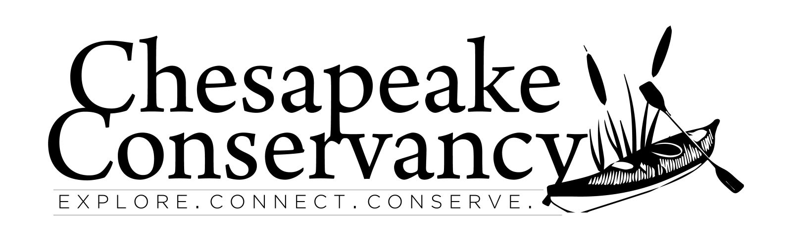

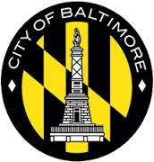
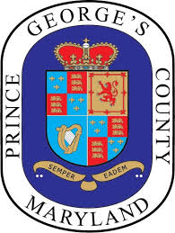


Notes:
A Coalition is only as powerful as the people that are invested in it.
I am new to PTA and a truism is that a quality of a school is often measured by how engaged and invested in the PTA is. And the same is true of a coalition. If it’s just another meeting to attend, action items that don’t effect me than why should I invest the time – let alone resources.
So why should you care about the Greater Baltimore Wilderness Coalition? Why should you invest the most precious resource of all – your time?

Slide 38
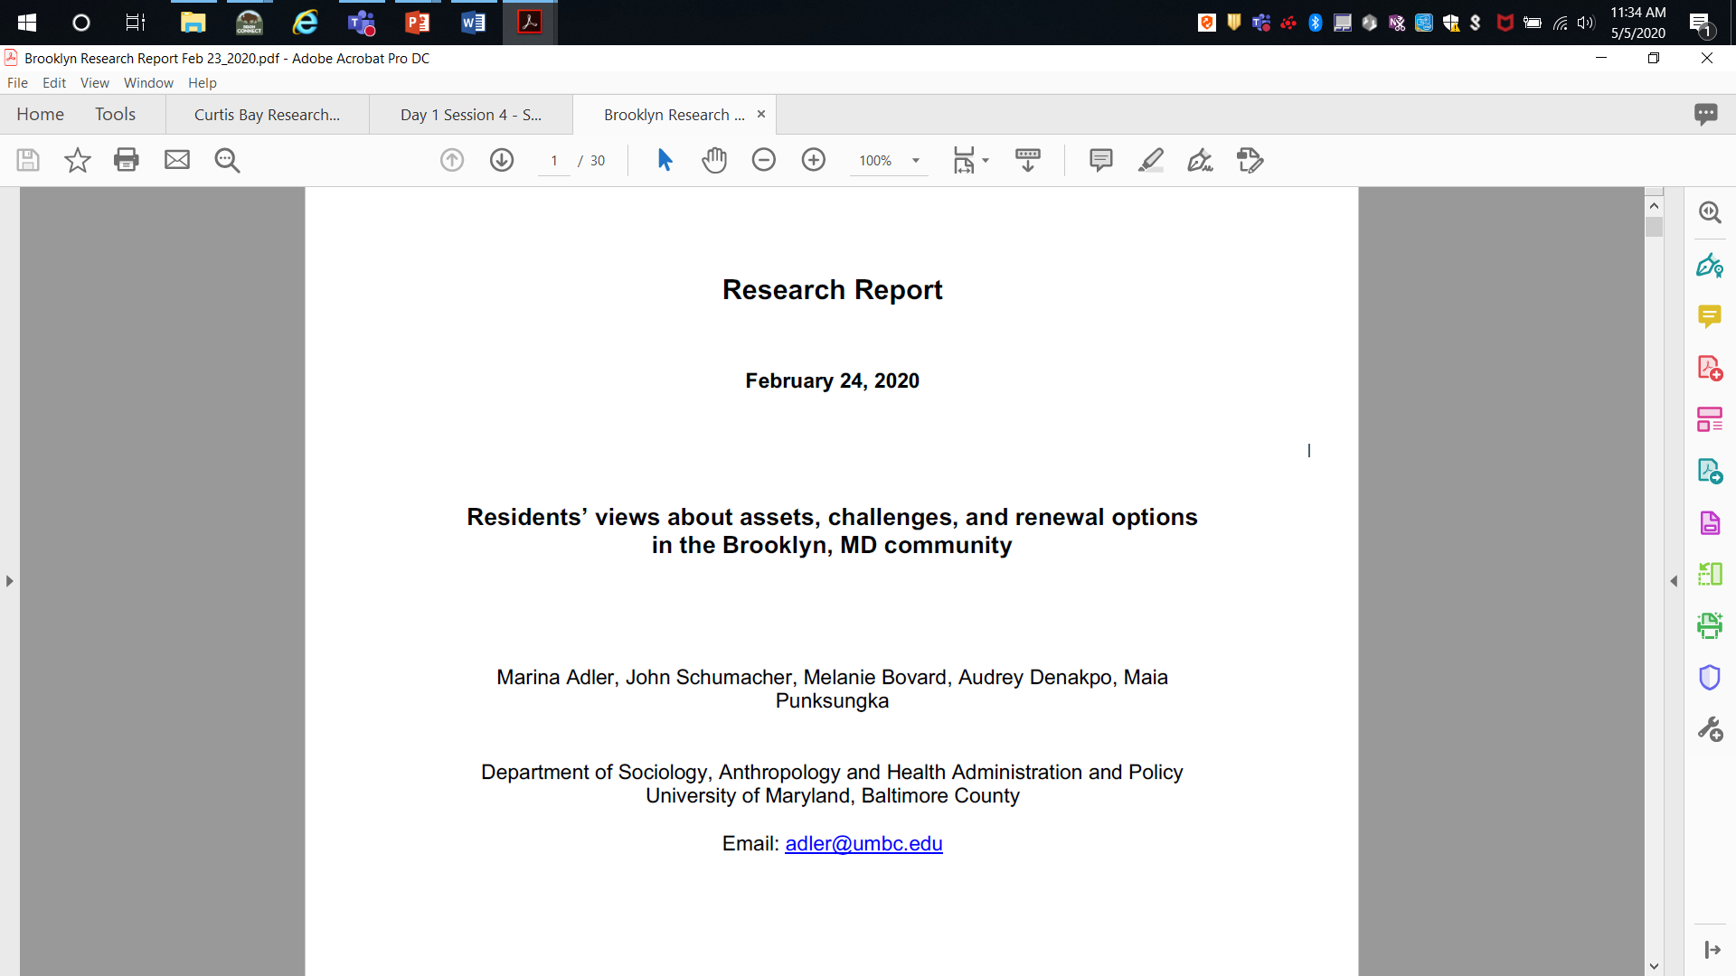

Slide 39
Table 3. Perceptions of Survey Respondents (N=93)
Appearance of community % fair or good
Cleanliness of streets 26.1
Cleanliness of yards 70.1
Public space maintenance 63.2
Appearance of store fronts 24.1
Neighborliness and safety % agree or strongly agree
Neighbors can be trusted 35.2
Neighbors help in emergency 50.0
Strong feeling of neighborliness 40.7
Cooperate to solve problems 17.7
Worry about traffic safety 89.6
Feel safe walking around 14.1
Notes:
Our 2017 research project focused on two main issues - the relationship between neighborhood improvement efforts and community cohesion in Curtis Bay, and the relationship between the Yard of the Week contest and social/physical order, revitalizing street faces, and community cohesion and safety.
Our findings suggest that Curtis Bay already has the conditions in place to go forward with continued neighborhood revitalization efforts. Community members are aware of the assets and challenges in their community – they appreciate their neighbors, safety, and cleanliness and are very interested in the YOTW contest. They are concerned about their community and particularly those who are invested in the community come to community meetings.
These preliminary results indicate that efforts of neighborhood revitalization and community building should not only focus on the physical conditions in the community, but also on how to increase the level of trust and social engagement among residents. Clearly the YOTW contest goes beyond mere physical yard maintenance. It increases neighborly interaction and serves to boost pride in their residence. Thus, we recommend expanding the contest to blocks, special occasions (holidays), and to porches.

Slide 40
Map of Vacant Properties with 911 Calls
Finding: 911 align closely to the list of vacant properties
Notes:
Use other data.
Unlike the heatmap of the 311 calls, the 911 call appear to
911 align closely to the list of vacant properties. There is one major hotspot area
that is important to note because it has several vacant properties and high call
volumes. This location is between 5th and 6th Street on Patapsco Avenue.
Patapsco Avenue is a busy thoroughfare with many active storefronts: a barber
13
shop, a church, a daycare, and several fast food establishments. While Figure 6
suggests that there is a relationship between vacant properties and 911 calls, it
also suggests that the businesses situated around this area are likely to call 911
if they observe disruptions.

Slide 41
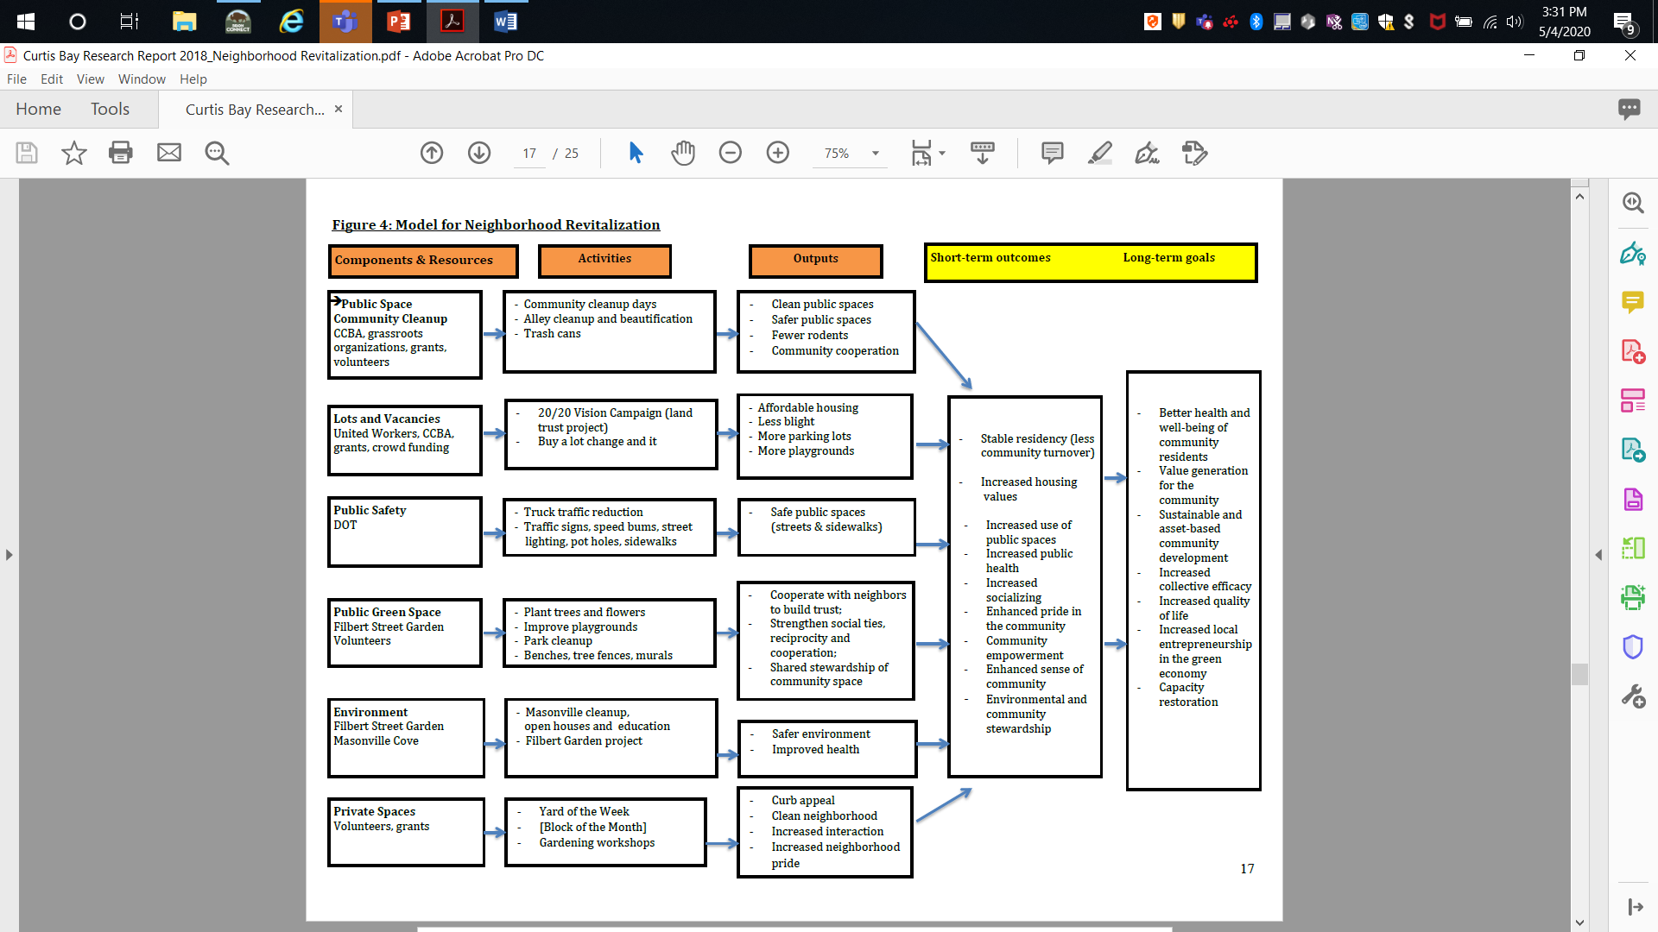

Slide 42
Findings from Curtis Bay and Brooklyn Reports
Responses were similar across race.
Responses varied by age and length of time living in the neighborhood.
Future efforts need to focus not only on the physical conditions and safety in the community, but also on how to increase the level of trust and social engagement among residents.
Notes:
Our findings suggest that Brooklyn already has the conditions in place to go
forward with continued neighborhood revitalization efforts, particularly those
focused on housing conditions. The community has a relatively large number of
assets, some of which are underutilized. Awareness of the strengths already in
the community can be an incentive to participate in improvements and in
attracting new residents. Across gender, age, ethnic background and homeowner
status, community members have very similar perceptions about the challenges
and future options of their community. They appreciate good neighbors, safety,
and clean housing conditions. Most welcome various forms of community
revitalization and would help bring it about. This is a major advantage and
resource to begin projects that will vitalize this community.
While most residents and community leaders care deeply about their community
long-term, unfortunately some younger people do not plan to stay in Brooklyn. In
order to retain young residents and/or attract young families to Brooklyn, housing
conditions have to be addressed, but also how to increase the trust among
neighbors. This can only be accomplished by harnessing the existing assets and
by increasing the connections among residents.
22
Our preliminary results indicate that any plans for neighborhood revitalization and
community building should not only focus on the physical conditions and safety in
the community, but also on how to increase the level of trust and social
engagement among residents.

Slide 43
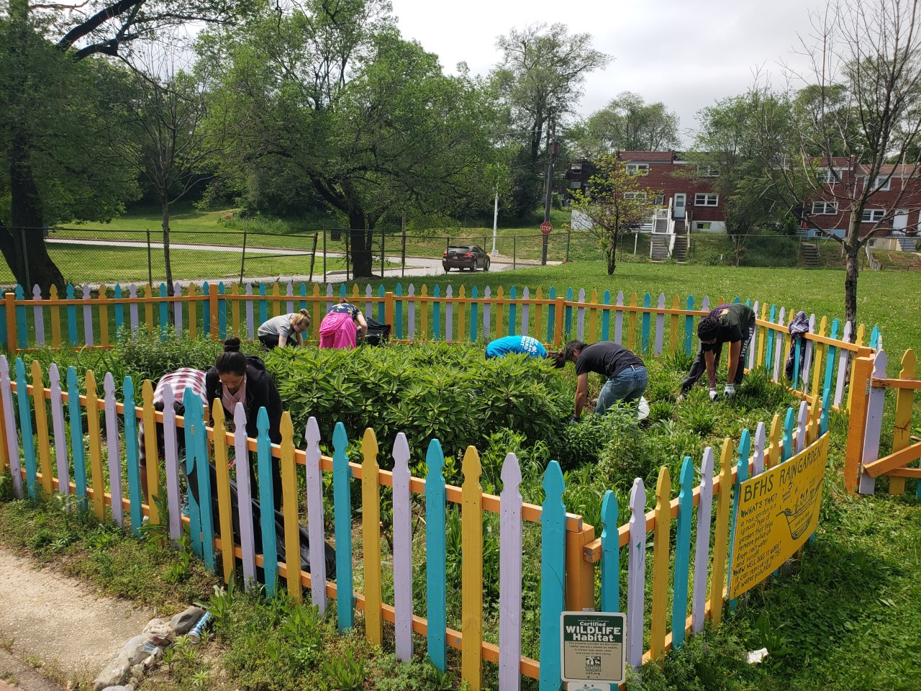
How Results are used by Masonville Cove Partnership
Projects should focus first on issues important to the community such as trash and safety.
Building trust in the community is paramount – build more bridges to community centers, leaders and churches. Hire community liaison.
Photo courtesy of National Aquarium
Notes:
Hire community liaisons that can attend community meetings, work with church leaders,
Have a grant that provides garbage cans to the community and then have a greant about pollinator gardends.
This goal, to engage Baltimore City residents in the creation of certified wildlife habitats at over 600 homes, schools, places of worship and community spaces, was originally set back in 2013, by several environmental organizations in

Slide 44
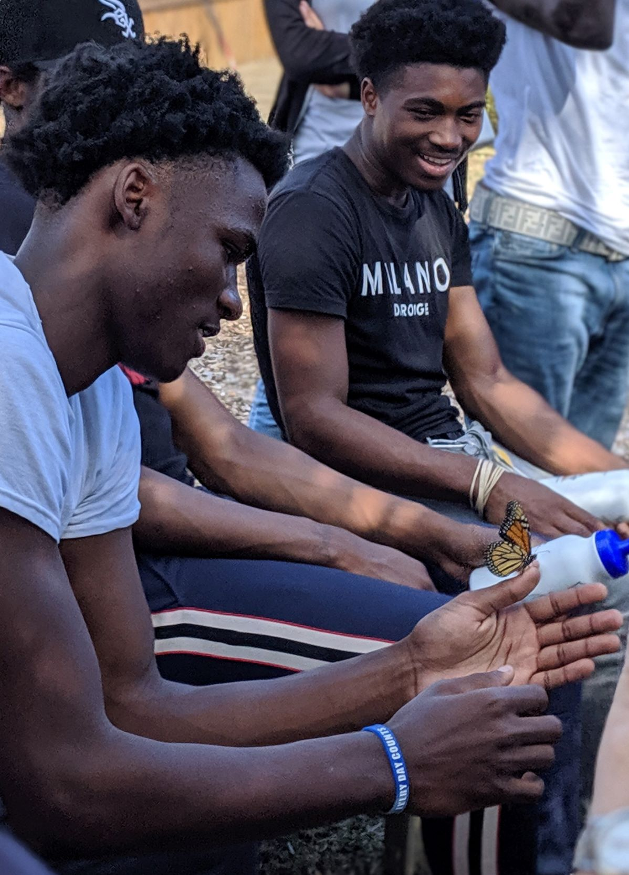
Summary
We need social science to understand the opportunities and impediments to achieving our conservation goals.
When we use social science we get more durable conservation solutions.
Social science is hard and complicated but new tools and data are available.
Partners who work in the community are good resources for existing data and collecting data.
We need to invest more in social science and overcome our organizational obstacles to using it.

Slide 45
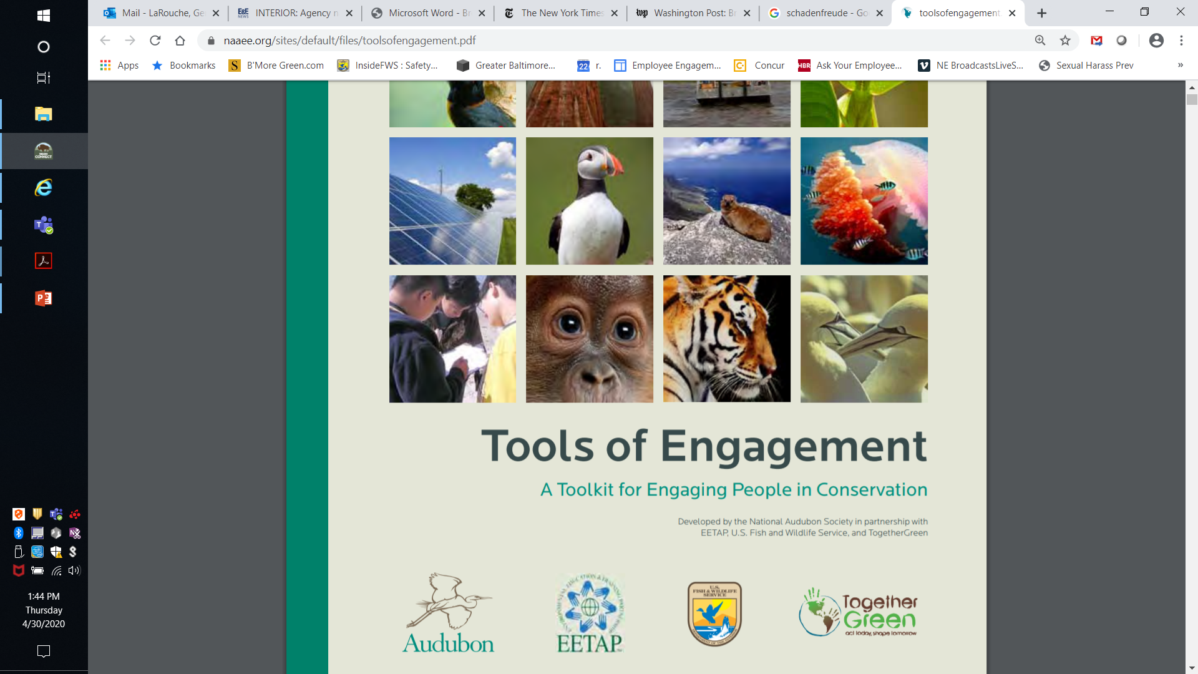
https://naaee.org/sites/default/files/toolsofengagement.pdf

