Slide 1
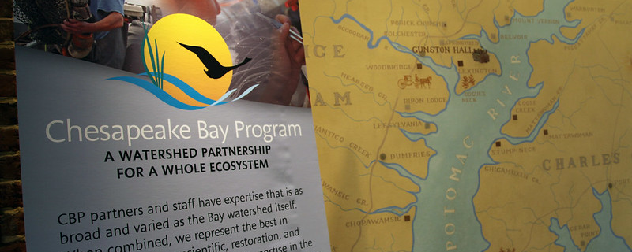
The Chesapeake Bay Program
Outcome Attainability
Presentation to the Citizens Advisory Committee
September 16, 2021
Carin Bisland, EPA CBPO

Slide 2
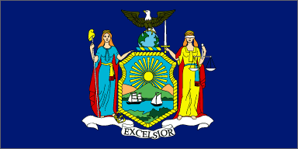
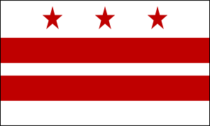
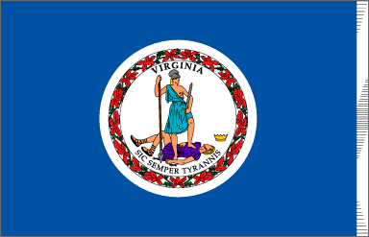
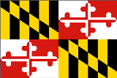



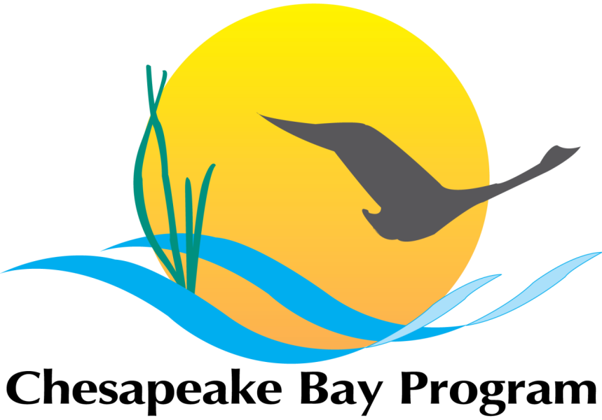
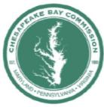
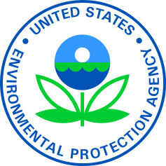






The Chesapeake Bay Program Partnership
NY
DC
VA
MD
PA
DE
WV
Bay Commission
Federal partners
A partnership of all the major players in the Chesapeake region, working collaboratively on science, policy and restoration efforts
Notes:
There are currently 9 signatories to the Agreement who are committed to achieving the goals and outcomes in the Agreement:
The Governors of the 6 states in the watershed
MD
PA
VA
NY
WV
DE
The Mayor of DC
The chair of the Chesapeake Bay Commission (tristate legislative body for MD, PA and VA)
The Administrator of EPA on behalf of the Federal government

Slide 3
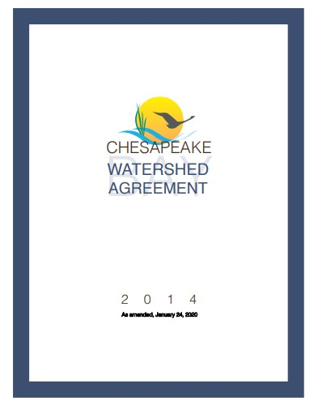
CBP’s Executive Council
agreed to
Watershed Agreement
GOALS and initial OUTCOMES
CBP’s Principals’ Staff Committee tracks OUTCOMES,
ensuring they are measurable and achievable; adapting as needed
CBP’s Management Board manages and tracks the STRATEGIES, adapting them as necessary over time for success
Vision: An environmentally and economically sustainable Chesapeake Bay watershed with clean water, abundant life, conserved lands and access to the water, a vibrant cultural heritage, and a diversity of engaged citizens and stakeholders.
Logic and Action Plans summarize specific commitments, short-term actions and resources required for success
Notes:
Chesapeake Bay Program partners also gathered input from citizens, stakeholders, academic institutions, local governments and more to draft an inclusive, goal-oriented document that would address current and emerging environmental concerns.
What the Agreement provides:
Simplification/Clarity
Goals are more clear (simpler) than those of C2K – therefore more understandable, measureable
Focus will be on higher priority goals and outcomes
Flexibility
Resource managers in each jurisdiction will be able to adapt their management strategies to better support their goals
This is not an “opt out” – it’s a sensible solution to the diverse ways that jurisdictions manage the equally diverse resources they have
Accountability
Annual reviews of partner management strategies and clear, simple goals on high priority issues will make it easier to track how efforts are going

Slide 4
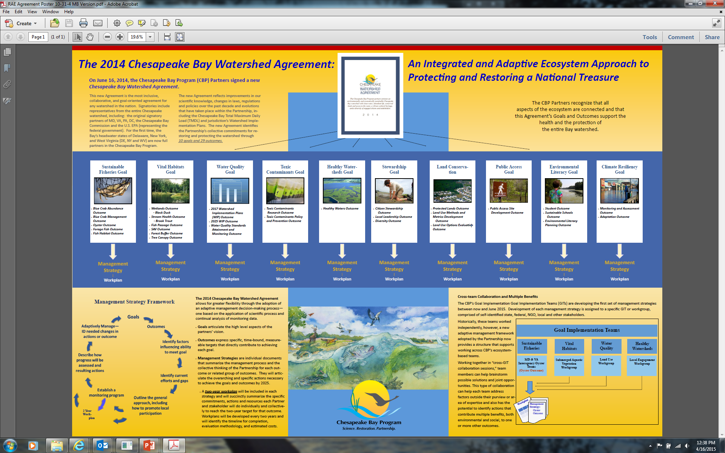

Slide 5

January 1, 2026 – What is the Headline we want to see?

Slide 6
What can we do now that will influence these headlines?
Good
Bad

Slide 7
Outcome Attainability Team (OAT)
For those Outcomes that have a target and a timeline:
  What do we know about the status?
  Which are on track, which are significantly off track?
  What don’t we know?
For those Outcomes that have either no target or timeline:
  How do we define success?
Based on the answers to the questions above, where do we focus our time and attention?
Caution: This is an analysis from the Outcome Attainability Team to the Management Board. Conclusions are subject to change based on Management Board feedback.

Slide 8
Watershed Agreement Outcomes
Sustainable Fisheries
Blue Crab Abundance & Management
Oyster Restoration
Vital Habitats
SAV
Clean Water
Watershed Implementation Plans - 2017 & 2025
Water Quality Standards Attainment & Monitoring
Engaged Communities
Diversity
Public Access
Citizen Stewardship
Sustainable Schools
Environmental Literacy Planning
Student MWEEs
Toxic Contaminants Policy and Prevention
Climate Change
Climate Monitoring and Assessment
Fish Habitat
Forage fish
Fish Passage
Stream Health
Forest Buffers
Tree Canopy
Wetlands
Toxic Contaminants Research
Healthy Watersheds
Local Leadership
Climate Adaptation
Conserved Lands
Protected Lands
Land Use Options Evaluation
Land Use Methods & Metrics
Black Duck
Brook Trout
Notes:
This is a different display of the 31 outcomes based on general themes and combining a couple (blue crab and WIPs) to make it easier to read on the screen, but this is the display of the 31 outcomes in the Agreement

Slide 9
Watershed Agreement Outcomes with Targets and Timelines
Sustainable Fisheries
Blue Crab Abundance & Management
Oyster Restoration
Vital Habitat
SAV
Clean Water
Watershed Implementation Plans - 2017 & 2025
Engaged Communities
Diversity*
Public Access
Citizen Stewardship
Sustainable Schools
Environmental Literacy Planning
Student MWEEs
Climate Change
Climate Monitoring and Assessment
Fish Passage
Stream Health
Forest Buffers
Tree Canopy
Wetlands
Local Leadership
Climate Adaptation
Toxic Contaminants Policy and Prevention
Healthy Watersheds
Fish Habitat
Forage fish
Toxic Contaminants Research
Water Quality Standards Attainment & Monitoring
Conserved Lands
Protected Lands
Land Use Options Evaluation
Land Use Methods & Metrics
Black Duck
Brook Trout
*Target and date set by CBP. Not in original Outcome language
Notes:
16 outcomes have targets and timelines, 15 are in the Agreement language, 1 was adopted by the PSC and announced by the EC as an indicator of success
Primary focus of the OAT are these, not because others aren’t important, but because these have specific measures that are easily identified as meeting or not meeting the outcome

Slide 10
Watershed Agreement Outcomes with Targets and Timelines
Sustainable Fisheries
Blue Crab Abundance & Management
Oyster Restoration
Vital Habitat
SAV
Clean Water
Watershed Implementation Plans - 2017 & 2025
Engaged Communities
Diversity*
Public Access
Citizen Stewardship
Sustainable Schools
Environmental Literacy Planning
Student MWEEs
Climate Change
Climate Monitoring and Assessment
Fish Passage
Stream Health
Forest Buffers
Tree Canopy
Wetlands
Local Leadership
Climate Adaptation
Toxic Contaminants Policy and Prevention
Healthy Watersheds
Fish Habitat
Forage fish
Toxic Contaminants Research
Water Quality Standards Attainment & Monitoring
Conserved Lands
Protected Lands
Land Use Options Evaluation
Land Use Methods & Metrics
Black Duck
Brook Trout
*Target and date set by CBP. Not in original Outcome language
Notes:
Of those, it appears that 6 still require substantial effort to be completed, but they are likely to be completed by 2025, if current efforts continue as planned.

Slide 11

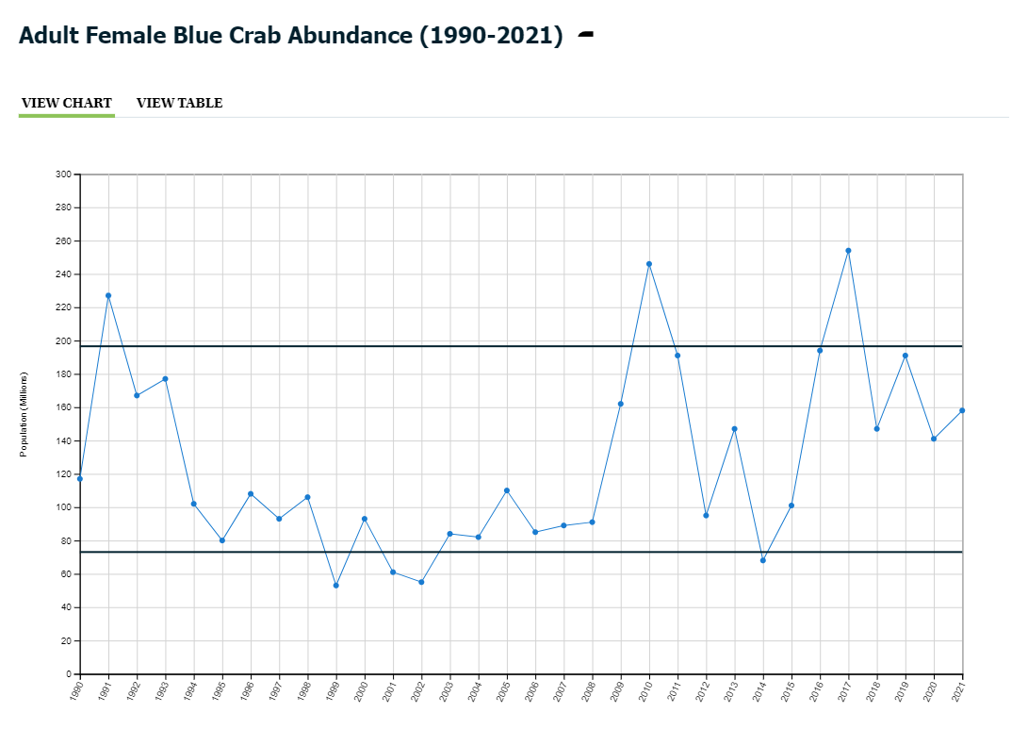
Blue Crab Abundance
Current Progress
Between 2020 and 2021, the abundance of adult (age 1+) female blue crabs in the Chesapeake Bay increased 12% from 141 million to 158 million. This number is above the new 72.5 million threshold which is considered to be the minimum sustainable level for female blue crabs in the Bay, but lower than the new target of 196 million.
Maintain a sustainable blue crab population based on the current 2012 target of 215 million adult females. Refine population targets through 2025 based on best available science.
On Track to Achieving Outcome
Since female-specific management was implemented in 2008, female abundance has increased and remained above the threshold (or at the threshold in 2014) of 70 million crabs, and even surpassed the target of 215 million crabs in 2010 and 2017.

Slide 12
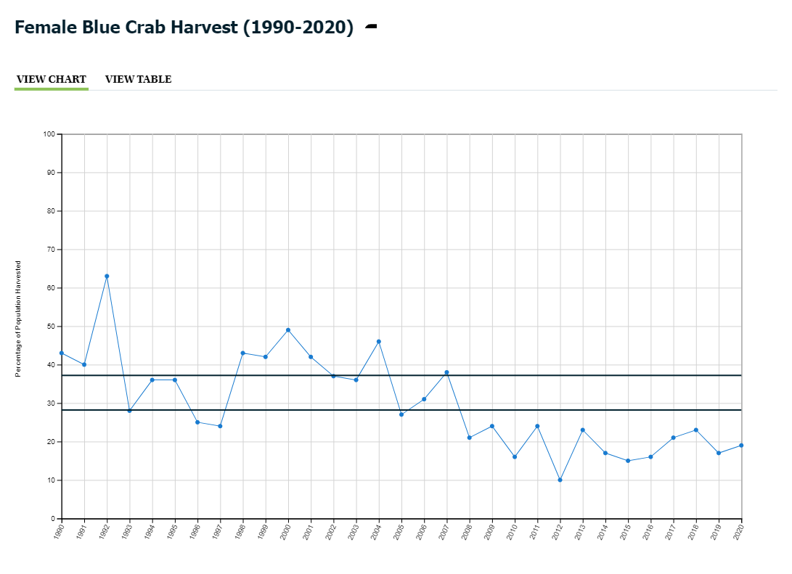
Blue Crab Management
Current Progress
An estimated 19% of the female blue crab population was harvested in 2020. This is below both the target (now 28%) and overfishing threshold (now 37%).
CURRENT ABILITY TO TRACK OUR PROGRESS
On Track to Achieving Outcome
Te female blue crab population has been below the target and above the overfishing threshold for the 13th consecutive year since female-specific management measures were implemented in 2008, which suggests that management has been effective. In November 2017, it was decided to maintain the existing blue crab management framework rather than establish a new, allocation-based framework for the Chesapeake Bay's commercial and recreational blue crab fisheries.
Manage for a stable and productive crab fishery including working with the industry, recreational crabbers and other stakeholders to improve commercial and recreational harvest accountability. By 2018, evaluate the establishment of a Bay-wide, allocation-based management framework with annual levels set by the jurisdictions for the purpose of accounting for and adjusting harvest by each jurisdiction.

Slide 13
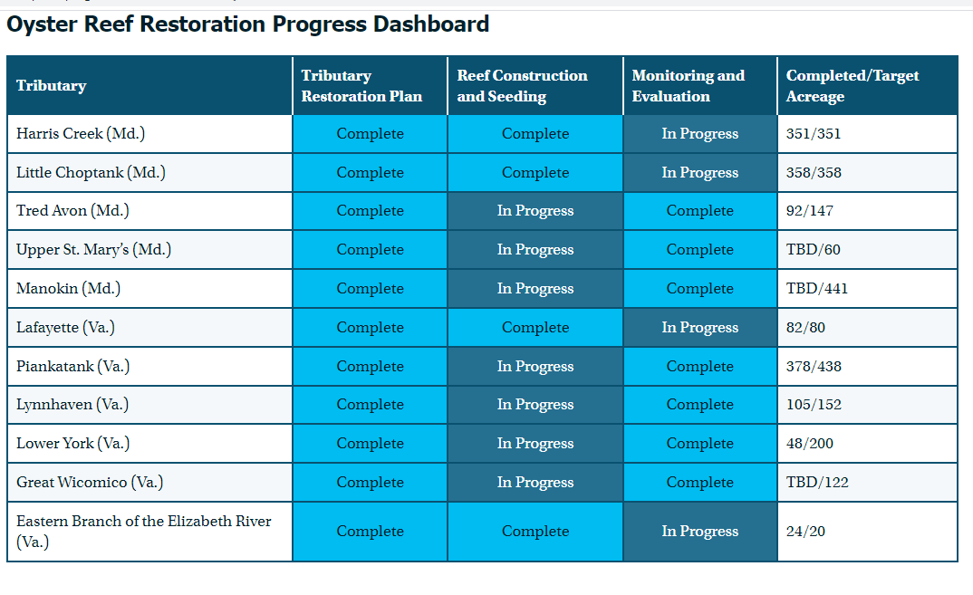
Oysters
Current Progress
Ten Chesapeake Bay tributaries have been selected for oyster reef restoration. The Sustainable Fisheries GIT approved the Eastern Branch of the Elizabeth River in Virginia as an eleventh bonus tributary in 2020.
Continually increase finfish and shellfish habitat and water quality benefits from restored oyster populations. Restore native oyster habitat and populations in 10 tributaries by 2025 and ensure their protection.
On Track to Achieving Outcome
As of 2020, three of the ten originally selected tributaries have been restored, in addition to the eleventh bonus tributary. Monitoring and evaluation will take place at three- and six-year intervals following construction and seeding. This monitoring and evaluation phase will not be complete until after 2025.

Slide 14

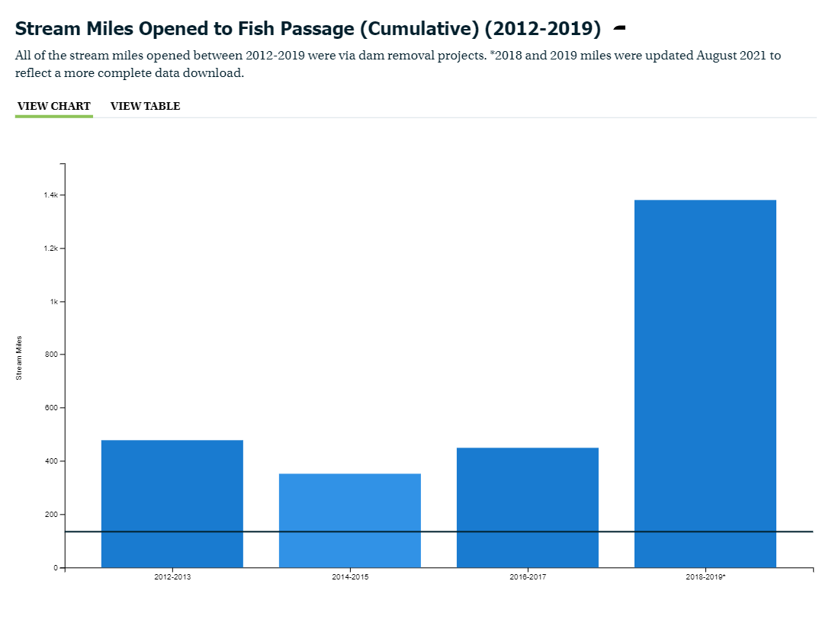
Fish Passage
Current Progress
In 2018 and 2019, 1,379 additional stream miles were opened to fish passage through dam removal projects, far exceeding the target to open an additional 132 miles every two years.
On Track to Achieving Outcome
By 2016, the fish passage outcome of opening 1000 miles by 2025 was exceeded. The outcome was modified to continue to open stream miles to access by migratory fish at the same rate (132 miles every two years). Much of the low hanging fruit with regard to dam removal has been picked and opportunities to restore fish passage through retrofitting or removal of culverts are being investigated.
Continually increase access to habitat to support sustainable migratory fish populations in the Chesapeake Bay watershed’s freshwater rivers and streams. By 2025, restore historical fish migration routes by opening an additional 132 miles every two years to fish passage. Restoration success will be indicated by the consistent presence of alewife, blueback herring, American shad, hickory shad, American eel and brook trout, to be monitored in accordance with available agency resources and collaboratively developed methods.*
*In January 2020, the outcome was modified from the original language.

Slide 15
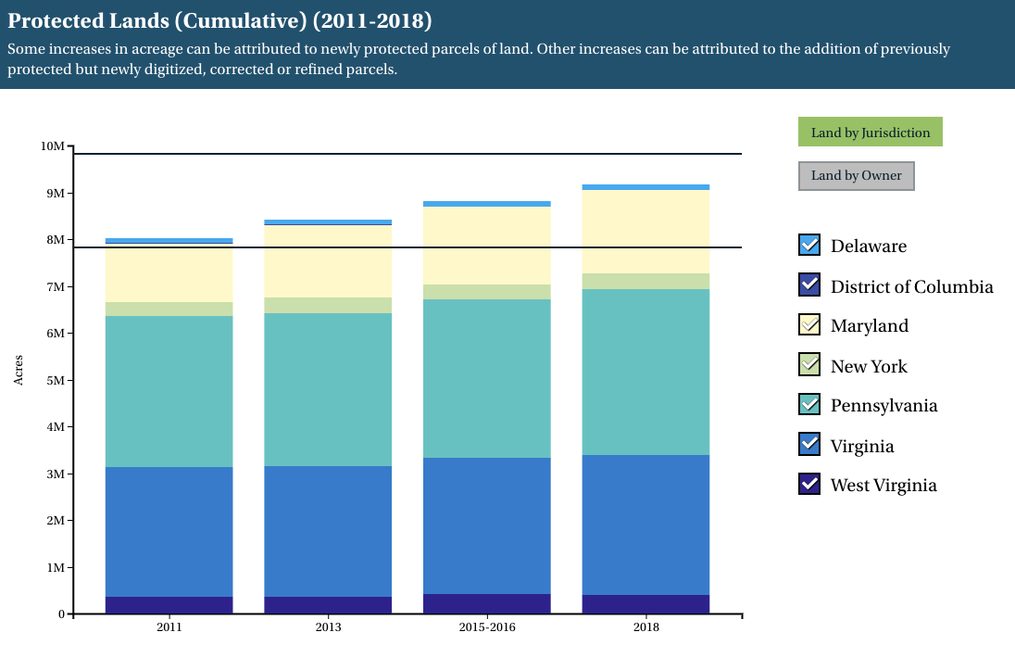
Protected Lands
Current Progress
According to data collected through early 2019, nearly 1.36 million acres of land in the Chesapeake Bay watershed have been permanently protected since 2010. This marks an achievement of 68% of the land conservation goal and brings the total amount of protected land in the watershed to 9.16 million acres.
On Track to Achieving Outcome
The actual average annual rate of protection (169,807 acres) since 2010 is above the average annual rate required (133,333 acres) for meeting the 2025 two-million-acre goal.
By 2025, protect an additional two million acres of lands throughout the watershed—currently identified as high-conservation priorities at the federal, state or local level—including 225,000 acres of wetlands and 695,000 acres of forest land of highest value for maintaining water quality.

Slide 16
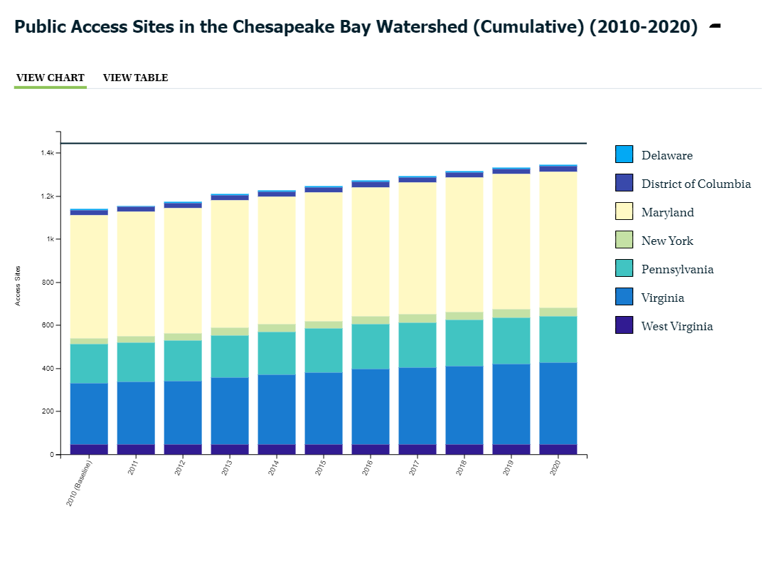
Public Access Site Development
Current Progress
In 2020, 12 new public access sites were added (six in Virginia, five in Maryland, and one in Pennsylvania). This brings the total to 206 public access sites that have opened on and around the Chesapeake Bay between 2010 and 2020, marking 69% achievement of the partnership’s goal to add 300 new access sites to the watershed by 2025.
On Track to Achieving Outcome
If the current trend from 2010-2020 continues, we expect to exceed target of 300 new public access sites by 2025.
By 2025, add 300 new public access sites, with a strong emphasis on providing opportunities for boating, swimming and fishing, where feasible.

Slide 17
Watershed Agreement Outcomes with Targets and Timelines
Sustainable Fisheries
Blue Crab Abundance & Management
Oyster Restoration
Vital Habitat
SAV
Clean Water
Watershed Implementation Plans - 2017 & 2025
Engaged Communities
Diversity*
Public Access
Citizen Stewardship
Sustainable Schools
Environmental Literacy Planning
Student MWEEs
Climate Change
Climate Monitoring and Assessment
Fish Passage
Stream Health
Forest Buffers
Tree Canopy
Wetlands
Local Leadership
Climate Adaptation
Toxic Contaminants Policy and Prevention
Healthy Watersheds
Fish Habitat
Forage fish
Toxic Contaminants Research
Water Quality Standards Attainment & Monitoring
Conserved Lands
Protected Lands
Land Use Options Evaluation
Land Use Methods & Metrics
Black Duck
Brook Trout
*Target and date set by CBP. Not in original Outcome language
Notes:
At least 3 are far off track. They will require additional support from technical and policy experts to identify specific and actionable options to increase the rate of implementation.

Slide 18

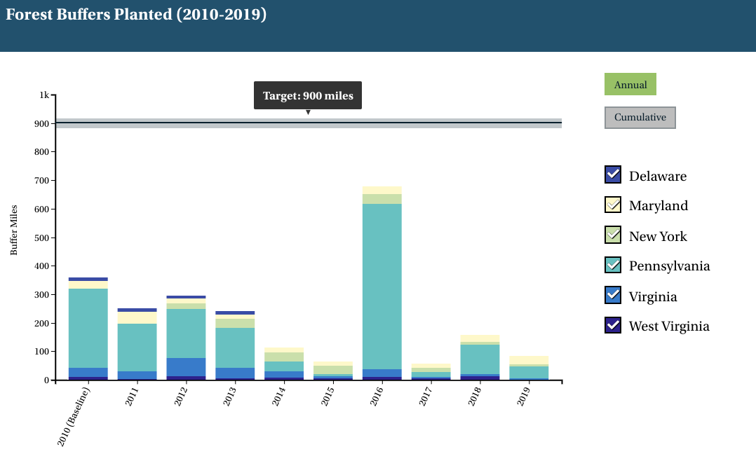
Forest Buffers
Current Progress
Between 2017 and 2018, about 158 miles of forest buffers were planted along rivers and streams, followed by about 83 miles in 2019. While this marks progress toward the outcome, it is 742 and 817 miles below the 900-mile-per-year target, respectively.
Not on Track
We are short of the 900-mile per year target and furthermore, this target is inadequate to meet the buffer goals outlined in the Phase III WIPs. To fill the gap between 2018 Progress and 2025 WIP III goals, we would need to add over 1,700 miles of forest buffers annually between 2019-2025.
Continually increase the capacity of forest buffers to provide water quality and habitat benefits throughout the Chesapeake Bay watershed. Restore 900 miles of riparian forest buffers per year and conserve existing buffers until at least 70 percent of riparian areas in the watershed are forested.
Progress needed to meet WIP3 goals (1719 miles/yr 2019-2025)

Slide 19
What is our Expected and Actual Progress?

Slide 20

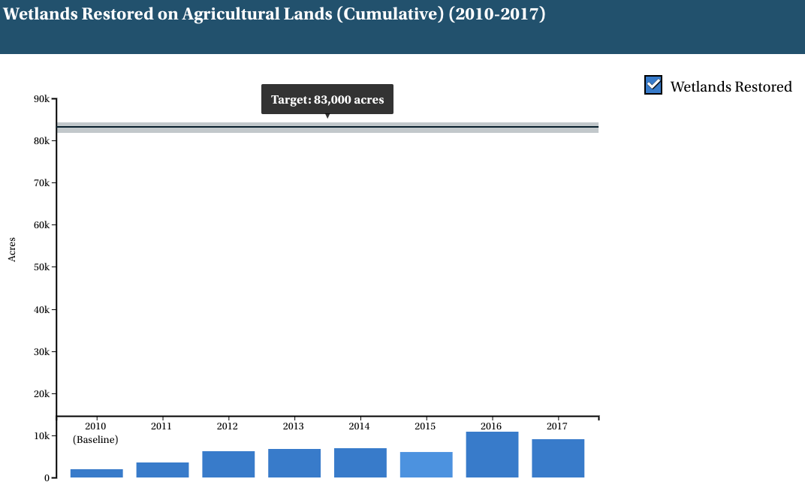
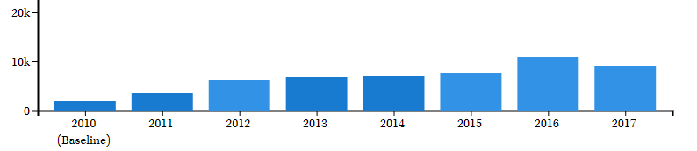
Wetlands
Current Progress
Between 2010 and 2017, 9,103 acres of wetlands were established, rehabilitated or reestablished on agricultural lands. While this outcome includes a target to restore 85,000 acres of tidal and non-tidal wetlands in the watershed, 83,000 of these restored acres should take place on agricultural lands. The wetlands restored on agricultural lands between 2010 and 2017 mark an 11% achievement of the 83,000-acre goal.
Outcome Achievement Uncertain
Wetland acreage data are inconsistently reported and inaccurate for assessing progress toward this outcome. Work is underway to identify a consistent means for collecting data by maximizing existing data reporting processes.
Continually increase the capacity of wetlands to provide water quality and habitat benefits throughout the watershed. Create or reestablish 85,000 acres of tidal and non-tidal wetlands and enhance function of an additional 150,000 acres of degraded wetlands by 2025. These activities may occur in any land use (including urban), but primarily occur in agricultural or natural landscapes.

Slide 21
2025 Watershed Implementation Plan
Current Progress
As of 2019, best management practices (BMPs) to reduce pollution are in place to achieve 39% of the nitrogen reductions, 49% of the phosphorus reductions and 100% of the sediment reductions needed to attain applicable water quality standards when compared to the 2009 baseline established in the Chesapeake Bay Total Maximum Daily Load (Bay TMDL).
By 2025, have all practices and controls in place to achieve applicable water quality (i.e., dissolved oxygen, water clarity/submerged aquatic vegetation and chlorophyll a) standards as articulated in the Chesapeake Bay Total Maximum Daily Load.
(Continued on next slide)

Slide 22
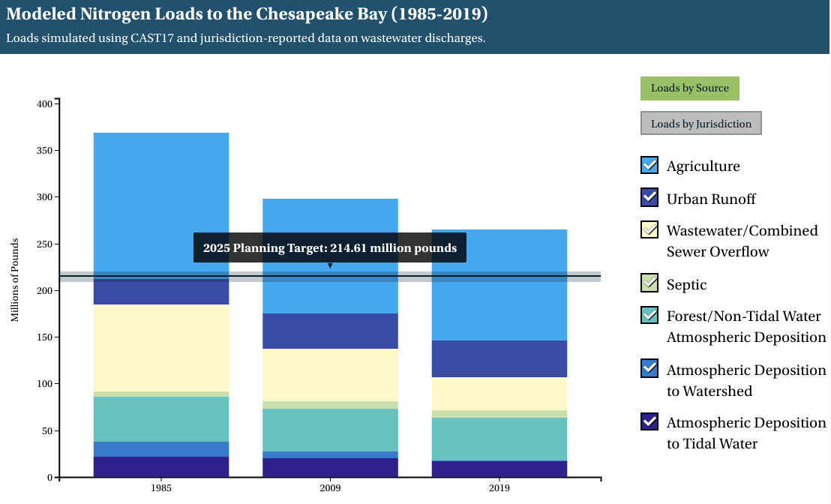
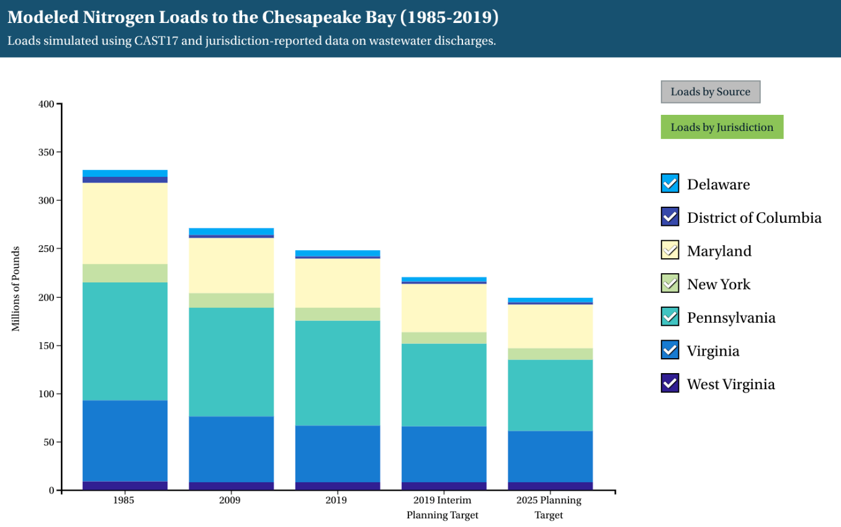
Nitrogen
Loads by Source
Loads by Jurisdiction

Slide 23
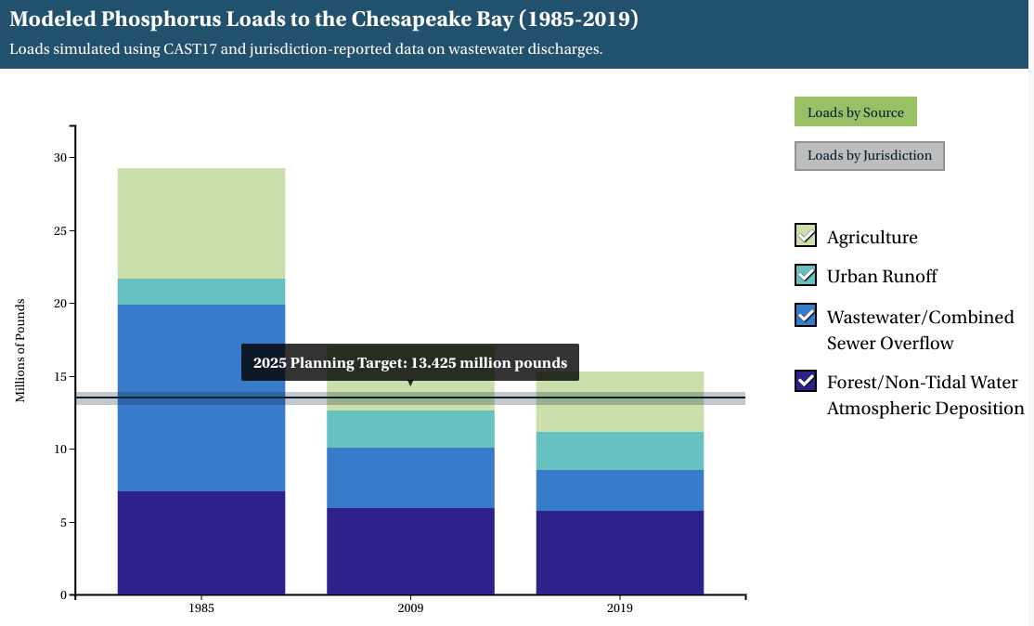
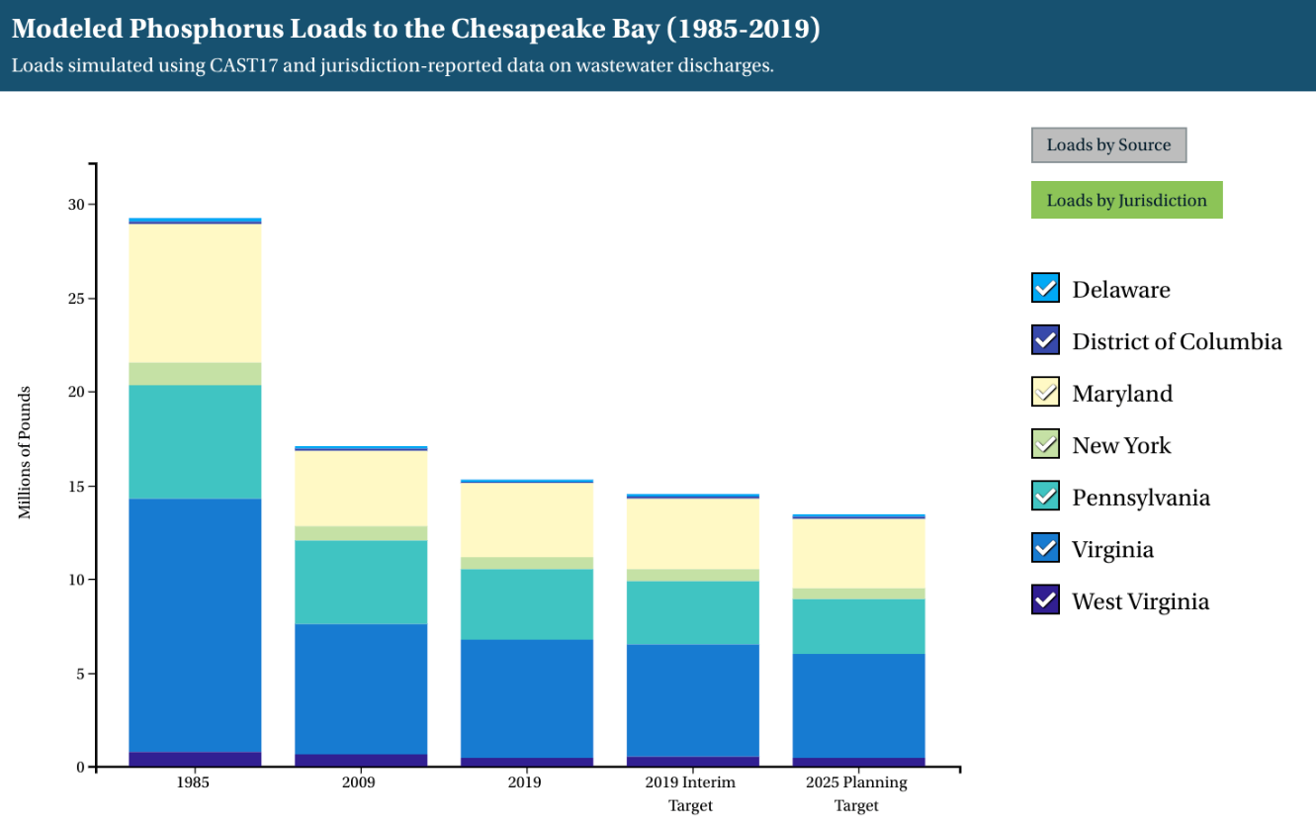
Phosphorus
Loads by Source
Loads by Jurisdiction

Slide 24
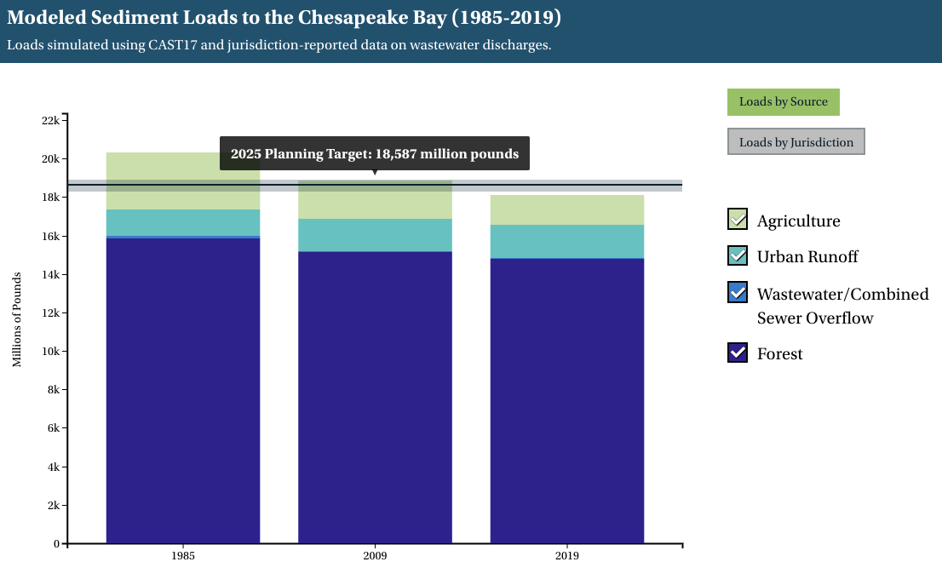
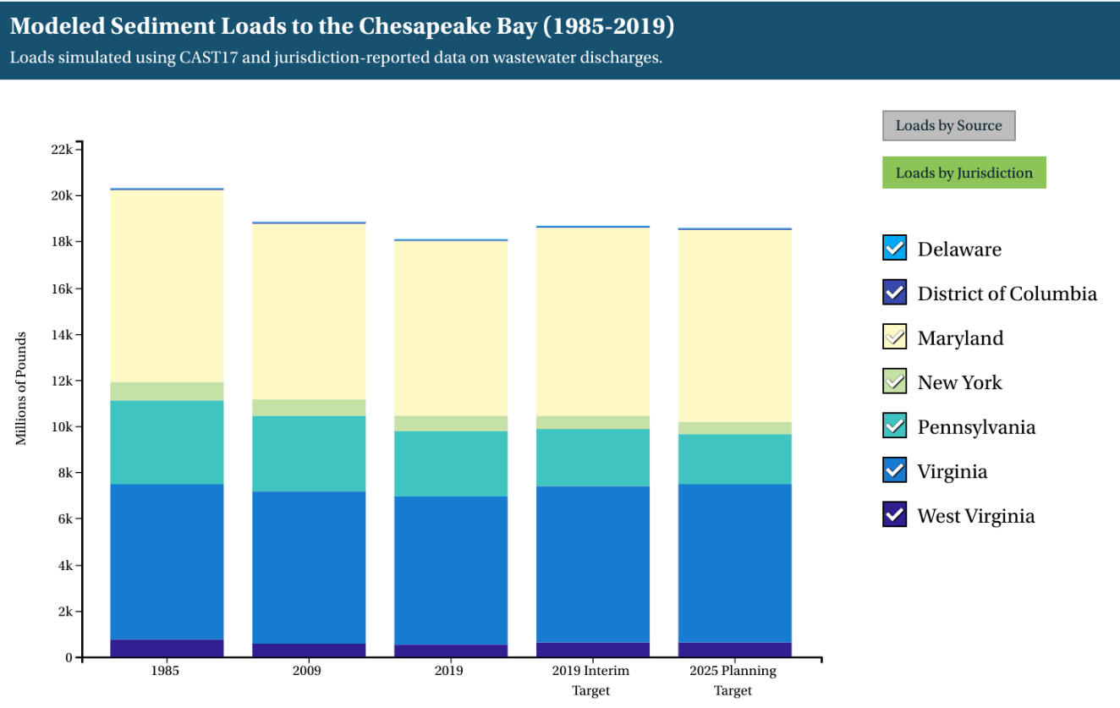
Sediment
Loads by Source
Loads by Jurisdiction

Slide 25
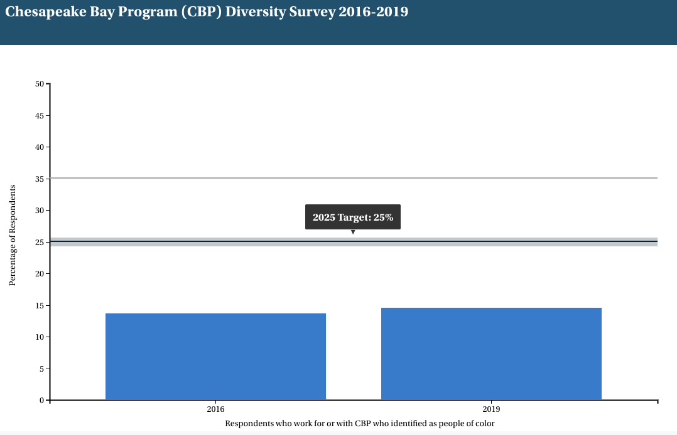
Diversity
Current Progress
In 2019, CBP’s diversity survey indicated a slight increase in the percentage of respondents who self-identified as people of color from 13.7% in 2016 to 14.6% in 2019. The 2019 survey results showed an increase in the percentage of people of color in leadership positions from 9.1% to 10.3%. While both the 2016 and 2019 surveys were distributed to approximately 750 people who work for or with the partnership, the latest survey had a low response rate of 38% compared to 50% in 2016. The lower response rate may have affected the results.
Not on Track
The Bay Program is not making progress at a rate necessary to achieve the diversity outcome.
Identify stakeholder groups not currently represented in the leadership, decision-making or implementation of current conservation and restoration activities and create meaningful opportunities and programs to recruit and engage these groups in the Partnership’s efforts.*
*In January 2020, the outcome was modified from the original language.
The partnership has set a target to increase the percentage of people of color in the Chesapeake Bay Program to 25% by 2025. The Chesapeake Bay Program has also set a target to increase the percentage of people of color in leadership positions to 15% by 2025.
(Continued on next slide)

Slide 26
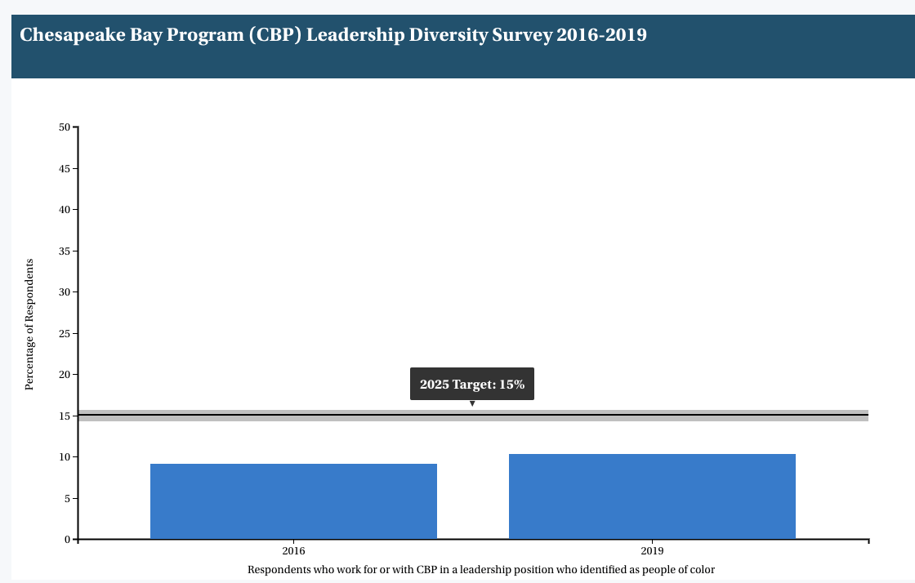

Slide 27
Watershed Agreement Outcomes with Targets and Timelines
Sustainable Fisheries
Blue Crab Abundance & Management
Oyster Restoration
Vital Habitat
Fish Passage
SAV
Clean Water
Watershed Implementation Plans - 2017 & 2025
Engaged Communities
Diversity*
Public Access
Citizen Stewardship
Sustainable Schools
Environmental Literacy Planning
Student MWEEs
Climate Change
Climate Monitoring and Assessment
Stream Health
Forest Buffers
Tree Canopy
Wetlands
Local Leadership
Climate Adaptation
Toxic Contaminants Policy and Prevention
Healthy Watersheds
Fish Habitat
Forage fish
Toxic Contaminants Research
Water Quality Standards Attainment & Monitoring
Conserved Lands
Protected Lands
Land Use Options Evaluation
Land Use Methods & Metrics
Black Duck
Brook Trout
*Target and date set by CBP. Not in original Outcome language

Slide 28
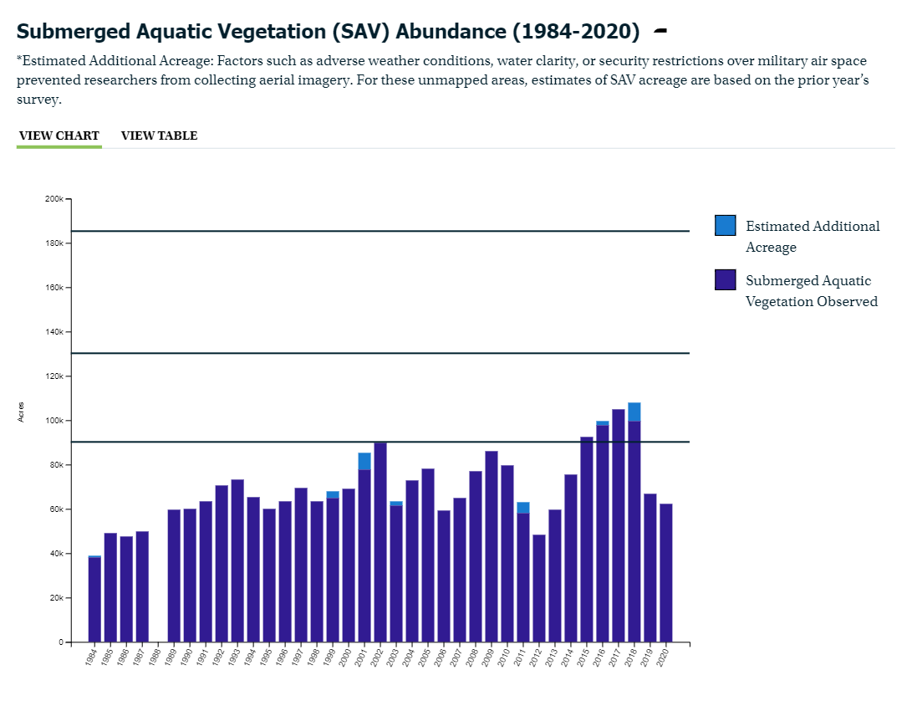
Submerged Aquatic Vegetation
Current Progress
According to preliminary data from the Virginia Institute of Marine Science (VIMS), 62,169 acres of underwater grasses were mapped in the Chesapeake Bay in 2020. This is 48% of the Chesapeake Bay Program’s 2025 restoration target of 130,000 acres and 34% of the partnership’s 185,000-acre goal.
Outcome Achievement Uncertain
Although the 62,169 acres mapped in 2020 is a 60% increase from the 38,958 acres observed during the first survey in 1984, it is a 20% decrease from the current 10-year average of 78,168 acres and a 7% decrease from 2019 when 66,684 acres of underwater grasses were mapped.
Sustain and increase the habitat benefits of submerged aquatic vegetation (SAV) in the Chesapeake Bay. Achieve and sustain the ultimate outcome of 185,000 acres of SAV Bay-wide necessary for a restored Bay. Progress toward this ultimate outcome will be measured against a target of 90,000 acres by 2017 and 130,000 acres by 2025.

Slide 29
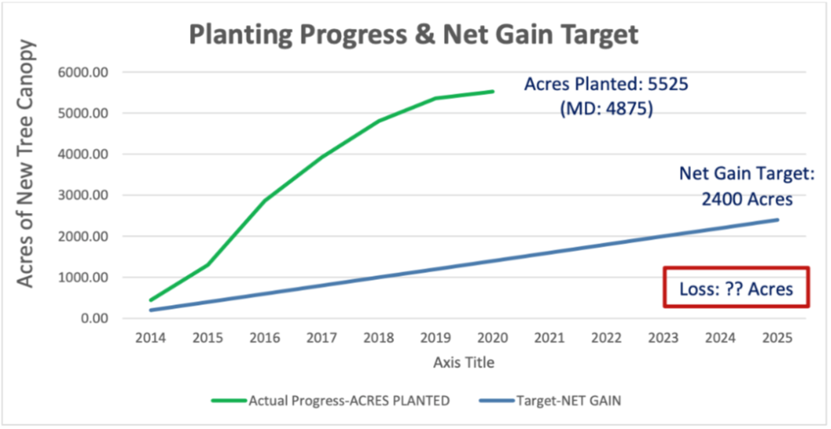
Tree Canopy
Current Progress
Between 2014-2020, states reported 5,525 acres of tree planting BMPs on developed lands, with most of those acres (4,875) reported by Maryland.
Continually increase urban tree canopy capacity to provide air quality, water quality and habitat benefits throughout the watershed. Expand urban tree canopy by 2,400 acres by 2025.
Outcome Achievement Uncertain
A high-resolution aerial tree canopy assessment—which would track net gain or loss of tree canopy over time—is still in the process of being completed for the entire watershed. As such, a more robust estimate of the baseline for this outcome is being developed.
Chart courtesy of the Chesapeake Bay Commission

Slide 30
Watershed Agreement Outcomes
With No Target And/Or Timeline
Sustainable Fisheries
Blue Crab Abundance & Management
Oyster Restoration
Vital Habitats
Fish Passage
SAV
Clean Water
Watershed Implementation Plans - 2017 & 2025
Water Quality Standards Attainment & Monitoring
Engaged Communities
Diversity
Public Access
Citizen Stewardship
Sustainable Schools
Environmental Literacy Planning
Student MWEEs
Toxic Contaminants Policy and Prevention
Climate Change
Climate Monitoring and Assessment
Fish Habitat
Forage Fish
Black Duck
Brook Trout
Stream Health
Forest Buffers
Tree Canopy
Wetlands
Toxic Contaminants Research
Healthy Watersheds
Local Leadership
Climate Adaptation
Conserved Lands
Protected Lands
Land Use Options Evaluation
Land Use Methods & Metrics
Notes:
These are outcomes that don’t have either a target or a timeline, where we can be subjective about defining success. Many of these have monitoring or tracking programs (WQ standards Attainment, Toxic contaminants – PCBs, citizen stewardship, sustainable schools, Env. Literacy planning, Meaningful watershed experiences, climate monitoring and assessment) to track progress or provide status, but no timeline to define success.

Slide 31
Watershed Agreement Outcomes
Summary
Sustainable Fisheries
Blue Crab Abundance & Management
Oyster Restoration
Vital Habitat
Fish Passage
SAV
Clean Water
Watershed Implementation Plans - 2017 & 2025
Engaged Communities
Diversity*
Public Access
Citizen Stewardship
Sustainable Schools
Environmental Literacy Planning
Student MWEEs
Climate Change
Climate Monitoring and Assessment
Stream Health
Forest Buffers
Tree Canopy
Wetlands
Local Leadership
Climate Adaptation
Toxic Contaminants Policy and Prevention
Healthy Watersheds
Fish Habitat
Forage fish
Toxic Contaminants Research
Water Quality Standards Attainment & Monitoring
Conserved Lands
Protected Lands
Land Use Options Evaluation
Land Use Methods & Metrics
Black Duck
Brook Trout
*Target and date set by CBP. Not in original Outcome language
Notes:
Our recommendations are that we keep up the pace for the green, get more clear on the yellow, have the GITs identify what success looks like for the black and blue, keep up the focused attention on the red, with more emphasis on wetlands and forest buffers.

Slide 32
Proposal
What: Three One-day facilitated workshops hosted by the Wetlands and Forestry Workgroups
Tidal Wetlands
Non-Tidal Wetlands
Forest Buffers
Who: Workgroup members, appropriate program managers identified by the workgroups, the Management Board, and others.
Outcomes:
Options and recommendations to accelerate implementation.
Recommendation for determining reasonableness of the target set in 2014.

Slide 33
Recommended Steps –
Premeeting
Review materials developed for achieving the Outcomes
Develop a description of key barriers to increasing rate of implementation
Review ideas for increasing the rate of implementation from the Biennial SRS meeting
Review how the Outcome target was developed and whether it continues to be reasonable and achievable within the timeframe
Develop an agenda to achieve the desired outcomes

Slide 34
Recommended Steps - Workshop
Three one-day facilitated workshops
  Tidal Wetlands
  Nontidal Wetlands
  Forest Buffers
Use facilitated approaches such as the SWOT analyses
Ensure the right people are in attendance
Develop draft options and recommendations for both desired outcomes.

Slide 35
Recommended Steps – Post Workshop
Provide draft options and recommendations to the Management Board for action.
As needed, provide options and recommendations to the Principals’ Staff Committee at a future quarterly meeting.
Consider how to take advantage of new funding opportunities.

Slide 36
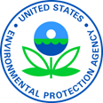
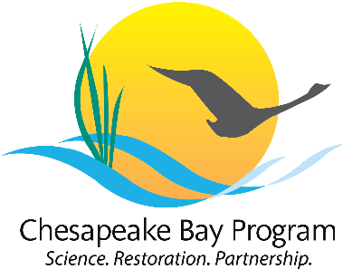
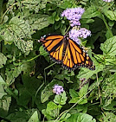
Questions?
Learn more:
www.chesapeakebay.net
www.chesapeakeprogress.com
www.epa.gov/chesapeake-bay-tmdl
Facebook: Chesapeake Bay Program
Twitter: @chesbayprogram
Instagram: @chesbayprogram
Carin Bisland,
Branch Chief, EPA/CBPO
410-267-5732
bisland.carin@epa.gov

