Slide 1
Phase 7 Land Use: Past, Present, and Future
Peter Claggett¹, Labeeb Ahmed¹, Jacob Czawlytko², Sean MacFaden³, Patrick McCabe², Sarah McDonald¹, Emily Mills², Jarlath O’Neill-Dunne³, Katie Walker²
¹ Lower Mississippi-Gulf Water Science Center, U.S. Geological Survey
² Chesapeake Conservancy’s Conservation Innovation Center
³ University of Vermont’s Spatial Analysis Laboratory
Water Quality Goal Implementation Team Meeting
April 25, 2022 (updated May 3rd, 2022)

Slide 2

Revised Land Use History for Phase 7
SPATIAL
DATA
LCMAP / NLCD (30m)
LANDFIRE
High-Resolution Land Use
Parcel and Road Segments
1987
1990
1992
1997
2000
2001
2002
2004
2006
2007
2008
2010
2011
2012
2013/14
2017/18
2020
2021/22
TABULAR
DATA
USDA Census of Agriculture
Decennial Census of Population and Housing
American Community Survey
LCMAP: Land Change Monitoring, Assessment, and Projection; CBLCD: Chesapeake Bay Land Cover Data series; NLCD: National Land Cover Database

Slide 3
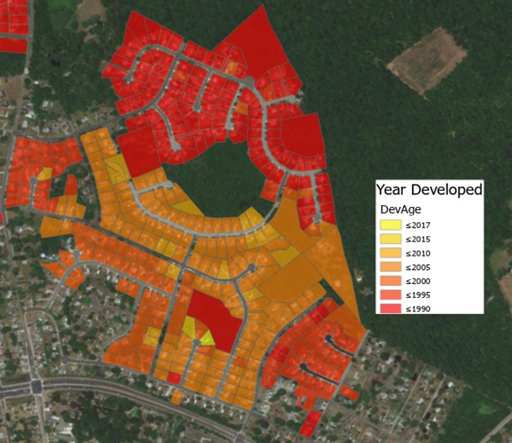
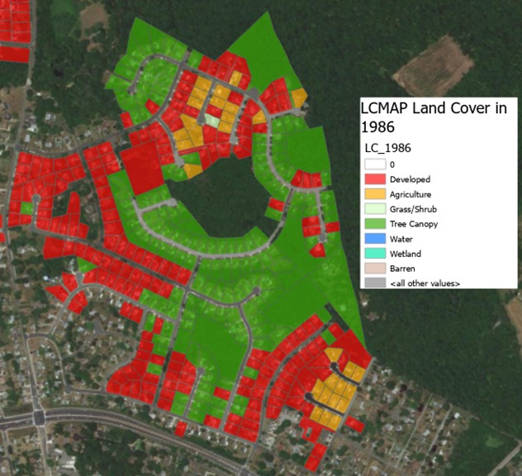
Back-Casting Development Example
Year Developed (LCMAP)
Land Cover 1986 (LCMAP)

Slide 4
CBP Complete Land Use/Cover Classification (62 classes)
1. Water (11)
111 1.1 Estuarine/ Marine
1.2 Lentic (fresh)
1.2.1 Lakes and reservoirs
  1.2.2 Riverine ponds
  1.2.3 Terrene ponds
  1.3 Lotic
  1.3.1 Channels
  1.3.1.1 Open Channel
  1.3.1.2 Tree Canopy over Channel
  1.3.1.3 Culverted
  1.3.2.Ditches
  1.3.2.1 Open Ditch
  1.3.2.2 Tree Canopy over Ditch
  1.3.2.3 Culverted
2. Development (12)
2.1 Impervious
    2.1.1 Roads
    2.1.2 Structures
    2.1.3 Other Impervious
    2.1.4 Tree Canopy (TC) over Impervious
    2.1.4.1 TC over Roads
    2.1.4.2 TC over Structures
    2.1.4.3 TC over Other Impervious
2.2 Pervious
2.2.1 Turf Grass
2.2.2 Transitional- barren
2.2.3 Suspended Succession 2.2.3.1 Barren
      2.2.3.2 Herbaceous
      2.2.3.3 Scrub-shrub
    2.2.4 Tree Canopy over Turf Grass
3. Natural (forest-related) (7)
3.1 Forest (>= 1 acre, 240-ft width)
3.2 Other Tree Canopy
3.3 Harvested Forest (<= 3 years)
3.3.1 Barren
3.3.2 Herbaceous
3.4 Natural Succession (> 3 years)
    3.4.1 Barren
    3.4.2 Herbaceous
    3.4.3 Scrub-shrub
4. Production (17)
4.1 Agriculture
4.1.1 Cropland
      4.1.1.1 Barren
      4.1.1.2 Herbaceous
4.1.2 Pasture/Hay
      4.1.2.1 Barren
      4.1.2.2 Herbaceous
      4.1.2.3 Scrub-shrub
4.1.3 Orchard/vineyard
    4.1.3.1 Barren
    4.1.3.2 Herbaceous
    4.1.3.3 Scrub-shrub
4.1.4 Animal Operations
    4.1.4.1 Impervious
    4.1.4.2 Barren
    4.1.4.3 Herbaceous
    4.2 Solar fields
4.2.1 Impervious
4.2.2 Pervious
4.2.2.1 Barren
    4.2.2.2 Herbaceous
    4.2.2.3 Scrub-shrub
4.3 Extractive (active mines)
    4.3.1 Barren
    4.3.2 Impervious
5. Wetlands and Water Margins (16)
5.1 Tidal
    5.1.1 Barren
    5.1.2 Herbaceous
    5.1.3 Scrub-shrub
    5.1.4 Other Tree Canopy
    5.1.5 Forest
5.2 Riverine (Non-tidal)
5.2.1 Barren
      5.2.2 Herbaceous
      5.2.3 Scrub-shrub
      5.2.4 Other Tree Canopy
      5.2.5 Forest
5.3 Terrene/Isolated (Non-tidal)
      5.3.1 Barren
      5.3.2 Herbaceous
      5.3.3 Scrub-shrub
      5.3.4 Other Tree Canopy
      5.3.5 Forest
5.4 Bare shore
Note: White, yellow, and blue classes are mapped for 2017/18. Grey classes will be added to all years with the production of the 2021/22 LULC.

Slide 5
1. Impervious, Roads
2.1 Impervious
    2.1.1 Roads
2. Impervious, Structures
2.1 Impervious
    2.1.2 Structures
3. Impervious, Other
2.1 Impervious
    2.1.3 Other Impervious
    4.2 Solar fields
    4.2.1 Impervious
4.3 Extractive (active mines)
4.3.2 Impervious
4. Tree Canopy Over Impervious
2.1 Impervious
    2.1.4 Tree Canopy over Impervious
5. Turf Grass
2.2 Pervious, Developed
2.2.1 Turf Grass
6. Tree Canopy over Turf Grass
2.2 Pervious. Developed
2.2.4 Tree Canopy over Turf Grass
7. Pervious Developed, Other
2.2 Pervious. Developed
2.2.2 Transitional- barren
2.2.3 Suspended Succession
    4.2 Solar fields
4.2.2 Pervious
8. Forest (all)
3.1 Forest (non-wetland)
5.1 Tidal
5.1.5 Forest (>= 1 acre, 240-ft width)
5.2 Riverine (Non-tidal)
5.2.5 Forest (>= 1 acre, 240-ft width)
5.3 Terrene/Isolated (Non-tidal)
5.3.5 Forest (>= 1 acre, 240-ft width)
9. Tree Canopy, Other
3.2 Other Tree Canopy
5.1 Tidal
5.1.4 Other Tree Canopy
5.2 Riverine (Non-tidal)
5.2.4 Other Tree Canopy
5.3 Terrene/Isolated (Non-tidal)
5.3.4 Other Tree Canopy
10. Harvested Forest
3.3 Harvested Forest (<= 3 years)
11. Natural Succession
3.4 Natural Succession (> 3 years)
5.4 Bare shore, Water Margins
12. Wetlands, Tidal non-forested
5.1 Tidal Wetlands
    5.1.1 Barren
    5.1.2 Herbaceous
    5.1.3 Scrub-shrub
13. Wetlands, Riverine Non-forested
5.2 Riverine Wetlands (Non-tidal)
    5.1.1 Barren
    5.1.2 Herbaceous
    5.1.3 Scrub-shrub
14. Wetlands, Terrene Non-forested
5.3 Terrene/Isolated Wetlands (Non-tidal)
    5.1.1 Barren
    5.1.2 Herbaceous
    5.1.3 Scrub-shrub
15. Extractive
4.3 Extractive (active mines)
4.3.1 Barren
16. Cropland
4.1 Agriculture
4.1.1 Cropland
4.1.3 Orchard/vineyard
17. Pasture/Hay
4.1 Agriculture
4.1.2 Pasture/Hay
18. Water
1.1 Estuarine/ Marine
1.2 Lentic
1.3 Lotic
Notes:
General classification with 18 classes.

Slide 6
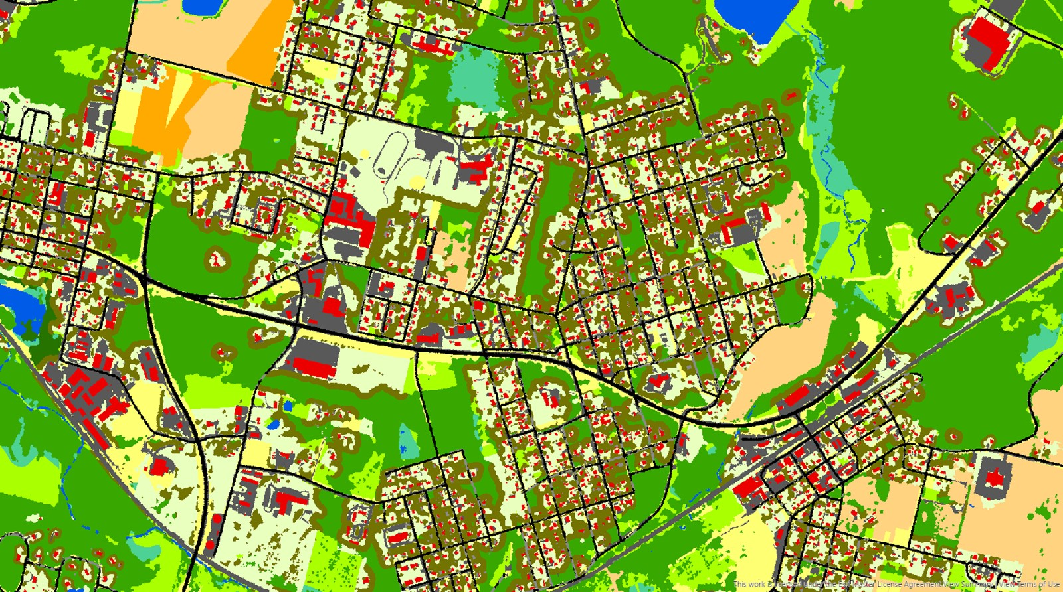
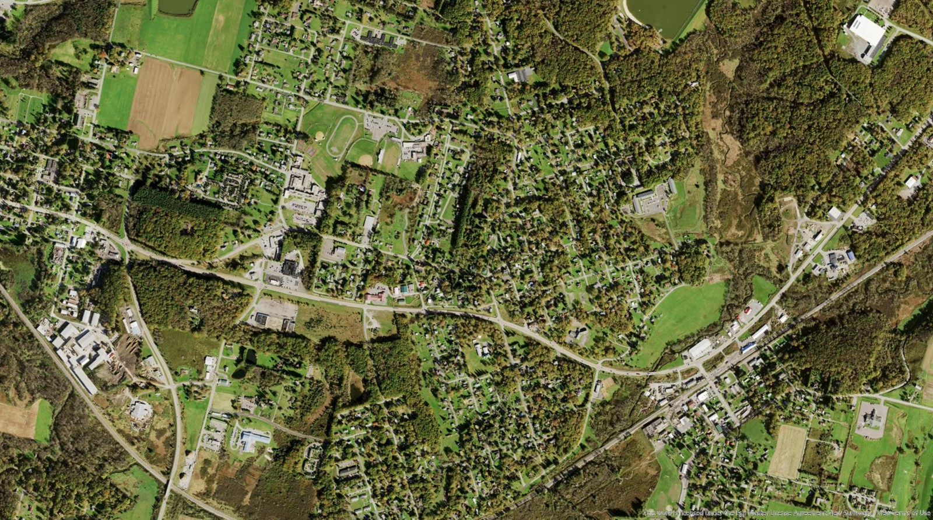
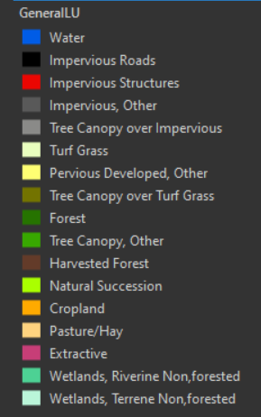
Garrett County, Maryland: 2018 Land Use

Slide 7
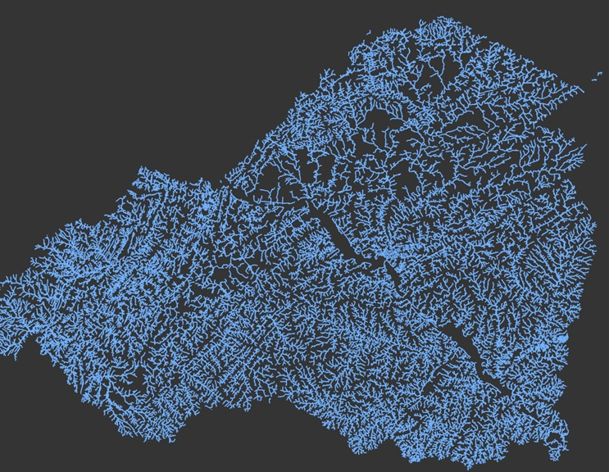
Phase 7 Hydrography
Lower Susquehanna Example
CBP Hyper-Resolution Streams, 1:2000
(Lower Susquehanna Example)
Attributes:
Channel type (gully, ditch, stream, etc.)
Bank height
Channel width
Floodplain width
Entrenchment ratio
Flow permanence probability
Stream order
Drainage area

Slide 8
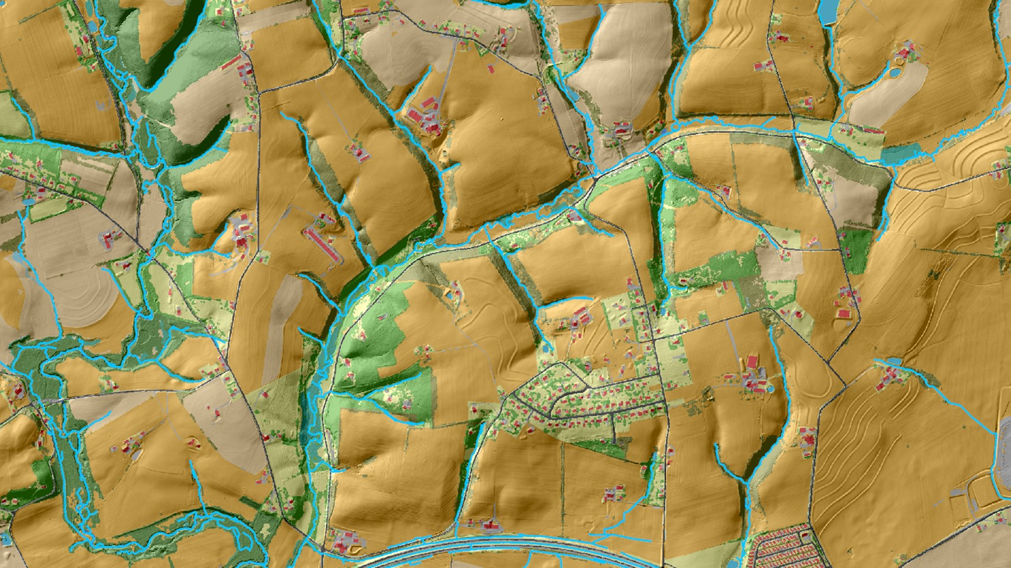
2017 High-res Land Use +
Hyper-res Hydrography (2K)

Slide 9
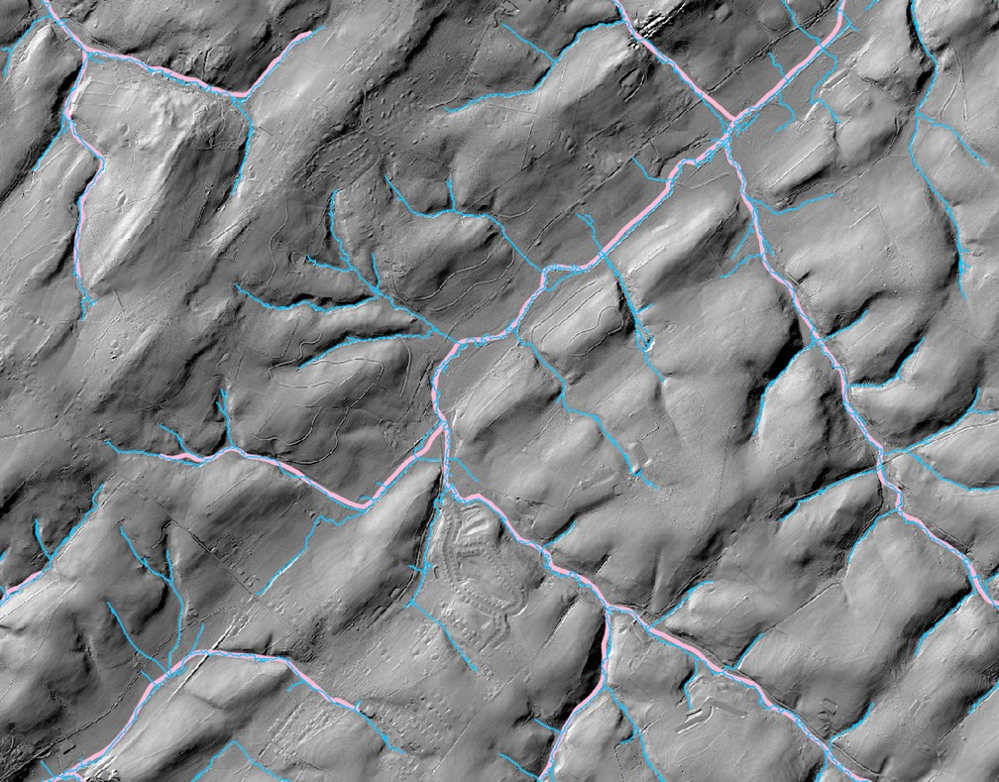
2x difference in stream density (2K vs 24K hydrography)
Added
Tributaries
Increased
Complexity
Shortened
Overland
Flowpaths
Extended headwaters
NHD24K
HyperRes

Slide 10
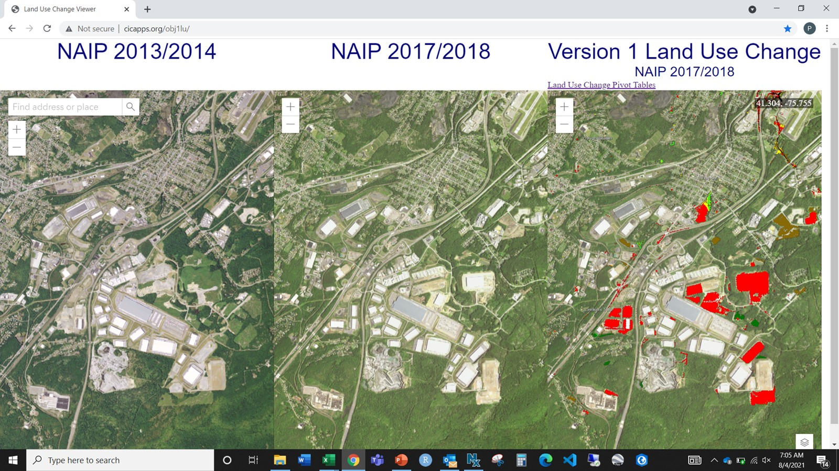

Slide 11
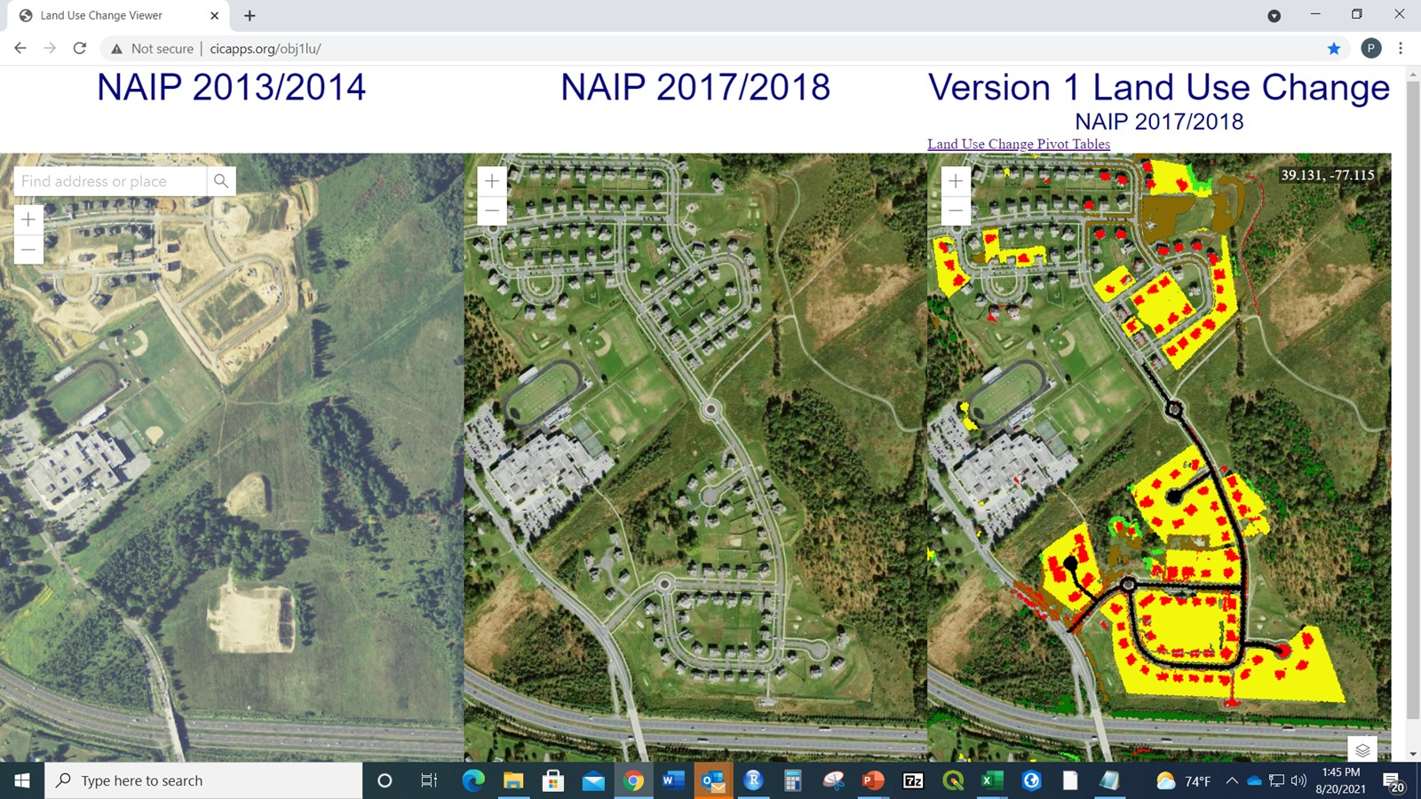
NAIP 2017/18
NAIP 2021/22
NAIP 2021/2022

Slide 12
Evaluating the environmental significance of high-resolution data
CalCAST
SPARROW
Maryland Healthy Watershed Assessment
Various ongoing USGS studies relating landscape condition to macro-benthic and fish community composition, stream temperature, and stream conductivity.

Slide 13
  Forecasting Future Changes in Land Use: Chesapeake Bay Land Change Model v5
County-level Population Projections
County-level
Employment Projections
Total Housing
Demand
Historic
Infill
Patterns
Potential
Infill
Development
Historic
Development
Patterns
Land Conservation Demand
Housing Land Demand
Employment Land Demand
Unprotected
Unprotected and Developable
Unprotected and Developable
Conservation Probability
Residential Probability
Commercial Probability
Road Gravity
Road Gravity
Road Gravity
Iterative & Stochastic
Housing Density
Job Density
Land Conservation
Residential Development
Commercial Development
Present
Land Cover
Future Land Cover
Summary Units
(P6 modeling segments)
Future Development Statistics
Notes:
Accessibility = peak travel times for single-occupancy vehicles between transportation modeling zones.

Slide 14
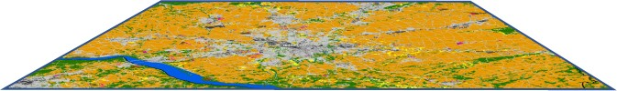
Multiple Stochastic Iterations
Every county is simulated 101 times for each scenario and target year, i.e., 2025.
Average of simulations by summary unit = future development
Relative Standard Deviation = estimate of uncertainty

Slide 15
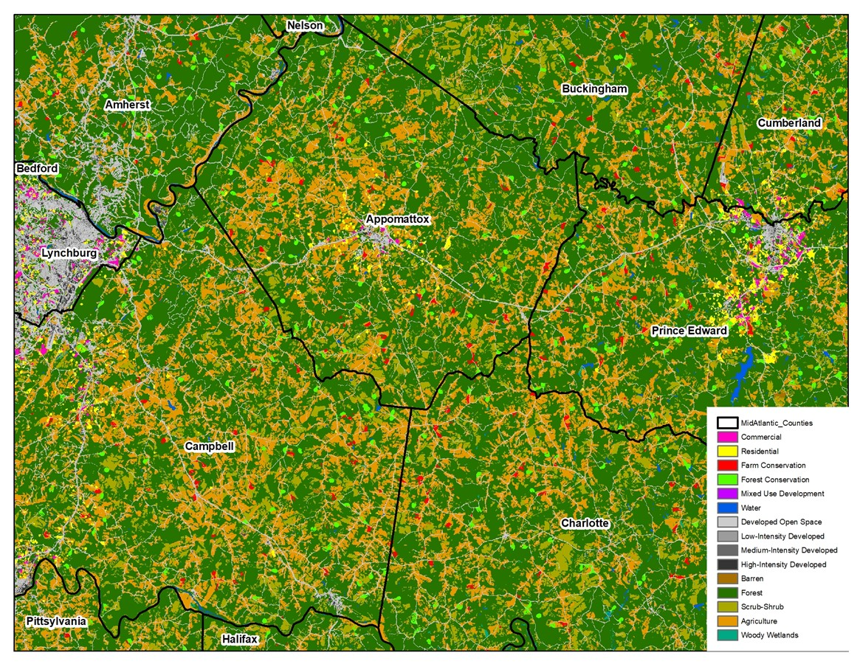
Land Change Model Outputs
Commercial and
Residential Growth
Farmland and
Forest Conservation

Slide 16
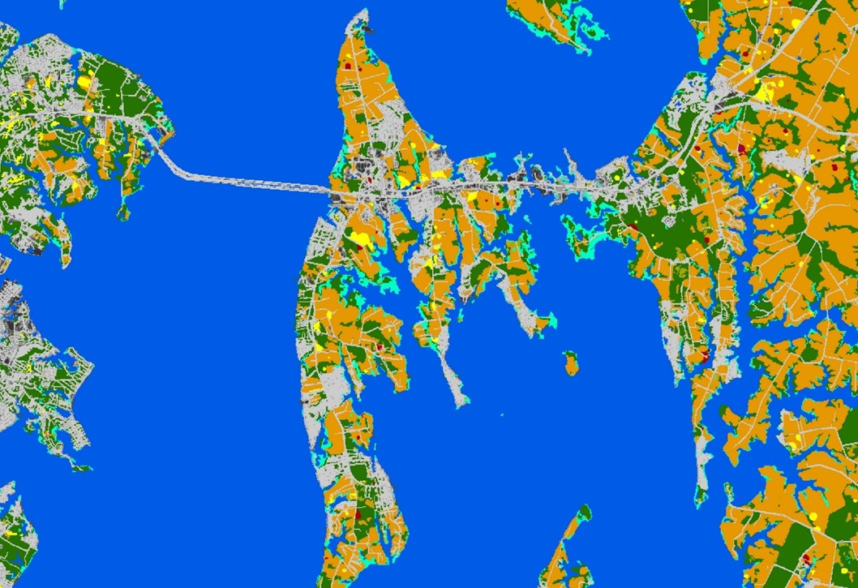
Land Change Model Outputs: Summary Statistics
Impervious surface and turf grass expansion
Forest conversion to development
Farmland conversion to development
Future population on sewer and septic
Rural Residential
57 acres
227 households on sewer
0.25 acre lots
27.8% Impervious
72.2% Turf grass
20-acres farmland loss
37-acres forest loss

Slide 17
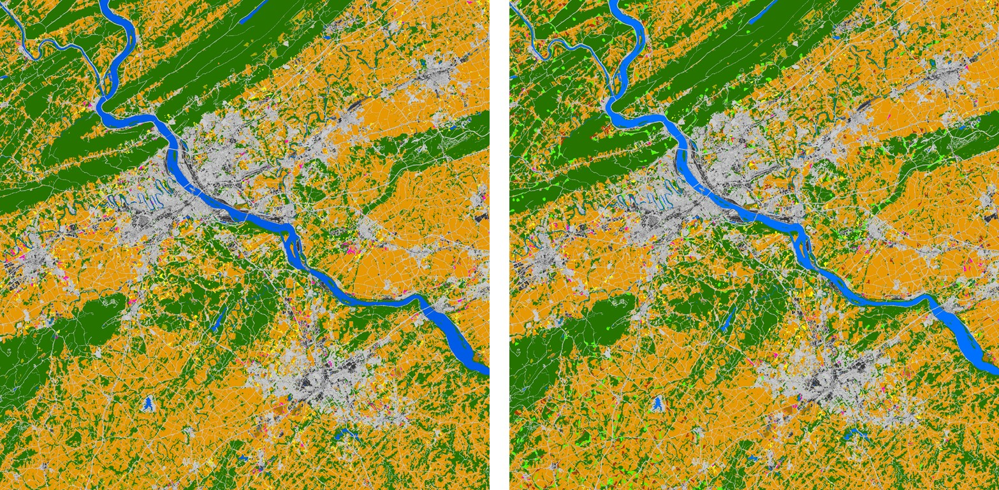
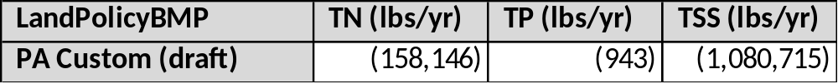
Crediting Land Conservation and Planning towards Water Quality Improvement
PA 2025 Baseline Condition
PA 2025 Land Policy BMP (draft)
Difference in land use translated into a change in pollutant loads =
Water quality credit afforded to land conservation and land use planning
Commercial
Residential
Mixed use
Forest Conservation
Farm Conservation
Commercial
Residential
Mixed use

Slide 18
CBLCM v5 (current version)
Relies on Capiella and Brown (2001) impervious surface coefficients.
Derives commercial and residential densities from Decennial Census and NLCD.
Parameterized using 30-meter resolution NLCD: 2001-2011.
Sewer/septic component of model manually implemented via spreadsheet
Simulates residential, commercial, and mixed-use development and forest and farmland conservation.
Estimates infill/redevelopment by county.
CBLCM v6 (revisions listed in priority order)
Derives impervious surface coefficients for residential and commercial growth from high-res land use data.
Derives commercial and residential densities from parcel data, high-res land use, and ancillary data.
Parameterized using 1-meter resolution land use change: 2013-2021 high res and 1987 – 2012 from revised land use backcast.
Recode and automate sewer/septic estimation and implement Smart Sewer expansion for all states to inform future scenarios.
Same as v5 with the addition of future solar fields and timber harvests.
  Tracks development capacity, age of housing stock, and successional stage of vegetation.
Simulates infill/redevelopment by parcel.

Slide 19
255 days
217 days
365 days
526 days
600 days
173 days
172 days
696 days
66 days
Land Use Timeline
2022
2023
2024
2025
2026
2027
Finalize 2017/18 LULC data
Finalize 2021 land cover for MD and DE
Draft 2021 LULC data for MD and DE
1-meter
Resolution
Land Use/
Land Cover
2013/14 – 2021/22
Finalize 2021/22 land cover – all counties
Update Land Cover Change:
2013/14 – 2017/18 – 2021/22
Finalize 2021/22 LULC data - all counties
Finalize LULC change – all counties
2013/14 – 2017/18 – 2021/22
Draft historical land use for MD
Historical
Land Use:
1985 - 2012
Finalize historical land use for MD
Finalize historical land use - all counties
Update development densities and impervious surface coefficients
Future
Land Use:
2022 - 2050
Re-parameterize CBLCM with high-res LULC change 2013/14 – 2021/22
Add solar fields and timber harvest simulations
Simulate infill/redevelopment at Census Block or Parcel level
Population on Sewer/Septic
Recode sewer/septic estimations
Implement SmartSewer expansion

Slide 20

Contact Information
(i.e., how to get a copy of the SCFM Toolbox?)
Peter R. Claggett
Research Geographer
pclaggett@usgs.gov
443-370-5724

