Slide 1

Chesapeake Bay Program Partnership’s
Basinwide BMP Verification Framework:
Building Confidence in Delivering on Pollution Reductions to Local Waters
Maryland WIP Partners Webinar
September 25, 2014

Slide 2
What is
BMP Verification?

Slide 3
“Verification: the process through which agency partners ensure practices, treatments, and technologies resulting in reductions of nitrogen, phosphorus, and sediment pollutant loads are implemented and operating correctly.”

Slide 4
“…implemented and operating correctly.”

Slide 5
Why
Verify BMPs?

Slide 6
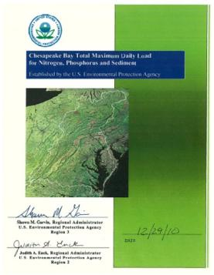
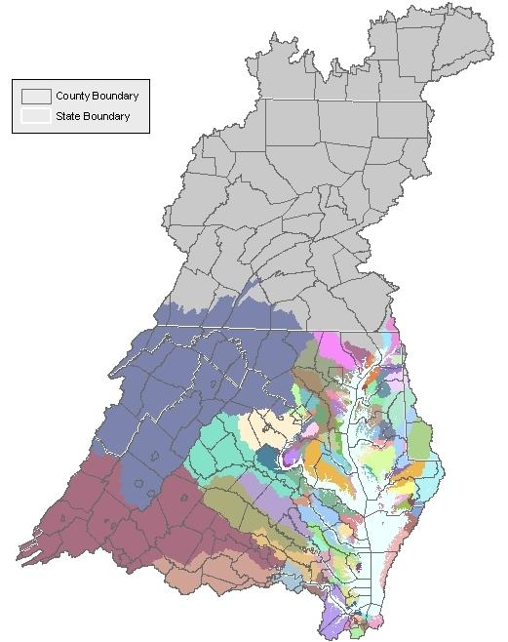

Chesapeake Bay TMDL: Pollution Diet for All Sectors and Sources
Pollution Delivered to the Bay (million pounds/year)
2017 Interim target
2025 Planning Target

Slide 7

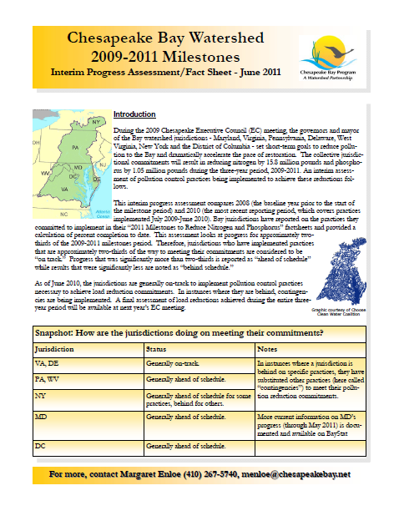
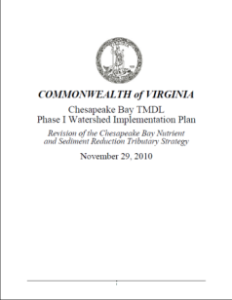
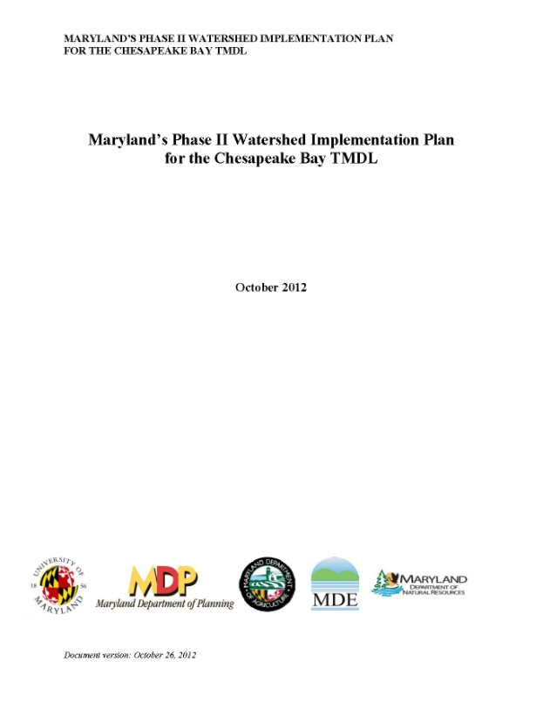
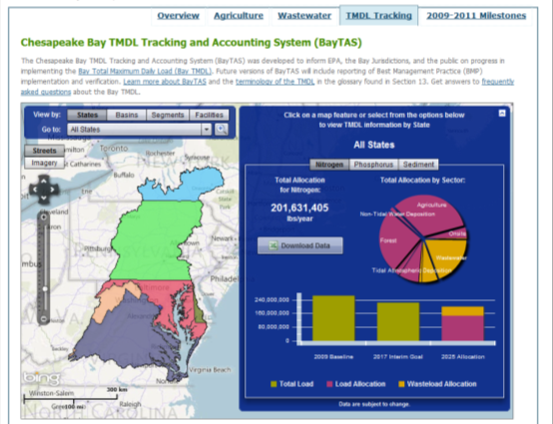

Slide 8
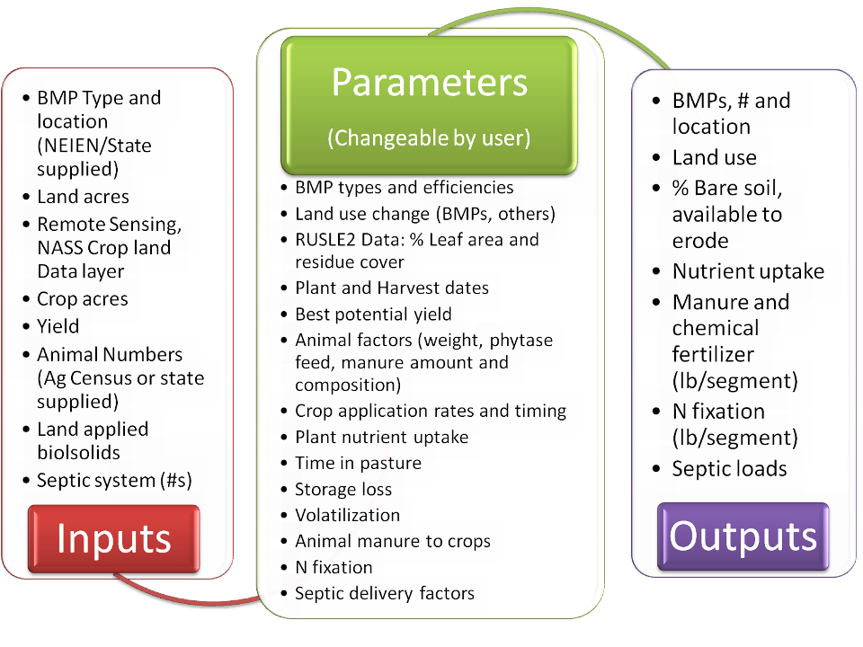
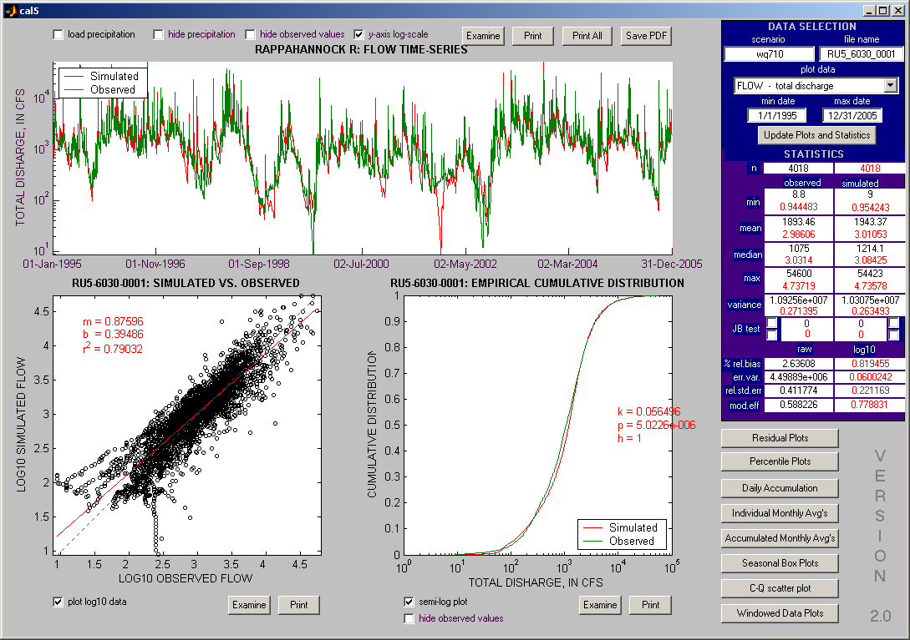
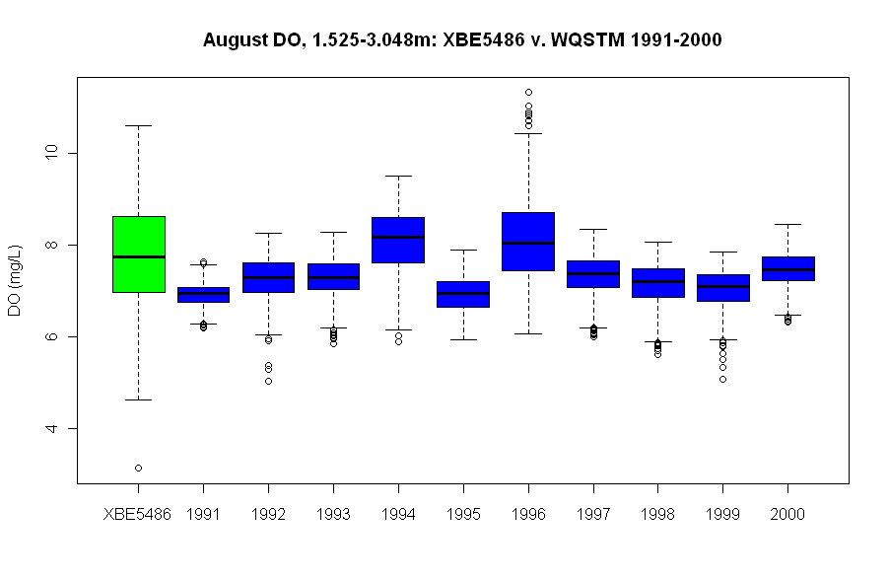
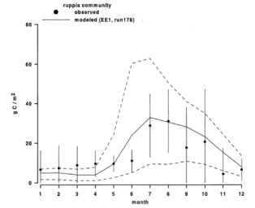
8

Slide 9
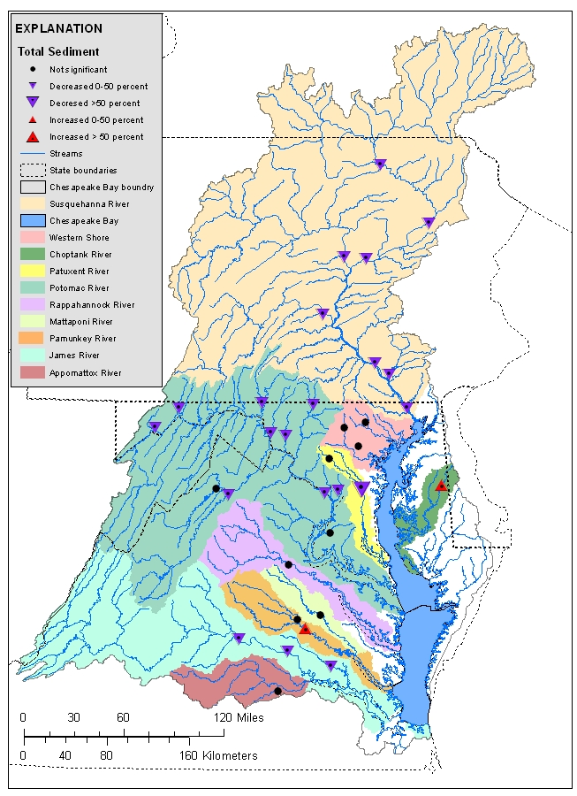
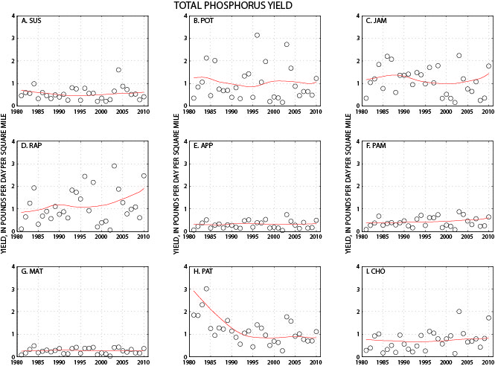
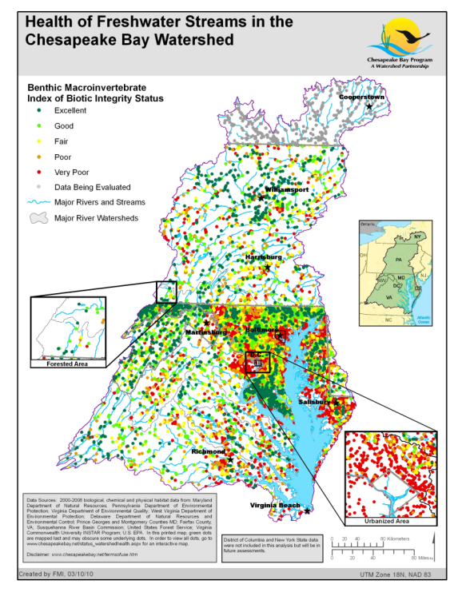
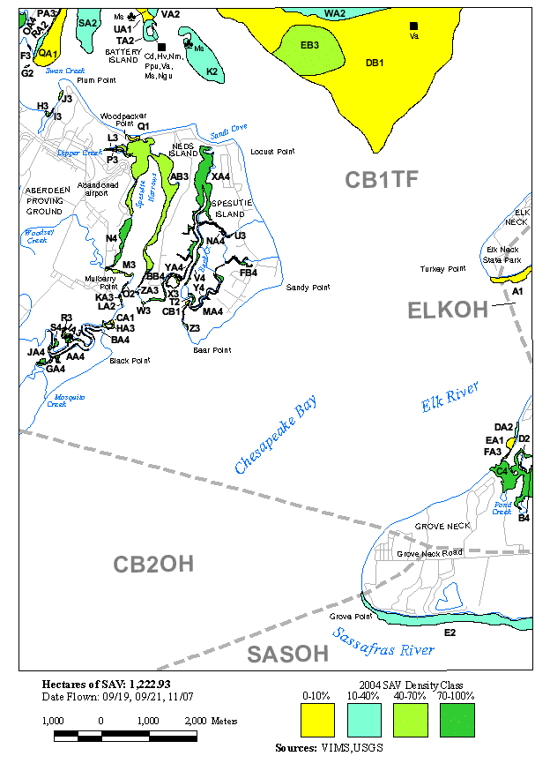
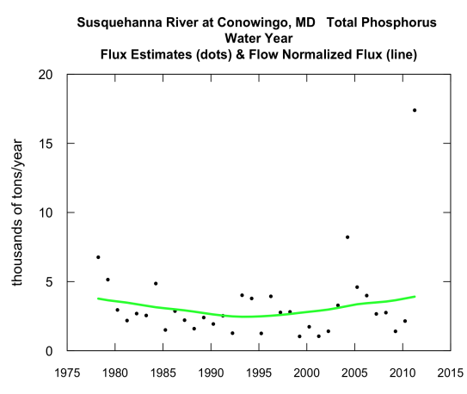
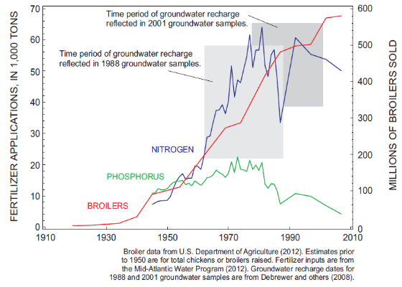

Slide 10
National Academy of Sciences
“The committee was unable to determine the reliability and accuracy of the BMP data reported by the Bay jurisdictions.”

Slide 11
National Academy of Sciences
“The committee was unable to determine the reliability and accuracy of the BMP data reported by the Bay jurisdictions.”

Slide 12
How?
BMP no longer present/functional removed from database
OR
BMP
installed,
verified, and reported by Jurisdiction
BMP verified/
upgraded with new technology
Initial Inspection
BMP gains efficiency
Data quality assurance/ validation
BMP Verification
Life Cycle
BMP lifespan ends – re-verify
BMP Performance
BMP nears end of life span
Follow-up Checks
BMP fully functional
BMP performance metrics collected

Slide 13
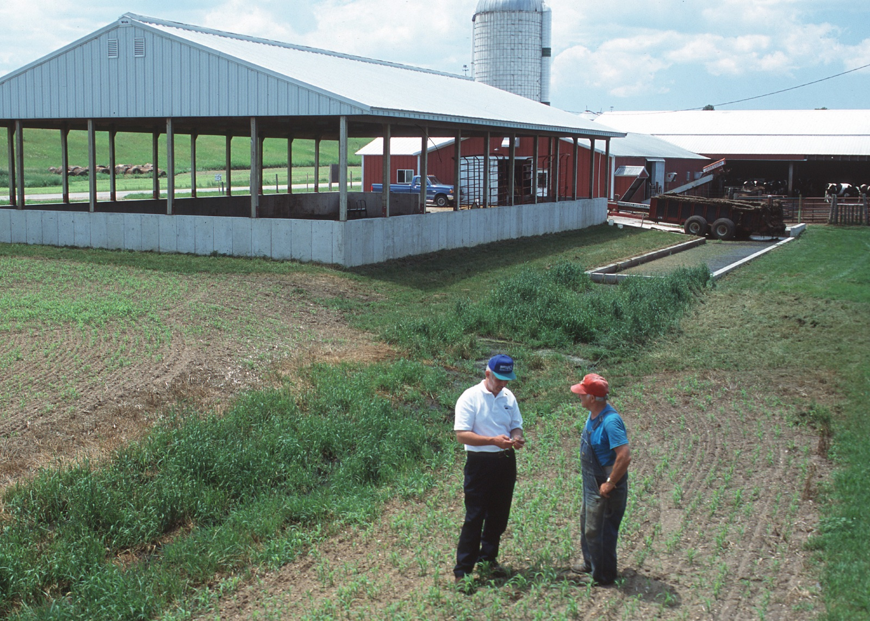
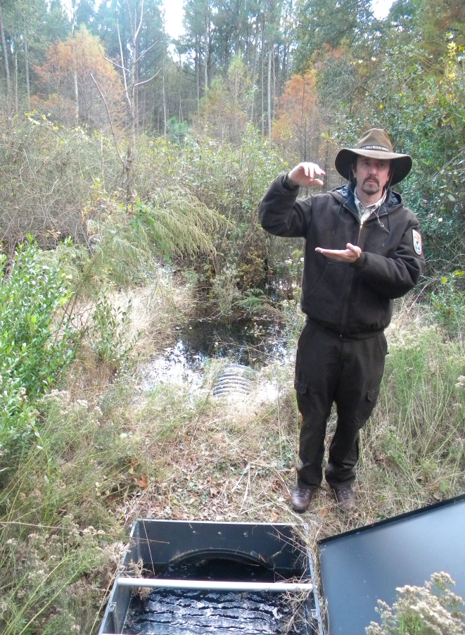
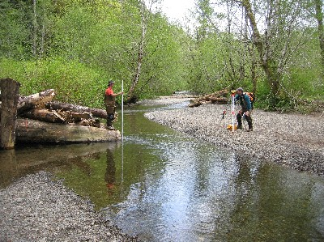
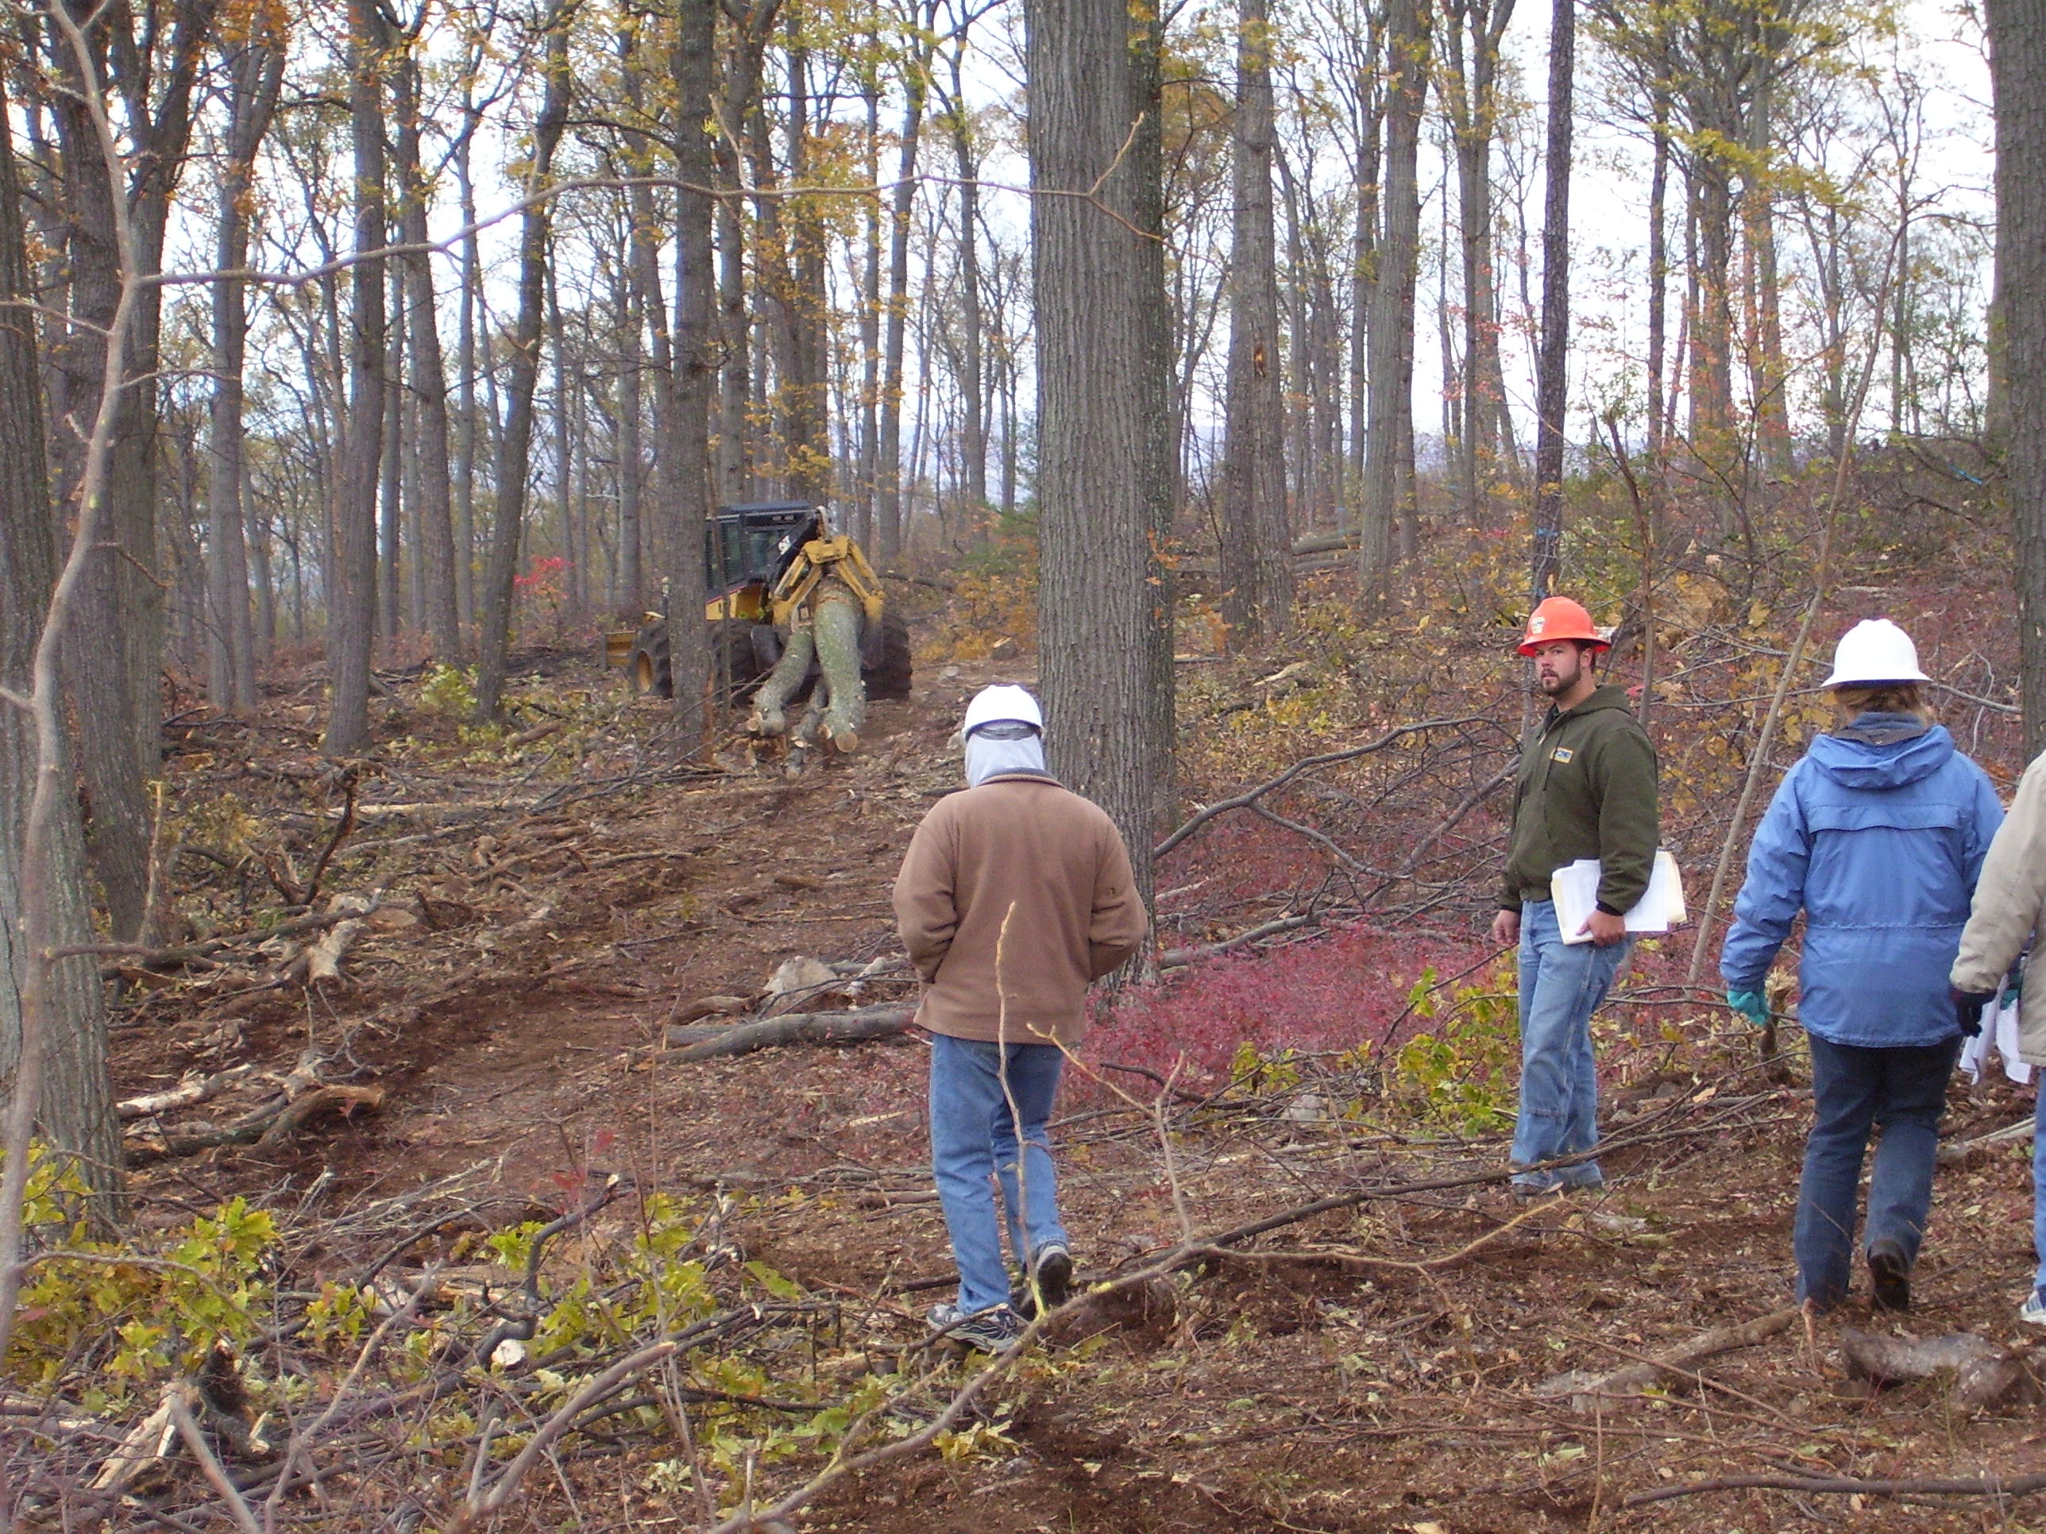
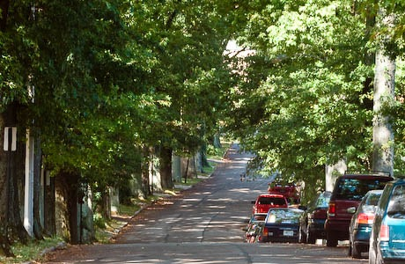
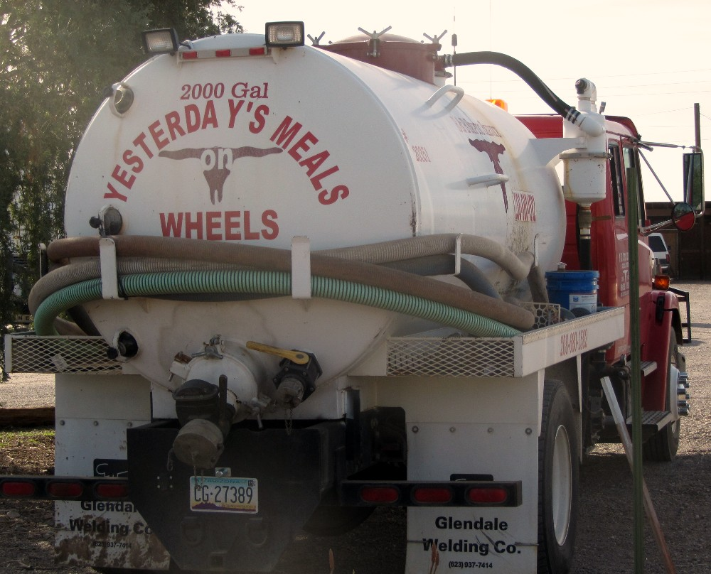
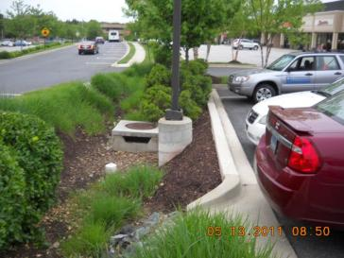
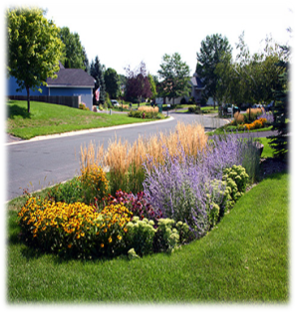
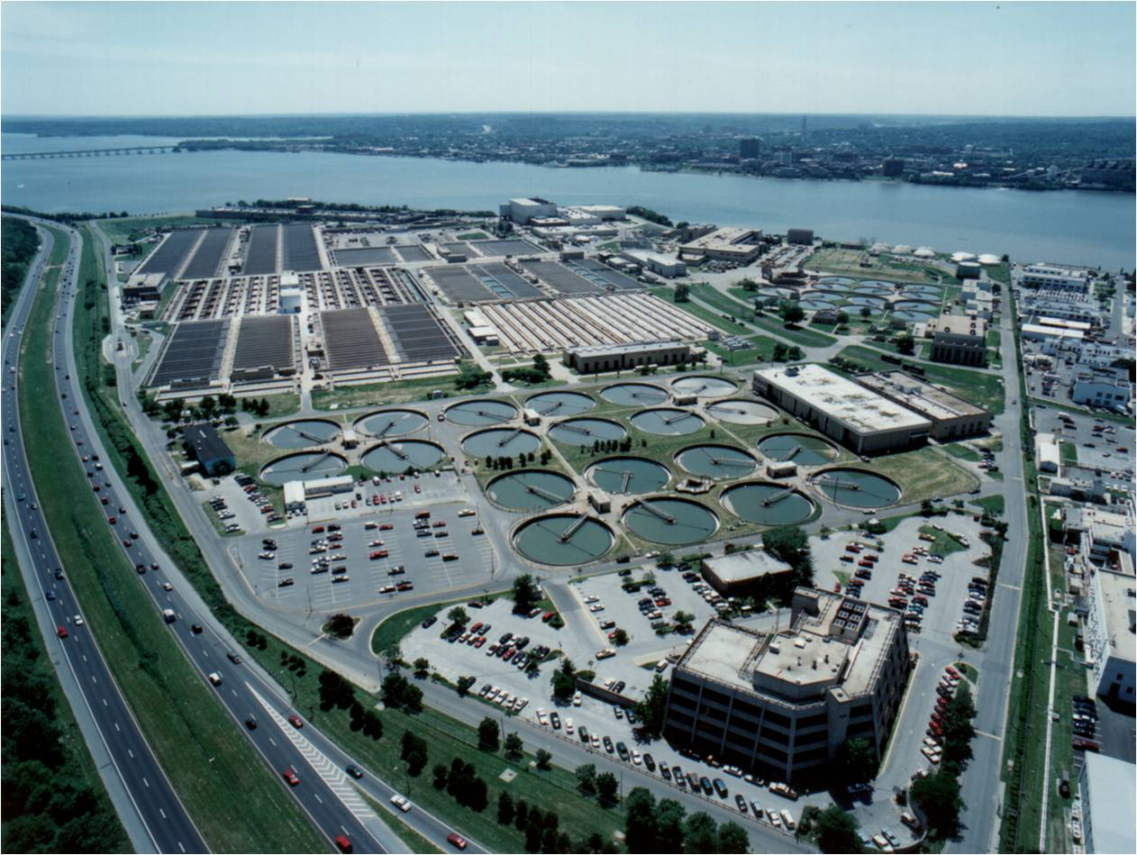
Who?

Slide 14
When?
September 2014
Framework Adoption by the Partnership
October 2014-July 1, 2015
Jurisdictions/Federal Agencies Development of Their BMP Verification Programs
July - September 2015
External Panel Review of the Jurisdictions/ Federal Agencies’ BMP Verification Programs
October - December 2015
EPA Review and Approval of the Jurisdictions’ BMP Verification Programs
Jurisdictions Ramp-up Their Verification Program Implementation
2016-2017
Full Implementation of the Jurisdictions’ Verification Programs
2018

Slide 15
12 Framework Elements
  Verification principles
  Review Panel
  Sector verification guidance
  Practice life spans
  Full access to federal cost-shared practice data
  Enhanced reporting of federally cost shared practices
  Accounting for non-cost shared practices
  Preventing double counting
  Clean-up of historic BMP databases
  Documentation of jurisdictional BMP verification programs
  Evaluation and Oversight
  Communications and outreach

Slide 16
Verification Principles
Practice reporting
Scientific rigor
Public confidence
Adaptive management
Sector equity

Slide 17
Agriculture Verification
Guidance
Defining and categorizing agricultural BMPs
Defining implementation mechanisms
Agricultural BMP verification methods
Follow-up assessment guidelines

Slide 18
Forestry Verification
Guidance
Agricultural riparian forest buffers
Agricultural tree planting
Expanded tree planting
Urban riparian forest buffers
Forest harvesting BMPs

Slide 19
Stormwater Verification
Guidance
Regulated BMPs
Semi-regulated BMPs
Non-regulatory BMPs
Legacy BMPs

Slide 20
Wastewater Verification
Guidance
Wastewater treatment facilities
Combined sewer overflows
Septic systems/septic system removals (connecting to wastewater treatment plants)
Advanced on-site treatment systems

Slide 21
Wetlands Verification
Guidance
Wetland restoration, creation and enhancement
Floodplain reconnection
Project design and siting, pre- and post construction
Inspection, maintenance, monitoring framework
Field assessment checklist

Slide 22
Streams Verification
Guidance
Individual stream restoration project verification
Maintenance, monitoring tied to performance
Inspection, maintenance, monitoring framework
Initial verification of installation
Recommended cycle of field verification

Slide 23
Transparency and Data Access
Aggregated data considered transparent upon validation
Treat cost-shared data and non-cost shared agricultural conservation practice data the same in terms of applying privacy restrictions
Public access to all credited practice data

Slide 24
Practice Life Spans
BMP no longer present/functional removed from database
OR
BMP
installed,
verified, and reported by Jurisdiction
BMP verified/
upgraded with new technology
Initial Inspection
BMP gains efficiency
Data quality assurance/ validation
BMP Verification
Life Cycle
BMP lifespan ends – re-verify
BMP Performance
BMP nears end of life span
Follow-up Checks
BMP fully functional
BMP performance metrics collected

Slide 25
Federal Cost Shared Practices
Data sharing agreements in place for all 6 states and all agencies involved in reporting
Credit conservation technical assistance
Hold USDA agencies accountable to commitment to enhance data reporting
Common protocols and schedule for annual accessing of federal cost- shared data

Slide 26
Accounting for Non-Cost Shared Practices
Focused on practices implemented without cost share and not covered by a regulatory program
Crediting practices that meet CBP or NRCS definitions and standards and CBP approved ‘Resource Improvement Practices’ implemented w/o public cost-share funds

Slide 27
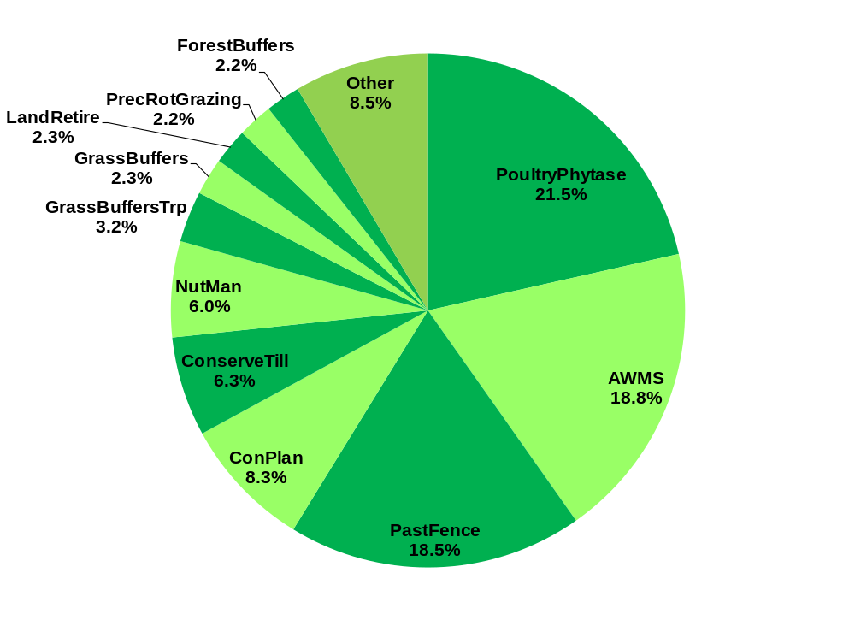
Prioritize Verification Towards Priority Practices

Slide 28
Prioritize Verification Towards Priority Practices

Slide 29
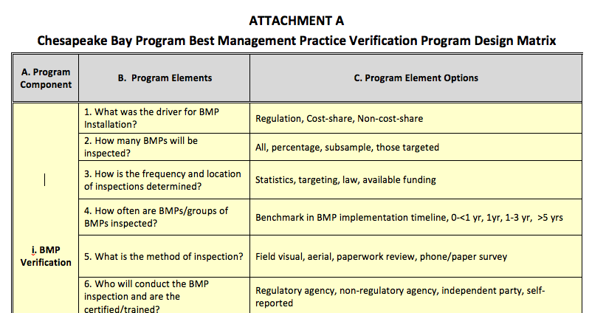
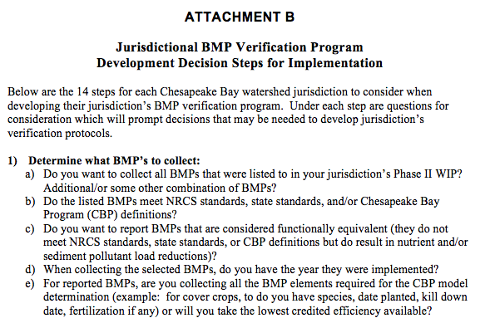
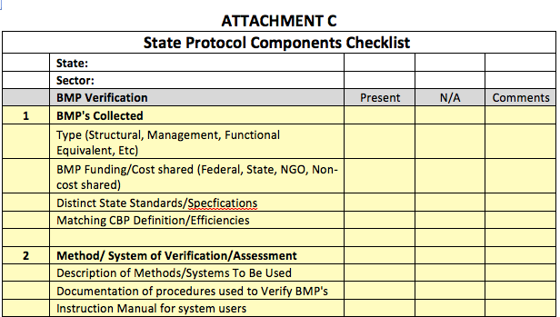
Jurisdictions’ Verification Programs

Slide 30
Jurisdictions’ Verification Programs
Table 8. Jurisdictional Verification Protocol Design Table
A. WIP Priority | B. Data Grouping | C. BMP Type | D. Initial Inspection (Is the BMP there?) |  |  |  | E. Follow-up Check (Is the BMP still there?) |  |  | F. Lifespan/ Sunset (Is the BMP no longer there?) | G. Data QA, Recording & Reporting
 |  |  | Method | Frequency | Who inspects | Documentation | Follow-up Inspection | Statistical Sub-sample | Response if Problem

Slide 31
Verification Implementation
Illustration of Diversity of Verification Approaches Tailored to Reflect Practices
Sector | Inspected | Frequency | Timing | Method | Inspector | Data Recorded | Scale
Stormwater | All | Statistics | <1 year | Monitoring | Independent | Water quality data | Site
 | Percentage | Targeting | 1-3 yrs | Visual | Regulator | Meets Specs | Subwatershed
 | Subsample | Law | 3-5 yrs | Aerial | Non-Regulator | Visual functioning | County
 | Targeted | Funding | >5 yrs | Phone Survey | Self | Location | State
Agriculture | All | Statistics | <1 year | Monitoring | Independent | Water quality data | Site
 | Percentage | Targeting | 1-3 yrs | Visual | Regulator | Meets Specs | Subwatershed
 | Subsample | Law | 3-5 yrs | Aerial | Non-Regulator | Visual functioning | County
 | Targeted | Funding | >5 yrs | Phone Survey | Self | Location | State
Forestry | All | Statistics | <1 year | Monitoring | Independent | Water quality data | Site
 | Percentage | Targeting | 1-3 yrs | Visual | Regulator | Meets Specs | Subwatershed
 | Subsample | Law | 3-5 yrs | Aerial | Non-Regulator | Visual functioning | County
 | Targeted | Funding | >5 yrs | Phone Survey | Self | Location | State

Slide 32
Evaluation and Oversight
Amend Partnership BMP protocol to address verification
Amend CBP Grant Guidance
Annual reviews of progress data submissions
Annual EPA reviews of changes to jurisdictions’ quality assurance plans
Periodic EPA audits of jurisdictions’ BMP verification programs

Slide 33
Communications and Outreach
Goals:
Build understanding of and support for BMP Verification
Ensure consistent public messaging
Manage expectations
Mechanisms
Online news features
Press releases
Editorials
Social media releases and messaging
Photo essays and video products
Web-based resources
Supporting print materials
Webinars, training sessions, and workshops

Slide 34
State and Local Partners’ Roles
Work towards accounting for all implemented practices which are reducing nutrient, sediment pollution
Help message on importance of verification to restoring local stream health, habitats, and recreational areas and protecting sources of drinking water
Make the investment and follow-through on demanding a return on your investment

Slide 35
Information Sources
http://www.chesapeakebay.net/groups/group/best_management_practices_bmp_
verification_committee
CBP Partnership’ BMP Verification Committee
CBP Partnership’s BMP Review Panel
Approved BMP verification principles
Final Chesapeake Bay Basinwide BMP verification framework report & appendices
Link to Dec 2013 USGS Agricultural Conservation Practices report

Slide 36
Rich Batiuk
Chair
Chesapeake Bay Program Partnership’s
BMP Verification Committee
Associate Director for Science, Analysis and Implementation
U.S. Environmental Protection Agency
Chesapeake Bay Program Office
410 Severn Avenue, Suite 307
Annapolis, Maryland 21403
410-267-5731 Work
443-223-7823 Mobile
410-268-5226 Home
batiuk.richard@epa.gov

Slide 37

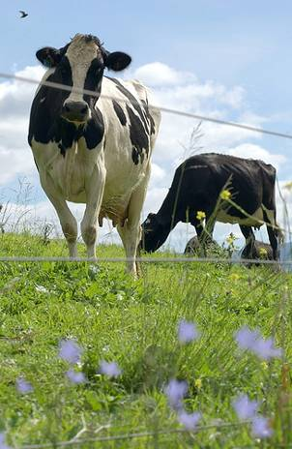

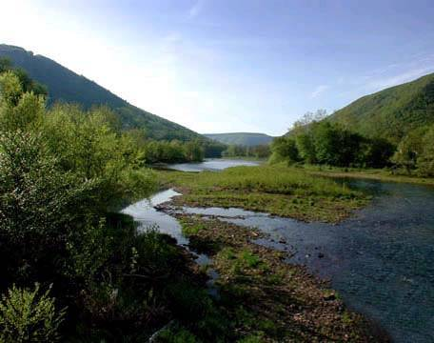




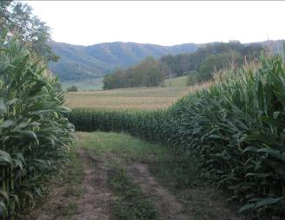
Questions
37

