Slide 1
WQGIT P7 Update: 4D Assessment Tool and Criteria Assessment Monitoring Advances
April 24, 2023
Peter Tango, Rebecca Murphy
USGS, UMCES

Slide 2
Historical interest in 4-dimensional (4D) water quality interpolation: 2008 STAC Workshop
Assessing the feasibility of developing a four-dimensional (4-D) interpolator for use in impaired waters listing assessment December 2008 STAC Publication 08-008
Recommendations from the STAC Expert Panel
Frank Curriero (Johns Hopkins University)
Eileen Hofmann (Old Dominion University)
Ragu Murtugudde (University of Maryland)
Jian Shen (Virginia Institute of Marine Science)
J. Andrew Royle (U.S. Geological Survey)
2008 Findings
The panel recommended a study to evaluate the different approaches available for developing a 4-D interpolator

Slide 3
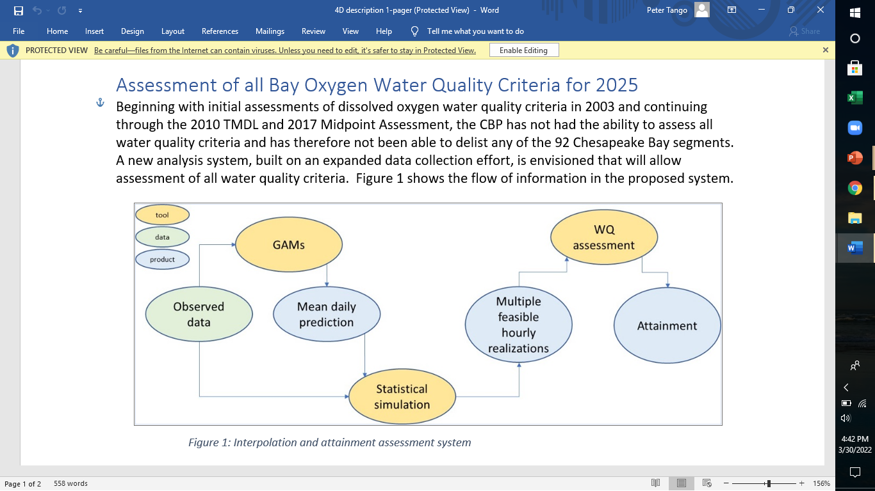
Where we are heading: Assessment of all Bay oxygen water quality criteria for 2025
+
Source: G. Shenk

Slide 4
4D Interpolator Tool: Work timeline
We are still very much in the early development and testing phases.
We are here

Slide 5
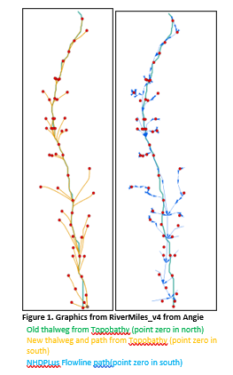
4D progress for interpolating dissolved oxygen concentrations (2022-early 2023)
A coordinate system has been proposed underpinning the tool (Angie Wie, GIS)
Success on having a working daily average prototype using Generalized Additive Models (GAMs) for a large chunk of the mainstem bay. (Elgin Perry and Rebecca Murphy)
Work ahead further calibrating and verifying its performance
Successful application of daily average prototype to the tidal Patuxent River (Rebecca Murphy)
Mainstem bay
Coordinate system
Testing for the 4D world
from Angie Wei, GIS team, 2023.

Slide 6
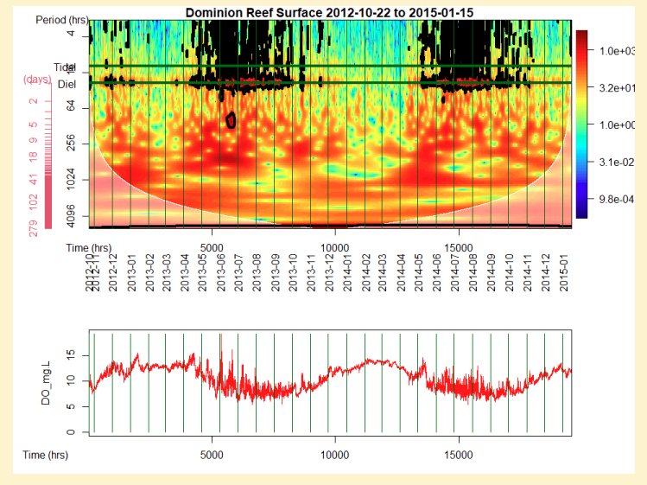
4D progress for interpolating dissolved oxygen concentrations (2022-early 2023)
Method exploration for short-duration d.o. dynamics component of the interpolator is underway (Elgin Perry)
Tetra Tech support in place to help on assembling data, creating the software of a working tool, documentation, etc.
Short duration D.O. pattern assessment with wavelet analysis
Elgin Perry, 2023

Slide 7
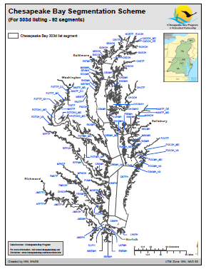
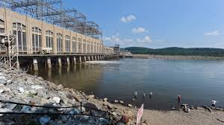
NOAA Deployments of 3 vertical arrays: Lower Potomac Mainstem Bay Lower Choptank River
2023 Habitat assessment update: New infrastructure
Dissolved Oxygen, Salinity, Temperature
River input monitoring sites
2023: 2 new deployments - river input water quality continuous monitoring sites (Patuxent, Choptank)
VA Appomatox online now too
Conowingo Dam, MD
One of 9 RIM sites

Slide 8

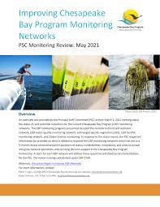
Satellite-assessment of SAV in Chesapeake Bay
2023 – EPA is providing support for work to address 2021 PSC Monitoring Review Report recommendations regarding the developing of satellite-based SAV monitoring programming capacity.

