Slide 1
Strategic Plan & Workplan Development
5/20/26
FAQs for Authors

Slide 2
How are key terms defined?

Slide 3
Key Terms
The Management Board agreed to develop a single Strategic Plan document consisting of a collaborative introduction and executive summary, followed by four Management Strategies that will serve as Goal chapters.
Strategic Plan refers to the whole document
Management Strategies refers to the individual Goal chapters
The Strategic Plan and its Management Strategies will be implemented, evaluated, and updated in a six-year cycle.

Slide 4
Strategic Plan Chapters & Sub-sections
Accountability
Goal 1 Management Strategies
Goal 2 Management Strategies
Goal 3 Management Strategies
Goal 4 Management Strategies
Appendix
Introduction
Executive Summary
Sub-section for each Outcome
Sub-section for each Outcome
Sub-section for each Outcome
Sub-section for each Outcome

Slide 5
Key Terms
Workplan: this document describe the major activities that will be collaboratively undertaken by Chesapeake Bay Program partners to make progress towards Outcome or Target attainment. Workplans over a three-year period.
Workplans are updated in a three-year cycle.

Slide 6
What is the timeline for Development?

Slide 7
Timeline Approved by MB
Public Feedback Period for Management Strategies: Tuesday, January 5, 2027 through Sunday, January 31, 2027
FINAL PSC approval
Each GIT approves its strategy. Cross GIT Meeting
Final GIT approval
MB approves template
Oct. 19 – Submit draft MS chapters
Nov. 5 - Present to PSC for feedback, revise and compile draft, PSC approves draft via email
Joint-GIT coordination meeting
GITS Revise & edit. Compile**
Publish**
**Dynamic web interface for a public-facing content would take additional time
PSC feedback
Public Feedback Period
Getting started
GITs incorporate feedback & finalize text
MB guidance: draft & refine template
Drafting
18-month countdown | 00 | 01 | 02 | 03 | 04 | 05 | 06 | 07 | 08 | 09 | 10 | 11 | 12 | 13 | 14 | 15 | 16 | 17 | 18
Month | Dec | Jan | Feb | Mar | Apr | May | Jun | Jul | Aug | Sep | Oct | Nov | Dec | Jan | Feb | Mar | Apr | May | Jun
Year | 25 | 2026 |  |  |  |  |  |  |  |  |  |  |  | 2027

Slide 8
Timeline
MAY – DECEMBER 2026
Drafting
FEBRUARY - APRIL 2027
Incorporate feedback
MAY
JUN
JUL
AUG
SEP
OCT
NOV
DEC
JAN
FEB
MAR
APR
MAY
JUN
2026
2026
2026
2026
2026
2026
2026
2026
2027
2027
2027
2027
2027
2027
JANUARY 5 – 31, 2027
Strategic Plan
Public Feedback Period
MAY – JUNE 2027
Strategic Plan and Workplan finalization and approval

Slide 9
Timeline
DECEMBER 2026
Policy Steering Committee approves draft Strategic Plan for Public Feedback Period release
APRIL 2027
Present revised Strategic Plan to Policy Steering Committee & incorporate input
MAY 2027
Goal Teams approve Strateic Plan
MAY
JUN
JUL
AUG
SEP
OCT
NOV
DEC
JAN
FEB
MAR
APR
MAY
JUN
2026
2026
2026
2026
2026
2026
2026
2026
2027
2027
2027
2027
2027
2027
NOVEMBER 5, 2026
Present draft Strategic Plan chapters to Policy Steering Committee & incorporate input
JANUARY 5 – 31, 2027
Strategic Plan Public Feedback Period
JUNE 2027
Policy Steering Committee approves Strategic Plan
Goal Teams approve Workplans

Slide 10
How do the Strategic Plan and Workplan relate to Adaptive Management and Accountability?

Slide 11
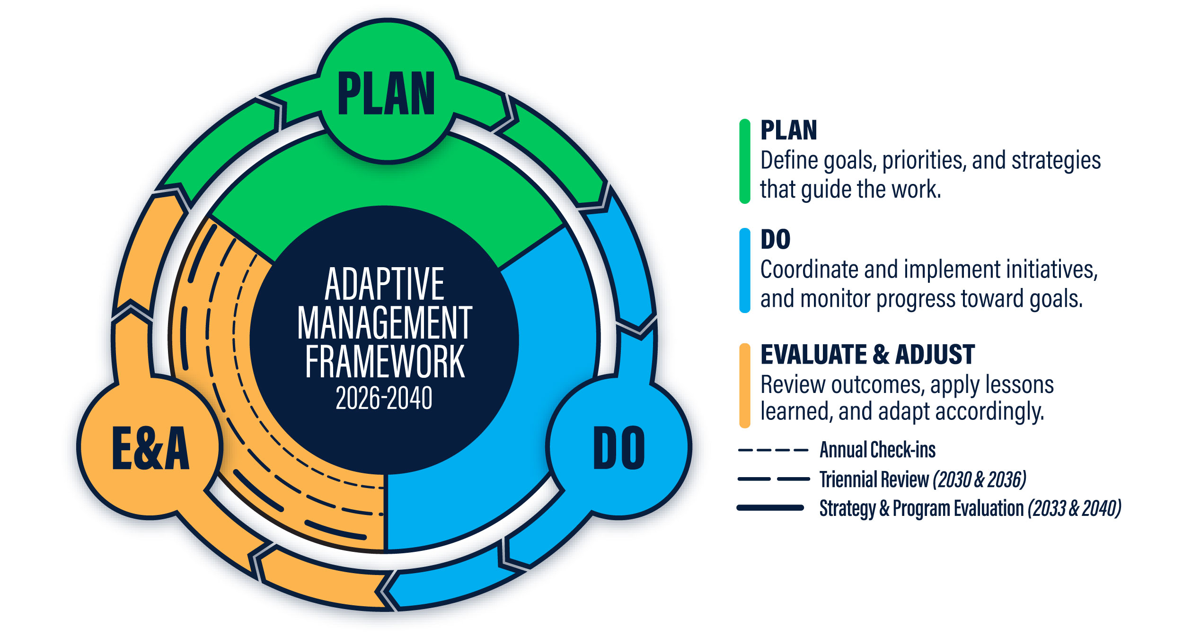
Accountability and Adaptive Management

Slide 12
Accountability and Adaptive Management
MS Develop. (up to 18 months) |  | Management Strategy (6 yrs) July 2027 – June 2033 |  |  |  |  |  |  | Management Strategy (6 yrs) July 2033 – June 2039 |  |  |  |  |  |  | Agreement Revision
2026 | 2027 |  | 2028 | 2029 | 2030 | 2031 | 2032 | 2033 |  | 2034 | 2035 | 2036 | 2037 | 2038 | 2039 |  | 2040
Workplans (3 yrs)
July 2027 – June 2030
Workplans (3 yrs)
July 2030 – June 2033
Workplans (3 yrs)
July 2033 – June 2036
Workplans (3 yrs)
July 2036 – June 2039
Annual Check-Ins – extended PSC meetings that communicate progress, and address and prioritize implementation needs
Triennial Reviews – cross-program review & symposium to document successes and challenges and initiate new Workplans
Strategy and Program Evaluation – assess the current progress towards achieving the Goals and Outcomes of the Agreement, evaluate the efficacy of existing Management Strategies and identifies opportunities for improvement
In 2040, the Strategy and Program Review will prompt revision to the Chesapeake Bay Watershed Agreement

Slide 13
How does the Strategic Plan and Workplan numbering system work?

Slide 14
Numbering System
Numbering format used throughout the Strategic Plan, Management Strategies, and Workplan documents:
[Goal Number].[Outcome Number*].[Management Approach Number].[Workplan Activity Number]
*“0” is used as the Outcome number for Goal-level analyses]

Slide 15
Goal # | Goal Name | Goal #. Outcome # | Outcome Name
1 | Thriving Habitat, Fisheries & Wildlife | 1.1 | Blue Crabs
1 | Thriving Habitat, Fisheries & Wildlife | 1.2 | Brook Trout
1 | Thriving Habitat, Fisheries & Wildlife | 1.3 | Fish Habitat
1 | Thriving Habitat, Fisheries & Wildlife | 1.4 | Fish Passage
1 | Thriving Habitat, Fisheries & Wildlife | 1.5 | Oysters
1 | Thriving Habitat, Fisheries & Wildlife | 1.6 | Stream Health
1 | Thriving Habitat, Fisheries & Wildlife | 1.7 | Submerged Aquatic Vegetation
1 | Thriving Habitat, Fisheries & Wildlife | 1.8 | Wetlands
2 | Clean Water | 2.1 | Reducing Excess Nitrogen, Phosphorous & Sediment
2 | Clean Water | 2.2 | Toxic & Emerging Contaminants
2 | Clean Water | 2.3 | Water Quality, Standards Attainment & Monitoring
3 | Healthy Landscapes | 3.1 | Adapting to Changing Environmental Conditions
3 | Healthy Landscapes | 3.2 | Healthy Forests & Trees
3 | Healthy Landscapes | 3.3 | Land Use Planning & Decision Support
3 | Healthy Landscapes | 3.4 | Protected Lands
4 | Engaged Communities | 4.1 | Local Government Leadership
4 | Engaged Communities | 4.2 | Public Access
4 | Engaged Communities | 4.3 | School District Environmental Literacy Planning
4 | Engaged Communities | 4.4 | Stewardship
4 | Engaged Communities | 4.5 | Student Environmental Literacy Experiences
4 | Engaged Communities | 4.6 | Workforce

Slide 16
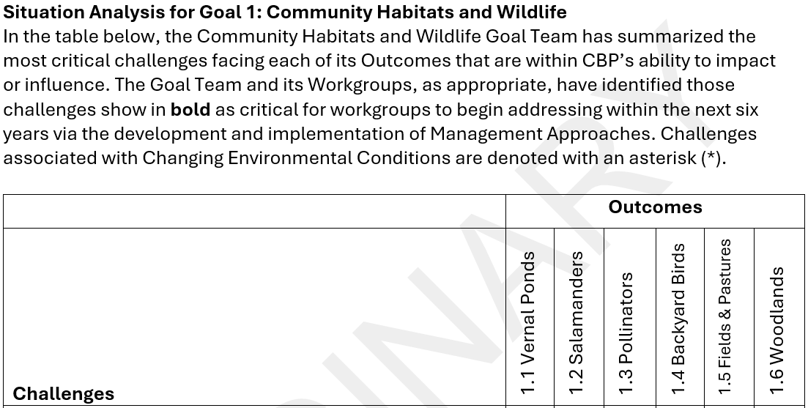
Management Strategies Numbering Ex
Backyard Birds is the fourth Outcome under Goal 1: Community Habitats and Wildlife

Slide 17
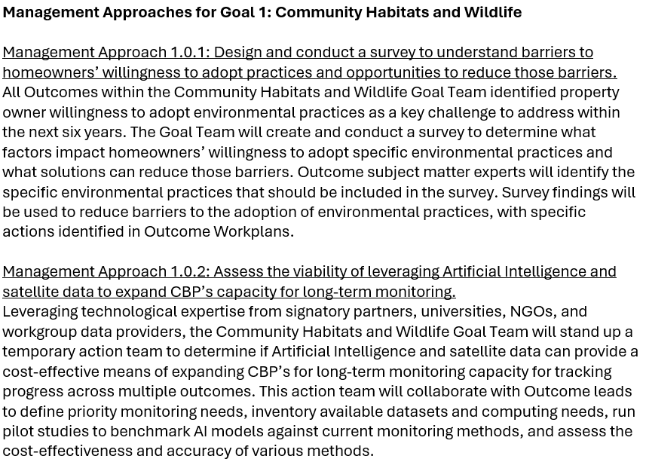
Management Strategies Numbering Ex
Management Approach 1.0.1
First Goal
Goal-level (not Outcome-specific)
First Management Approach

Slide 18
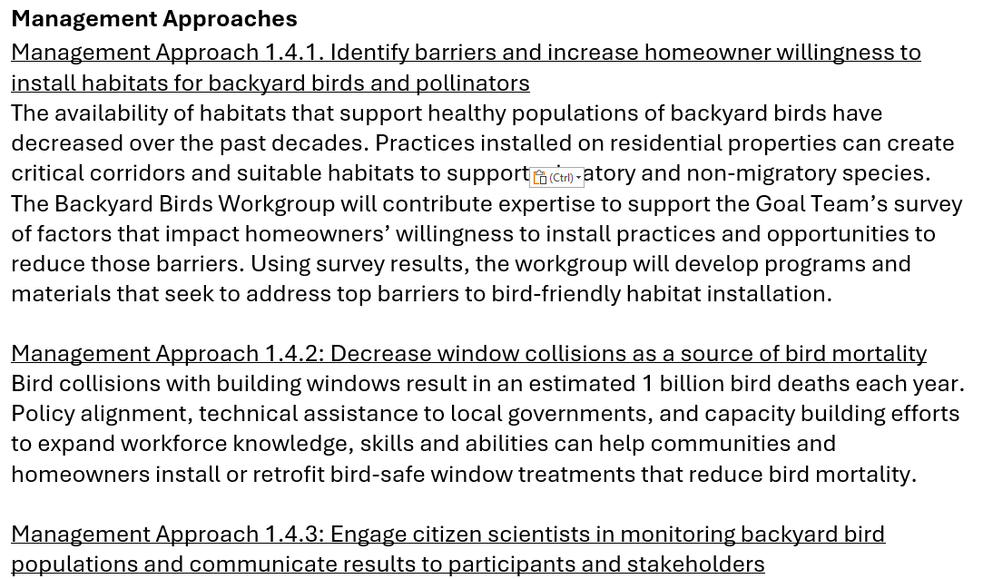
Management Strategies Numbering Ex
Management Approach 1.4.1
First Goal
Fourth Outcome
First Management Approach

Slide 19
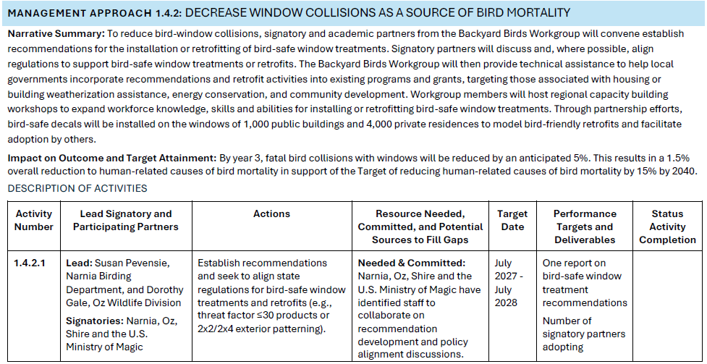
Workplan Numbering Ex
Management Approach 1.4.2.1
First Goal
Fourth Outcome
Second Management Approach
First Activity

