Slide 1


category goes here and here
A Proposed Framework for Analyzing Water Quality
and Habitat Effects on Aquatic Living Resources
of Chesapeake Bay
Kenneth Rose
France-Merrick Professor in Sustainable Ecosystem Restoration
University of Maryland Center for Environmental Science
Horn Point Laboratory

Slide 2
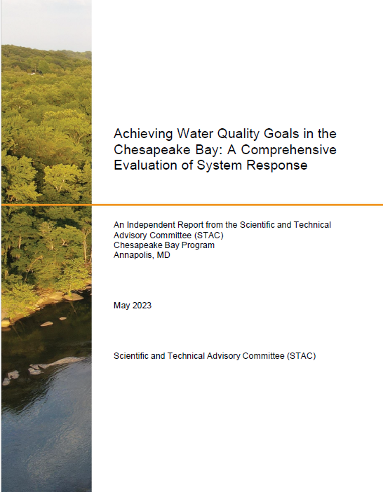
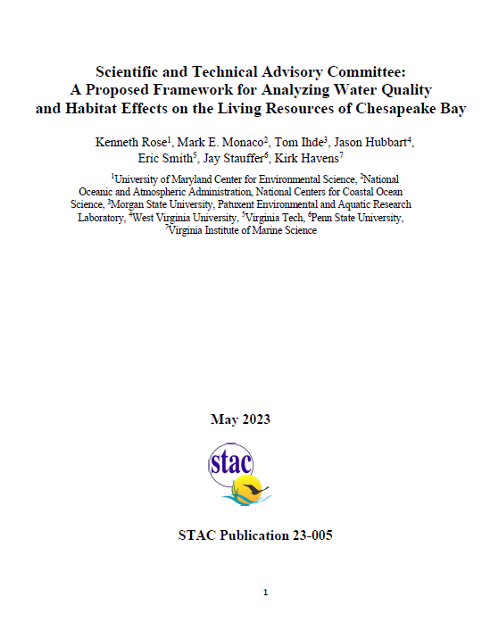

Slide 3
Many reasons to relate water quality and habitat changes to living resources
Valued by stakeholders and society
Restoration is costly
Realistic and feasible targets and goals
Watershed Agreement
Ecological and economic efficiency - “reckoning”
Expectations
Adaptive management
Winner and losers

Slide 4
CESR Executive Summary
Finding: Significant enhancement of living resources can be achieved through additional management actions without complete achievement of water quality standards across all habitats.
Policy implication: The legal requirements of the Clean Water Act (the water quality goal) divert attention away from considering multiple means of improving living resources (support of aquatic life as the designated use) as articulated in the Chesapeake Bay Watershed Agreement.
Policy implication: Opportunities exist to adjust approaches to prioritize management actions that improve living resource response (e.g., shallows).

Slide 5
LR Report
1 Introduction
2 Why now?
3 Management Questions that Could Be Answered
4 Existing Links Between WQ/Habitat & LR
4.1 Assessing Progress of Restoring LR of the CB
4.2 Example of Analyses for CB Living Resources
4.2.1 Habitat-based Assessment
4.2.2 Statistical Analysis of LR Monitoring Data
4.2.3 Living Resource Models
5 LR and Other Large-scale Restoration Efforts

Slide 6
6 Going Forward
7 Proposed Framework (Concepts)
7.1 Complex Life cycles and life history strategies
7.2 Variability, uncertainty, and stochasticity
7.3 Model complexity
7.4 Vital rates
7.5 Habitat suitability and capacity
7.6 Biological organization
7.7 Nonequilibrium theory and baseline
7.8 Multiple Influencing Factors
7.9 Tradeoffs (win-lose), Win-win, and Lose-lose
7.10 Power to detect responses
7.11 Explicit and implicit representations
7.12 Relative versus absolute predictions

Slide 7
8 Strategic determination of an analysis plan
8.1 Selecting species
8.2 Available Data
8.3 Response and explanatory variables
8.4 Biological, temporal, & spatial scales
8.5 Analytical approaches
8.6 Coordination and combining results
9 Final comments
10 Acknowledgements
11 References

Slide 8
Chesapeake Bay
Shift (expansion) from historical focus on water quality
Information and data rich
Many scientists = a lot of past and ongoing activities
Done at other large-scale restoration efforts
Q: How would we go about doing this task?

Slide 9
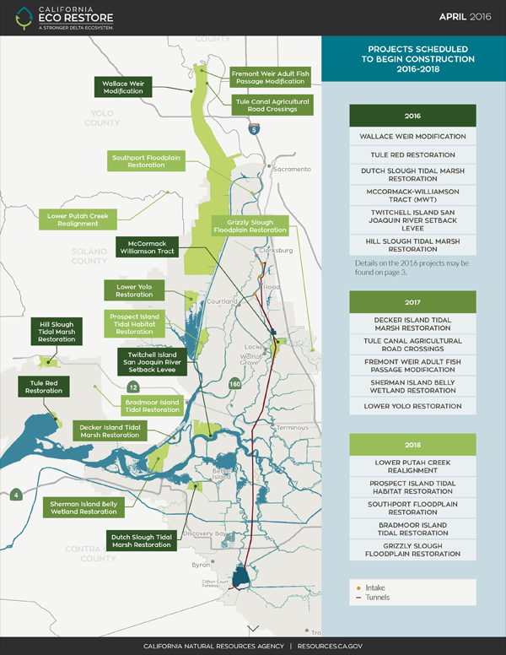
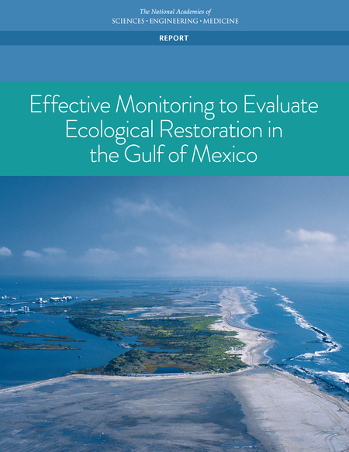
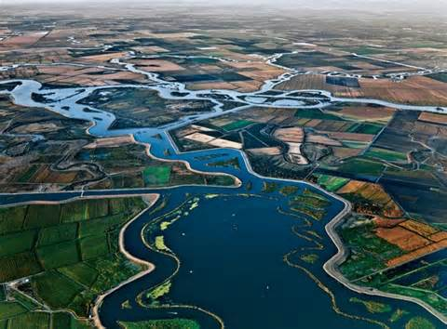
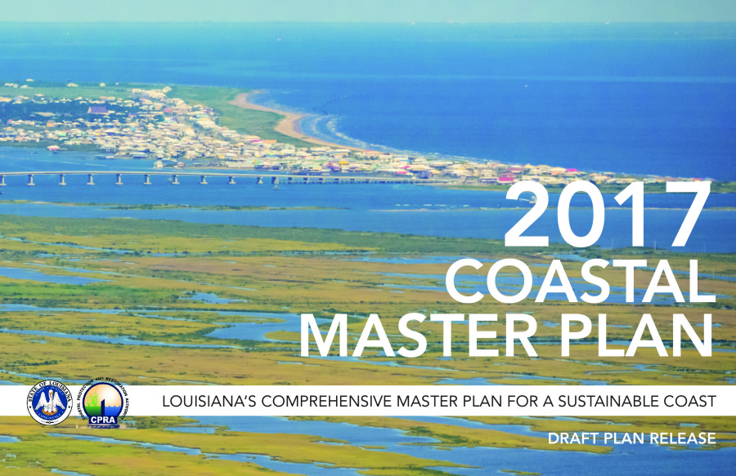
Chesapeake Bay is not alone!

Slide 10
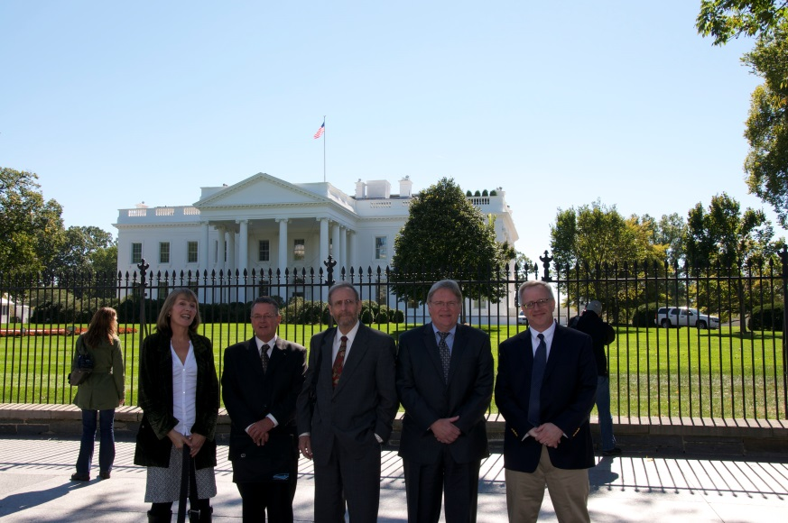
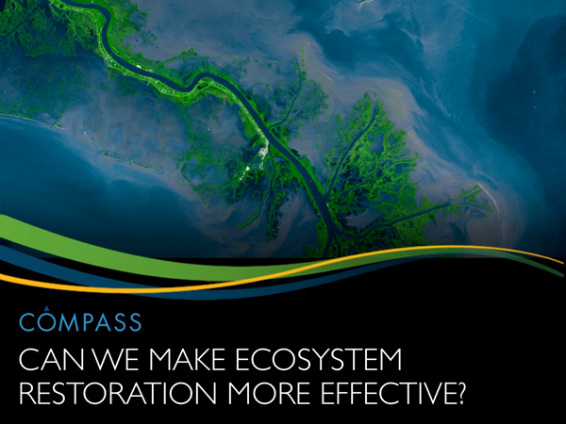
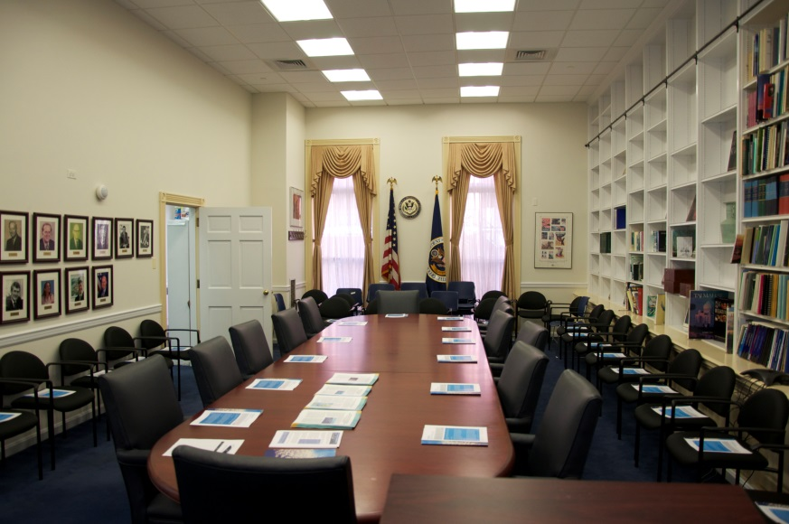
Question: Spending billions on restoration in the US and yet so many are unhappy

Slide 11
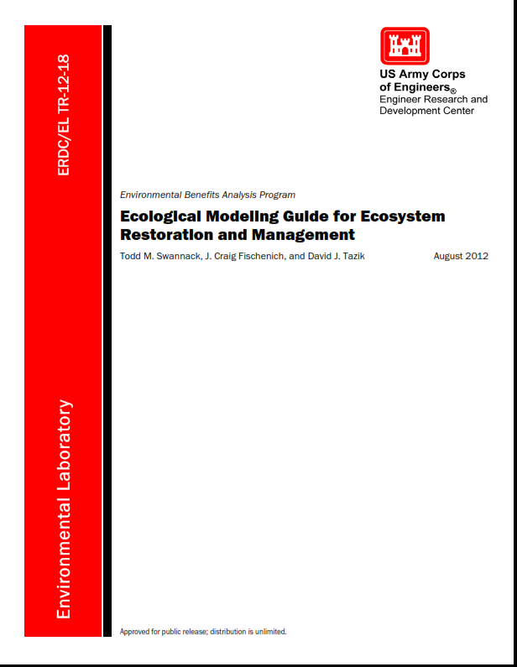
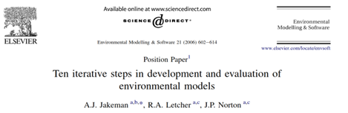
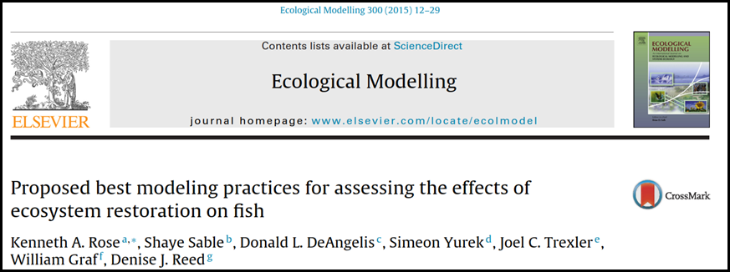
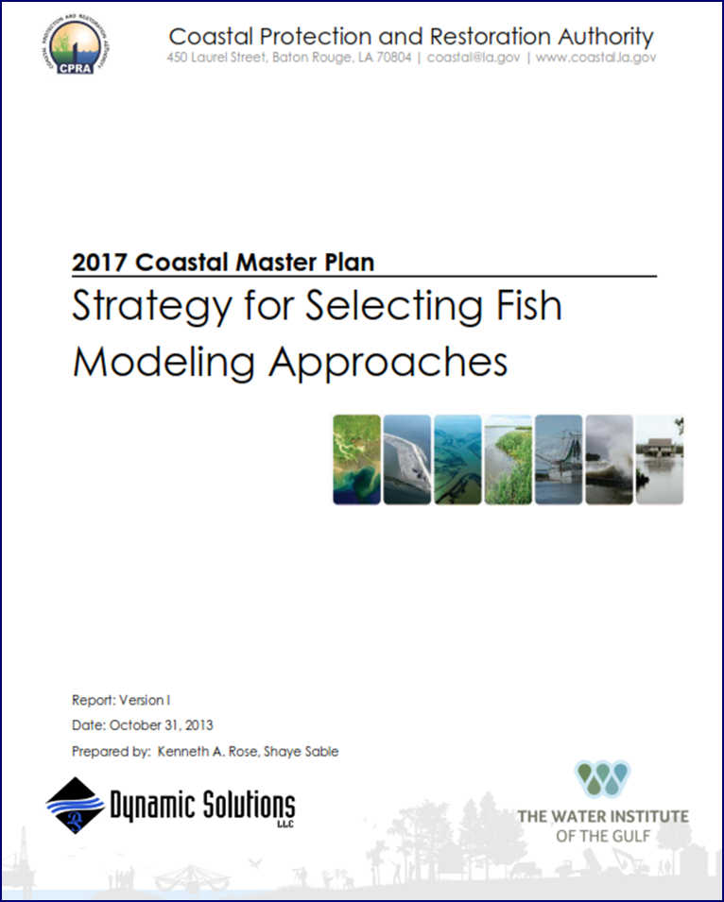
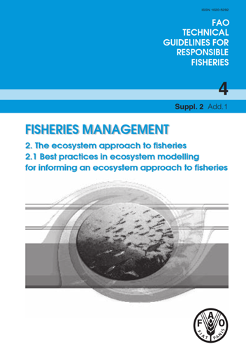
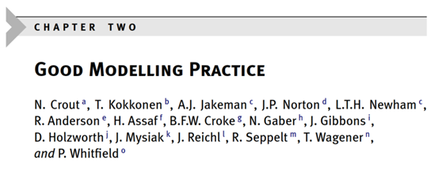

Slide 12
LR Report: Pathways
Status-quo
Moderate expansion
Major expansion
New approach – comprehensive assessment

Slide 13
Management Questions
What is the expected (projected) response of living resources
to water quality and habitat conditions in the Bay:
  (a) without the TMDL and habitat targets
  (b) present TMDL and habitat attainment continued
  (c) under full TMDL and habitat goals
  (d) “optimized”

Slide 14
Management Questions
Given the current state or condition, how can the analyses inform what types and magnitude of changes in water quality and habitat are needed to evoke an agreed-upon target set of the desired living resources’ responses?
What are the certainties and critical uncertainties of the analyses and how can they help guide future monitoring and modeling efforts?

Slide 15
Continued Status-Quo
Provides much useful information on progress
Focused on the first question
  WQ
  Habitat goals reached
  Simple population status indicators
Comprehensive approach - answer all questions
Status-quo → moderate → major → comprehensive
  More relevant questions and answers
  Tradeoff is effort and uncertainties

Slide 16
Existing links WQ/Habitat to LR
WQS
Agreement indicators
Report cards
Others

Slide 17
Existing links WQ/Habitat to LR
Seitz et al. 2009
Woodland et al. 2021
Adamack et al. 2017
Fulford et al. 2010
Ihde et al. 2016
Monitoring data
WQ modeling system
Habitat → population → food web

Slide 18
Existing links WQ/Habitat to LR
Many completed analyses
  Excellent
  Independent
Species, methods, spatial/temporal coverage vary
Addressed study-specific questions
  Not “TMDL” and CBP habitat restoration

Slide 19
Going Forward
Foundational concepts
Synthesize existing analyses
  Not collate
  Not vote tally
  Framework to put effects in context
Strategically and tactically design analyses

Slide 21
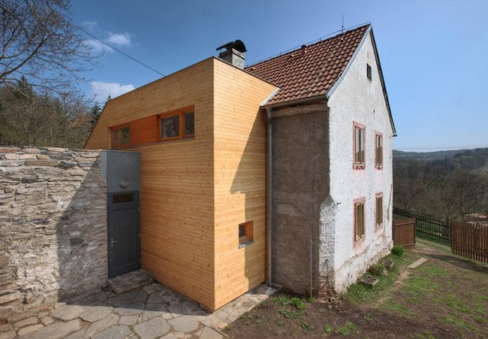
Living Resources: Framework
Selecting species
Available data
Response and explanatory variables
Biological, temporal, and spatial scales
Analytical approaches
Coordination and combining results
shutterstock.com

Slide 22
Final Comments
We know the question(s)
Incentive (demand?) and ingredients are available
  “most studied estuary in the world”
  Not meeting many goals
  Other restoration programs are assessing LR response
Leverage existing analyses; identify new analyses
Follow the framework, we can add analyses
  “meta-methods”
  “meta-results”

Slide 23
Final Comments
Living Resource Modeling & Assessment WG
Assessment of LR responses and likely responses
  “expectations”
Use it to “optimize” WQ and habitat efforts
  “inverse problem”
Start with feasibility level
  Low hanging fruit or key issues
  “test the waters”
  Use shallows (hotspots, 3 contrasting estuaries)
  Strategic

Slide 24
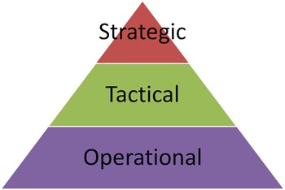

https://alandersen.co/2017/10/05/are-your-windows-
of-opportunity-open-or-close-a-trail-tip/
https://www.ruralhealthinfo.org/toolkits/networks/4/planning

