Slide 1
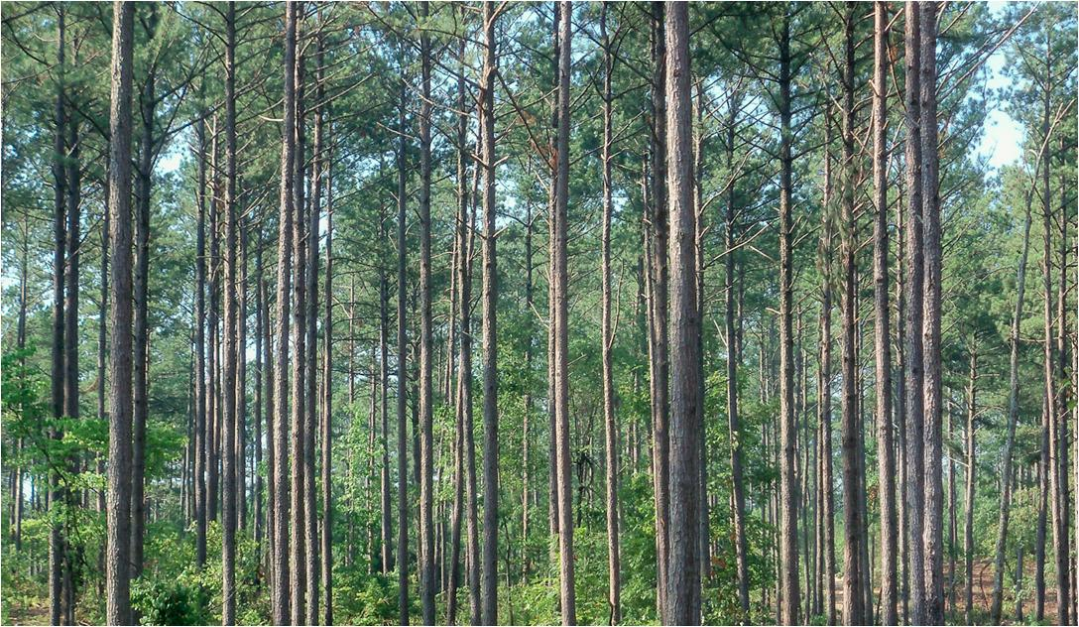
Scenario Builder and Watershed Model Progress toward the MPA
Gary Shenk, Guido Yactayo, Gopal Bhatt Modeling Workgroup 12/2/14

Slide 2
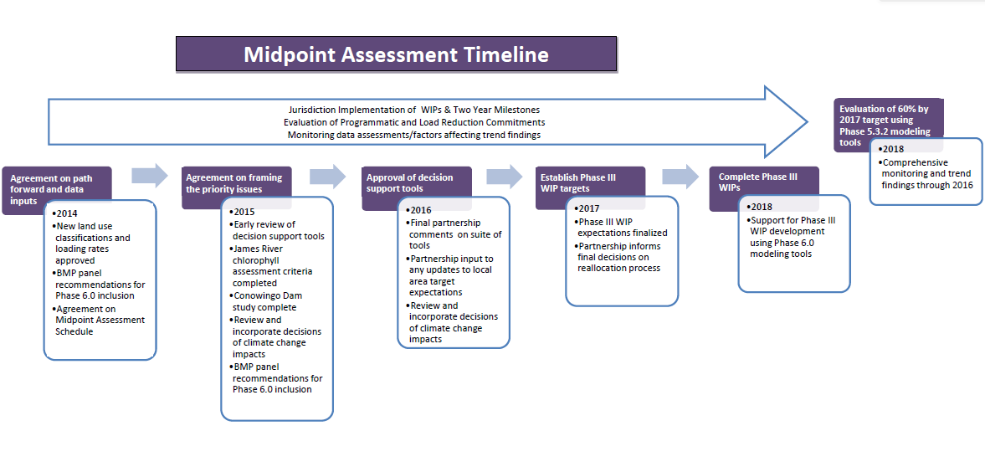
CREATE
The Models
REVIEW
The Models
USE
The Models

Slide 3
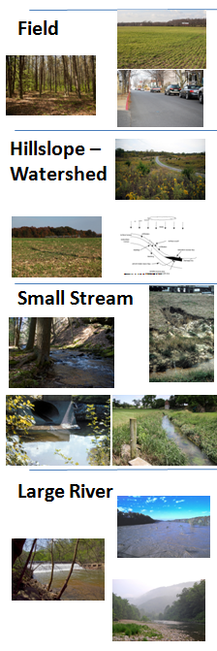
Phase 6
Nutrients
Sediment
Can we estimate EOF loads directly based on available information?
Should we update the sediment EOF estimates?
Can we estimate watershed delivery based on landscape parameters?
Can we estimate small stream effects?
Directly Simulated in HSPF for river averaging at least 100 cfs
Calibrated to WQ data

Slide 4


Slide 5
1-Slide Status Report
Land Use Types and Acreage
Land Use Loading Rates
Climate Change
Scenario Builder Development and Code Versioning
Watershed Model Development and Code Versioning
Calibration Methodology
Sensitivities to inputs
Fine-scale Processes
Atmospheric Data
Groundwater Lag
Better Representation of Reservoirs

Slide 6
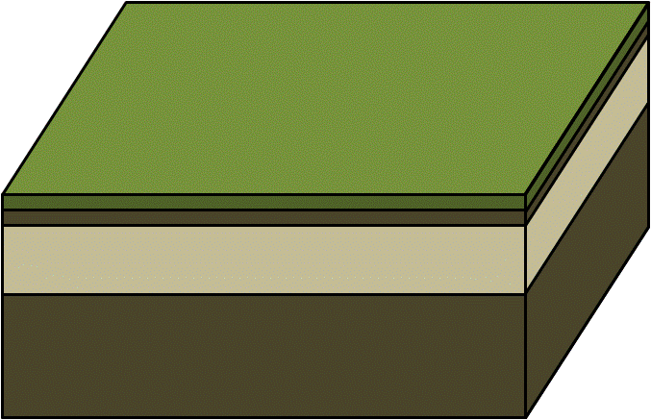

Phase 6
Fertilizer
Manure
Atmospheric
deposition
(…)
Precipitation
Nutrient
Submodels
BMPs,
Land to Stream,
Stream to River
HSPF
Temporal
Nutrient
model
}
Hydrology
submodel
Sediment
submodel
River

Slide 7
Phase 6
Fertilizer
Manure
Atmospheric
deposition
(…)
Precipitation
Nutrient
Submodels
Nutrient
Submodels
Guido Yactayo
BMPs,
Land to Stream,
Stream to River
Temporal
Nutrient
model
}
Hydrology
submodel
Sediment
submodel
River

Slide 8
Recommendations for Phase 6-PQUAL Nitrogen Sensitivity
Guido Yactayo – UMCES
gyactayo@chesapeakebay.net

Slide 9
Objectives
To estimate multiple watershed models sensitivity to nutrient inputs in the Chesapeake Bay
To develop, review and implement model sensitivities in the phase 6 version of the Chesapeake Bay Watershed model
To decide on Phase 6-PQUAL nitrogen sensitivities
* The input-output relationship or the effect of changes in nutrient inputs on nutrient export is referred to in this analysis as sensitivity.

Slide 10
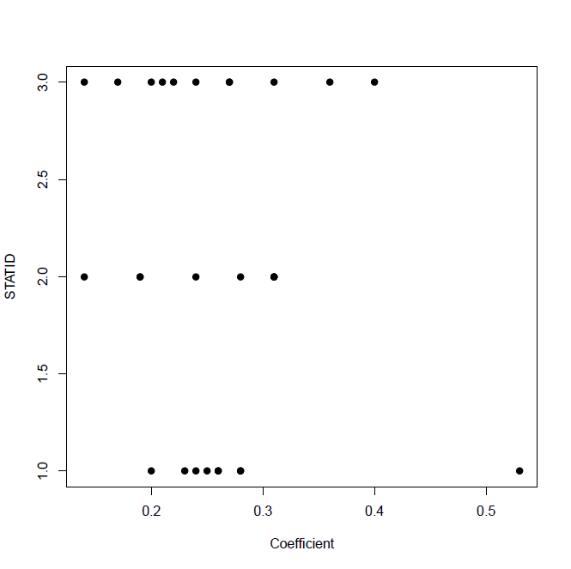
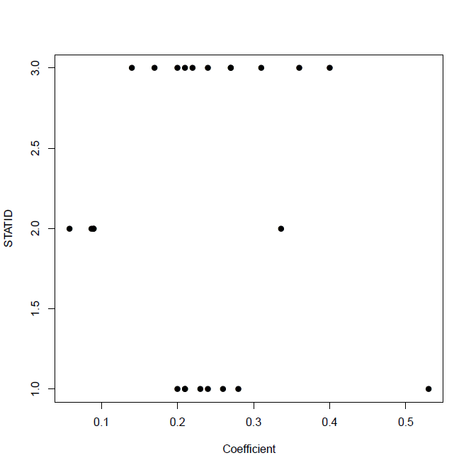
Sensitivities to total nitrogen inputs
Following STAC recommendations of using multiple models, APEX, SPARROW, and P532-AGCHEM models were included in this analysis.
The models sensitivities represent the relationship between nutrient predicted yields and input loads for cropland.
Sensitivity to fertilizer TN inputs
Sensitivity to manure TN inputs
APEX – CEAP
APEX – CEAP
SPARROW
SPARROW
Phase 5.3.2
Phase 5.3.2
APEX – CEAP: Ratio between output and input (No-practice, 2006, and 2011 scenarios including all input sources in cropland areas)
SPARROW: source specific coefficient (Various studies in the Chesapeake bay and Northeastern and Mid-Atlantic regions) *
Phase 5.3.2: Ratio between input and output, slope of multivariate regression, and slope between output and input (14 scenarios , hwm, hom, lwm, alf, and hyw)
* Preston and Brakebill (1999), Ator et al. (2011), Moore et al. (2011), and Preston et al. (2011).

Slide 11
Sensitivity implementation on phase 6
Total nitrogen sensitivities from other existing models support the Phase 532-AGCHEM findings.
Phase 532-AGCHEM sensitivities are available not only for TN but also by nitrogen species.
Phase 532-AGCHEM DIN and organic nitrogen sensitivities have been implemented in phase 6.
Phase 5.3.2
Phase 6

Slide 12
Decide on Phase 6 nitrogen sensitivities
Phase 532-AGCHEM sensitivities are more extensive and robust than other models sensitivities.
The new recommendation is to adopt the Phase 5.3.2 AGCHEM nitrogen sensitivities.
Please review both the Phase 5.3.2 AGCHEM and multiple model sensitivity analyses in order to make a decision.
https://archive.chesapeakebay.net/Modeling/phase5/Phase532/Sensitivity/

Slide 13
Phase 6
Fertilizer
Manure
Atmospheric
deposition
(…)
Precipitation
Nutrient
Submodels
Gopal Bhatt
BMPs,
Land to Stream,
Stream to River
Temporal
Nutrient
model
}
Hydrology
submodel
Sediment
submodel
River

Slide 14
Phase 6
Nutrient
Submodels
HSPF
Temporal
Nutrient
Model
UNEC

Slide 15
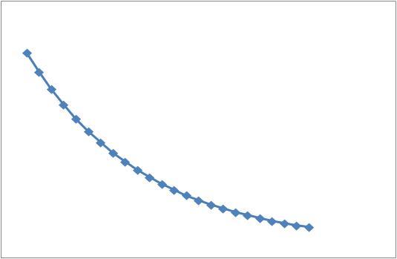
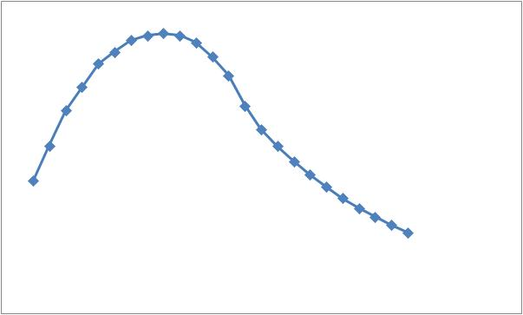
UNEC - Nitrogen
Each Loading Event
Surface
Nutrient
Submodels
HSPF
Time =>
Concentration=>
Sum=
Subsurface

Slide 16
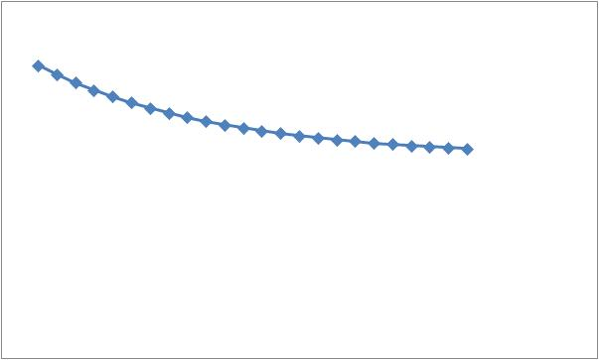
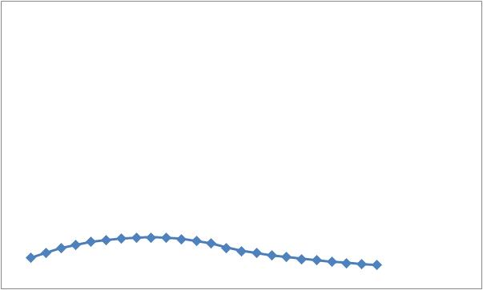
UNEC - Phosphorus
Each Loading Event
Surface
Nutrient
Submodels
HSPF
Time =>
Concentration=>
Sum=
Subsurface

Slide 17
Unit Nutrient Export Curve (UNEC)
An examination of transit time distribution

Slide 18
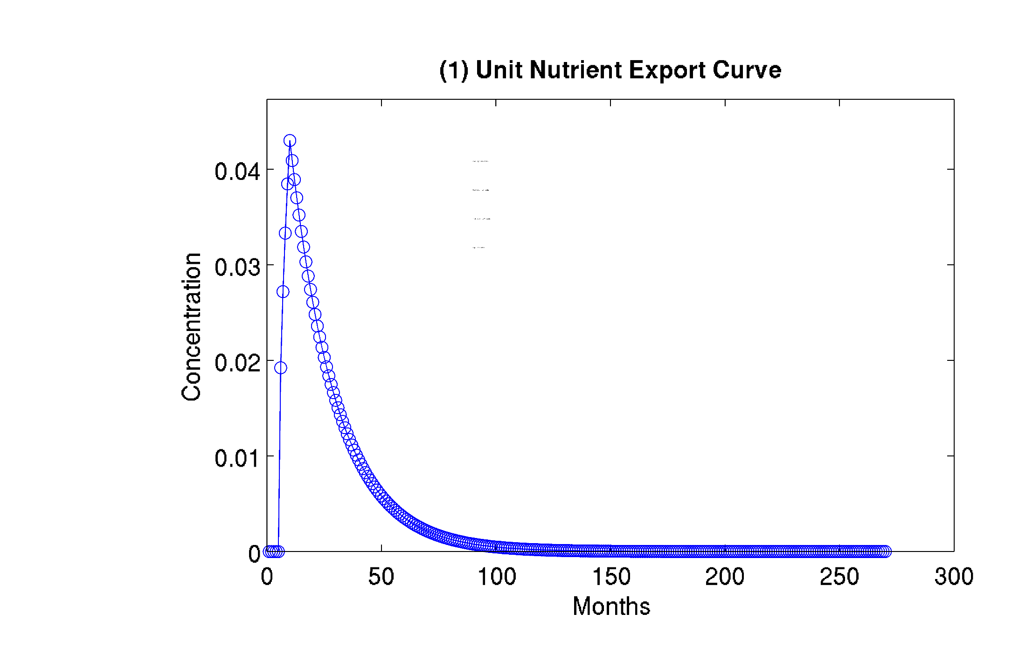
Unit nutrient export curve stochastically describes transport of nutrients as a probability density function. In other words, transit times are variable for inputs applied at same time.
Lead Edge = 5 months
Peak Conc. = 10 months
Trail Edge = 1200 months
Recession = 0.05
Lag in nutrient export
for a dirac-delta (pulse) input
22

Slide 19
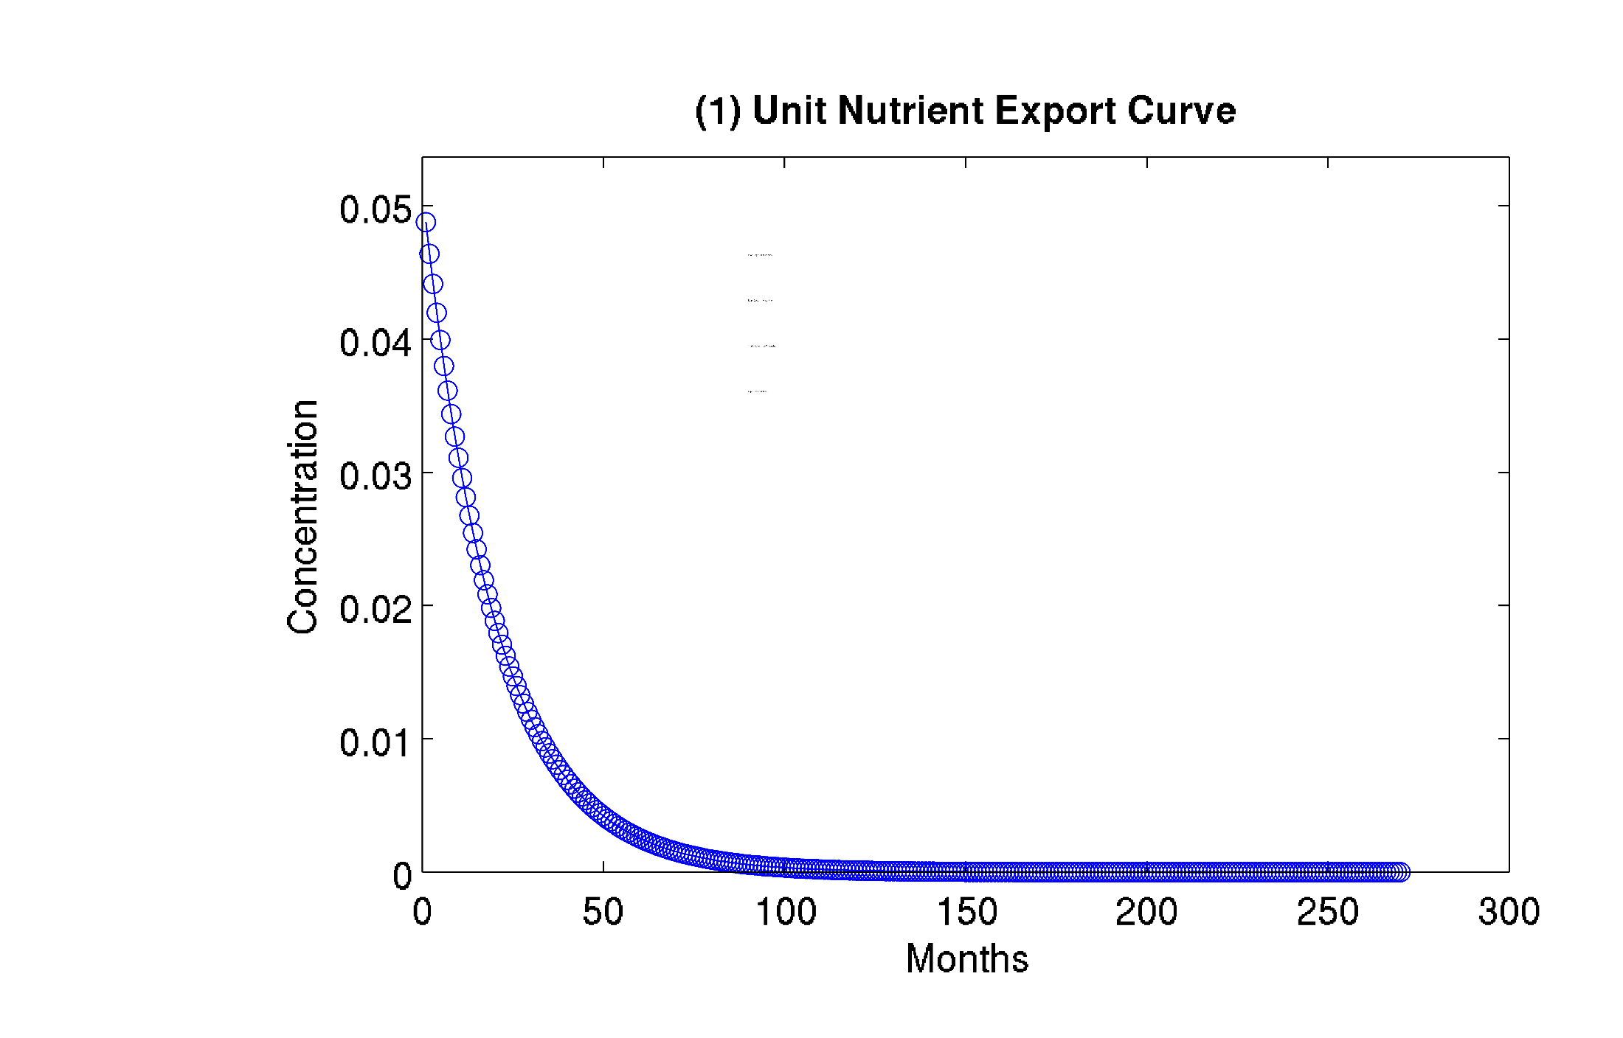
Here, a unit nutrient export curve is described using one parameter.
This parameter would be obtained from mean transit times estimated from models (e.g. MODFLOW, APLE) and observations.
Lead Edge = 0 months
Peak Conc. = 0 months
Trail Edge = 1200 months
Recession = 0.05
15

Slide 20
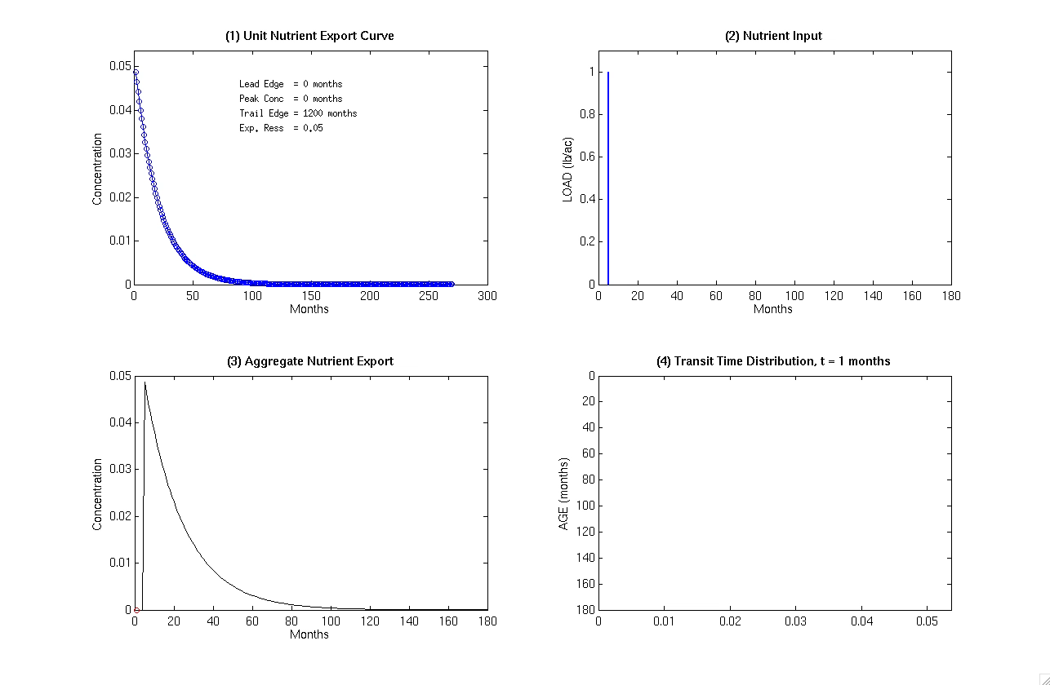
Dirac-delta / Pulse input

Slide 21
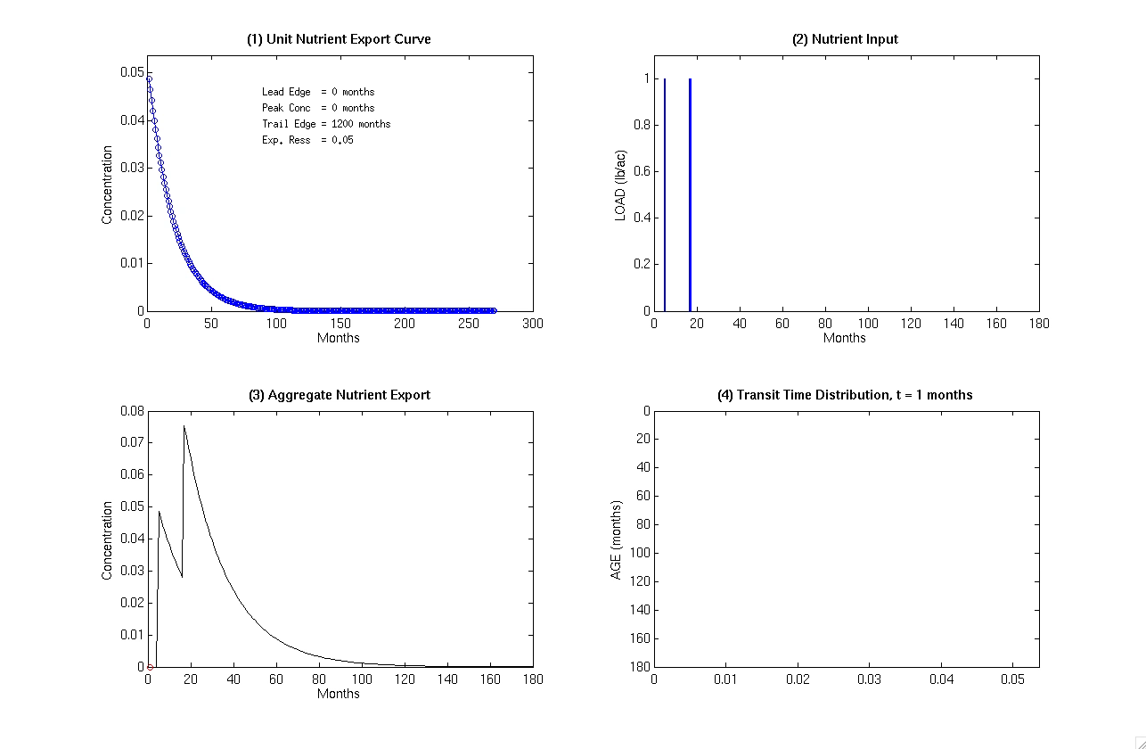
Dirac deltas / Pulse inputs
UNECs are superimposed to obtain the output as the convolutions of inputs.

Slide 22
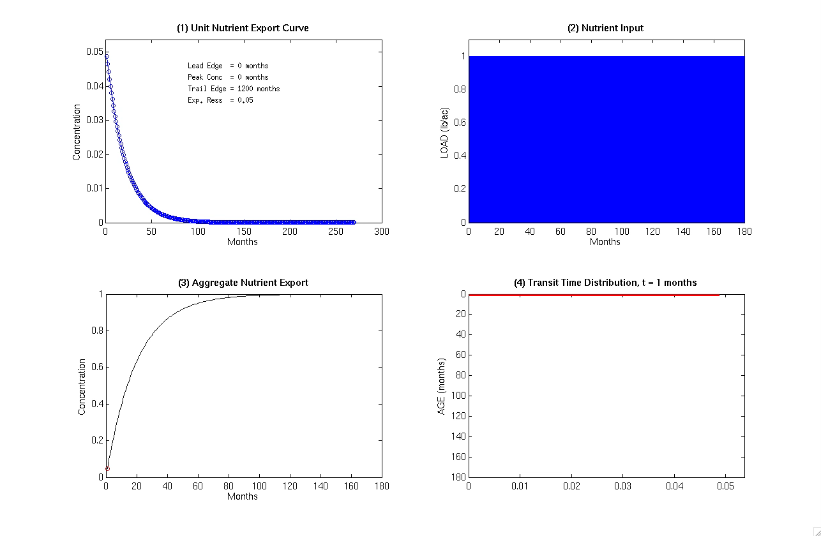
Continuous inputs

Slide 23
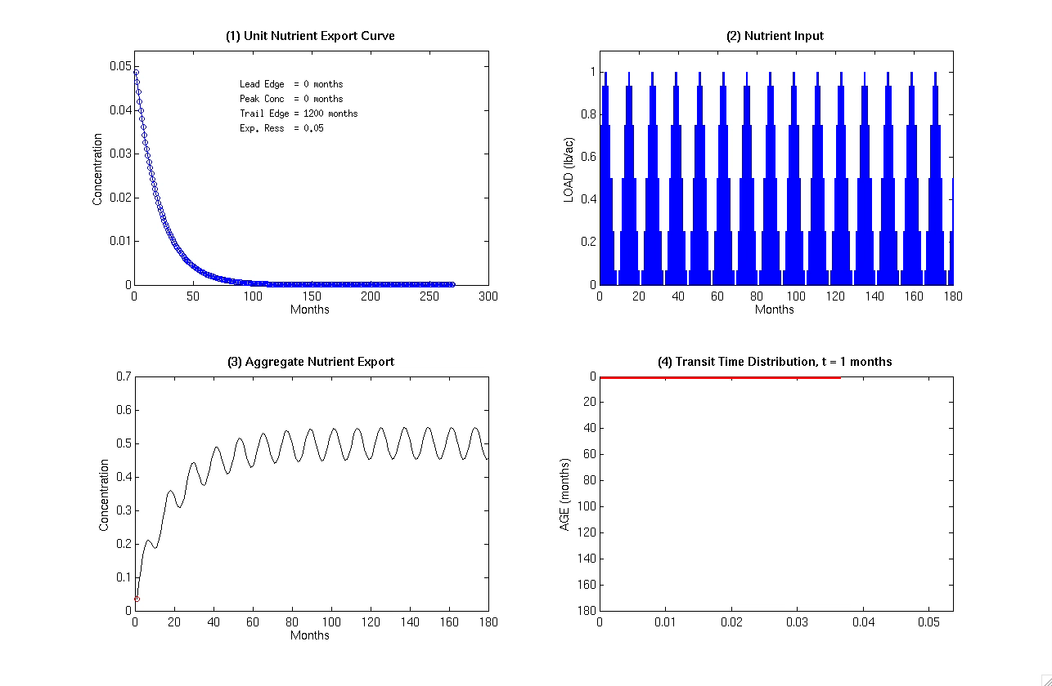
Sinusoidal inputs

