Slide 1
Chesapeake Bay TMDL 2017 Midpoint Assessment: Building the capacity for success in Phase III WIPs
Jim Edward, Deputy Director – EPA/CBPO
Citizens Advisory Committee Meeting
September 8, 2017

Slide 2
What is the Midpoint Assessment?
Review of progress towards meeting the 2017 60% interim target and the 2025 Chesapeake Bay TMDL goal
Optimize implementation of the Bay jurisdictions’ WIPs and ensure we’re on track for development of Phase III WIPs
Gather, review, and incorporate new data and science into the Partnership’s decision support tools

Slide 3
Midpoint Assessment Guiding Principles
Continue implementation, tracking progress and reporting results, with stable tools through at least 2017
Enhance decision support and assessment tools to enable successful engagement of local partners
Incorporate new or refined BMPs and verification of practices into existing accountability tools and reporting protocols
Address emerging issues (e.g., climate change)
Prioritize midpoint assessment actions and use adaptive management to ensure goals are met

Slide 4
Current Status of Midpoint Assessment Priorities and Impacts to the Phase III WIPs

Slide 5
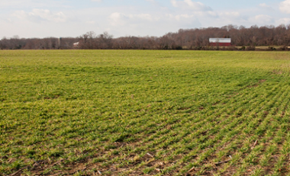
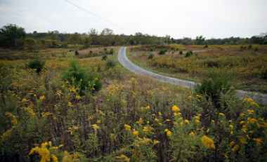
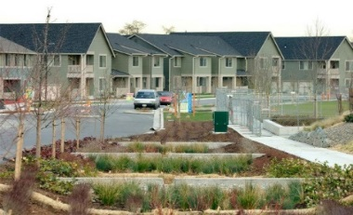
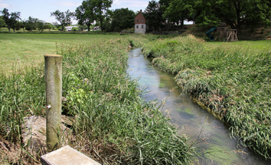
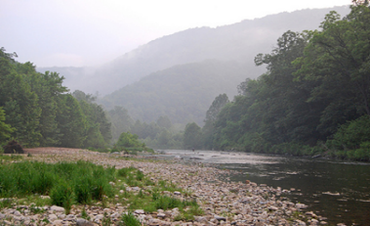
Completed 1 Year Partnership Review of Phase 6 Modeling Tool Refinements
Phase 6 Watershed Model Structure
Average Load + Inputs * Sensitivity
Land Use Acres
BMPs
Land to Water
Stream Delivery
River Delivery
*
*
*
Direct Loads
*
*

Slide 6
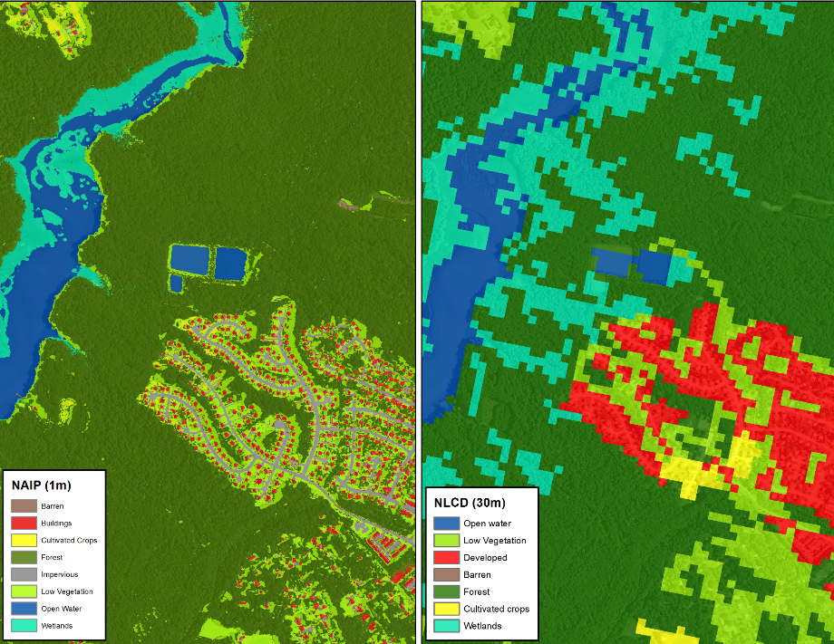
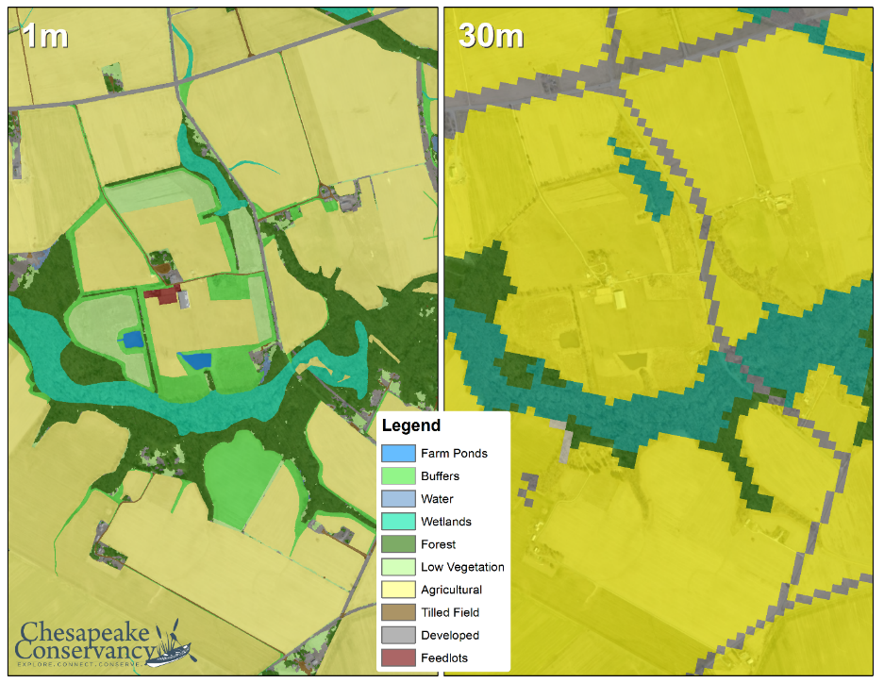
Advanced from 30 Meter to 1 Meter Resolution of Land Cover Basinwide
Phase 6
Phase 5
Phase 6
Phase 5
Urban/Suburban Settings
Rural Settings

Slide 7
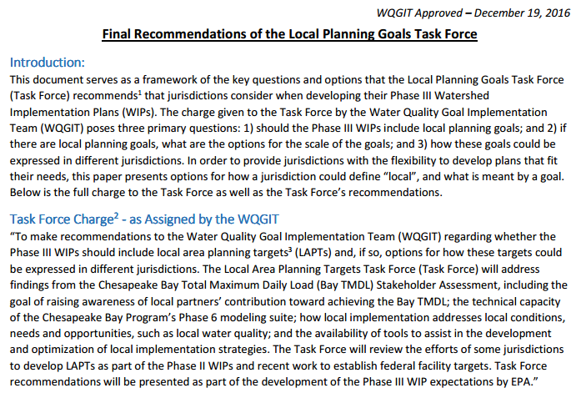
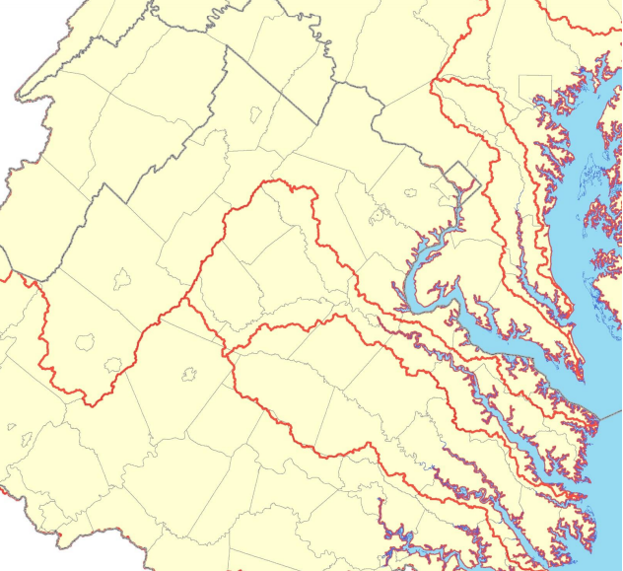
Partnership Approved Local Planning Goal Recommendations

Slide 8
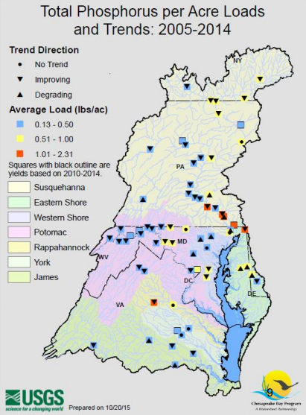
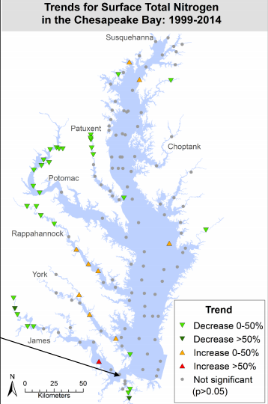
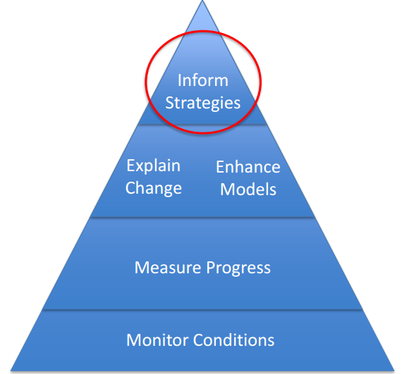
Monitoring Trends to Support Phase III WIPs
Notes:
The commitments we have undertaken as a Partnership over these last few decades have been making a demonstrable, positive difference in not only the Chesapeake Bay but its hundreds of rivers, streams, and creeks throughout the watershed.
The bottom line is we are making progress and we are seeing tangible results of our collaborative efforts to improve the water quality of the Bay and its local waters, as well as to the living resources so essential to the health of the larger Bay watershed.
USGS and other Bay partners are currently focused on conducting analyses of water quality changes to better understand and explain the factors affecting water quality response to BMPs; analyzing trends of nutrients and sediment in the watershed; and assessing attainment of WQ standards.
Monitoring data provides a direct measure of progress toward reducing pollutant loads and attaining the states’ and District of Columbia’s Chesapeake Bay water quality standards.
Efforts are underway to show state and local jurisdictions where we are seeing positive trends and areas where there is little improvement or degrading trends. This could help with targeting implementation.
During the 2013 to 2015 assessment period, an estimated 37 percent of the Chesapeake Bay and its tidal tributaries met water quality standards.
Long-term trends in total nitrogen loads delivered to tidal waters indicate improving conditions at the majority of the River Input Monitoring stations, including the five largest rivers.
Long-term trends in total phosphorus loads indicate improving conditions at 4 stations (and degrading conditions at another 4 stations).

Slide 9
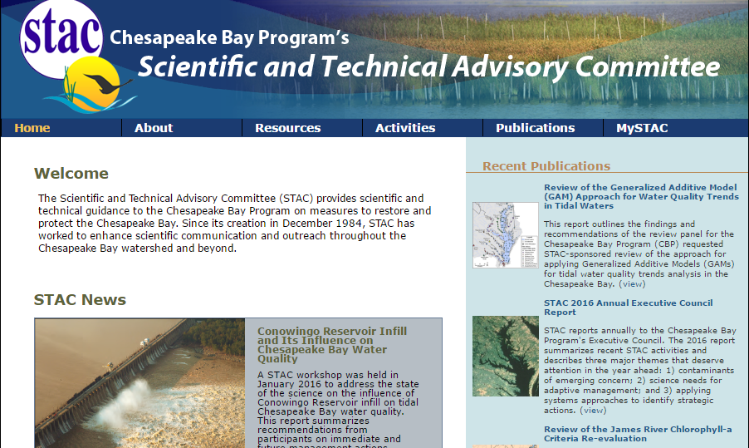
STAC Workshops & Peer Reviews
Notes:
The Partnership’s Scientific and Technical Advisory Committee has played a critical role in the Midpoint Assessment through their peer reviews of the Phase 6 modeling tools (e.g., Scenario Builder/Nutrient Input approach (complete), Watershed Model (finalizing), and Water Quality Sediment Transport Model (finalizing)) and the approaches taken to factor climate change impacts into the 2017 Midpoint Assessment (underway).
There is also an upcoming STAC workshop on climate-resilient BMPs, to assist jurisdictions in the development and implementation of their Phase III WIPs and future two-year milestones.
These peer reviews and workshops provide further credibility and confidence in the decision support tools we use to support implementation efforts, adapt to changing conditions, and measure progress.

Slide 10
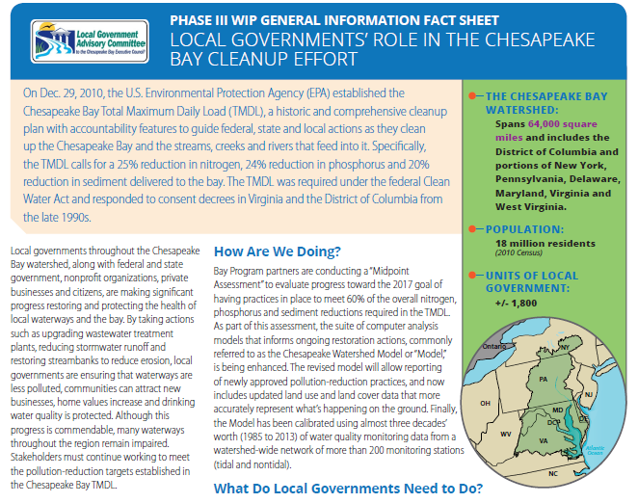
Communications & Engagement

Slide 11
Upcoming Midpoint Assessment Policy Decisions – Impacts to Phase III WIPs

Slide 12
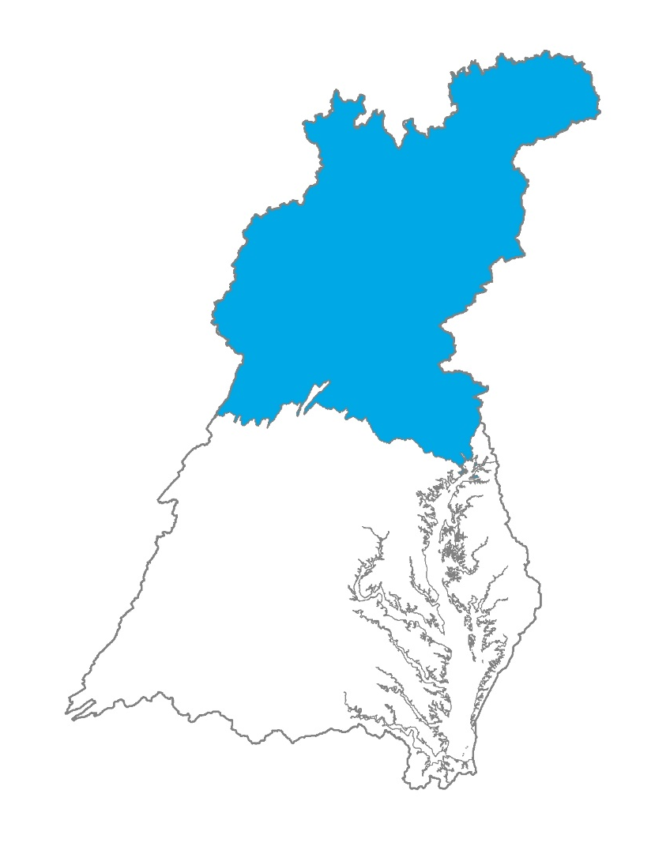
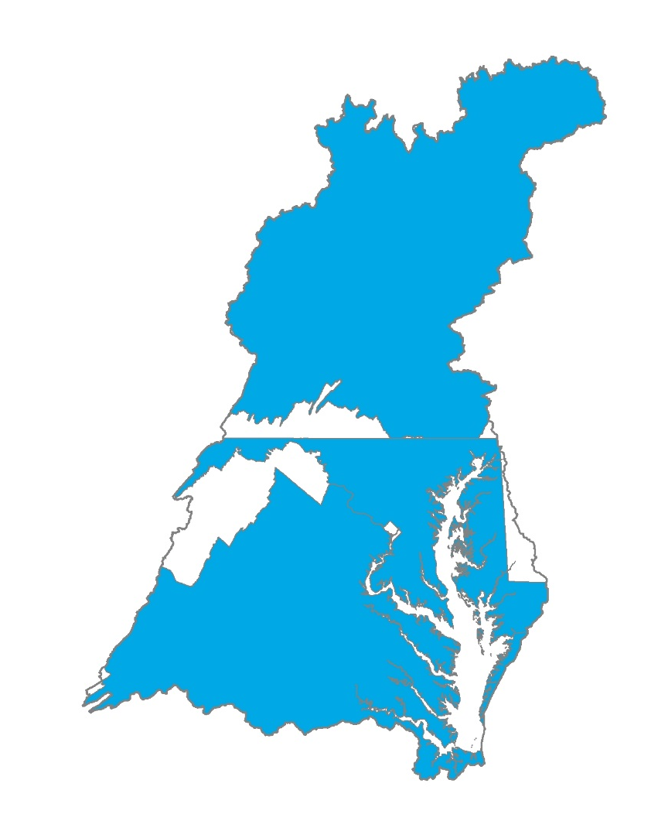
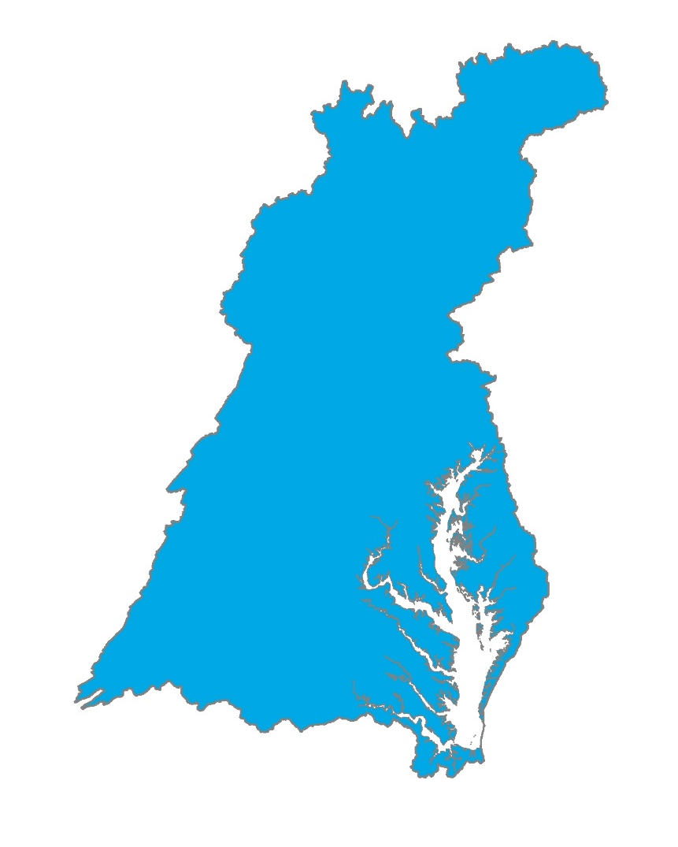
Conowingo Dam Infill Policy Decisions
Who?
How?
Allocation equity rules used in the Bay TMDL
Most cost effective practices and locations
When?
By 2025
Beyond 2025
Post 2025

Slide 13

Accounting for Growth Using 2025 growth projections in Phase III WIPs
2025 growth projection
Load reductions necessary to meet the 2025 Phase III WIP Planning Target (lock box)
Notes:
A decision before the Partnership in the fall will be whether to develop Phase III WIPs based on 2025 growth projections.
This would entail running the Phase III WIP input decks on these 2025 conditions.
This approach accounts for growth in pollutant load (and any declines) directly into the development of the Phase III WIPs. Jurisdictions would still need to offset any increases in growth, which is consistent with the expectation in the 2010 Bay TMDL, only this time directly in the Phase III WIP planning and commitments.
The Phase III WIP planning targets – the “lock box” – would not change. Any increases in growth would be an additional load above and beyond the Phase III WIP planning targets (i.e., the nutrient and sediment reductions) the jurisdictions would need to address.
Growth will not be uniform across the watershed. Each jurisdiction will be given their own 2025 growth projections this September, which will be updated on a two-year basis, to coincide with the jurisdictions’ two-year milestone development process (to account for any changes in that growth load).
The use of 2025 growth projections in the Phase III WIPs also provides a way to “credit” conservation.
For example, growth offsets can be reduced through conserving forests in areas vulnerable to development.
States and local partners can target their land conservation efforts and development patterns in ways in which they can decrease future expenditures to offset growth in pollutant loads.

Slide 14
Climate Change Policy Decisions
The Partnership will decide by Fall 2017 whether to address climate change considerations:
Quantitatively – accounting for additional loads due to climate change impacts projected through 2025 in the Phase III WIPs
AND/OR
Qualitatively – adaptively manage climate change considerations through the implementation of BMPs (with climate resilient characteristics) through the Phase III WIPs and 2-year milestones

Slide 15
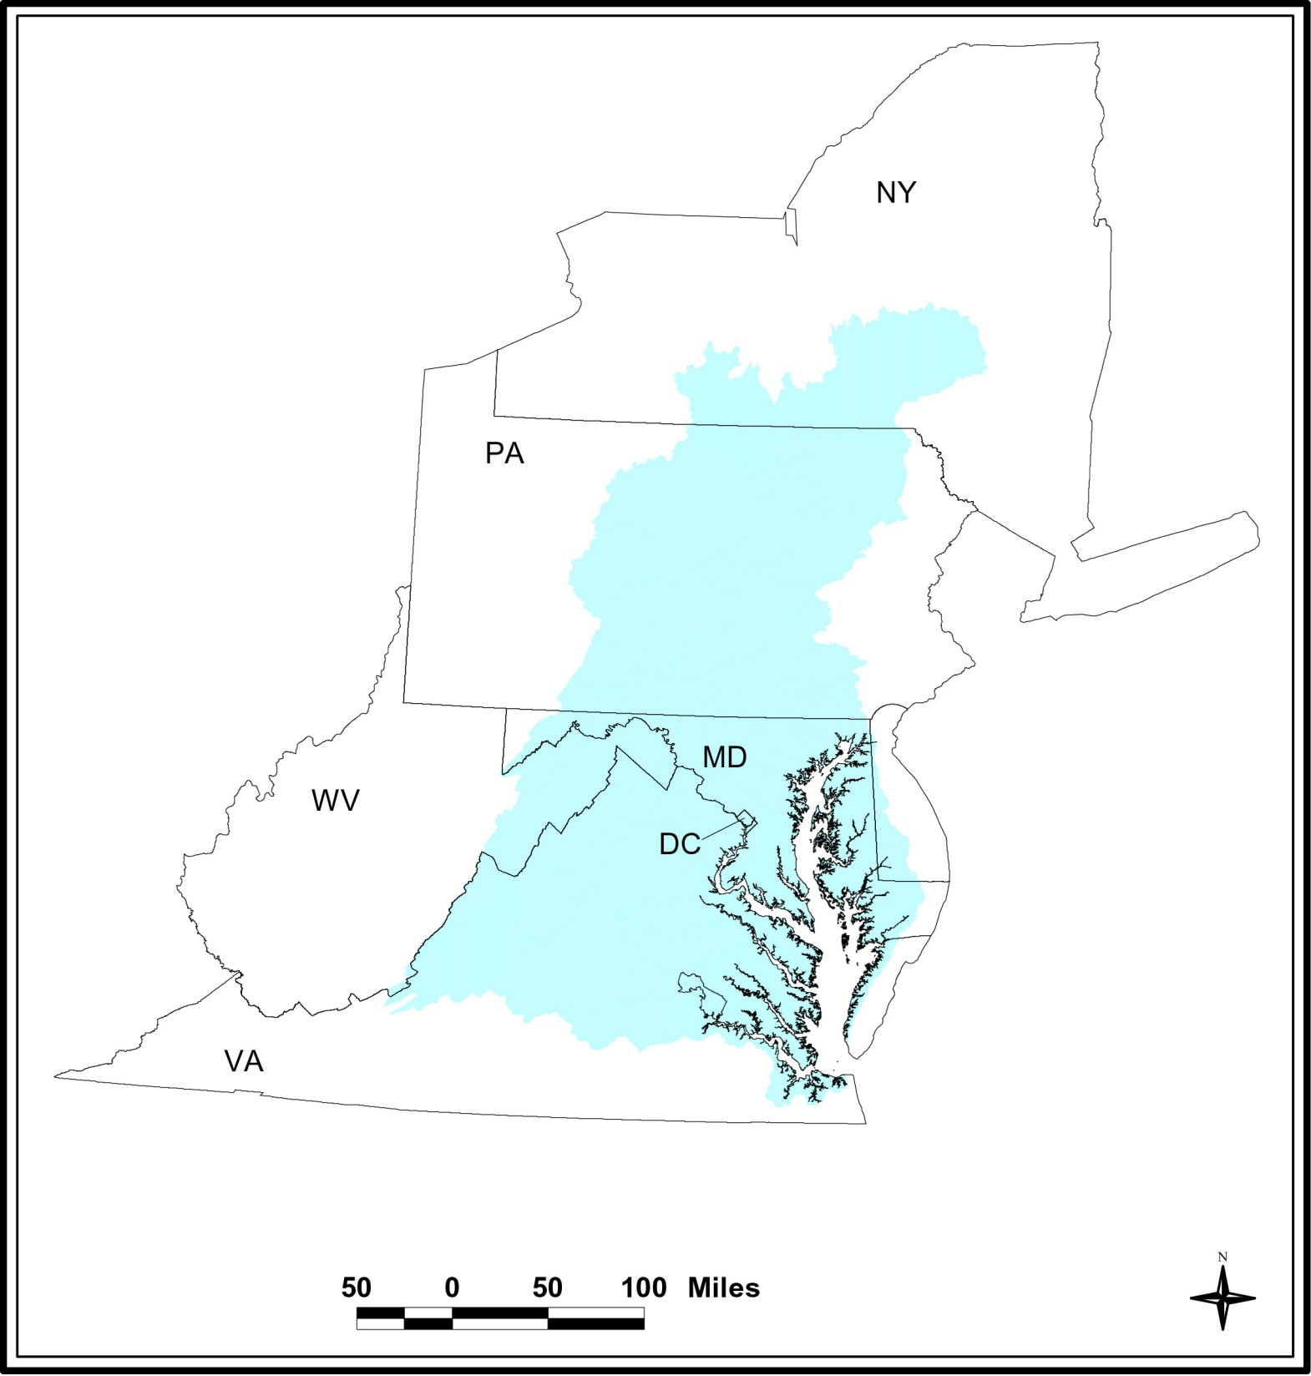
Midpoint Assessment
Challenges and Opportunities by State
DE

Slide 16
New York
Challenges
Further reductions from wastewater
Consistent source of ag cost share $
Opportunity targeted
Pounds reduced to get to one less pound delivered to the Bay
Opportunities
Upper Susquehanna Coalition
Innovative approaches, practices and delivery
Significant improving trends in local streams and rivers
DE

Slide 17
Pennsylvania
Challenges
34 million pound nitrogen deficit
Unachievable stormwater goals
Over 90% needs to come from ag
No dedicated state ag cost share $
Lacking programmatic capacity
Need more boots on the ground
Minimal enforcement of existing laws; level of compliance not known
Opportunities
Improving trends across most rivers
Solid state regulations
Shared vision from “PA in the Balance” conference
Ag, natural resources critical to local and state economies
DE

Slide 18
West Virginia
Challenges
Possible cuts in federal cost share
Opportunities
Motivated to demonstrate voluntary approach can work
Wastewater goals achieved ahead of schedule
Significant improving trends in local streams and rivers
Possible nitrogen for phosphorus exchanges
DE

Slide 19
Maryland
Challenges
Achieving stormwater goals by 2025
Phosphorus saturated soils, groundwater lags on Eastern Shore
Must achieve WQ standards in each of 54 Bay segments
Opportunities
Significant improving Bay WQ trends
Excess capacity in wastewater sector
Solid financing programs in place and working
Engaged local county, municipal partners
DE

Slide 20
District of Columbia
Challenges
Keep on track with Blue Plains upgrade
Ensure wastewater data reporting and tracking is consistent with revised Blue Plains permit
Opportunities
Achieved 2025 nitrogen, phosphorus goals
All sources are regulated
Solid financing, regulatory infrastructure in place
DE
Notes:
Basis for second bullet under Challenges, as reflected in EPA’s interim 2016-2017 milestones evaluation:
Key Areas to Address to meet 2016-2017 Milestones
The District Department of the Environment (DDOEE) will coordinate more closely with DC Water to track and report on wastewater, Combined Sewer Overflow (CSO) annual progress and milestones consistent with the revised language in the draft 2017 Blue Plains Permit.

Slide 21
Delaware
Challenges
Phosphorus saturated soils, groundwater lags on Eastern Shore
Not on ag practice implementation trajectory to achieve nitrogen 2025 goals
Opportunities
Signs of improving trends
Strong state watershed assessment/ planning system in place
Engaged local counties, municipal partners
DE

Slide 22
Virginia
Challenges
Achieving stormwater goals by 2025
Fluctuating state ag cost share program funding levels
Must achieve WQ standards in each of 38 Bay segments
Opportunities
Significant improving Bay WQ trends
Excess capacity in wastewater sector
Solid state regulations, laws in place
Trading, offset infrastructure in place and being used
DE

Slide 23
Phase III WIP Expectations – Top 4
Programmatic and numeric implementation commitments for 2018-2025
Strategies for engagement of local, regional and federal partners in implementation
Account for changed conditions: climate change, Conowingo Dam infill, growth
Develop, implement local planning goals below the state-major basin scales

Slide 24
Phase III WIP Expectations: Schedule
Preliminary Draft – June 2016
EPA solicited Partnership feedback over the summary and early fall and revised document accordingly
Interim Version – January 2017
Final Version – November 2017 (anticipated)
EPA will update document to reflect Partnership policy decisions on how to address Conowingo, climate change and growth

Slide 25
Jurisdictions’ Local Engagement Plans
Local participation and collaboration in the Bay TMDL and WIP process is critical to our success in meeting our shared water quality goals.
In developing their Phase III WIPs, each of the Bay states is expected to build comprehensive local engagement plans that demonstrate the important roles of our local partners
States will also be developing local planning goals, working with local and regional partners. These goals are intended to raise awareness of local partners’ contributions toward meeting the Bay TMDL targets.

Slide 26
Strengthening Local Engagement
Many water quality improvements happen at the local level – therefore, local participation is critical to our success
Phase III WIP Local Engagement Strategies – expected to clearly demonstrate role of our local partners in meeting WIP and milestone commitments
Measurable local planning goals are intended to facilitate local engagement in Phase III WIP implementation and address local conditions, needs, and opportunities
Notes:
Many of the restoration actions taken to improve water quality happen at the local level.
Local participation and collaboration in the Bay TMDL and WIP process is critical to our success in meeting our shared water quality goals.
Through the Phase III WIP development process, each of the Bay states is expected to build comprehensive local engagement plans that demonstrate the important roles of our local partners, including local governments, and contain commitments for actions to be taken to get the needed reductions.
In addition, states will develop local planning goals, working with local and regional partners. These goals are intended to raise awareness of local partners’ contributions toward meeting the Bay TMDL and address local conditions, needs, and opportunities.

Slide 27
EPA Support for Local Engagement
For the 4th straight year, in FY17, EPA provided $5 million in set-aside grants to the states and DC for “Local Government Funding” and plan to do the same in FY18.
In FY2107, EPA provided $500,00 in WIP Assistance Funding to the seven Bay jurisdictions to be used exclusively for projects related to local engagement and development of local planning goals.
$12 million in EPA funds was awarded to local governments and community organizations in FY 17 through the Innovative and Small Watershed Grants Programs managed by NFWF.
This is in addition to the $30 million EPA provided to the jurisdictions in FY17 through its CB Implementation and Accountability Grants.

Slide 28
Jurisdictions’ Local Engagement Plans
Delaware
Audiences
Local governments
Conservation districts
MS4 permitees
Goals
Identify BMPs
Understand the value of water
What do local governments need to make Phase III WIP commitments
Outreach/Engagement Strategies
In-person meetings
Information packets
Eastern Shore Healthy Watershed Roundtable
Notes:
Delaware is still working on their communications and engagement strategy for local governments. Since only a small number of governments fall within the watershed, in-person meetings are planned with each municipality. Information packets containing materials developed by the Local Government Engagement Initiative have been handed out to local governments.
Delaware identified several goals in their communications: help local governments identify what BMPs they already have in place so they can get credit; help identify gaps in capacity at the local level and address what local governments need to make their Phase III WIP commitments; and understand the value of water when they live far from the Bay.
Several communities in Delaware are MS4 regulated and the state is looking for guidance and technical assistance on how to integrate these into the Phase III WIPs. The state is exploring how local governments can collaborate with others involved in the Eastern Shore Healthy Waters Roundtable.

Slide 29
Jurisdictions’ Local Engagement Plans
District of Columbia
Audiences
Local officials
Federal facilities
Goals
What worked well, identifies audiences, trusted messengers and trusted sources
Collaborate with federal facilities
Outreach/Engagement Strategies
Current programs in place that focus on local waters.
Contracting out assistance with messaging and outreach strategy
Local engagement strategy
Notes:
The District of Columbia is also working on their local engagement and communications strategy. The local engagement strategy will include what has worked well in the past, and identifies audiences, trusted messengers and trusted sources. DC currently has a number of programs in place focusing on local waters and is looking into how Phase III WIP outreach could be folded into these programs. They are currently contracting out the development of messaging and an outreach strategy. They plan to message the Phase III WIPs by describing and incorporating information about existing commitments and other obligations that DC is on track to meet (e.g. sewage plant upgrades). DC faces the issue of collaborating with the federal government, as a large acreage of federal facilities lie within their borders.

Slide 30
Jurisdictions’ Local Engagement Plans
Maryland
Audiences
Local officials
Technical Partners
Local practitioners
Goals
What do you think you can achieve by 2025?
What new capacity do you plan to build by 2025?
Outreach/Engagement Activities
Webinars
Open house strategy sessions
New York
Outreach/engagement strategies not yet known.
Notes:
Maryland
Maryland is focusing on three audiences that they need to reach with their outreach and engagement process: local officials, technical partners and local practitioners. Maryland municipalities will be asked to consider: what do you think you can achieve by 2025? What new capacity do you plan to build by 2025?
Maryland believes their 2025 goals are in reach and the state hopes that many localities will develop new capacity between now and 2025 that will help them improve their pace of reductions beyond 2025.
Their specific outreach and engagement activities include: kickoff webinars in March 2017; a day-long open house strategy session held in May 2017 where Maryland Department of the Environment worked with local practitioners (divided by subsector) to provide initial guidance and offer continued support. Municipalities should provide their draft contributions to the WIP by October 2017 so MDE can perform a gap analysis.

Slide 31
Jurisdictions’ Local Engagement Plans
Pennsylvania
Audiences
Local governments
Business leaders
Community organizations
Farmers
Goals
Ensure everyone has a voice at the appropriate time
Bottom up development
Teamwork with partners
Local awareness of economic and environmental benefits of healthy local waterways.
Local engagement/action to build a plan that is implementable.
Outreach/Engagement Strategies
Roadmap for local government engagement
Kick-off meeting
Steering Committee
On-the-ground success stories
Events
Promotional videos
Notes:
Pennsylvania has formed a steering committee to aid in the development of Pennsylvania’s WIP. They plan to employ different methods at different times to ensure everyone has a voice at the appropriate time. They also have developed a roadmap for local engagement that will be used by the steering committee. The roadmap includes planning, progress and model worksheets to assist in engagement and outreach efforts. PA held a kickoff meeting on June 5 that was attended by over 240 people.
PA plans to work with the PA Dept of Agriculture, DCNR, other government agencies, agriculture, environmental, community, academic and business partners in their Phase III WIP development.

Slide 32
Jurisdictions’ Local Engagement Plans
Virginia
- Audiences
Local government officials
Soil and conservation district staff
- Goals
Re-engage local governments
Update on the Phase III WIP process
Outreach/Engagement Activities
Outreach meetings throughout state
Tools webinar
Spreadsheet of implementation strategies and BMPs
Update sessions
Emails
Regional meetings
Notes:
Virginia began conducting outreach meetings throughout the state in January 2017, focusing on engaging local governments and soil and conservation district staff. The purpose of the meetings was to re-engage local government and update them on the Phase III WIP process. The meetings describe the model, process and timeline for the next few years. The webinar is intended for local governments, to train them on available tools and get them to report on practices. Virginia uses a spreadsheet of implementation strategies and BMPs that they will ask local governments to update and submit their final implementation strategies and BMP list by January 2018.
In June 2017, Virginia will begin providing update sessions to include draft planning targets, water quality trends and information on the model. They also send regular communications via email to local governments. The Virginia Association of Counties plans to add on to existing regional roundtables on water quality.

Slide 33
Jurisdictions’ Local Engagement Plans
West Virginia
Audiences
Local governments
Goals
Understand BMP options
Communicate about the midpoint assessment
Market co-benefits
Outreach/Engagement Strategies
In-person, non-council meeting to reach local officials
Basic training for local officials
Hardcopy mailers sent to local officials
Notes:
West Virginia is focused around making sure its local governments understand all the intricate details of the midpoint assessment and Phase III WIPs, namely, understanding their BMP options; the co-benefits of actions that have already been taken (e.g. the rate increase on water bills to pay for water treatment plant upgrades); and why the midpoint assessment is important.
They are considered one in-person, non-council meeting for local governments, followed by a series of basic training sessions of what local officials need to know. They also plan to send a series of hardcopy mailers to local officials containing information about the Phase III WIPs and CBP, and include the website and diagrams.

Slide 34
Time to Refocus the Partnership on BMP Verification
August 21, 2017 memo sent by CBP Director Nick DiPasquale to Management Board and Water Quality Goal Team Members
Only reported practices that are verified will be credited in the Phase 6 Model starting with the 2018 annual progress reporting cycle (July 1, 2017 – June 30, 2018).
those reported practices, treatments, and technologies for which documentation of verification has not been provided through each jurisdictions’ NEIEN-based report systems may not be credited for nitrogen, phosphorus or sediment pollutant load reductions for that year.

Slide 35
Links to Additional Resources
WQGIT web page: http://www.chesapeakebay.net/groups/group/water_quality_goal_implementation_team
Chesapeake Assessment Scenario Tool: http://cast.chesapeakebay.net/
Chesapeake Progress / Water Quality: http://www.chesapeakeprogress.com/clean-water#water-quality

Slide 36

Jim Edward
Deputy Director
Chesapeake Bay Program Office
410-267-5705
edward.james@epa.gov
Lucinda Power
Implementation and Evaluation Team Leader
U.S. EPA Chesapeake Bay Program Office
410-267-5722
power.lucinda@epa.gov
www.chesapeakebay.net
www.epa.gov/chesapeakebaytmdl

