Slide 1

Conserving and Restoring West Virginia’s Exceptional Rivers and Streams since 1989
Chesapeake Bay citizens advisory committee
Thursday, February 20th, 2020
Notes:
Thank you for the opportunity to present
Introductions

Slide 2
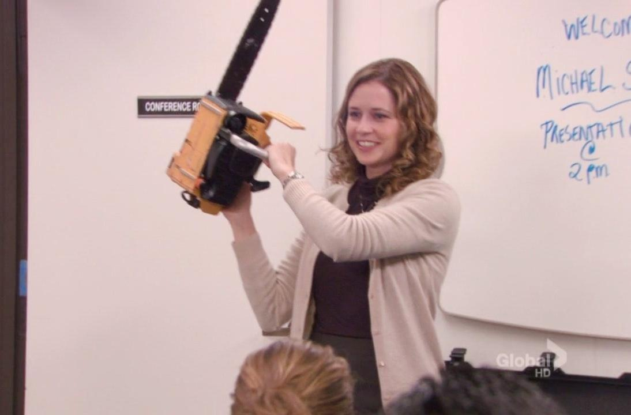
Notes:
(Begin with a joke – reference to the Office)
Explain that I’ll be presenting on behalf of WV Rivers Coalition in the place of our executive director, Angie Rosser. There is no substitute for Angie, but I will do my best. → i.e., set expectations.

Slide 3
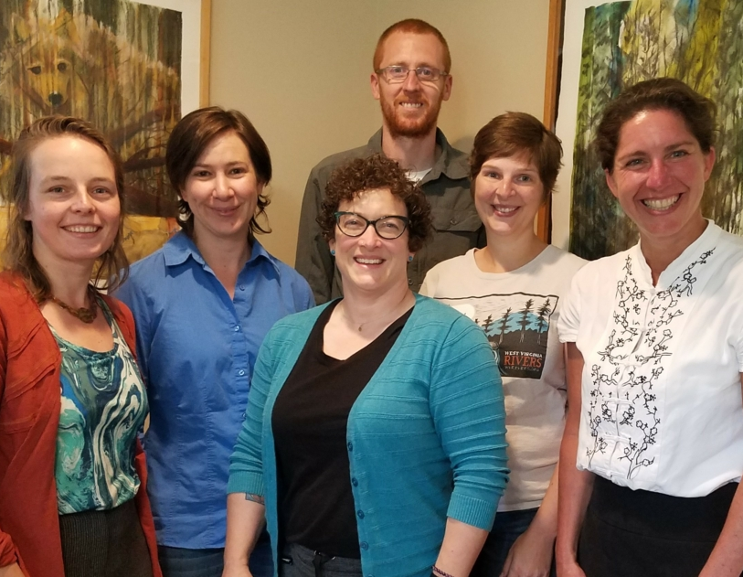
Who we are
Notes:
I like to start off presentations not with what we do, but who we are.
WV Rivers Coalition has a staff of six that work all throughout the state to protect our rivers and defend our public lands.
As the Easter Panhandle Field Coordinator, my three primary duties include:
serve as the State Lead in WV for the Choose Clean Water Coalition
serve as Host Partner for the Safe Water Conservation Collaborative – a vibrant network of water utilities, land trusts, and community partners that is “Protecting Drinking Water through Land Conservation”
lead a project team in implementing conservation practices in the Elks Run Watershed to protect Harpers Ferry’s drinking water and improve stream health.
Briefly introduce our other staff positions – Public Lands Campaign Coordinator (re-hiring now), Staff Scientist, Program Director, Operations Manager, and Executive Director

Slide 4
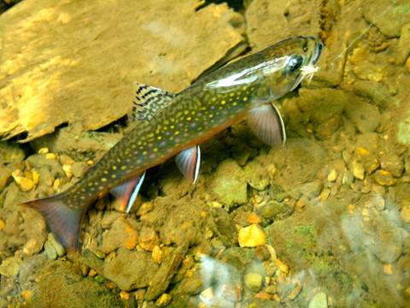
“We value clean water as the foundation of life…
Notes:
Value statement – foundational, feel good, verbatim from vision/values.
-State Fish = native eastern brook trout
-populations across the state are declining → not just losing clean water, but we are losing what defines us as West Virginians and our cultural heritage

Slide 5
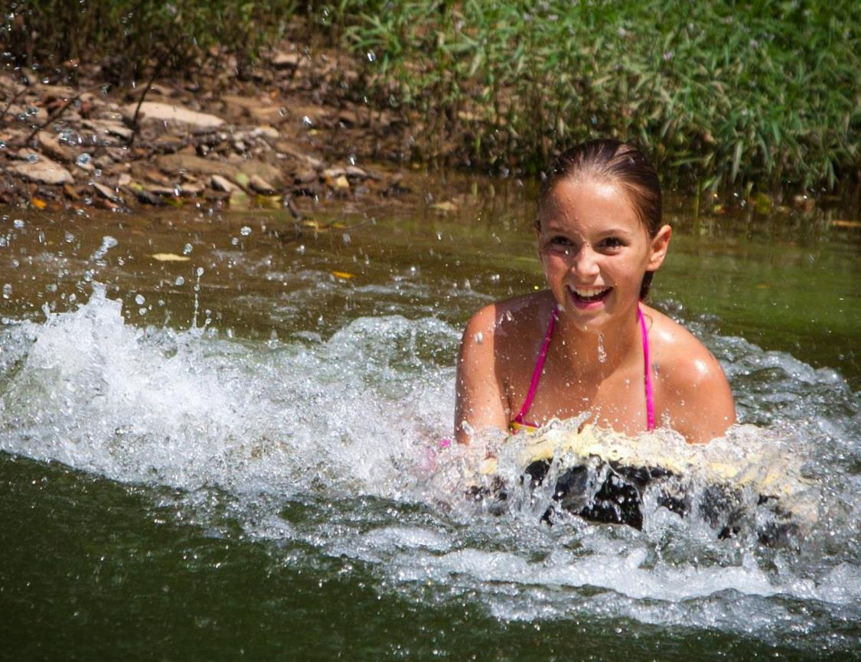
…We believe all people should respect and be able to enjoy clean rivers…
Notes:
Value statement – foundational, feel good, verbatim from vision/values.
-Most likely, all of us in this room had experiences like this when we were a kid. It’s what draws us to our work.
-For me personally, I grew up swimming in the South Fork of the Potomac River as it flows through Petersburg, WV.

Slide 6
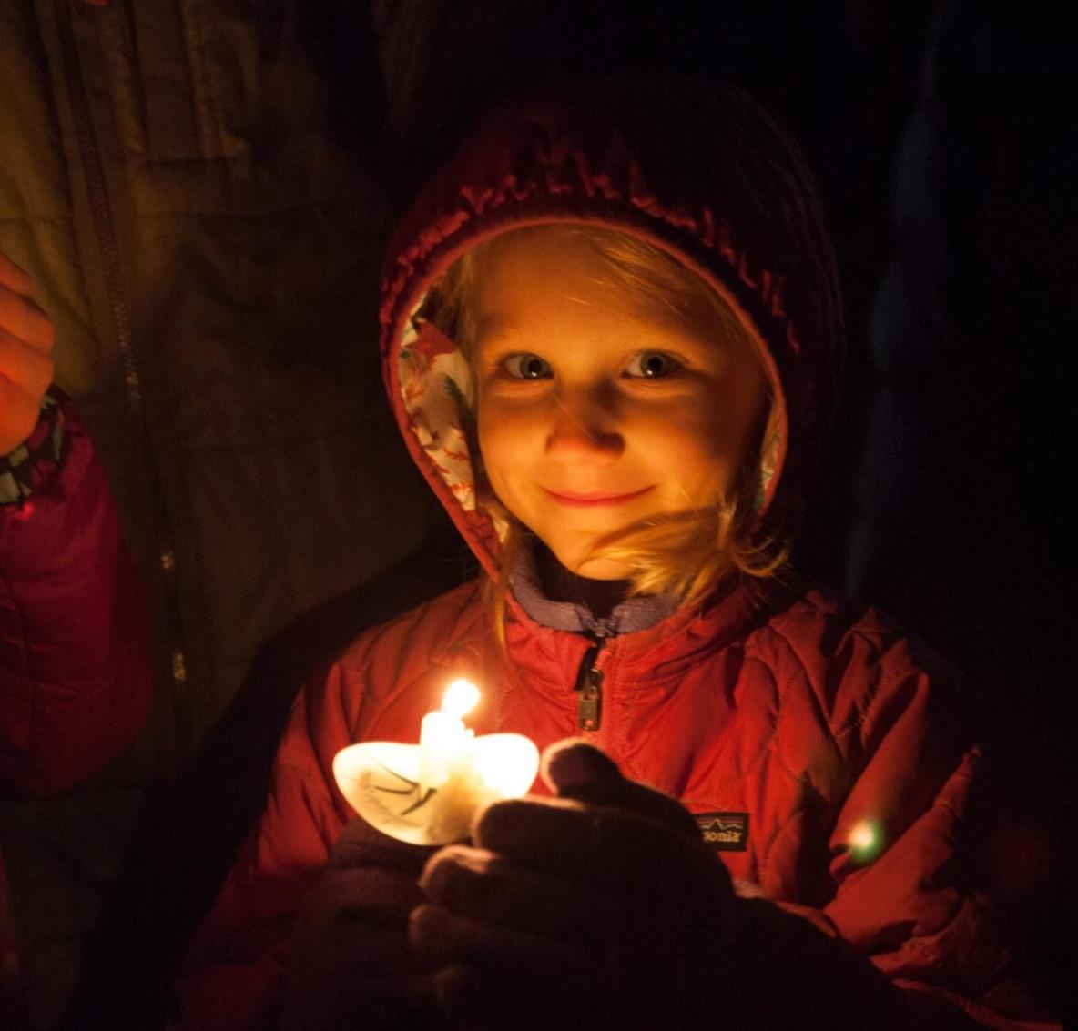
…We envision community life centered on sustainability, health and
shared prosperity…
Notes:
Value statement – foundational, feel good, verbatim from vision/values.

Slide 7
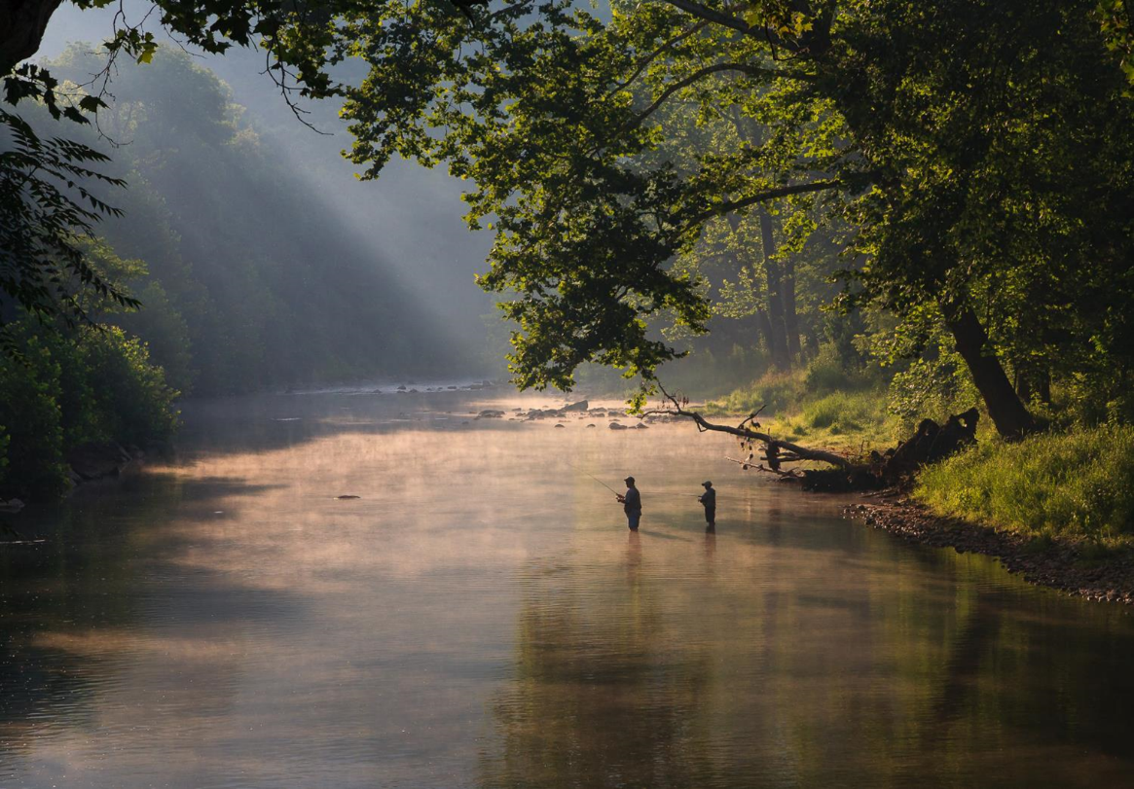
…where the relationship between people and the natural world is honored, celebrated, protected and sustained.”
Notes:
Value statement – foundational, feel good, verbatim from vision/values.

Slide 8
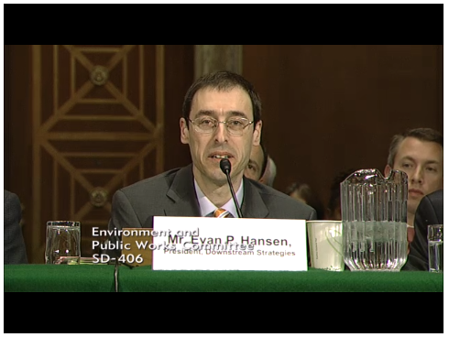
Sound Science
Sensible Policy
Notes:
Use the slides on pages 8-12 to depict how we do our work:
-We use sound science to create sensible water policy that is grounded in facts.
-Evan Hansen is a member of the House of Delegates, representing Monongalia County (i.e., Morgantown). He is also one of our science advisors.

Slide 9
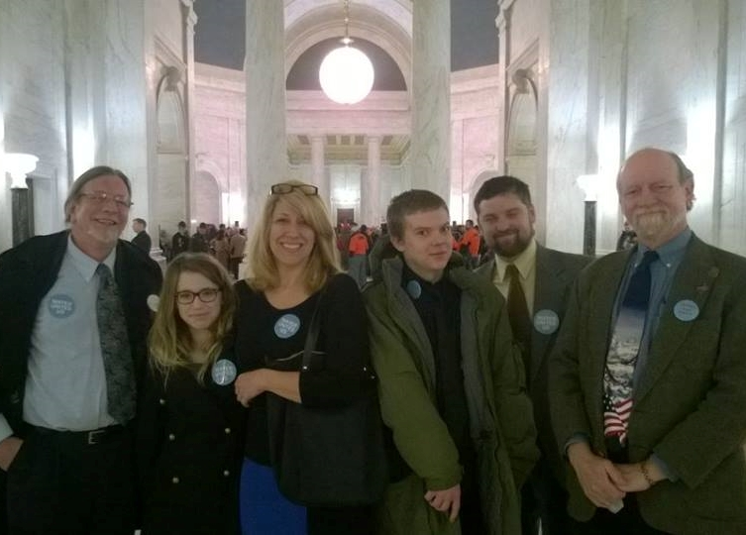
Creative Alliances
Constituent Power
Notes:
Use the slides on pages 8-12 to depict how we do our work:
We create broad alliances around public health & quality of life, and using those alliances to create constituent power
Our basic formula is “Science + People = change”
As a headwaters state, it’s critical to us, and the bay, that WV citizens support our work to protect rivers and defend public lands.

Slide 10
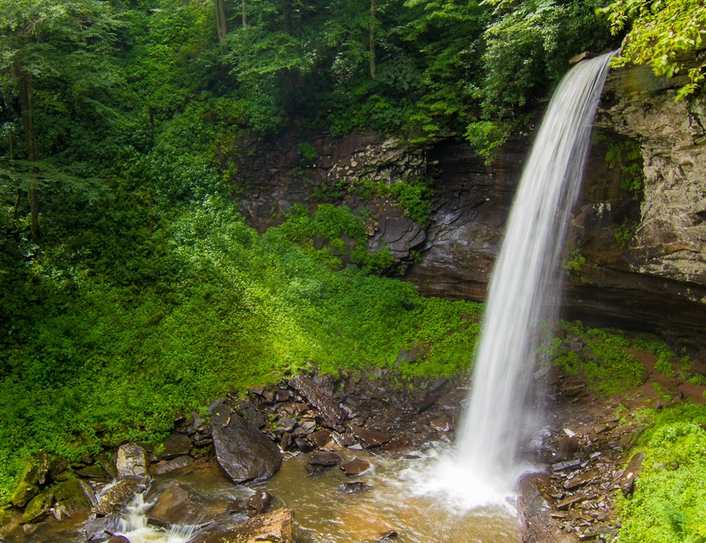
Inspiring Stories
Imagining Tomorrow
Notes:
-We work to inspire, and be inspired by, the citizens of our state, so that together we can create a future that is both full of hope, and also attainable.
-Through everything we do we emphasize the powerful connection between people and nature. We make it personal.

Slide 11
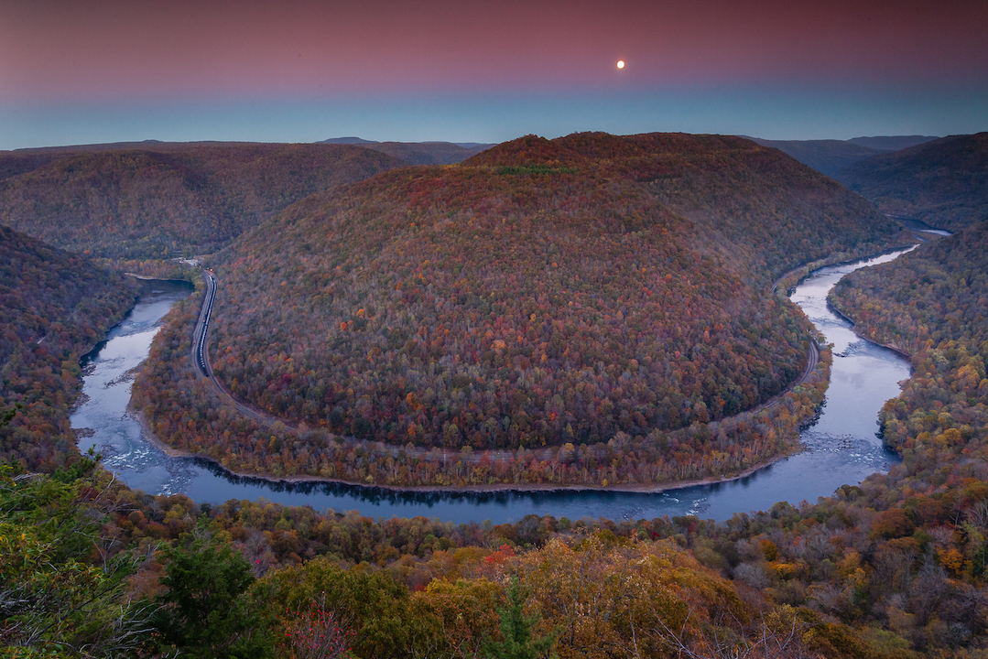
Defending Public Lands
Notes:
Right now there is federal legislation to re-designate the “New River Gorge National River” to a “National Park & Preserve”.
This Saturday there is a public meeting to discuss this change.
These opportunities bring more people into our state to connect with our lands and waters.

Slide 12
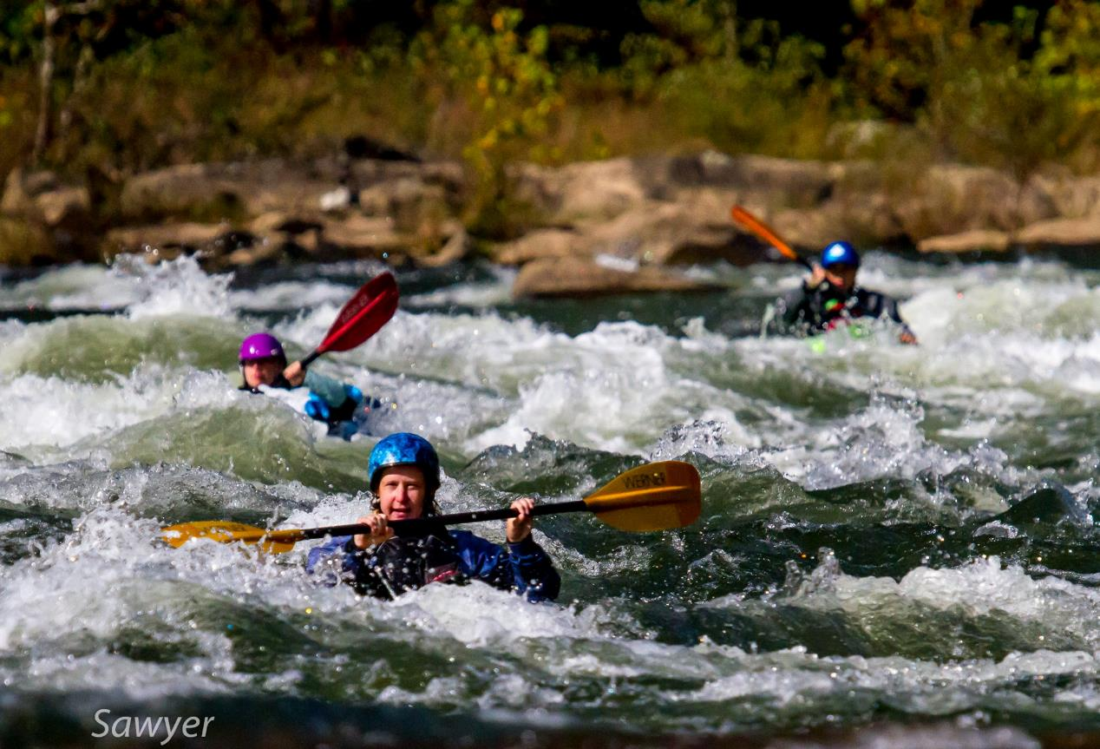
Appreciating our rivers & streams!
Notes:
-WV has some of the best whitewater rivers on the East Coast – the Gauley, Youghiogheny, New, Shenandoah, and others.
-Picture is our board chair, Chrissy Zellner. Behind her is Mike Sawyer, who is also on our board.
-I was a raft-guide on the Shenandoah & Potomac Rivers for 6 years and truly believe that in order to protect our streams & rivers, we must first gain an appreciation of them.

Slide 13
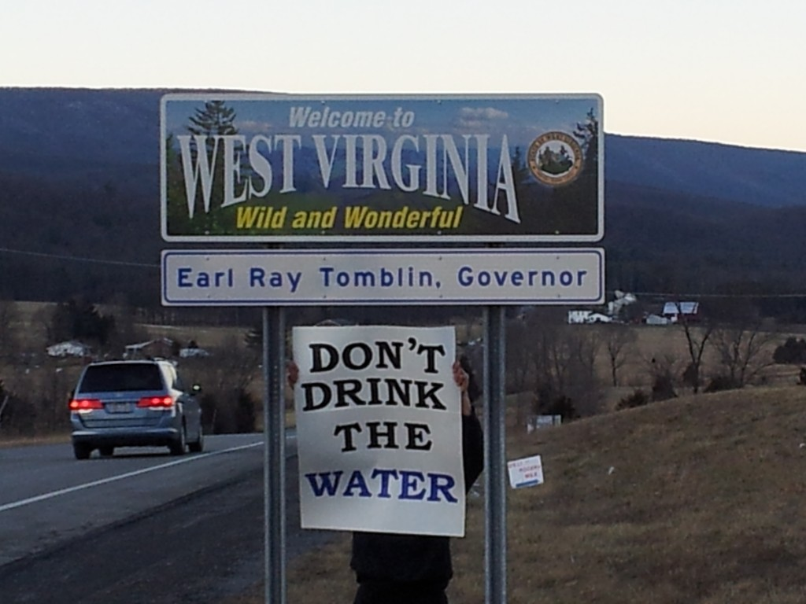
Notes:
But we have challenges and our fair share of problems…
Photo taken around the time of the Water Crisis.

Slide 14
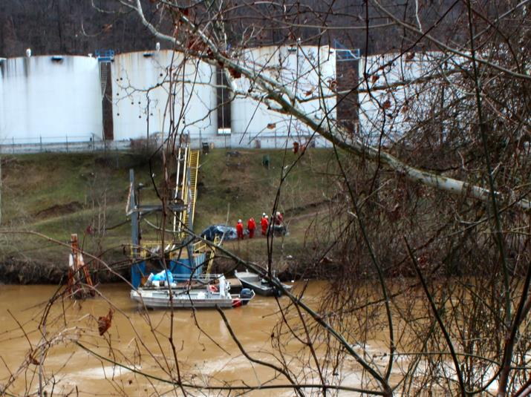
Notes:
A water crisis in West Virginia awoke a nation to the vulnerability of our drinking water supplies. In January 2014 at least 10,000 gallons of a coal cleaning chemical leaked out of a rusty tank into the Elk River a mile and a half above our state’s largest drinking water system. It poisoned the water of 300,000 people, one in every 6 West Virginians.
The health affects of the exposure continues to haunt many of them today.

Slide 15
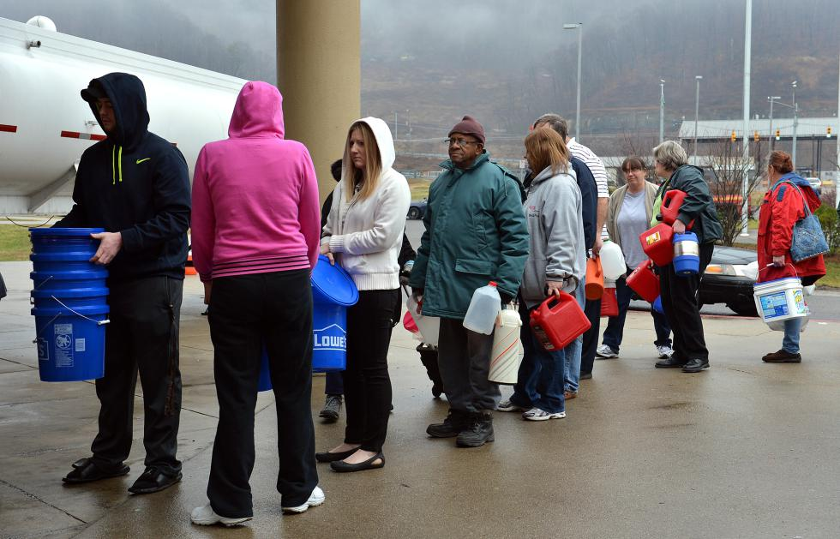
Notes:
This is what that looked like on the ground, for 300,000 WV citizens, who had to find access to what is an undeniable basic human necessity – water. This picture was taken near Elk View, WV.
WV Rivers created a report with Downstream Strategies that laid out the regulatory failures, information gaps, and recommended reforms. Sent the report to the WV legislature, that was largely adopted. This report combined science and sound policy with constituent power, which led to change → Aboveground Storage Tank Act and the Source Water Protection Act (373)

Slide 16
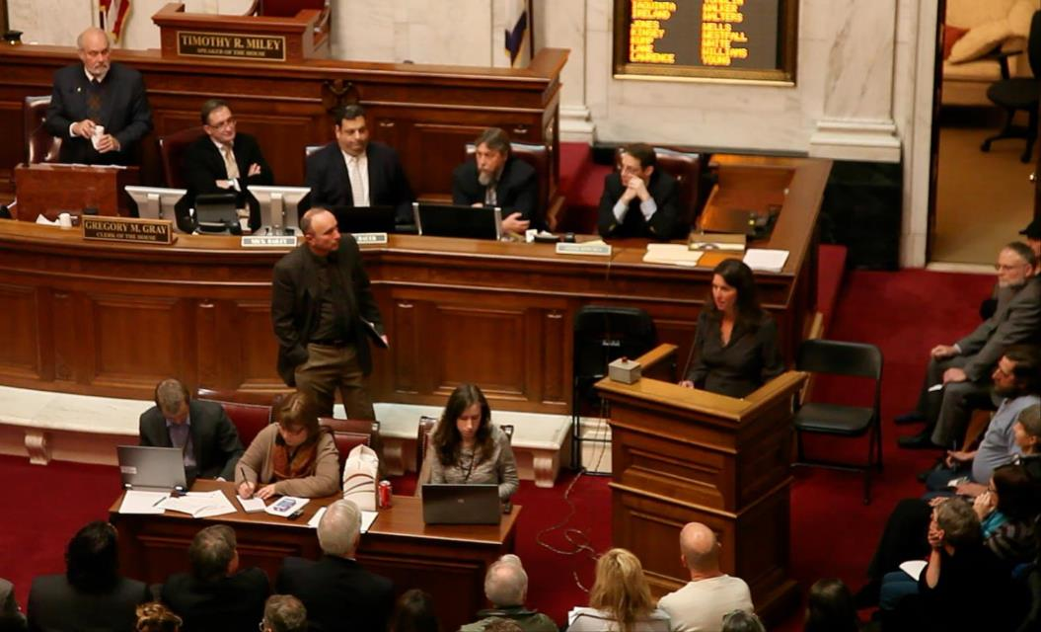
Notes:
Angie Rosser and David Lillard testifying at the WV legislature → bringing the science and facts to our elected officials so that from their official capacity they can create the change we need.

Slide 17
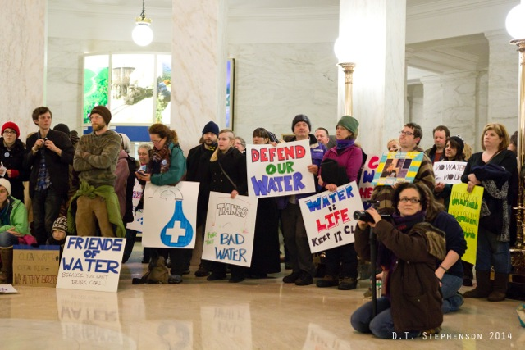
Notes:
This is what was happening outside the testimony – i.e., people power
Science + people = effective change, and we did get effective change.
SB373 to mandate all water utilities that serve more than 25 people are required to have source water protection plan to identify contamination threats and propose management strategies to mitigate the impacts they have on our community drinking water supplies.

Slide 18

Notes:
SB373 went into effect in March 2014.
Water utilities and their communities worked together for two years to develop SWPP across the state, which went into effect in June 2016.
WV Rivers created the “Safe Water for WV” program to assist water utilities and their communities in implementing SWPPs
Water utilities alone don’t have the funding, technical capacity, or staffing to implement the plans.
And most importantly, safe water depends on all of us doing what we can to protect our drinking water before it gets to the intake – i.e., source water protection.

Slide 19
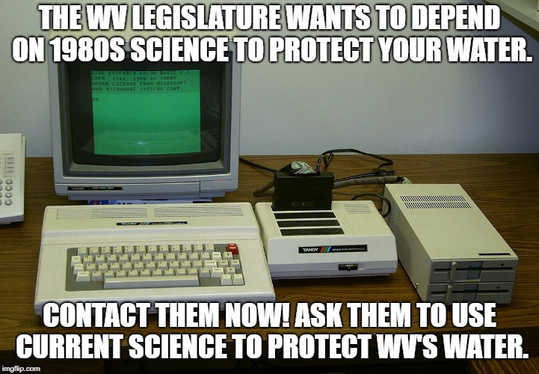
2020 Legislative Priorities
Water Quality Standards – updating Human Health Criteria
Notes:
We believe that clean water is a human right and the foundation of life, and that all people should be able to enjoy West Virginia’s rivers and streams for all of their uses. Strong, science-based water quality standards ensure that residents have access to clean water and that their health is protected.
EPA has updated the National Recommended Water Quality Criteria to protect human health for 94 chemical pollutants. These criteria set limits on the allowable amount of the chemicals to be present in a waterbody. EPA’s updates reflect the latest scientific information. WVDEP has chosen to only adopt the updated criteria for 56 pollutants.
We made the following recommendations to DEP on updating West Virginia’s human health criteria, which were originally set based on science conducted prior to 1985:
Using a higher fish consumption rate;
adopting EPA criteria that strengthen standards;
establishing criteria for unregulated chemicals, such as PFAS; and
not weakening any existing standards.
TIMELINE –
December 2019 - Submitted proposal to DEP for updating standards.
April 2020 → DEP files new proposal and opens up public comment.
July 2020 → DEP files final revised rule.
November 2020 → legislature rule-making review
January 2021 → consideration by full legislature

Slide 20
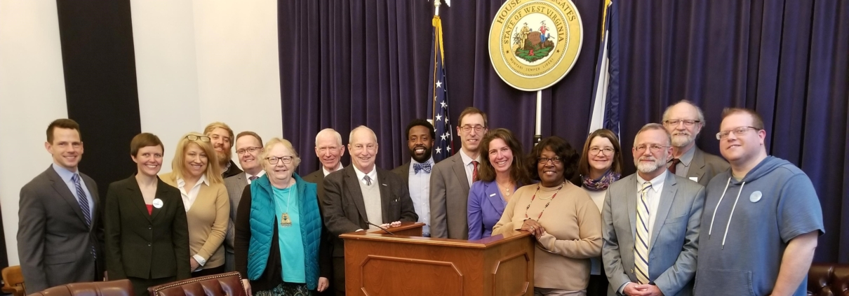
2020 Legislative Priorities
Water Quality Standards – PFAS & Clean Drinking Water Act
Notes:
Clean Drinking Water Act of 2020: The Act addresses the risks posed by group of unregulated chemicals called polyfluoroalkyl substances, or “PFAS”. PFAS, also known as “forever chemicals”, are man-made, persist and accumulate in the environment, and are known to cause cancer and other adverse health effects. We support this legislation that aims to reduce the presence of PFAS in our drinking water supplies by:
Establishing a PFAS human health water quality criteria to set safe limits on the amount of PFAS chemicals allowed to be discharged in our water supplies.
Requiring polluters to report and monitor their use of PFAS.
Creating an interagency WV PFAS Action Response Team.
Establishing a statewide maximum contaminant level (“MCL”) that sets a safe limit on the amount of PFAS allowed in tap water.
PICTURE - Legislators, business owners, legal experts and safe water supporters joined together for a press conference on the Clean Drinking Water Act of 2020 on February 6th, 2020. Angie Rosser next to Delegate Evan Hansen, who introduced the legislation.

Slide 21
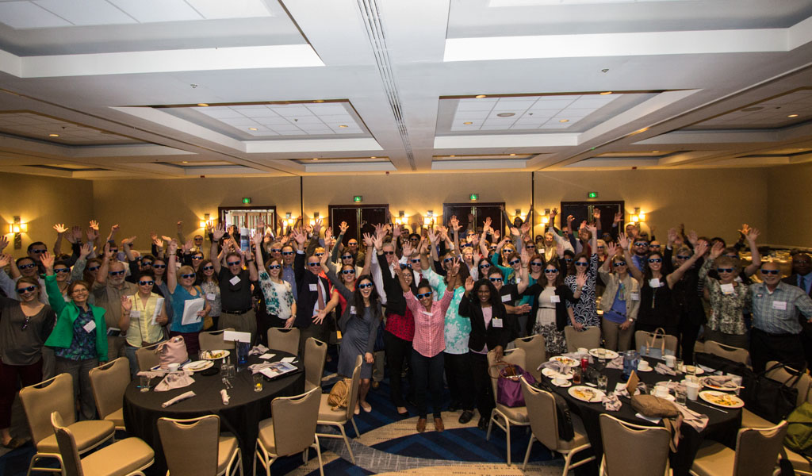
Notes:
250+ partners working together with a unified voice on clean water policy across the Chesapeake Bay Watershed
Priorities– Agriculture, Communications, Equity, Federal Affairs, Shale, Stormwater, and TMDL
WV Rivers serves as state lead for 20 active members in our state

Slide 22
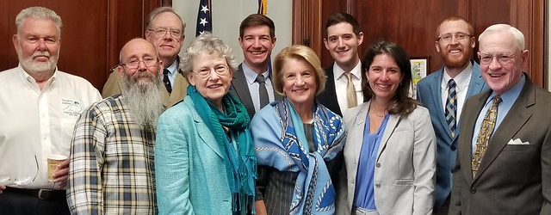
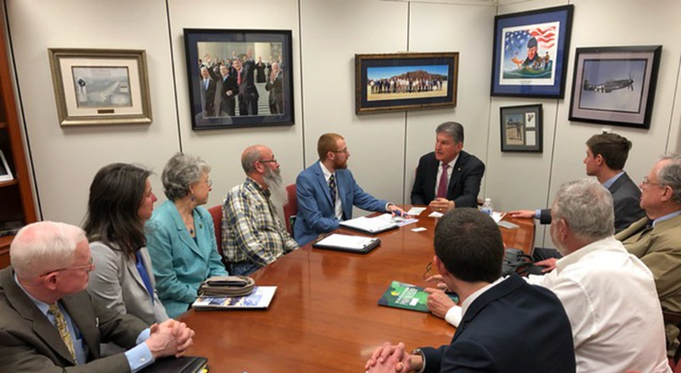
Notes:
-Bay Day pictures (from 2019) – meeting with Senator Capito & Senator Manchin
-Upcoming Bay Day 2020 – March 4th, 2020
Appropriations asks - WV has two key senators on Appropriations Committee, so they are in very influential positions. Senator Manchin is also chair of Senate Energy & Natural Resources Committee.
Interior Appropriations request letter - covers our funding requests for EPA, USGS and the National Park Service. Last year the EPA Chesapeake Bay Program funding jumped from $73 million to $85 million - the first increase in 5 years. This year we have keyed our $90.5 million request to the dollar amount in the Chesapeake Bay Program reauthorization bills. This also includes increased funding for the Chesapeake Small Watershed Grants and the Innovative Nutrient and Sediment Reduction Grants, which are managed by the National Fish & Wildlife Foundation. There is a fair chance this could become law sometime this year, and we want to request the dollar amount that is in that bill for FY21.
Agriculture Appropriations request letter – Our primary message is to fully fund the Farm Bill conservation programs. We single out EQIP, RCPP and CREP for special significance among those programs, and also make a generic pitch for USDA to focus on funding conservation in high priority areas, such as south central PA.
Commerce, Justice, Science Appropriations request letter - This focuses solely on the NOAA Chesapeake Bay Office and their responsibilities, trying to stop the erosion of the Office’s funding over the years and increase funding for things like oyster restoration, fisheries science and environmental education (B-WET).

Slide 23
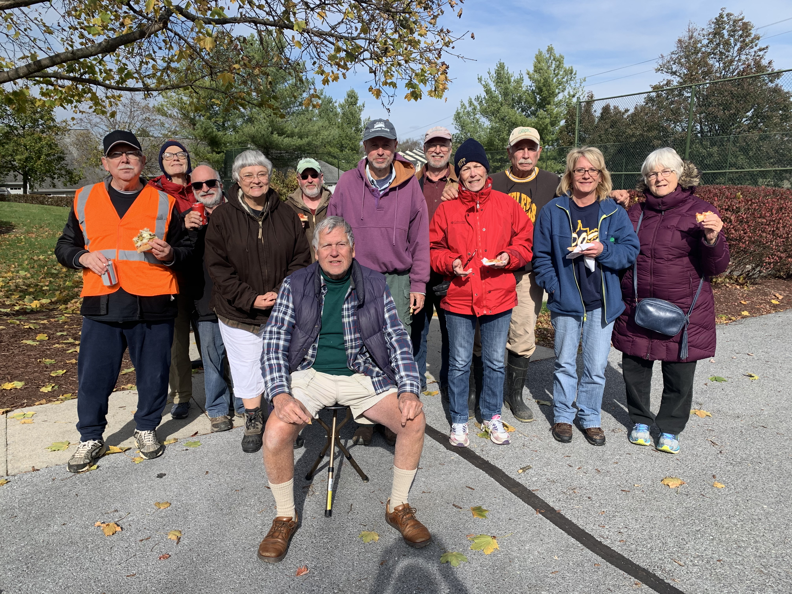
Notes:
(Photo is from November 2019 trash clean-up with the Opequon Creek Project Team).
Primary focus for our 20 active CCWC member organizations in WV:
Capacity building – We have 6 active watershed groups in WV’s portion of the Chesapeake Bay Watershed, all at various stages of decline. Most have been active for 5-10+ years and are having trouble with recruiting and retaining new members, and in particular, leadership. Look at this picture – you’ll notice they are all retirement age – those in leadership positions are working more now than when they were working. They want to truly retire!
We recently worked with River Network staff to survey these 6 groups and their capacity building needs. After a self-assessment, 5/6 determined the internal structure & function of their organization was unhealthy (insufficient leadership structure, poor funding strategy, lack of planning, etc.).
We are in the process of planning a capacity building workshop for them in spring/summer 2020. However, we are hearing from multiple groups that they don’t have the capacity to attend a capacity building workshop – catch 22.
DEIJ – in line with the CCWC priority for Equity, we would like to see greater understanding & adoption of DEIJ practices within our organizations. This may also address some of their capacity building needs.
Look at this picture – there is no diversity.
WV Rivers Coalition is working with CCWC staff to facilitate a DEIJ workshop for our staff & board, that we can then hopefully replicate and share what we learned with other CCWC members in WV.

Slide 24
A majority of voters believe the government should play a major role in preserving headwaters in West Virginia.
DK
Major Role
Minor Role
No Role
90.5% felt strongly that protecting water supplies should be a higher priority over keeping costs for businesses low.
74% felt that pollution standards along waterways in WV were too lax.
*Polling data 2015, with funding from the Virginia Environmental Endowment
Notes:
-WV Rivers polling data (March 2015) through third-party independent polling group found that the majority of voters in WV believe that government should play a role in preserving headwaters.
-WV citizens understand the value of protecting our headwaters for all uses, including safe drinking water.
(Most importantly, Joe Maroon (on CAC) is Executive Director of Virginia Env. Endowment. We have a big proposal pending with them, they are sunsetting grantmaking in WV. They helped fund this poll.)

Slide 25
Clean streams and protection of public areas are voters’ top priorities
How much of a priority do you think each of these should be for use of this public land?
Clean streams for drinking water,
fish habitat, and recreation
Permanent protection of
natural public areas
Supporting the tourism-based economies
of local communities
Access for hunting and fishing
Providing opportunities for outdoor
recreation activities
Development for mining
Development for natural gas drilling
Development for logging
top priority
*Polling data 2015, with funding from the Virginia Environmental Endowment
Notes:
-Clean streams for drinking water, fish habitat, and recreation were the top priority for the use of public lands.

Slide 26
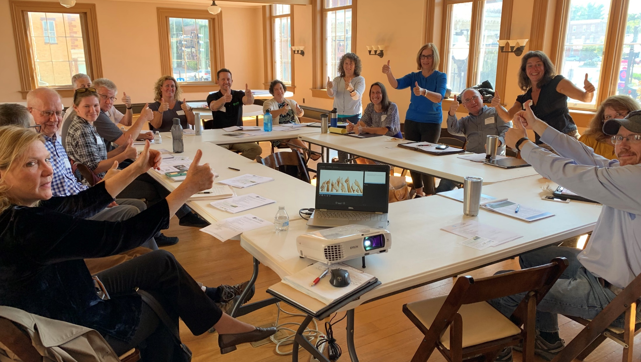
Notes:
Safe Water Conservation Collaborative
Formed as an off-shoot of Safe Water for WV Program
A vibrant network of partners working together to achieve our shared Mission – “Protecting Drinking Water through Land Conservation”
~25 members, including 5 water utilities, 7 land trust, and other conservation organizations & agencies.
Website at www.safewatercollaborative.org.

Slide 27
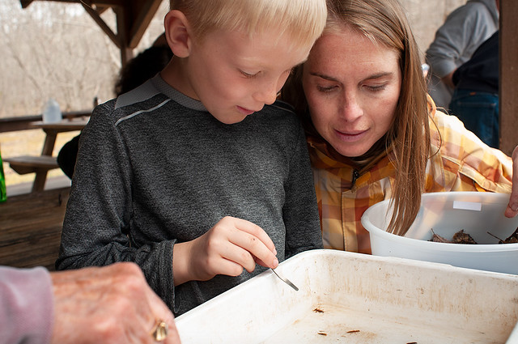
Notes:
Volunteer Water Quality Monitoring Program, in partnership with Trout Unlimited, has the goal to “train and equip volunteers from across the state to monitor streams that support trout populations and high quality warmwater fisheries that have the potential to experience impacts from shale gas development.”
Our monitoring work is a great example of educating & inspiring the next generation of environmental stewards.

Slide 28
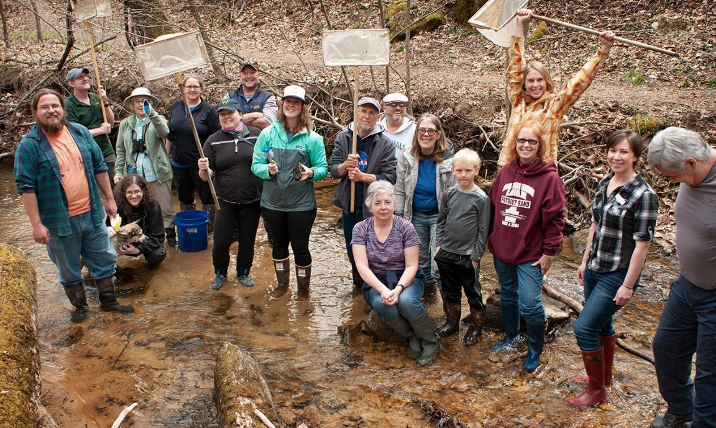
Notes:
This picture from a training that we co-sponsored with WV-DEP, Autumn Crowe on the far-right (staff scientist). We do QAQC on the data and then enter into their database.

Slide 29
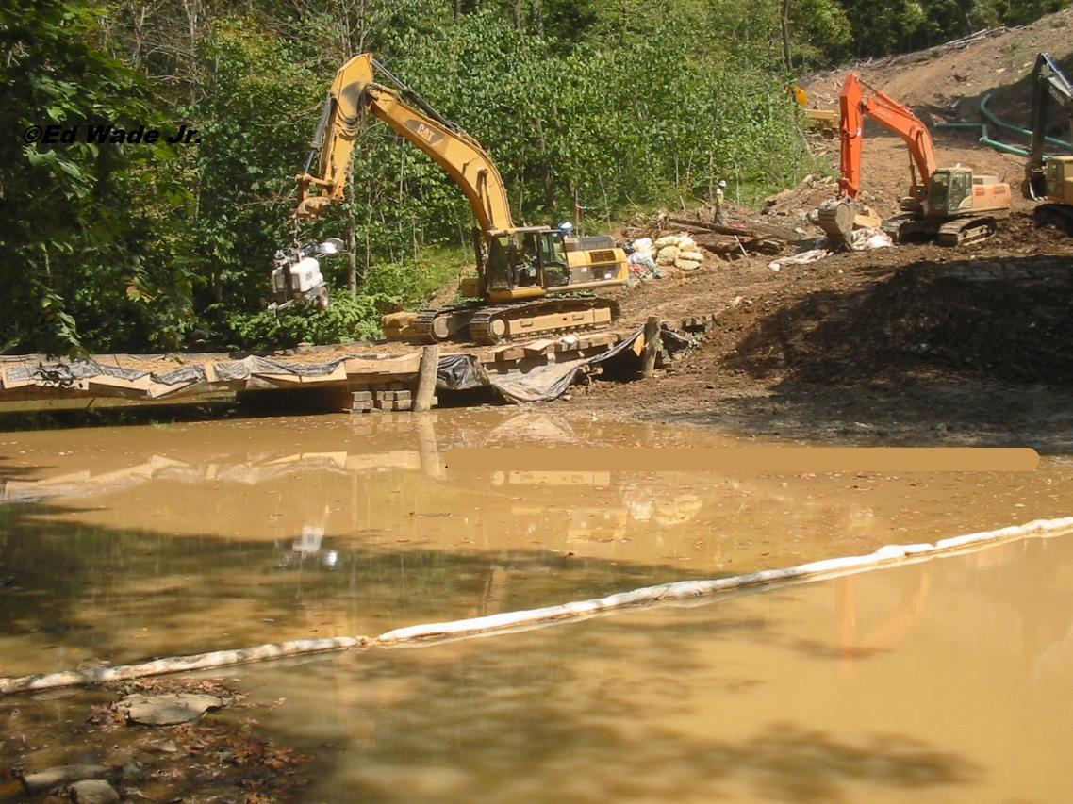
Notes:
This is a picture of an active pipeline construction, which is a major area of focus for the monitoring program.
Sedimentation is the biggest issue, which directly relates to TMDL for Bay.
Detecting violations and bringing them to knowledge of DEP enforcement.

Slide 30
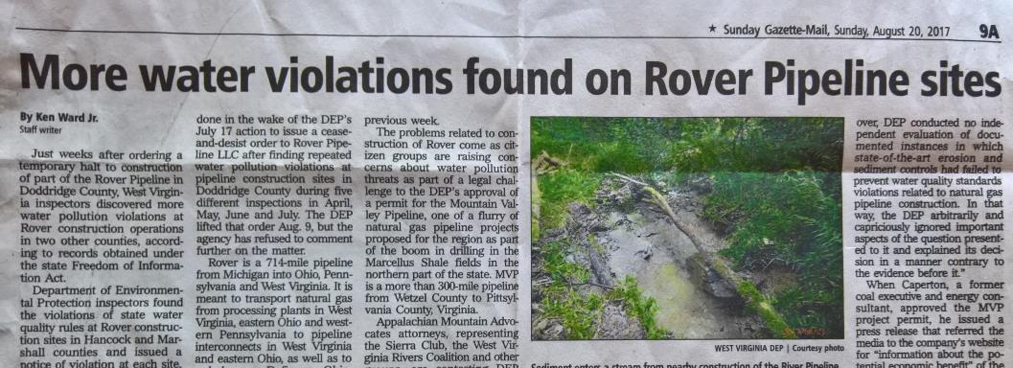
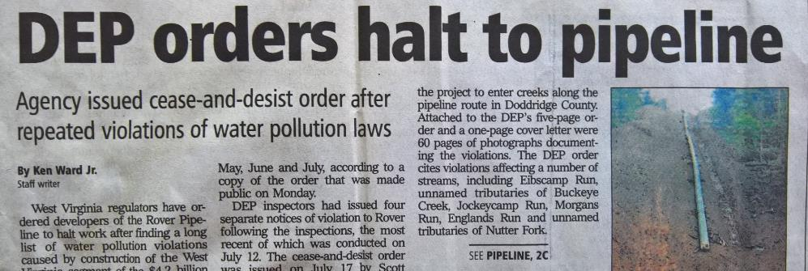
Notes:
Example of how problems have been identified through monitoring, that have led to real change and holding pipelines accountable to the law.
Has been a successful program →
Our volunteers have conducted over 6,000 sampling trips since 2013
162 violations submitted to WV DEP over the life of the program
Over 500 volunteers trained

Slide 31
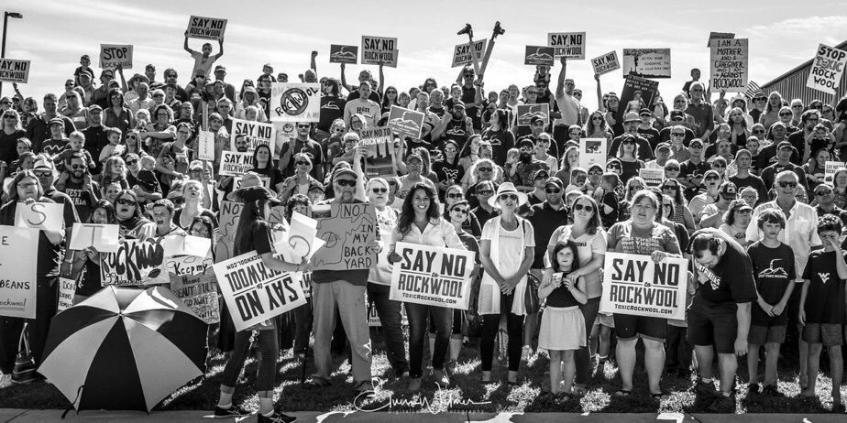
Notes:
Last but not least, acknowledge that there are lots of issues always arising. We are fortunate to have active, engaged, involved citizens in Eastern Panhandle that play a critical role in protecting environment & natural resources from industrial development.
Making connections to local citizens and their lawmakers 5 hours away in Charleston. We serve as a bridge to provide analysis, technical review, policy recommendations, etc. for public and decisions makers to all be better informed in what decisions they can make to have a difference.

Slide 32
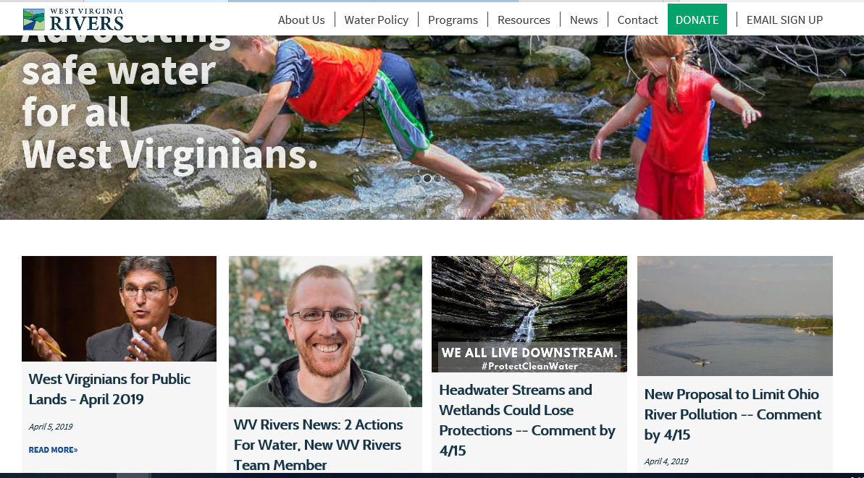
WVRivers.org
Notes:
Visit our website (wvrivers.org) for more information and to learn about all of our water policy & programs.

Slide 33
Angie Rosser
Executive Director
arosser@wvrivers.org
304-637-7201
Tanner Haid
Eastern Panhandle Field Coordinator
thaid@wvrivers.org
304-886-2665
Notes:
Thank you!
Any questions?

