Slide 1
Financing Riparian Forest Buffer through the Maryland Water Quality Financing Administration and the Clean Water State Revolving Fund
Michael Roberts, PE
Deputy Director, MWQFA
March 30, 2022

Slide 2
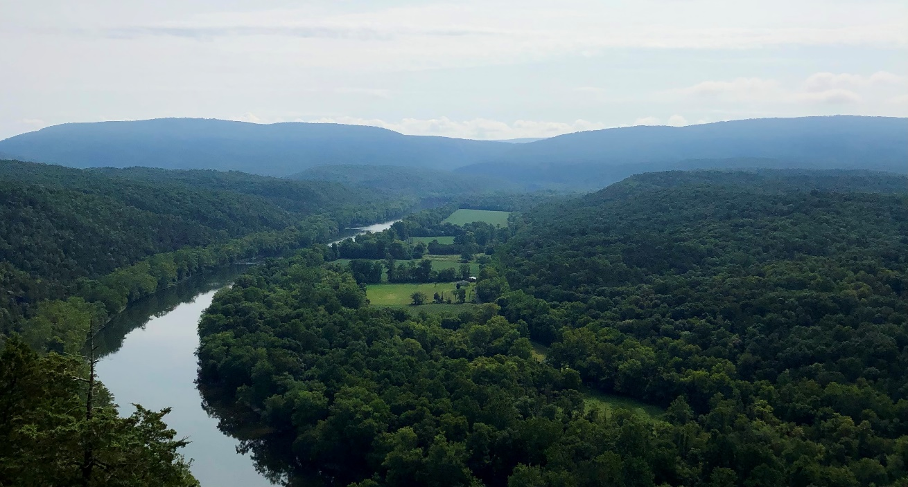
CWSRF Forestry Financing Capacity
Clean Water State Revolving Funds are capitalized by annual EPA capitalization grants obtained from federal discretionary funds, from SRF loan repayments, and from SRF program income. WIFIA is a complimentary federal loan program that provides credit subsidy and access to Treasury rates. Significant cost savings are possible for borrowers through the SRF/WIFIA versus the private market.
Every Chesapeake Bay state has a financing authority for water quality projects and can apply to WIFIA. The CWSRF is managed in Pennsylvania by PennVest, in Delaware by the Department of Natural Resources and Environmental Control (DNREC), in Virginia by the Virginia Department of Environmental Quality (VDEQ), and in West Virginia by the Department of Environmental Protection (WVDEP).

Slide 3
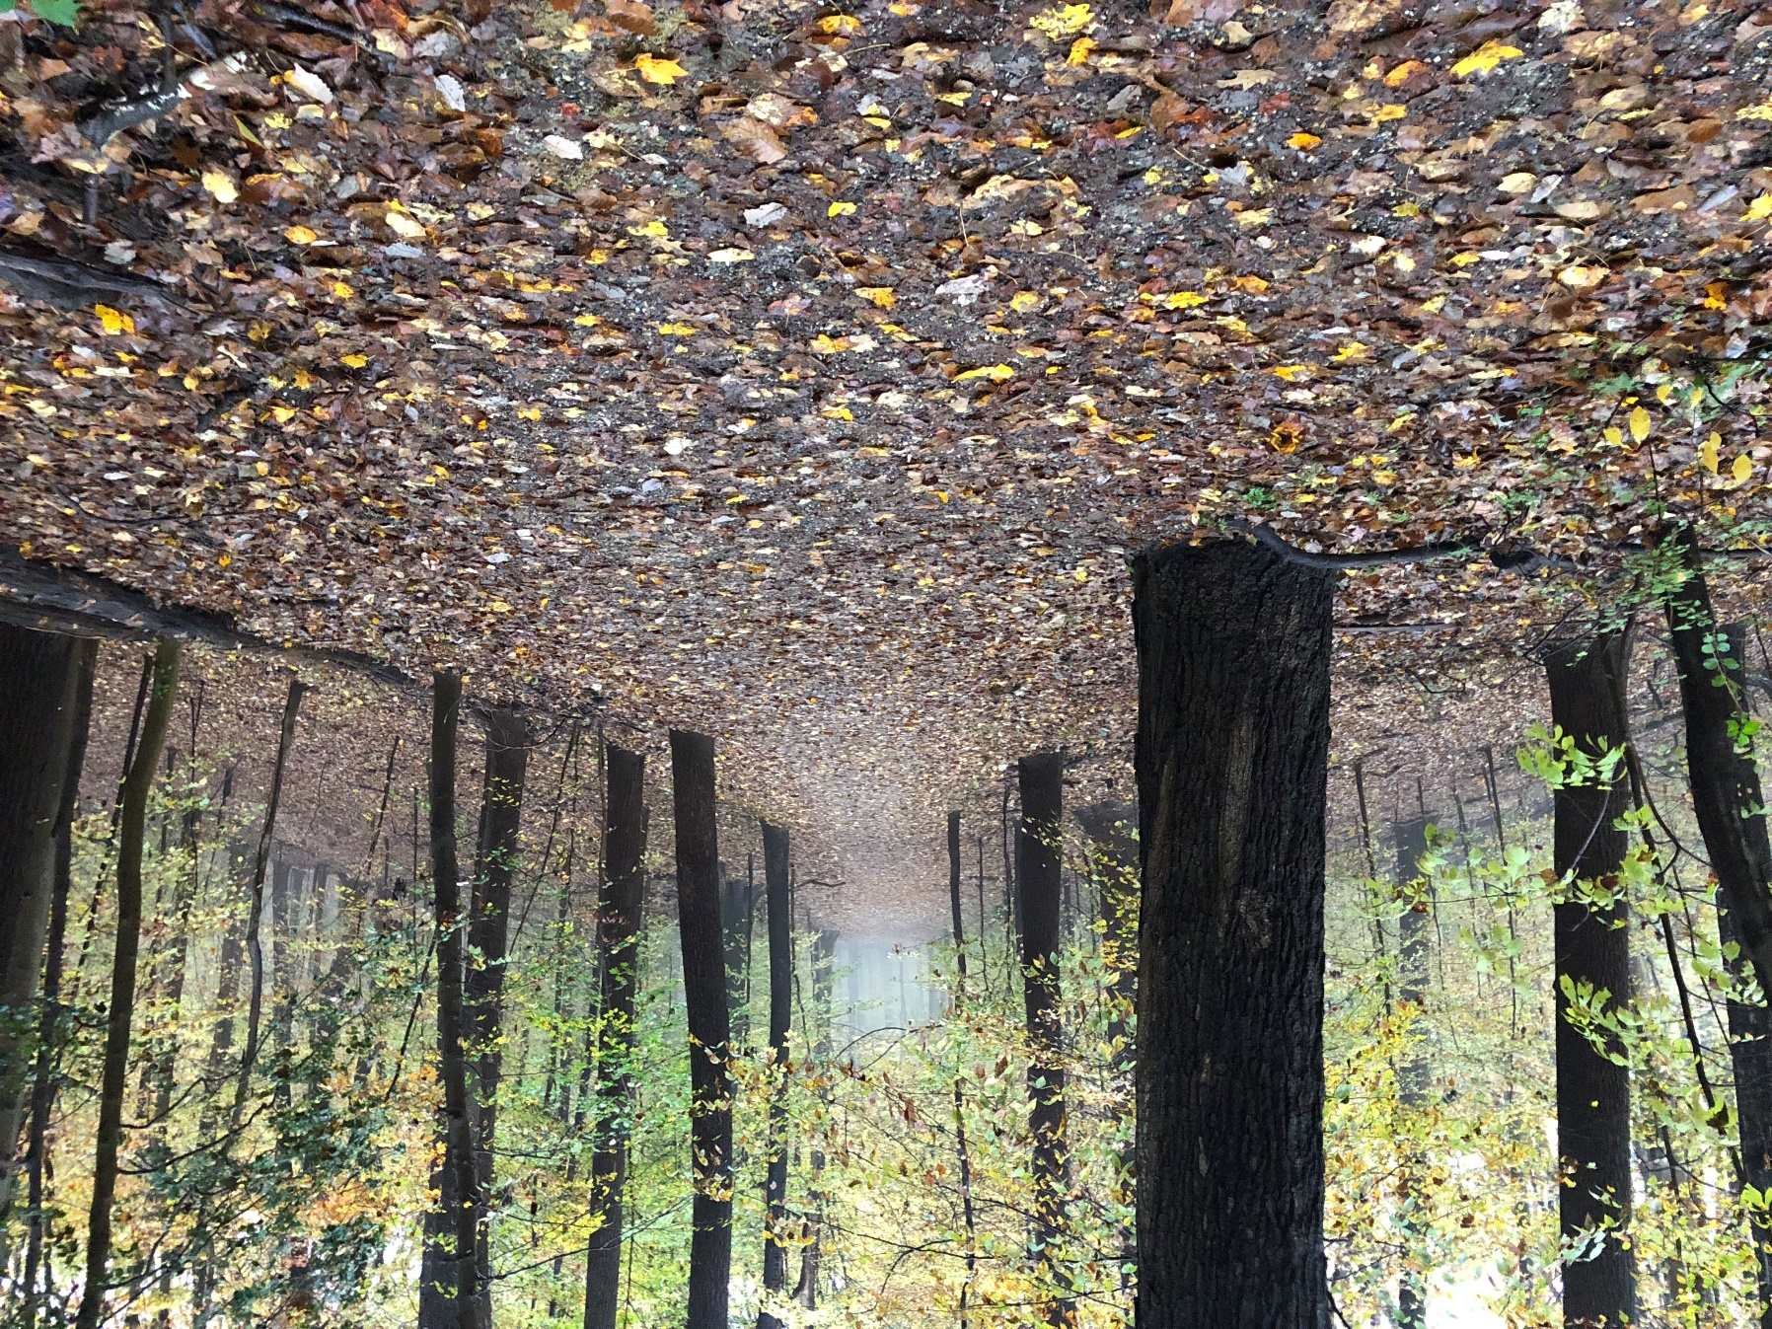
Forestry Benefit Accounting Systems
Establish state standards and metrics for forest ecosystem restoration and protection that fully quantify water quality benefits from practices and provide certainty facilitating private investment. This can serve as a national model for use of the CWSRF in financing forest ecosystem restoration.

Slide 4
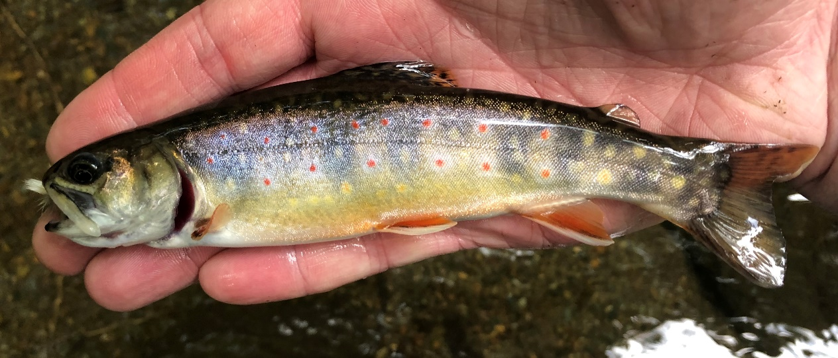
Source Water Protection
Develop a holistic business case for integrating forest ecosystem restoration and protection and watershed best management practices into drinking water utility plans and programs for source water protection. Develop watershed financing partnerships including regional entities. Align federal, regional, state, and local technical, management, and financial capacity to fund cost-effective BMP’s across Chesapeake Bay watersheds. This financing strategy would protect both drinking water quality and health of the Chesapeake.

Slide 5
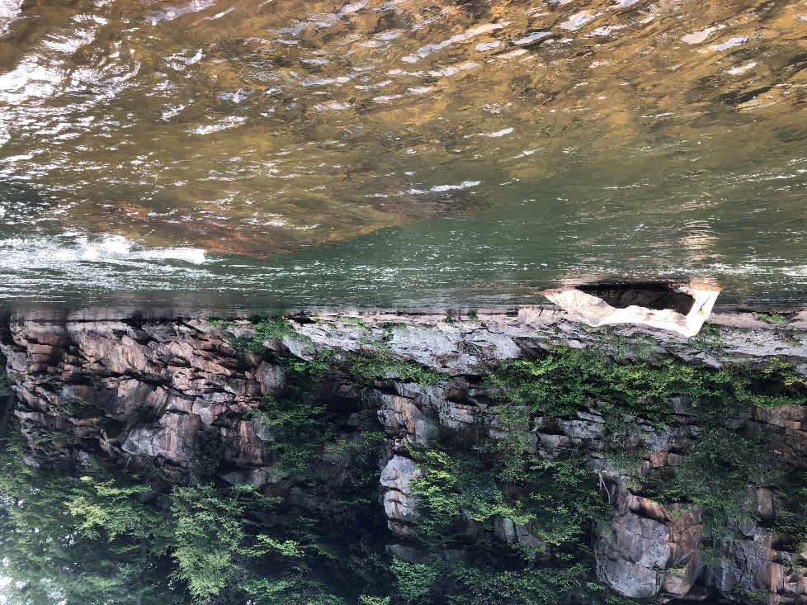
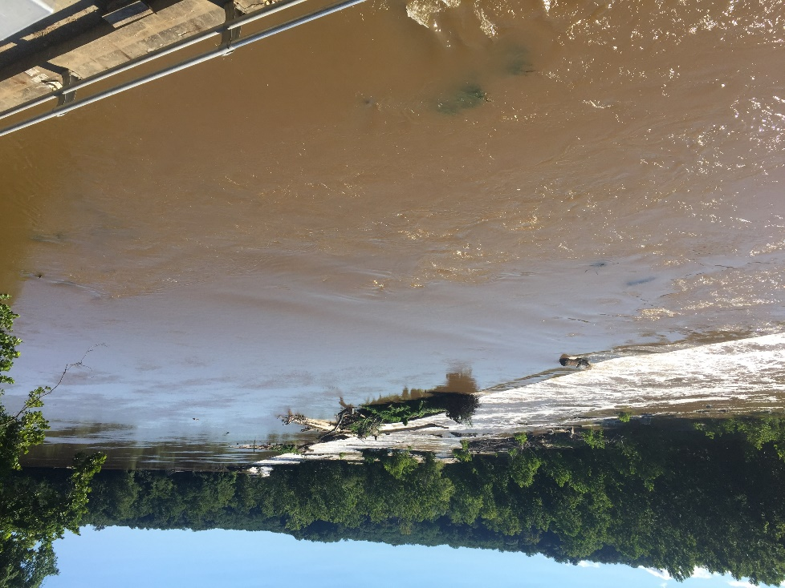
Potomac River Watershed
Landscape-scale BMP implementation in the Potomac watershed would be competitive in MWQFA’s Water Quality Integrated Project Priority System are would optimize drinking water quality for Washington, DC.
Potential for small surcharge on water bills of the 6.2M people that live in DC to repay a large loan to perform restoration of the Potomac watershed.

Slide 6
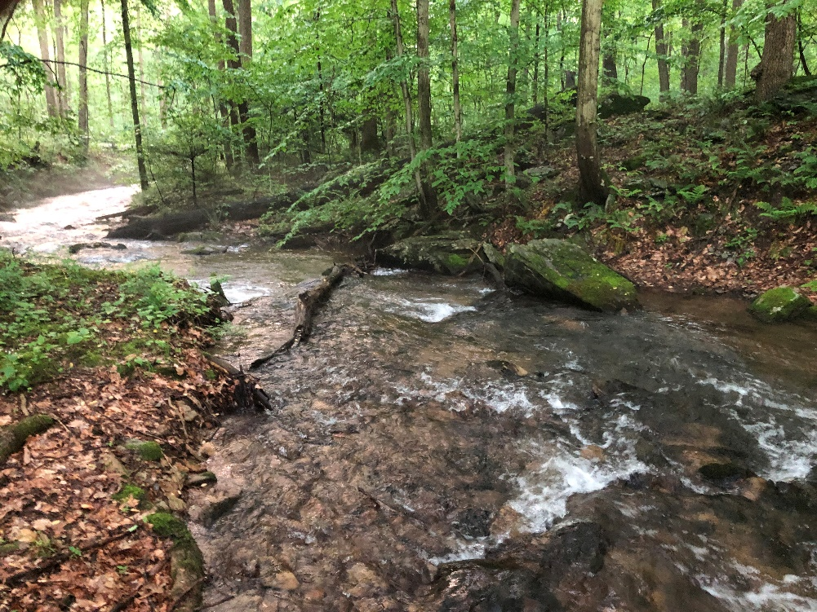
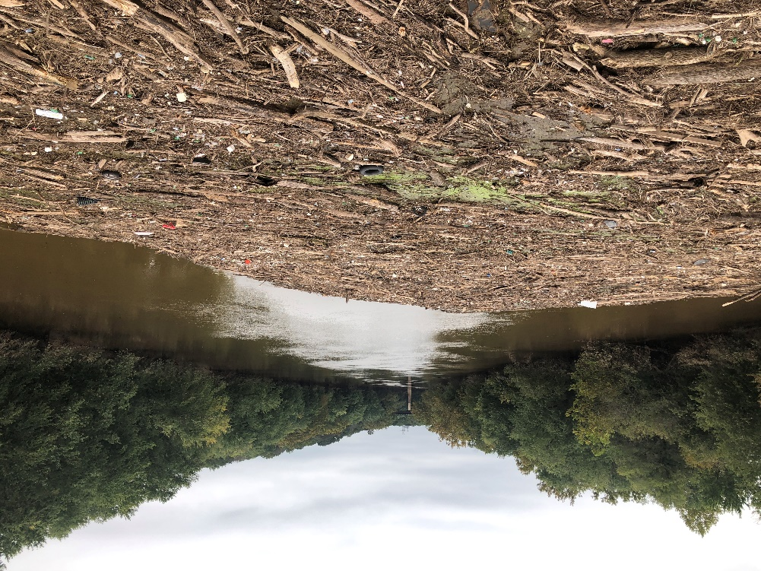
Monocacy River Watershed
Fund landscape-scale conservation projects through CWSRF loans and guarantee authority. Provide for the funding of the full range of CWSRF eligibilities. DWSRF is also an available funding mechanism.

Slide 7
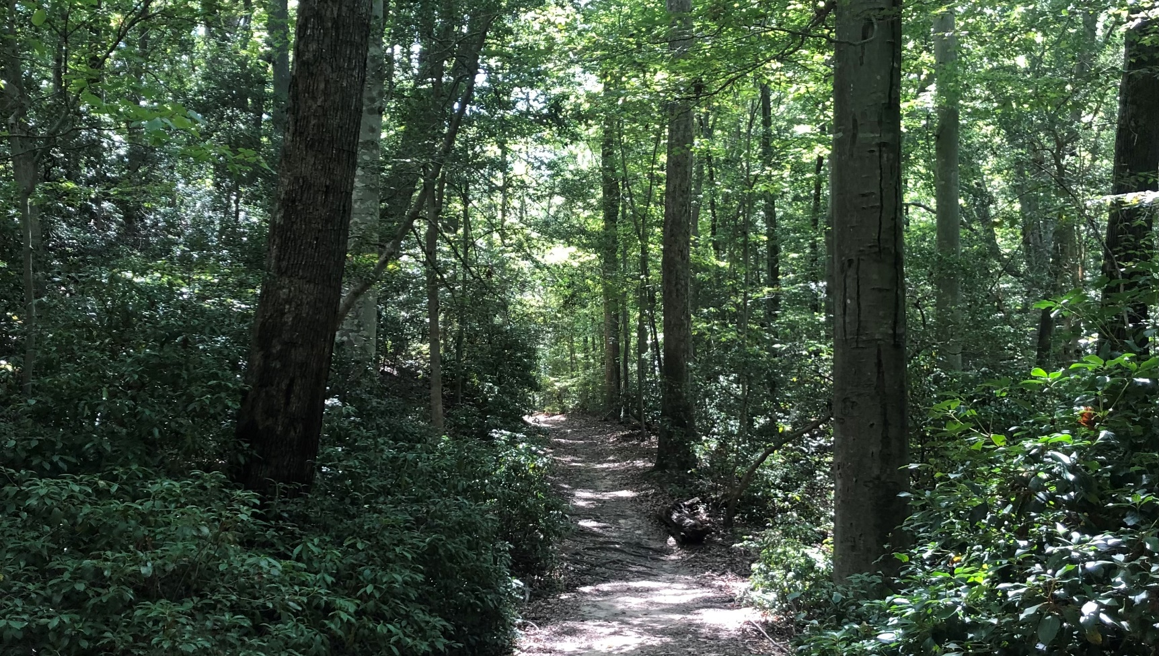
Forestry
Land Trust Alliance accreditation is required for all land trusts receiving MWQFA assistance. More than 30 accredited land trusts operating in Maryland that could provide technical services such as outreach, transaction development, and easement monitoring to watershed financing partnerships. Any land trust can partner with an accredited land trust or be referred to LTA to initiate accreditation.

Slide 8
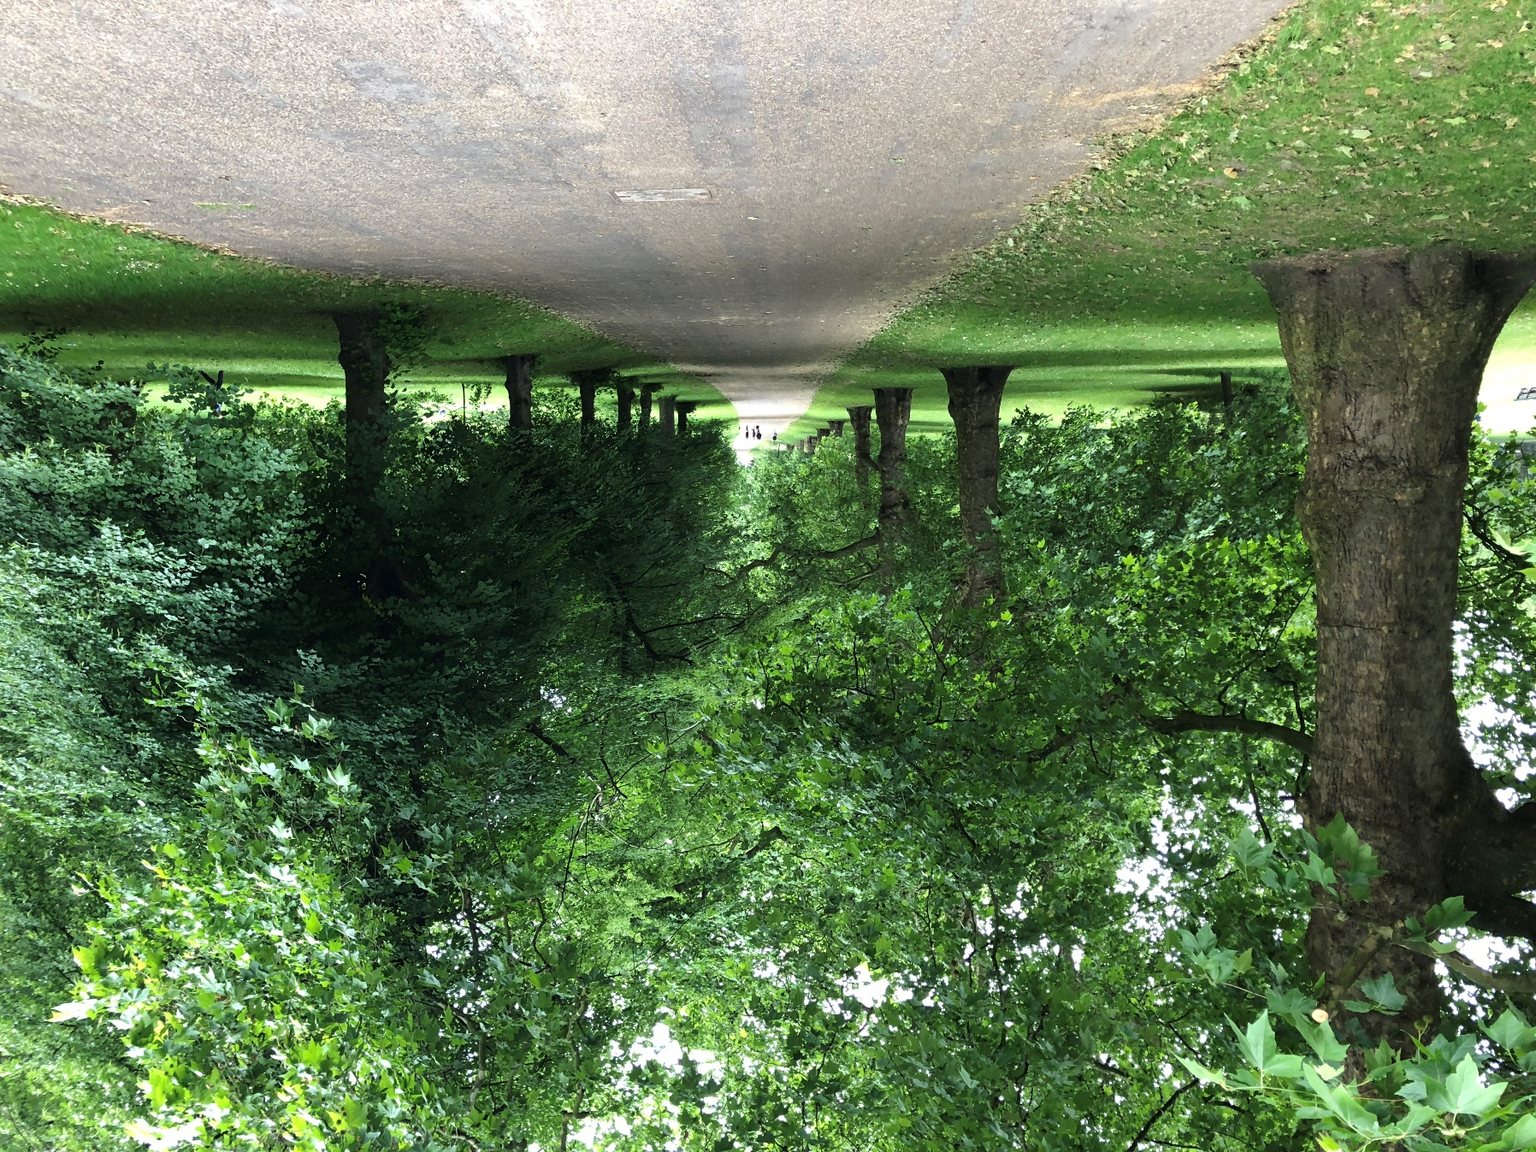
Proximate Principle - Olmsted
Frederick Law Olmsted was inspired by the community gathering spaces that he saw in England and set out to establish public parks for passive recreation in America. As he developed Central Park, he recorded surrounding property values and developed the Proximate Principle. Every property that was adjacent to public passive green space was expected to have a marginal increase of 20% in value.¹ The incremental increase in tax revenues from increased appraisals could be used to repay a CWSRF loan.
¹Olmsted, Frederick Law. Civilizing American Cities: Writings on City Landscapes. De Capo Press, New York, New York. 1997.

