Slide 1
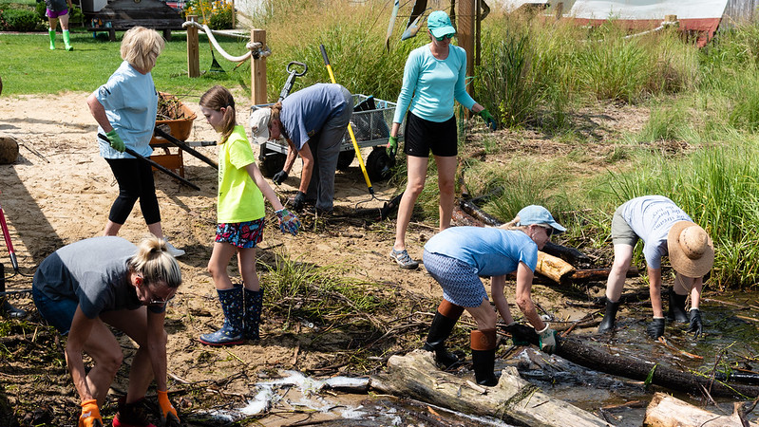
Inspire Local Stewardship with “Chesapeake Behavior Change”
Amy Handen
EPA Chesapeake Bay Program
Habitat Goal Team
May 4, 2022

Slide 2
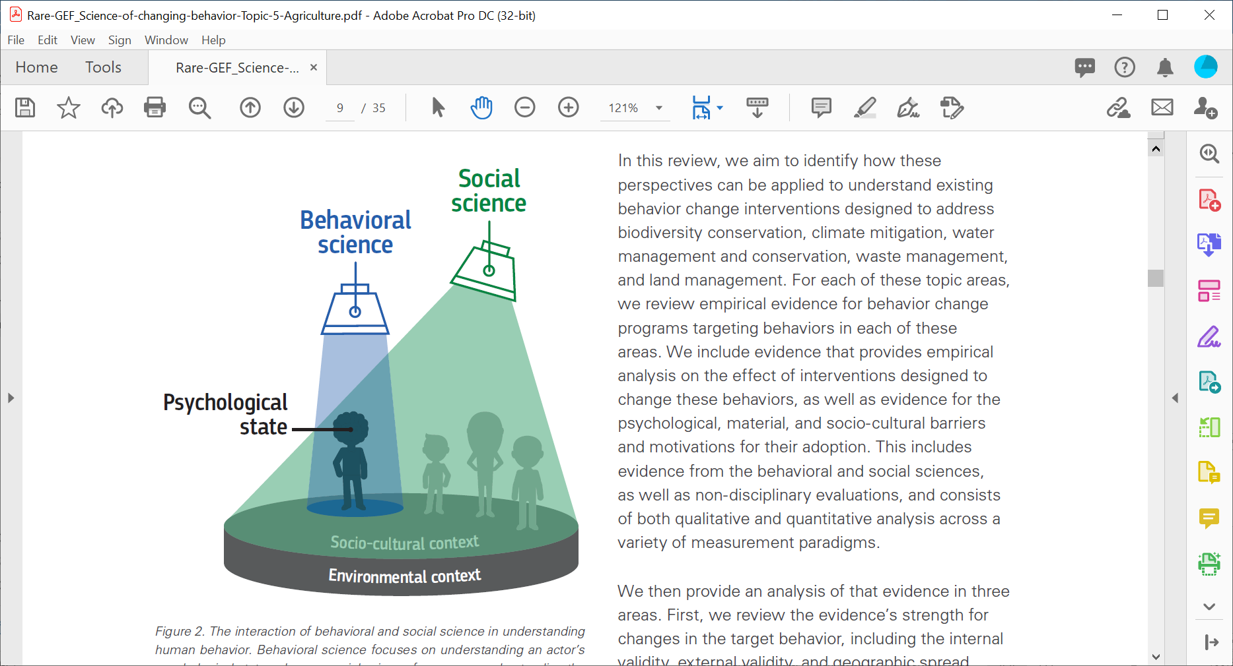
(Bujold et al, 2020)

Slide 3
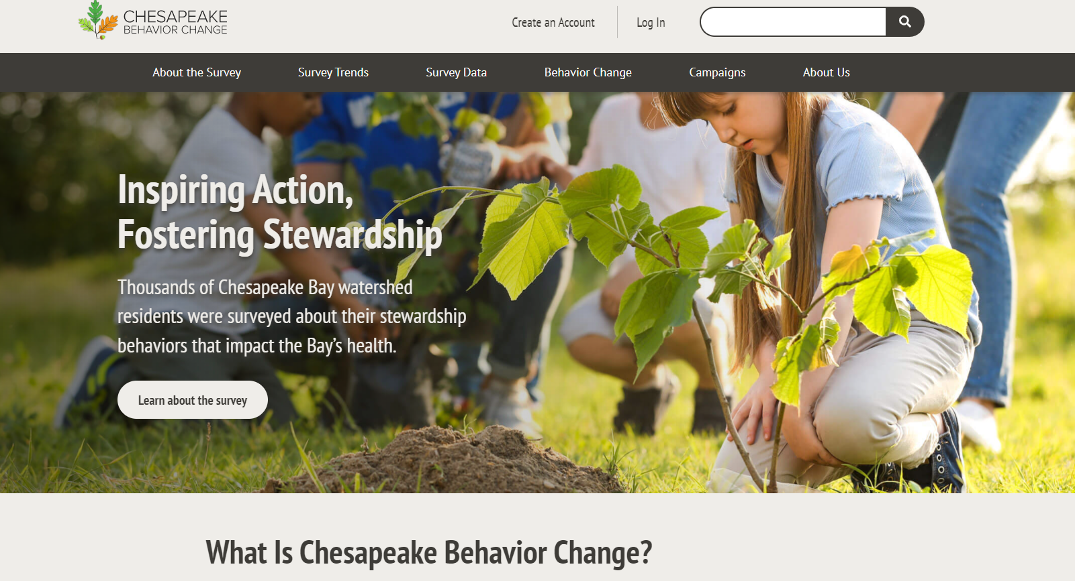
A new tool for behavior change practitioners
Sharing of resources and best practices
Campaign planning template
Case study database

Slide 4
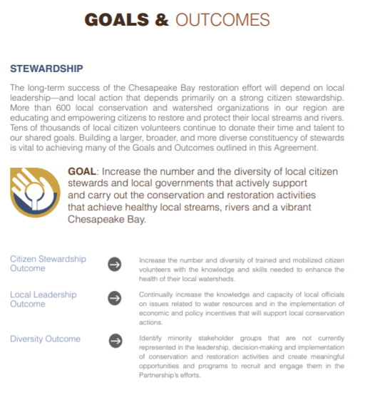
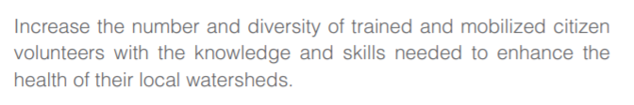

Slide 5
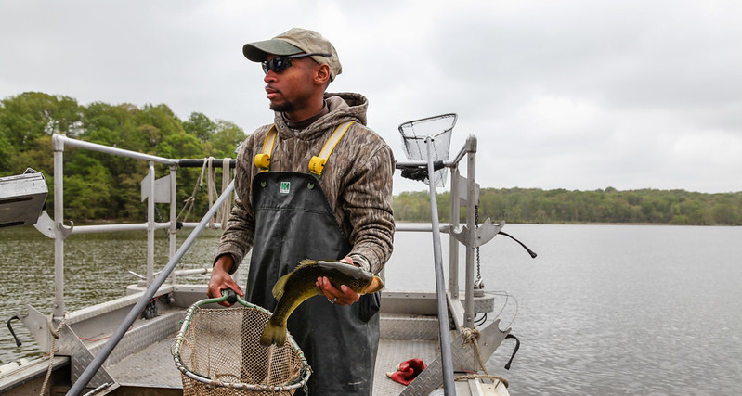
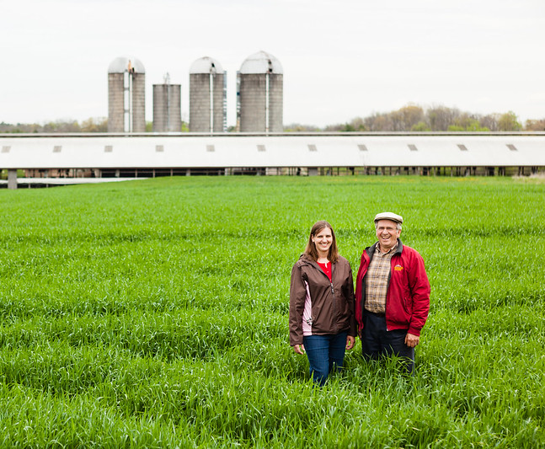

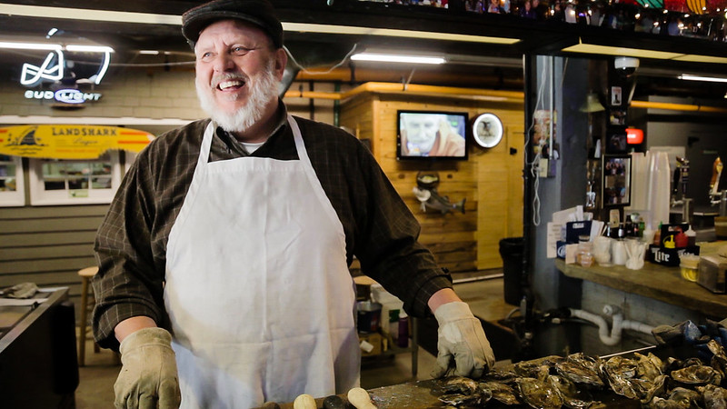
(Photo Credit: CBP)

Slide 6
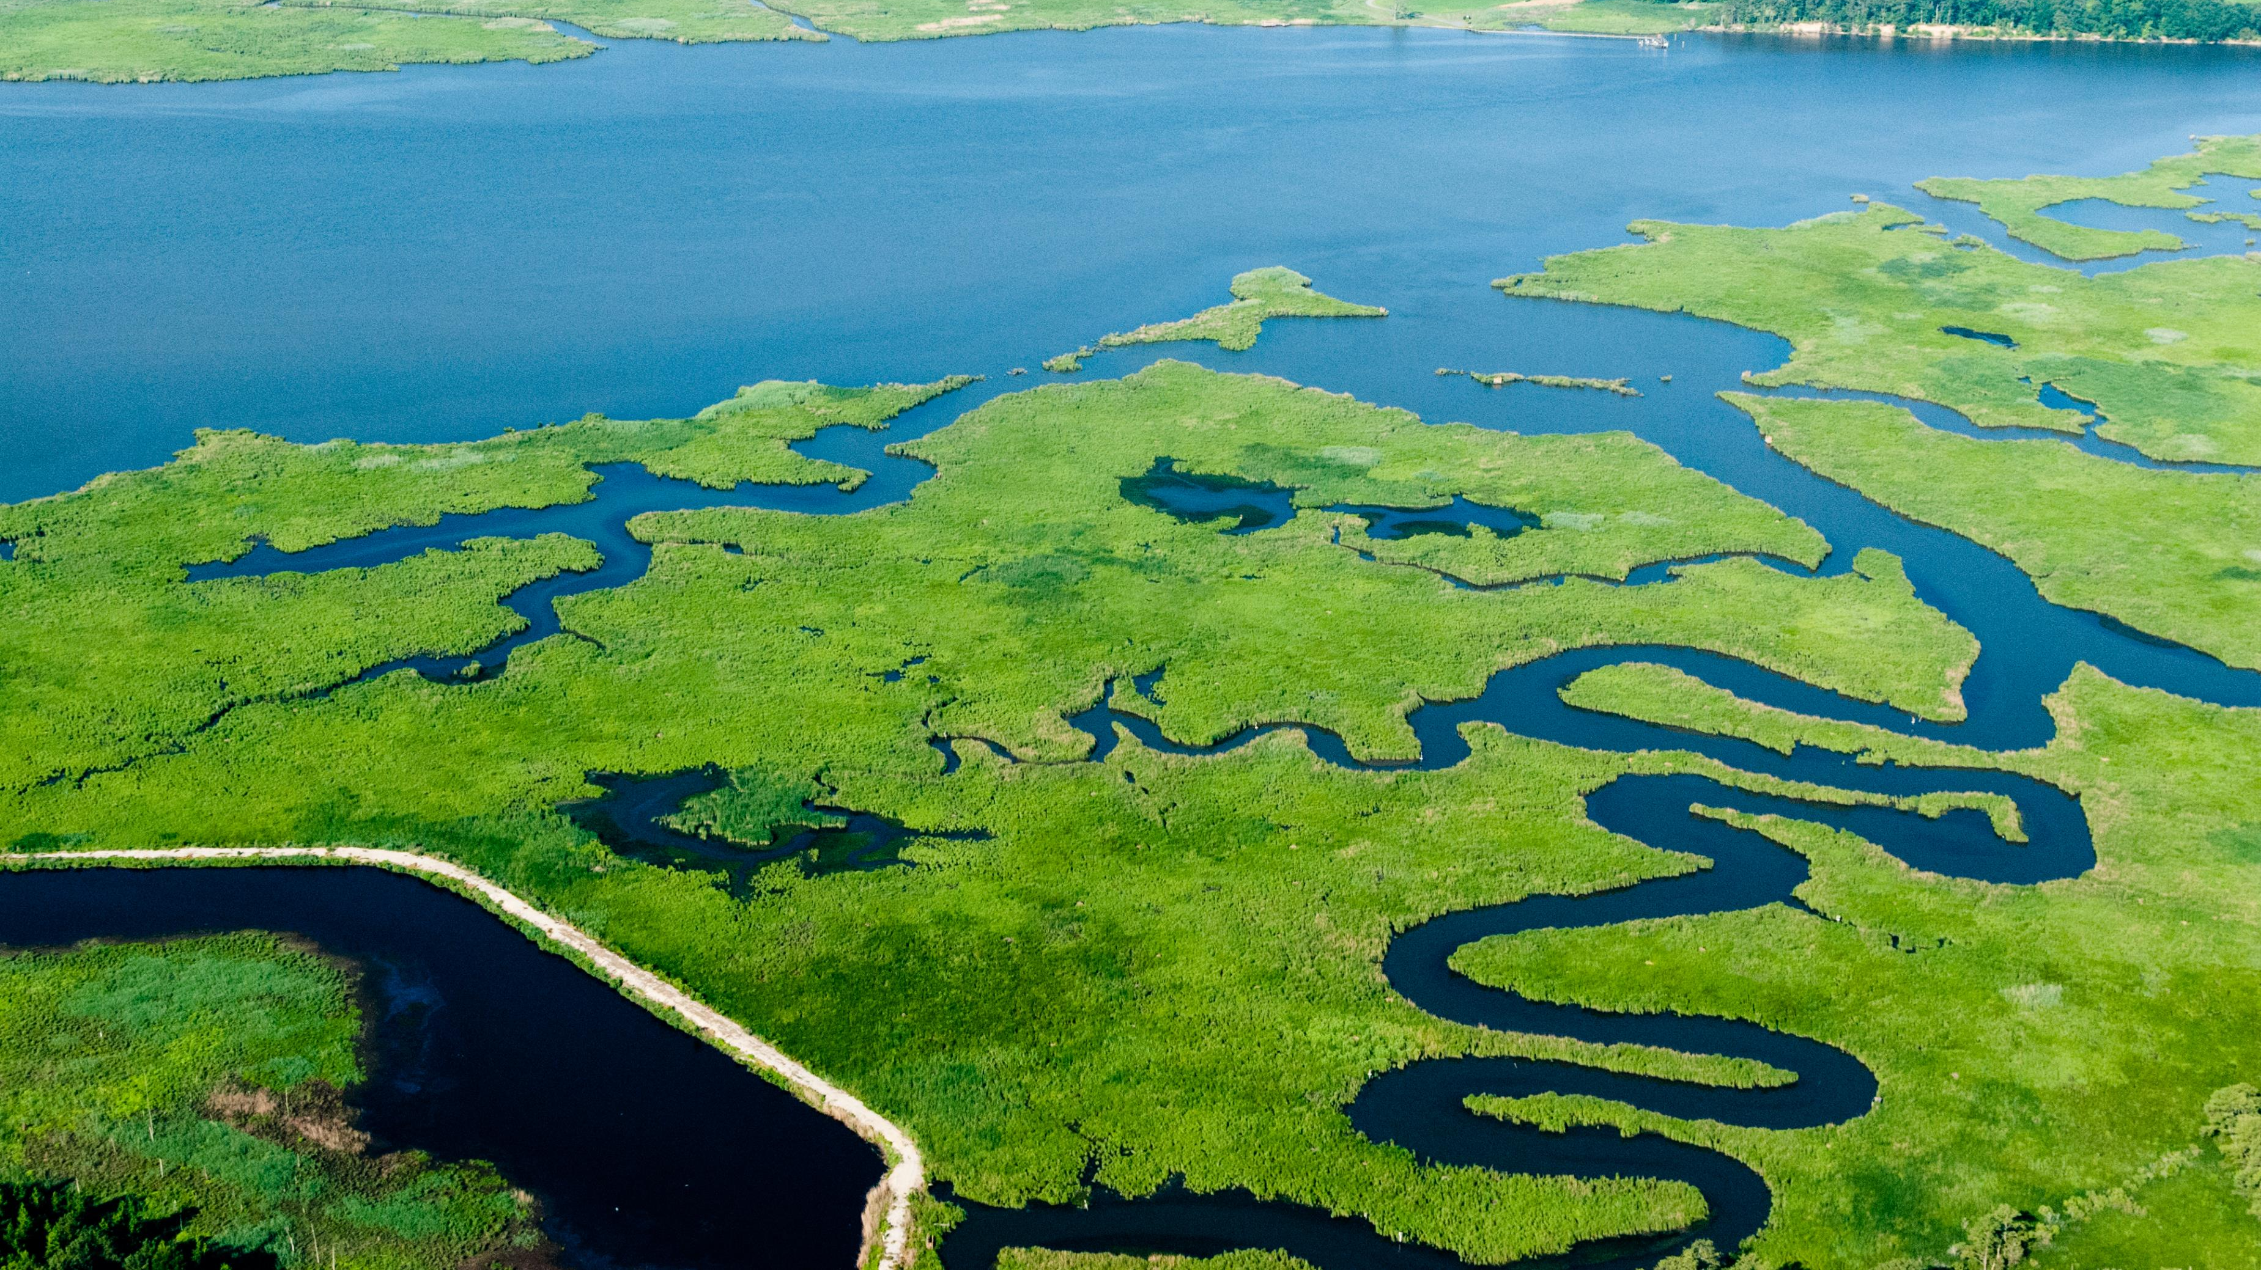
(Photo Credit: CBP)

Slide 7


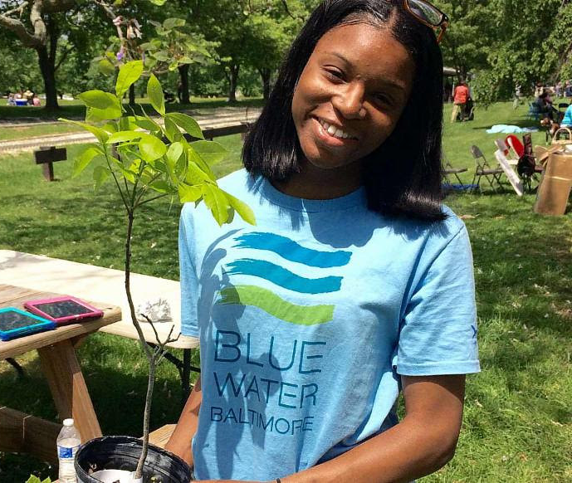
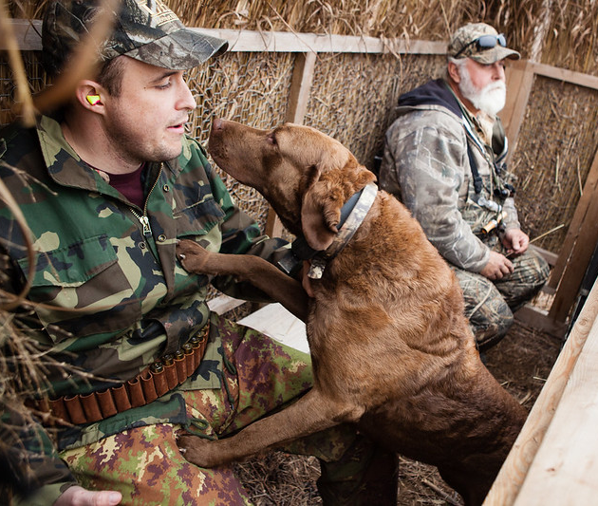

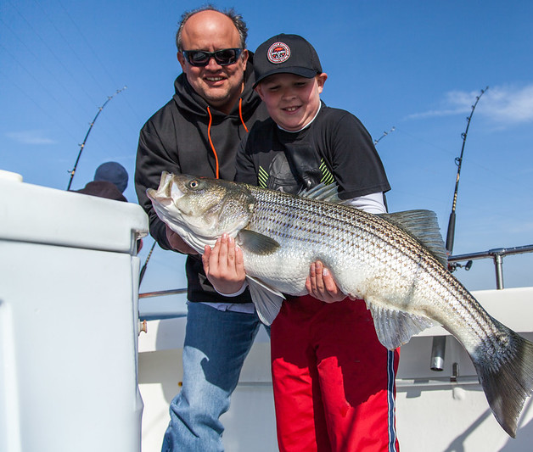
(Photo Credit: CBP)

Slide 8
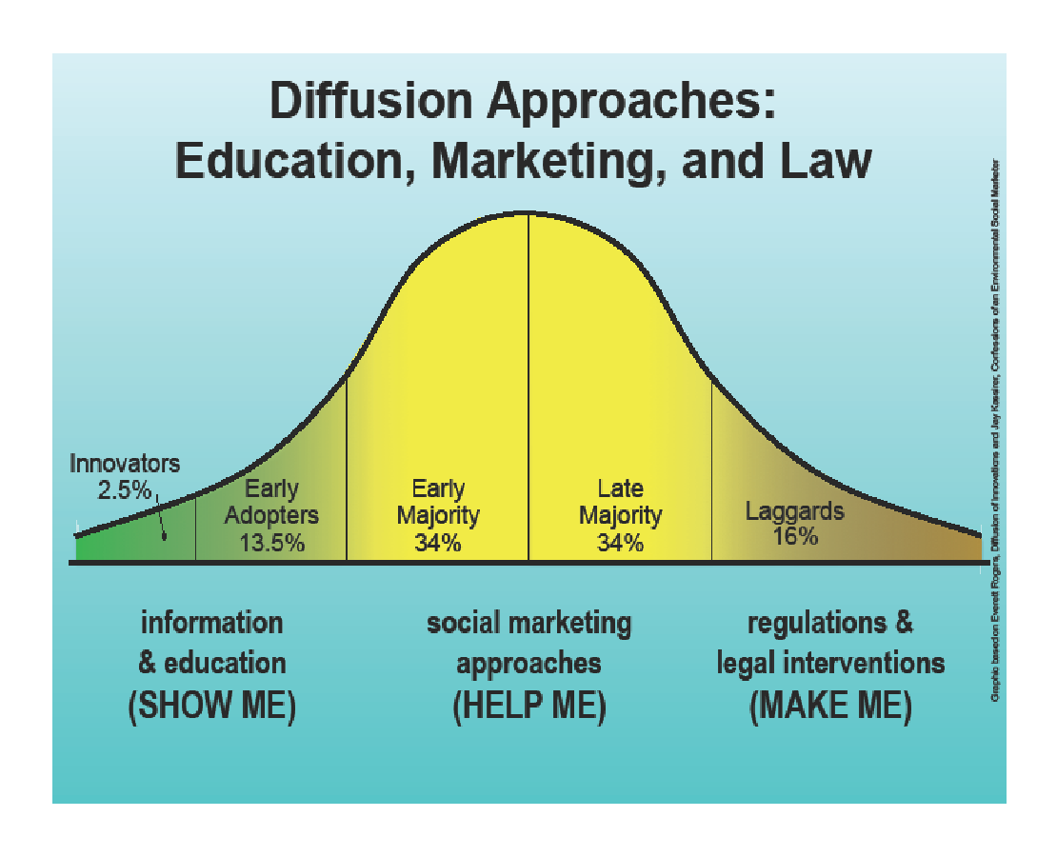
Credit: Nancy R. Lee, University of Washington & Puget Sound Partnership
Adapted from Everett Rogers, Jay Kassirer, Mike Rothschild, Dave Ward, Kristen Cooley

Slide 9
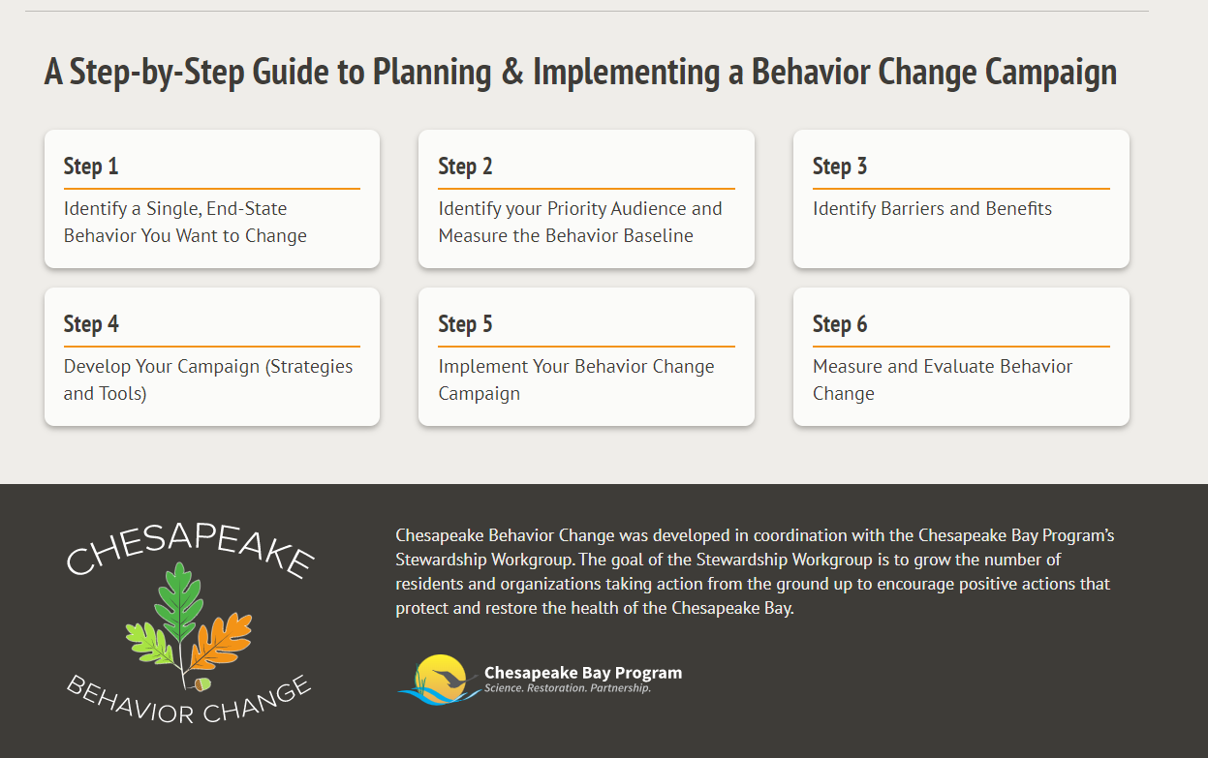

Slide 10
Choose the Right ONE Behavior to Influence
Impact: This behavior’s impact on water quality
Opportunity: Share of the public who have not yet adopted the behavior
Likelihood: How ready people are to adopt
Physical science Social Science
Notes:
Steve/Kacey

Slide 11
Rain Barrel is Connected
and Emptied Between Rainstorms
Opportunity: 31% Not Performing Behavior
Likelihood among Non-Performers
(Asked of those with a rain barrel):
“Is your rain barrel connected to a downspout and being emptied between rain storms?”
(If no or not sure): “Looking forward over the next year or so, how likely are you to do each of these things using the scale very likely, somewhat likely, or not likely?
…Empty your rain barrel between rainstorms..”
Stewardship Indicator Survey
(N=5,212 Chesapeake Bay Watershed residents, 2017)

