Slide 1
2024 CHESAPEAKE EXECUTIVE COUNCIL PLANNING
November 6, 2024

Slide 2
PLANNING TEAM CHAIRS
Rachel Felver, Chesapeake Bay Program Communications Director
Alliance for the Chesapeake Bay
(410) 267-5740 | rfelver@chesapeakebay.net
Jackie Specht, Assistant Secretary of Aquatic Resources
Maryland Department of Natural Resources
(443) 924-0011 | jackie.specht1@maryland.gov

Slide 3
WHERE TO FIND EVERYTHING
2024 EC Briefing Book Page:
https://www.chesapeakebay.net/who/ecbook/2024-executive-council-meeting-briefing-book

Slide 4
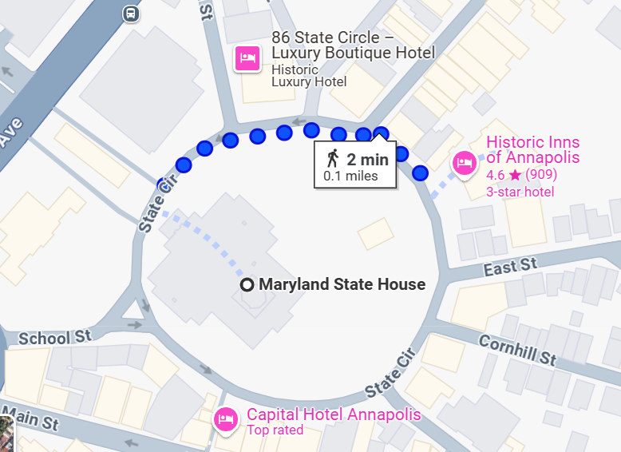
LOGISTICS UPDATE
Location fully set.
Closed meeting: Governor’s Reception Room, Annapolis State House
Public Meeting: Governor Calvert House, Annapolis, Md.
Logistics Information
Parking
Hotels
Public Transit
Catering
We need dietary restrictions!
Will be a continental style breakfast.

Slide 5
EC MEMBER RSVP STATUS
Unable to Attend
Attendance Confirmed
EPA Michael Regan, Administrator
CBC VA Delegate David Bulova, Chair
DE John C. Carney Jr., Governor
DC Muriel Bowser, Mayor
MD Wes Moore, Governor
NY Kathy Hochul, Governor
PA Josh Shapiro, Governor
VA Glenn Youngkin, Governor
WV Jim Justice, Governor (Designee: Scott Mandirola)
Advisory Committees
SAC Chair – Chuck Herrick 3. STAC Chair – Larry Sanford
LGAC Chair – Daniel Chao
Notes:
Invitations are being drafted.

Slide 6
EC MEMBER GUESTS
CBC Anna Killius, Executive Director
DE
DC
EPA Adam Ortiz, Region 3 Administrator
MD Josh Kurtz, DNR Secretary
NY
PA
VA Travis Voyles, Secretary
WV

Slide 7
EC ACTIONS
Beyond 2025 Charge
Final: https://d18lev1ok5leia.cloudfront.net/chesapeakebay/documents/Final-2024-EC-Charge-Beyond-2025.pdf
Agricultural Advisory Committee Directive
All signatures needed by Friday, November 8.
Final: https://d18lev1ok5leia.cloudfront.net/chesapeakebay/documents/Ag-Advisory-Committee-Directive.pdf

Slide 8
DRAFT MEETING AGENDA

Slide 9
BRIEFING BOOK
PRODUCT | BRIEFING BOOK DUE DATE | EC PLANNING MEMBER LEAD
EC Member Bios | November 15 | Planning Team Members
LGAC Report | November 15 | Laura Cattell Noll
STAC Report | November 15 | Meg Cole
Stakeholders’ Report | November 15 | Jess Blackburn
State of the Program | November 15 | Rachel Felver
Notes:
Can we set a goal of having all briefing book materials in by Thanksgiving?

Slide 10
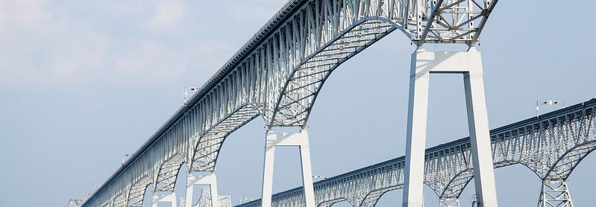
THEME
Charting a Course Beyond 2025

Slide 11
PLANNING TEAM MEMBERS
JURISDICTION | PLANNING COMMITTEE MEMBER
Chesapeake Bay Commission | Adrianne Kotula Anna Killius*
Delaware | Phil Miller
District of Columbia | Julia Wakeling
Environmental Protection Agency | Lucinda Power* Greg Barranco
Maryland | Jackie Specht*
New York | Cassie Davis
Pennsylvania | Jill Whitcomb
Virginia | Liz McKercher Kevin McLean*
West Virginia | Scott Settle*
Local Government Advisory Committee | Laura Cattell Noll*
Scientific and Technical Advisory Committee | Meg Cole
Stakeholders Advisory Committee | Jessica Blackburn
*New planning committee member

Slide 12
PLANNING COMMITTEE RESPONSIBILITIES
Liaison between your jurisdiction, Executive Council member and Principals’ Staff Committee member.
Responsible for getting information on security, communications, lunch orders and feedback on agenda items.
EPA Region 3 is responsible for being a liaison between EPA CBPO and EPA HQ on logistics, invitations, talking points, etc.

