Slide 1
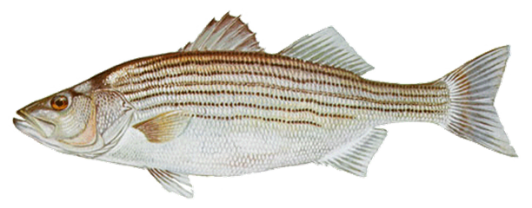

Assessing Climate Change & Summertime Resident Chesapeake Bay Striped Bass Habitat
Tom Parham, Jim Uphoff, Andrew Keppel, Renee Karrh
September, 2023
Fish GIT

Slide 2
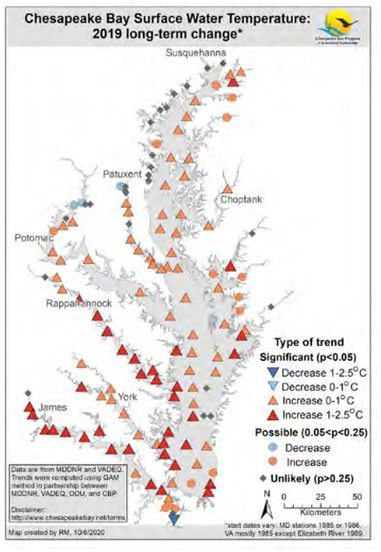
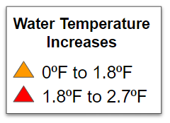
A Changing Chesapeake Bay
Climate Change Impacts
Bay water temperature increasing over last three decades - Most Bay stations showing between 1° to 2°F increase since 1999. Increases are not consistent throughout water column (R. Murphy, 2020)
Marine heat waves becoming more frequent in Bay waters (Mazzini and Pianca, 2021)
Nutrient and Sediment Reduction
Since the 1980’s and more aggressive recently, Bay States have been working to reduce excess nutrients and sediment to increase available oxygen for Bay organisms and clearer water for SAV.

Slide 3
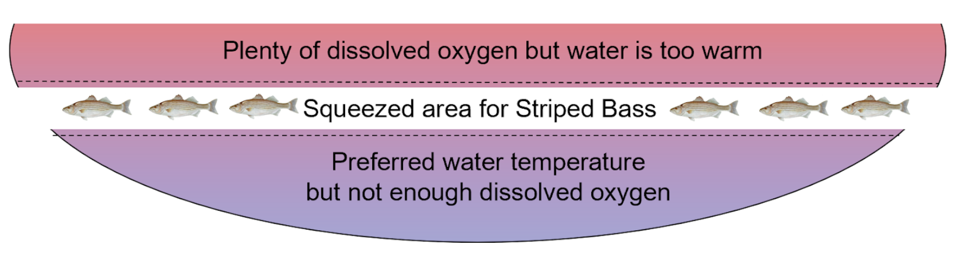
Striped Bass Squeeze Hypothesis
In warmer summer months, elevated surface water temperatures and increasing amounts of oxygen poor bottom waters force some or many striped bass into a band of cooler water with adequate oxygen.

Slide 4
Determining Summer Habitat Thresholds for Resident Striped Bass
To assess habitat conditions, we needed to develop dissolved oxygen (DO) and water temperature requirements (WT) for “typical” harvestable resident fish during worst habitat conditions (June - August)
  Smaller fish are more tolerant of poor water quality and larger fish are less tolerant
We developed Chesapeake Bay specific requirements for resident striped bass using results from scientific literature: Bioenergetics models, direct observation, tagging, telemetry, and literature reviews.
  Mostly studies were Bay specific with some SE reservoir studies
Four habitat categories: Suitable, Tolerable, Marginal, and Unsuitable

Slide 5
Chesapeake Bay Striped Bass Thresholds for Dissolved Oxygen (DO) & Water Temperature (WT)
Suitable - Supports "normal" occupancy and growth potential, no mortality
DO ≥4 mg/l, WT ≤82.4°F (28°C)
Tolerable - Supports occupancy for a modest period of time with limited or negative growth potential, little or no mortality (~1 month)
DO <4 mg/l & ≥3 mg/l, WT >82.4°F(28°C) & ≤84.2°F (29°C)
Marginal - Supports very brief occupancy with potential for high mortality beyond brief exposure (Just passing through)
DO <3 mg/l & ≥2 mg/l, WT >84.2°F (29°C) & ≤86°F (30°C)
Unsuitable - Not suitable conditions experiencing either hypoxia or excess water temperature
DO <2 mg/l, WT >86°F (30°C)

Slide 6
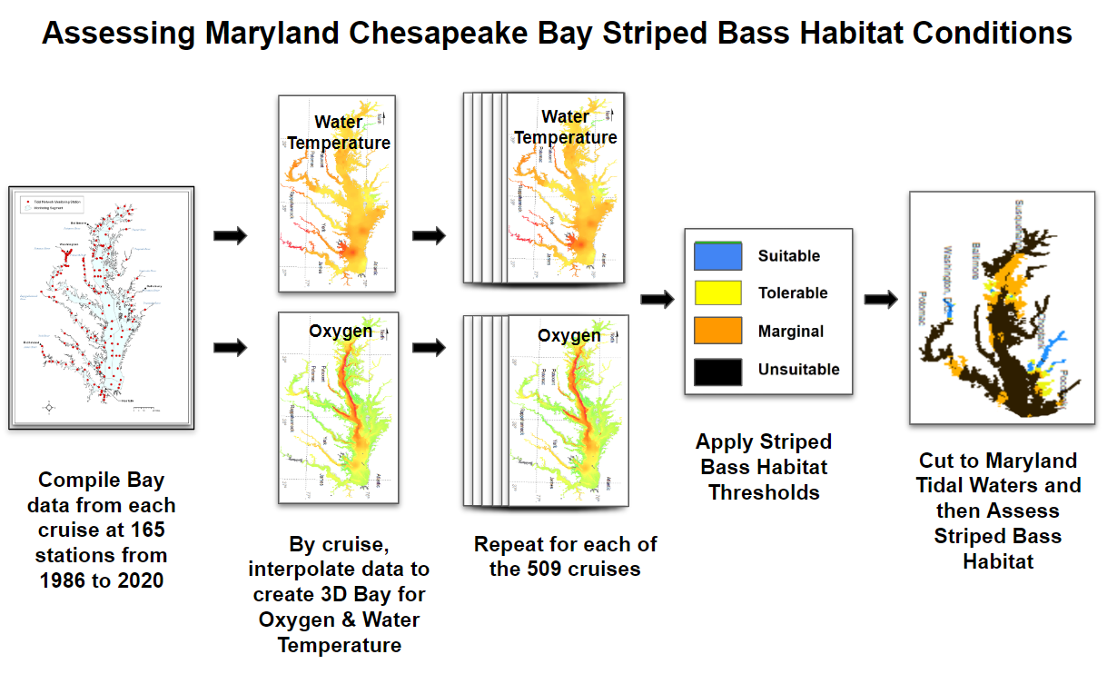
Process for Assessing Maryland Striped Bass Habitat (DO and WT)

Slide 7
How have resident Striped Bass habitat conditions changed since 1986?

Slide 8
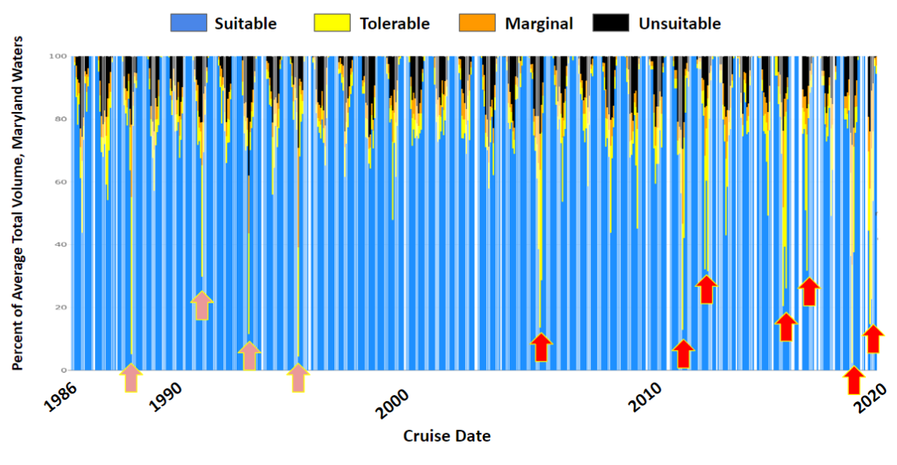
Maryland-wide Striped Bass Habitat Conditions
Single months of degraded conditions:1988, 1991, 1993, 1995
Consecutive months of degraded conditions: 2005, 2011, 2012, 2016, 2017, 2019, 2020

Slide 9
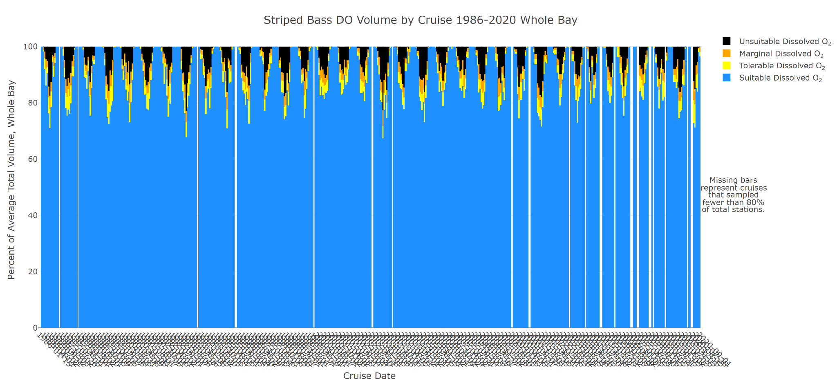
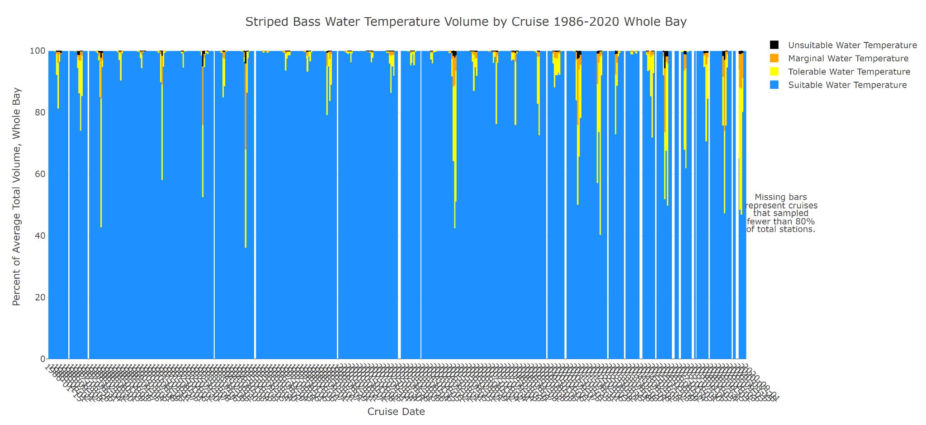
Striped Bass Dissolved Oxygen Conditions
Oxygen Summary
Nutrient and Sediment reduction efforts have offset warming Bay waters and increasing populations to keep oxygen conditions stable
  Warmer water holds less oxygen, more biological activity, stratification
  Increases in watershed population: 1980-12.7M, 2017-18.4M
Percent of Average Total Volume, Maryland-wide Waters
2010
1986
1990
2000
2020
Striped Bass Water Temperature Conditions
Water Temperature Summary
Declining habitat conditions are primarily due to increasing water temperature
1986
1990
2000
2010
2020
Cruise Date

Slide 10
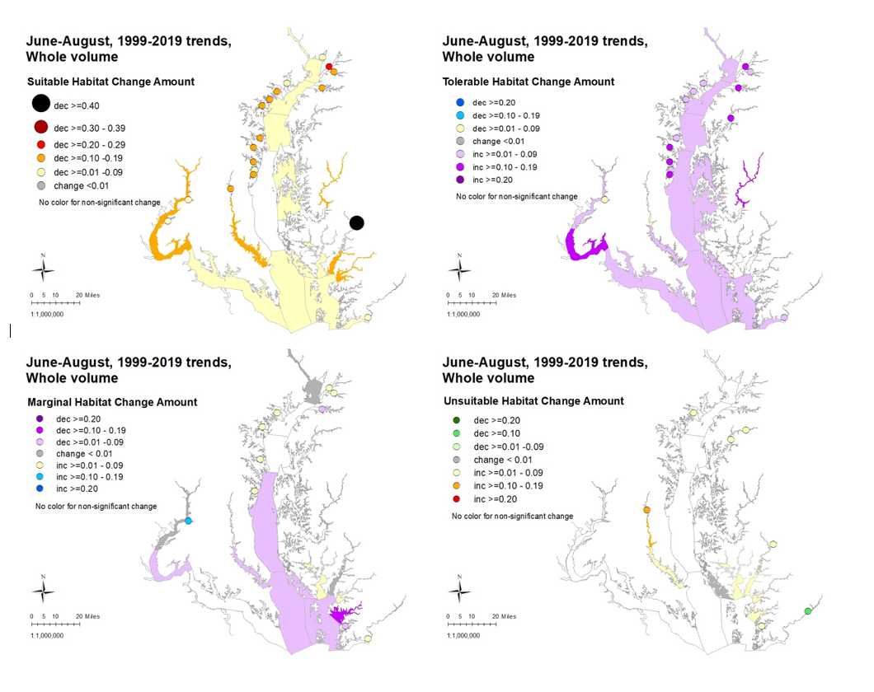
Habitat Quality
Degrading
Shifting from suitable towards Tolerable habitat conditions

Slide 11
How have resident Striped Bass habitat conditions at popular fishing locations changed since 1986?

Slide 12
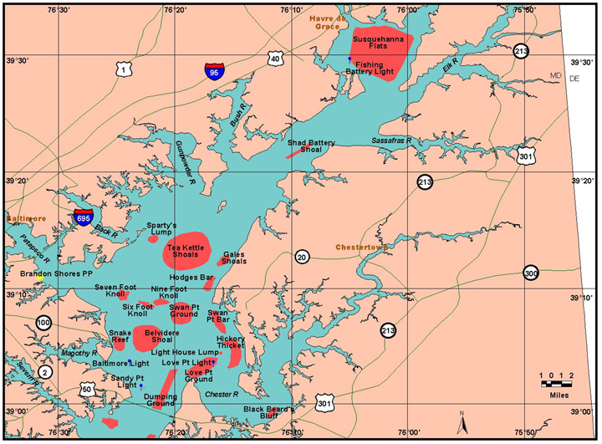
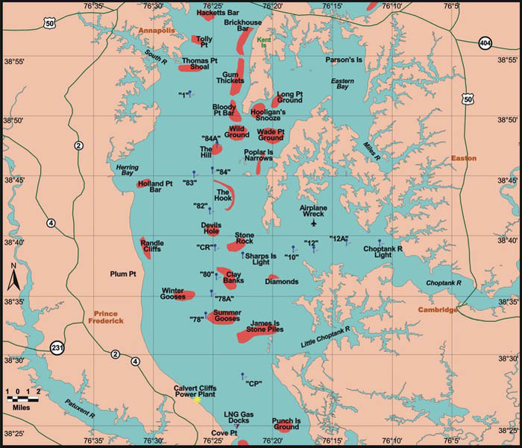
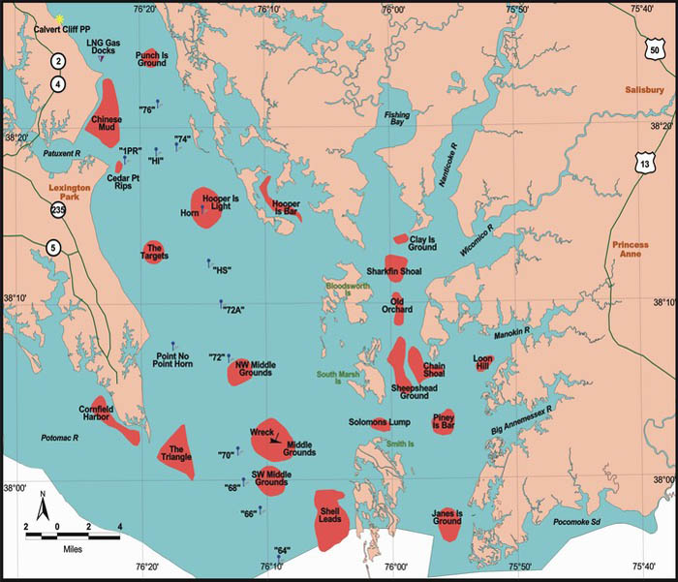
Popular Maryland Fishing Areas
These prime fishing areas are where fish congregate
(Genovese, P. 2000)

Slide 13
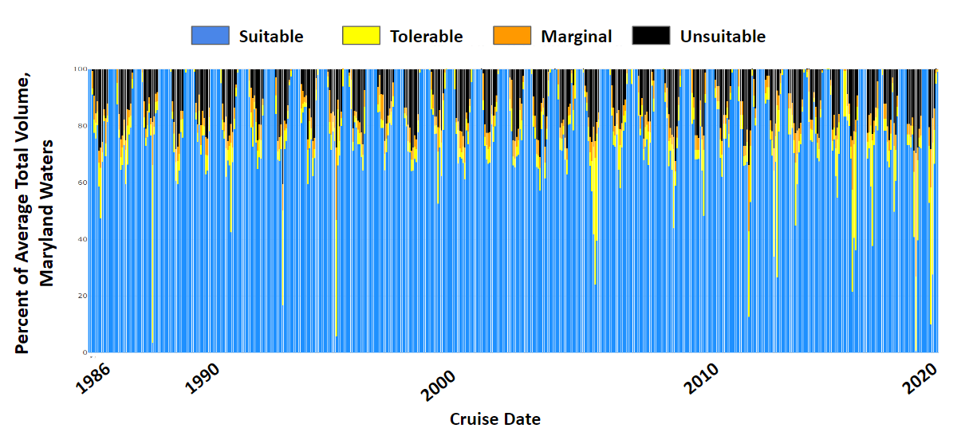
Habitat Conditions at Popular Maryland Fishing Areas
Same pattern of increasing frequency and duration of degrading conditions
Unsuitable Maryland-wide habitat is ~10% to 15%. At popular fishing areas, this increases to about 30% of total habitat

Slide 14
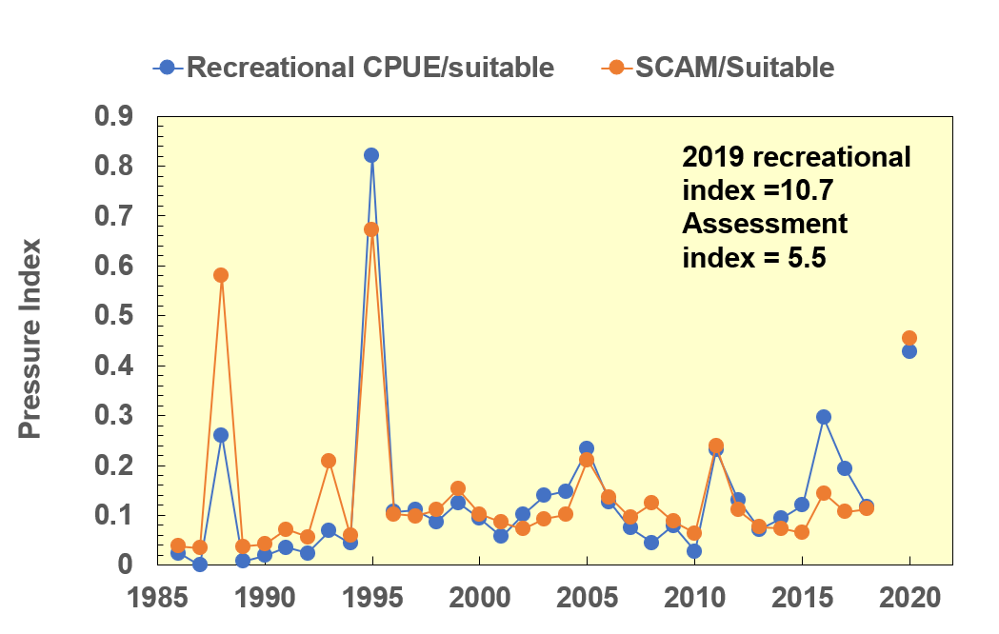
Maximum habitat pressure index for the Striped Bass Water Temperature-Oxygen squeeze

Slide 15
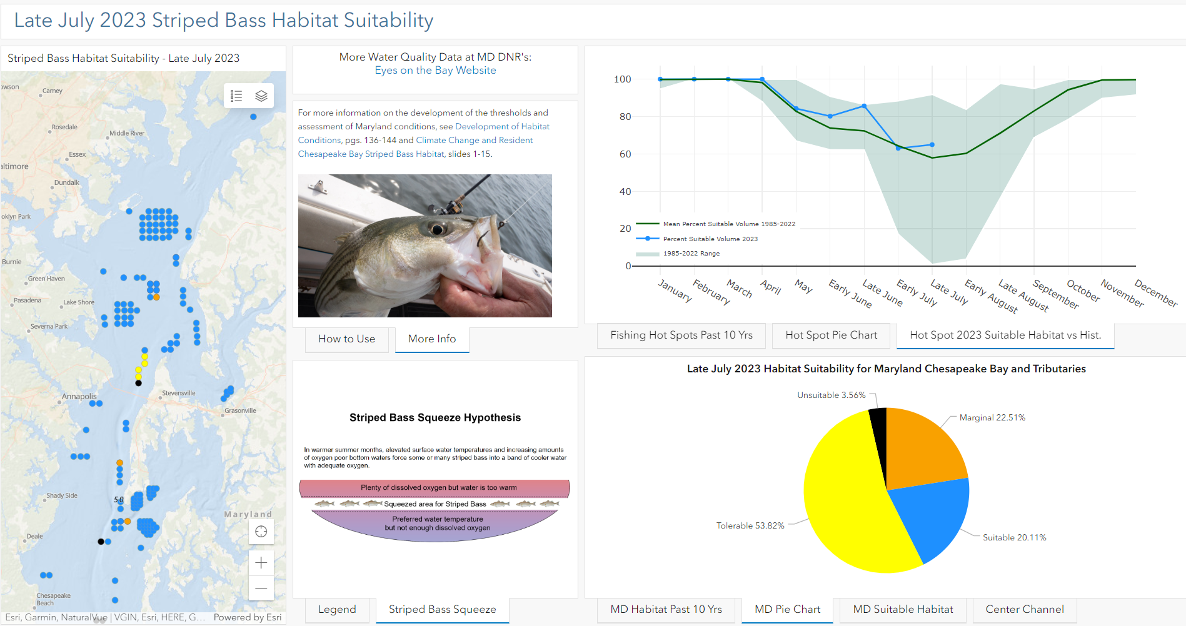
Late July 2023 Striped Bass Habitat Suitability

Slide 16
Summary of Past & Present Conditions (1986-2019)
Striped bass habitat has degraded since 1986, mostly in the last 10-20 years. In Maryland, Suitable habitat has decreased between 1% and 10%
In popular fishing areas, conditions follow similar pattern of increasing frequency, intensity and duration but a higher % of habitat is degraded
Increasing water temperature is the major driver

Slide 17
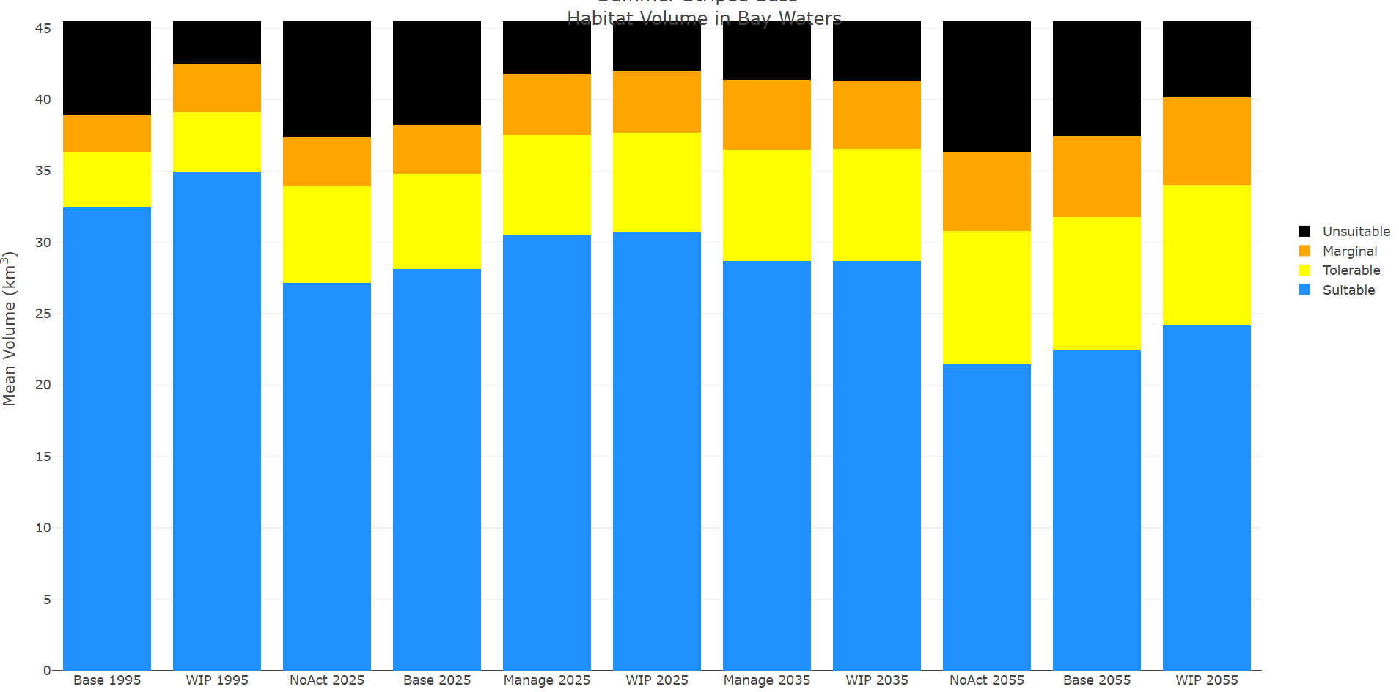
Future Conditions of Maryland Striped Bass Habitat
The Chesapeake Bay fishery will likely experience more frequent, longer lasting and more degraded habitat conditions.
Despite climate change, it is still extremely important to continue nutrient and sediment reduction actions.
NO ACTION 2025
NO ACTION 2055
BASE 1995
WIP 2025
WIP 2055

Slide 18
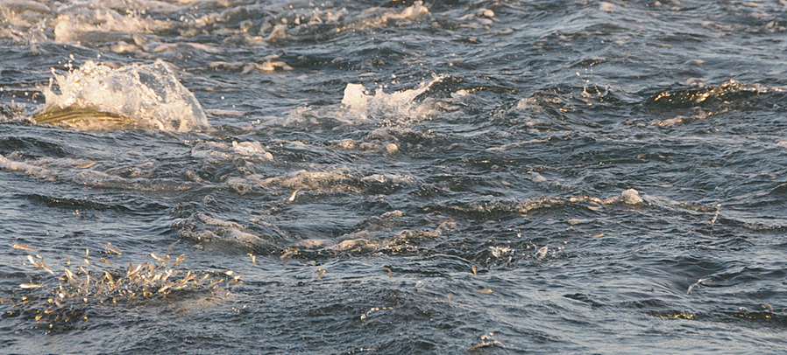
Special thanks to Maryland DNR Resource Assessment Service & Fishing and Boating Service Bay monitoring, data management, analysis and administrative folks

