Slide 1

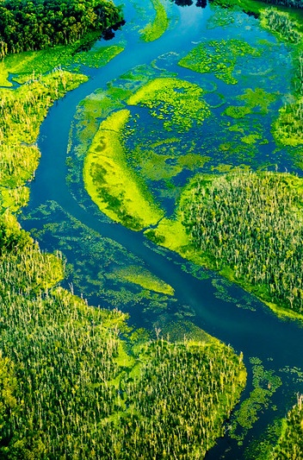


Beyond 2025 Update
January 11, 2024

Slide 2
STEERING COMMITTEE PROPOSED PRODUCTS BY EC2024
Where we are
Summary of where we are with the 2014 Watershed Agreement
Where do we want to be
Vision
What we do
Impact assessment
How we work
Assessment of our overall partnership
Recommendations on what to do with the Watershed Agreement post-2025 and on our partnership
Path Forward
Notes:
Product we are aiming to create by end of Phase 1. SC is responsible for final product with recommendations. But we do have contractual support to offer us an independent evaluation of some questions that will give us more insights into the impact of our work and of our partnership.

Slide 3
HIGH LEVEL TOPICS
OVERARCHING QUESTIONS & CONSIDERATIONS
Climate Change
Clean Water
Healthy Watersheds
Shallow Water Habitats
People
Vision – Value - Vanguard
Living Resources
Climate
People
Cross-Program Coordination
Notes:
Vision: what do we want to hand the next generation?
Value: what are we doing that works and what could be improved?
Vanguard: what idea would be transformational for the future of the Bay and its watershed?
Climate: how does climate change interact with your topic and recommendations?
People: will your recommendations more effectively put people at the center of our Bay efforts in the future?
Living Resources: will your recommendations maximize our impact on living resources?
Cross-program coordination: how can your recommendations break silos and improve coordination?

Slide 4
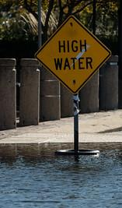


CLIMATE CHANGE
Recommendations to transform CBP partnership policies, programs, and projects to address the significant ongoing and future impacts that climate change will impose on the Bay and its watershed and people across generations.
Develop strategies to better incorporate climate mitigation, adaptation and resilience across the watershed and tidal Bay
Key Themes / Focus Areas
Projected climate impacts for Chesapeake ecosystems/Modeling
Resilience, Adaptation and Mitigation
Food security and Agriculture
Resistance-Resilience-Transition
Strengthening cross-program coordination (integration)

Slide 5



CLEAN WATER
Reconsidering our accountability framework and how it influences implementation
Empowering partners across the Chesapeake Bay watershed to identify and pursue effective solutions for achieving Chesapeake Bay Total Maximum Daily Load (TMDL) planning targets.
Effectively coordinating monitoring and restoration programs within and across the Chesapeake Bay Program partnership.
Key Themes / Focus Areas
Chesapeake Bay TMDL
Water Quality Assessment
Nonpoint Source Management
Water Quality Monitoring
Water Quality Standards

Slide 6
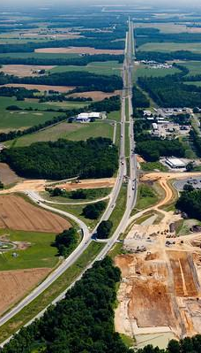


HEALTHY WATERSHEDS
Considering the spectrum of health across all catchments in the Bay watershed, to be able to characterize health at the local level
Information for decision-making that supports protection of intact habitats, as well as restoration and maintenance of degraded habitats
Opportunity to integrate with state wildlife action plans, due for update in 2025, with state-defined priority habits and living resource
Key Themes / Focus Areas
Spectrum of watershed health and helping communities understand their local watershed to target conservation practices.
Land Conservation
Habitat Conservation
Stewardship and Resilience of watershed lands

Slide 7
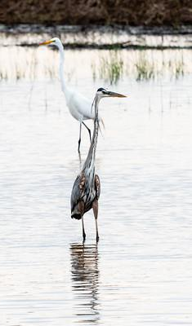



SHALLOW WATER HABITATS
Vision- Promote healthy and sustainable shallow water habitats that support resources, communities, and economies that are resilient to long-term changes in watershed conditions.
Scope- Defined as edges where land meets water and the nearshore waters of 3 ecological zones: Non-tidal Fresh, Tidal Fresh, Tidal Estuarine.
Listening- We have met with shallow water workgroups and held a public listening session for feedback on what, where and how to focus on shallow water habitat.
Key Themes / Focus Areas
Social science and access for people
Modeling - Decision Tools
Shoreline protection and integrity
Living resource impacts and prioritization
Data needs and monitoring
Land Use Planning

Slide 8
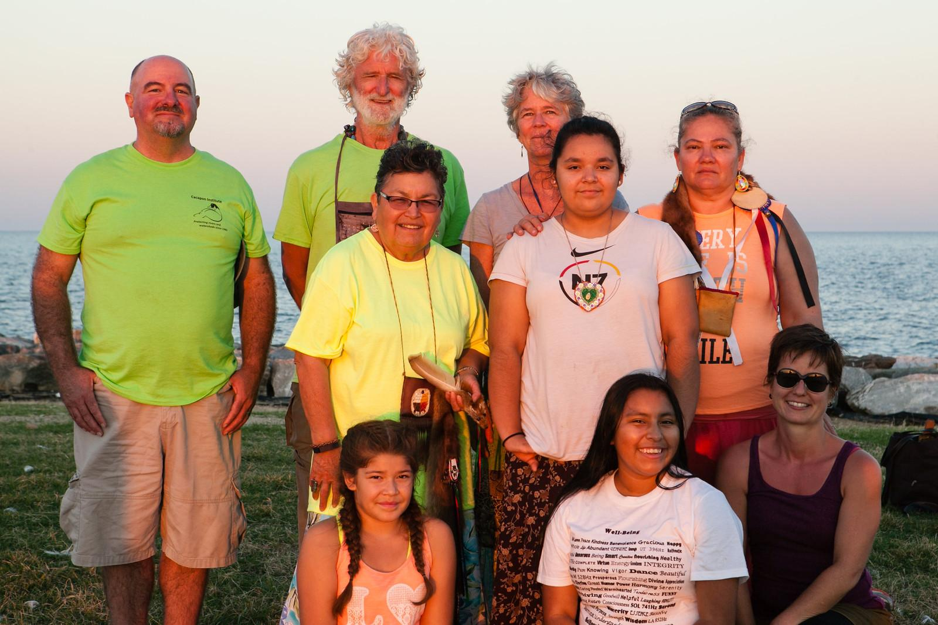




PEOPLE
Focus on systems-level and process-based recommendations that will ensure people are part of the vision for the Bay program.
Ensuring the Bay Program’s role as a capacity building entity.
Facilitating effective engagement with relevant groups to support stakeholder centered decision making.
Key Themes / Focus Areas
Directed Public Engagement
Diversity, Equity, Inclusion and Justice (DEIJ)
Social Science
Stewardship
Public Health

Slide 9
PROPOSED STEERING COMMITTEE TIMELINE
February 2024:
2-day symposium
March-April 2024:
Adopt small group recommendations
Draft Steering Committee product
May-June 2024:
Solicit public feedback
July 2024:
Revise and affirm Steering Committee recommendations
August-September 2024:
Seek approval from Management Board and Principals’ Staff Committee
October 2024:
Present to and request approval from Executive Council

Slide 10
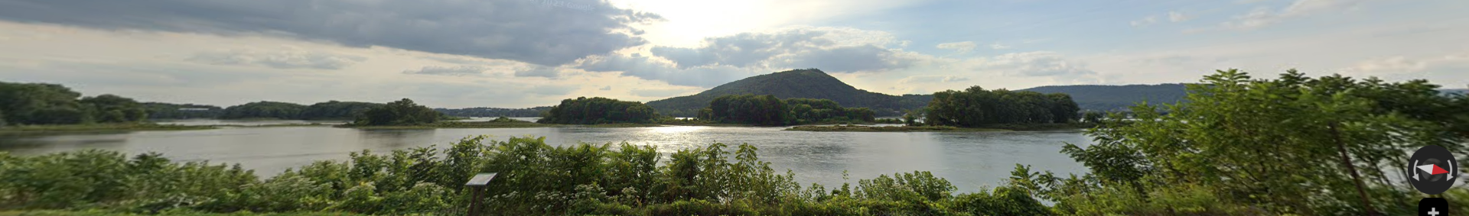
FEBRUARY SYMPOSIUM
When: Wednesday, 02/27 to Thursday 02/28
Where: Susquehanna River Basin Commission (Harrisburg, PA)
Beautiful overlook of the Susquehanna. Lodging suggestions will be shared ASAP (no room blocks)
What: Share and Discuss Cross-Cutting Small Group Recommendations
Draft agenda will be shared by January 24. Input being received by group leads and facilitator
Why: Initiate refinement of recommendations for EC
Who: Steering Committee representatives and Small Group invitees.
Limited; meeting space allows 65 individuals; Hybrid option for viewing/listening.

Slide 11

QUESTIONS?
Photo by:
Will Parson/Chesapeake Bay Program
Will Parson/Chesapeake Bay Program
All photos by Will Parson/Chesapeake Bay Program

