Slide 1

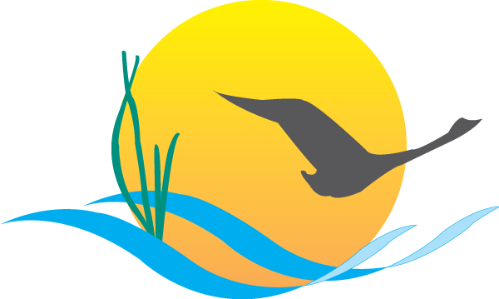
Bay Barometer
2021-2022
An Annual Report on the State of the Program and the Health of the Chesapeake Bay
Jake Solyst, Chesapeake Bay Program

Slide 2
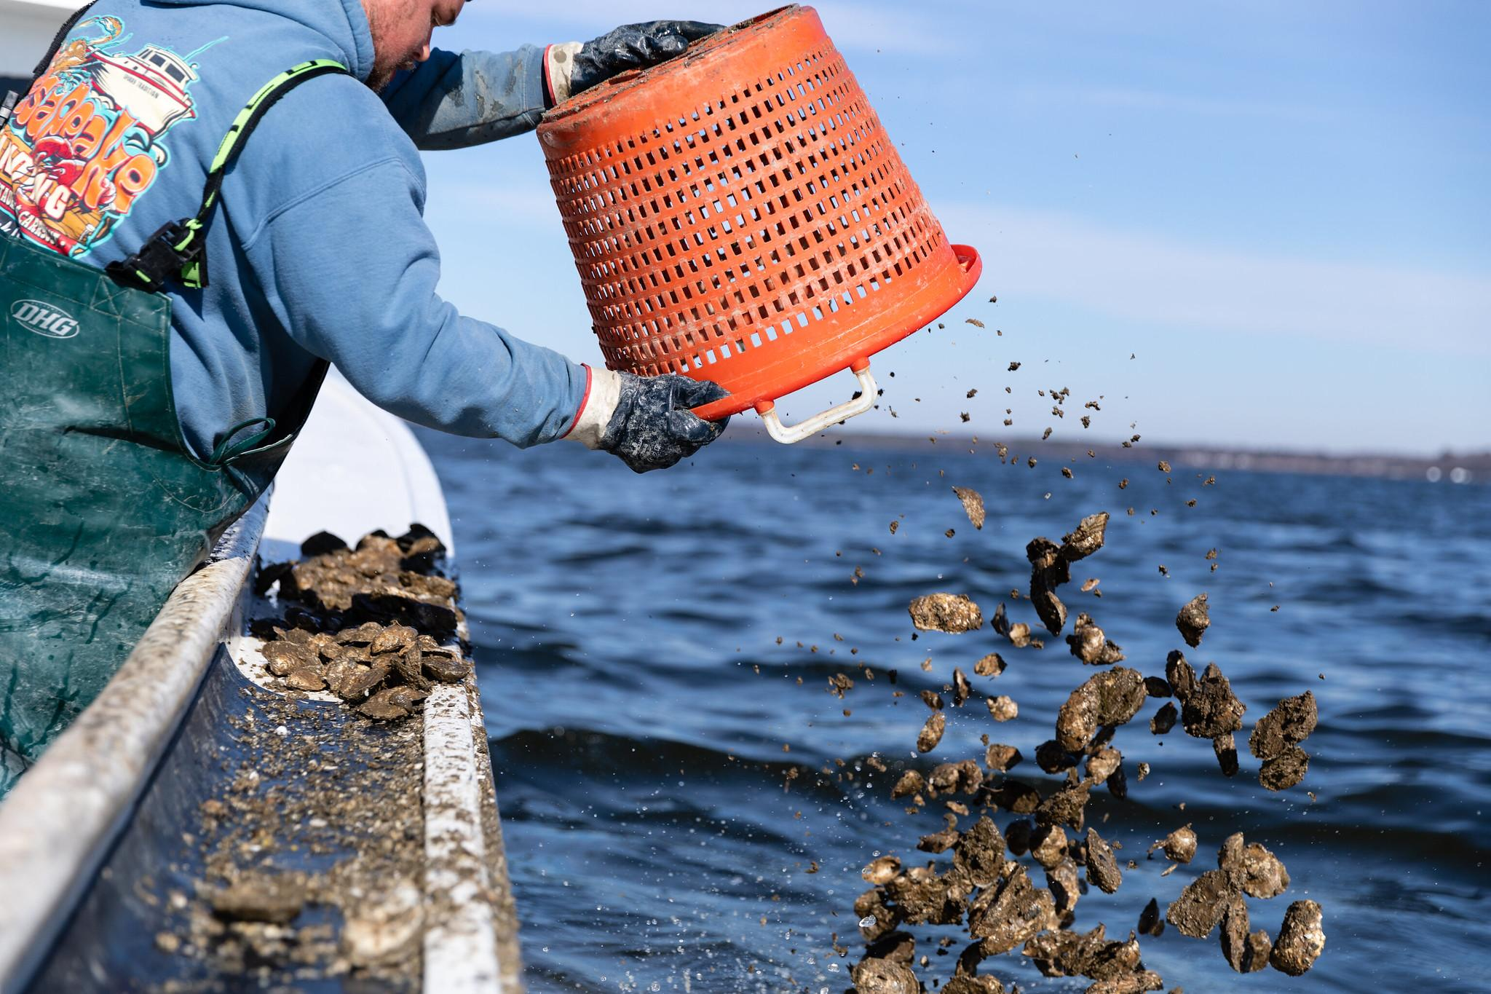
A two-part report
Outcome updates
Status and trend for nine of the most recently updated outcomes from the Chesapeake Bay Watershed Agreement.
Partnership achievements
16 stand-out achievements from 2022, including award-winning studies, community-based restoration projects, and progress toward the Diversity, Equity, Inclusion and Justice Plan.
Photo by Will Parson/Chesapeake Bay Program

Slide 3
Outcome updates
Blue Crab Abundance
Oysters
Fish Passage
Protected Lands
Public Access Site Development
Fish Habitat
Forage Fish
Toxic Contaminants Research
Land Use Options Evaluation
Land Use Methods and Metrics
Sustainable Schools
Brook Trout
Forest Buffers
Submerged Aquatic Vegetation
Blue Crab Abundance
Oysters
Public Access Site Development
Sustainable Schools
Forest Buffers
Submerged Aquatic Vegetation
Tree Canopy
Wetlands
Black Duck
2025 Watershed Implementation Plans
Diversity
Water Quality Standards Attainments & Monitoring
Toxic Contaminants Policy and Prevention
Climate Adaptation
Stream Health
Healthy Watersheds
Local Leadership Citizen
Stewardship
Climate Monitoring and Assessment
Environmental Literacy Planning
Student MWEEs
2025 Watershed Implementation Plans
Water Quality Standards Attainments & Monitoring
Toxic Contaminants Policy and Prevention

Slide 4
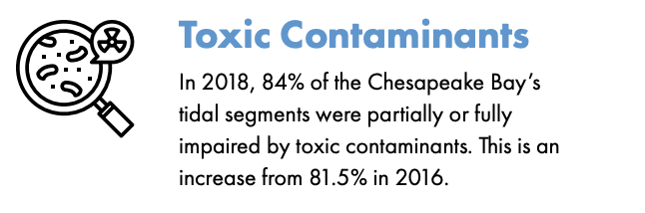
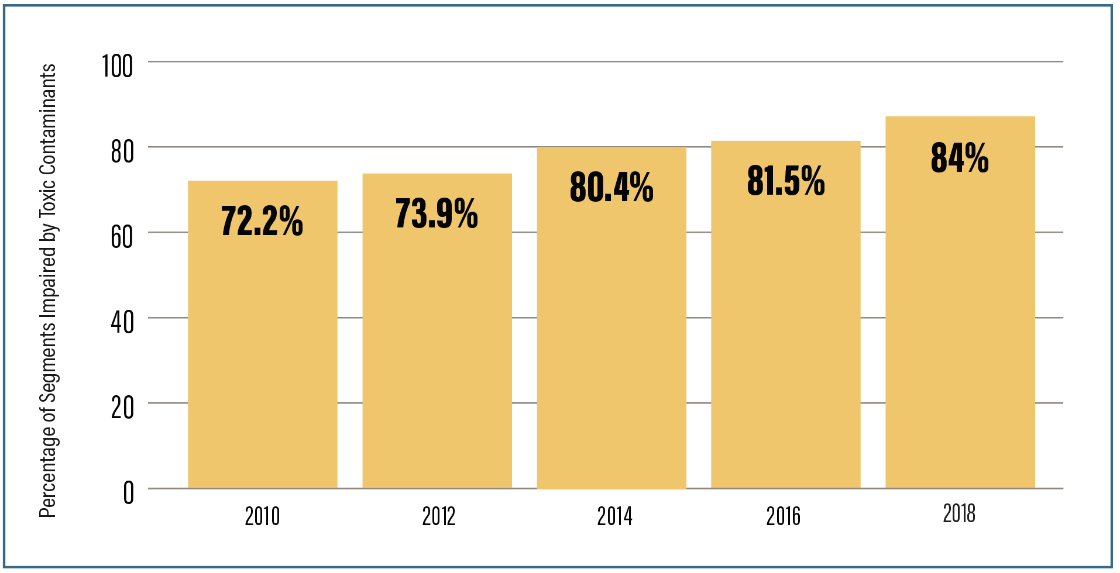
Outcome status (pages 2-3)
Toxic Contaminants Policy and Prevention
Blue Crab Abundance
Submerged Aquatic Vegetation
Water Quality Standards Attainment & Monitoring
Oysters
Public Access Site Development
Sustainable Schools
Forest Buffers
2025 Watershed Implementation Plans
Reducing Pollution
Outcome trend (pages 4-7)

Slide 5

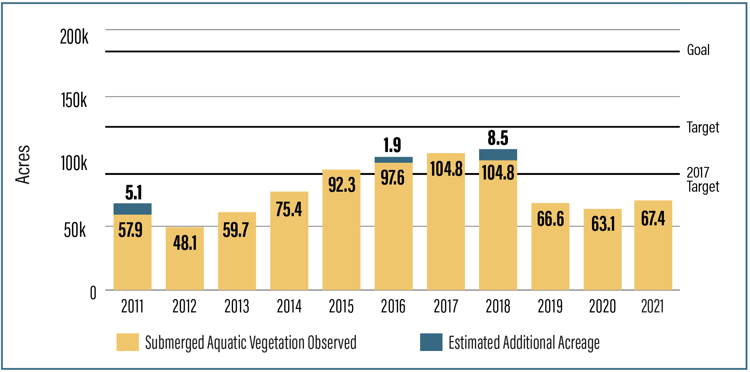
Outcome updates
Underwater grasses: Approximately 67,470 acres of underwater grasses were mapped in the Chesapeake Bay in 2021, a 7% increase from 2020.

Slide 6
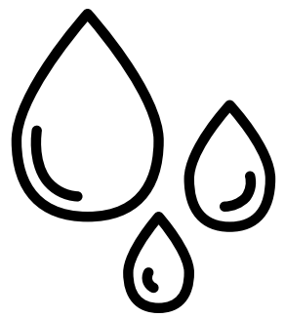
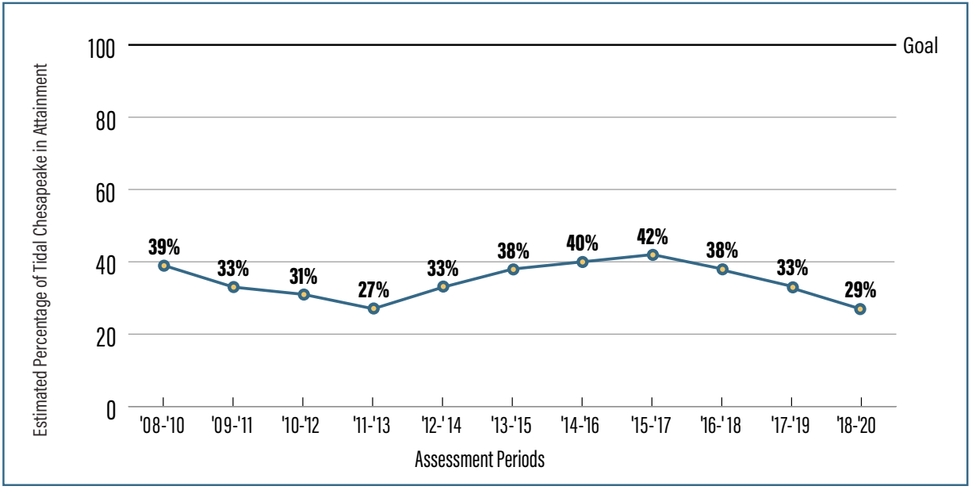
Outcome updates
Water Quality: An estimated 29.6% of the Bay and its tidal tributaries met water quality standards during the 2018-2020 assessment period, a 3.5% decrease from the 2017-2019 period.

Slide 7

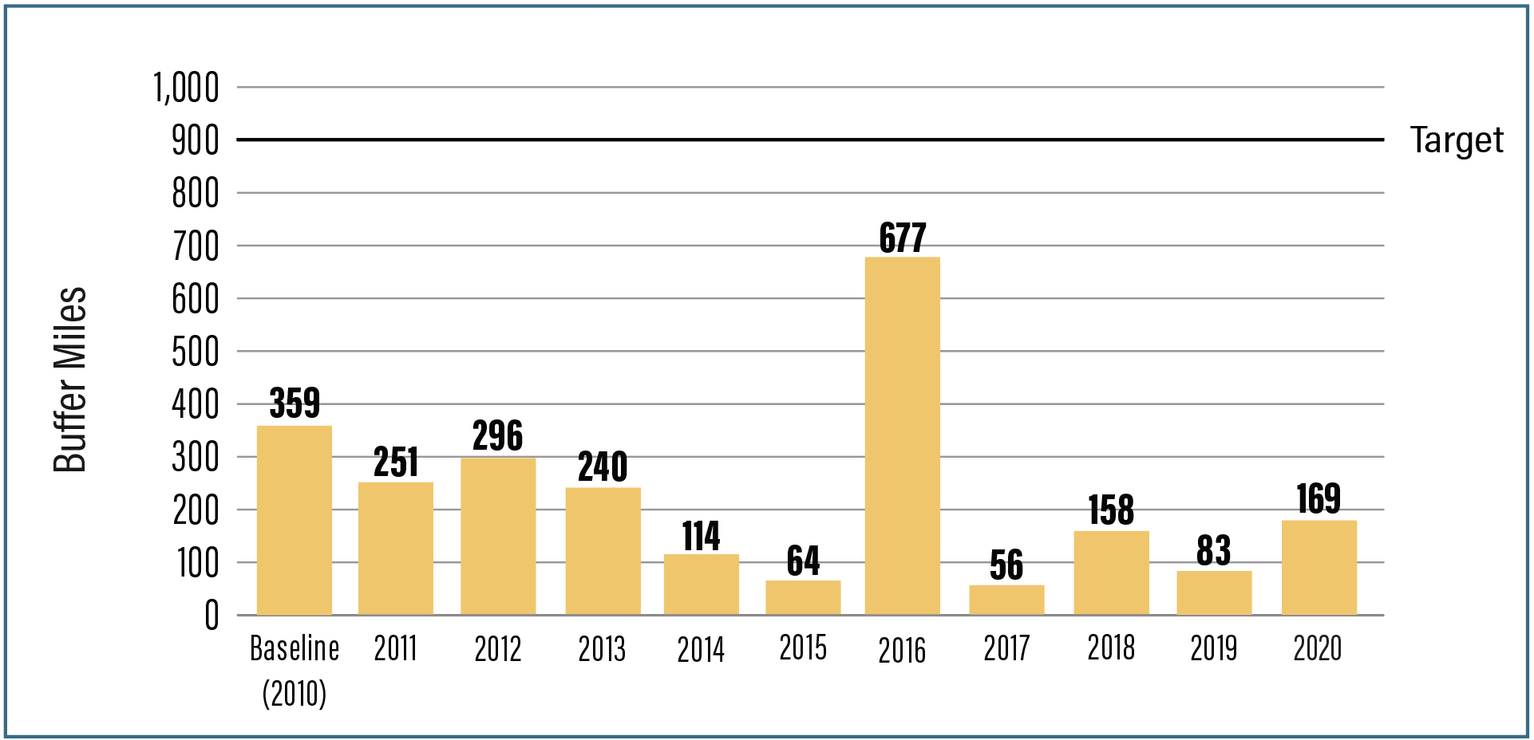
Outcome updates
Forest Buffers: In 2020, 169 miles of forest buffers were planted along rivers and streams in the Chesapeake Bay watershed.

Slide 8

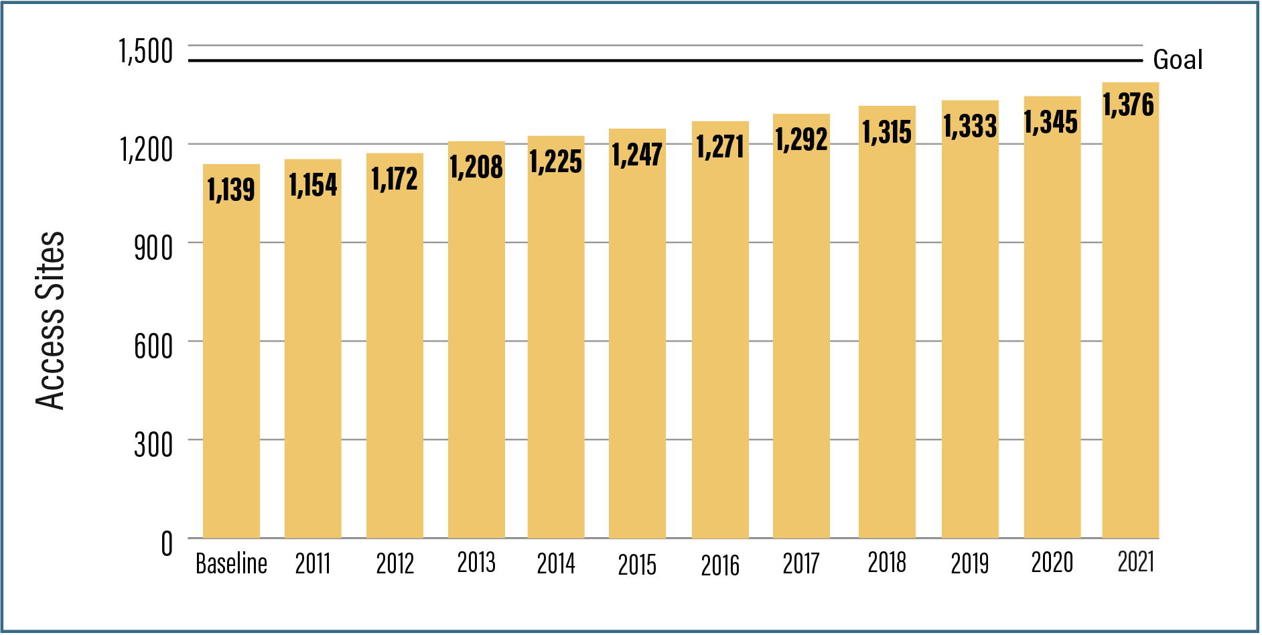
Outcome updates
Public Access: Thirty-one new public access sites were opened on or around the Chesapeake Bay in 2021, with 237 opened since 2010

Slide 9

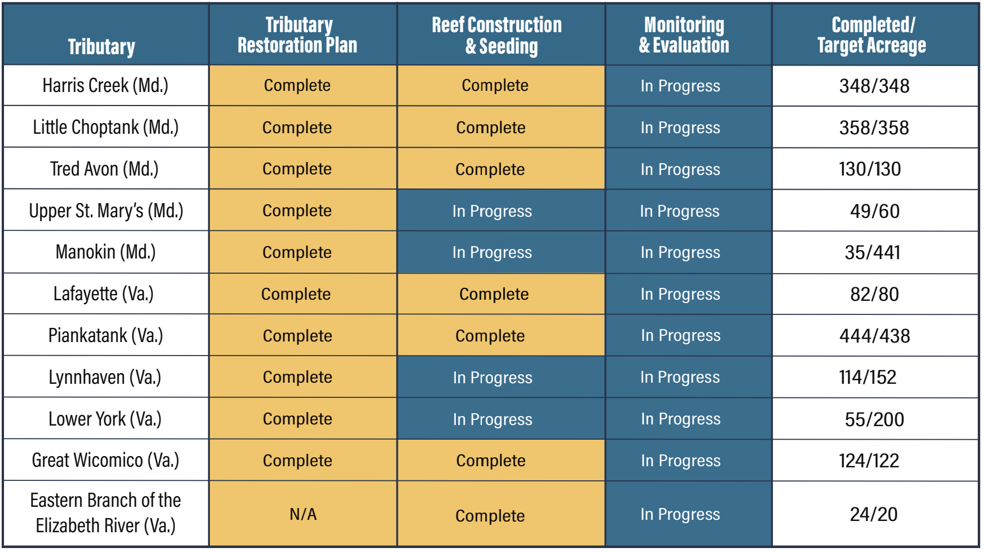
Outcome updates
Oysters: As of 2021, oyster habitat has been restored in six of the 10 originally selected tributaries.

Slide 10
Partnership achievements
Workshops to accelerate Forest Buffer and Wetlands Outcomes (Page 4)
New “Very-High Resolution Land-Use Land-Cover” dataset (Page 5)
Report on growth of Chesapeake Bay Program monitoring program (page 5)
Accelerated Conservation and Restoration GIS tool (Page 6)
Completed assessment on Maryland watersheds (page 7)
Progress on the partnership’s DEIJ Plan (Page 7)
Investments for the Bay (page 7)
Launch of “Chesapeake Behavior Change” website (page 8)
Annual Local Government Advisory Committee updates (page 8)
Annual Scientist and Technical Advisory Committee updates (page 8)
Engagement and education (page 8)

Slide 11
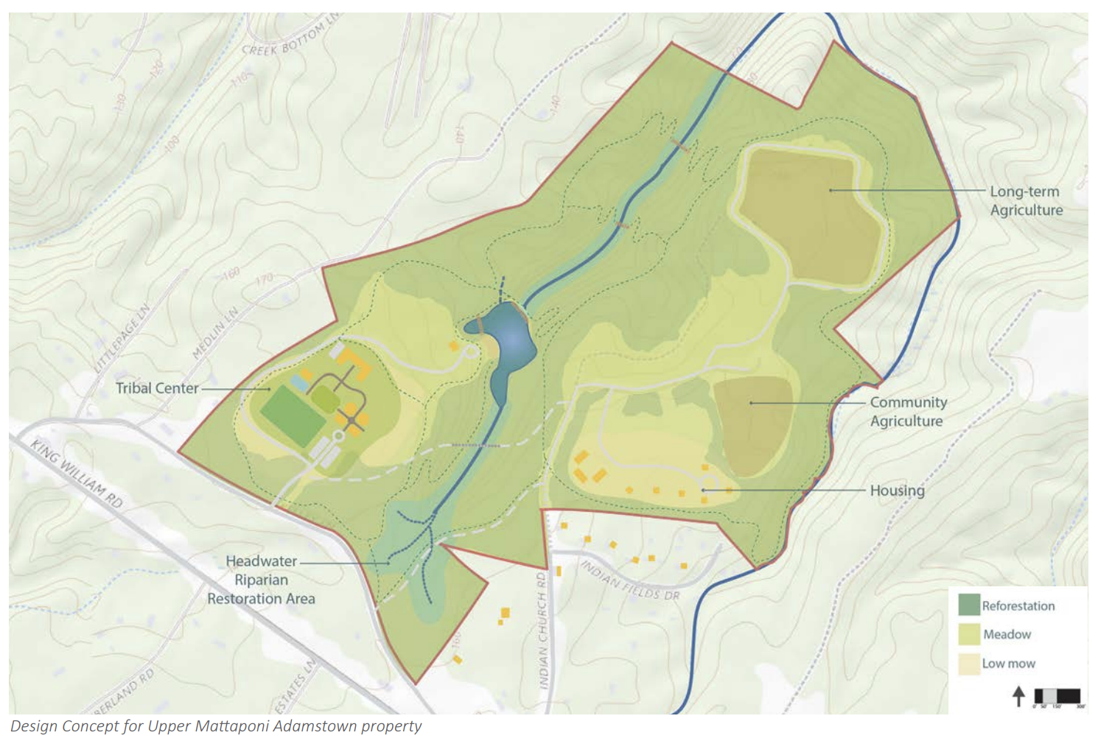
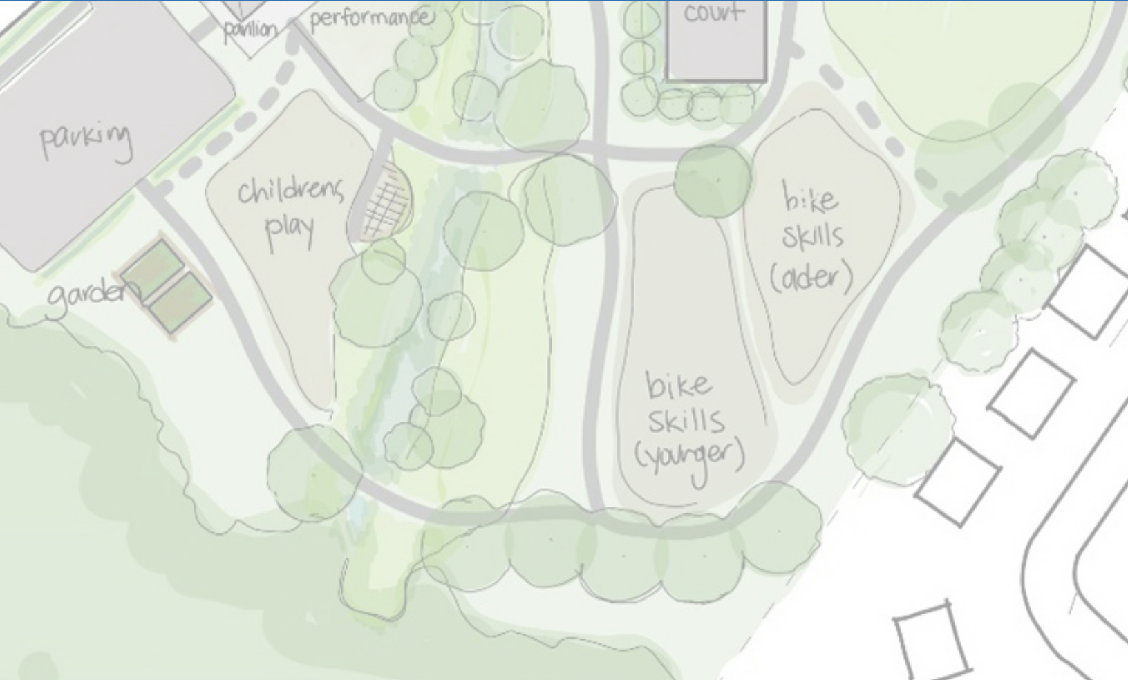
Partnership achievements
Targeted Outreach for Green Infrastructure
https://d18lev1ok5leia.cloudfront.net/chesapeakebay/TOGI-Final-Report.pdf

Slide 12
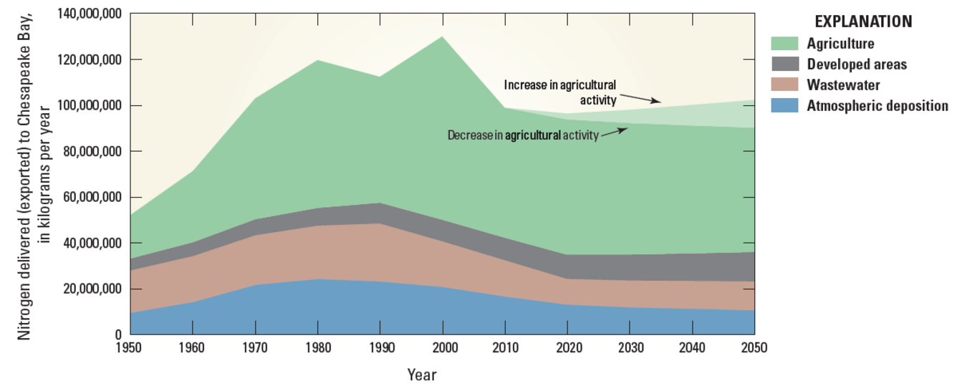
Partnership achievements
Nitrogen in the Chesapeake Bay Watershed—A Century of Change
www.usgs.gov/centers/chesapeake-bay-activities/science/greatest-opportunities-future-nitrogen-reductions

Slide 13
Outcome attainability
On-Course
Off-Course
Uncertain
Blue Crab
Abundance Oysters
Fish Passage
Protected Lands
Public Access Site Development
Fish Habitat
Forage Fish
Toxic Contaminants Research
Land Use Options Evaluation
Land Use Methods and Metrics
Sustainable Schools
Brook Trout
Forest Buffers
Submerged Aquatic Vegetation Tree Canopy
Wetlands
Black Duck
2025 Watershed Implementation Plans
Diversity Water Quality Standards Attainments & Monitoring
Toxic Contaminants Policy and Prevention
Climate Adaptation
Stream Health
Healthy Watersheds
Local Leadership Citizen Stewardship
Climate Monitoring and Assessment
Environmental Literacy Planning
Student MWEEs
Completed: Blue Crab Management; 2017 Watershed Implementation Plans

Slide 14
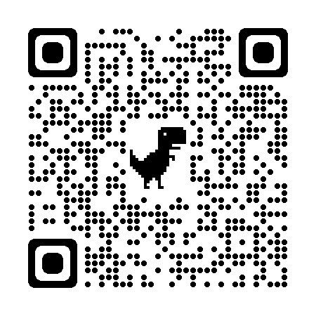
Questions?
jsolyst@chesapeakebay.net

