Slide 1
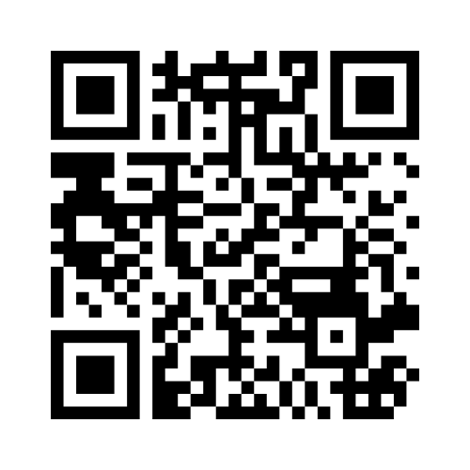
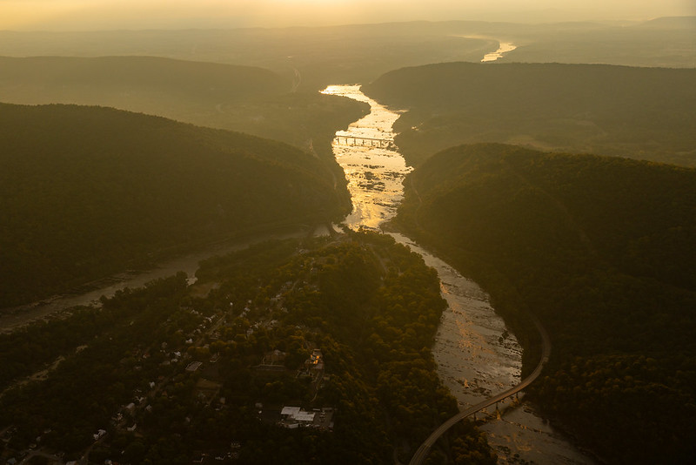
Good Morning! We will get started at 9:05
While we wait:
Please take a few minutes to answer the three questions in the Mentimeter poll:
Join at www.menti.com | Use code 56 91 75 4
The sun rises over Harpers Ferry, W.Va., on Sept. 4, 2023. The Shenandoah River, right, joins the Potomac just downstream of the National Historical Park. (Photo by Marielle Scott/Chesapeake Bay Program with aerial support by Southwings)
Notes:
Goals of mentimeter exercise:
Icebreaker
Understand the audience make-up
Learn audience goals
Questions
Open Ended Question: What is your favorite water-related song? (Kaylyn: Islands in the Stream)
Word cloud: Where do you live (CBW states/jurisdictions, other)?
Open Ended Question: What are your goals for this session?

Slide 2
Water Quality Status and Trends Resources
October 19, 2024
Chesapeake Watershed Forum
This information is preliminary and is subject to revision. It is being provided to meet the need for timely best science. The information is provided on the condition that neither the U.S. Geological Survey nor the U.S. Government shall be held liable for any damages resulting from the authorized or unauthorized use of the information.

Slide 3
Introductions
Tool #2: Tributary Summary Story Maps
Chesapeake Bay Program (CBP) 101
Hands-On Activity
Tool #1: Chesapeake Bay Watershed Data Dashboard
De-Brief, Feedback, & Wrap Up

Slide 4
Introductions
1

Slide 5
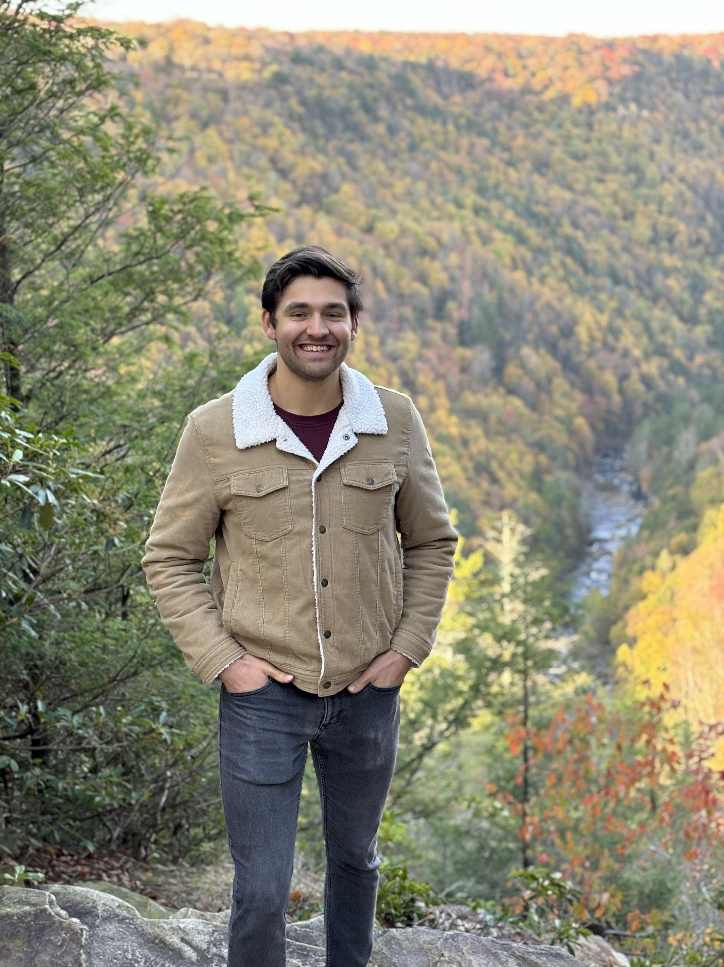
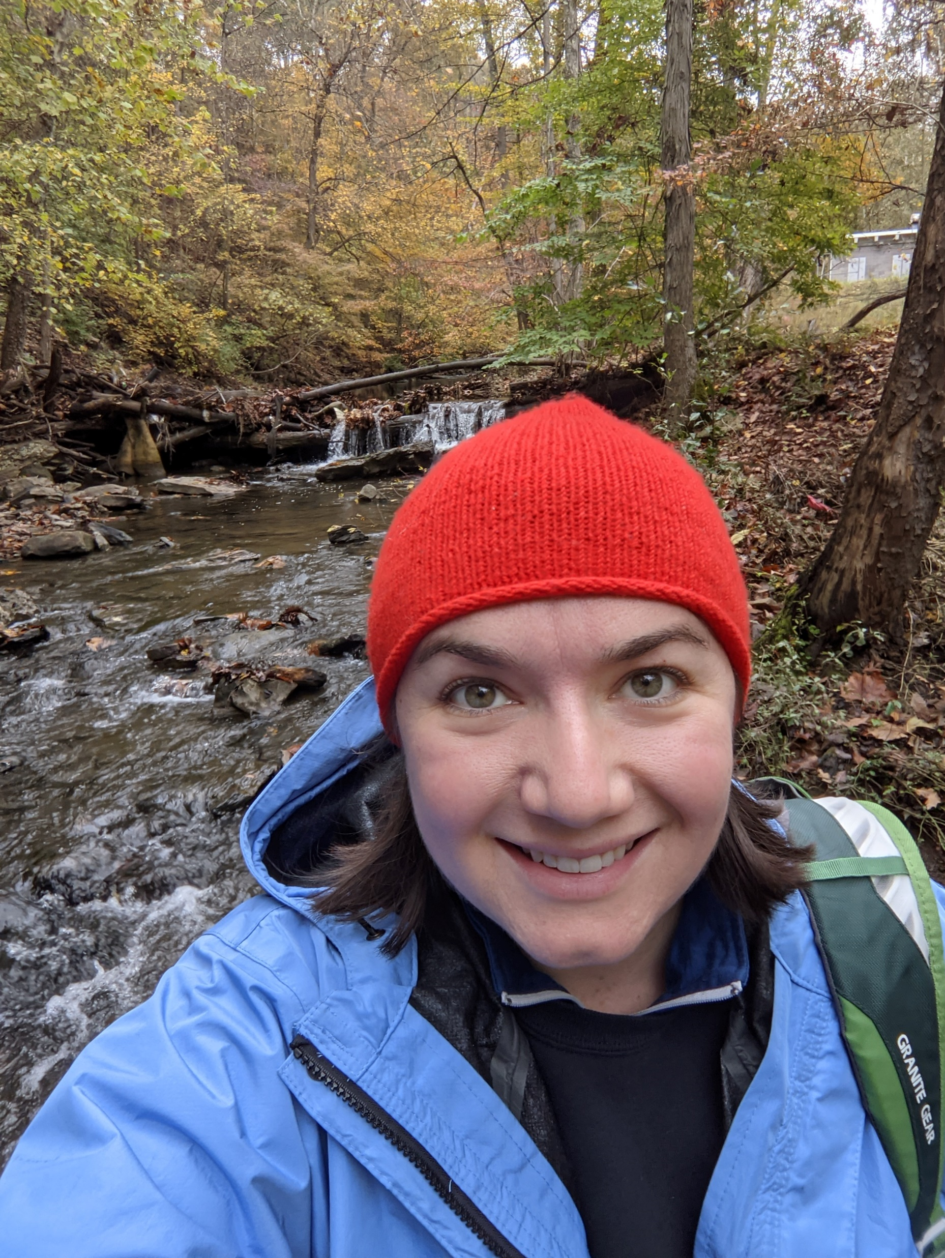
Speakers
Alex Gunnerson
Geographer
USGS at Chesapeake Bay Program
Kaylyn Gootman, PhD
Integrated Analysis Coordinator
US EPA at Chesapeake Bay Program

Slide 6
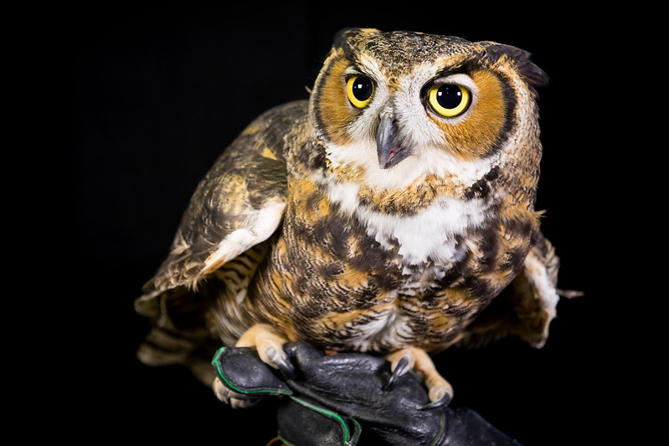
Let’s hear from you!
“Hooooo” is here today?
A non-releasable great horned owl lives in an aviary at Tuckahoe State Park in Caroline County, Md., on Jan. 17, 2018. Several such raptors, or birds of prey, travel throughout Maryland as part of the park's Scales and Tales educational program. (Photo by Will Parson/Chesapeake Bay Program)
Notes:
Go to mentimeter results and review comments from those in attendance

Slide 7
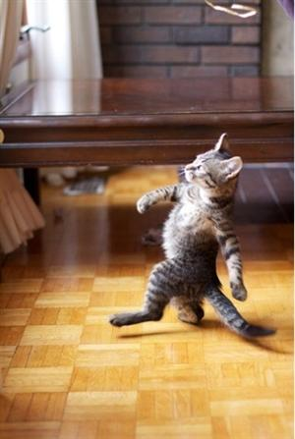
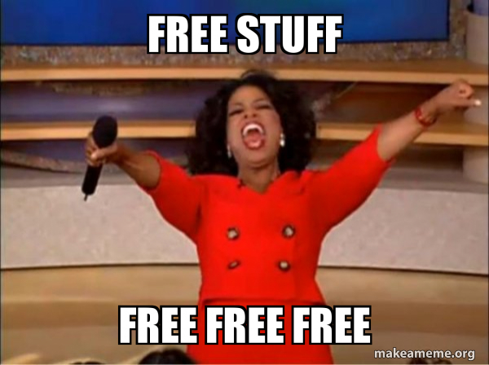
Objectives for Today’s Session
YOU IN ~90 MINUTES:
(SCIENCE)
SKILLS & CONFIDENCE
1) Introduce free, science-based, CBP partnership-developed resources available to you and your organizations
2) Walk away with the skills and confidence to leverage these tools to provide basin-wide context for your work and efforts

Slide 8
Chesapeake Bay Program 101
2

Slide 9
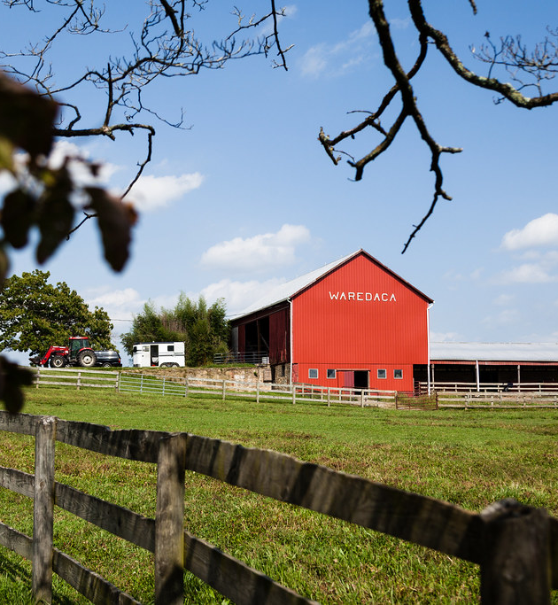
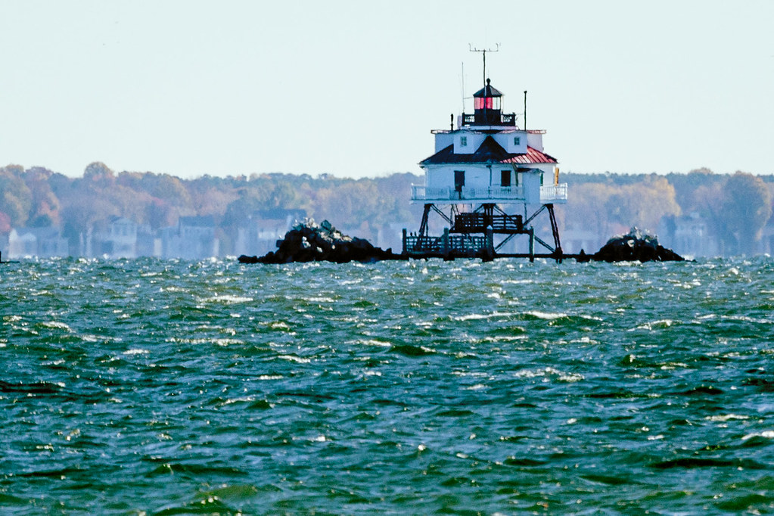
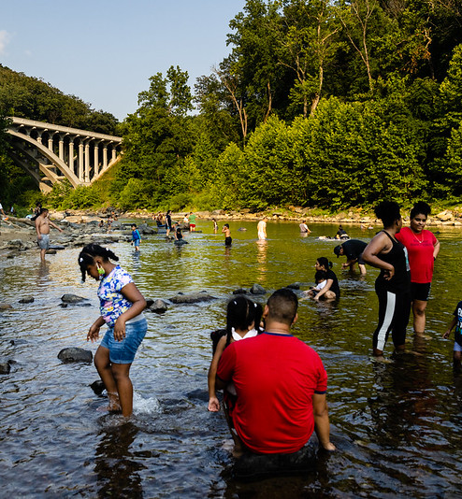
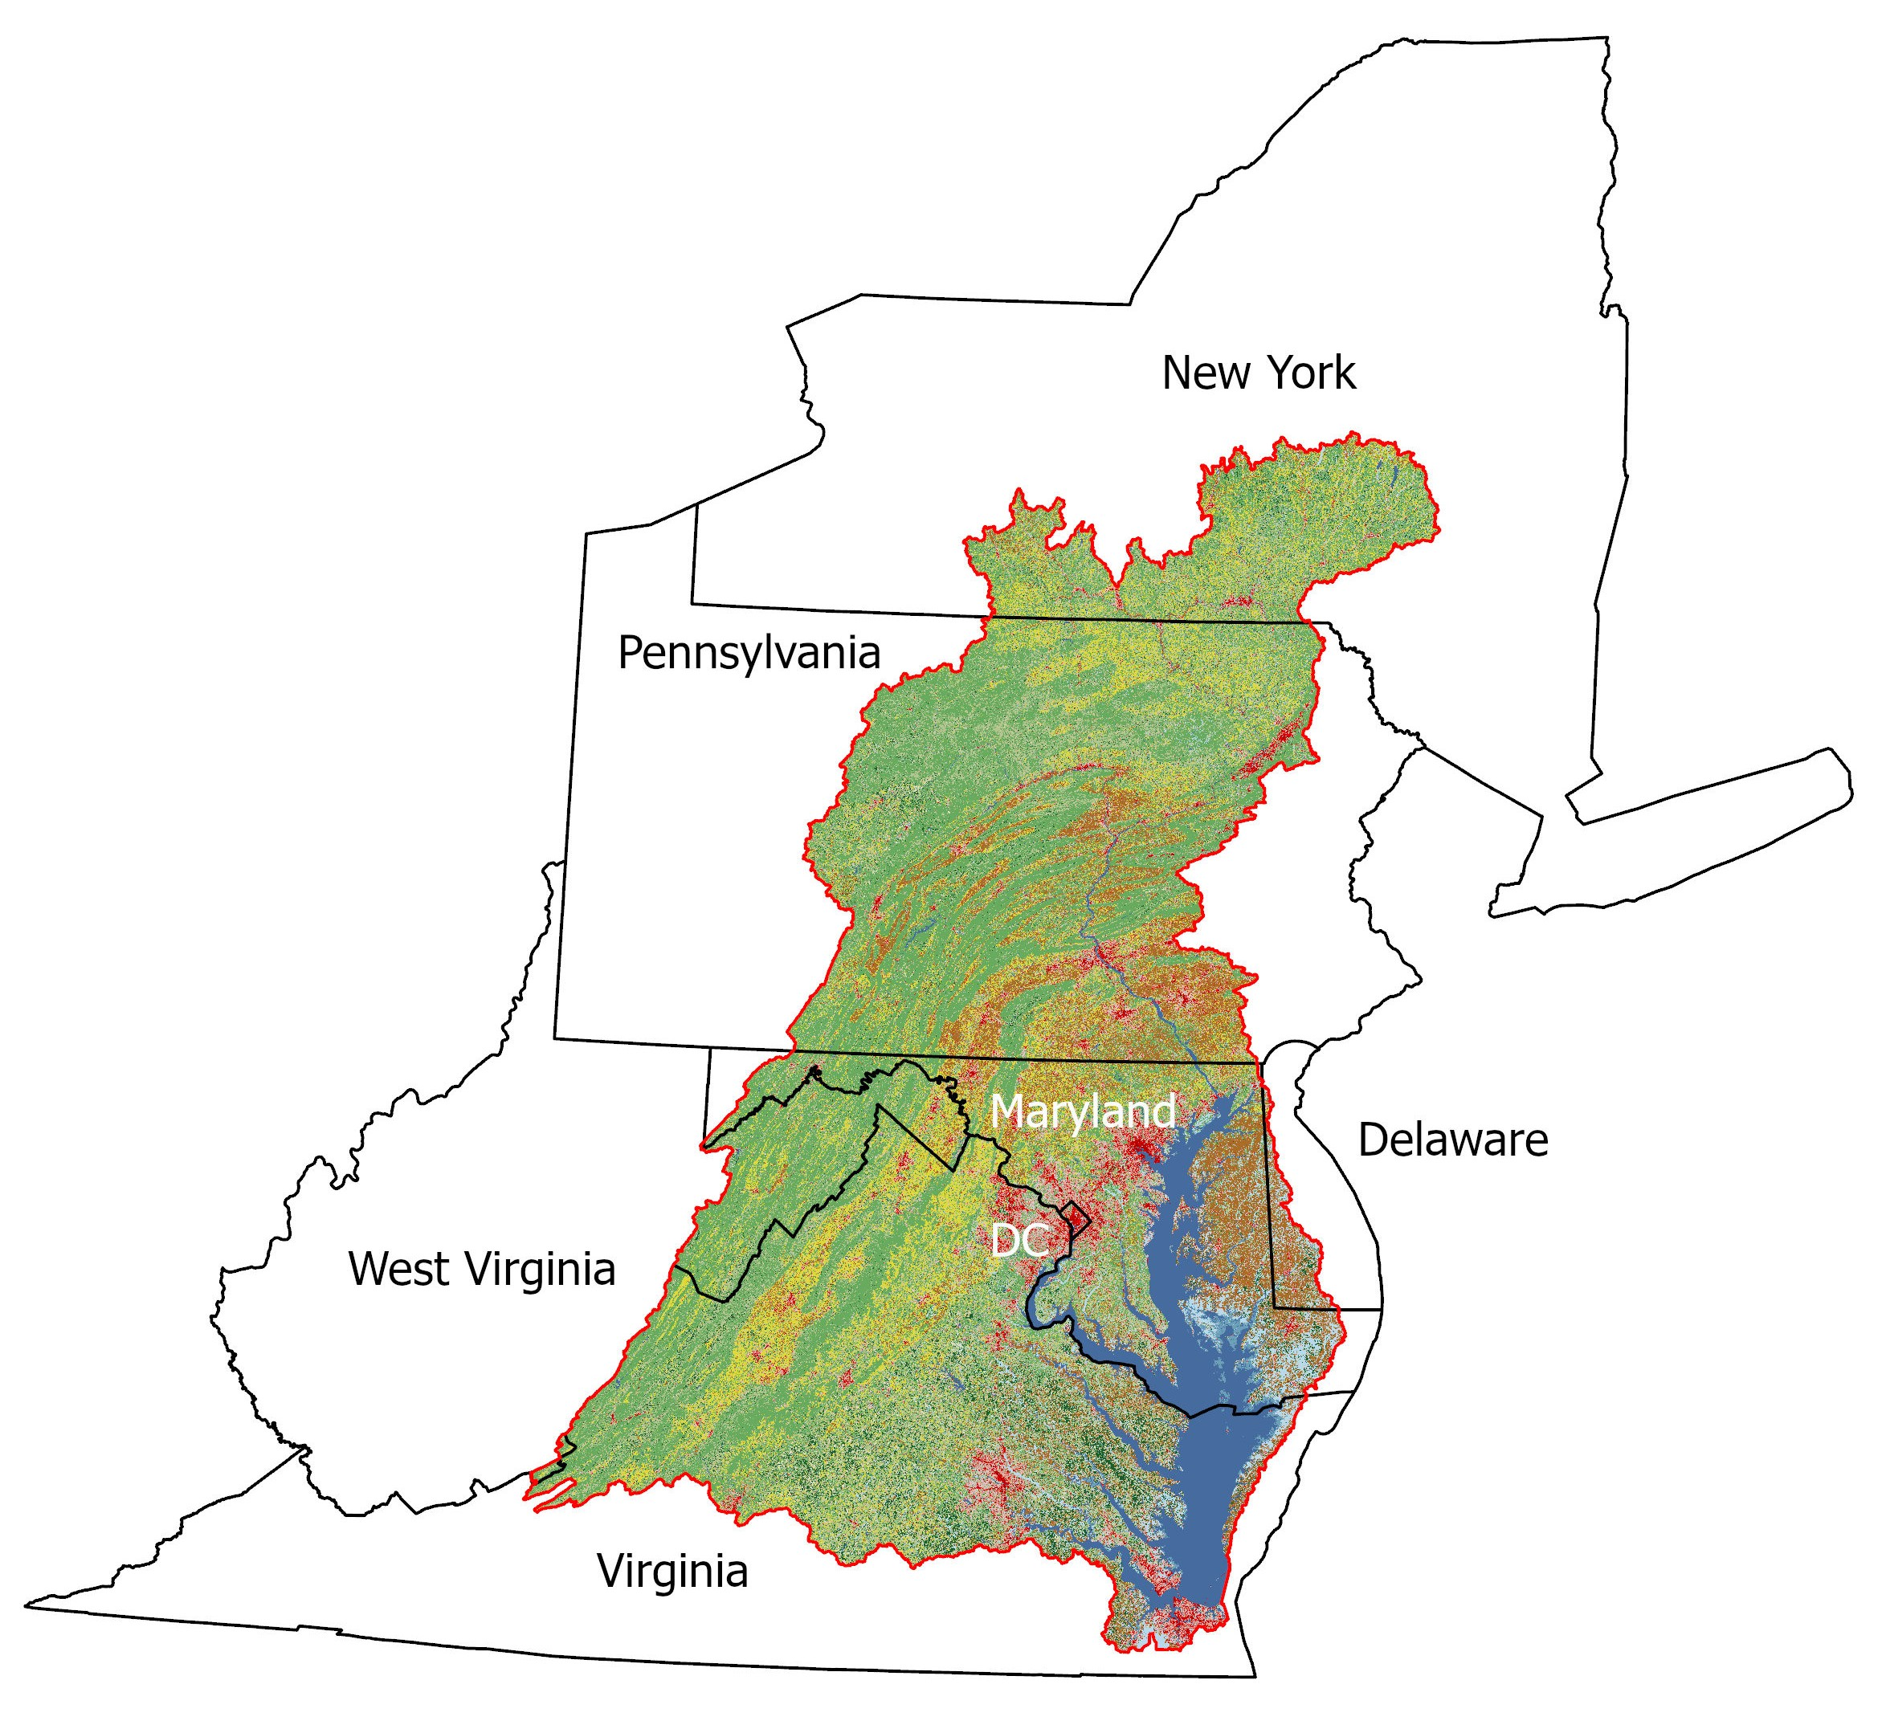
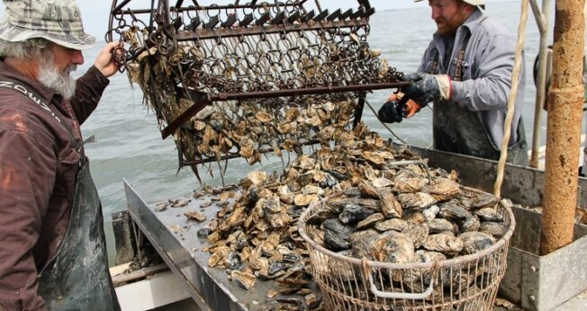
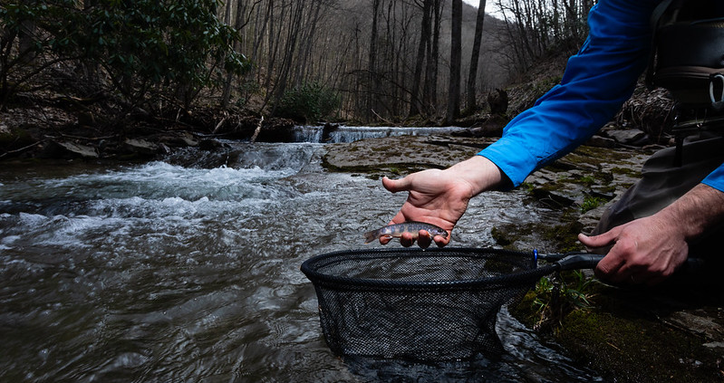
The Fabulous Chesapeake
E$10 billion in agricultural production
Largest Estuary in U.S.
18 million people
500 million pounds of seafood
64,000 Square Mile watershed
14:1 land-to-water ratio
3600 species of plants and animals
Notes:
The Bay supports more than 3,600 species of plants and animals, including several hundred species of finfish and shellfish and over 2,700 plant species.
The Chesapeake Bay watershed is home to more than 18 million people that live, play and work in the region. Ten million of them live along or near the Bay’s shores. About 150,000 new people move into the Bay watershed each year.
All representing different ethnicities, cultures, values and beliefs that make up our diverse watershed residents.
All representing different ethnicities, cultures, values and beliefs that make up our diverse watershed residents.

Slide 10
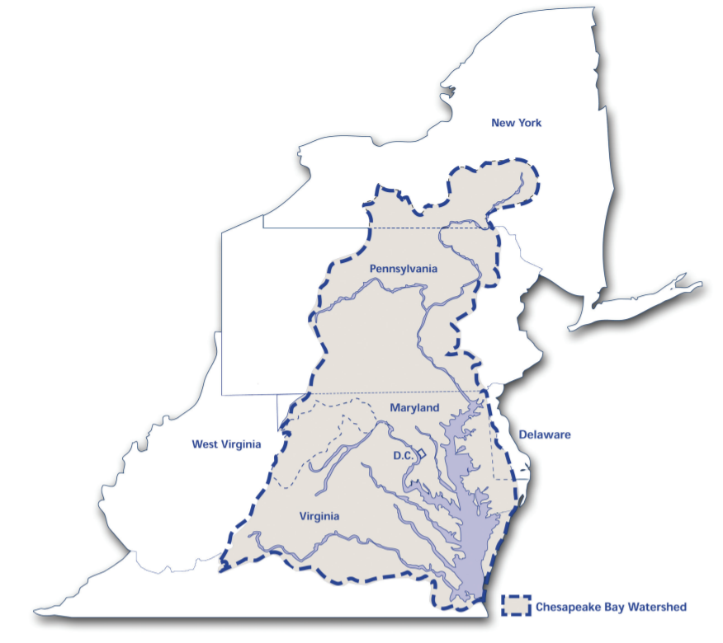
The Chesapeake Bay Program
The Chesapeake Bay Program (CBP) is a regional partnership devoted to restoring and protecting the Chesapeake Bay and its watershed.
Nearly 40 agencies and programs in Delaware, District of Columbia, Maryland, New York, Pennsylvania, Virginia, and West Virginia
19 federal agencies
Approximately 1,800 local governments, represented through the Local Government Advisory Committee
More than 20 academic institutions, represented through the Scientific and Technical Advisory Committee
More than 60 non-governmental organizations, including businesses, non-profits and advocacy groups.
Notes:
These initial research findings led to the formation of the Chesapeake Bay Program. The original Chesapeake Bay Agreement was a simple pledge signed in 1983 that recognized that a cooperative approach was necessary to address the Bay’s pollution problems.
The signatories of the Agreement of 1983 became the Chesapeake Executive Council:
the governors of Maryland, Pennsylvania and Virginia,
the mayor of the District of Columbia,
the administrator of the U.S. Environmental Protection Agency (EPA), and
the chair of the Chesapeake Bay Commission.
Since that original agreement in 1983 there have been several agreements and directives signed by the Executive Council to advance bay restoration and protection.
Common thread over time = lots of folks have a joint goal over many years of restoring the Bay in various ways
With each iteration of the Bay Agreement, and generally over time, partnership has tried to
bring in more partners
bring in more information and (3) get more specific/detailed information
add more goals and outcomes and (5) make the goals/outcomes more specific

Slide 11
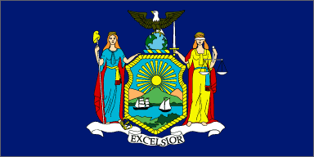
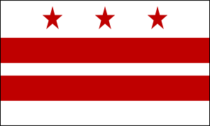
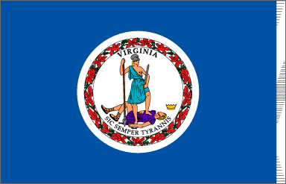
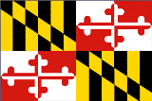



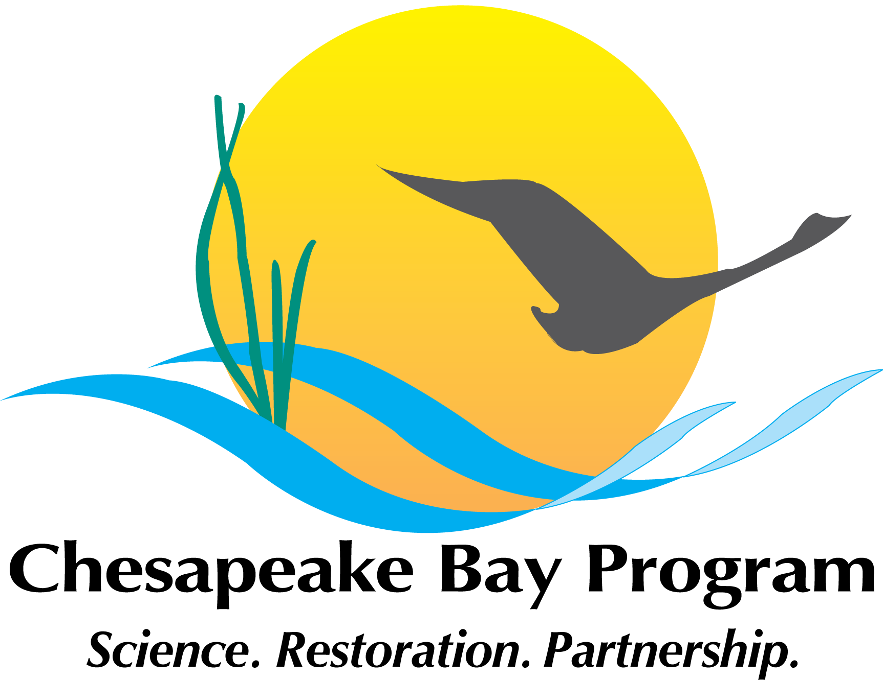


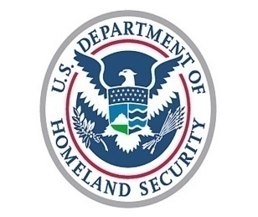
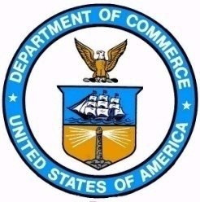
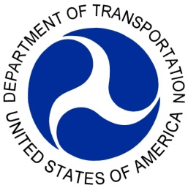

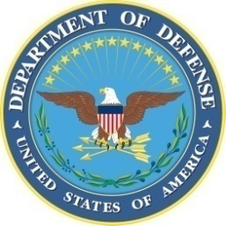

NY
DC
VA
MD
PA
DE
WV
Bay Commission
Federal Partners
A partnership of all the major players in the Chesapeake region, working collaboratively on science, policy and restoration efforts.
11

Slide 12
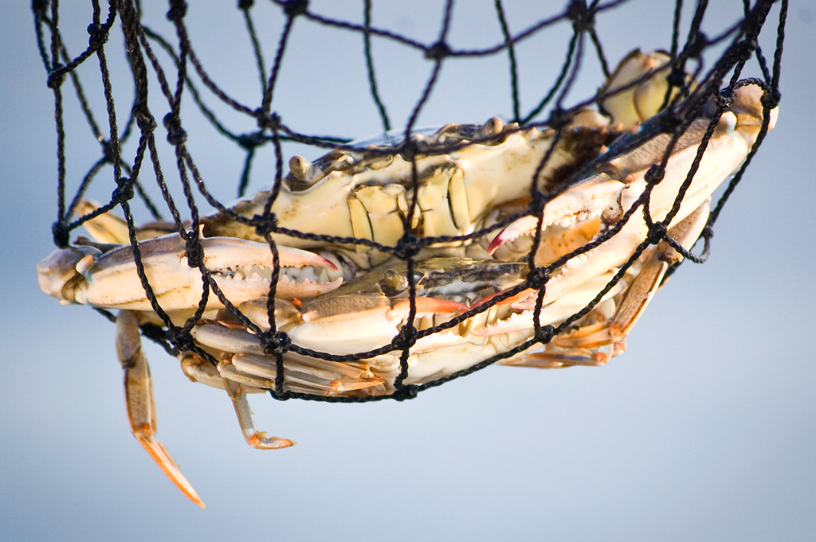
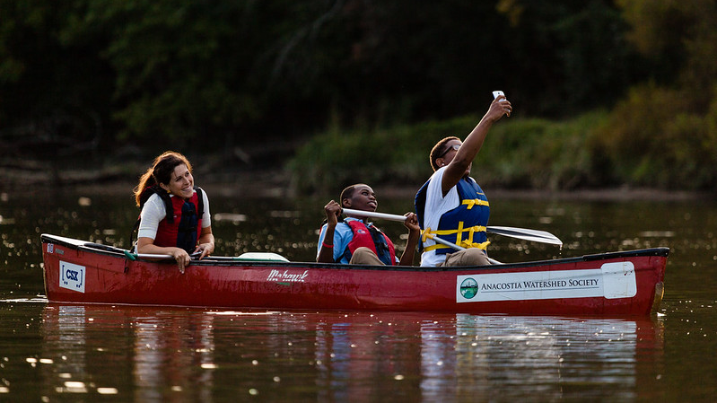
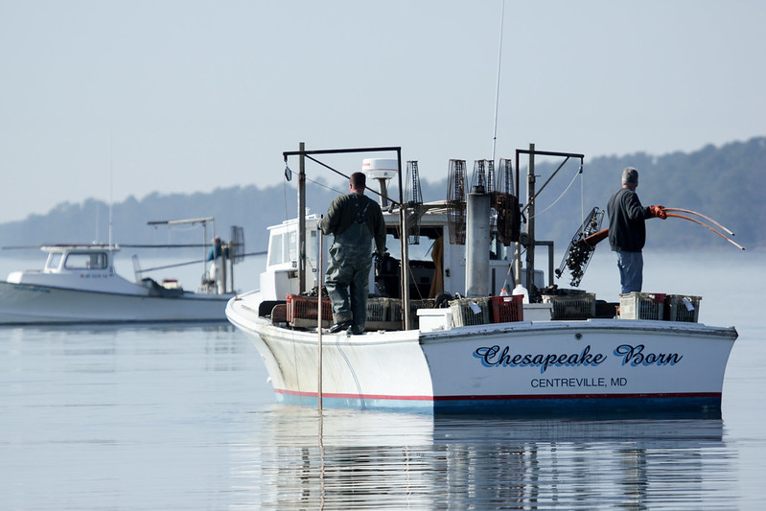
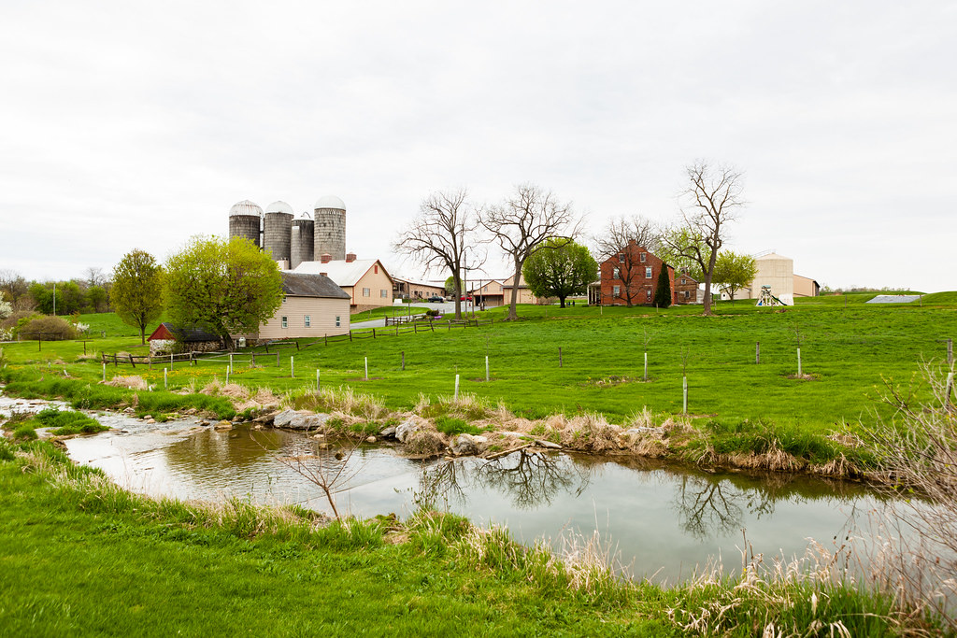

Slide 13
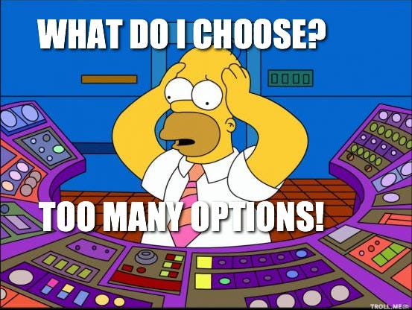
Bay Program Decision-Support Tools
The CBP frequently uses computer-based tools to identify and prioritize conservation and restoration activities.
Some support decision-making groups in the partnership (e.g., Goal Implementation Teams).
Many are broadly applicable to a range of partner organizations and environmental and socioeconomic goals.
We are going to focus on two today!

Slide 14
Tool #1: Chesapeake Bay (CB) Watershed Data Dashboard
3

Slide 15
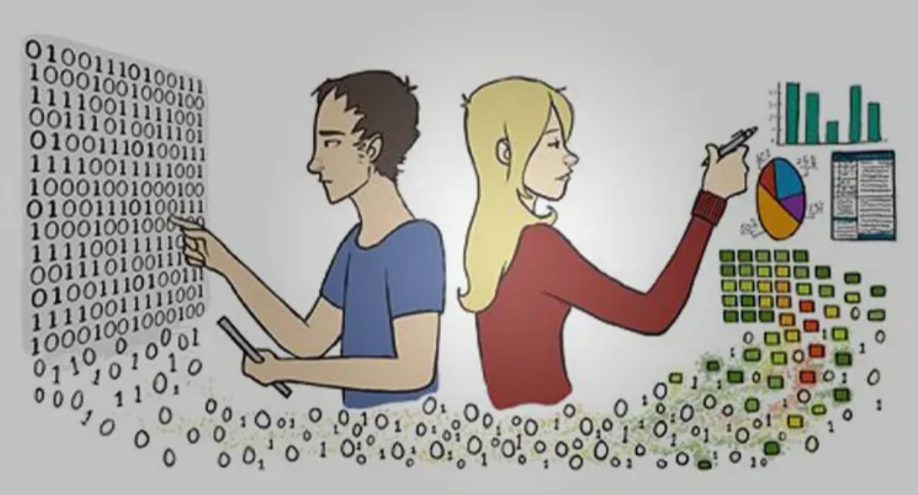
Chesapeake Bay Watershed Data Dashboard
The “Data Dashboard” is an online tool that provides access to and visualization of a large amount of scientific data and technical information to help guide water quality and watershed planning efforts.

Slide 16
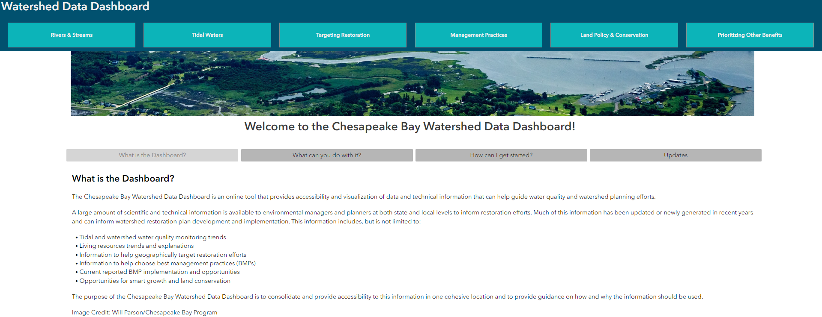
Chesapeake Bay Watershed Data Dashboard

Slide 17
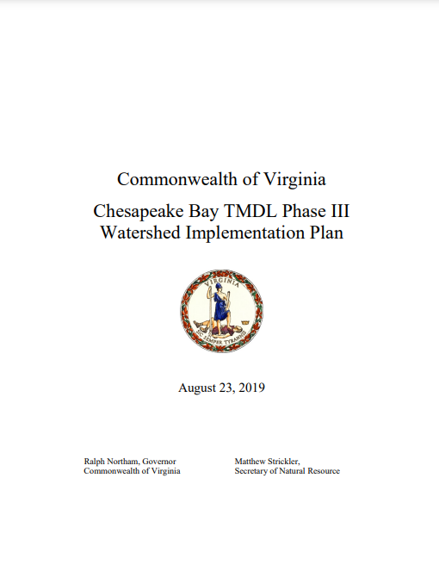
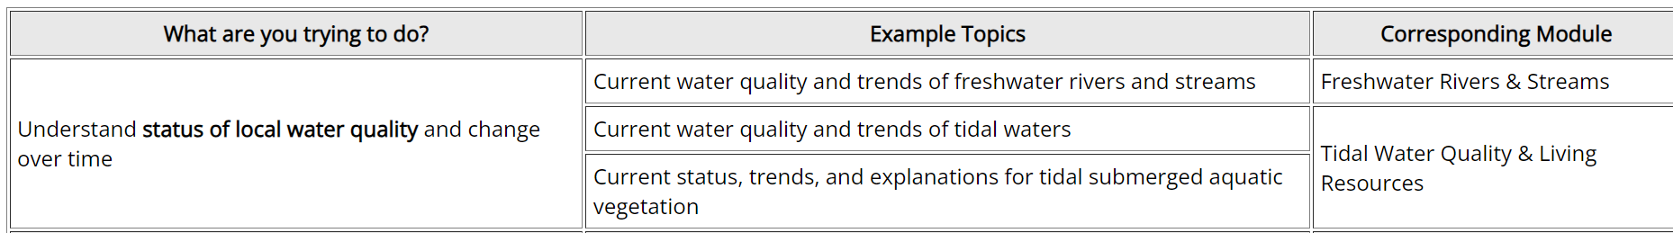
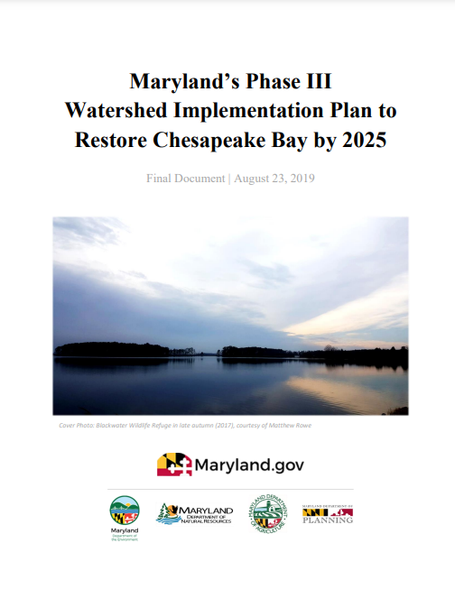
Chesapeake Bay Watershed Data Dashboard
Informs restoration efforts for environmental managers and planners at both state and local levels.
Provides guidance on how and why the information should be used.
Assists with watershed implementation plan (WIP) development and execution.

Slide 18
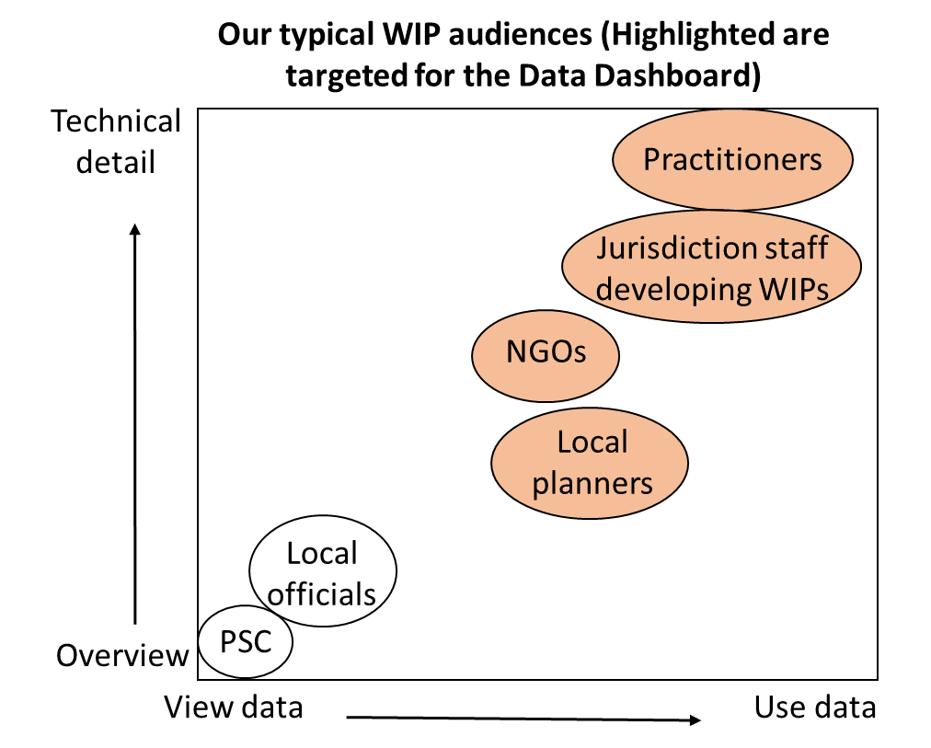
Targeted Audiences
Anyone seeking information that can aid in their planning process for water quality restoration.
Possible users include:
State agency staff
NGO partners
Local planners (e.g. municipality level, soil conservation district level, county level, etc.)
Watershed organizations

Slide 19
Tool #2: Tributary Summary Story Maps
4

Slide 20
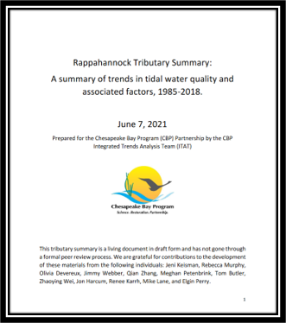
Tool #2: Tributary Summary Story Maps
The CBP and its partners compiled tributary basin summaries for 12 major tributary groups in the CBW

Slide 21
Tributary Summaries Answer these Q's:
1) How has tidal water quality changed over time?
2) How and which factors may influence water quality change over time?
3) How do observed changes in aquatic conditions connect to driving factors?

Slide 22
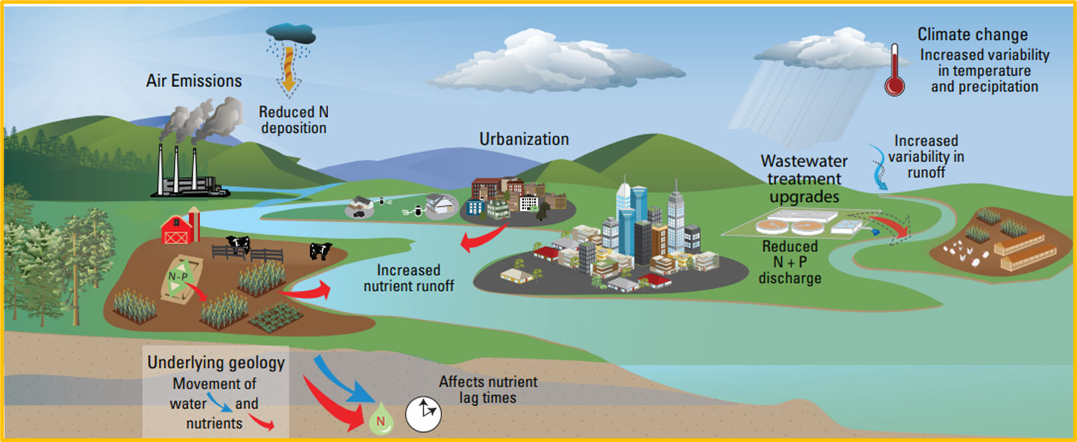
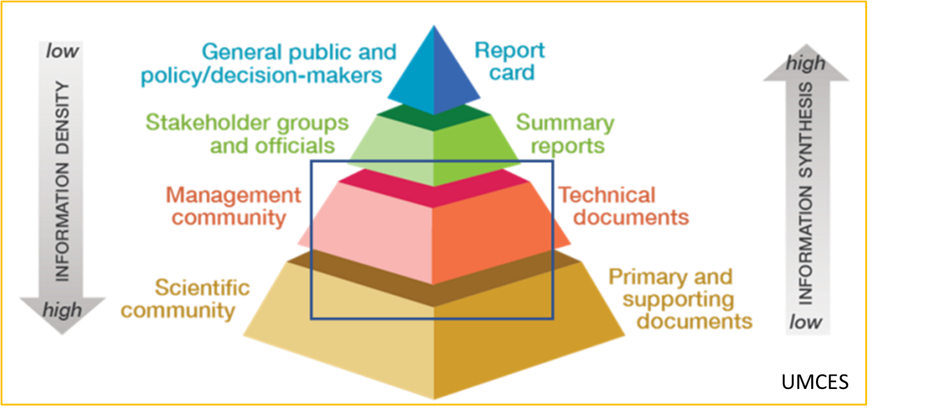
Synthesizing and Communicating Science:
Access relevant information in one centralized location
Understand trends in environmental conditions and the factors influencing that change
Gain basin-wide context to inform decision making and research
Notes:
The tributary summaries synthesize science and communicate these points:

Slide 23
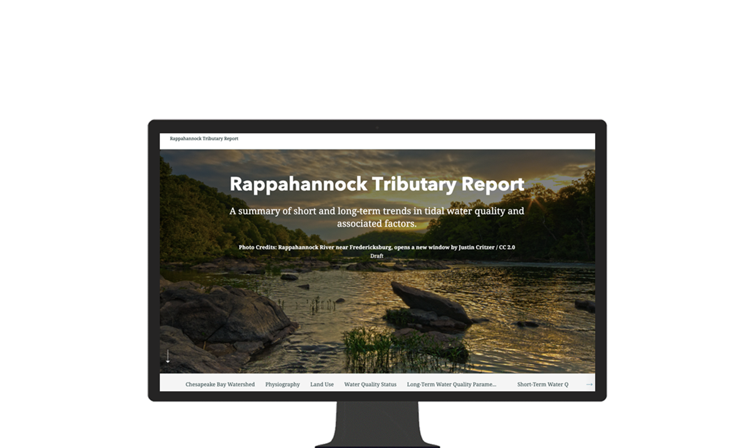
Present the information in a different way

Slide 24

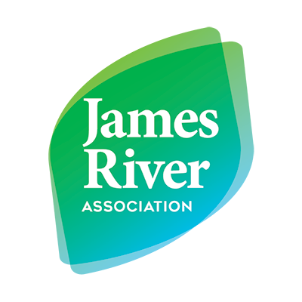
DESIGN FOR DESIGN TOGETHER

Slide 25
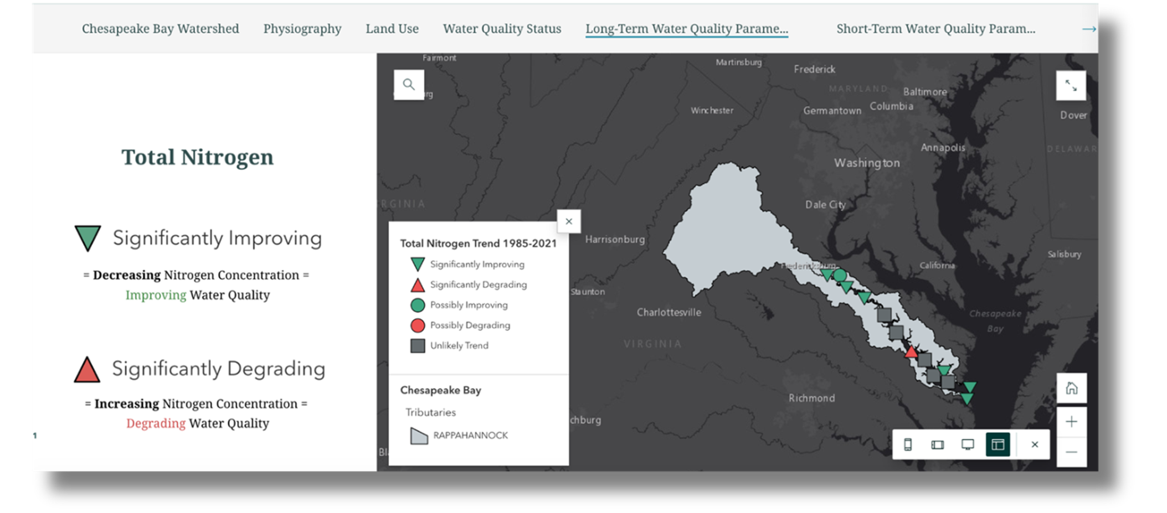
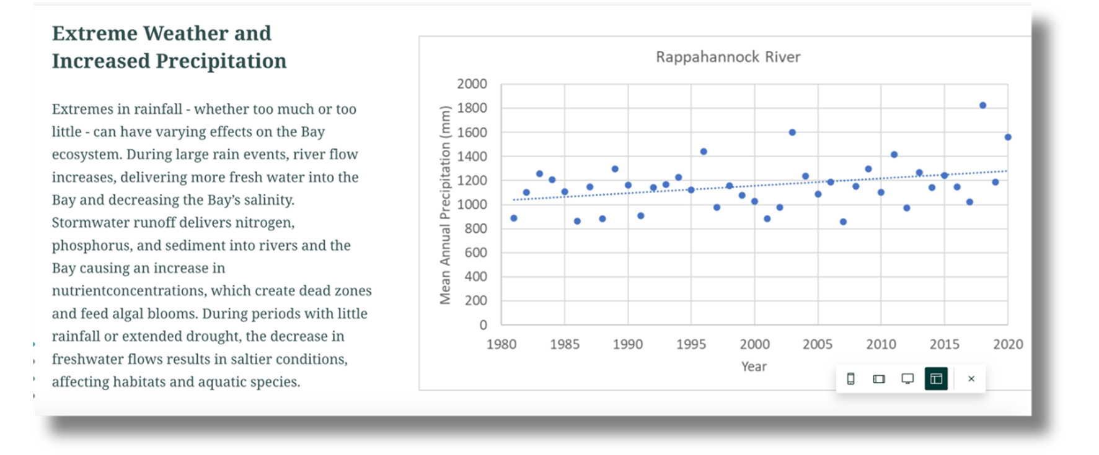
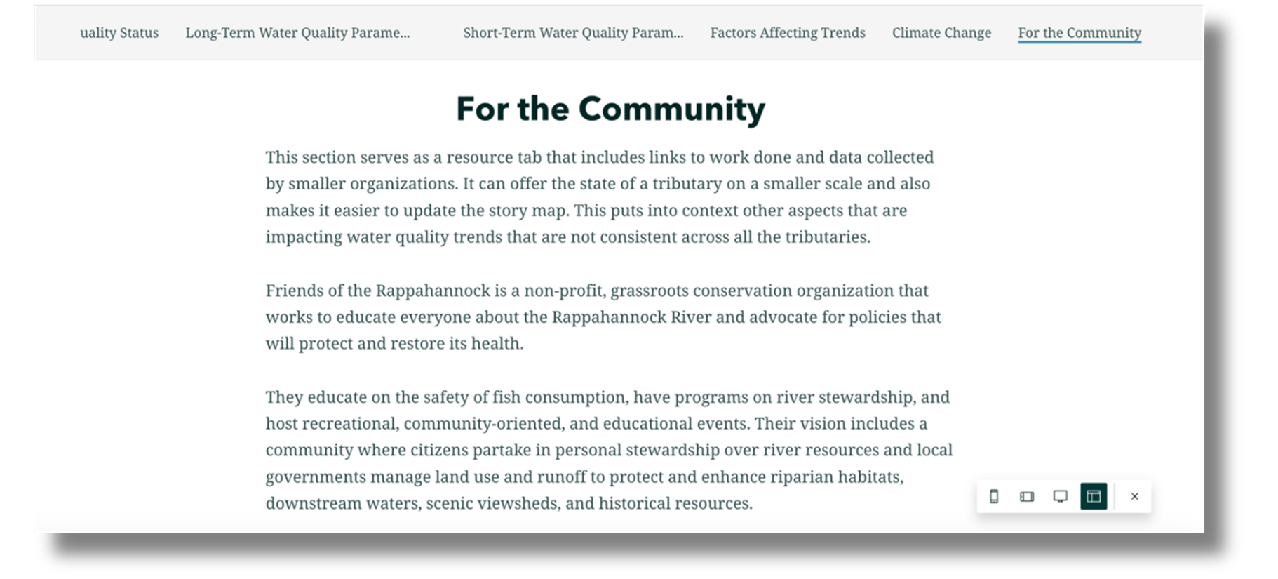

Slide 26
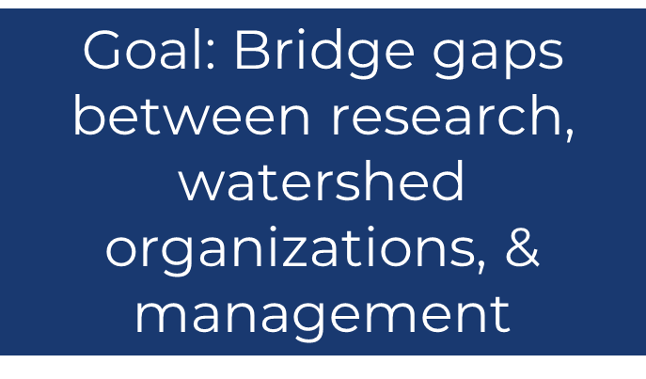

Slide 27
What can you do with these tools?
Answer questions related to water-quality over time.
How have landscape factors in my watershed changed?
What clues might explain observed change (or lack of change)?
What should I target to turn a degrading trend around or maintain improvements?
Inform decision-making.
Has my river been getting better or worse?
Provide basin-wide context for your work.
Target restoration efforts geographically, by sector, or by practice.
Support Chesapeake Assessment Scenario Tool (CAST) scenario development.
Build local watershed stories to engage with stakeholders.
Outreach and communication of water quality information.
Supporting evidence for advocacy work and grant applications.

Slide 28
What can you do with these tools?
Answer questions related to water-quality over time.
How have landscape factors in my watershed changed?
What clues might explain observed change (or lack of change)?
What should I target to turn a degrading trend around or maintain improvements?
Inform decision-making.
Has my river been getting better or worse?
Provide basin-wide context for your work.
Target restoration efforts geographically, by sector, or by practice.
Support Chesapeake Assessment Scenario Tool (CAST) scenario development.
Build local watershed stories to engage with stakeholders.
Outreach and communication of water quality information.
Supporting evidence for advocacy work and grant applications.

Slide 29
What can you do with these tools?
Answer questions related to water-quality over time.
How have landscape factors in my watershed changed?
What clues might explain observed change (or lack of change)?
What should I target to turn a degrading trend around or maintain improvements?
Inform decision-making.
Has my river been getting better or worse?
Provide basin-wide context for your work.
Target restoration efforts geographically, by sector, or by practice.
Support Chesapeake Assessment Scenario Tool (CAST) scenario development.
Build local watershed stories to engage with stakeholders.
Outreach and communication of water quality information.
Supporting evidence for advocacy work and grant applications.

Slide 30
What can you do with these tools?
Answer questions related to water-quality over time.
How have landscape factors in my watershed changed?
What clues might explain observed change (or lack of change)?
What should I target to turn a degrading trend around or maintain improvements?
Inform decision-making.
Has my river been getting better or worse?
Provide basin-wide context for your work.
Target restoration efforts geographically, by sector, or by practice.
Support Chesapeake Assessment Scenario Tool (CAST) scenario development.
Build local watershed stories to engage with stakeholders.
Outreach and communication of water quality information.
Supporting evidence for advocacy work and grant applications.

Slide 31
Hands-On Activity
5

Slide 32
Hands-On Activity
5a
Case Study #1: Use decision support tools to target conservation and restoration activities

Slide 33
Case Study #1: Targeting Conservation and Restoration Activities
Outcome - Participants will learn how to:
Leverage the watershed data dashboard and tributary summary story maps to identify target watersheds for conservation and/or restoration activities.
Use these tools to provide justification in applications for funding.

Slide 34
Case Study #1: Targeting Conservation and Restoration Activities
Case Study #1 Background:
Your role: grant writer at an environmental non-profit in the Potomac watershed
Your goal: identify a threatened sub-watershed within the Potomac River Basin where your organization can implement riparian forest buffer plantings for maximum benefit to the local community
Your task: identify a key sub-watershed for restoration and justify your selection to use in grant funding applications
Notes:
You are a grant writer for an environmental non-profit in the Potomac watershed. Your team is seeking to identify threatened sub-watersheds within the Potomac River Basin where your organization can implement riparian forest buffer plantings for maximum benefit to the local community. As part of the requirements for the grant you are applying to, you need to provide documentation explaining why these areas were selected for restoration. Your task is to identify three key sub-watersheds for restoration and justify your selection.

Slide 35
Case Study #1: Targeting Conservation and Restoration Activities
Live Demonstration
Links:
Potomac Tributary Summary Story Map:
https://storymaps.arcgis.com/stories/f29c5aebf63c475da9162a15af8467c5
Watershed Data Dashboard:
https://gis.chesapeakebay.net/wdd
Notes:
You are a grant writer for an environmental non-profit in the Potomac watershed. Your team is seeking to identify threatened sub-watersheds within the Potomac River Basin where your organization can implement riparian forest buffer plantings for maximum benefit to the local community. As part of the requirements for the grant you are applying to, you need to provide documentation explaining why these areas were selected for restoration. Your task is to identify three key sub-watersheds for restoration and justify your selection.

Slide 36
Hands-On Activity
5b
Case Study #2: Use decision support resources to support outreach and engagement activities

Slide 37
Case Study #2: Supporting Outreach and Engagement Activities
Outcome - Participants will learn how to:
Leverage the watershed data dashboard and tributary summary story maps to augment presentations and handouts to stakeholders with figures, graphics, and data.

Slide 38
Case Study #2: Supporting Outreach and Engagement Activities
Case Study #2 Background:
Your role: education and outreach specialist for an environmental non-profit in the Potomac watershed
Your goal: provide context to residents and decisionmakers about the health of their land and waters, as well as opportunities to improve environmental quality in their community
Your task: produce an outline for a presentation with information and examples of visuals you could use in this communication effort
Notes:
You are an education and outreach specialist for an environmental non-profit in the Potomac watershed. You want to provide context to residents and decisionmakers about the health of their land and waters, as well as opportunities to improve environmental quality in their community. Your task is to produce an outline for a presentation with information and examples of visuals you could use in this communication effort.

Slide 39
Case Study #2: Supporting Outreach and Engagement Activities
Live Demonstration
Links:
Tributary Summaries:
https://storymaps.arcgis.com/stories/f29c5aebf63c475da9162a15af8467c5
Watershed Data Dashboard:
https://gis.chesapeakebay.net/wdd
Notes:
You are a grant writer for an environmental non-profit in the Potomac watershed. Your team is seeking to identify threatened sub-watersheds within the Potomac River Basin where your organization can implement riparian forest buffer plantings for maximum benefit to the local community. As part of the requirements for the grant you are applying to, you need to provide documentation explaining why these areas were selected for restoration. Your task is to identify three key sub-watersheds for restoration and justify your selection.

Slide 40

Hands-On Activity
5c
*
Your Turn!
*Watershed Forum-Style!

Slide 41
Explore the tools:
Track 1: Restoration or Conservation Suitability
Identify key watersheds for your conservation or restoration activities
Track 2: Communication Materials
Utilize resources to outline communications
Track 3: Choose Your Own Adventure
Define your priorities and questions to answer using these tools and resources

Slide 42
De-Brief
6a

Slide 43
Guided Discussion Questions
Which tools/modules did you use? What was your conclusion?
What did you learn from using these resources?
How might your workflow or decision-making change with this information?

Slide 44
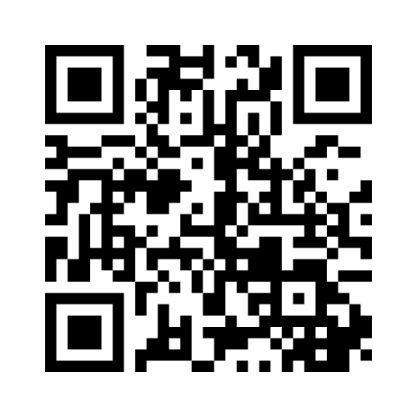
Feedback
6b
Go to www.menti.com and enter 35 58 84 69

Slide 45
Wrap-Up
6c

Slide 46
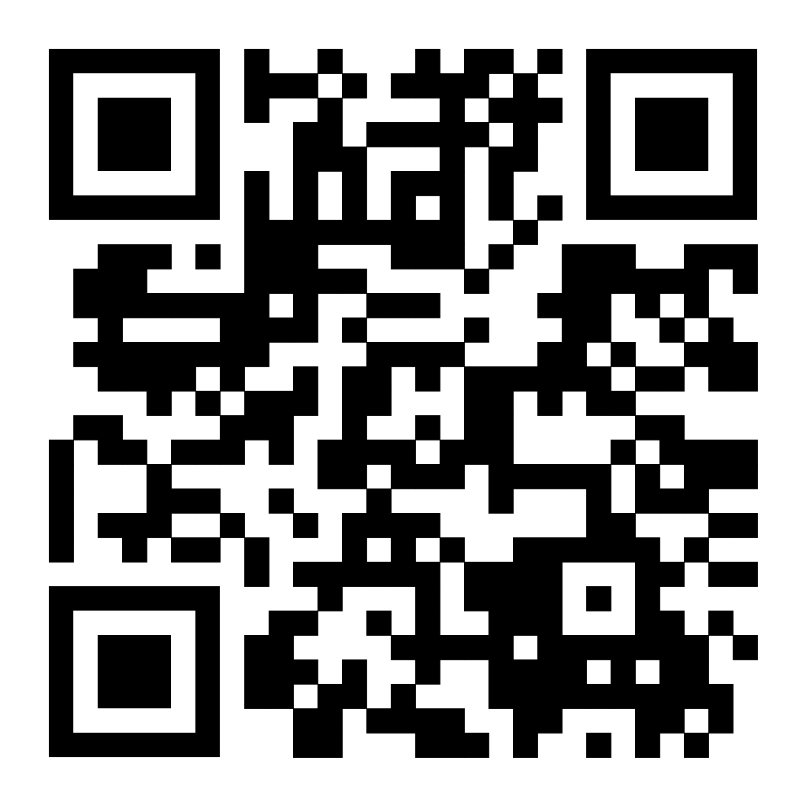
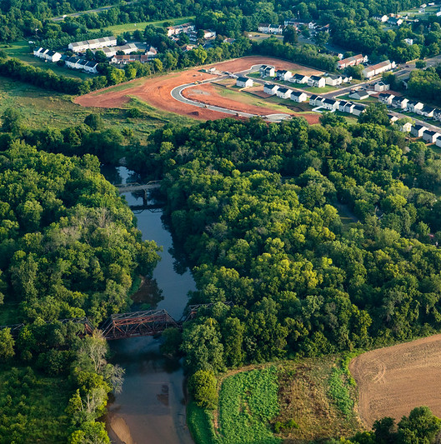
Thank You!
Scan here for access to the information we discussed today:
Alex Gunnerson, agunnerson@chesapeakebay.net
Dr. Kaylyn S. Gootman, gootman.kaylyn@epa.gov

