Slide 1

Maryland’s Progress on 2014 Chesapeake Bay Watershed Agreement
Dave Goshorn
Senior Bay Restoration Coordinator / Acting Assistant Secretary Aquatic Resources
Maryland Department of Natural Resources
Presentation to Chesapeake Bay Program’s Citizens Advisory Committee
February 24, 2023
Maryland’s Progress on Chesapeake Bay Watershed Agreement
Dave Goshorn, Senior Bay Restoration Coordinator, MD DNR
Citizen’s Advisory Committee
February 24, 2023

Slide 2
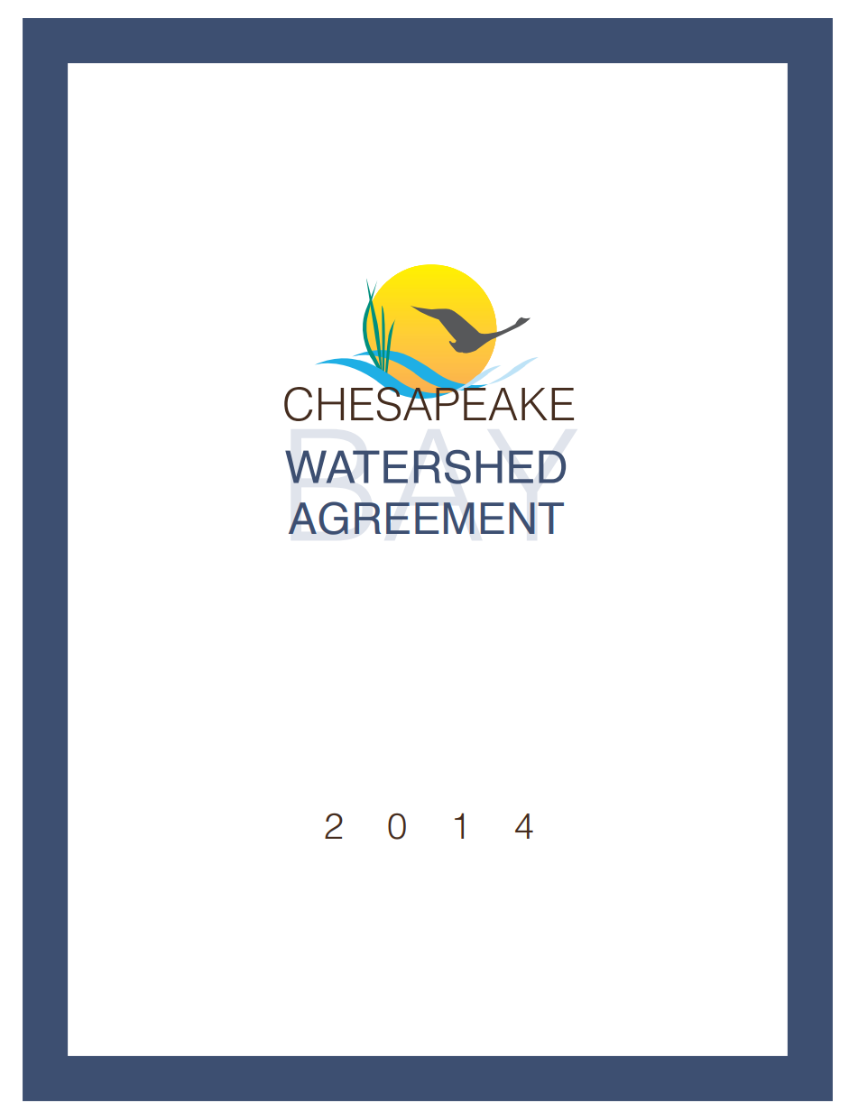
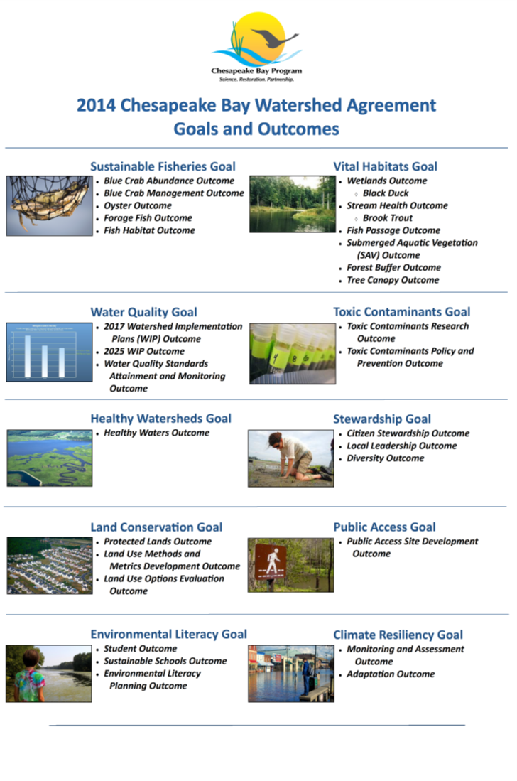
Maryland’s Progress on Chesapeake Bay Watershed Agreement
Dave Goshorn, Senior Bay Restoration Coordinator, MD DNR
Citizen’s Advisory Committee
February 24, 2023
Presentation to Maryland Bay Cabinet, March 26, 2019
Notes:
Big Picture
10 goals / 31 Outcomes
Won’t go through all 31 – just selecting a few for reasons I’ll explain

Slide 3
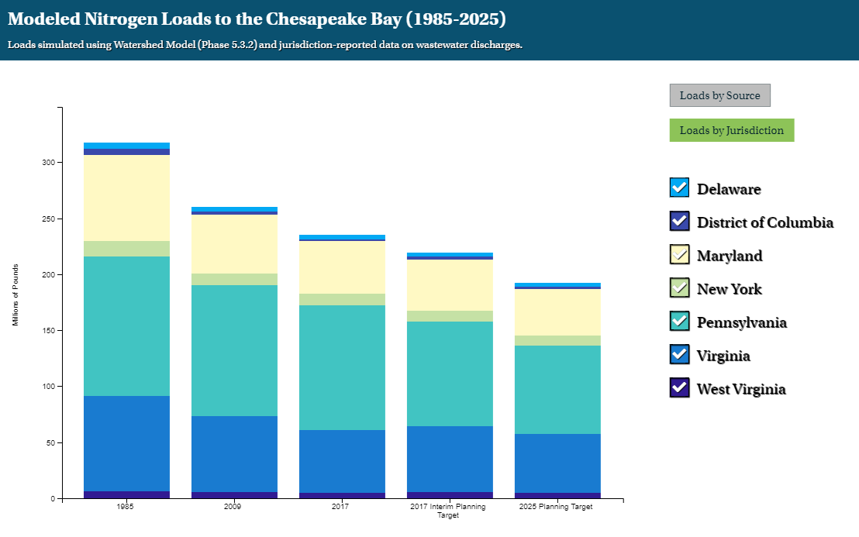
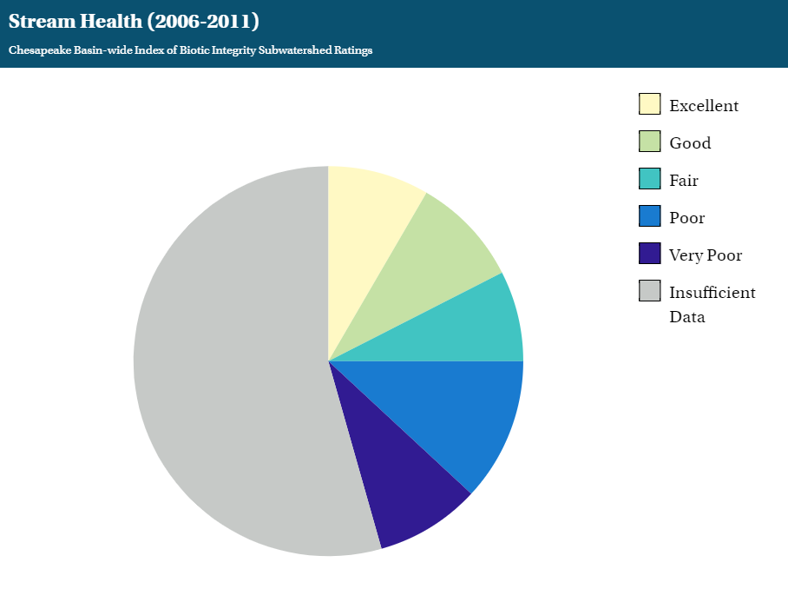


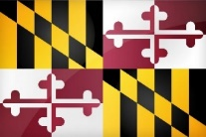
Environmental Literacy Goal
Student
Current Progress
s
2017 Survey MD consistently out-performs watershed-wide implementation of MWEEs.
Future MD progress may be impacted by lack of dedicated DOE PIN for Environmental Literacy.
Continually increase students’ age-appropriate understanding of the watershed through participation in teacher-supported, meaningful watershed educational experiences and rigorous, inquiry-based instruction, with a target of at least one meaningful watershed educational experience in elementary, middle, and high school depending on available resources.
Maryland’s Progress on Chesapeake Bay Watershed Agreement
Dave Goshorn, Senior Bay Restoration Coordinator, MD DNR
Citizen’s Advisory Committee
February 24, 2023
Presentation to Maryland Bay Cabinet, March 26, 2019
Notes:
MD Bay Cabinet
2019 Evaluation
Example Slide
Outcome language on left
Explanotory graphs/comments on right
Red/Yellow/Green of progress for CBP and MD in upper right

Slide 4
Outcome | CBP | MD |  | Outcome | CBP | MD
SUSTAINABLE FISHERIES GOAL |  |  |  | TOXIC CONTAMINANTS GOAL
Blue Crab Abundance |  |  |  | Toxic Contaminants Research
Blue Crab Management |  |  |  | Toxic Contaminants Policy & Prevention
Oyster |  |  |  | STEWARDSHIP GOAL
Forage Fish |  |  |  | Stewardship
Fish Habitat |  |  |  | Local Leadership
VITAL HABITATS GOAL |  |  |  | Diversity
Wetlands |  |  |  | LAND CONSERVATION GOAL
Black Duck |  |  |  | Protected Lands
Stream Health |  |  |  | Land Use Methods & Metrics Development
Brook Trout |  |  |  | Land Use Options
Fish Passage |  |  |  | PUBLIC ACCESS GOAL
Submerged Aquatic Vegetation |  |  |  | Public Access Site Development
Forest Buffer |  |  |  | ENVIRONMENTAL LITERACY GOAL
Tree Canopy |  |  |  | Student
WATER QUALITY GOAL |  |  |  | Sustainable Schools
2017 WIP |  |  |  | Environmental Literacy Planning
2025 WIP |  |  |  | CLIMATE RESILIENCY GOAL
Water Quality Standards & Attainment |  |  |  | Monitoring and Assessment
HEALTHY WATERSHEDS GOAL |  |  |  | Adaptation
Healthy Watersheds
Maryland’s Progress on Chesapeake Bay Watershed Agreement
Dave Goshorn, Senior Bay Restoration Coordinator, MD DNR
Citizen’s Advisory Committee
February 24, 2023
Presentation to Maryland Bay Cabinet, March 26, 2019
Notes:
You will see this slide again, but here are all 31 WITH MY JUDGEMENTS
You will see Red, yellow, green but also red/yellow and green/yellow when I couldn’t decide
All are judgement calls
Some outcomes are qualitiative – so obviously judgement calls
Some outcomes have very specific metrics by very specific due dates, but many of them are judgement calls still because:
Just because we have metrics, doesn’t mean that we have the data to know where we are relative to those metrics, and
Some have been making progress at a certain pace which has now recently changed and not clear if that recent or long-term rate will be the case for the rest of the time.

Slide 5
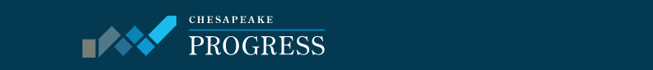
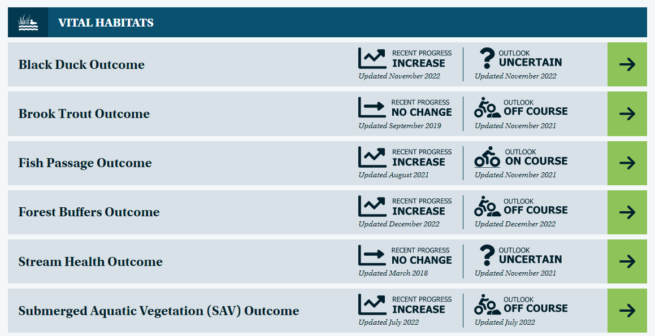
Maryland’s Progress on Chesapeake Bay Watershed Agreement
Dave Goshorn, Senior Bay Restoration Coordinator, MD DNR
Citizen’s Advisory Committee
February 24, 2023
Presentation to Maryland Bay Cabinet, March 26, 2019
Notes:
Example of ChesapeaekeProgress
Great resource for many of these
This is just for 1 goal (Vital Habitats) but have these for all 10 Goals and 31 Outcomes

Slide 6
Outcome | CBP | MD |  | Outcome | CBP | MD
SUSTAINABLE FISHERIES GOAL |  |  |  | TOXIC CONTAMINANTS GOAL
Blue Crab Abundance |  |  |  | Toxic Contaminants Research
Blue Crab Management |  |  |  | Toxic Contaminants Policy & Prevention
Oyster |  |  |  | STEWARDSHIP GOAL
Forage Fish |  |  |  | Stewardship
Fish Habitat |  |  |  | Local Leadership
VITAL HABITATS GOAL |  |  |  | Diversity
Wetlands |  |  |  | LAND CONSERVATION GOAL
Black Duck |  |  |  | Protected Lands
Stream Health |  |  |  | Land Use Methods & Metrics Development
Brook Trout |  |  |  | Land Use Options
Fish Passage |  |  |  | PUBLIC ACCESS GOAL
Submerged Aquatic Vegetation |  |  |  | Public Access Site Development
Forest Buffer |  |  |  | ENVIRONMENTAL LITERACY GOAL
Tree Canopy |  |  |  | Student
WATER QUALITY GOAL |  |  |  | Sustainable Schools
2017 WIP |  |  |  | Environmental Literacy Planning
2025 WIP |  |  |  | CLIMATE RESILIENCY GOAL
Water Quality Standards & Attainment |  |  |  | Monitoring and Assessment
HEALTHY WATERSHEDS GOAL |  |  |  | Adaptation
Healthy Watersheds
Maryland’s Progress on Chesapeake Bay Watershed Agreement
Dave Goshorn, Senior Bay Restoration Coordinator, MD DNR
Citizen’s Advisory Committee
February 24, 2023
Presentation to Maryland Bay Cabinet, March 26, 2019
Notes:
Back to this
I am going to show 5 examples (click through)

Slide 7

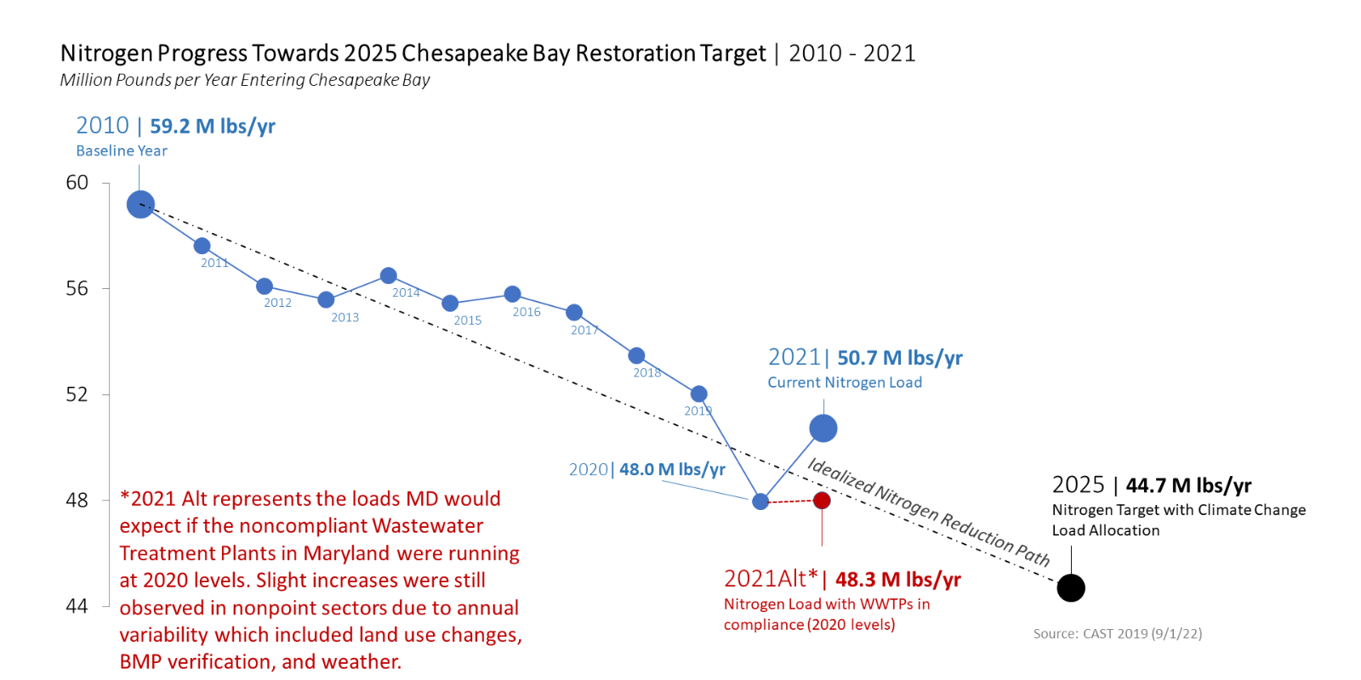
Water Quality Goal
2025 WIP
Current Progress
s
Recent issues at Back River and Patapsco WWTP’s have resulted in significant (but hopefully temporary) setbacks in progress.
By 2025, have all the practices and controls installed to achieve the Bay’s dissolved oxygen, water clarity/submerged aquatic vegetation and chlorophyll a standards as articulated in the Chesapeake Bay TMDL document.
Maryland’s Progress on Chesapeake Bay Watershed Agreement
Dave Goshorn, Senior Bay Restoration Coordinator, MD DNR
Citizen’s Advisory Committee
February 24, 2023
Notes:
CBP is red because we already admitted we won’t get there
Next slide zooms in on the graphic

Slide 8
Water Quality Goal
Maryland’s Progress on Chesapeake Bay Watershed Agreement
Dave Goshorn, Senior Bay Restoration Coordinator, MD DNR
Citizen’s Advisory Committee
February 24, 2023
Notes:
Blue dot on end shows where we are
Red dot on end shows where we should / could / will be
Note text at end on impacts of rain. This kind of “noise” becomes more important as we get close to the deadlines

Slide 9
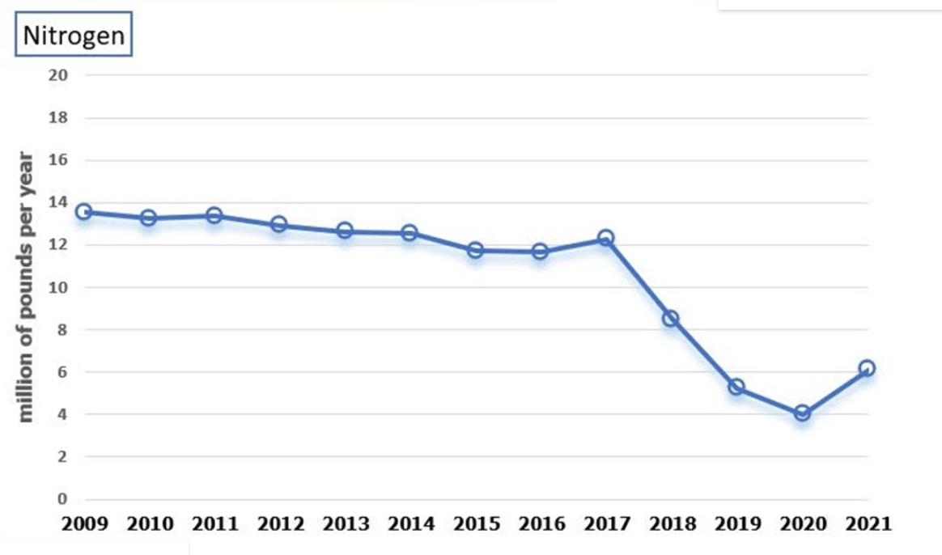
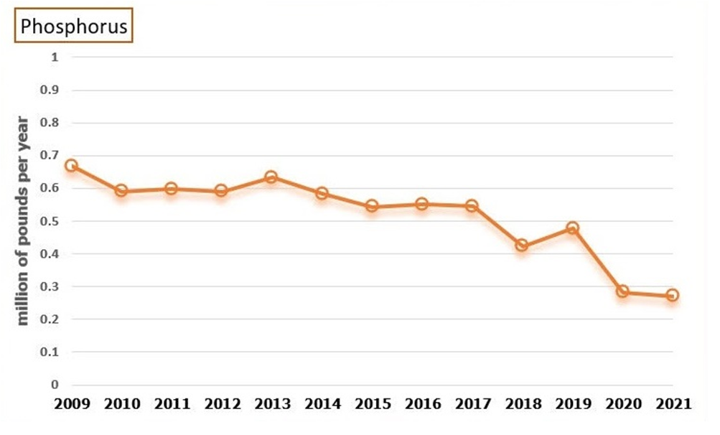
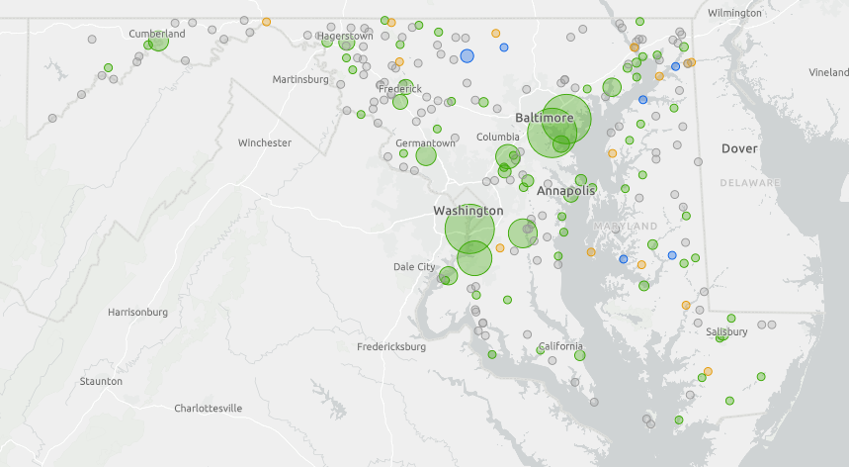
Water Quality Goal
WWTPs
Maryland's investments in wastewater technology have yielded the largest nutrient reductions of any pollution source.
Having invested over $1 Billion in ENR upgrades, the State achieved more than 50% reduction in WWTP Nitrogen loads to the Bay.
Maryland’s Progress on Chesapeake Bay Watershed Agreement
Dave Goshorn, Senior Bay Restoration Coordinator, MD DNR
Citizen’s Advisory Committee
February 24, 2023
Notes:
Thanks mostly to Bay Restoration Fund

Slide 10
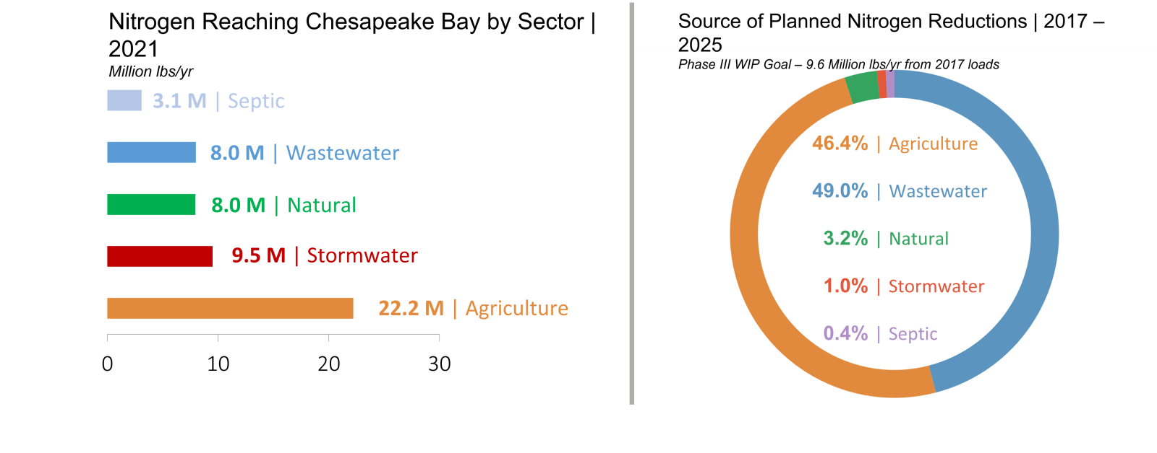
Water Quality Goal
Maryland’s Progress on Chesapeake Bay Watershed Agreement
Dave Goshorn, Senior Bay Restoration Coordinator, MD DNR
Citizen’s Advisory Committee
February 24, 2023
Notes:
Left side = where we are now
Right side = where rest of reductions need to come from

Slide 11
Water Quality Goal
So will Maryland get there?
We have a plan that should get us there if:
Back River and Patapsco WWTP’s resume functioning as intended.
No surprises
Weather and commodity prices cooperate.
Regardless, if we miss or if we succeed, it shouldn’t be by much.
Our real focus should be on post-2025
Maryland’s Progress on Chesapeake Bay Watershed Agreement
Dave Goshorn, Senior Bay Restoration Coordinator, MD DNR
Citizen’s Advisory Committee
February 24, 2023
Notes:
Left side = where we are now
Right side = where rest of reductions need to come from

Slide 12

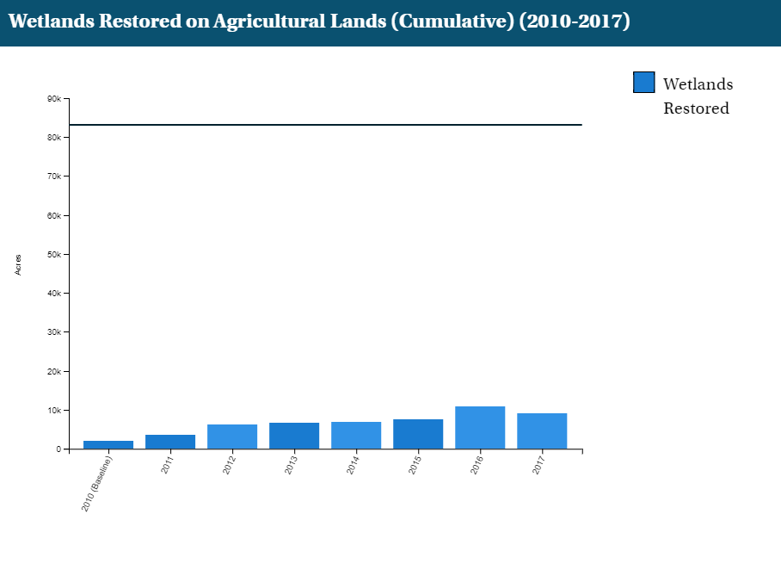
Vital Habitats Goal
Wetlands
Current Progress
s
Inadequate participation and resources for accurate and consistent reporting and analysis.
Need commitment by policy makers for prioritization and outreach to local implementers.
Continually increase the capacity of wetlands to provide water quality and habitat benefits throughout the watershed. Create or re-establish 85,000 acres of tidal and non-tidal wetlands and enhance the function of an additional 150,000 acres of degraded wetlands by 2025. These activities may occur in any land use (including urban) but primarily occur in agricultural or natural landscapes.
Baywide 2017 progress = 9,103 acres (11% of goal)
MD 2017 progress = 2,943 acres
Baywide 1,773 acre LOSS 2016 – 2017
Maryland’s Progress on Chesapeake Bay Watershed Agreement
Dave Goshorn, Senior Bay Restoration Coordinator, MD DNR
Citizen’s Advisory Committee
February 24, 2023
Notes:
Taking the next 3 together – shouldn’t be a surprise
Wetlands – not much progress.
Note “old” data on right hand graph

Slide 13
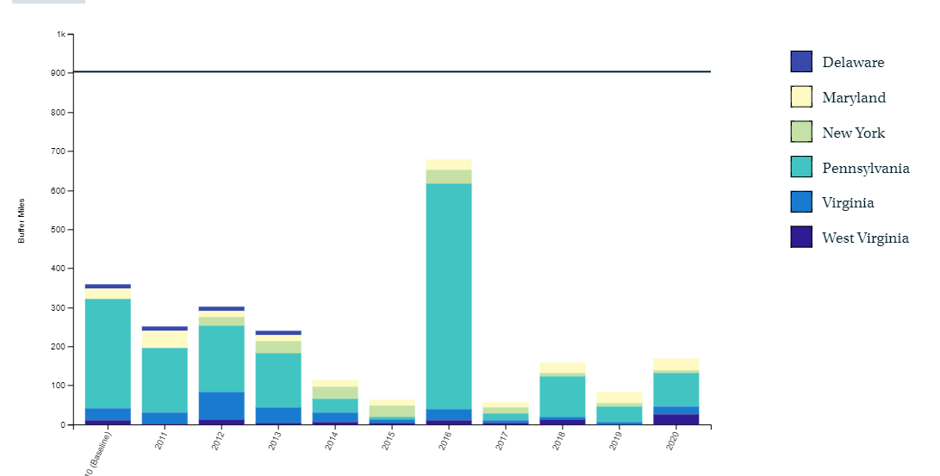
Vital Habitats Goal
Forest Buffer
Current Progress
s
Buffers have LOTS of co-benefits
CREP is complicated and many contracts are expiring
Landowner education and assistance is essential
We need high-level leadership (EC Action?)
Continually increase the capacity of forest buffers to provide water quality and habitat benefits throughout the watershed. Restore 900 miles per year of riparian forest buffer and conserve existing buffers until at least 70 percent of riparian areas throughout the watershed are forested.
2014-2020
Baywide = 200 miles/yr
(22% of goal)
MD = 22 miles/yr
(1998 – 2004 MD avg = 157 miles/yr)
Maryland’s Progress on Chesapeake Bay Watershed Agreement
Dave Goshorn, Senior Bay Restoration Coordinator, MD DNR
Citizen’s Advisory Committee
February 24, 2023
Notes:
Forest Buffer
MD’s recent progress (since 2014) has only averaged 22 miles/yr
BUT, MD’s progress in the past has been significantly greater – so we can do more

Slide 14
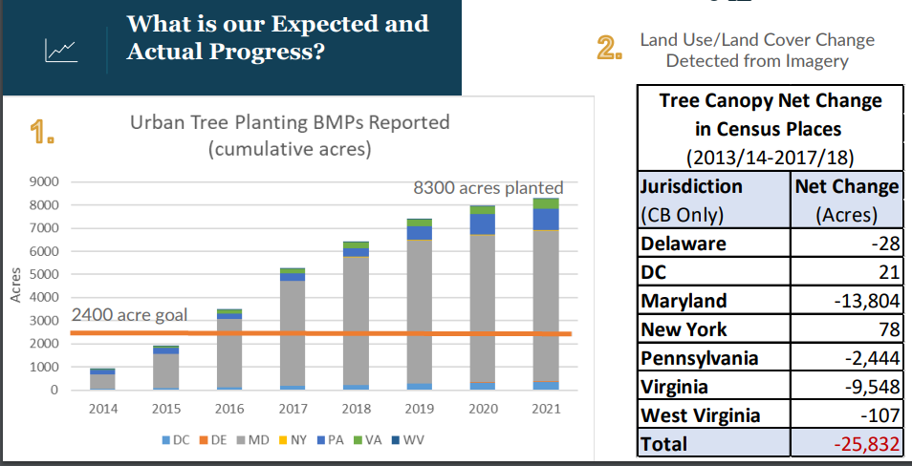
Vital Habitats Goal
Tree Canopy
Current Progress
s
Currently lacking baseline data but working to develop through existing databases
Continually increase urban tree canopy capacity to provide air quality, water quality and habitat benefits throughout the watershed. Expand urban tree canopy by 2,400 acres by 2025.
Maryland’s Progress on Chesapeake Bay Watershed Agreement
Dave Goshorn, Senior Bay Restoration Coordinator, MD DNR
Citizen’s Advisory Committee
February 24, 2023
Notes:
Urban Tree Canopy
Note significant plantings, but even greater losses

Slide 15
Vital Habitats Goal
So Wetland and Trees are not looking good – we won’t get to our 2025 goals.
But there are some hopeful new developments…
New Wetland and Forest Buffer Action Plans
Maryland’s 5 Million Tree Goal and associated funding ($2.5M/yr until 2031)
Potentially new funding via BIL and IRA
New authorities in Maryland’s Comprehensive Finance Act
Pay-for-Performance
Co-Benefits
Cross-State Implementation
Maryland’s Progress on Chesapeake Bay Watershed Agreement
Dave Goshorn, Senior Bay Restoration Coordinator, MD DNR
Citizen’s Advisory Committee
February 24, 2023
Notes:
Urban Tree Canopy
Note significant plantings, but even greater losses

Slide 16

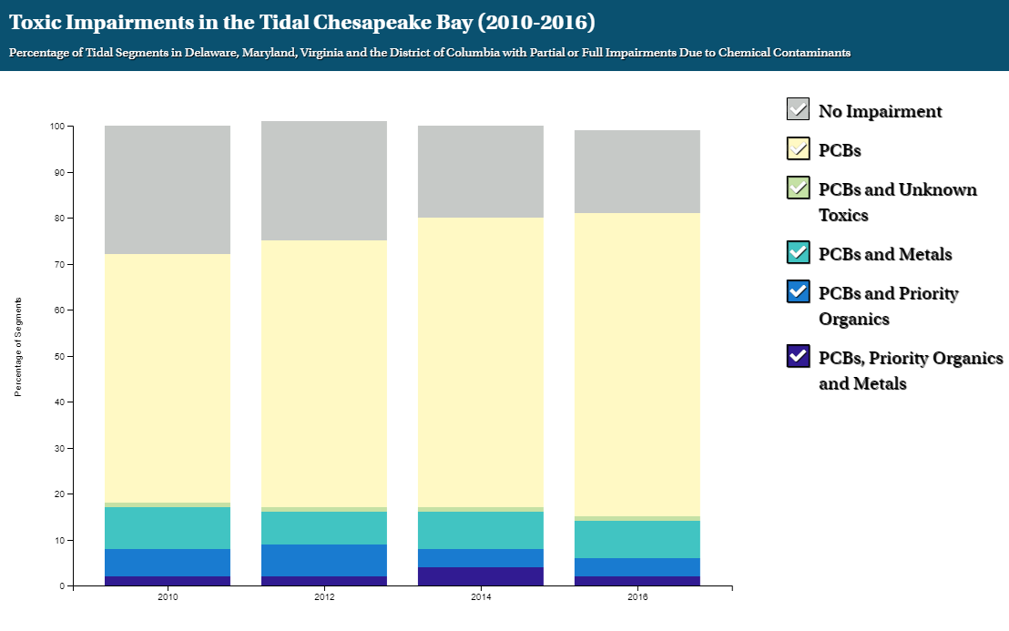
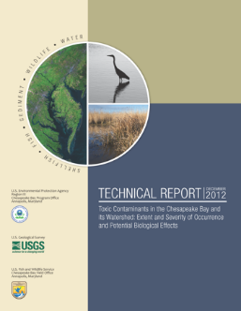
Toxic Contaminants Goal
Toxic Contaminants Research
Current Progress
s
83% of Bay and tributaries are impaired by toxic contaminants - a continued increase since 2010.
Need greater focus on BMP co-benefits for nutrients and contaminants.
Continually increase our knowledge of the impacts and mitigation options for toxic contaminants. Develop a research agenda and further characterize the occurrence, concentrations, sources and effects of mercury, PCBs and other contaminants of emerging and widespread concern. In addition, identify which best management practices might provide multiple benefits of reducing nutrient and sediment pollution as well as toxic contaminants in waterways.
Maryland’s Progress on Chesapeake Bay Watershed Agreement
Dave Goshorn, Senior Bay Restoration Coordinator, MD DNR
Citizen’s Advisory Committee
February 24, 2023

Slide 17
Toxic Contaminants Goal
Toxic Contaminants Policy and Prevention
Current Progress
s
PCB loads to Bay continue via stormwater, wastewater, atmospheric deposition.
14 documented impacts to human health from PCBs
Exploring concept of establishing a PCB Consortium.
Continually improve practices and controls that reduce and prevent the effects of toxic contaminants below levels that harm aquatic systems and humans. Build on existing programs to reduce the amount and effects of PCBs in the Bay and watershed. Use research findings to evaluate the implementation of additional policies, programs, and practices for other contaminants that need to be further reduced or eliminated.
Maryland’s Progress on Chesapeake Bay Watershed Agreement
Dave Goshorn, Senior Bay Restoration Coordinator, MD DNR
Citizen’s Advisory Committee
February 24, 2023

Slide 18

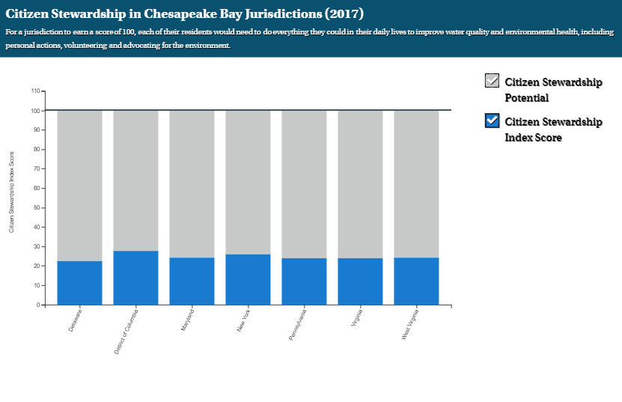
Stewardship Goal
Stewardship
Current Progress
s
Bay wide and MD residents scored 24 out of 100 in 2017 citizen stewardship survey. Measured personal action, volunteerism, and advocacy.
Need increased emphasis on public engagement
Increase the number and diversity of trained and mobilized volunteers with the knowledge and skills needed to enhance the health of their local watersheds.
Maryland’s Progress on Chesapeake Bay Watershed Agreement
Dave Goshorn, Senior Bay Restoration Coordinator, MD DNR
Citizen’s Advisory Committee
February 24, 2023

Slide 19

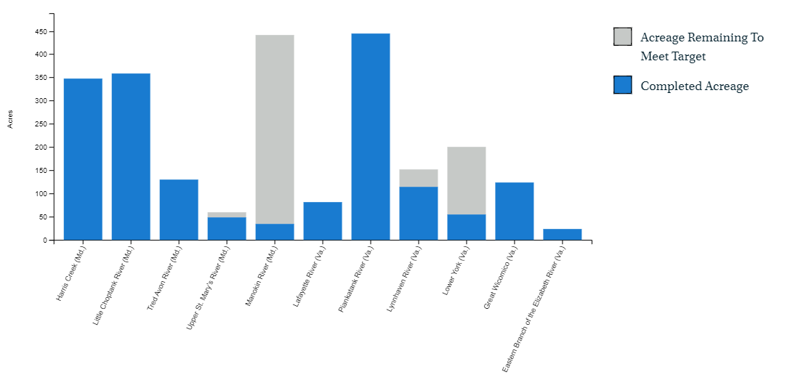
Sustainable Fisheries Goal
Oysters
Current Progress
s
These are the largest oyster restoration projects globally.
Maryland has successfully initially restored 4 of its 5 tributaries.
Continually increase finfish and shellfish habitat and water quality benefits from restored oyster populations. Restore native oyster habitat and populations in 10 tributaries by 2025 and ensure their protection.
Maryland’s Progress on Chesapeake Bay Watershed Agreement
Dave Goshorn, Senior Bay Restoration Coordinator, MD DNR
Citizen’s Advisory Committee
February 24, 2023

Slide 20

So where do we go from here?
Science – never be afraid of the science.
Partnership – We need to stick together.
Maryland’s Progress on Chesapeake Bay Watershed Agreement
Dave Goshorn, Senior Bay Restoration Coordinator, MD DNR
Citizen’s Advisory Committee
February 24, 2023

