Slide 1
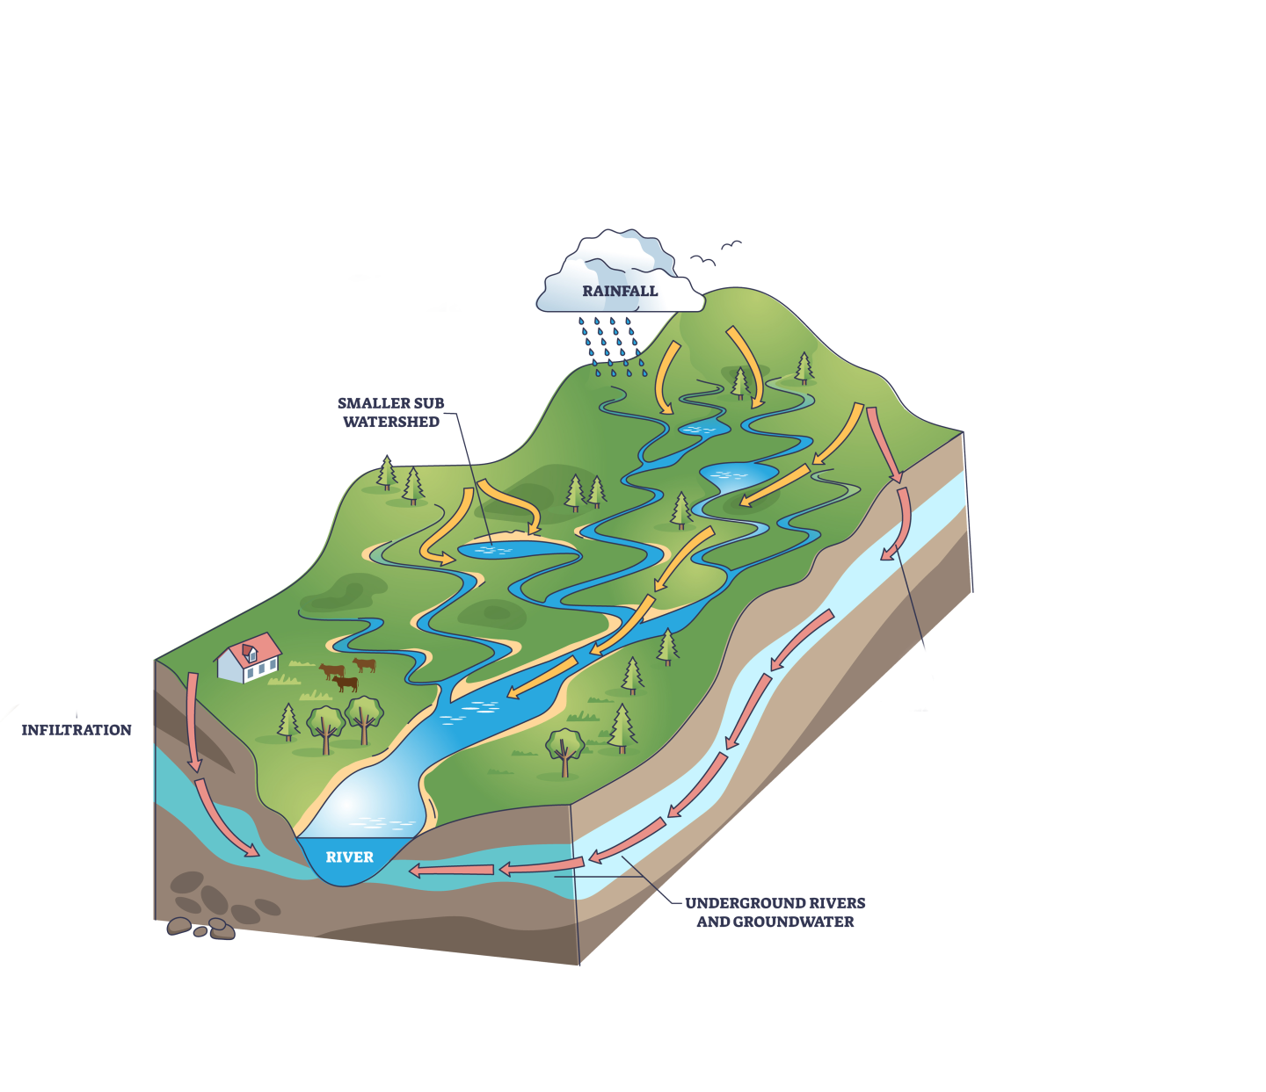
Healthy Watersheds 2024
Biennial Strategy Review System Presentation
June 13, 2024
Jeff Lerner, HWGIT Co-chair, U.S. Environmental Protection Agency
Peter Claggett, HWGIT Coordinator, U.S. Geological Survey

Slide 2
Healthy Watersheds 2024
Presentation Outline
HWGIT Goals and Strategies
Accomplishments ​
Status
Challenges ​
Alignment with other outcomes, goal teams, and workgroups
Future Directions
Management Board Support

Slide 3
Healthy Watersheds Outcome Strategy
NPDES, Stormwater, and 319 programs
(State and Local Gov'ts)
Land Conservation
(NGO’s, States, Feds)
Land Use and Green Infrastructure Planning
(Local Governments)
Protect
Prevent
Permit & Finance
Identify and Monitor
Healthy Watersheds
Role of Healthy Watersheds GIT
Outreach & Communication
Science & Data, Planning Support
Capacity Building

Slide 4
Direct Accomplishments: 2022-2024
Maryland Healthy Watersheds Assessment
Chesapeake Healthy Watersheds Assessment 2.0
Healthy Watersheds Indicator, draft (impervious and protected lands in state-identified healthy watersheds)

Slide 5
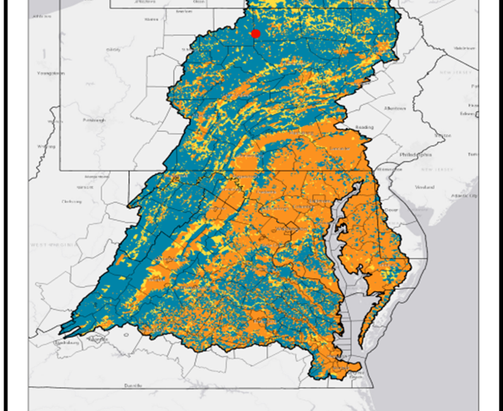
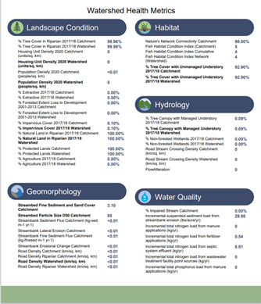
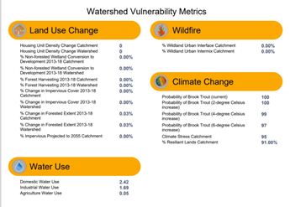
Chesapeake Healthy Watersheds Assessment (CHWA) 2.0
CHWA
●Stream Health
●Landscape Integrity
https://gis.chesapeakebay.net/chwa/

Slide 6
Indirect Accomplishments: 2022-2024
Land Use Methods and Metrics Indicators: Impervious Cover Change, Riparian Forest Change (LUWG)
High-resolution Land Use/Land Cover Data for years: 2013/14, 2017/18, 2021/22 due September 2024 (LUWG)
Hyper-resolution Hydrography Data due September 2024 (LUWG)
Initiation of “Community Response to Land Use Change” GIT-funded project (LUWG)
County Tree Canopy Fact Sheets (FWG/USGS/CIC)
State of Chesapeake Forests 2.0 (FWG/USGS/CIC)
Riparian Forest Indicators (FWG/USGS/CIC)
Local government workshops (LLWG)
Mid-Atlantic Planning Collaboration Webinar (LUWG)
  ~ 150 planners attended, AICP credit,

Slide 7
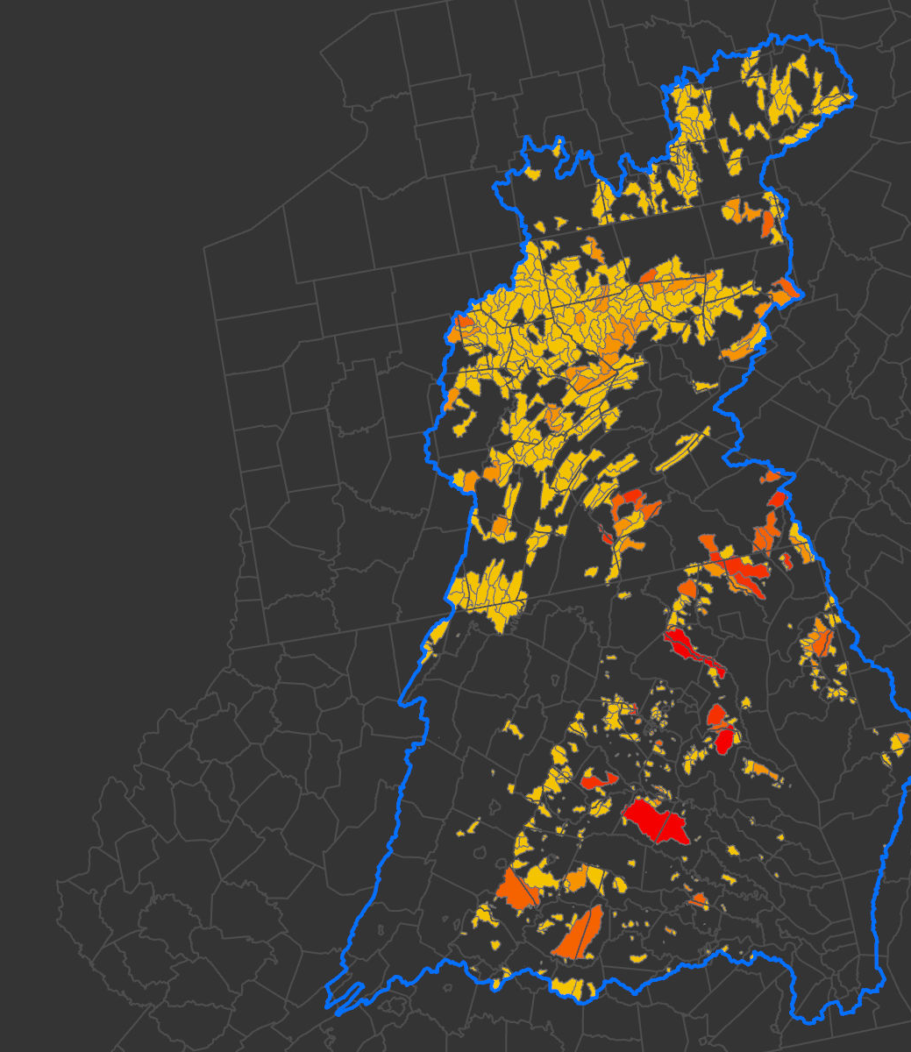
Land Use/Land Cover Change in
Healthy Watersheds
2013/14 – 2017/18
Healthy watersheds along the I-95 corridor tend to have higher amounts of development.
I-95 approx.

Slide 8
Land Use Change & Land Protection
in State-Identified Healthy Watersheds
Over 20,000 acres of new development occurred within State-Identified Healthy Watersheds (SIHWs).
Most development occurred on forest and open space lands, compared to agriculture.
The rate of development (by area) was only slightly less in healthy watersheds compared to the rest of the Chesapeake region.
A greater percentage of lands within healthy watersheds are protected compared to all other lands.
But- we are not confident knowing when protection took place.

Slide 9
Status
Maintaining stream health???
Protecting and preventing stream health degradation???
Building local capacity to protect healthy watersheds???
Why status is uncertain? Lack of monitoring and reporting.
Stream health (e.g., Fish IBI, Benthic IBI, Conductivity, Temperature, Nutrients, Metals)
New development permits
Land protection
Land use planning policies
Local awareness of healthy streams and landscapes

Slide 10
Challenges
Regulatory programs are insufficient to maintain watershed health given their limited scope and expected changes in land use and climate.
States define watershed health differently and have different levels of regulatory engagement that inhibit a consistent and comparable approach for characterizing and monitoring watershed health.
No accountability for the healthy watersheds outcome because stream health and land protection efforts in state-identified healthy watersheds are not monitored.
The work needed to monitor and maintain watershed health overlaps with other workgroups, goal teams, and outcomes.

Slide 11
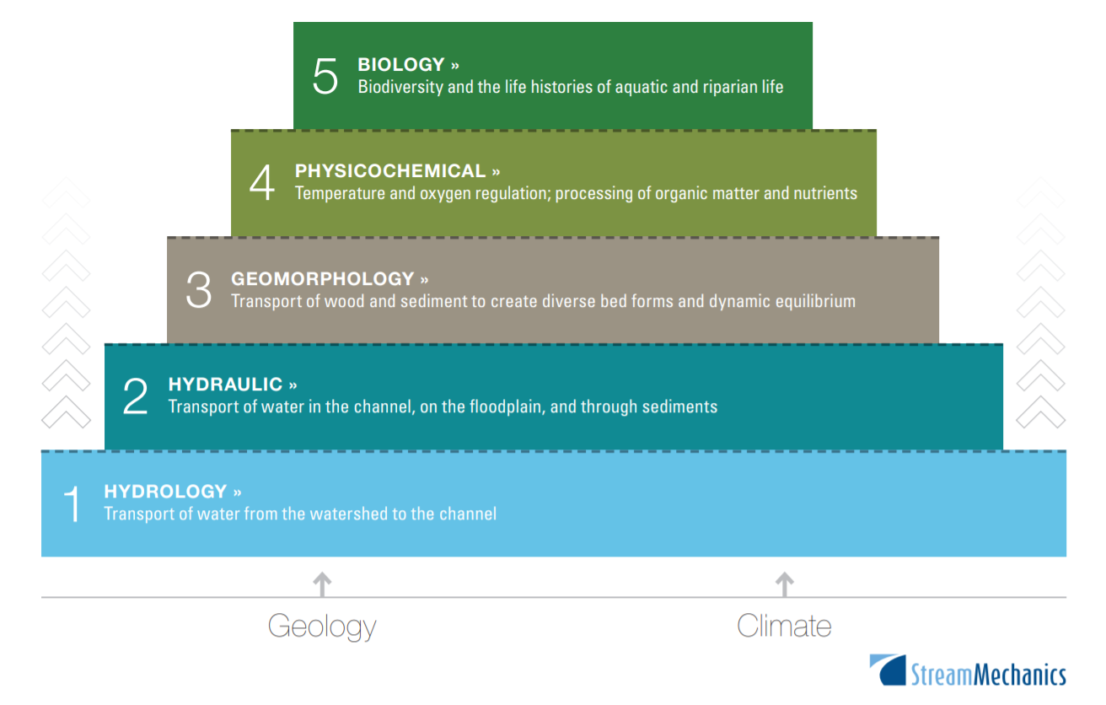
Science informing stream and watershed health
Watershed-Stream Functional Pyramid
Stream Functional Pyramid
7
Biology
Primary Productivity, Benthic IBI, Fish IBI
6
Physiochemical
Nutrients, Sediment, Toxics, pH, Specific Conductivity, Temperature
5
Fluvial Geomorphology
Riparian vegetation, Channel and Floodplain dimensions, Channel Sinuosity and Incision, Entrenchment Ratio
4
Hydrology & Hydraulics
Runoff ratio, Lag Time, Flashiness Index, Hydrograph Recession Constant, Baseflow Index, 1-day and 7-day high and low flows
3
Land and Resource Management Practices
Land protection, restoration, fertilize and manure applications, crop rotations, Best Management Practices.
2
Watershed Characteristics
Land cover, Land use, Landforms / Geomorphology, Drainage Area, Shape, and Slope
1
Landscape Evolution and Land Use History
Geology and Climate

Slide 12
Alignment: Maintaining Watershed Health Takes a Village
Land Conservation
& Management
Outreach & Communication
Watershed Science
Land Use Planning
SHWG
USGS
CCP
PLWG
LUWG
USWG
LLWG
SET
STAR
BTAT
CRWG
WWG
FWG
BTAT: Brook Trout Action Team
CCP: Chesapeake Conservation Partnership
CRWG: Climate Resiliency Workgroup
FWG: Forestry Workgroup
LLWG: Local Leadership Workgroup
LUWG: Land Use Workgroup
PLWG: Protected Lands Workgroup
SET: Strategic Engagement Team
SHWG: Stream Health Workgroup
STAR: Scientific, Technical, and Reporting team
USGS: U.S. Geological Survey
USWG: Urban Stormwater Workgroup
WWG: Wetlands Workgroup

Slide 13
Future Directions (Beyond 2025)
Data, Tools and Monitoring:
  Provide consistent and integrated watershed-wide characterization and monitoring of stream and watershed health and land conservation efforts.
  Provide science, data, and tools to enable targeting and prioritization of land conservation and stream restoration actions at multiple scales.
Planning:
  Provide science, data, models, and tools to enable green infrastructure planning (e.g., forests, farms, and open space) to protect watershed health at multiple scales.
Local Engagement and Capacity:
  Create and support a network of networks enabling two-way communication with local and NGO implementers to share needs, information, and data and to improve the functionality and utility of tools.
Watershed Actions:
  Integrate land conservation, management, and stewardship more explicitly into the goals of the Bay Program
  Expand public access to waters and natural lands through the creation, stewardship and improvement of more parks and trail networks.
Measure Watershed Outcomes:
  Quantify ecosystem services and integrate them into restoration and conservation decision processes.

Slide 14
Management Board Ask #1
Improve the alignment of outcomes
The intent of the Stream Health Outcome is to improve the ecological integrity of streams. The intent of the Healthy Watersheds Outcome is to sustain those improvements and maintain the condition of currently healthy streams.
Revise the scope of the healthy watersheds outcome to include all healthy streams and their watersheds in the Bay basin (not just State-Identified Healthy Watersheds).
Align stream and watershed health outcomes, data, science, policies, and management.
Align CBP support activities for local land use planning and land conservation efforts.

Slide 15
Management Board Ask #2:
Support the tracking of protected lands
For the 2022 protected lands data, only 62% of the records (by area- 7.14 million acres) have valid "date-of-establishment" field values. For the remaining 38% of the records (2.97 million acres), we don't know when they were protected!
For the 62% valid records, 764,000 acres were protected after 2010. The outstanding records represent 4x this area. Therefore, our progress towards land protection goals is uncertain.
Most protected lands lacking a valid date field are owned by Federal or State agencies. These lands are mostly in Maryland, Virginia, West Virginia, and New York.

Slide 16
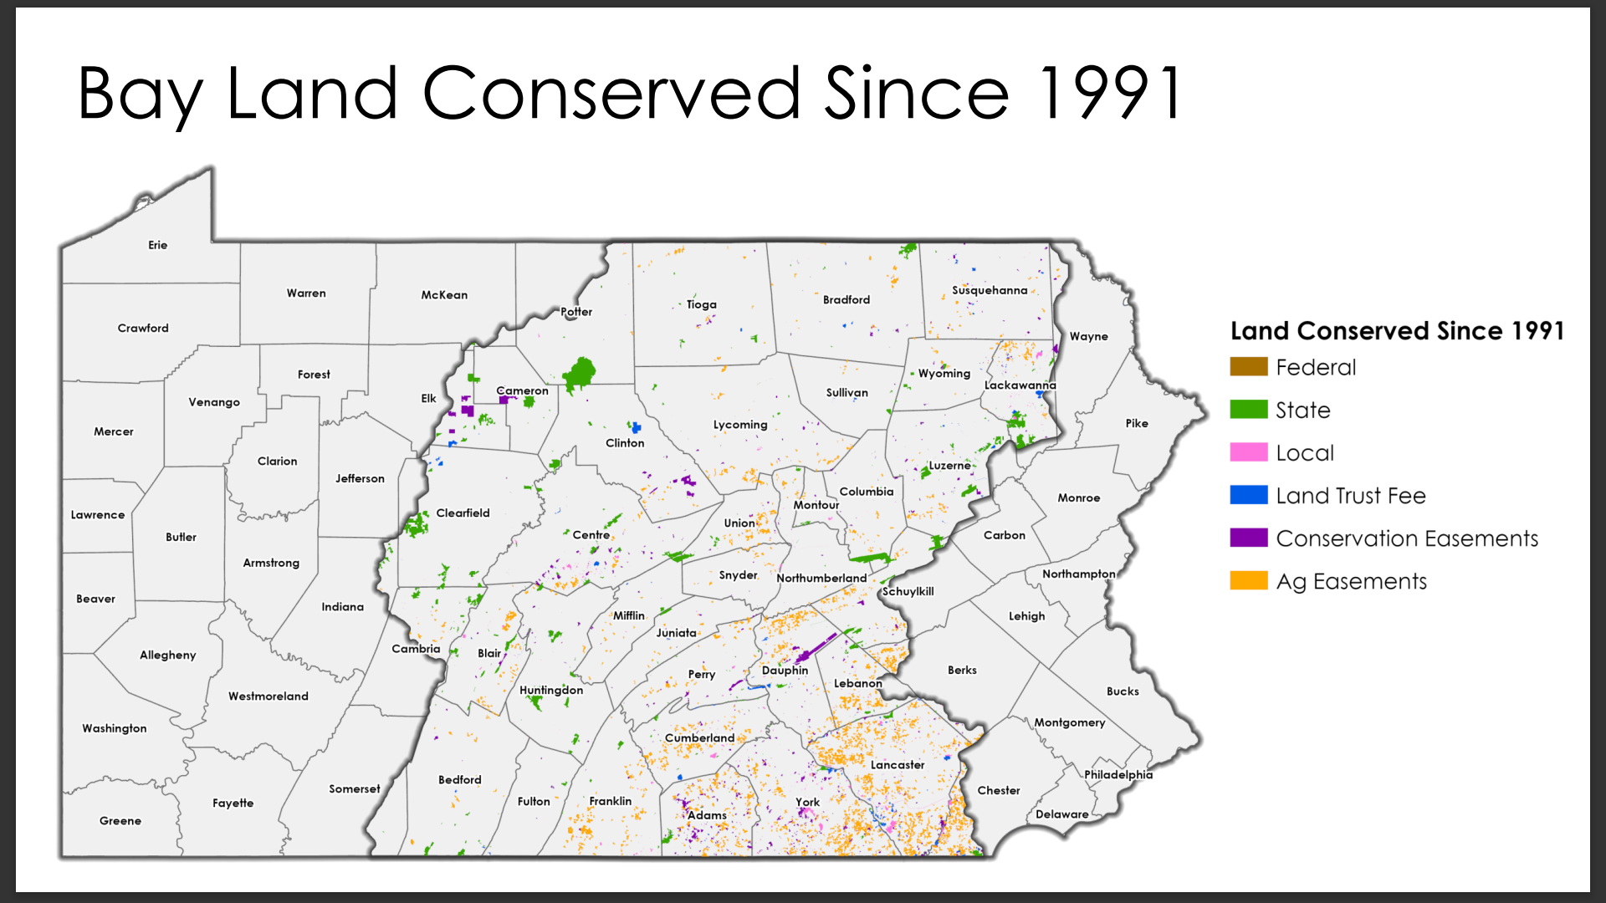
Joshua VanBrakle, PA-DCNR

Slide 17
Management Board Ask #3:
Support the new CBP Land Use Strategy
The importance of planning and conservation to maintain healthy streams and watersheds and to sustain restoration progress in the face of population growth and associated changes in land use (and climate) has been a primary concern of the CBP Partners since its inception.
Over the past 40 years, the CBP has struggled to define a value-added role in planning and conservation because both are activities largely governed by local governments or NGO’s.
The proposed new Land Use Strategy, endorsed by the Land Use Workgroup and presented to the WQGIT and HWGIT, provides guidance on how the CBP can be more supportive and effective in promoting more sound land use decisions.

