Slide 1
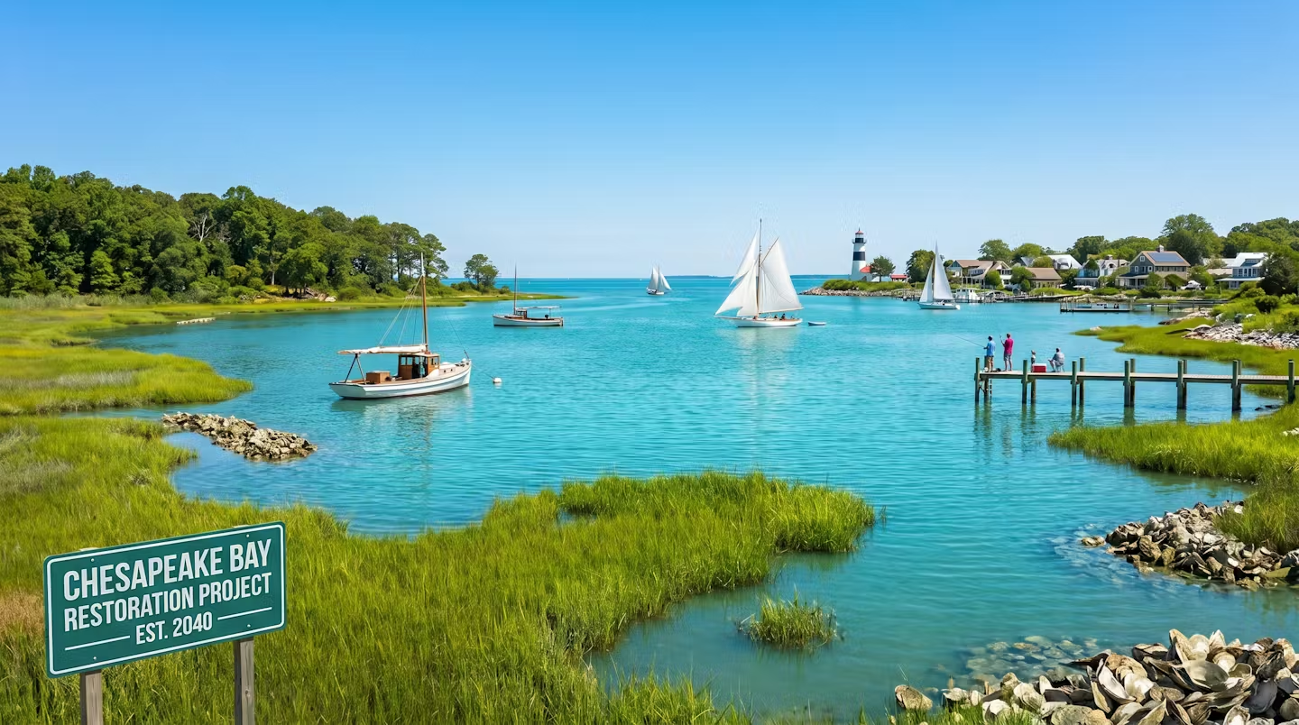
Healthy Landscapes Goal
(ai-generated image)

Slide 2
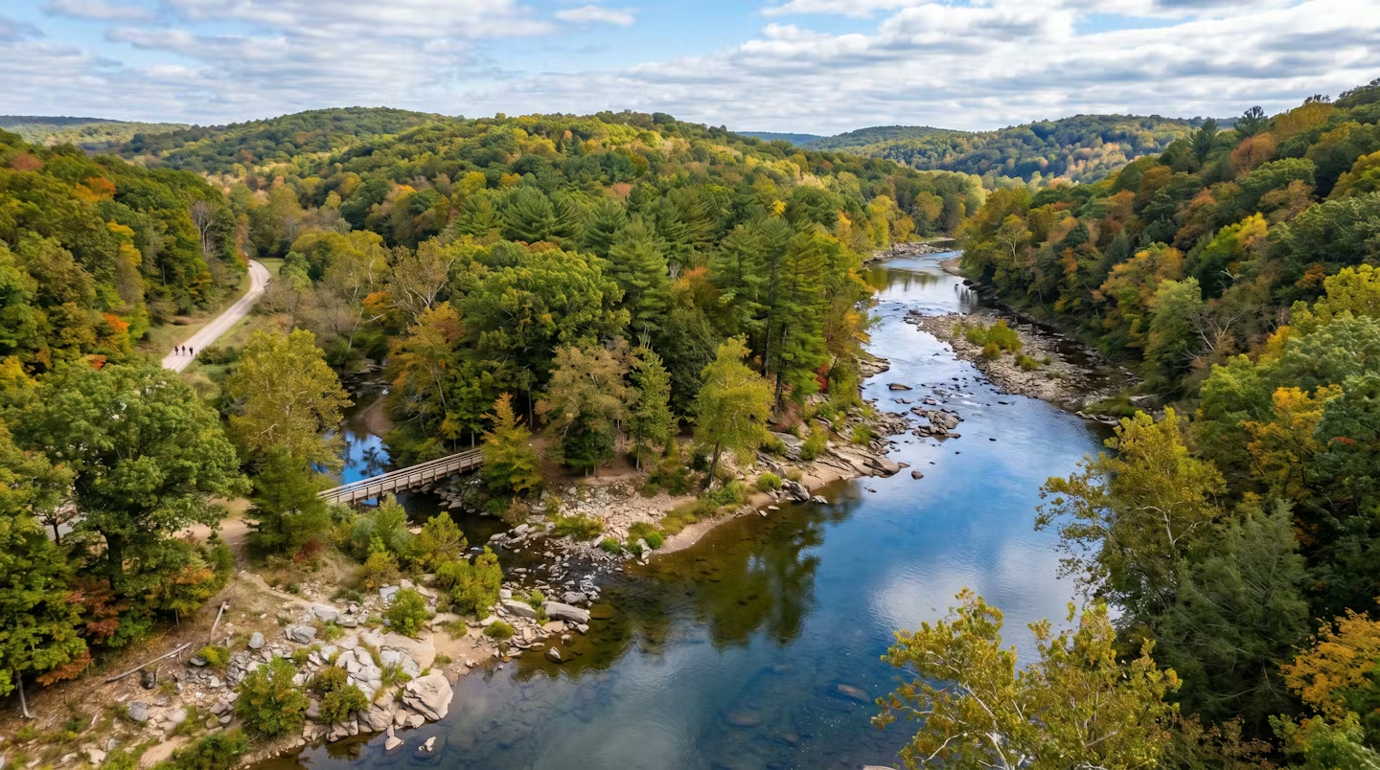
Healthy Landscapes Goal
(ai-generated image)

Slide 3
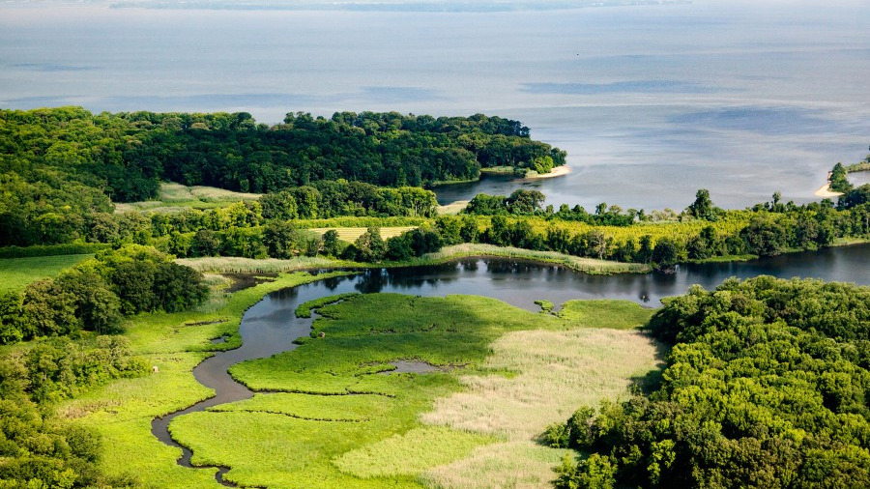
Healthy Landscapes Goal:
Conserve, protect, restore and enhance landscapes of ecological, economic, recreational and cultural value to improve water quality, provide habitat for wildlife and increase resilience.

Slide 4
Why Healthy Landscapes?
Because land development and degradation, severe and frequent flooding, and excessive and prolonged heat, threaten infrastructure, human life, working lands, wildlife habitat, and progress-to-date in reducing and controlling pollution to the Chesapeake Bay.

Slide 5
Healthy Landscape Solutions
Enhance organizational capacity to:
Protect land for recreation, wildlife habitat, and preserving rural character and lifeways;
Accommodate growth while minimizing land conversion;
Implement nature-based solutions for enhancing resiliency to environmental change;
Plant trees- particularly in riparian areas and communities;
Manage forests for habitat, water quality, and timber resources.
Notes:
The land around the identified healthy streams is important. It doesn’t just help determine the quality of the water. Maintaining healthy watersheds is what will help maintain healthy waters- it is the source. Focusing on restoration alone will not help us to improve the quality of our environment-maintaining quality we already have is the most cost-effective method of reaching our goals. The Maintain Healthy Watersheds GHow do we maintain it then? What if the quality degrades?
oal Team seeks to sustain watershed health where it is high, exceptional, and/or outstanding, and to increase the overall number of healthy watersheds in the future.- CHWA helps us learn more about metrics on the landscape that can affect health and water quality

Slide 6
Ways that the CBP can enhance organizational capacity?
Identify and cultivate funding sources
Fund projects (i.e., for implementation, capacity, technical assistance, or policy guidance)
Inform state and federal policies, programs, and legislation
Leverage technologies to characterize and monitor landscape conditions
Develop and improve data, models, and tools relevant to organizational decisions
Conduct science and investigations to inform decisions affecting landscapes
Synthesize science and data to inform landscape decisions
Share examples/case studies of organizations using innovative approaches and information to make decisions
Build connections across organizations for shared assistance (networking)

Slide 7
Healthy Forests & Trees
Restore and maintain forests and trees: in communities, riparian areas, and other areas.
Protect valued areas: forests, wetlands, farmland, tribal lands, urban greenspace, and lands supporting healthy streams.
Healthy Landscapes
Goal
Protected Lands
Land Use Planning & Decision Support
Inform land use planning decisions: produce and share data and case studies relevant to both local needs and the health of local waterways.
Reduce future risks to people and habitats: from changes in temperature, precipitation, and land use.
Adapting to Changing Environmental Conditions

Slide 8
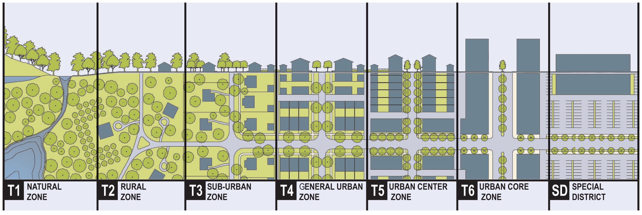
Complementary
Nature of Our
Outcomes
Very-low density zoning
Conservation zoning
Park planning
Recreation trails
Walkability
Transit-oriented development
Redevelopment
Mixed use
Infill/redevelopment
Cluster housing
Planning
Low-impact development
Soil amendments
Natural/native landscaping
Connected greenways
Community and distributed solar
Green roofs
Pervious pavement
Detention vaults
Solar roofs
Street trees
Living shorelines
Floodplain connectivity
Wind turbines, solar farms
Silviculture
Resiliency
Working farms and forests
Source-water protection
Wildlife habitat protection and connectivity
Floodplain and wetland protection
Community parks and recreation areas
Trail networks
Greenspace conservation
Trail networks
Conservation
Conservation of forest habitats
Conservation of working lands
Sustainable forest management
Riparian forest buffers
Street trees
Riparian forest buffers
Reforestation of plantable areas
Controlling pests, disease, and invasives
Street trees
Controlling pests, disease, and invasives
Forests
* Image from the Center for Applied Transect Studies (https://transect.org/rural_img.html)

Slide 9
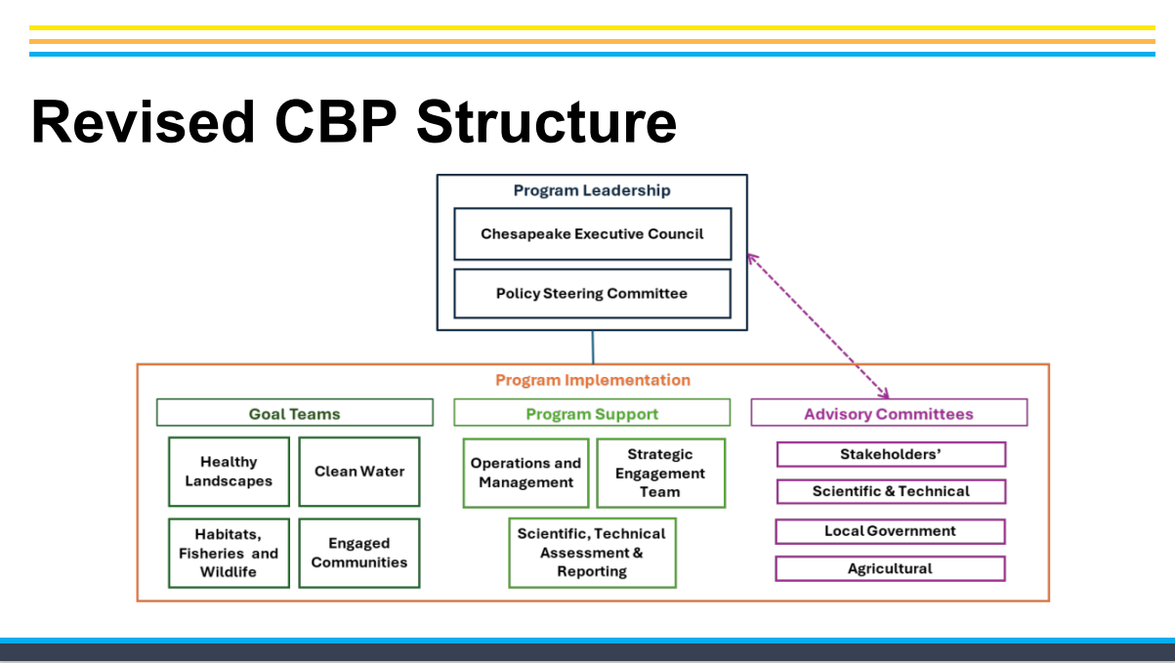

Slide 10
- Who does what
EPA + Governors + CBC
Strategic Direction
Dept. Secretaries
Policy Advice and Implementation
Academics, NGO’s, Public and Private
Program Directors
EPA-led CBP Office
Implementation
Management Strategies
Workplans
Adaptive Management
Support
Administration, Communication,
Modeling, Monitoring,
GIS
Advisory
Science
Industry
Local government
Interest groups

Slide 11
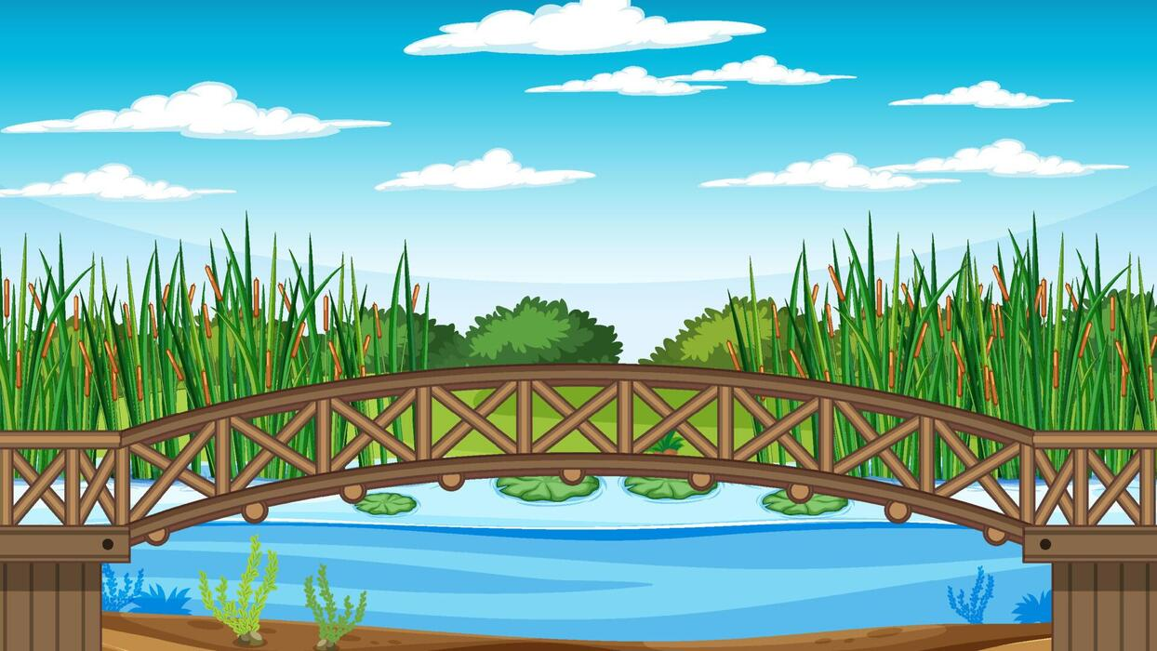
Goal Teams are conduits of information between
the PSC and Workgroups
Policy guidance
Policy
Steering
Committee
Policy decisions
Cross-outcome and
Cross-goal coordination
Goal
Teams
Programmatic
Needs & Priorities
Workgroups
Outcome challenges and progress

Slide 12
Healthy Landscapes Goal Team
Steering Committee
Healthy Landscapes
Claire Jantz, PA-DCNR
Ken Hyer, USGS
Peter Claggett, USGS
Forestry
Anne Hairston-Strang, MD-DNR
Nanci Sonti, USFS
Katie Brownson, USFS
Adaptation
Natalie Snider, MD-DNR
Ben McFarlane, HRPDC
Julie Reichert-Nguyen, NOAA
Land Use
Debbie Herr Cornwell, MDP
Rosa Hance, Choose Clean Water
Jackie Pickford, USGS
Protected Lands
Jeff Lerner, EPA
Sophie Waterman, USGS

Slide 13
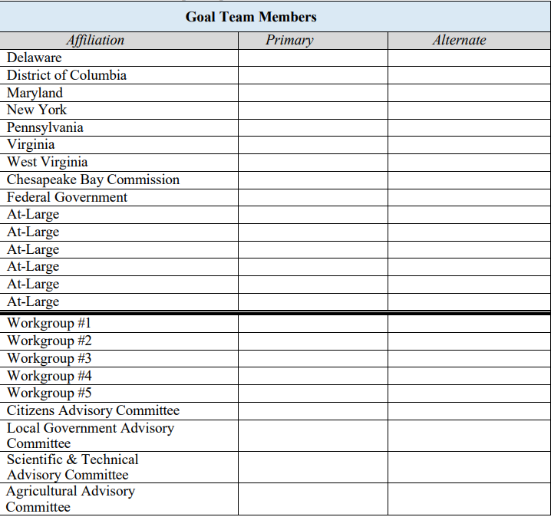

Slide 14
Chesapeake Bay Strategic Plan & Management Strategies
Basic Thoughts
I. Not terribly different than the Management Strategies from 2025, but updated
II. Vocabulary:
- Strategic Plan: The entire document that covers all 4 Goal Teams Includes a bunch of front-end material
- Management Strategies: There will be one prepared for each Goal (4 total)
- Workplans: Each outcome will have a workplan. Captures the partnership projects for 3 years (7/26-6/30)
III. Benefits:
- Strategic Plan: One comprehensive plan – addresses earlier GAO reports
- Management Strategy: Allows us to address more cross cutting issues and challenges (at the goal level, NEW!)
We still have a comprehensive stand-alone sub-chapter for each Outcome (SAME)
Designed to be durable for a 6-year period
More program focused at the Management Strategy level
Public feedback step included
- Workplans: Shorter duration (1-3 years), more project focused.
IV Cons:
- Some redundancy between "goal-level" and "outcome level" sections in situational analysis
- Concerns regarding capacity and funding for years 2 and 3 in the workplans.
- Still figuring out a section on signatory Statutory authorities (though we will ask the jurisdictions to help)

Slide 15
Chesapeake Bay Strategic Plan & Management Strategies
Implementation Team
I. Executive Summary
II. Introduction
- Vision
- Overview
III. Accountability
- Principles and Governance
- Monitoring, Assessment, Reporting
- Adaptive Management
Workgroups
Subchapter for each Outcome (oct 19, 2026):
- Outcome and Targets
- Baseline and Current Condition
- Measuring Progress and Indicators
- Challenges to Progress
- Signatory Programs (most relevant)
- Management Approaches
- Participating Partners
PROGRAM LEVEL
Goal Team – we will build one MS for the HLGT
IV Management Strategy (MS) for Healthy Landscapes GT
- Goal language and Importance
- Situation Analysis: Challenges
- Goal management Strategies
- One sub-chapter for each Outcomes
Land Use Planning and Decision Support
Healthy Forests and Trees
Adapting to Changing Environmental Conditions
Protected Lands
Workplans: (due Spring 2027) - PROJECT LEVEL
- Narrative summary
- Impact on attainment
- Major actions
- Lead and partners
- Resources (FTE’s, $$$)
- Timeline
- Performance targets and deliverables

Slide 16
Chesapeake Bay Strategic Plan & Management Strategies
Management Strategy Outline:
Management Strategy for Healthy Landscapes Goal
a. Goal Language and Importance
b. Goal 1 Situation Analysis
I. Shared challenges for partnership to address, including those related to Changing Environmental Conditions
c. Management approaches to address the shared challenges for the goal
d. Sub-Chapter for each of our 4 Outcome
I. Outcome language (including targets)
II. Baseline and Current Condition
III. Measuring Progress and Indicators
IV. Outcome Situation Analysis
V. Snapshot of Signatory Programs
VI. Management Approaches
VII. Participating Partners

Slide 17
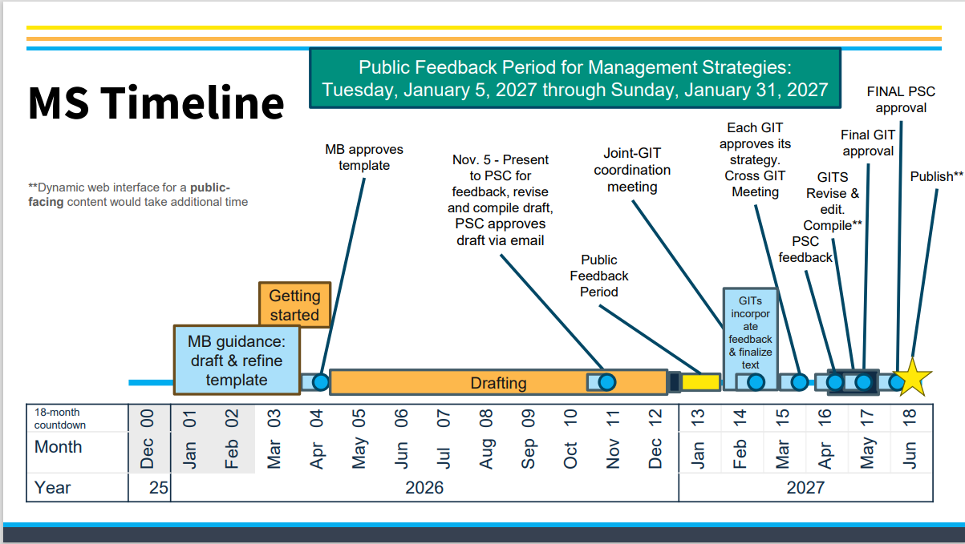

Slide 18
Chesapeake Bay Strategic Plan & Management Strategies
Writing Strategy:
Goal Team Level:
Led by the steering committee
Likely more concise than the outcome subchapters
Volunteers WELCOME!!!
Outcome level:
Small team from the Workgroup drafts the majority of the document
Standing topic at WG meetings
Stay connected with the Goal Team (your content directly influences ours)
Do feel free to reuse content form older Management Strategies
Alternate models are also welcome!

Slide 19
Chesapeake Bay Strategic Plan & Management Strategies
Other thoughts:
Questions as you prepare the MS:
-Let us know – perhaps we discussed it?
-Sarah Brzezinski still leads the management Strategies
-Make the best decision that works for your Outcome! We do want consistency, but we also acknowledge that these are largely internal documents for each Workgroup and each Outcome.
The partnership has a template for each:
Management Strategy Template – let's review
Workplan Template – let's review
Timelines – let's discuss in detail

Slide 21
Proposed Healthy Landscapes Management Strategy Drafting Timeline
Submit
Final Draft
Oct. 19th
Complete
1st Draft
Complete
2nd Draft
Authorship
Shared folders
Timelines
Targets
Baseline and Current Condition
Measuring Progress and Indicators
Critical challenges (within our control & require a partnership approach)
Management Approaches to address challenges
Refine
Targets
Baseline and Current Condition
Measuring Progress
Indicators
Critical challenges
Management Approaches
Add
Signatory Programs
Participating Partners
Refine (2 weeks)
Outstanding elements
Workgroups
Authorship
Shared folders
Timeline
Vision
Importance
Principles and Governance
Monitoring, Assessment, Reporting
Adaptive Management
Refine
Introduction section
Accountability section
Importance
Add
Cross-outcome challenges
Prioritization of challenges
Management Approaches
Signatory Authorities
Refine (2 weeks)
Outstanding elements
Add
Cross-goal challenges
and considerations
Goal
Team
May ‘26
Jun ‘26
Jul ‘26
Aug ‘26
Sep ‘26
Oct ‘26

