Slide 1
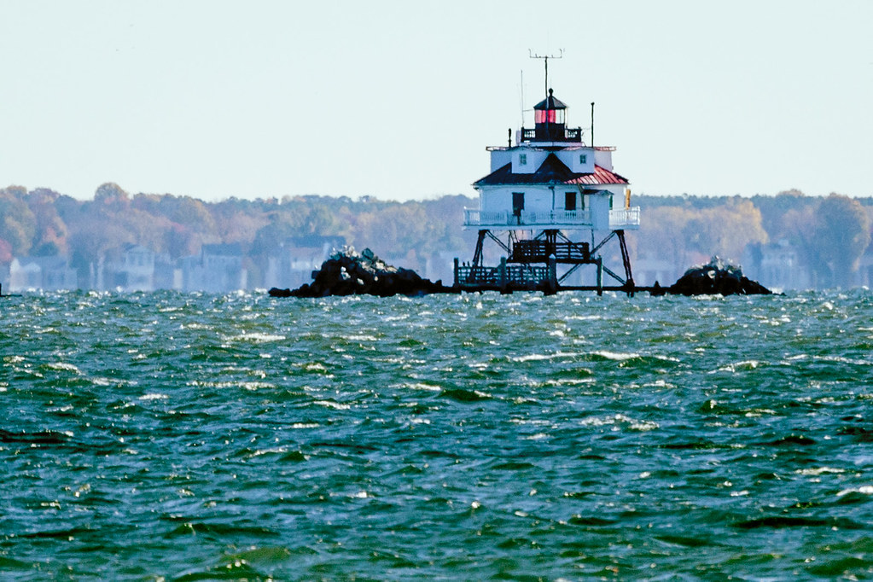


Chesapeake Bay Program Updates
Citizens Advisory Committee Quarterly—February 2023
Martha Shimkin
Deputy Director,
EPA Chesapeake Bay Program

Slide 2
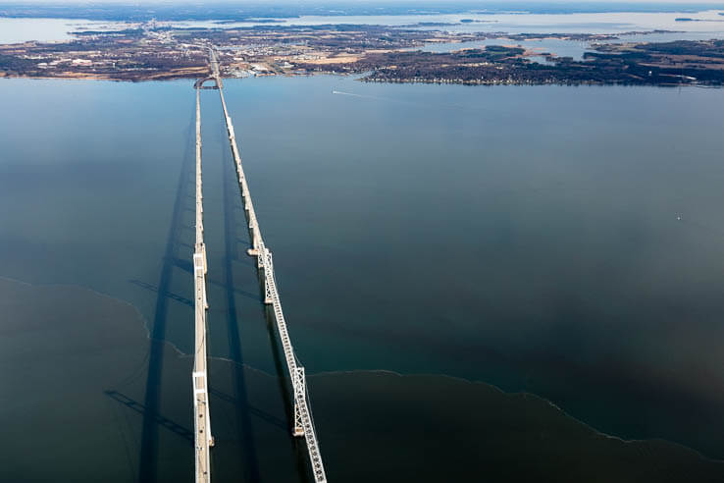
2025 and Beyond
CBP DEIJ Consultants
GIT Funding
AGENDA

Slide 3
2025 and Beyond – EC Charge to the PSC
Recommend “a critical path forward that prioritizes and outlines the next steps for meeting the goals and outcomes of the Watershed Agreement leading up to and beyond 2025.”
2023 EC meeting: Recommendations on how to best address and integrate new science and restoration strategies leading up to 2025.
2024 EC meeting: Recommendations that continue to address new advances in science and restoration, along with a focus on our partnership for going beyond 2025.

Slide 4
2025 and Beyond – Status Update
Recommendations leading up to 2025
A small ad hoc group of volunteers will begin developing recommendations and partnership actions to meet the goals of the 2014 Agreement leading up to 2025.
The ad hoc team will report back to the Management Board and PSC with recommendations.
Recommendations beyond 2025
Proposed options for organizing framework were shared and discussed at Management Board meeting on Feb 22

Slide 5
5 PROPOSALS
Proposal 1: Steering Committee
Proposal 2: Three Task Forces
Proposal 3: Task Force Hybrid
Proposal 4: GIT/STAR-led
Proposal 5: GIT/STAR-led w/ Steering Committee
  Contractual support will be provided for all options.

Slide 6
Option 1:
Steering Committee
A single Steering Committee will be formed to assess and make the full set of recommendations.
Would ensure appropriate representation from across the partnership
Why? | Who | How many? | Total
Who is responsible for decision-making? | 9 signatories (NY, PA, DE, WV, MD, DC, VA, CBC, EPA) | 1-2 per signatory | 18
Who has the authority? (e.g. funders) | NPS, NOAA, FWS, USGS, NRCS | 1 per signatory | 5
Buy-in from external stakeholders who are accountable for implementation | CAC, STAC, LGAC | 1 per with alternates | 3
Total |  |  | 26

Slide 7
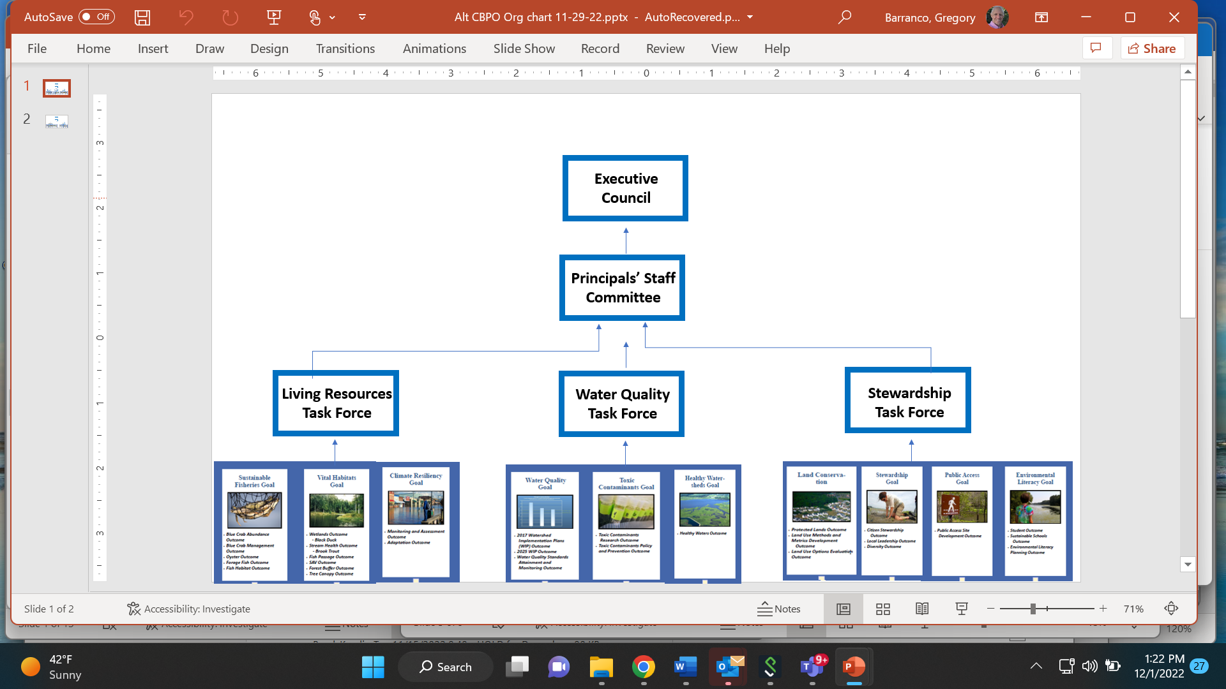
Option 2: Three Separate Task Forces
PSC
Management Board

Slide 8
Option 3: Task Force Hybrid
PSC
Management Board
Steering Committee
Cross-outcome Task Forces
Living Resources
Task Force
Water Quality
Task Force
Stewardship
Task Force
  Outcomes could be spread over 2, 3 or 4 task forces.

Slide 9
Option 4: Goal Team/STAR-Led
The GITS and STAR will provide recommendations to the Management Board (and possibly additional representation from GITs) which will act as a “joint committee” to synthesize and iron out differences between recommendations sent forward.
The Goal Teams (including GIT 6 and STAR) will work collectively with their workgroups (and others) to develop recommendations
PSC
Management Board
Fisheries GIT
Habitat GIT
Water Quality GIT
Healthy Watersheds GIT
Stewardship
GIT

Slide 10
Option 5: Goal Team/STAR-Led w/ Steering Committee
PSC
The GITS and STAR will provide recommendations to the Steering Committee which will synthesize and iron out differences between recommendations to be sent forward to the Management Board and PSC.
The Goal Teams (including GIT 6 and STAR) will work collectively with their workgroups (and others) to develop recommendations
Management Board
Steering Committee
Fisheries GIT
Habitat GIT
Water Quality GIT
Healthy Watersheds GIT
Stewardship
GIT

Slide 11
DEIJ Consultants
EPA committed to fund a DEIJ Coordinator position for at least a year to help jump start implementation of the DEIJ Strategy Implementation Plan.
Through a grant with DC DOEE, CBPO has brought on Resolve Conservation to provide critical leadership and coordination support.
The DEIJ Coordinators will focus on helping Goal Teams and Workgroups identify and take actions that will improve DEIA and EJ outcomes, through an assessment and intensive training program.
DEIJ Coordinators kicked off work in December and are getting to know the partnership through interviews, meetings, etc.
Let’s extend invitation to DEIJ Coordinators to next CAC meeting.

Slide 12
Goal Implementation Team Funding
Provides supplemental funding to help Goal Teams meet responsibilities, targets, Outcomes and Goals under the Chesapeake Bay Watershed Agreement
Projects must address components of the outcome’s management strategy and logic and action plan by responding to identified needs, gaps, factors, planned actions or barriers that have been identified.
Approximately 900K in EPA funds is annually distributed among projects.

Slide 13
Goal Implementation Team Funding
Annual cycle includes: goal team project identification, GIT collaborative project scoring based on criteria, CBT competes proposals and manages contracts.
From 2014-2022, 115 projects totaling $7.1 million
https://cbtrust.org/grants/git/

Slide 14
GIT (Number) | Total Number of Projects | Total Contract Value of all Funded Projects | Total Number of Outcomes by GIT
Sustainable Fisheries (GIT 1) | 15 | $989,008 | 5
Habitat (GIT 2) | 25 | $1,430,800 | 6
Water Quality (GIT 3) | 15 | $1,060,823 | 7
Maintain Healthy Watersheds (GIT 4) | 12 | $661,390 | 3
Fostering Chesapeake Stewardship (GIT 5) | 27 | $1,710,619 | 7
Enhance Partnering, Leadership and Management (GIT 6) | 8 | $396,873 | 1
Scientific, Technical Assessment and Reporting (STAR) | 12 | $823,105 | 2
Communications | 1 | $75,000 | -
TOTAL | 115 | $7,147,618 | 31
GIT Funding Program
Total Projects and Funding Over All Years
2014-2022

Slide 15
Goal Implementation Team Funding - Examples
Water Quality: Intensity Duration Frequency Curves
Stewardship: Stewardship Indicator Development and ChesapeakeBehaviorChange.org
Local Leadership: A Local Government Guide to the Chesapeake Bay
Diversity: Equitable Grant Funding in the Chesapeake
Habitat: Targeted Outreach for Green Infrastructure (TOGI) in Vulnerable Areas
Healthy Watersheds: The Maryland Healthy Watersheds Assessment
Fisheries: Chesapeake Bay Striped Bass Nursery Habitat Assessment

Slide 16
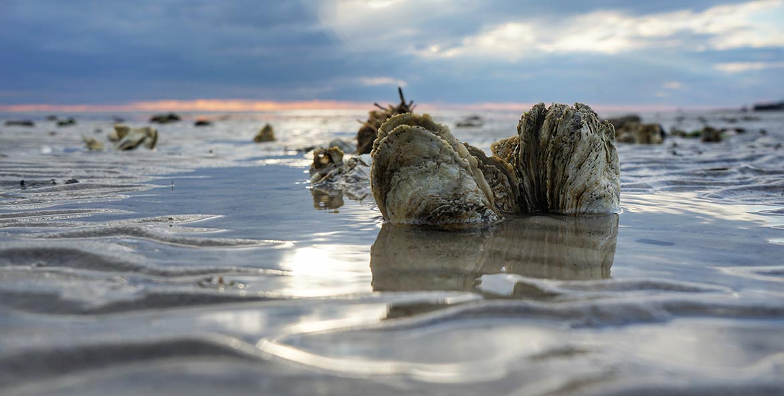
Questions?
Martha Shimkin, shimkin.martha@epa.gov

