Slide 1




Chesapeake Bay Riparian Forest Buffer Outcomes Fund
[INSERT DATE HERE]
Developed by the Environmental Policy Innovation Center
Policyinnovation.org
With support from the EPA, Chesapeake Bay Trust, and the Chesapeake Bay Program

Slide 2
Agenda
Pay for Success
Overview of proposed fund
Buyers, outreach, agreements and contracting
Q&A
This project has been funded wholly or in part by the United States Environmental Protection Agency (U.S. EPA) under assistance agreement 96374201 to the Chesapeake Bay Trust. The contents of this document do not necessarily reflect the views and policies of the Environmental Protection Agency, nor does the EPA endorse trade names or recommend the use of commercial products mentioned in this document.

Slide 3
How’d this project come to be?
The Forestry Workgroup has been thinking about overcoming barriers to buffer plantings for a long time.
Notes:
Originally this project was to design a natural filters REVOLVING FUND. However, upon digging in, we found that the need was more for an aggregated source of projects that alleviated capacity constraints for local governments.
An outcomes-purchase fund idea was pitched and well received.
A major hurdle for increasing buffers has been lack of a consistent demand for buffer projects.; that is what led us to prioritize a program of outcomes purchase over a revolving fund.

Slide 4
Benefits of RFBs
In addition to nutrient reduction…
Wildlife habitat (coldwater fish, migratory birds)
Drinking water protection
Carbon
Flood resilience
Property values
Other Chesapeake Bay Program Management Strategies
Notes:
Riparian forest buffers are strips of land along bodies of water planted with trees, shrubs, and other perennial plants. They provide a ton of benefits like
Cleaner water, by absorbing nutrients before entering adjacent waterways.
Stabilizing stabilize soils and prevent erosion.
Reduce flooding, as well as coastal impacts from storm surges and sea level rise.
Sequestering air pollutants and carbon,
As well as providing wildlife habitat enhancements for both terrestrial and aquatic species.

Slide 5
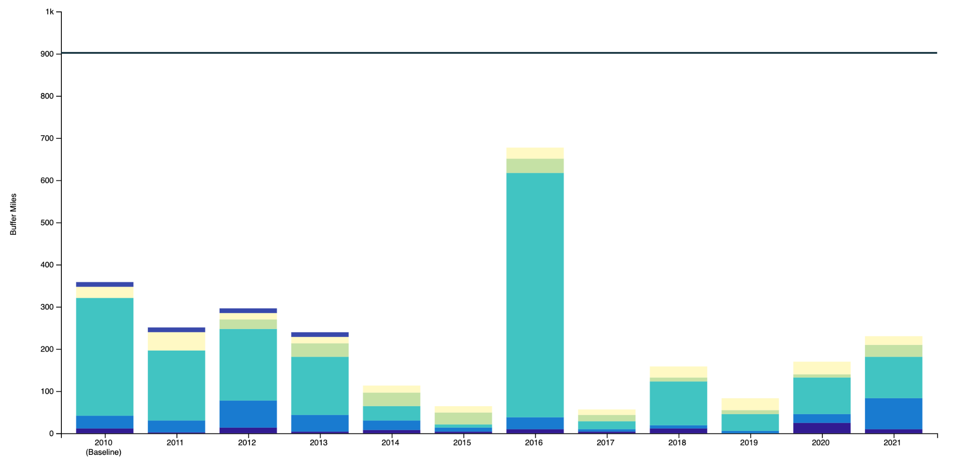
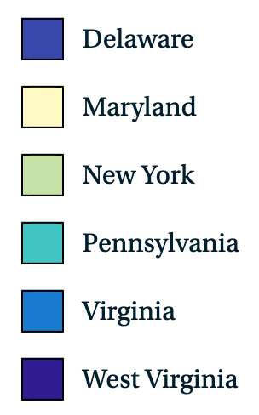
Drivers
WIP III Goals and Progress by State for Riparian Forest Buffers (acres)
 | DE | MD | NY | PA | VA | WV
Cumulative total (acres) | 143 | 17,193 | 2,822 | 11,659 | 3,538 | 2,820
WIP III goal | 692 | 19,821 | 8,743 | 96,971 | 58,375 | 5,898
Progress | 21% | 87% | 32% | 12% | 6% | 48%
Acres needed to reach goal | 549 | 2,628 | 5,921 | 85,312 | 54,837 | 3,078
TMDL & WIP Goals
MS4 Permits
Voluntary Efforts
MD CFA/CWCA
PA CWPP
& Others!
Sources:
Table: CAST Model
Graph: CBP riparian forest buffer Management Strategy
Source: Watershed Agreement-related data reported on Chesapeake Progress.
Notes:
We recognize there is already a lot of work happening to plant buffers and fund these efforts. There is a lot of state and Fed money for these kinds of BMPs.

Slide 6
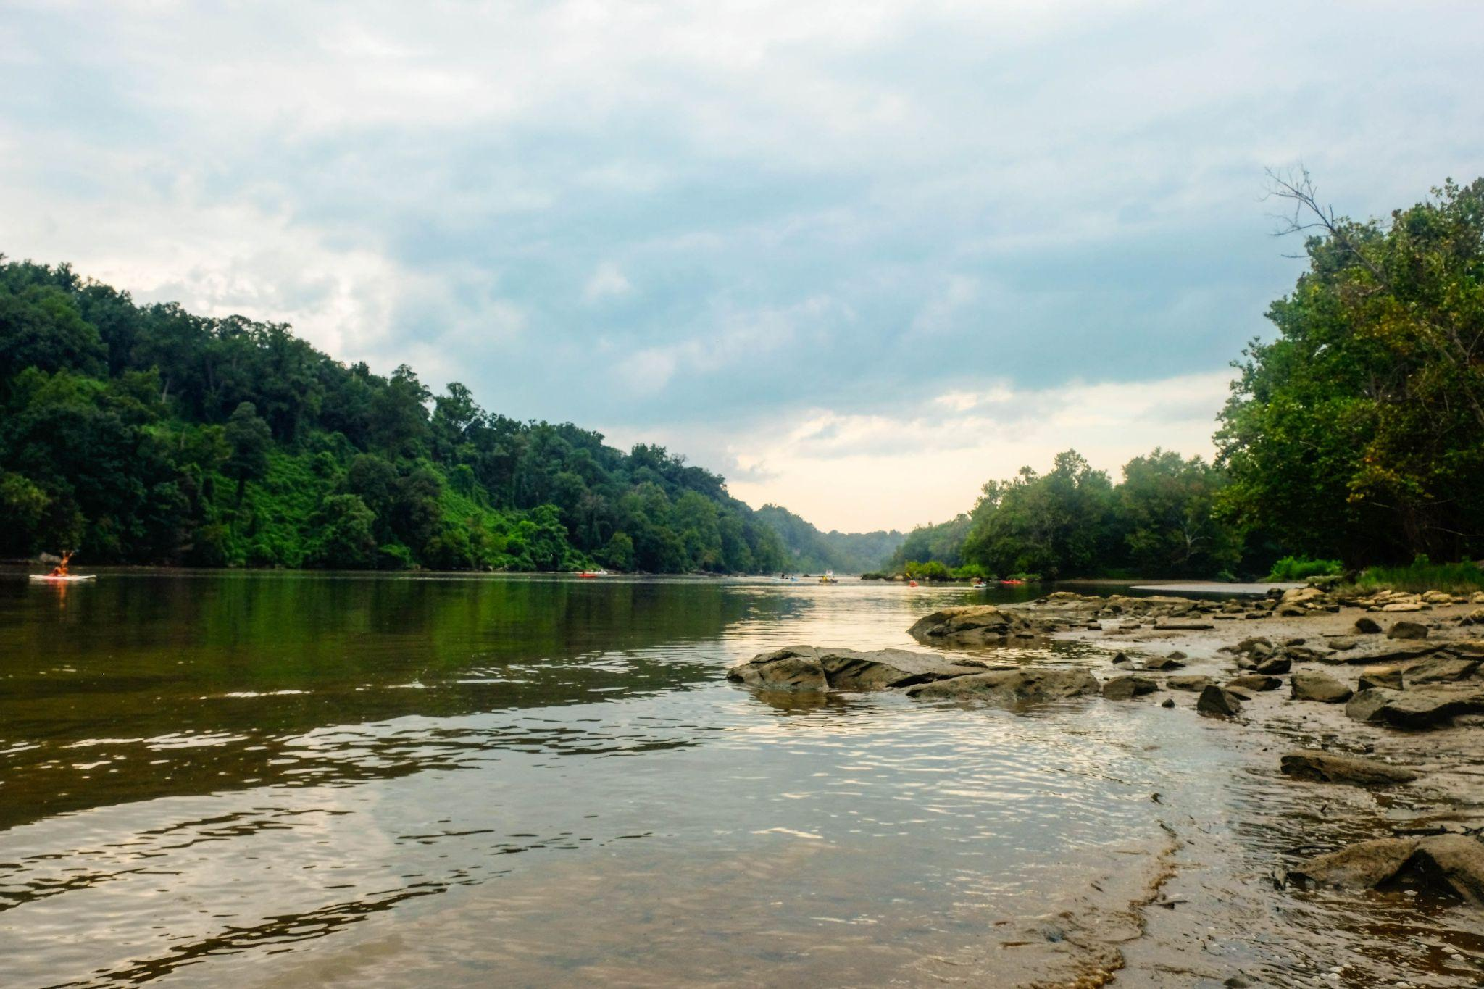
Payment for OUTCOMES, not activities
NO itemized budgets/receipts
Invoice for contracted price
Risk shifts to private sector
Saves money and time
Pay for Success
Notes:
Full Delivery
This differs from traditional procurement where reimbursements for time and materials are paid out at regular intervals (monthly, quarterly, etc.). Full Delivery does not require the contractor to submit itemized budgets and receipts, rather an invoice for the agreed upon price once outcomes have been successfully delivered.
The payment scheme of full delivery contracts, where payment is reserved for the delivery of outcomes, is known as Pay for Success contracting (PFS). The Fund’s contracts will be structured this way because PFS creates positive economic pressure, allowing the private sector to take on the risk of achieving project outcomes, which means more work can be accomplished for less public funding.
Not only are PFS contracts paid out upon delivery of successful outcomes, there is evidence that this innovation takes significantly less time. In Florida, traditional procurement has taken up to three phases funded over 16 years, compared to a new PFS contract that is shaving off a decade from the process. Not only are they faster, they can also be cheaper: RFPs in Maryland show PFS contracts costing one third of past procurement.

Slide 7

Maryland’s Clean Water Commerce Program
Request for proposals
Entities bid $/lb N
Based on model
Include co-benefits
State selects projects
Verification
Payment
Cleaner water
Notes:
EXAMPLE of existing Pay for Success program within the watershed

Slide 8
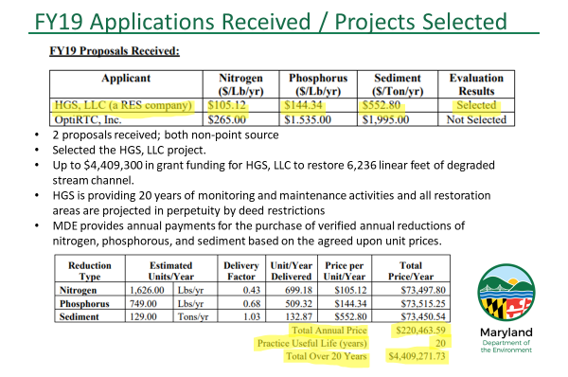

Slide 9
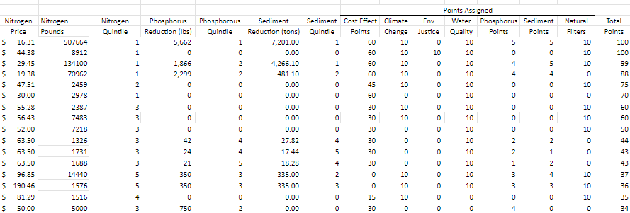
Scoring and Selecting $20M of Outcomes

Slide 10
Chesapeake Bay Riparian Forest Buffer Outcomes Fund

Slide 11
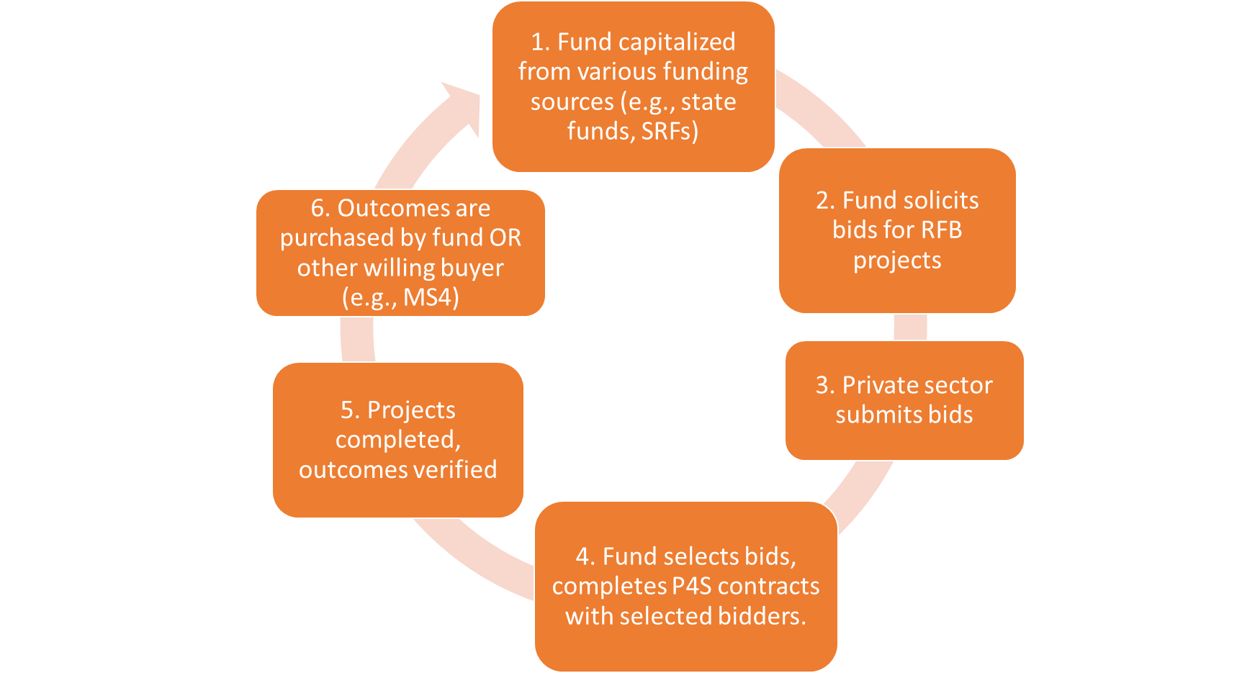
Notes:
FUND SPECIFICS
Statewide or even regional fund
Certainty for the private sector bidders/implementers who would know they have a buyer
Bidders encouraged to sell to MS4s or other buyers (fund = price floor)
Localities can copy the paperwork from the fund and save time/energy
Maybe the outcomes fund can also be a lender to smaller/less well capitalized bidders?
For equity/supporting small projects: Can have tiers, loans available for smaller projects, etc.
One-stop shop
Doesn’t compete with other buyers
Paperwork reduction
Loans and carve-outs available for:
Smaller projects
EJ priorities
Could cover 1 or more states (MD, PA, VA, etc.)

Slide 12
Funding
Local Bonds FCA fee-in-lieu MS4 funds | Federal IIJA IRA EPA programs Greenhouse Gas Reduction Fund (EPA) NFWF Chesapeake Watershed Investments for Landscape Defense (Chesapeake WILD) RCPP SRF (via states) FEMA grants
State Chesapeake & Atlantic Coastal Bays Trust Fund State ARPA funds State of MD Reforestation Fund Clean Water Commerce Act Bay Restoration Fund Clean Streams Fund
Private Foundations
Notes:
Many potential funding sources that don’t seek financial return (grants!)

Slide 13
Notes:
FUND SPECIFICS
Statewide or even regional fund
Certainty for the private sector bidders/implementers who would know they have a buyer
Bidders encouraged to sell to MS4s or other buyers (fund = price floor)
Localities can copy the paperwork from the fund and save time/energy
Maybe the outcomes fund can also be a lender to smaller/less well capitalized bidders?
For equity/supporting small projects: Can have tiers, loans available for smaller projects, etc.
One-stop shop
Doesn’t compete with other buyers
Paperwork reduction
Loans and carve-outs available for:
Smaller projects
EJ priorities
Could cover 1 or more states (MD, PA, VA, etc.)

Slide 14
Outcome = Acres of riparian forest buffer established
Chesapeake Bay Program Guide - what “counts” toward Bay Program goals
Rural: A-12. Forest Buffers and Grass Buffers
Urban: D-7: Urban Tree Planting BMPs
Recommended buffer width of 100 feet, 35-foot minimum buffer.
Verification of outcomes should follow the Chesapeake Bay Program Forestry Workgroup’s BMP Verification Guidance.
Outcome Definition & Standard
Notes:
Standards for this outcome are tied to existing standards through the Chesapeake Bay Program.
A buffer can be credited (reported) when its installation according to plan is confirmed. (from verification guidance)
Verification methods for rural/agricultural projects are further detailed in the Chesapeake Bay Program Resource Improvement Practice Definitions and Verification Visual Indicators Report (pp 19-20).

Slide 15
Notes:
FUND SPECIFICS
Statewide or even regional fund
Certainty for the private sector bidders/implementers who would know they have a buyer
Bidders encouraged to sell to MS4s or other buyers (fund = price floor)
Localities can copy the paperwork from the fund and save time/energy
Maybe the outcomes fund can also be a lender to smaller/less well capitalized bidders?
For equity/supporting small projects: Can have tiers, loans available for smaller projects, etc.
One-stop shop
Doesn’t compete with other buyers
Paperwork reduction
Loans and carve-outs available for:
Smaller projects
EJ priorities
Could cover 1 or more states (MD, PA, VA, etc.)

Slide 16
Solicitation Scoring Criteria |  | Max Points (out of 100)
Cost Effectiveness |  | 50
Bidder Qualifications |  | 20
 | Environmental Justice 80+ Socioeconomic Score on MDE EJ Tracking Tool USDA: historically underserved landowner | 10
 | Climate change flood control and mitigation; disaster resilience | 10
 | Water quality prioritize impaired waterways | 10
Co-Benefits
Notes:
A group of reviewers will score each proposal independently using the following scoring matrix. Reviewers can include, but are not limited to, fund managers, experts in relevant fields, state and local government employees, and members of academic institutions.
This matrix was developed as a hybrid model based on Maryland Clean Water Commerce Act Application, Anne Arundel County’s Stormwater Program and the need to address specific demands of the Fund. We suggest the Fund revisit the scoring criteria after the completion of a pilot round of solicitations to ensure it is creating incentives that deliver a balance of projects across urban and rural geographies and a range of project sizes, and that it does not exacerbate environmental injustices.
Cost Effectiveness (price per acre per year)** - Bid should include: Number of acres established (outcomes), Total project cost, Project term (i.e., permanent protection, 15 year contract, etc.
Bidder Qualifications - Bid should include: Letters of reference, Team leadership resumes, List of prior projects, Other materials to substantiate bidder qualifications.
Co-Benefit 1: Alleviating environmental harms and risk by disadvantaged communities:
located in communities identified by a Socioeconomic Score (Distribution Across Maryland) of 80 or higher using MDE’s Environmental Justice Tracking Tool
located on land owned or operated by a producer classified as historically underserved by USDA
Co-Benefit 2: Enhancing adaptation against climate change
Examples include: flood control and mitigation, disaster resilience
Co-Benefit 3: Contributing towards attainment of local water quality standards (i.e., to prioritize impaired waterways)

Slide 17
Notes:
FUND SPECIFICS
Statewide or even regional fund
Certainty for the private sector bidders/implementers who would know they have a buyer
Bidders encouraged to sell to MS4s or other buyers (fund = price floor)
Localities can copy the paperwork from the fund and save time/energy
Maybe the outcomes fund can also be a lender to smaller/less well capitalized bidders?
For equity/supporting small projects: Can have tiers, loans available for smaller projects, etc.
One-stop shop
Doesn’t compete with other buyers
Paperwork reduction
Loans and carve-outs available for:
Smaller projects
EJ priorities
Could cover 1 or more states (MD, PA, VA, etc.)

Slide 18
Notes:
FUND SPECIFICS
Statewide or even regional fund
Certainty for the private sector bidders/implementers who would know they have a buyer
Bidders encouraged to sell to MS4s or other buyers (fund = price floor)
Localities can copy the paperwork from the fund and save time/energy
Maybe the outcomes fund can also be a lender to smaller/less well capitalized bidders?
For equity/supporting small projects: Can have tiers, loans available for smaller projects, etc.
One-stop shop
Doesn’t compete with other buyers
Paperwork reduction
Loans and carve-outs available for:
Smaller projects
EJ priorities
Could cover 1 or more states (MD, PA, VA, etc.)

Slide 19
Notes:
FUND SPECIFICS
Statewide or even regional fund
Certainty for the private sector bidders/implementers who would know they have a buyer
Bidders encouraged to sell to MS4s or other buyers (fund = price floor)
Localities can copy the paperwork from the fund and save time/energy
Maybe the outcomes fund can also be a lender to smaller/less well capitalized bidders?
For equity/supporting small projects: Can have tiers, loans available for smaller projects, etc.
One-stop shop
Doesn’t compete with other buyers
Paperwork reduction
Loans and carve-outs available for:
Smaller projects
EJ priorities
Could cover 1 or more states (MD, PA, VA, etc.)

Slide 20
Fund Management
National / regional: Chesapeake Conservancy NFWF Private investment company U of MD Environmental Finance Center | MD-focused: MARBIDCO (MD Agricultural & Resource-Based Industry Development Corporation) MDE MDA
Notes:
This is a big area of exploration. Govt vs non-govt? Who can be responsive and adaptive?

Slide 21
Buyers’ Options
 | Direct Contract with Bidder | Transfer Contract from Fund | Direct Purchase from Fund
Timing | Day 0 | Day 0 -> end Yr 5 | After final payment (yr 5)
Risk to Buyer | Highest | Variable | Lowest
Level of effort | Highest | Variable | Lowest
Payments | All payments to project developer | Pro rata based on contracted schedule | Single payment to fund
Who Earns $.01 | Project developer | Project developer and Fund | Fund
Notes:
Kavita

Slide 22
To Bidders:
Direct email
Meeting presentations
Member associations
To Landowners:
Most done by bidders
Trade associations
County farm bureaus
Grain Producers Assn
NRCS
UMD Extension
Fund Outreach
Notes:
Bidders are expected to be restoration firms mainly
Outreach by direct email, presentations at meetings they attend, including member associations like ERBA
Landowners:
Bidders have an incentive to recruit landowners so most outreach will be by bidders.
Fund will do general outreach to landowner partners, trade associations, county Farm Bureaus,
The fund will conduct some general outreach to trusted partners of landowners, including farmers. For example, trade associations for agricultural producers, such as county Farm Bureaus and the state Grain Producers Association, should be educated on the Fund so otherwise-hesitant farmers can use them as resources. Similarly, the Fund will conduct education of government technical assistance providers such as with the Natural Resources Conservation Service, University of Maryland Extension, and county agriculture marketing professionals and business development specialists.

Slide 23
Contracts issued under this fund will utilize the Full Delivery approach where the contractor takes responsibility for all elements of the project from design to maintenance. Payment is contingent on the contractor delivering verified acres of riparian forest buffers established.
At the end of each phase, verification of the outcome will be assessed.
Sample Agreement
Phase | Activity | Payment
I | Planting | 30%
II | After 1-2 years of maintenance | 30%
III | After 3 years of maintenance | 40%
Notes:
Kavita

Slide 24
Price Assumptions
 | Full delivery price/ac established (including bidder margin) | Acres needed (60% rural, 30% suburban, 10% urban) | Total
Rural/ag - 15 year contract | $12,000 | 788 | $9,460,800
Rural/ag - w/ easement | $20,000 | 788 | $15,768,000
Suburban - 15 year contract | $20,000 | 394 | $7,884,000
Suburban - w/ easement | $86,327 | 394 | $34,030,103
Urban - 15 year contract | $45,000 | 131 | $5,913,000
Urban - w/ easement | $86,327 | 131 | $11,343,368
Total needed to meet MD WIP goal (2,628 acres) |  |  | $84,399,271
Notes:
Kavita
Iterative process from those FAP, Price paper and CAST data, followed by interviews and steering committee
The total cost of establishing enough riparian forest buffers to meet Maryland’s goals might range from about $80 million to $120 million. This range is based on the following assumptions:
The number of riparian forest buffer acres needed to meet the goal is 2,628 total new established acres.
Rural outcomes will likely cost approximately $12,000-20,000/acre, depending on the length of site protection (i.e., presence of a conservation easement). Rural areas might account for as much as 60-80% of the Fund’s purchased outcomes.
Urban and suburban outcomes will cost approximately $20,000-86,000/acre, depending on land costs. Suburban areas might deliver about 30% of the Fund’s purchased outcomes and urban areas might deliver just 10-20% of the Fund’s purchased outcomes.
Pricing will likely increase over time so this should be included in projections.

Slide 25
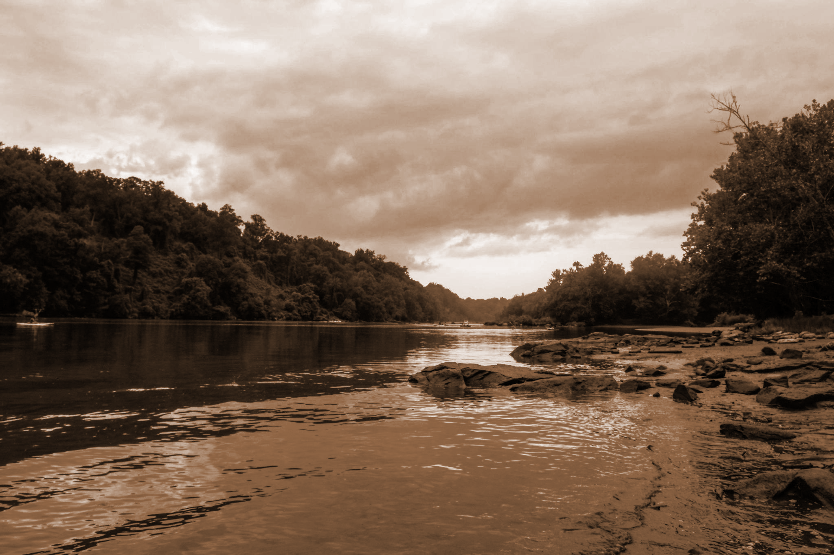
Identify buyers and requirements
Refine scoring criteria
Assess challenges
Adapt program before scaling up
Urban/suburban/rural
Howard, Carroll, Harford, Baltimore
Prototype
Notes:
Launching as a pilot initially will help iron out many details related to costs, pricing, contracting, technical assistance levels, staffing levels and more. The initial pilot could aim to work with a wide variety of project implementers, community types (urban and rural), and carry out a formal reflection process that leads to adaptive management of the Fund.
The Fund could launch via a multi-county pilot in Carroll and Howard Counties. Howard County has established a need and desire for increased riparian forest buffer plantings, and Carroll County has a vast rural area opportunity, plus some work currently underway with the Alliance for the Chesapeake Bay. Launching in a couple of counties will narrow the number of variables the newly-formed fund has to deal with, support developing early partnerships and examples, and build on existing riparian forest buffer strategy. The idea behind such a pilot would be to assess the Fund’s potential challenges with setting pricing, covering staffing costs, revealing unexpected expenses and tasks that need to be built into a scaling plan and fund rollout, etc.
Harford and Baltimore Counties have also been suggested as potentially worth exploring for pilots.

Slide 26
Thank you
For follow up, email [INSERT NAME HERE]: [INSERT EMAIL ADDRESS HERE]

