Slide 1
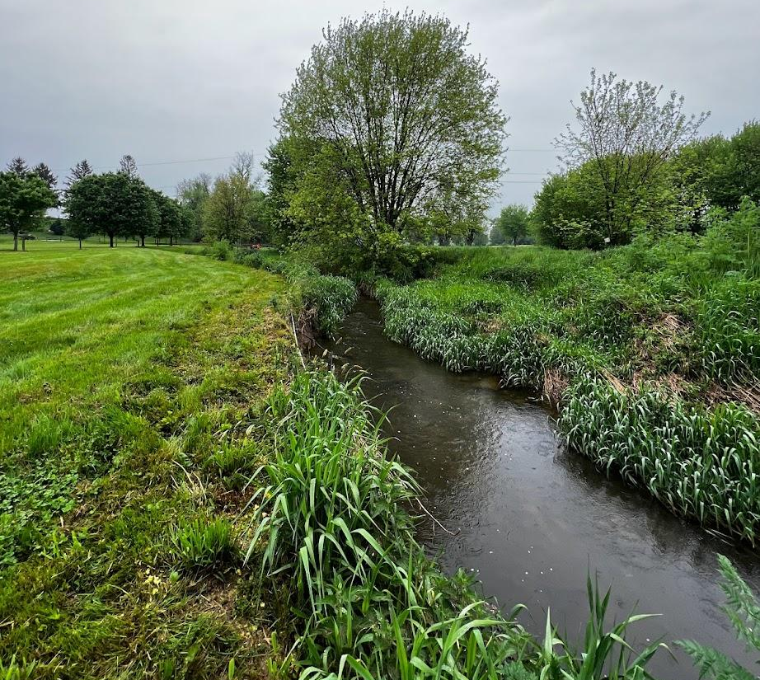
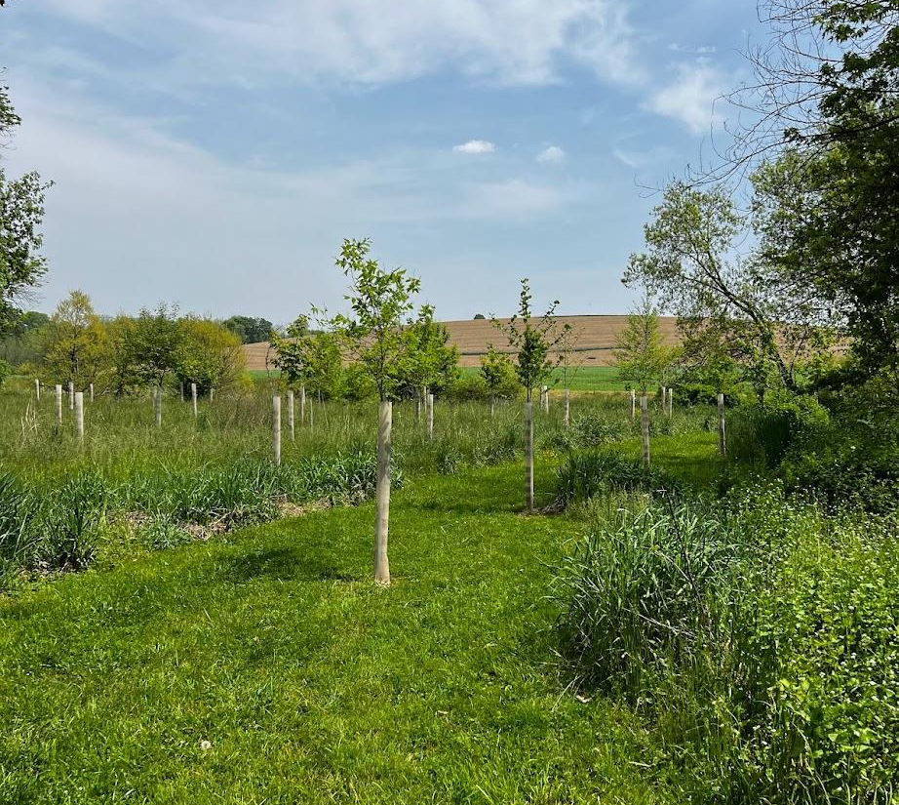
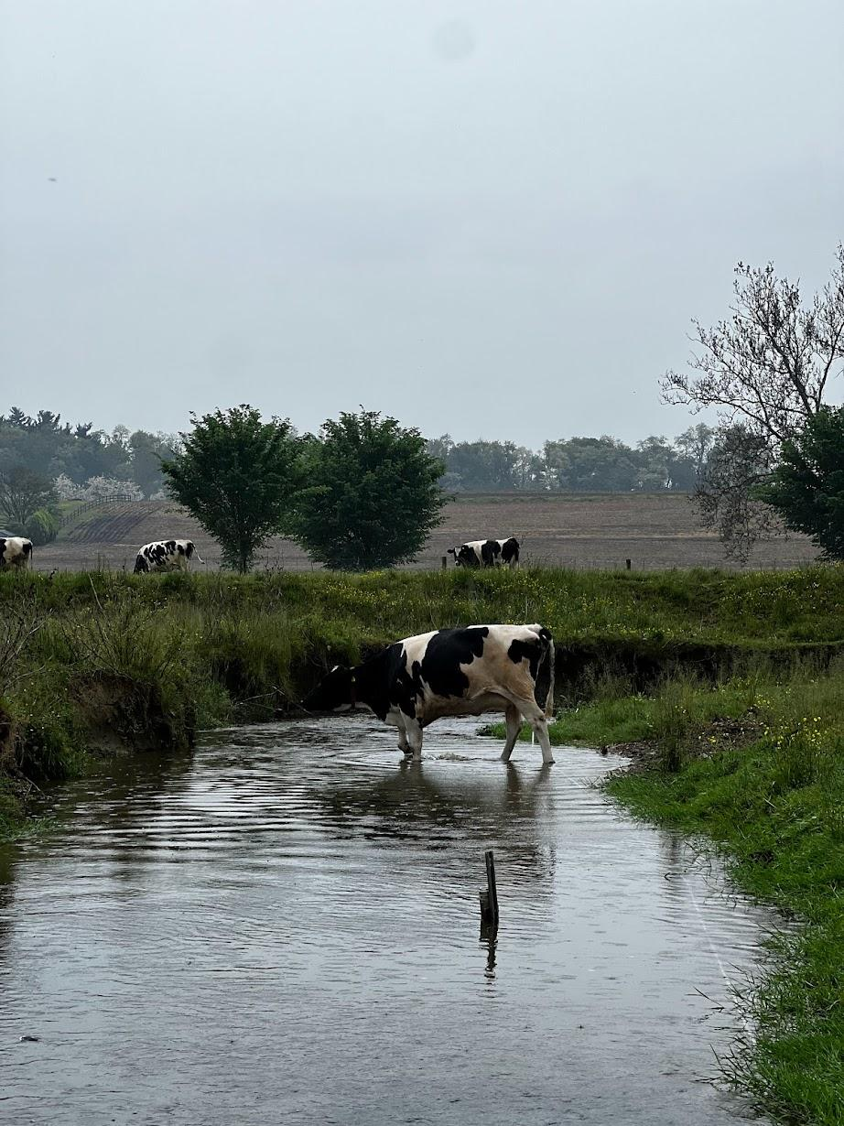
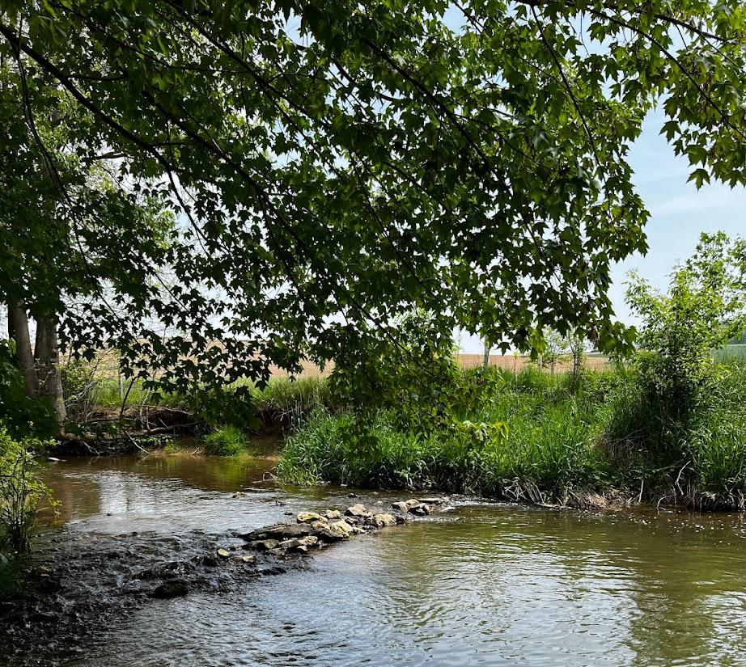



Stream-Macroinvertebrate Responses to Management Practices
What responds, where and why — a synthesis across the Chesapeake Bay watershed
· Sergio A. Sabat-Bonilla · A.C. Belvin · G.B. Noe · K.O. Maloney · E.A. Frimpong · P.L. Angermeier · S.A. Entrekin
PhD Candidate · Aquatic Entomology Lab · Virginia Tech
CBP Stream Health Work Group | 26 June 2026
Notes:
Good morning, and thank you for having me. I'm Sergio Sabat-Bonilla, a PhD candidate in the Aquatic Entomology Lab at Virginia Tech, working with the USGS Chesapeake stream science group. Over the next twenty-five minutes I'll walk through a synthesis we recently published on how stream macroinvertebrates respond to management practices across the Bay watershed — what responds, where, and why — and what it might mean for this group

Slide 2
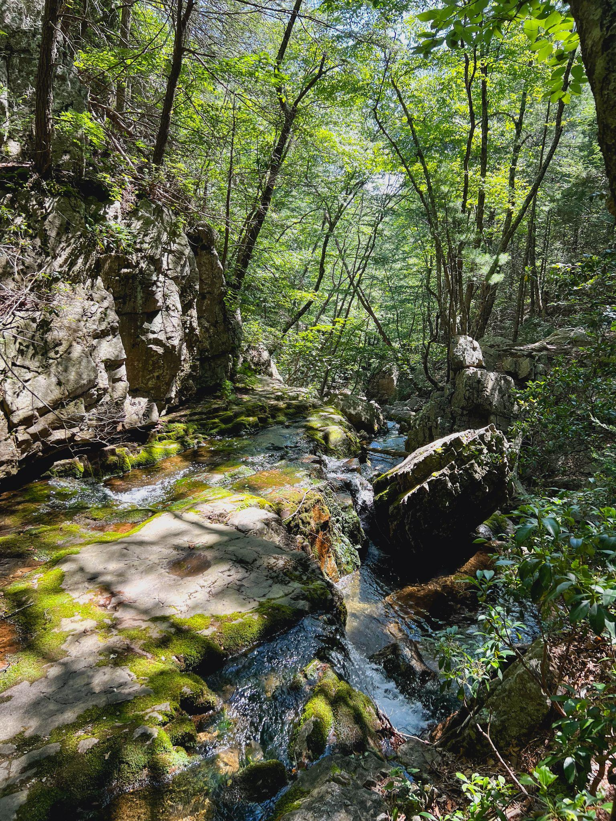
What we'll cover today
Roadmap
1
Why this matters now
Load-reduction goals vs. local stream condition
2
What we did
A standardized evidence synthesis
3
What we found
Region sets the biotic response
4
What it means for SHWG
Coastal Plain & Chessie B-IBI
5
Where we go
Forthcoming USGS Chesapeake stream science
1 / 19
Notes:
A quick map of the talk. divided into 5 sections
first, the knowladge gap between load-reduction goals and local stream condition.
Second, what we did in this synthesis.
Third, what we found
Fourth, what it means for Stream Health Working Group and the Chesapeake Bay Program as a whole,
And fifth, where we go from here

Slide 3
The problem: load-reduction goals don't ensure local stream condition
Where the CBP stands?
What practices target vs. deliver?
66.7% of non tidal stream miles rated healthy
  Watershed condition improved (+10.3%) since 2000
However, trends differ by bioregion:
  Coastal Plain has declined -10%
3
3
Most management practices target reductions nitrogen, phosphorous & sediment loads to the Bay
However, in water quality monitoring, only nitrogen is reliably declining
3
10
Which practices improve condition, where and can standard biomonitoring detect it?
The literature gap
[3] Buchanan et al. 2025 · [10] Zhang et al. 2025
2 / 19
Notes:
To start things of, the core problem,
On the left, the current non-tidal stream health condition for the Bay: 66.7 percent of nontidal stream miles rate healthy, and watershed condition has improved about ten percent since 2000 — but trends differ by bioregion,with the Coastal Plain showing declining conditions roughly ten percent contrary to the rest.
Why this might be happening even when accounting for management, its that most practices are implemented primarily to reduce nitrogen, phosphorus, and sediment loads to the Bay — yet in the water-quality monitoring record, only nitrogen is reliably declining.
Thus, the big unknown still is which practices actually improve biological condition, where, and under what conditions. As well as how and if standard biomonitoring protocols can detect this?
That is the question we took on — not whether loads are declining, but whether load reductions translate into biological responses in nontidal streams.

Slide 4
From load reductions to biological response: three gaps
Targeting
Implementation
Response
Practices must reduce nutrient loads and address biological limitants (habitat → richness; resources → biomass)
Practices not at the scale, density or configuration needed
Where practices are in place, lack expected biological response
Chesapeake Ecosystem Science Review (CESR) names two drivers of the response gap :
2
Overestimating nonpoint-source practice effectiveness
Monitoring not designed to detect a biological response
Our synthesis quantified what common practices are leading to biological response for stream macroinvertebrates
[2] CESR, STAC Pub. 23-006
3 / 19
Notes:
three gaps in our understanding of how to go from load reductions to desired biological responses and conditions
On the left, a targeting gap: we lack concrete and replicable information on how practices that reduce loads can or may also address biological limitants like habitat and resources in order to see biological responses.
In the middle, an implementation gap, as we need to know how practices must be deployed at a scale, density or configuration that promotes these biological repsonses.
And on the right, a response gap, as we need more information on what truly leads to these biological responses and how can we measure these.
The CESR names two drivers of that response gap specifically: overestimating nonpoint-source practice effectiveness, and monitoring not designed to detect a biological response.
Our synthesis is aimed squarely at that response gap for stream macroinvertebrates — quantifying what is and isn't known about whether practices actually move the biological needle.

Slide 5
Community structure + ecosystem function: two lenses of biological response
Structural
Functional
What roles and energy pathways are supported?
Who is present and how many?
■ Taxa richness, abundance, density
■ Total community biomass
■ EPT richness, % EPT
■ Feeding-group biomass
■ Shannon diversity
■ Secondary production
■ Tolerance indices (HBI, % tolerant)
■ Trait-based indices
compositional change, sensitive-taxa loss, dominance shifts
resource use, energetic recovery
Pairing community and ecosystem metrics expands assessment from “who responds?” to “what ecological functions are responding?”
[1] Sabat-Bonilla et al. 2026
4 / 19
Notes:
One framing runs through the entire talk, and you can see it laid out here in two columns.
On the left, a structural lens — taxa richness, abundance, EPT, Shannon diversity, tolerance indices — asking 'who is present and how many?' These are what the indices of biological integrity like the Chessie B-IBI are built on: reliable sentinels of compositional change, sensitive-taxa loss, and dominance shifts.
On the right, a functional lens — total community biomass, feeding-group biomass, secondary production, trait-based indices — asking 'what roles and energy pathways are supported?'
pairing these expands assessment from 'who responds?' to 'what ecological functions are responding?'

Slide 6
Systematic review + standardized effect-size synthesis
Scope of the synthesis
4 physiographic provinces — Appalachian Plateau · Valley & Ridge · Piedmont · Coastal Plain
8 NRCS practice groups —
AC · OC · RFB · RHC · SRC · SSP · SHIM · SW
390 → 29 studies — Strict before-after-control-impact (BACI) inclusion
123 response metrics — Standardized across studies
Effect sizes — Log-response ratios + Hedges' g
Model selection — AICc to find the best predictors
Filtering the evidence
390
papers from Web of Science
(initial query)
29
studies retained after
BACI inclusion criteria
[1] Sabat-Bonilla et al. 2026
5 / 19
Notes:
Here's what we did.
On the left, the filtering funnel: we started with 390 papers from Web of Science and, after applying strict before-after-control-impact inclusion criteria, retained 29 studies.
On the right, the scope: four physiographic provinces — Appalachian Plateau, Valley and Ridge, Piedmont, and Coastal Plain — and eight NRCS conservation-practice groups, which I'll define on the next slide.
We standardized every reported response onto common effect sizes — log-response ratios for direction and Hedges' g for magnitude — across 123 response metrics, and used Akaike Information Criterion Corrected model selection to find what actually predicts the response.
So this is a standardized, apples-to-apples synthesis.

Slide 7
Management Practice (MP) categories
Natural Resources Conservation Service Conservation Practice Standards
AC
Access Control
livestock & stream access fencing
OC
Open Channel
drainage ditches, re-graded channels
RFB
Riparian Forest Buffers
Forested riparian zones along streams
RHC
Riparian Herbaceous Cover
Grass buffers, filter strips
SRC
Stormwater Runoff Control
Stormwater retention ponds
SSP
Streambank & Shoreline Protection
Bioengineering, armoring
SHIM
Stream Habitat Improvement & Mgmt
In-stream restoration, large wood
SW
Structures for Wildlife
Habitat structures, wetland creation
[1] Sabat-Bonilla et al. 2026
6 / 19
Notes:
Before the findings, the management practice vocabulary
You can see all eight categories listed on the slide, drawn from the NRCS Conservation Practice Standards.
AC is Access Control — livestock and stream-access fencing. OC is Open Channel — drainage ditches, re-graded channels. RFB is Riparian Forest Buffers — forested riparian zones along streams.
RHC is Riparian Herbaceous Cover — grass buffers and filter strips. SRC is Stormwater Runoff Control — retention ponds. SSP is Streambank and Shoreline Protection — bioengineering and armoring.
SHIM is Stream Habitat Improvement and Management — in-stream restoration, large wood. And SW is Structures for Wildlife — habitat structures and wetland creation.

Slide 8
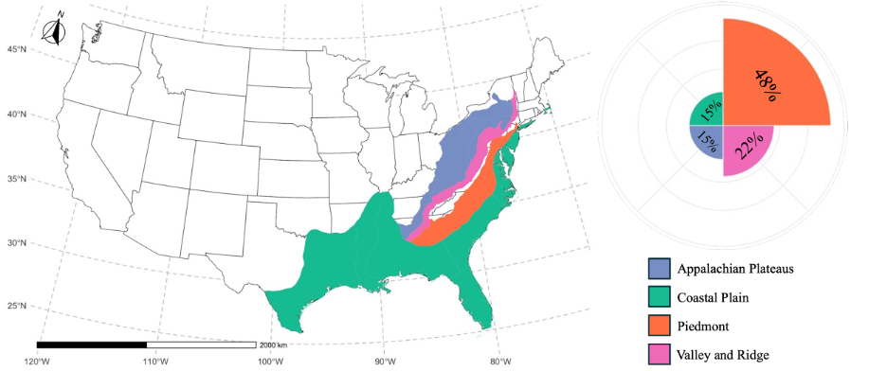
The evidence base is uneven, dominated by Piedmont studies
The Coastal Plain paradox
distinct management practices implemented in Coastal Plain
171
4
15%
of studies
in our synthesis
The regions with the most diversity of practice is among the least-studied
[1] Sabat-Bonilla et al. 2026, Fig. 1 · [4] CAST 2024
7 / 19
Notes:
This slide has two parts.
On the left is a map of the eastern United States with the four physiographic provinces shaded: Appalachian Plateau in blue, Coastal Plain in green, Piedmont in orange, and Valley and Ridge in purple.
Next to it is a radial bar chart where each wedge is one province and its length is that province's share of our 29 studies.
The picture is lopsided: nearly half the studies are Piedmont at 48 percent, Valley and Ridge is 22 percent, and the Appalachian Plateau and Coastal Plain are each about 15 percent.
On the right is what I'm calling the Coastal Plain paradox: 171 distinct management practices implemented there according to Chesapeake Assessment Scenario Tool, but only 15 percent of the studies in our synthesis. The region with the most diversity of practices and management is among the least studied.

Slide 9
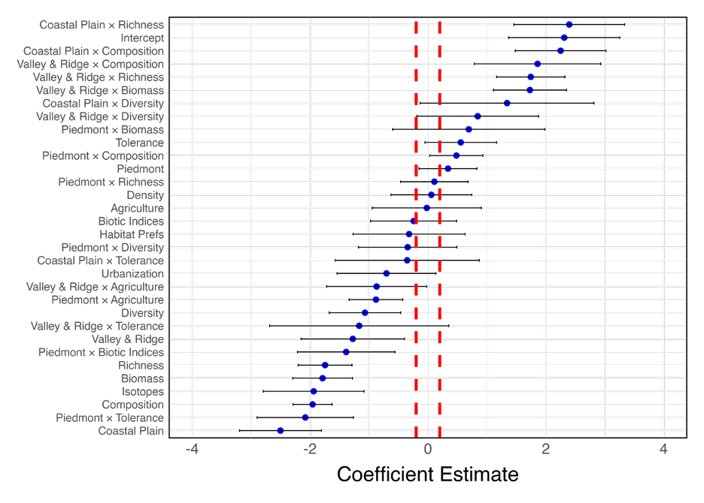
Finding 1: Macroinvertebrate responses are region dependent
Why region dominates
Macroinvertebrate respond primarily driven by the Region based on our model. Followed by the relationship between Region × Land use & Region × metric
effect size = + App. Plateau, Piedmont
effect size = -
Valley & Ridge,
Coastal Plain
[1] Sabat-Bonilla et al. 2026, Fig. 6
8 / 19
Notes:
Finding 1: macroinvertebrate responses are region-dependent.
First, let me orient you to the coefficient-summary plot from our model — the terms that survived AICc-based stepwise selection.
Each row on the y-axis is a model term: either a main effect like 'Piedmont' or 'Richness,' or a two-way interaction like 'Piedmont by Richness.'
The x-axis is the estimated coefficient — how strongly that term shifts the effect size — with horizontal bars showing uncertainty and red dashed thresholds at plus and minus 0.2.
Points to the right mean more positive responses; points to the left, more negative.
What it shows is that province terms, and their interactions with land use and metric type, dominated the reduced model.
As the callout boxes on the right summarize: Appalachian Plateau and Piedmont had more positive macroinvertebrate responses, while Valley and Ridge and the Coastal Plain leaned to weaker or negative.
Region carried more weight than practice type.

Slide 10
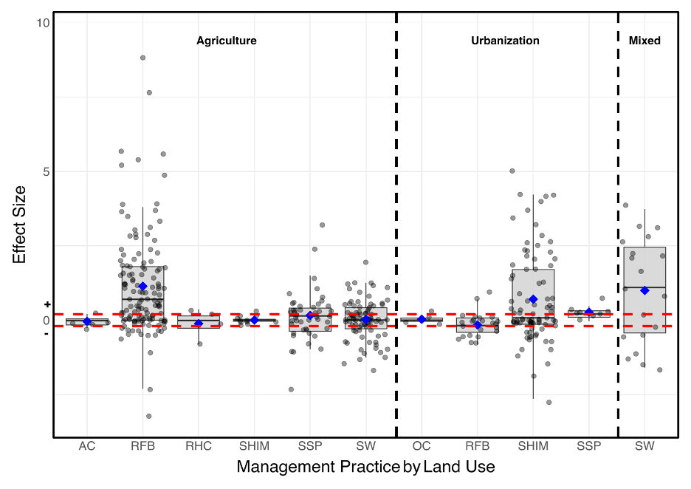
Finding 2: Macroinvertebrates response vary by land use and management practice
Agricultural
Riparian Forest Buffer
Positive response
Effect Size = 1.14
Urban Stream Habitat Improvement & Mgmt
Positive response
Effect Size = 0.24
Urban
Riparian Forest Buffer
No detectable response
Effect Size = −0.16
[1] Sabat-Bonilla et al. 2026, Fig. 3
9 / 19
Notes:
Finding 2: The y-axis is the effect size: above zero means a more positive macroinvertebrate response, zero means none. The x-axis shows management-practice categories grouped by land-use context — Agriculture on the left, Urbanization in the middle, Mixed on the right.
In each box, the thick line is the median, the box is the interquartile range, the whiskers extend to 1.5 times that range, the blue diamond is the mean, and the grey dots are individual study values.
The red dashed lines at plus and minus 0.2 mark positive, negative, or no-response thresholds. What we found is that macroinvertebrate responses vary by land use and management practice.
Three patterns appear: agricultural Riparian Forest Buffers sit well above the line with a mean effect size of 1.14; urban Stream Habitat Improvement shows a modest positive of 0.24; and urban Riparian Forest Buffers show no detectable effect at minus 0.16. T
the takeaway is not a clean ranking of practices — it's that the same practice in a different land-use context can behave very differently.

Slide 11
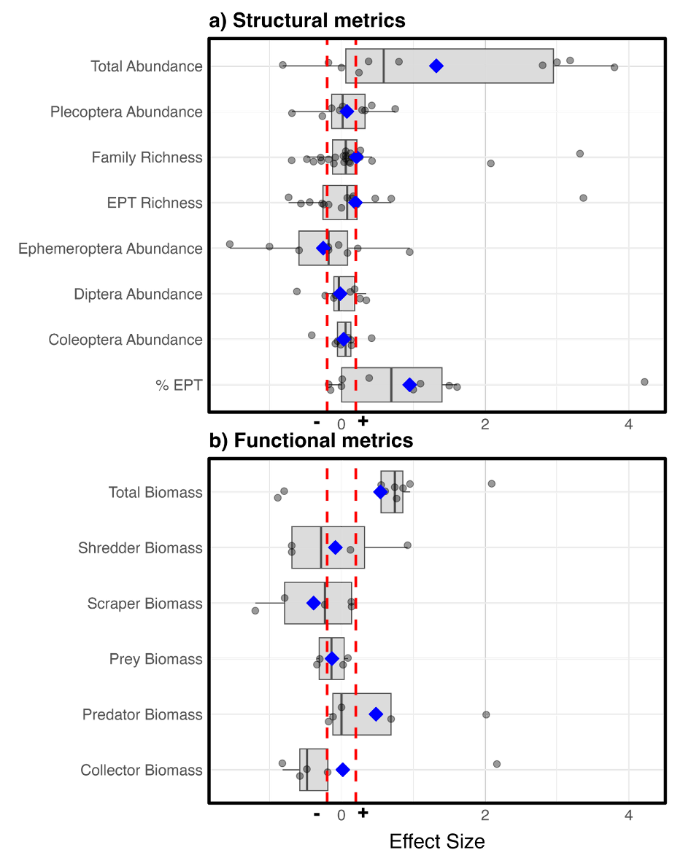
Finding 3: Structural ≠ functional recovery
An improving multimetric index can mask energetic deficit
What this means
Structural metrics can improve when tolerant or opportunistic taxa recolonize, even if biomass and trophic capacity remain limited
Why pair structure and function?
Structural metrics -> rapid compositional turnover
Functional metrics -> energy flow & production
Together, they separate compositional gains from process-level recovery
[1] Sabat-Bonilla et al. 2026 Figure 5
10 / 19
Notes:
Finding 3: This figure has two panels of horizontal boxplots, read the same way as Finding 2.
Panel (a) at the top shows structural metrics: total abundance, Plecoptera abundance, family richness, EPT richness, Ephemeroptera abundance, Diptera abundance, Coleoptera abundance, and percent EPT.
Most sit positive — abundance near a mean of 1.3, percent EPT with a median around 0.7.
Panel (b) below shows functional metrics: total biomass, shredder biomass, scraper biomass, prey biomass, predator biomass, and collector biomass. Biomass spreads widely, from strongly negative to strongly positive.
So structural metrics can improve when tolerant or opportunistic taxa recolonize, even if biomass and trophic capacity remain limited.
Thus, Pairing the two separates compositional gains from process-level recovery.
This is a reason to complement structural indices with a functional metric — with the caveat that biomass was our only well-replicated functional signal.

Slide 12
How far this evidence reaches
Modest replication
29 studies; a small, region-skewed sample likely inflates the share of ‘no-response’ outcomes
Region skew
Piedmont over-represented (48%); Coastal Plain under-represented (15%) despite hosting the most MPs
Short monitoring windows
Most studies ≤3 yr post-implementation; functional recovery typically lags this window
Strict inclusion criteria
BACI requirements excluded grey literature & shorter studies that may carry signal
Design heterogeneity
Reach lengths & protocols varied; effect-size standardization mitigates but doesn't eliminate
[1] Sabat-Bonilla et al. 2026
11 / 19
Notes:
How far this evidence reaches — because the limits shape every suggestion I'll make.
First, modest replication: 29 studies is a small, region-skewed sample that likely inflates the share of no-response outcomes by missing moderate effects.
Second, region skew: Piedmont is over-represented at 48 percent, while the Coastal Plain is under-represented at 15 percent despite hosting the most management practices.
Third, short monitoring windows: most studies ran three years or less post-implementation, shorter than functional recovery may take (which in streams is still an unclear aspect).
Fourth, strict inclusion criteria: our BACI requirements excluded grey literature and shorter studies that may carry signal.
And fifth, design heterogeneity: reach lengths and protocols varied across studies; effect-size standardization mitigates this but doesn't eliminate it.
The honest bottom line: this synthesis maps where signal is strong or absent not a prescription of what practices should be put where

Slide 13
A way to read the practice→response chain
Two pathways from practice to biological response
No-management practice pathway
Stressors
›
Instream
conditions
›
Assemblages
›
Response
Practice density acts on biota indirectly via water-quality and habitat, with thresholds bounding the response
9
Management practice -mediated pathway
Practice
regime
›
Modified
stressors
›
Instream
conditions
›
Assemblages
›
Response
[1] Sabat-Bonilla et al. 2026 · [9] Mouser et al. 2026
12 / 19
Notes:
Given these limits, here is a way to read the practice-to-response chain.
The slide shows two pathway diagrams. The top pathway has no management practice: stressors flow directly to instream conditions, then assemblages, then the response we measure.
With a key insight from Mouser et al.: practice density acts on biota indirectly, via water quality and habitat, with thresholds bounding the response.
The bottom pathway adds a management-practice regime that modifies those stressors before they reach the stream.
The practical reading: a practice is most likely to register when it targets where the dominant stressor enters, is dense enough to shift that stressor, and is monitored long enough to catch the biological response.

Slide 14
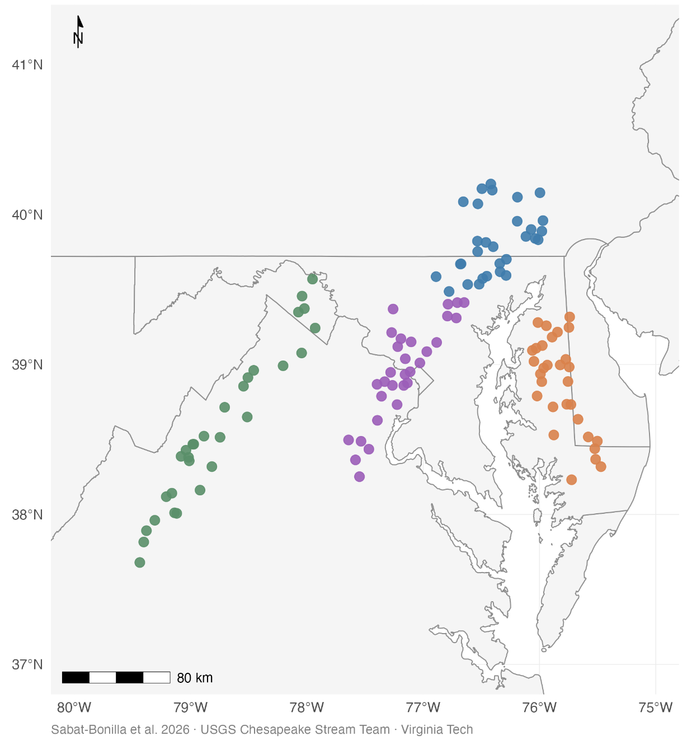




Applying the synthesis: upcoming work
Assessment of 120 streams · community structure, density, biomass, traits
Shenandoah Valley
Delmarva
SE PA/MD
Developed MD-DC-VA
Ch. 2 — Does condition reflect function?
Tests whether similar Chessie B-IBI scores represent similar density, biomass, and trait organization.
Ch. 3 — How do land use and management shape response?
Tests how regional stressors and MP coverage structure macroinvertebrate responses across metrics.
13 / 19
Notes:
This slide previews how we're applying the synthesis in our forthcoming work.
On the left is a site map showing 120 streams we've sampled across four study regions, color-coded: Shenandoah Valley in green, Delmarva in orange, southeast Pennsylvania and Maryland in blue, and developed Maryland-DC-Virginia in purple.
These span the gradient from agricultural to urban land use across the Mid-Atlantic.
On the right are two dissertation chapters building directly from this synthesis.
Chapter 2 asks: does condition reflect function? It tests whether similar Chessie B-IBI scores represent similar density, biomass, and trait organization — directly following from Finding 3, where structural and functional metrics diverged.
Chapter 3 asks: how do land use and management shape response? It tests how regional stressors and management-practice coverage structure macroinvertebrate responses across metrics — extending Findings 1 and 2 with direct environmental predictors at 120 sites.
Both chapters use community structure, density, biomass, and trait data — the paired lenses from the beginning of the talk.

Slide 15
What others are finding: three converging layers
Systematic-review
29 BACI studies across 4 provinces and 8 MP groups.Published evidence: where macroinvertebrate respond to management.
Sabat-Bonilla et al. 2026
1
6
Empirical & causal-inference
Response depends on regional stressor context.
Management practices effects can be positive, negative or indirect.
7
USGS Chesapeake science
Policy-evaluation
Identifies implementation and response gaps.
Calls for monitoring that detects biological response, not just implementation.
STAC 2023 (CESR)
2
Convergent finding: Biological response is regional, stressor-dependent and not guaranteed by practice implementation alone
[1] Sabat-Bonilla et al. 2026 · [2] STAC 2023 · [6] Noe et al. 2024 · Emmons et al. 2024 [7], 2025 [8]
14 / 19
Notes:
This is not a lone result — three independent lines of evidence converge, and you can see them stacked on the slide.
The first row is our systematic-review layer: 29 BACI studies across four provinces and eight practice groups, establishing the published evidence for where macroinvertebrates respond to management.
The second row is the empirical and causal-inference layer from the broader USGS Chesapeake stream science, including Noe et al. and Emmons et al., showing that response depends on regional stressor context and that management-practice effects can be positive, negative, or indirect.
The third row is the policy-evaluation layer — the CESR framework from STAC 2023 — which identifies implementation and response gaps and calls for monitoring that detects biological response, not just implementation.
The convergent finding: biological response is regional, stressor-dependent, and not guaranteed by practice implementation alone.

Slide 16
What this could mean for assessment — points for discussion
1. Taxonomic resolution
2. Functional / energetic metrics
Could functional measures of biomass, production or decomposition show whether improved habitat or resources are being used?
Where family-level metrics flatten Coastal Plain signal, could targeted finer resolution recover useful variation?
3. Reference-site adequacy
4. Practice-response detection
Where least-disturbed sites are scarce (Coastal Plain), are the abiotic reference criteria worth revisiting?
Indices of biotic integrity detects condition — would a complementing their design with functional metrics help assess management effects?
[1] Sabat-Bonilla et al. 2026 · [3] Buchanan et al. 2025
15 / 19
Notes:
This slide presents four open questions:
First, taxonomic resolution: where family-level metrics flatten Coastal Plain signal, could targeted finer resolution recover useful variation?
Second, functional and energetic metrics: could measures of biomass, production, or decomposition show whether improved habitat or resources are actually being used?
Third, reference-site adequacy: where least-disturbed sites are scarce, as in the Coastal Plain, are the abiotic reference criteria worth revisiting?
And fourth, practice-response detection: indices of biotic integrity detect condition — would complementing their design with functional metrics help assess management effects specifically? Four questions for the group, not recommendations.

Slide 17
Why the Coastal Plain may respond differently: three filters
1
Physical
2
Stressor
3
Trait
Geology, hydrology, substrate, gradient sets the habitat template
Agriculture (nutrients, sediment) vs. urban (flashy flows, contaminants) manifest unevenly
Regional species pools differ in life history, dispersal
Provinces where our model showed weak/negative responses (Coastal Plain, parts of Valley & Ridge) match the Chessie B-IBI bioregions where stream condition is static or declining
[1] Sabat-Bonilla et al. 2026 · [8] Emmons et al. 2025
16 / 19
Notes:
Why might the Coastal Plain respond differently — and why flag it in particular?
First, a physical filter: geology, hydrology, substrate, and gradient set a very different habitat template — low-gradient, sandy, groundwater-influenced streams.
Second, a stressor filter: agricultural stressors like nutrients and sediment versus urban stressors like flashy flows and contaminants manifest unevenly across provinces.
Third, a trait filter: regional species pools differ in life history and dispersal capacity.
provinces where our model showed weak or negative responses — the Coastal Plain and parts of Valley and Ridge — match the Chessie B-IBI bioregions where stream condition is stalled or declining.

Slide 18
Take-home messages
1
Measurable biological responses need several factors to align
Region → Stressor → Practice → Metric → Time
1, 9
2
Region shaped responses as much as the practice
Consistent with Chessie B-IBI bioregion trends and regional stressor profiles
7, 8
3
Pairing structural with functional metrics may help
Functional gains can precede or diverge from structural recovery
1
4
The Coastal Plain may warrant targeted, collaborative attention
Most practices, fewest studies, among the degrading bioregions
3
5
Consider biological-recovery timescales
Not project-reporting timescales, plan 5-, 10-, 20-year monitoring horizons
1
[1] Sabat-Bonilla et al. 2026 · [3] Buchanan et al. 2025 · Emmons et al. 2024 [7], 2025 [8]
· [9] Mouser et al. 2026
17 / 19
Notes:
Five take-home messages, all as considerations rather than directives
One: measurable biological responses need several factors to align — Region, Stressor, Practice, Metric, and Time. That five-factor chain is the recurring anchor.
Two: region shaped responses as much as the practice itself, consistent with the Chessie B-IBI bioregion trends and regional stressor profiles you already track.
Three: pairing structural with functional metrics may help — functional gains can precede or diverge from structural recovery, and that divergence is information.
Four: the Coastal Plain may warrant targeted, collaborative attention — most practices, fewest studies, among the degrading bioregions.
Five: consider biological-recovery timescales — not project-reporting timescales — and plan five-, ten-, twenty-year monitoring horizons

Slide 19

Acknowledgement
Funding:
U.S. Geological Survey [Dept. of Interior G&C 23037] · USFS Slow the Spread Program · Virginia Tech College of Agriculture and Life Sciences
Manuscript: doi.org/10.1016/j.jenvman.2026.129172
Data & R code: github.com/Ssabatbonilla/MacroResponsesToManagementPractices-Review
Contact: ssabatbonilla@vt.edu
18 / 19
Notes:
Thank you — to the U.S. Geological Survey, the USFS Slow the Spread Program, and the Virginia Tech College of Agriculture and Life Sciences for funding this work, and to my co-authors.
The paper is open access at the DOI on the slide, and the data and R code are public on GitHub.
With that, I'd love to open it up — I'm genuinely here to learn from you all, and welcome any question and comments

Slide 20
References
[1] Sabat-Bonilla et al. 2026. Stream-macroinvertebrate responses to management practices across the Chesapeake Bay watershed. J. Environ. Manag. 403:129172.
[2] STAC. 2023. Chesapeake Ecosystem Science Review (CESR). STAC Pub. 23-006.
[3] Buchanan et al. 2025. Stream Biological Health in the Chesapeake Bay Watershed, 2018–2023 Update. ICPRB Report ICP25-1.
[4] CAST. 2024. Management Practice Implementation Database. Chesapeake Bay Program.
[5] Smith et al. 2017. Refinement of the Basin-Wide Index of Biotic Integrity for non-tidal streams and wadeable rivers in the Chesapeake Bay watershed. ICPRB Report 17-2.
[6] Noe et al. 2024. Linking management practices to local stream condition. USGS Fact Sheet.
[7] Emmons et al. 2024. Causal inference approaches reveal positive and negative effects of management practices on biological condition. J. Environ. Manag. 361:121234.
[8] Emmons et al. 2025. Stressor-driven changes in freshwater biological indicators inform spatial management strategies. Ecol. Indic. 174:113501.
[9] Mouser et al. 2026. Stream health shows indirect and threshold responses to agricultural conservation practices. Freshwater Science 45(3). doi:10.1086/742701.
[10] Zhang et al. 2023. Progress in reducing nutrient and sediment loads to Chesapeake Bay. WIREs Water 10(5):e1671.
19 / 19

Slide 21
The Coastal Plain: integrating our ecology with ICPRB’s work
Riparian forest buffers — our top Piedmont performer — were weak to inverse here, but on only ~2 Coastal Plain studies: a flag to explore, not a pattern.
Piedmont
Agricultural · RFB
Coastal Plain
Agricultural · RFB
IBI + 0.27
Composition + 0.67
Richness weak response
Tolerance + 0.59
IBI no response
Composition weak response
Richness + 0.69
Tolerance no response
Sensitive taxa gain — classic positive response
Inverse / no responses on same metrics
Sabat-Bonilla et al. 2026 · Smith, Buchanan & Nagel 2017 (ICPRB) · Buchanan et al. 2025 · Chapter 2 (in prep)
17 / 19
Notes:
Let me close on the Coastal Plain, because it is where our data are weakest and the integration matters most. In our sample, agricultural RFBs (our top Piedmont performer) were weak to inverse here, but that rests on only about two studies, so I treat it as a flag, not a finding. What makes it coherent is the convergence of three things: our ecological reasoning (low-gradient, sandy, groundwater-fed systems where a buffer's biological pathway differs); the family-level index's known difficulty resolving chironomid-dominated communities; and ICPRB's own documentation that the Coastal Plain, the MAC bioregion, is where reference sites are scarcest and the index behaves least cleanly. Put together, the ecology and the assessment limits point the same way. That is exactly what I want to learn from Claire's group — what they are already seeing and doing about the Coastal Plain — rather than claim I have solved it.

