Slide 1
Stream Health Workgroup Meeting June 26, 2026
Goal Team Structure and Management Strategy Development
Alison Santoro
MD DNR
Co-chair, SHWG

Slide 2
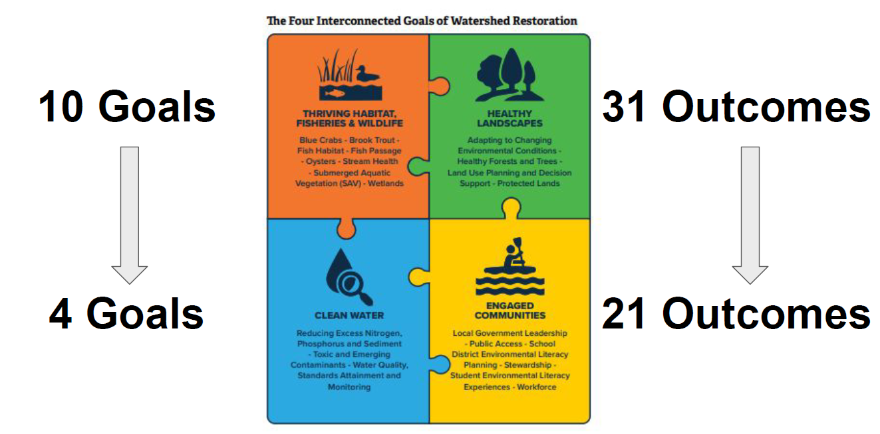
Stream Health Outcome
2025 Agreement - Structure

Slide 3
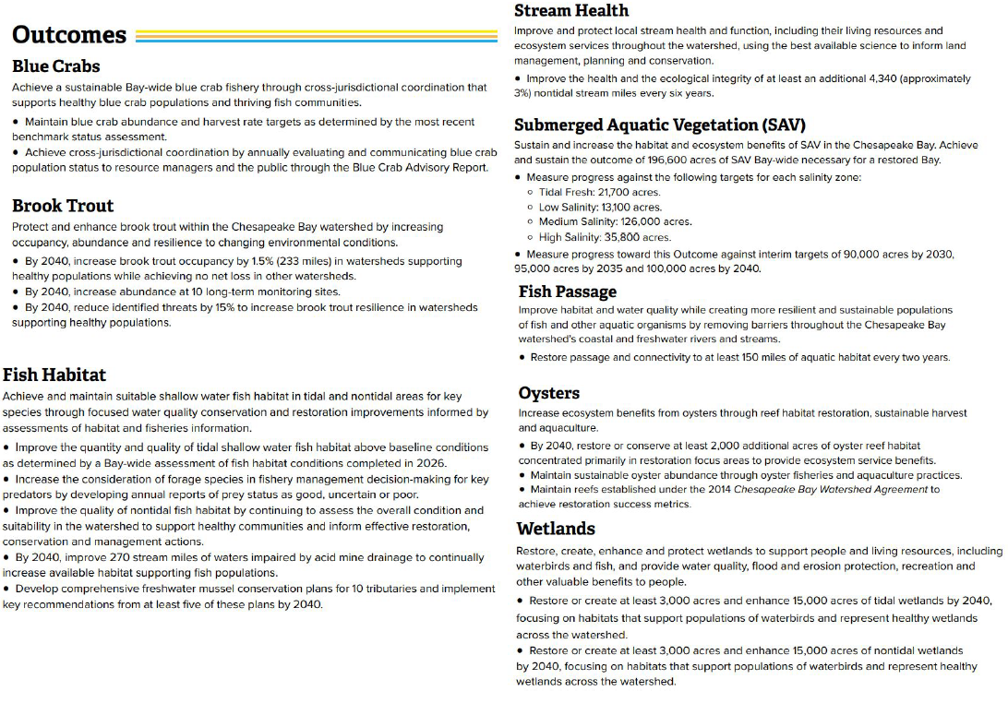
Stream Health Outcome
2025 Agreement - Structure
Thriving Habitat, Fisheries, and Wildlife Goal Team

Slide 4
Stream Health Outcome
2025 Agreement - Structure
Changes to our Goal Team
Combined Habitat GIT and Sustainable Fisheries GIT
Management Board will be retired July 1
New “PSC” - Policy Steering Committee
  similar level of leadership as Principals’ Staff Committee
Changes to Stream Health Workgroup
Designate up to 15 “voting” members
  where unanimous consent cannot be reached
  CBWA signatory representatives and subject matter experts
  co-chairs are discussing membership with GIT leadership

Slide 5
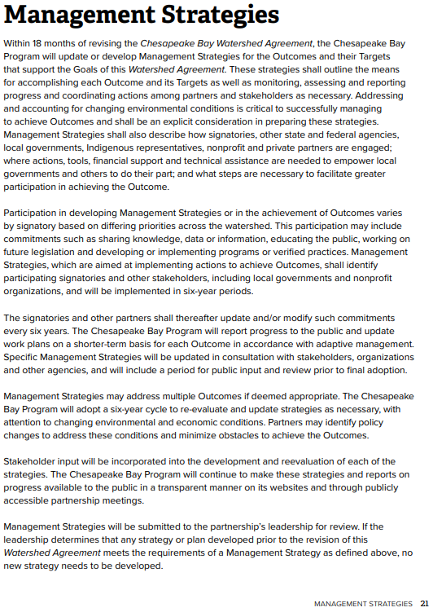
Stream Health Outcome
Management Strategy
These strategies shall outline the means for accomplishing each Outcome and its Targets as well as monitoring, assessing and reporting progress and coordinating actions among partners and stakeholders as necessary.
Chesapeake Bay Watershed Agreement (CBP, 2025)

Slide 6
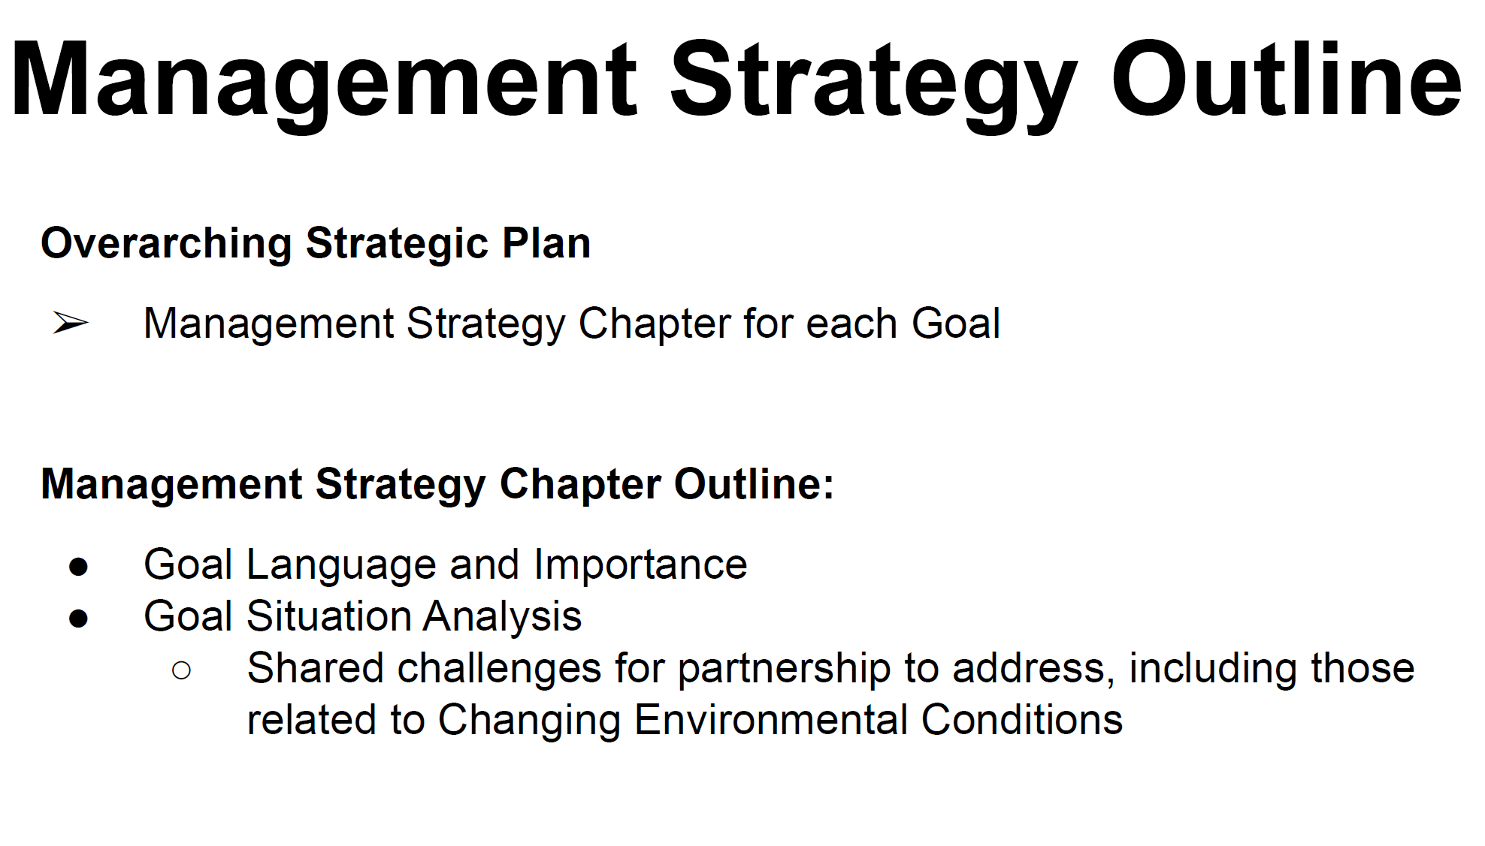
Stream Health Outcome
Management Strategy

Slide 7
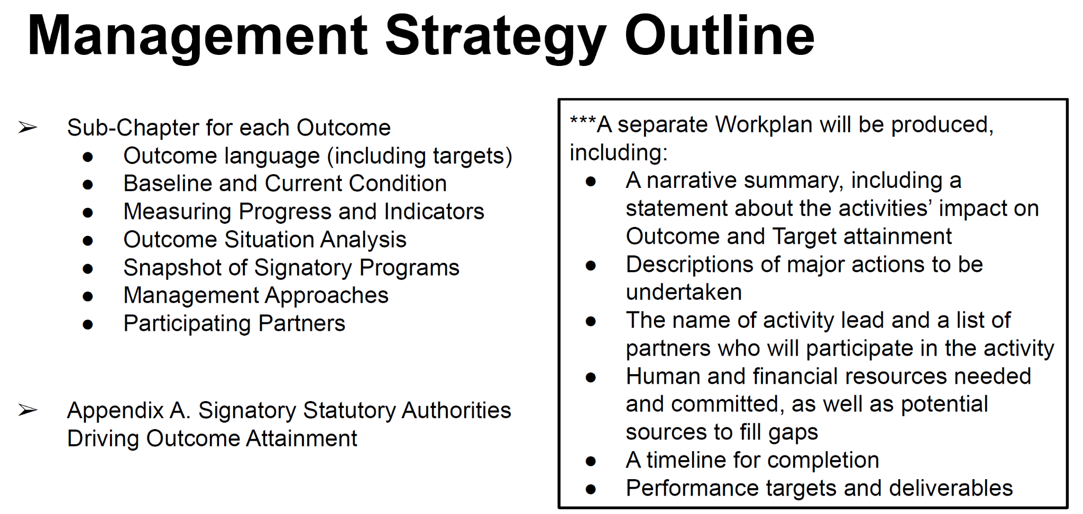
Stream Health Outcome
Management Strategy

Slide 8
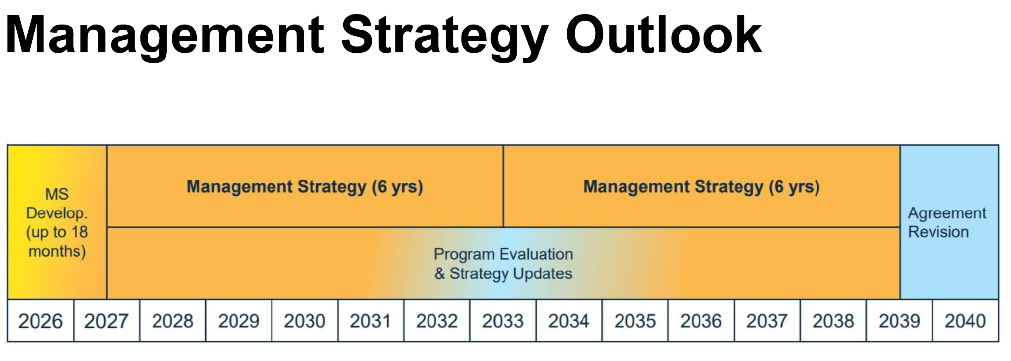
Stream Health Outcome
Management Strategy

Slide 9
Stream Health Outcome
Management Strategy
Timeline:
June - August 2026: workgroups fill out management strategy subchapter template
August 21, 2026: Completed draft MS due to Goal Team chairs
  This is the same day as our next WG meeting - do we want to schedule a late July/early August check-in to review the draft Strategy?
Additional revisions after GT chair review
September 2026 - June 2027: Develop outcome work plans

Slide 10
Stream Health Outcome
Management Strategy
How you can help now:
Develop and review Management Strategy draft
  especially signatory programs sections
How you can help later:
Develop and review the new workplan

