Slide 1
Stream Health Workgroup
Outcome Assessment
What advice do you have for the Management Board on how to consolidate, reduce, update, remove, replace or add new outcomes within your Cohort/GIT?​
“Update” = Outcome intent is largely kept intact. Unique language may be necessary if it is more than just a SMART update. Key principle is maintaining the intent.
“Replace” = This language suggests that a novel Outcome replaces a current one and that it relates in its intent or subject area.
“Consolidate” (i.e., Combine) = Multiple Outcomes would be combined in a single Outcome, or activities contributing to an Outcome are dispersed across others.
“Reclassify” = Outcome is changed to output or a different structure is adopted.
“Remove” = The Outcome is removed from the 2014 Agreement.

Slide 2
Stream Health Workgroup
Outcome Assessment
What advice do you have for the Management Board on how to consolidate, reduce, update, remove, replace or add new outcomes within your Cohort/GIT?​
Decision points:
Should Stream Health still be an outcome in the Bay Agreement?
Do we need to update the outcome?
Continually improve stream health and function throughout the watershed. Improve health and function of 10 percent of stream miles above the 2008 baseline for the Chesapeake Bay watershed.
Specific language and outcome target will be discussed in Feb SHWG meeting, due in April
Should we add new outcomes to the Bay Agreement?

Slide 3
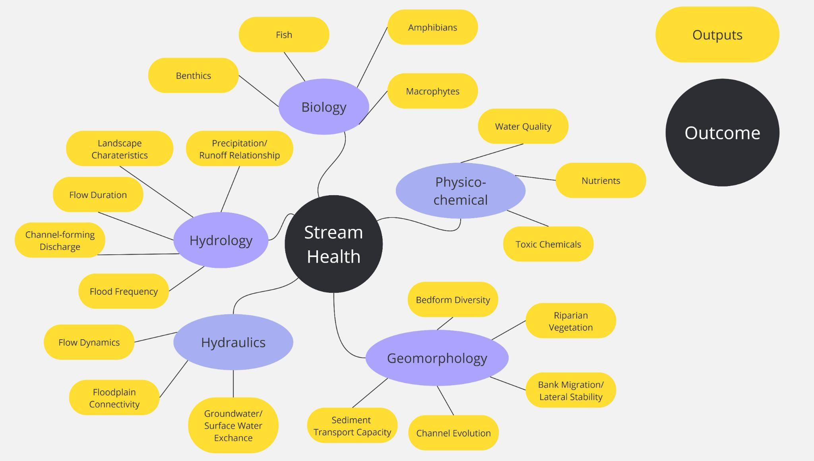
Stream Health Workgroup
Outcome Assessment
Is Stream Health an OUTCOME or an OUTPUT?

Slide 4
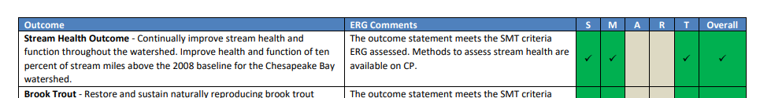
Stream Health Workgroup
Outcome Assessment
Is the Outcome SMART (Specific, Measurable, Achievable, Realistic, Time-bound)?
Specific language and outcome target will be discussed in Feb SHWG meeting, due in April

Slide 5
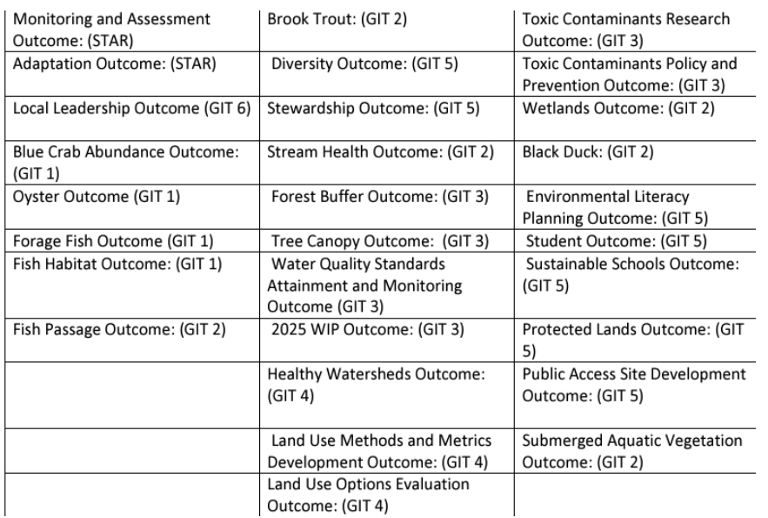
Stream Health Workgroup
Outcome Assessment
Connections to other Outcomes
Top Related Outcomes:
Brook Trout
Fish Habitat
Fish Passage
Healthy Watersheds
Wetlands
Forest Buffer
Water Quality
Toxic Contaminants

Slide 6
Stream Health Workgroup
Outcome Assessment
EC Charge: That changes reflect
A renewed and greater emphasis on engaging all communities of the watershed as active stewards of a healthy and resilient Chesapeake Bay and its watershed
Our mandate to address water quality and living resources throughout the Bay and watershed
Elevating conservation as a key pillar of the Chesapeake Bay Program, alongside science, restoration, and partnership
A grounding in the most recent scientific understandings and issues that have emerged since the current Chesapeake Bay Watershed Agreement was signed in 2014
Goals and outcomes that are measurable and time bound. Time frames should be sufficient to accomplish the outcomes as quickly as possible. In particular, our regulated nutrient and sediment load reductions, especially those within non-point sources
Acknowledgement that our scientific understanding is continuously evolving and that our efforts need to constantly adapt accordingly
The fact that while each partner shares a common goal, we are all approaching this goal from different perspectives, challenges, and opportunities.

Slide 7
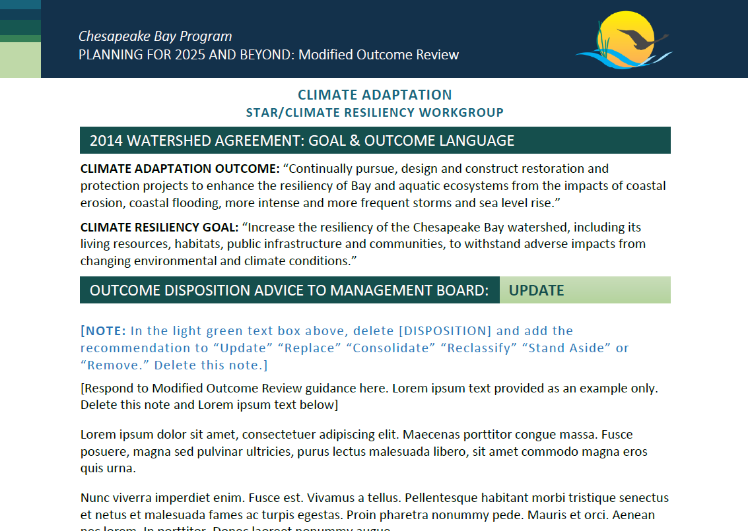
Stream Health Workgroup
Outcome Assessment
The Task: Develop a 2 page Outcome Review document for Management Board
February 11 - document due to our GIT chairs
February 27 - MB Meeting with 20 minute discussion on Stream Health Outcome
Example

Slide 8
Stream Health Workgroup
Outcome Assessment
Miro discussion - we need your input!
Four sets of topics based on the guidance questions
Input will be synthesized into the Outcome Review document
https://miro.com/app/board/uXjVLsXrI-Y=/
Specific outcome language with targets will be discussed at the SHWG meeting on Feb 21

