Slide 1
Stewardship Workgroup
March 31, 2026

Slide 2
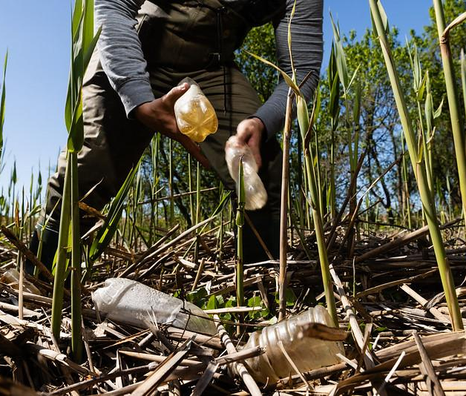
Icebreaker
Are you organizing or attending a spring stewardship event?
Please share!
Photo by Will Parson/Chesapeake Bay Program

Slide 3
Welcome & Introductions
Network Science Training #4 Takeaways
Chesapeake Bay Program Updates
Collaboration Discussion
Action Team Updates & Planning for 2026
Wrap-Up

Slide 4
Chesapeake Bay Program Updates
Revised Watershed Agreement
Engaged Communities Goal & Stewardship Outcome and Target
Structure & Governance
GMF outlining roles/ responsibilities of Goal Teams, Workgroups, Action Teams
Management Strategies & Workplans
Notes:
15 MINUTE SECTION

Slide 5
Engaged Communities Goal
Engage and grow a community of local stewards and leaders through education, recreation and professional opportunities to ensure the long-term success of restoration and conservation efforts.
Stewardship Outcome & Target
Outcome: Increase the public’s participation in stewardship actions that contribute positively to lands, waters, wildlife, fisheries and communities throughout the Chesapeake Bay watershed.
Target: Through 2040, build the capacity of leaders in the community and environmental professionals with the social science data, technical assistance and support needed to develop, improve and carry out individual- and community-level stewardship programs, including those that will help advance Chesapeake Bay Watershed Agreement Goals and Outcomes.
Notes:
Revised Watershed Agreement: https://www.chesapeakebay.net/files/documents/CBWA-2025-IV-Final-Facing.pdf
Engaged Communities: https://www.chesapeakebay.net/what/goals/engaged-communities

Slide 6
Structure & Governance
Governance & Management Framework (GMF) for the Chesapeake Bay Program is being worked on by the MB and PSC.
Aspects that may affect the Stewardship Workgroup are:
Definition of roles and responsibilities, membership, leadership, and decision-making processes/authorities for the Goal Teams, Workgroups, and Action Teams
Public meeting procedures
Consent based decision-making process
Accountability/ Adaptive Management
Management Strategies & Workplans details
Notes:
Governance Document https://www.chesapeakebay.net/files/documents/CBP-Governance-Document-Version-5.0_2023-06-14-134248_MB-VERSION-03.12_CLEAN.pdf
March 12 MB Actions & Decisions: https://www.chesapeakebay.net/files/documents/March-12-MB-Actions-and-Decisions.pdf

Slide 7
Action Teams – Background
 | Action Team Purpose
Resource Hub | Build/ expand a stewardship resource hub. Create a useful hub of information and tools for stewardship practitioners to use and reference to help them strategically improve and increase their individual and community-scale stewardship efforts. Promote the use of resources gathered on the resource hub.
Community-Level Stewardship | Track and report on a more complete picture of stewardship, i.e., collect information about community-scale or group stewardship actions in addition to the information about individual actions that the stewardship indicator already collects. Communicate this clearer picture of the breadth of accomplishments of the various stewardship partners across the watershed. Develop a plan/methodology to identify what community-scale stewardship actions already exist across the watershed, to establish a baseline for future measurement of community-scale stewardship beyond 2025.
Chesapeake Steward Map (CSM) Map Ambassadors | Create, maintain, and continually improve the Chesapeake Steward Map to ultimately achieve its stated purpose to: Increase connections and collaborative partnerships among stewards across the Chesapeake region by identifying hubs and gaps in connectivity and highlighting opportunities to facilitate strategic connections for sharing knowledge and resources.

Slide 8
Action Teams – Brief Updates
 | Next Meeting | Recent Updates | Potential Next Steps
Resource Hub | JULY, date TBD | Met in January Discussed hub platform options and future interviews Paused meetings until July | Interviews with stew. practitioners to determine most valuable resources to gather and how to best share them (e.g., newsletter, website, blog of success stories, speaker series, etc.)
Community-Level Stewardship | APRIL or MAY, date TBD | Met in January. Conducted outreach for feedback on definitions via email and conversations | Begin to explore how we start to capture examples that fit the definitions and start to build out the broader picture of the existing work in the watershed.
Chesapeake Steward Map (CSM) | CSM 101: April 13, May 11, June 8 Map Ambassadors: APRIL or MAY, date TBD | Map Ambassadors met in March Survey updated Outreach scheduled | Conduct outreach to increase the number of users on the Map. Conduct training to teach users how to use the map. Train and engage the Map Ambassadors group. Continue troubleshooting technical and logistical challenges.

Slide 9
Action Teams – Community Level Stewardship
Common questions/points of interest:
What do we mean by “habitual” or “socially norm”?
Conversations and Comments:
Maureen Mitchell, Anacostia Riverkeeper
Ru Williams, Elizabeth River Project
Dexter Locke, Forest Service (STEWMAP)
Don Callihan, Friends of Oregon Ridge
Ashley Traut, Greater Baltimore Wilderness Coalition
Definitions:
Community-Scale Stewardship Actions:
Habitual activities carried out by a group or network of people, that seek to improve, achieve, and/or socially norm the responsible use and protection of the natural environment through conservation and sustainable practices to enhance ecosystem resilience and human well-being (based on a definition from Chapin et al, 2010). These activities may benefit from technical assistance, social science data collection/analysis, and support from capacity building initiatives.
Community-Scale Stewardship Measures:
Quantifiable benefits to the environment that are a result of a community-scale stewardship action, project, or program (based on a definition from Hajkowicz & Collins, 2009).

Slide 10
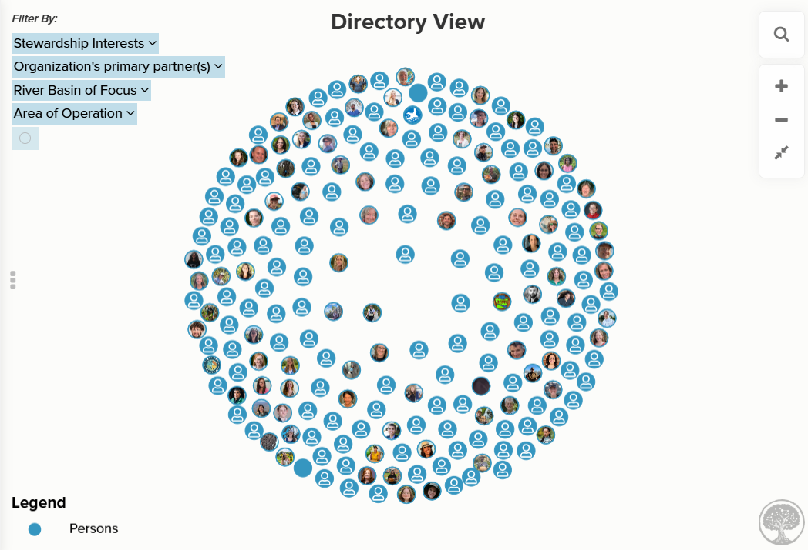
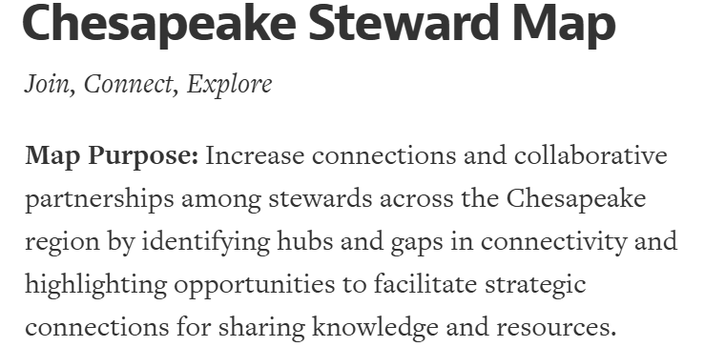
Action Teams – Chesapeake Steward Map
Updates/ Ongoing Work:
Survey updated
Network cultivation, outreach, and training
Outreach & Learning Opportunities:
June 1-2, postering at CCRS
Chesapeake Steward Map 101 Info Hours, open to anyone:
Monday, April 11: 12:00-1:00pm
Monday, May 11: 12:00-1:00pm
Monday, June 8: 12:00-1:00pm
Do you have an upcoming meeting or event where I could talk about the Chesapeake Steward Map?

Slide 11
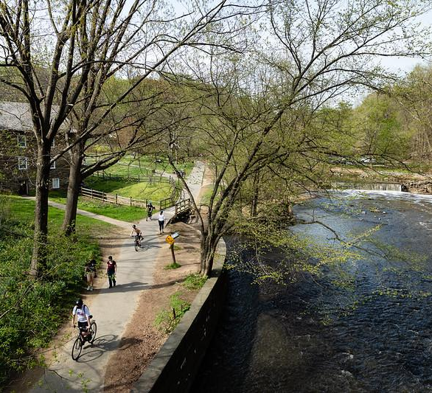
Network Science Training
Four Sessions:
Intro to Networks
Weave the Network: Increase Network Engagement
Weave the Network: Cultivate Trust
Activate Your Network Leadership
Photo by Will Parson/Chesapeake Bay Program
Notes:
Playbook: https://www.canva.com/design/DAGpVx9ZvJk/L_uH0Z6K678b4tvSDhvOYQ/view?utm_content=DAGpVx9ZvJk&utm_campaign=designshare&utm_medium=link2&utm_source=uniquelinks&utlId=he4cabdbcaf#1

Slide 12
Network Science Training
“Networks succeed when we invest in relationships and trust—because those are the structures that allow collaboration and innovation to happen.”
-- Kacey Wetzel, CBT
Photo by Will Parson/Chesapeake Bay Program
Notes:
Playbook: https://www.canva.com/design/DAGpVx9ZvJk/L_uH0Z6K678b4tvSDhvOYQ/view?utm_content=DAGpVx9ZvJk&utm_campaign=designshare&utm_medium=link2&utm_source=uniquelinks&utlId=he4cabdbcaf#1

Slide 13
Network Science Training
Activating Network Leadership
Effective networks thrive when leaders:
Prioritize trust and relationships
Share leadership and decision-making
Encourage experimentation and learning
Intentionally connect people across the system
Frame collaboration as essential to resilience and impact
Photo by Will Parson/Chesapeake Bay Program
Notes:
Activating Network Leadership https://docs.google.com/document/d/1WubnODinPPyL7RyLl8WkBPqR0_hInOhk7-7F2zWJhbo/edit?pli=1&tab=t.0#heading=h.feen9u9dq57e
Playbook: https://www.canva.com/design/DAGpVx9ZvJk/L_uH0Z6K678b4tvSDhvOYQ/view?utm_content=DAGpVx9ZvJk&utm_campaign=designshare&utm_medium=link2&utm_source=uniquelinks&utlId=he4cabdbcaf#1

Slide 14
Network Science Training
Key Insights from Kacey (Activating Leadership):
Relationships = Currency of Networks
Distributed Leadership Makes Networks Stronger
Use Learning Loops and Small Experiments
Intentional Network Weaving is Critical
Relationships Sustain Networks Beyond Funding
Working Within Bureaucracies (it’s possible)
Frame Network Work Strategically
Photo by Will Parson/Chesapeake Bay Program
Notes:
Activating Network Leadership https://docs.google.com/document/d/1WubnODinPPyL7RyLl8WkBPqR0_hInOhk7-7F2zWJhbo/edit?pli=1&tab=t.0#heading=h.feen9u9dq57e
Playbook: https://www.canva.com/design/DAGpVx9ZvJk/L_uH0Z6K678b4tvSDhvOYQ/view?utm_content=DAGpVx9ZvJk&utm_campaign=designshare&utm_medium=link2&utm_source=uniquelinks&utlId=he4cabdbcaf#1

Slide 15
Network Science Training
Communicating the Value of Networks
When communicating the value of networks, focus on:
Resilience - Networks help programs withstand change.
Efficiency - Collaboration and experimentation save time and resources.
Results - Strong relationships enable better outcomes.
Infrastructure - Trust and partnerships are essential systems that make the work possible.
Photo by Will Parson/Chesapeake Bay Program
Notes:
Messaging Guide – Communicating the Value of Networks https://docs.google.com/document/d/1MznssHPtWGh4vnL8N5EFIeu-bDgxv4IlqGQpxwgPfSI/edit?pli=1&tab=t.0
Playbook: https://www.canva.com/design/DAGpVx9ZvJk/L_uH0Z6K678b4tvSDhvOYQ/view?utm_content=DAGpVx9ZvJk&utm_campaign=designshare&utm_medium=link2&utm_source=uniquelinks&utlId=he4cabdbcaf#1

Slide 16
Network Science Training
Key Insights from Kacey (Messaging):
Frame Networks as Risk Mitigation
Emphasize Efficiency and Cost Savings
Describe Relationships as “Social Infrastructure”
Translate Network Concepts into Institutional Language
Position Networks as a Strategy for Resilience
Align Messaging with Broad Public Priorities
Normalize Collaboration as Core Work
Use Plain Language
Photo by Will Parson/Chesapeake Bay Program
Notes:
Messaging Guide – Communicating the Value of Networks https://docs.google.com/document/d/1MznssHPtWGh4vnL8N5EFIeu-bDgxv4IlqGQpxwgPfSI/edit?pli=1&tab=t.0
Playbook: https://www.canva.com/design/DAGpVx9ZvJk/L_uH0Z6K678b4tvSDhvOYQ/view?utm_content=DAGpVx9ZvJk&utm_campaign=designshare&utm_medium=link2&utm_source=uniquelinks&utlId=he4cabdbcaf#1

Slide 17
Network Science Training
Discussion
How can the SWG help communicate the value of networks throughout the CBP or externally to partners?
How can the SWG better function as a network?
Photo by Will Parson/Chesapeake Bay Program
Notes:
Playbook: https://www.canva.com/design/DAGpVx9ZvJk/L_uH0Z6K678b4tvSDhvOYQ/view?utm_content=DAGpVx9ZvJk&utm_campaign=designshare&utm_medium=link2&utm_source=uniquelinks&utlId=he4cabdbcaf#1

Slide 18
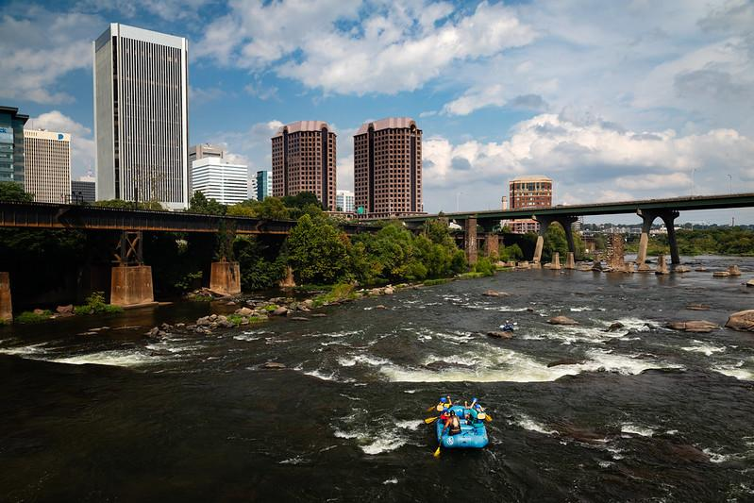
How can the SWG better function as a network?
Weaving the work of the 3 action teams (e.g., collecting and sharing success stories)
Engage stew. practitioners (mutual support and value)
Building trust
Network of networks
Integration of stewardship focus across CBP groups
Photo by Will Parson/Chesapeake Bay Program
Notes:
We might not be at the activating network leadership level yet… we could do a network assessment of the Stewardship Workgroup?
Would hosting a SWG specific networks training or workshop be valuable? If so, would it really make sense to do so right now or maybe further down the line?

Slide 19
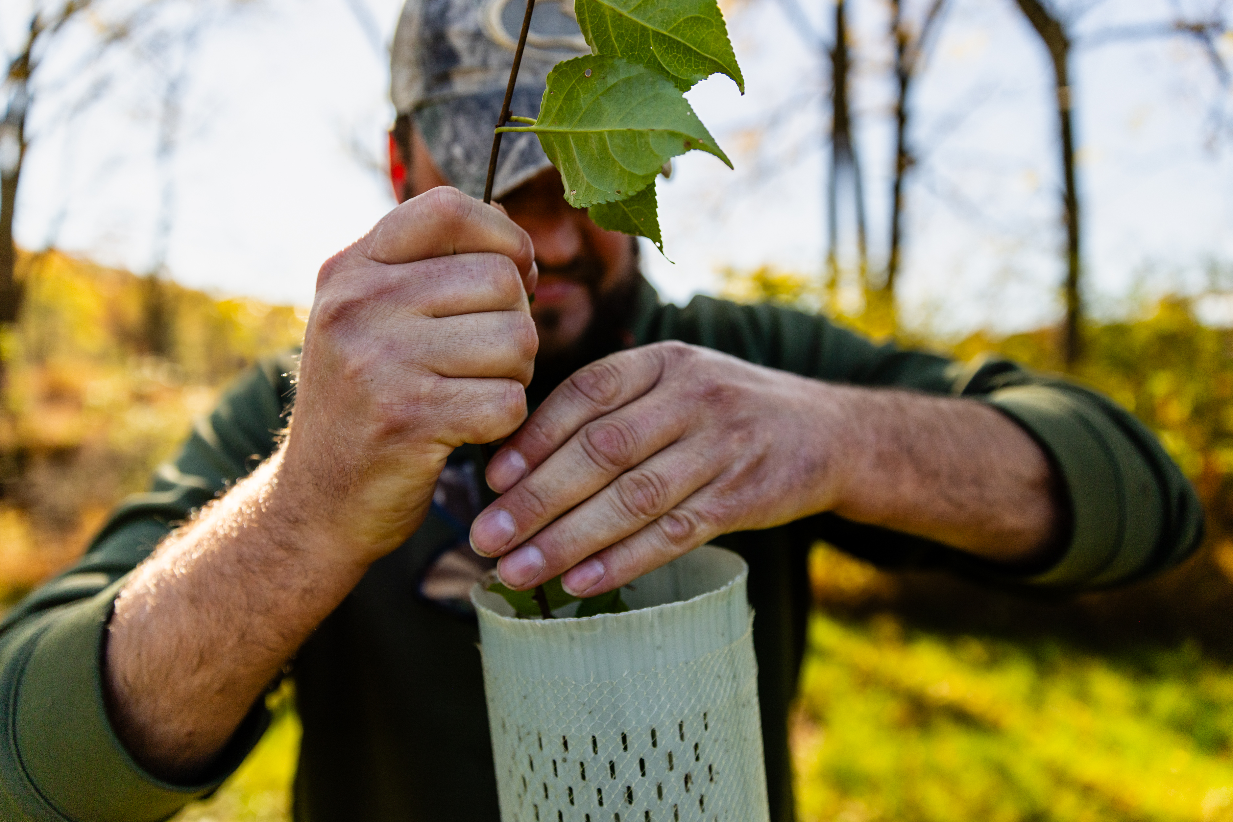
Collaboration Discussion
Do you have any upcoming opportunities that you'd like to collaborate with SWG colleagues on?
Do you have any challenges with a specific stewardship program you'd like to work through with SWG colleagues?
Lightning Talks: What topics or speakers would you like to recommend?
Photo by Will Parson/Chesapeake Bay Program

Slide 20
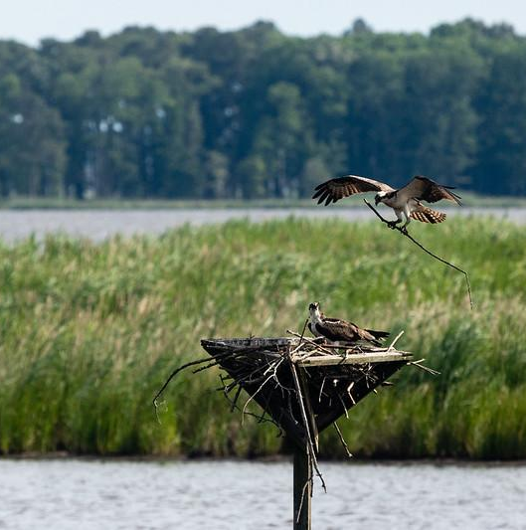
Thank you!
Comments, questions, ideas?
Meredith Lemke (CRC), Staffer lemkem@chesapeake.org
Marissa O’Neill (DOEE), Chair marissa.oneill@dc.gov
Photo by Will Parson/Chesapeake Bay Program

