Slide 1
Workforce Workgroup
August 21, 2026
Notes:
PRESENTATION TITLE

Slide 2
Agenda
Welcome / Introductions
Employer Engagement - DC Workforce Investment Council
Management Strategy Updates
Choose Clean Water Webinar Recap
K-12 Career & Technical Education Action Team Update
Round Robin
Adjourn

Slide 3
DC Workforce Investment Council
Pat Philippe
Associate Director of
Business Engagement

Slide 4
Management Strategies Drafting Updates
Outcome Subchapter Outline:
Outcome and target(s) language
Baseline and current condition
Monitoring progress and indicators
Outcome Situation Analysis
  Challenges + within vs. outside of CBP’s ability to influence
Snapshot of signatory programs
Management Approaches – broad actions to address challenges to goal/outcome attainment
Participating partners
Appendix 1: Signatory statutory authorities driving outcome attainment
Notes:
CBP Updates: Julie Lawson

Slide 5
Management Strategies Drafting Updates
Next Steps:
Continue work on indicator development and Management Approaches
Working on identifying indicator species, missing career paths, and Industry Recognized Credentials of value
Monday, August 24th: Workgroup will receive the draft document to provide comments/feedback.
Friday, September 4th: Deadline for workgroup feedback
September 11th: Draft Management Strategy submitted to Engaged Communities Goal Team for review
Notes:
CBP Updates: Julie Lawson

Slide 6
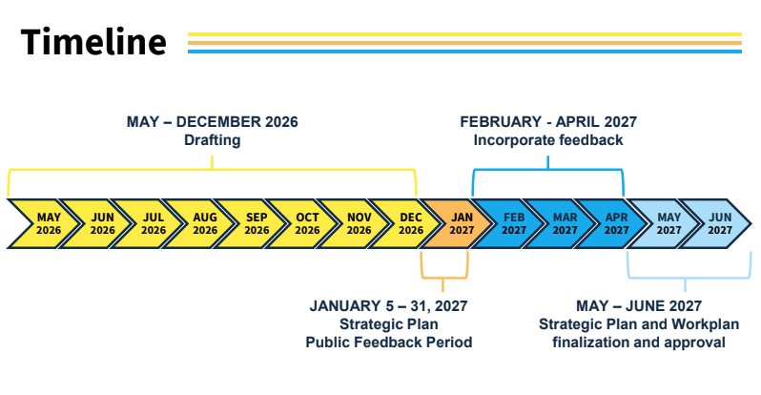

Slide 7
Choose Clean Water Coalition Webinar Recap
Received feedback from CCWC members about workforce challenges
Identified a few specific industry gaps
Discussed example workforce development programs, resource websites, job boards, and career fairs
Notes:
Meredith
https://www.chesapeakebay.net/files/documents/CCWC-Workforce-Webinar-Summary.pdf

Slide 8
K-12 Career & Technical Education Action Team
First meeting: August 26, 1:00-2:00pm
Agenda
Introductions
K12 CTE Action Team Purpose Discussion/Brainstorm
CBP Process/Timeline/Logistics
Discuss/brainstorm proposed management strategy(ies)
Connecting with education and workforce workgroups
CTE in practice conversation/sharing
Future meetings - preferences on scheduling
Notes:
Bart
https://www.chesapeakebay.net/what/event/k12-cte-action-team-meeting-august-2026

Slide 9
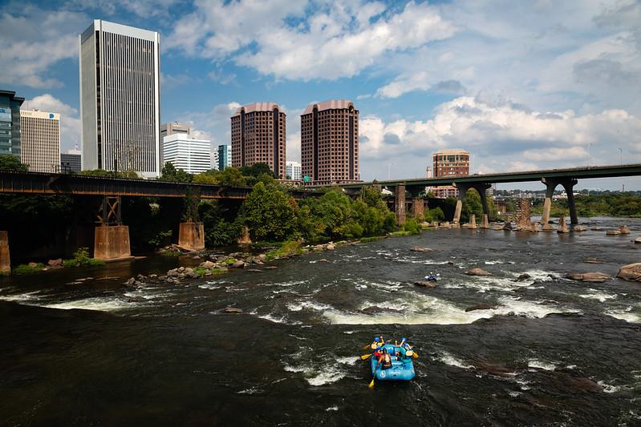
Member Share Outs
For group awareness:
Programs, funding, relevant legislation, etc.
Opportunities for mutual support and collaboration
Photo by Will Parson/Chesapeake Bay Program
Notes:
Collaborative Learning: Julie Lawson

Slide 10
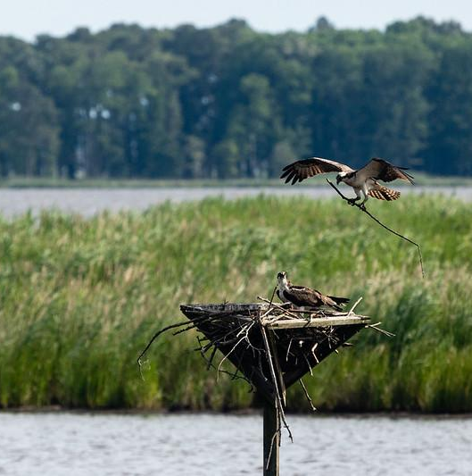
Thank you!
Any questions? Get in contact with Julie, Bart, Meredith, or Daniel.
Next meeting: Friday, October 16, 2026
Photo by Will Parson/Chesapeake Bay Program
Notes:
CONCLUSION

