Slide 1
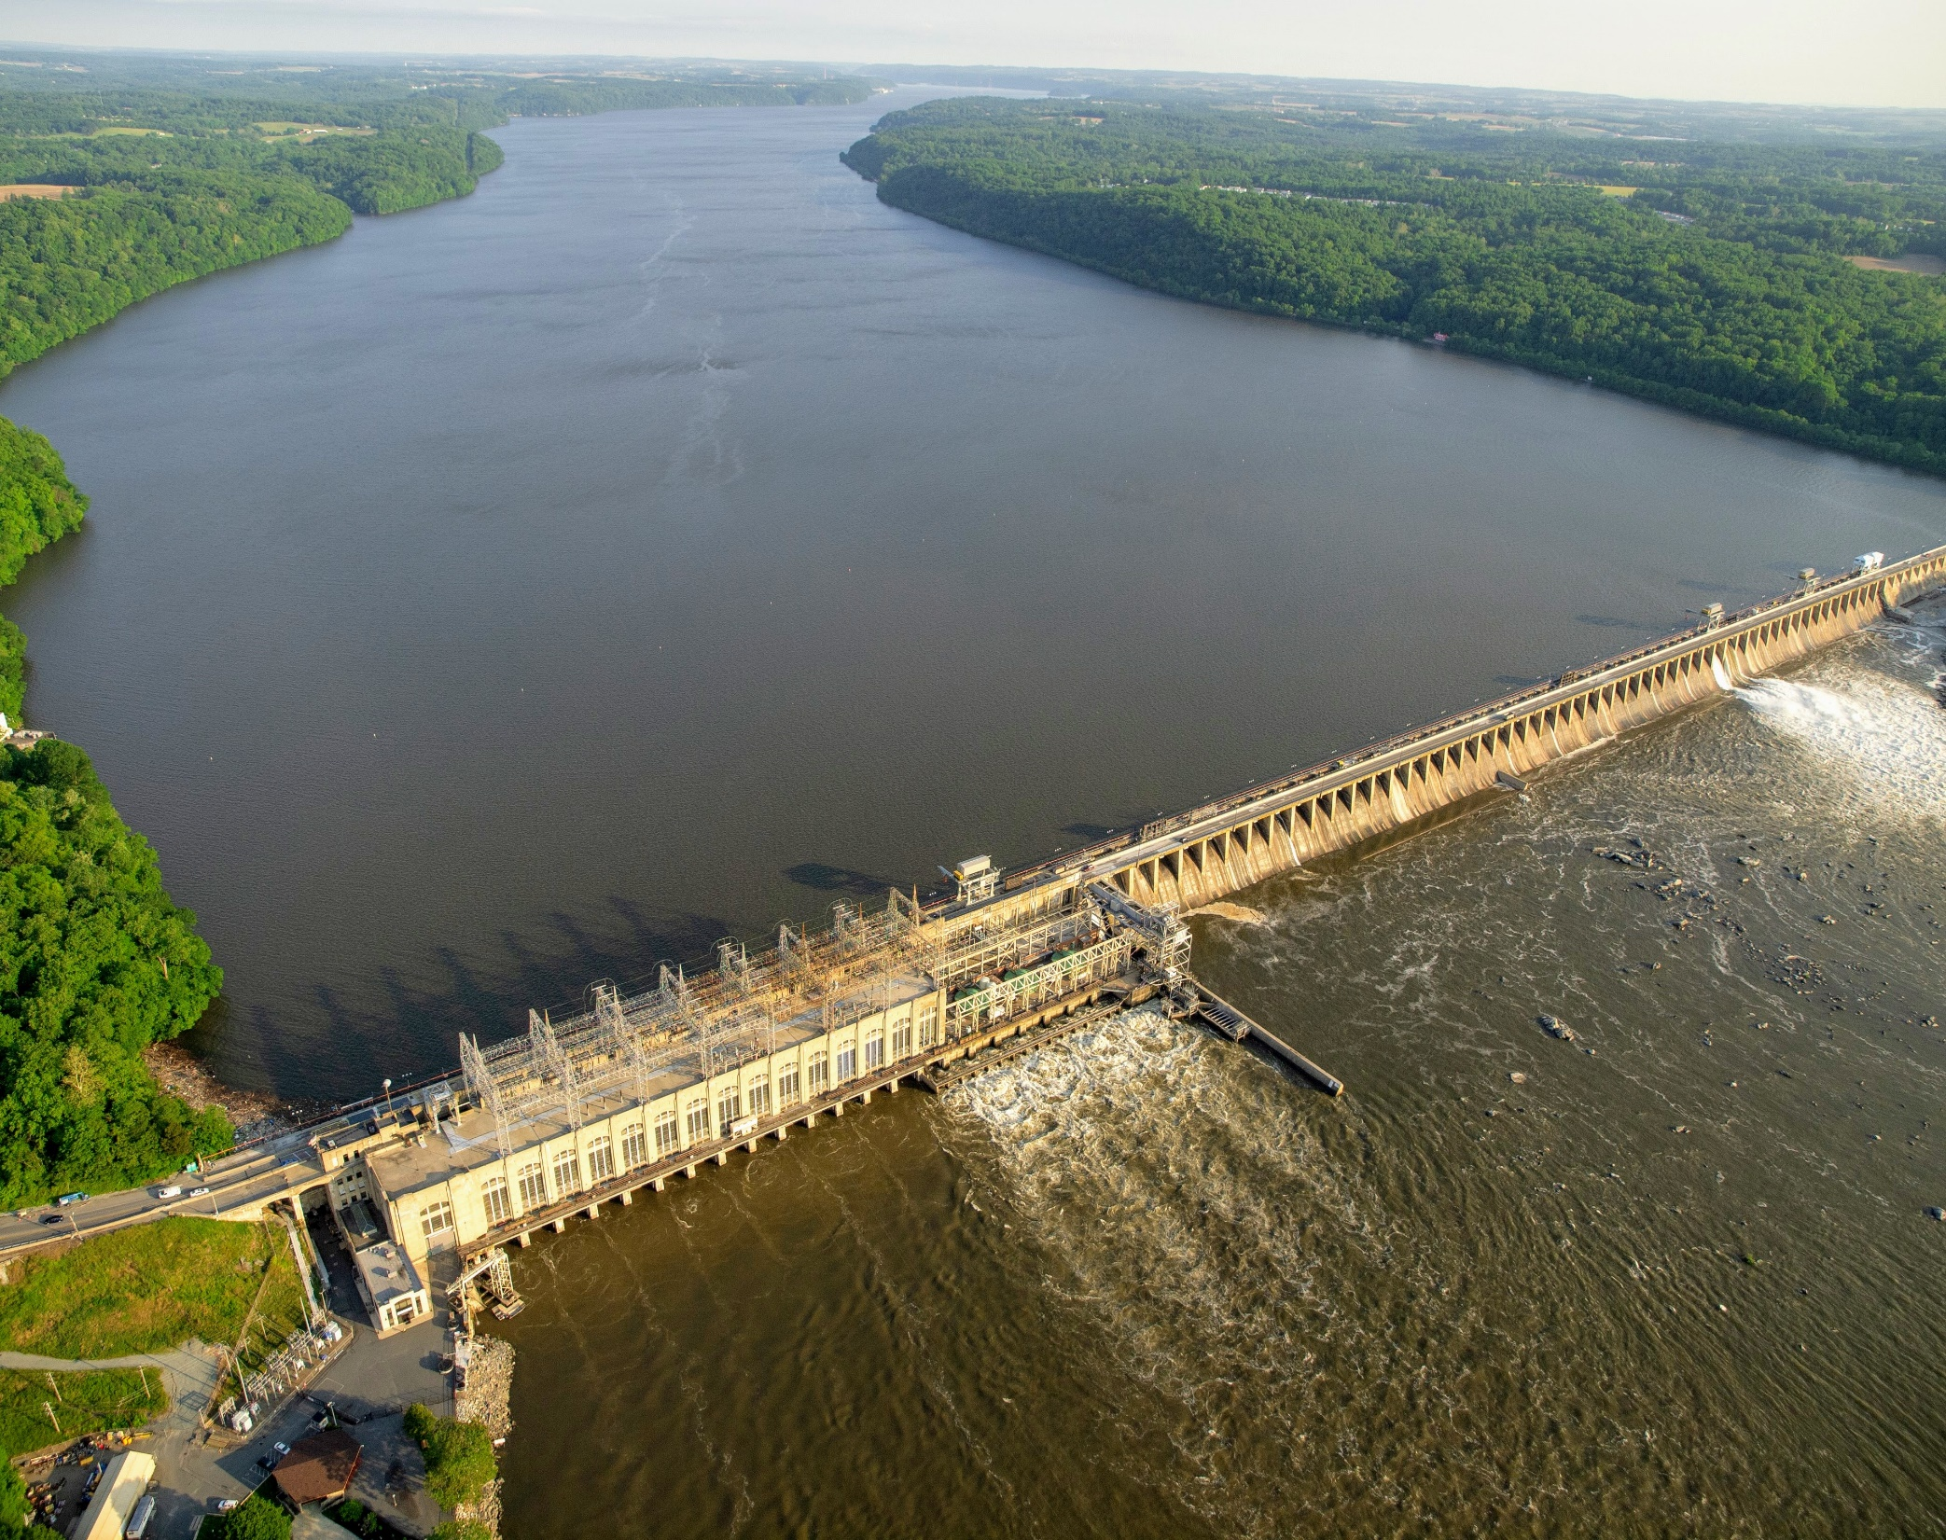

A Dredging Solution for the Conowingo Reservoir
Chesapeake Bay Program’s
Citizens Advisory Committee
February 25, 2022

Slide 2
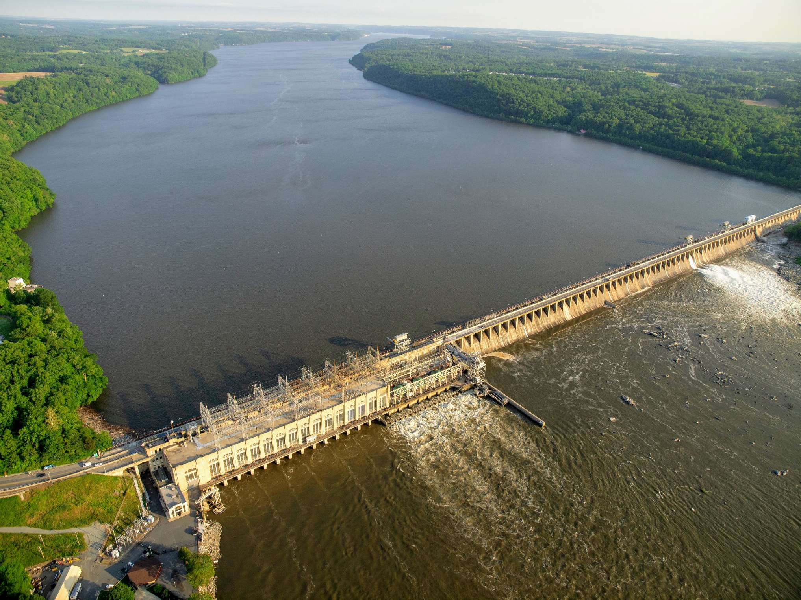
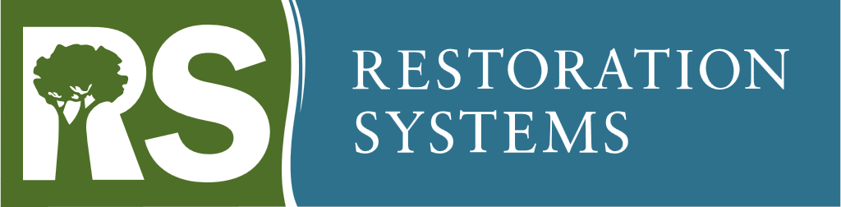


Conowingo Systems
George Howard, CEO and Co-Founder
Jeff Corbin, Dir., Environmental Policy and Water Markets
Jane “Deni” Chambers, CEO and Founder
Sam Merrill, Ph.D., Hon. Lt. Col., Principal

Slide 3
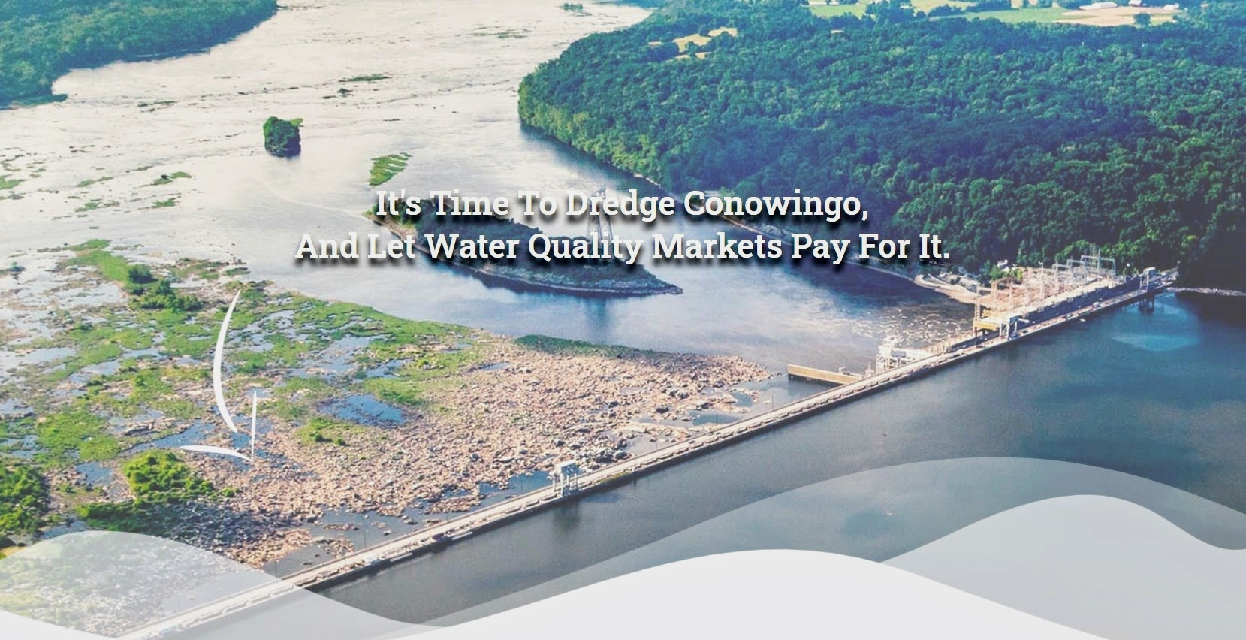
Conowingo Systems
conowingosystems.com

Slide 4
The Premise…
The Reservoir is Full (“Dynamic Equilibrium”)
Nutrient/Sediment Trapping is Greatly Diminished
  Impact = 6,000,000 lbs. N/260,000 lbs. P
The FIX Should be Returning the Trapping Capacity
Negate/Diminish the Need for a C-WIP
Dredging Benefits Outweigh any Potential Impacts
Dredging Should be Option 1
The C-WIP should be a Fall-Back Alternative

Slide 5
The Premise…
**CAC Question – What is the value of dredging vs. BMPs upstream?
------
Trapping Capacity is returned
The biggest BMP in the Bayshed becomes a BMP again
Water Quality impacts from scour events is reduced
The C-WIP does not address scour
Scour will become more severe & frequent

Slide 6
Conowingo – WIP
Full Implementation is Highly Questionable
EPA Review
“EPA has little confidence that the CWIP will be fully implemented to meet the necessary nitrogen reductions without dedicated funding mechanisms in place and the commitment from the public sector to provide an initial investment to initiate CWIP implementation.”
Costly -- $54 – 200 Million/yr.
Perpetual Costs ($1-2 Billion/Decade)
-------
**CAC Question – What are the economic opportunities?

Slide 7
Our Proposal
Return Trapping Capacity of Reservoir
Large-Scale Dredging (>20 MCY³ – 1995 Levels) – All or Part?
Annual Dredging Over 10-ish Years
Privately Financed (P3 Option)
**CAC Question – Is Public Subsidy required?
Generate Water Quality Credits (Nitrogen)
Doable & Cost-Effective
Not “Cheap” “Quick” or “Easy”

Slide 8
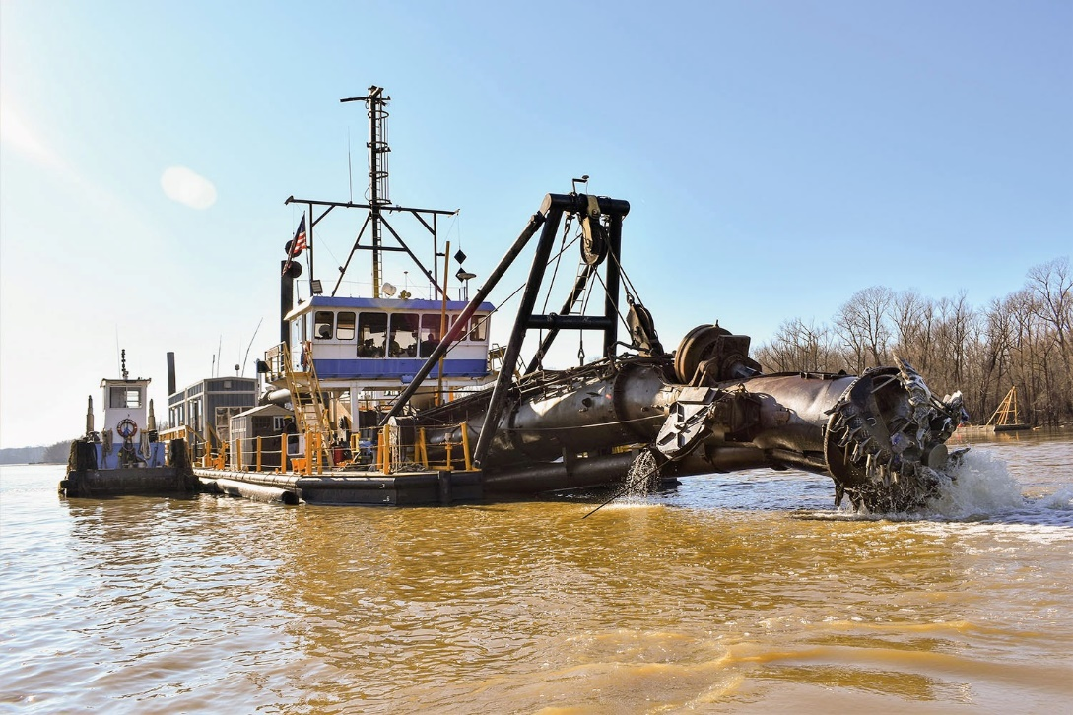
Our Proposal
Large-Scale Dredging is not a Moon Shot
MPA Dredges ~5 Million CY³ Every Year
James and Barren Islands >90 MCY³
www.waterwaysjournal.net

Slide 9
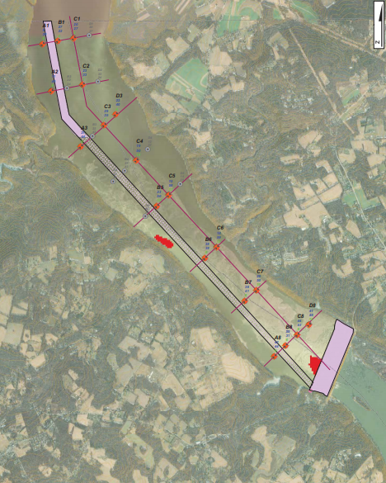

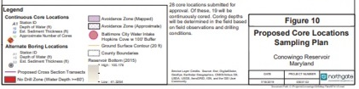
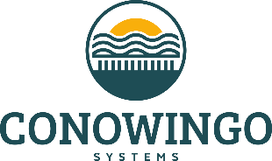
Pilot Project
Northgate Environmental Management
Sediment Characterization Report
https://mde.maryland.gov/programs/Marylander/Pages/conowingo_pilot.aspx
CAC Question
Does it matter where we get the pollution reductions?

Slide 10
Challenges
Dredge Material
  Where to place the material?
    Upland Storage/Disposal
    Riverside Transport/Treatment
    Island/Habitat Building
  Contaminant Analyses – underway!
  Options for Innovative Reuse?
  **CAC Question – What are the ecological opportunities?
  Revenue
  Need Commitment to Buy Reductions
  Tweak WQ Trading & Offset Programs?

Slide 11
Credit Quantification
Expert Panel
Additional Modelling Work
Funding Being Pursued

Slide 12
Conowingo Systems
  Build the “Wall of Support”

Slide 13


