Slide 1
Achieving the Goal of Stewardship
2014 Chesapeake Watershed Agreement

Slide 2
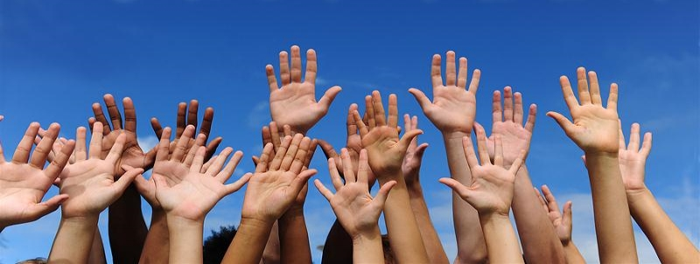
The Stewardship Goal
“Increase the number and diversity of local citizen stewards and local governments that actively support and carry out conservation and restoration activities that achieve healthy local streams, rivers and a vibrant Chesapeake Bay.”

Slide 3
the Bay Agreement Recognizes …
That long term success depends on the support and action that arises from local citizens and local conservation groups.
Local government leaders must have the capacity and tools to address watershed issues and the support to implement policies and incentives that support restoration efforts.
The base of the environmental movement and its leadership must be more diverse and inclusive.

Slide 4
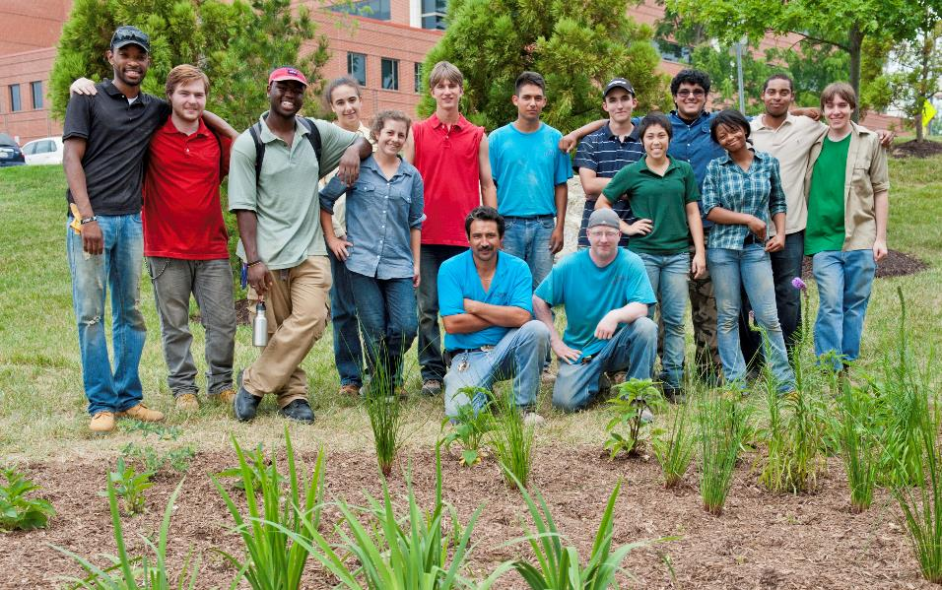
Citizen Stewardship
Increase the number and diversity of trained and mobilized citizen volunteers with the knowledge and skills needed to enhance the health of their local watersheds.

Slide 5
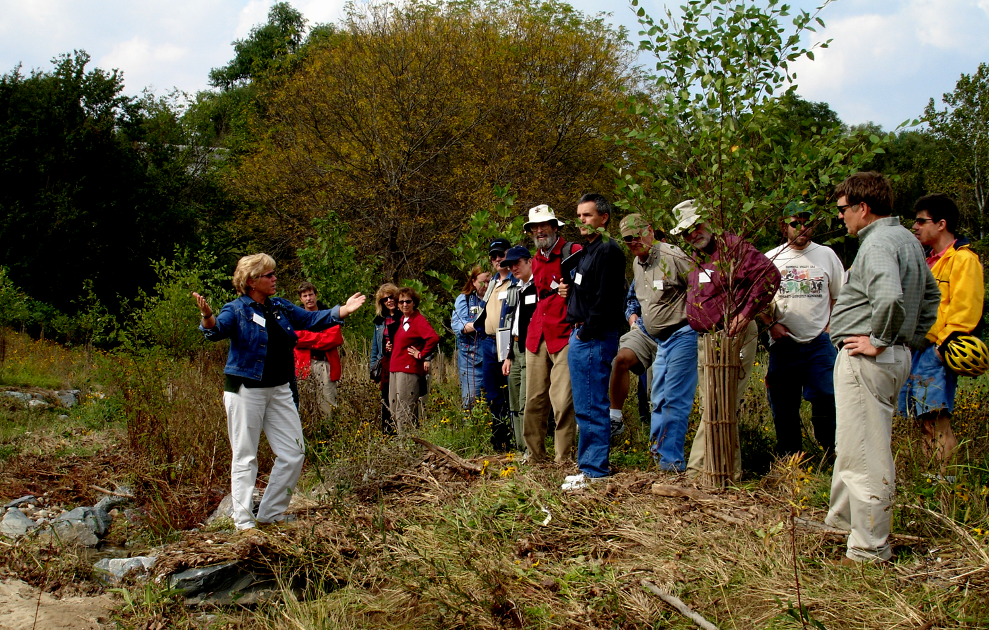
Citizen Stewardship
Increase the number and diversity of trained and mobilized citizen volunteers with the knowledge and skills needed to enhance the health of their local watersheds.
Citizen stewards
Individual Behavior change
Volunteers/Collective Action
Local champions

Slide 6
Moving from Personal Action to Citizen Leadership
Citizen
Leadership
Volunteerism &
Collective Community Action
Individual Citizen Actions & Behaviors
Increased Knowledge, training and skills
Increased level of engagement

Slide 7
Small Group Discussions
What does success look like? Who are the citizen stewards within this framework?
What are examples of successful actions at each of these levels of citizen stewardship?
What types of actions, programs, or tools would be effective at increasing stewards at each level?

Slide 8
Next Steps: Management Strategy
Strategy is a first step
March 2015 Draft
Background, baseline, barriers, 2- year action plan
Who will be involved?
Actions that can be taken by:
States
Federal Agencies
Chesapeake Bay Program
NGO and other Partners

