Slide 1
Revisiting the Adjustor Curves
Anchor rates based on literature review
The “anchor rates” were the rates of percent Total Phosphorus removal based on the runoff treated in inches as was derived from the expert panel literature review.
Panel originally opted to use logarithmic trendline to fit the anchor rates
Discovered that a 5th order polynomial was actually a better fit to the anchor rates
Especially for larger amounts of runoff depth captured

Slide 2
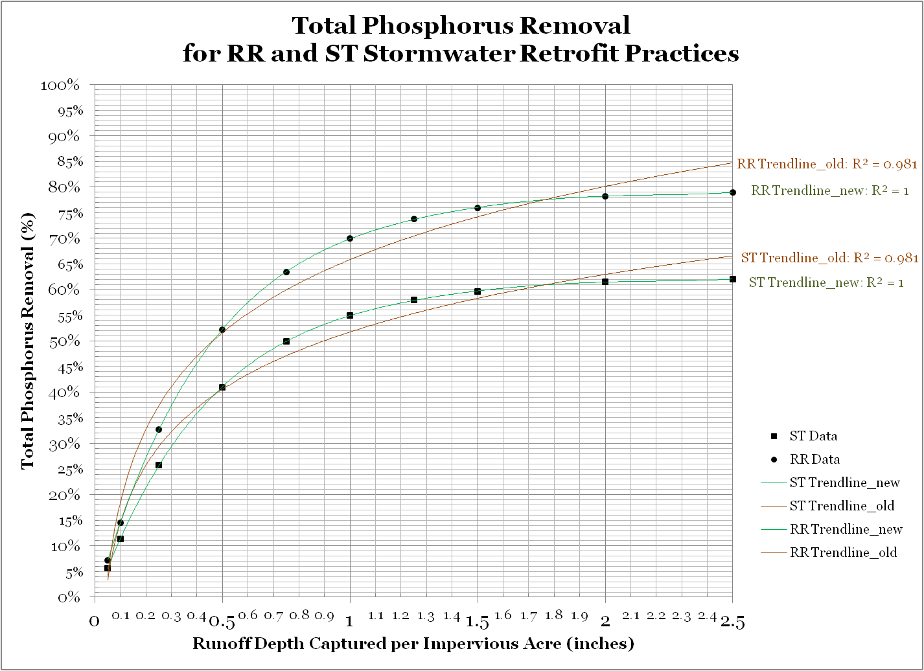

Slide 3
So??
Expert Panel report still reflects the log curve
Trendline equations in the FAQ document reflect the polynomial curve
Several state guidance documents use the curves from the panel report which reflects the “old” curves (log)

Slide 4
Next Steps
Recommend USWG makes a decision on which curves to use going forward
Need for consistency in the guidance being distributed
Implications:
Logarithmic: changes to the trendline equations in the FAQ document (and some associated training materials)
Polynomial: the expert panel report should be revised to reflect
Model currently uses polynomial curves; if changed to log could not be reflected until 2015

Slide 5
Urban BMP Factsheets

Slide 6
Fact Sheet Topics
Basics of Ches Bay Pollutant Reduction Plans
Stormwater Retrofits
Stormwater Practices for New and Redevelopment Projects
Stream Restoration
Urban Nutrient Management
Erosion and Sediment Control
Residential BMPs (i.e. homeowner)
Septic Systems
Urban Filter Strips

Slide 7
Fact Sheet Contents
Practice Description
Best Places to Implement Them in Your Community
How to Find & Rank Candidate Sites
General Cost Estimation
What Technical Support is Needed
Brief Summary of How to Compute Credits
Add’l Community Benefits Provided
What to Report to State/Local Records to Keep
How to Verify Practice in Future
State Specific Info and contacts

