Slide 1
New Approaches to Land Cover Mapping
Land Use Working Group
January 30, 2014
Andrew Brenner
Senior Program Director

Slide 2
Overview of Presentation
Who is Quantum Spatial?
From the general to the specific
Impervious
Land cover
Land use
The value of good data

Slide 3




Quantum Spatial
Recent merger of top 3 geospatial firms … ~500 people
Full spectrum geospatial services
Unprecedented capability, capacity, and geographic reach
Remain as independent companies for life of existing contracts … Quantum for all new pursuits

Slide 4
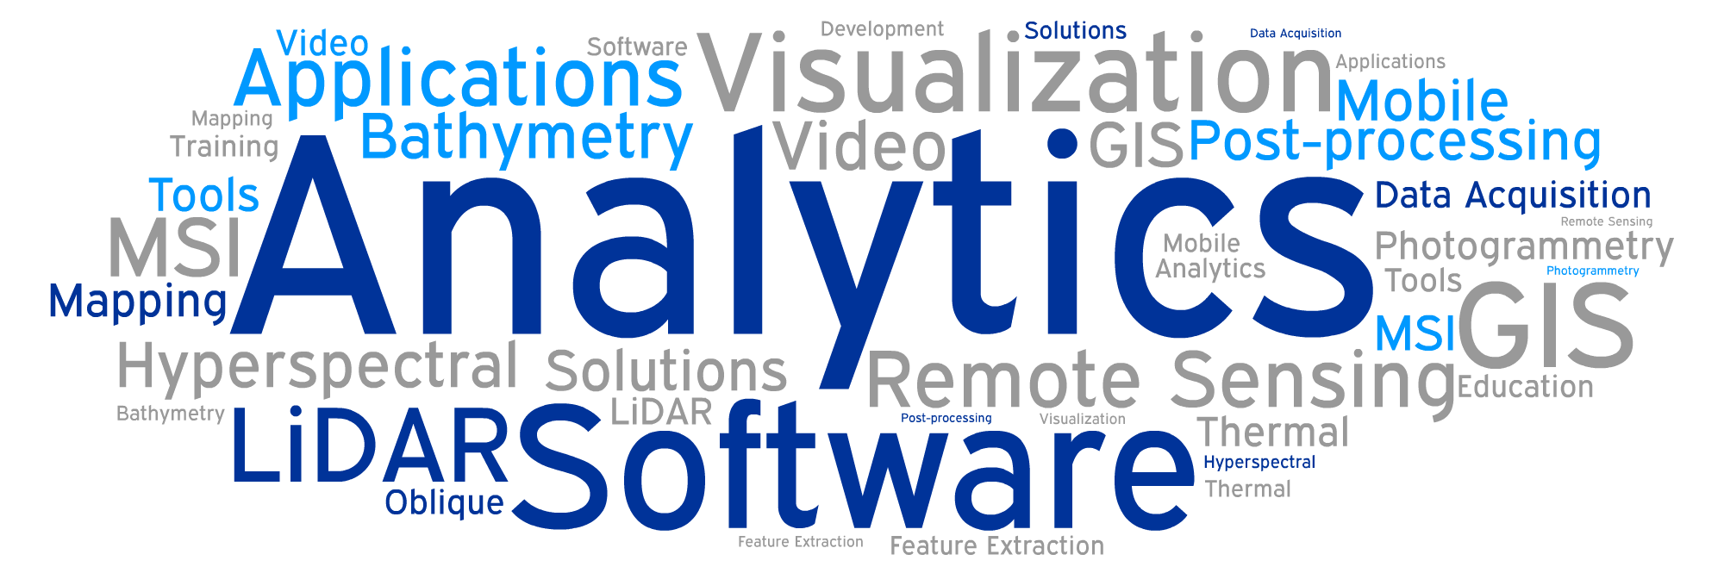
Data Information Understanding

Slide 5
From the General to the specific
Geospatial Solutions

Slide 6
Can better data save money?
If we can focus on the specific sources can we have a greater impact on the system
Not all farmers are the same
Not all home owners are the same
Not all fields are the same
Specific data can
Identify site specific problems
Focus implementation activities
Reduce implementation costs
Improve effectiveness
But
Costs money
Requires more analysis
Implementation costs dwarf the planning costs
Ineffective implementation impacts costs and credibility of program

Slide 7
Focused datasets
Gets you what you want
Quantifies variables of interest and tells you where they are
Quantifies impervious, land cover and loading that relates to the pollutant processes
Using approximations creates lack of credibility
Provides land owner specific data
Can move from planning to action
Targeted actions means maximizing the impact on watershed

Slide 8
Creating Data
Geospatial Solutions

Slide 9
LiDAR and Imagery
Allows the creation of the data you want
Avoids crosswalking from other datasets
Stacked view of bare earth model and corresponding vegetation classified LiDAR point cloud, colored by CIR orthoimagery, of research forest in NW California.

Slide 10
Resolution
Spectral
Spatial
Temporal
Data
Spatial accuracy
Image fade from LiDAR point cloud with RGB values (from NAIP) to bare-earth model colored by elevation showing terrain normally obscured by vegetation, Tahoe National Forest, CA.

Slide 11
Data Sets
Geospatial Solutions

Slide 12
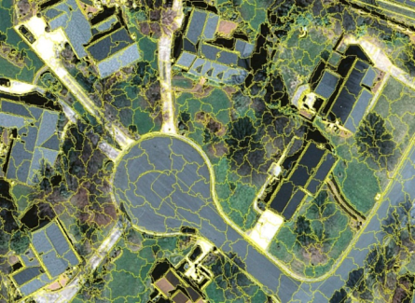
Impervious
Level of detail
Planning
Modeling
Source identification
Assessment
Stormwater utilities
Cartography

Slide 13

Definition of Impervious
Impervious
Buildings
Buildings and structures
Greenhouses
Roads
Road to edge of pavement
Gravel roads
Other
Parking lots
Sidewalks
Driveways
Patios
Swimming pools (water/non water)
Park walkways
Concrete pads
Decks
Pervious
Grass
Water
Forest when not covering impervious
Wetlands
Bare soil (even when compacted)
Railways
Baseball fields
Running tracks
Green roofs

Slide 14
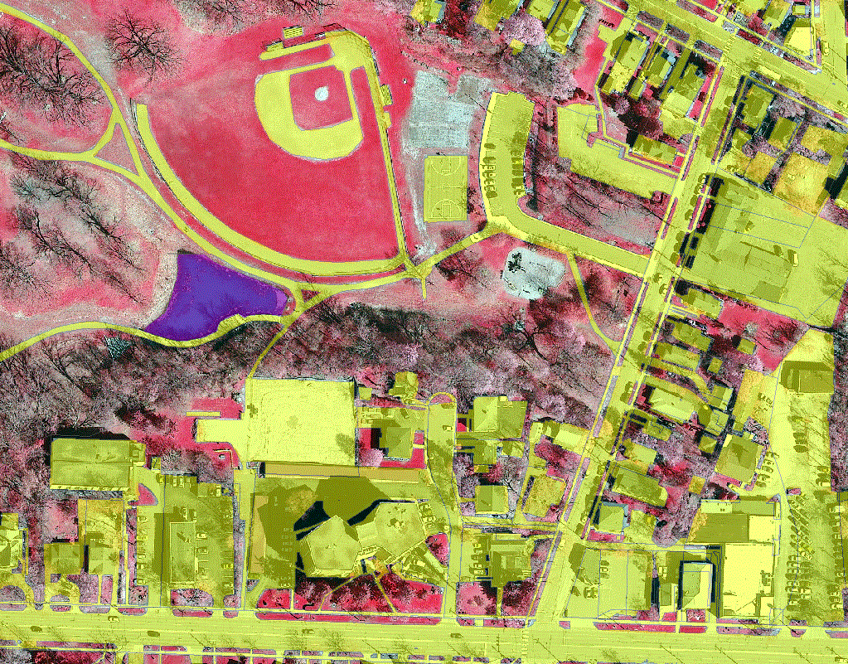
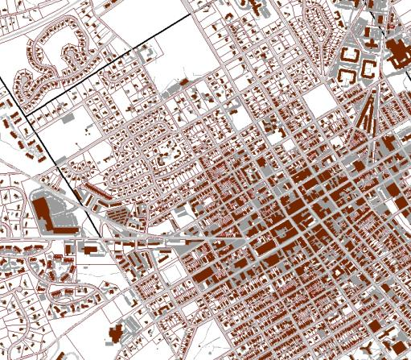
Assessment Level
6” – 1 ft imagery
3 – 4 bands
1 - 3 classes
200 sq ft. MMU
95% accuracy
Can determine connected and non- connected with other data
Chester County
91% Pervious
9% Impervious
26% Buildings
30% Roads
44% Other

Slide 15
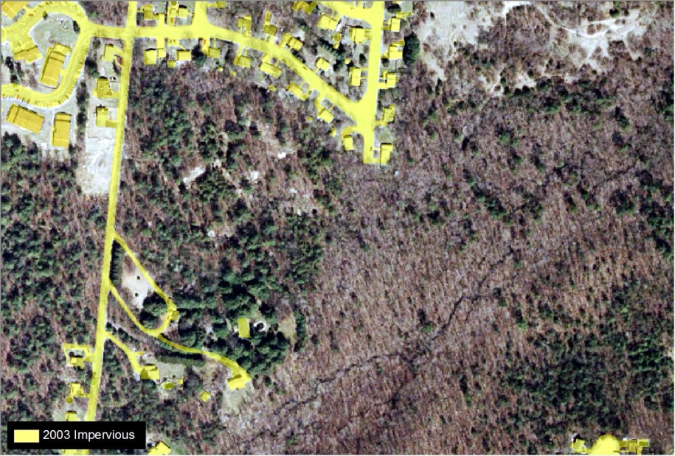
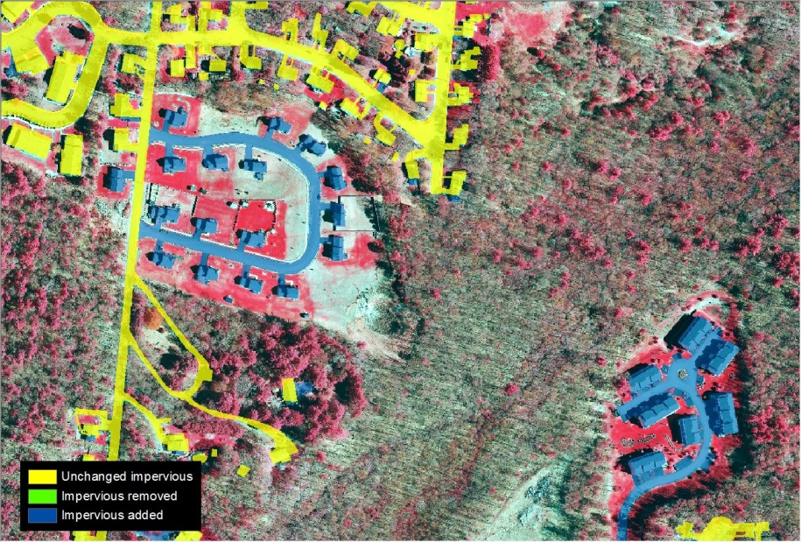
Planning Level
1 m imagery
3 – 4 bands
1 class
800 sq ft. MMU
90% accuracy
Can determine connected and non- connected with other data

Slide 16
Land Cover
Geospatial Solutions

Slide 17
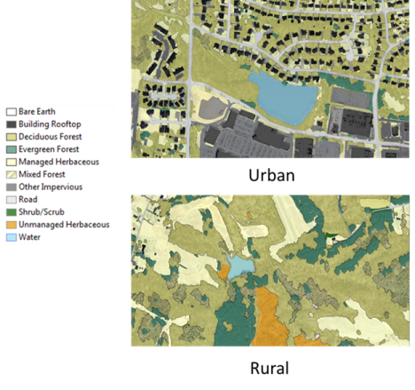
Urban Land Cover
Two levels
Canopy
Deciduous
Evergreen
Ground
Herbaceous/grassland
Turf grass
Fertilized
Unfertilized
Grassland
Shrub
Soil
Construction
Other

Slide 18
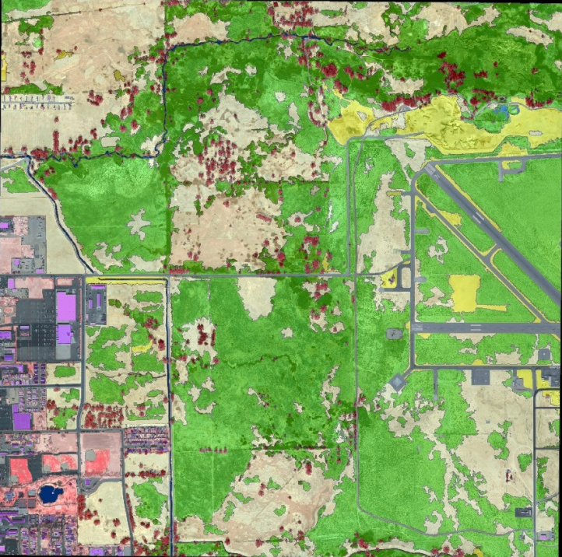
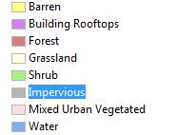
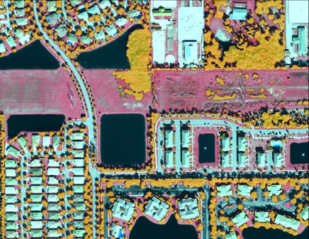
Examples
City of Bishop
LiDAR - Imagery
Buildings
Impervious
Land cover with tree heights
Broward County
LiDAR - Imagery
Urban Canopy

Slide 19
Natural Lands
Forests
Upland, Floodplain, Riparian
Wetlands
Tidal
Floodplain
Emergent, Shrub, Forested
Beaches
Sand, Rock
Water

Slide 20
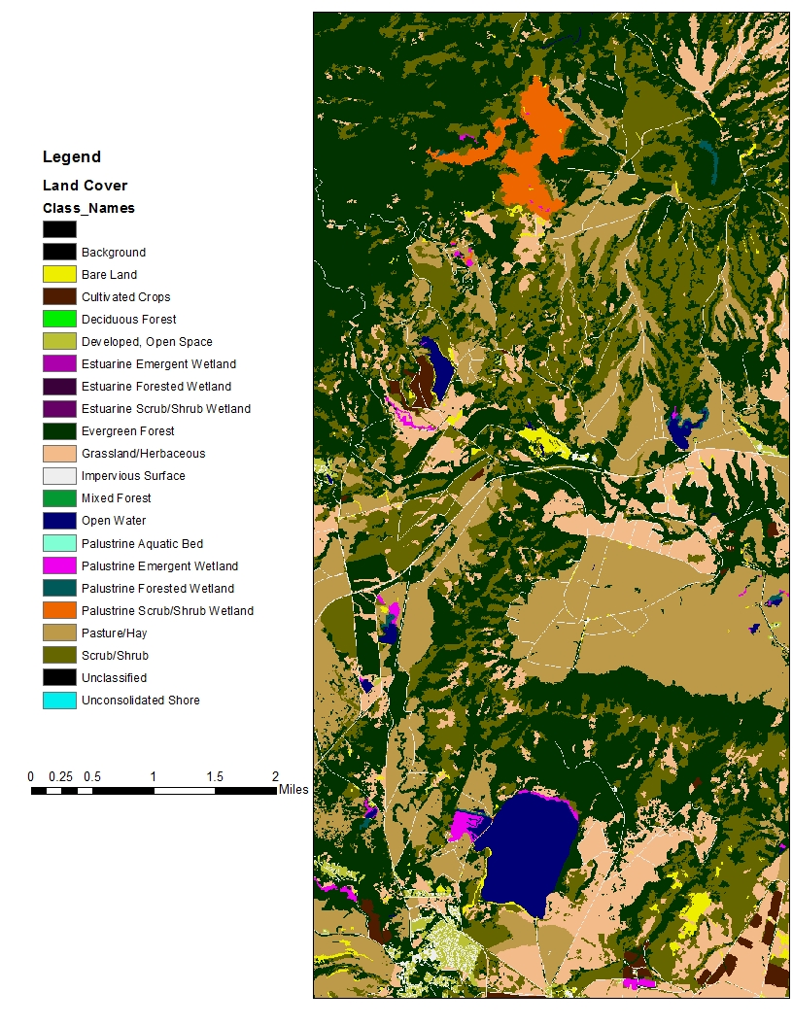
NOAA C-CAP
The classes used by the High Resolution C-CAP are:
Impervious
Developed, Open Space
Cultivated Crops
Pasture/Hay
Grassland/Herbaceous
Deciduous Forest
Evergreen Forest
Mixed Forest
Scrub/Shrub
Palustrine Forested Wetland
Palustrine Scrub/Shrub Wetland
Palustrine Emergent Wetland
Estuarine Forested Wetland
Estuarine Scrub/Shrub Wetland
Estuarine Emergent Wetland
Unconsolidated Shore
Bare Land
Open Water
Palustrine Aquatic Bed

Slide 21
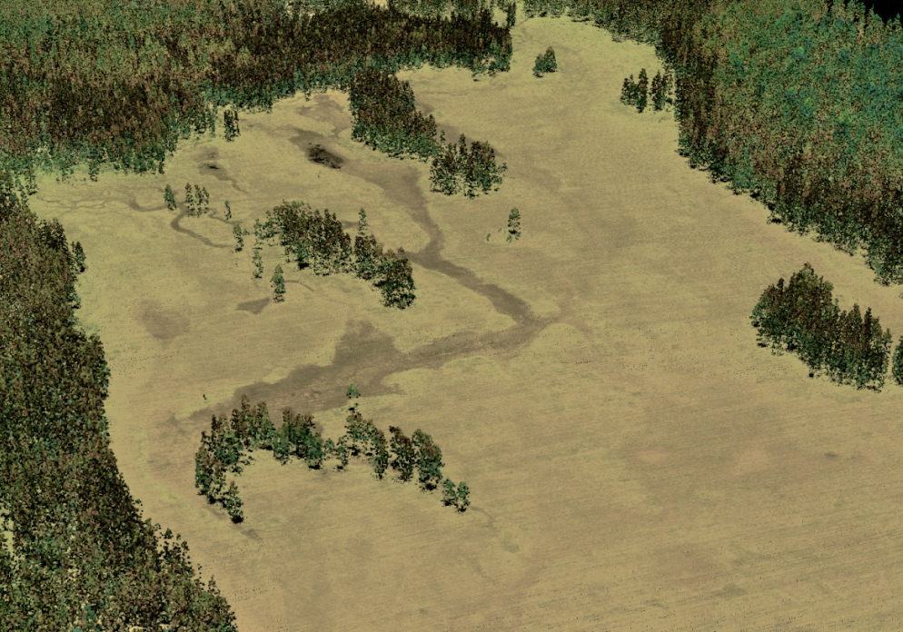
High Density LiDAR - Imagery
8 ppsm opens up new possibilities
Colorized point clouds
Greater identification of gaps, streams, erosion features etc.
3D point cloud colored by height and intensity, looking over the Warm Springs Reservation site.

Slide 22
Other Land Covers
Other land covers generate run off and NPS pollution
Create a detailed land cover for county can start to pin-point source sources
Detailed local load calculations
Buffer strip assessment
Agricultural assessment
Fertilizer assessment

Slide 23
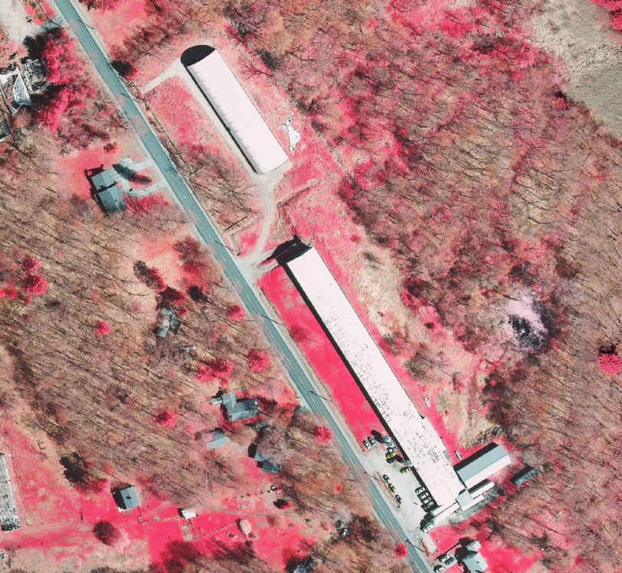
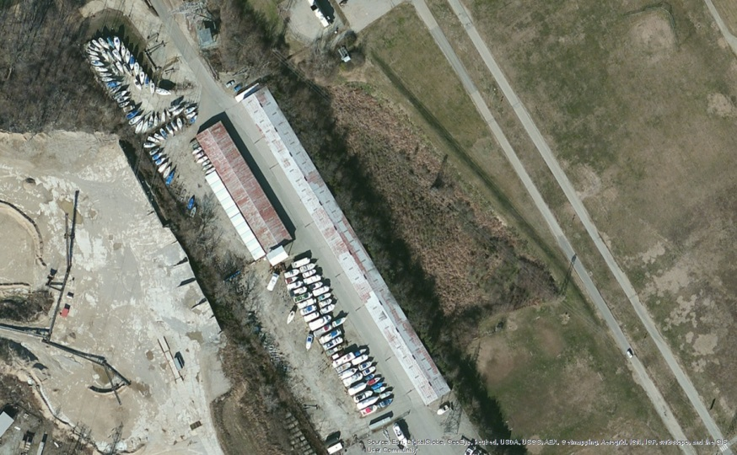
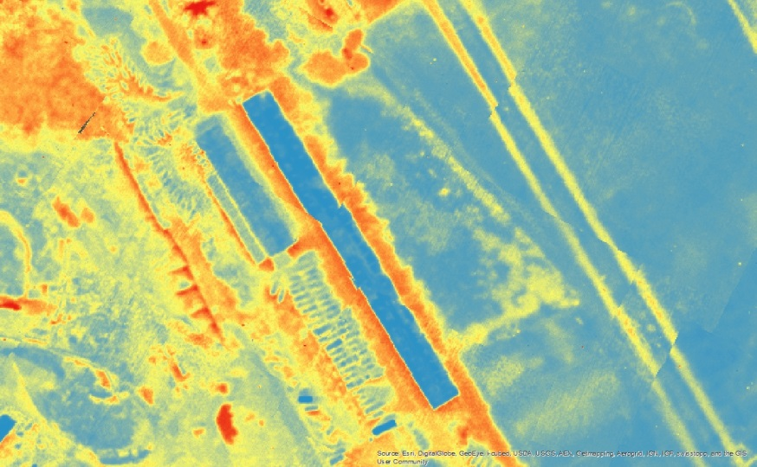
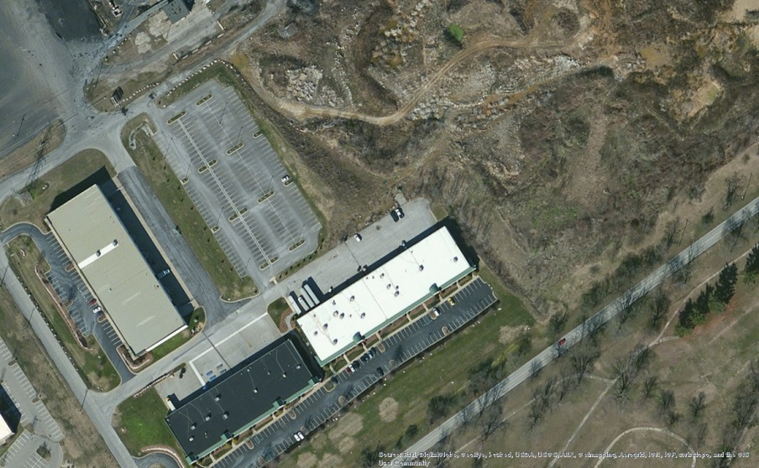
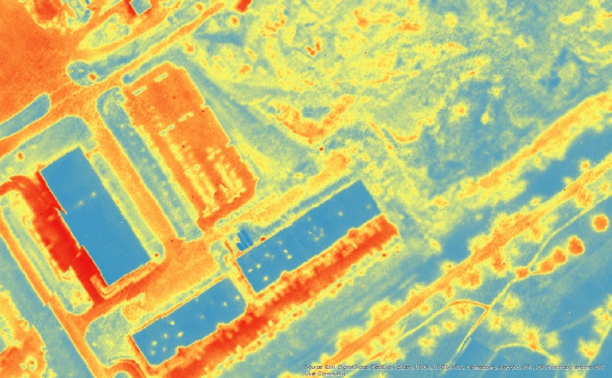
Agricultural

Slide 24
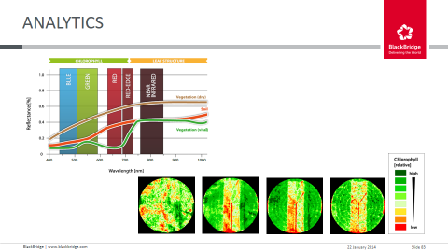
Cultivation Practices
Plowing ridges from high density LiDAR
Chlorophyll Concentration from RapidEye imagery

Slide 25
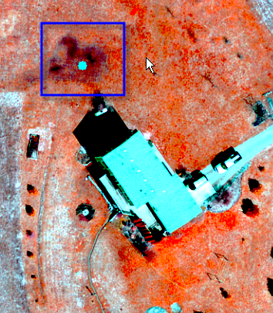
Septic Leakages
Septic systems
Can be a source of N, P and e coli
Difficult to quantify
Using infra-red imagery and GIS analysis
Can identify failure signatures and then develop strategy to deal with it.
Notes:
Brandywine Picnic Park – always floods during a rain event
Can clearly see structures in the floodplain as opposed to just address points in the centroid of the parcel

Slide 26
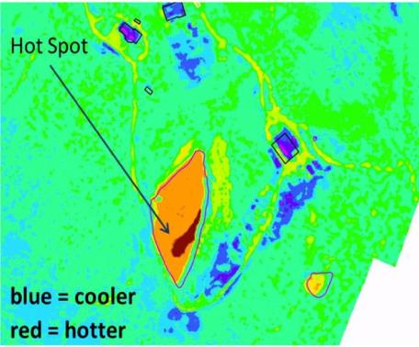
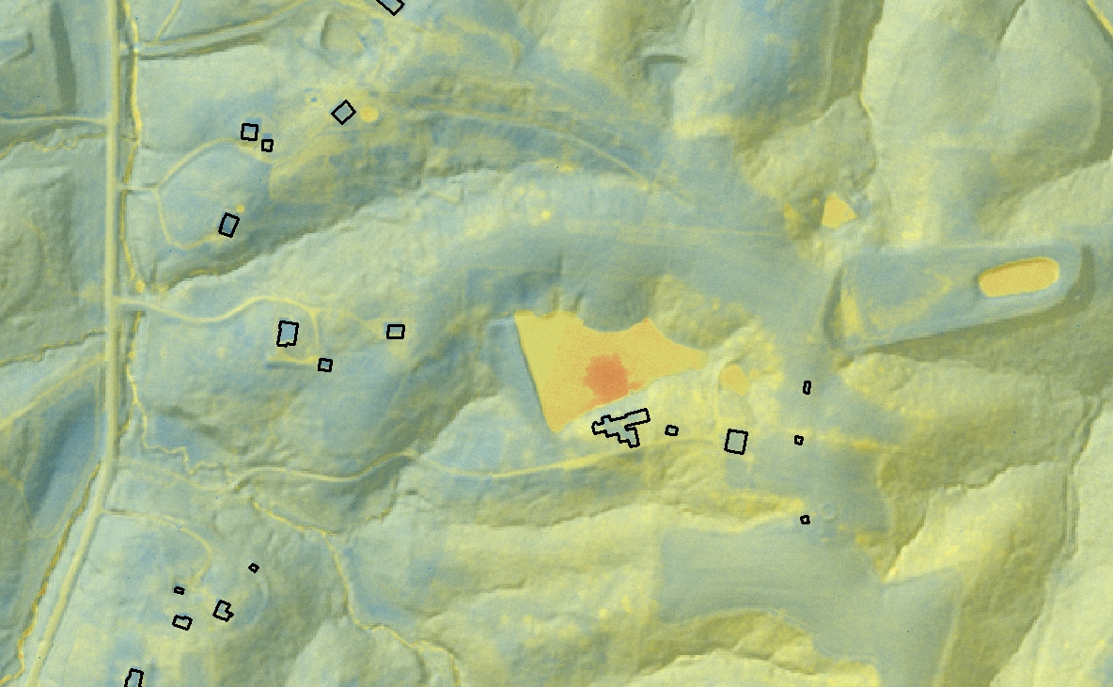
Illicit Discharges
Thermal analysis of non-storm water discharges from the storm water system
Precision 0.1 ºC
Discharges into water bodies
Can also identify other leakages

Slide 27
Land Use
Geospatial Solutions

Slide 28
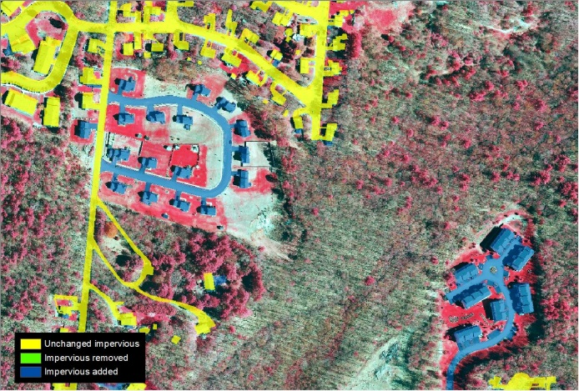
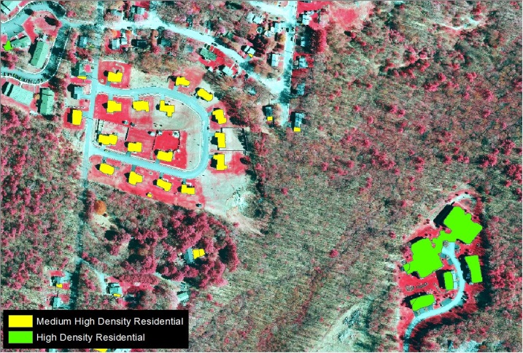
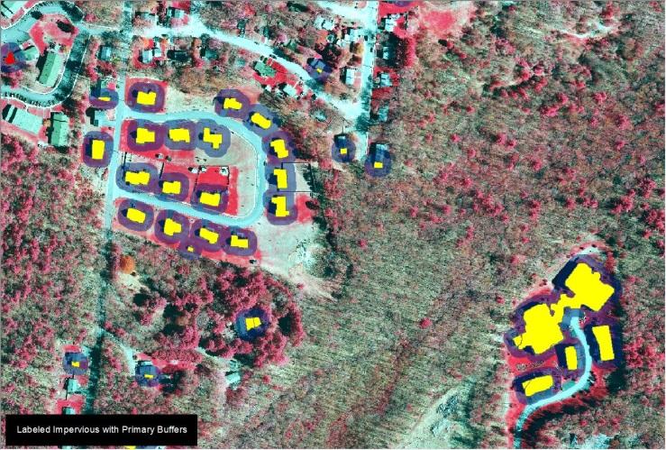
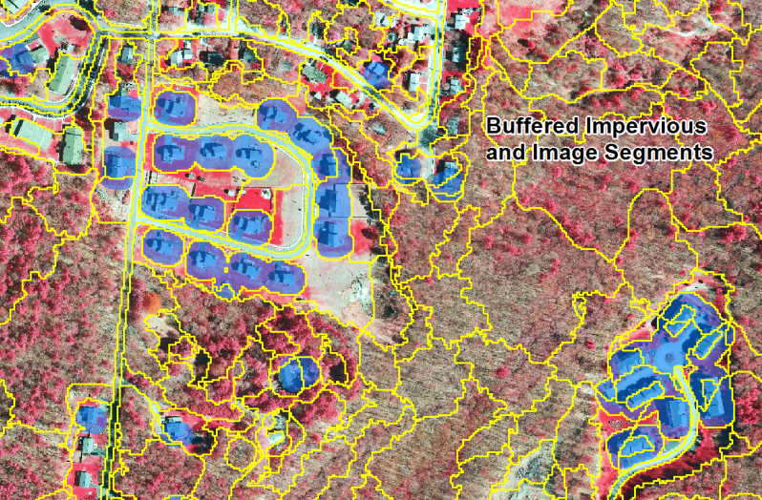
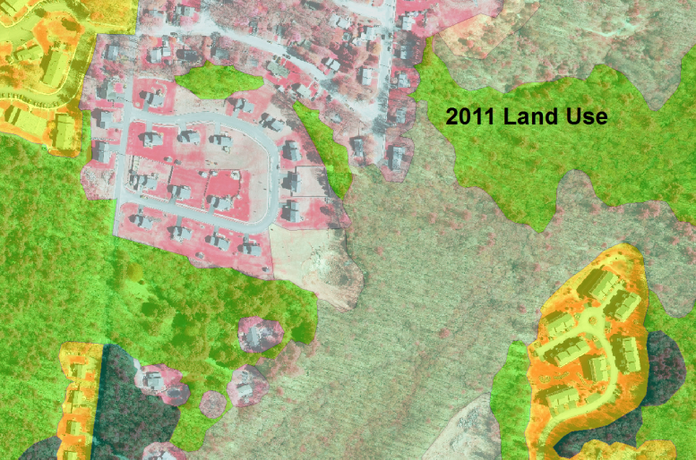
Development of Land Use

Slide 29
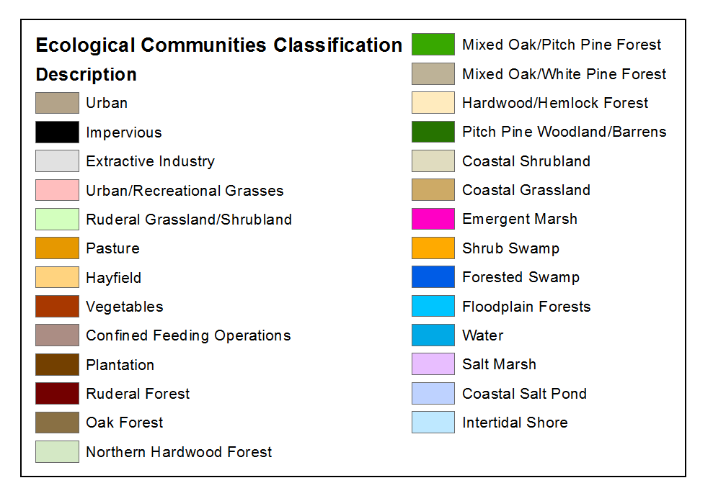
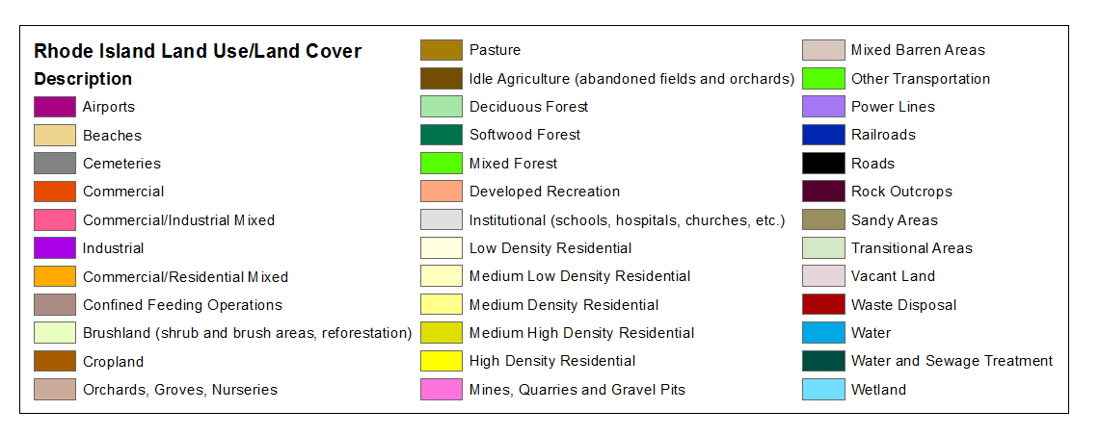
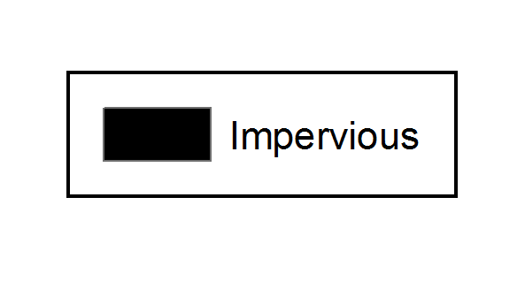
Leveraging Levels of Information

Slide 30
Pay For What You Need
Good data leads to good decisions
Good decisions lead to fewer law suits
Precise data means that you have focused actions rather than general recommendations
Focused actions mean that money spend will have a measureable impact
Pay for good data - it will pay you back
Will provide value to others too

Slide 31
Questions
?
Andrew Brenner
abrenner@photoscience.com
734-680-6424

