Slide 1

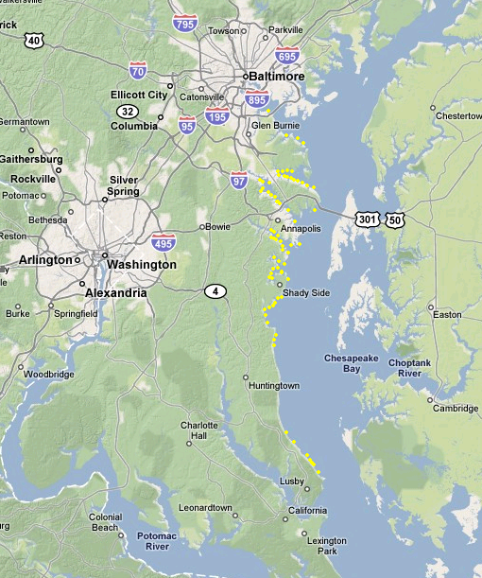
Executive Council 2012
Overview
Margaret Enloe
CBP Communications Director
Themes
Draft Agenda
State of the Program
Milestones

Slide 2
Theme
Working Title:
Drop by Drop, Step By Step:
Implementing the Plan
Meeting to highlight:
Urban & Ag – Both Doing Their Part
Local action
Includes local gov’t and and non-gov’t (e.g. Soil Conservation Districts)
Water Quality Monitoring: Seeing Results

Slide 3
Annotated Agenda (Draft)
10:15-10:30 EC members arriving
10:30-12:30 Morning Session – PUBLIC
10:30-10:40 Welcome, Agenda, Overview – EC Chair
10:40-11:50 Program Updates – CBP Director/Advisory Comm. Chairs
(10:40) State of Program: Program overview (5 min); Report from PSC on Deliverables from Last EC Meeting (5 min); Milestones (10 min); Restoration Indic. (10min)
(11:10-40) CAC, STAC, LGAG briefings (10 min ea.)
(11:40) Open Discussion between EC and presenters (30 mins)
12:10-12:30 Tent: Lightening Talks – W’shed groups fr PA, MD, VA, DC
12:30-1:40 Lunch - PRIVATE
12:30 Walk to/transition to lunch, location TBD
12:40-1:30 2 DiscussionTopics (TBD) (20 min ea.)
1:30 Briefing on Theme & Press Event

Slide 4
Annotated Agenda (Draft)
1:40-2:10 Afternoon Session – Activity (TBD)
1:40 Walk to Activity; stop for photo opps
1:55 Move to press conference location (if different)
2:15 – 3:15 Press conference
2:15 Welcome by site representative (TBD)
2:20 Administrator Jackson remarks
2:25 Governor O’Malley remarks
2:30 Governor McDonnell remarks
2:35 Governor Corbett remarks
2:40 Senator Hanger remarks
2:45 Mayor Grey remarks
2:50 USDA Secretary Vilsack
2:55-3:15 Media Q&A and buffer time

Slide 5
State of the Program
Report will include:
Director’s Message
Goal Team updates
Restoration Progress (Indicators)
Bay Health - Indicators (released to date of EC)
CBP Director’s Presentation will include:
Director’s overview
Bay Health – indicators released
Restoration Progress
Examples of jurisdictions’ individual successes in last year
Examples of agencies’ individual successes in last year

Slide 6
Milestones
2009 -11 Milestones & 2012-13 Milestones Presenter: Jeff Corbin
Will include:
Backgrounder
2009-11 Milestone Fact Sheets
2011 Progress Run Report
2012-13 Milestones Template
Nutrient and Sediment Trends Summary

