Slide 1


Establishing a Baseline for Local Leaders: Recommendations & Methodologies
December 14, 2017
Christine brittle, Ph.d.

Slide 2
Goal, Outcome, and Objective
STEWARDSHIP GOAL: Increase the number and diversity of local citizen stewards and local governments that actively support and carry out the conservation and restoration activities that achieve healthy local streams, rivers, and a vibrant Chesapeake Bay.
LOCAL LEADERSHIP OUTCOME: Continually increase the knowledge and capacity of local officials on issues related to water resources and in the implementation of economic and policy incentives that will support local conservation actions.
PROJECT OBJECTIVE: Develop a methodology for establishing a baseline of performance to measure progress toward attaining the goal and outcome stated above, which allows the Chesapeake Bay Program’s Local Leadership Workgroup to track trends in the level of action taken by local officials in order to practice adaptive management and to ensure that resources are allocated in a way that facilitates the desired outcomes.

Slide 3
The Challenge: Chesapeake Bay
6 States + DC
~200 Counties
~2,400 Cities and Towns
Over half have fewer than 2,000 residents
Thousands of Local Leaders!
Maps by Bay Program GIS Team
Notes:
Maps by Howard Weinberg, GIS Analyst with the Bay Program
200 Counties (if D.C. not counted) This includes those large cities in VA that exist outside of counties and are part of the County GIS layer.

Slide 4
Where We Are
Discussed with Chesapeake Bay Program Local Leadership Workgroup (July):
Defining the audience
Defining knowledge domains
Local connections
Regulations and infrastructure
Information seeking
Actions taken
How best to gather input

Slide 5
Recommendations: Defining the Audience
Hybrid approach
Include some local leaders who are known to you (e.g., taken a training course, participated in an activity) to better measure your actual impact
Include a stratified random sample of local leaders selected across the Bay area to serve as a true baseline

Slide 6
Recommendations: Defining Knowledge Domains
Support for all the domains
Local connections
Regulations and infrastructure
Information seeking
Actions taken

Slide 7
Recommendations: How to Gather Input
Three main sources
Process measures: count and record # trainings & # participants (annually: done internally)
Participant satisfaction surveys (annually: provide partners with a paper survey to distribute and tally the results)
Paper/electronic survey of local leaders (once soon for baseline and then every three years; done using an external contractor)

Slide 8
Update: Pilot Survey of Local Leaders
Pilot survey was fielded November-December 2017
Test sample, n=9 completes (all local leaders)
Response rate to untargeted respondents was about 10% (not a clean list, limited follow-up)
Known respondents participated at ~40%
20 questions
Response time varied from 4-16 minutes, with a mean of 9 minutes, and a median of 7 minutes [a little too long]

Slide 9
Key Measures in Pilot
Local connections
How much are you thinking about water resources when making policy decisions for your community? [Recommend dropping]
How much impact do you think the decisions you make have on water resources in your community? [Recommend dropping]
How much are you thinking about downstream communities and/or the Chesapeake Bay when making policy decisions for your community?
How much impact do you think the decisions you make have on downstream communities and/or the Chesapeake Bay?
How much do you think about downstream communities and/or the Chesapeake Bay when making decisions related to …
Which of the following do you see as a priority for your local community? [Recommend combining or dropping a few categories]
When your community takes steps to protect the environment, including water resources and the Chesapeake Bay, how much impact does that have on …

Slide 10
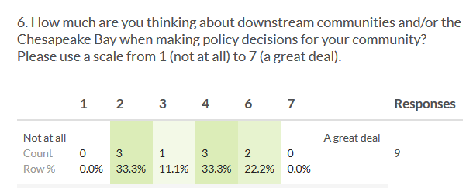
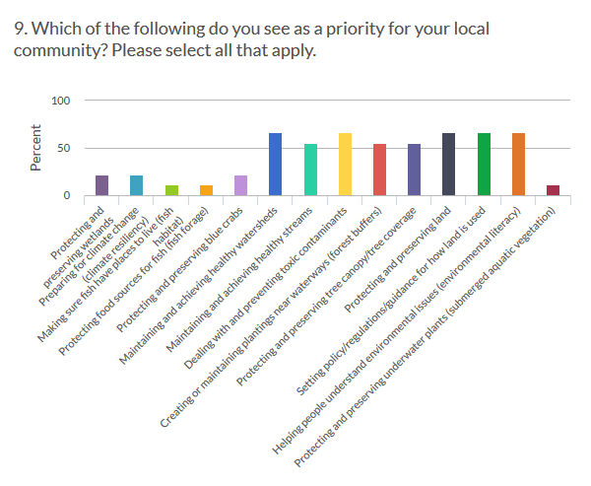
Sample Results: Local Connections

Slide 11
Key Measures in Pilot
Regulations and infrastructure
In general, how well do you understand environmental rules and regulations at the:
Local level
State level
Regional level
Federal level
Which of the following rules or regulations is your community subject to, now or in the future?

Slide 12
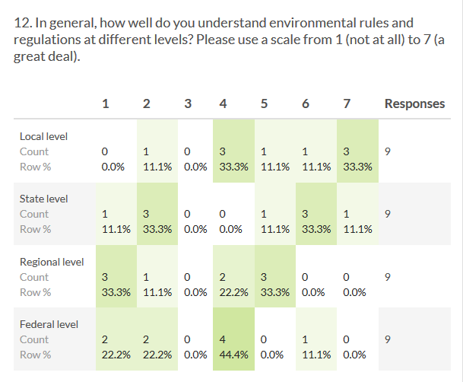
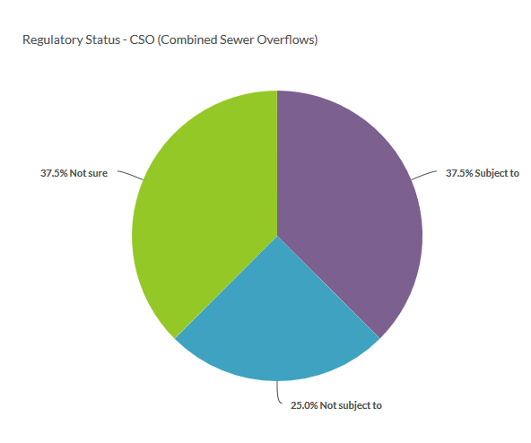
Sample Results: Regulations and Infrastructure

Slide 13
Key Measures in Pilot
Information seeking
Which of the following tools would you use or consider as means to protect or improve water resources for your community?
If you had a question about environmental regulations or how best to implement environmental policy, would you know who to contact for information or assistance?
If you wanted to learn more about environmental policy and/or water resources, which of the following resources do you know of? Which would you want to access?

Slide 14
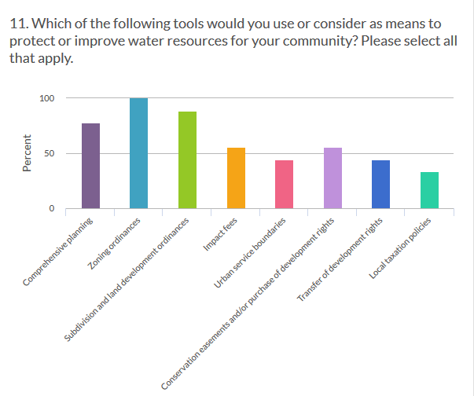
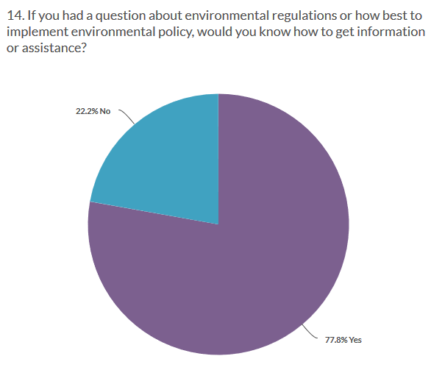
Sample Results: Information Seeking

Slide 15
Key Measures in Pilot
Actions taken
In the last three years, which of the following has your community undertaken related to water resources or environmental improvements?

Slide 16
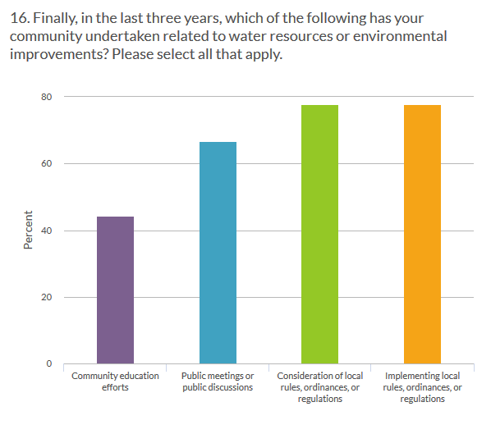
Sample Results: Actions Taken

Slide 17
Recommendations Going Forward
Make minor changes to pilot survey for length and clarity
Implement baseline survey (soon) using a stratified, random sample of local leaders
n=600 participants (stratify by state and community size, expected response rate~30%)
Repeat survey every 2-3 years, using a hybrid sample
n=400 random participants (expected response rate~30%)
n=200 known participants (expected response rate~50%)

Slide 18
Thank You! Christine Brittle, Ph.D. christine@uncommoninsights.com

