Slide 1
Farm Service Agency (FSA)
Natural Resource Conservation Service (NRCS)
Soil and Water Conservation District (or County Conservation District – depending on your state)
Photo: Marissa Morton
Notes:
1

Slide 2
Roles In Agricultural Conservation
Other Federal Agencies: Environmental Protection Agency (EPA)
State Agencies
Local Government
Photo: Marissa Morton
Notes:
2

Slide 3



University Roles
Land Grant Universities
Land-Grant College Act of 1862, or Morrill Act, Act of the U.S. Congress (1862) that provided grants of land to states to finance the establishment of colleges specializing in “agriculture and the mechanic arts.”
Cooperative Extension
The Cooperative Extension System is a non-formal educational program implemented in the United States designed to help people use research-based knowledge to improve their lives. The service is provided by the state's designated land-grant universities.
Photo: Marissa Morton
Notes:
3

Slide 4
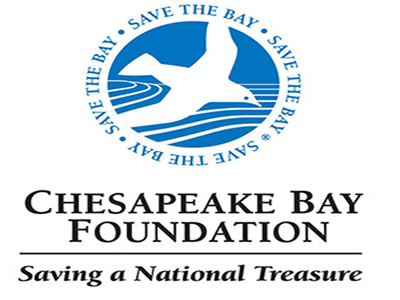


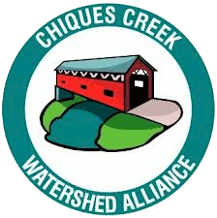


Non-Profit Organization Roles
Variable and Capacity Dependent
Place Based?
Outcome Based?
Practice Based?
Photo: Marissa Morton
Notes:
4

Slide 5
Farm Bill Program Basics
Photo: Marissa Morton
Notes:
5

Slide 6
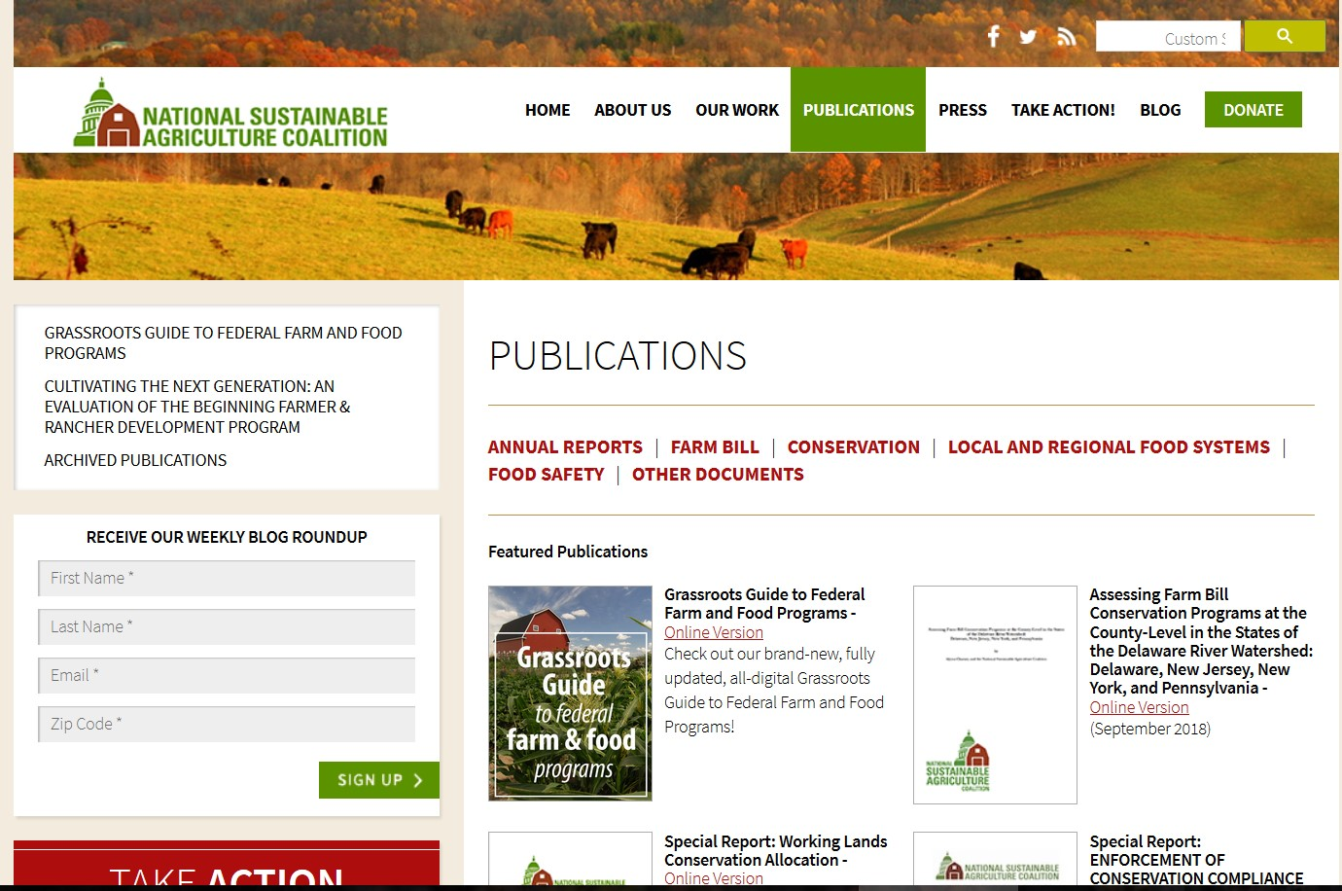
sustainableagriculture.net/publications/
Photo: Marissa Morton
Notes:
6

Slide 7
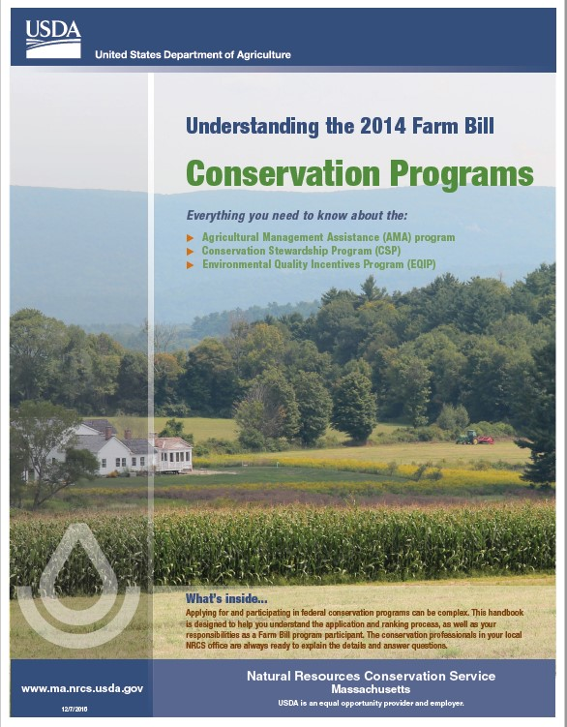
Photo: Marissa Morton
Notes:
7

Slide 8
Regional Conservation Partnership Program (RCPP)
Enables state and local agencies, non-profit organizations, and other entities to partner regionally with the Natural Resources Conservation Service on special projects to promote farmer adoption of conservation activities to address key natural resource concerns.
Environmental Quality Incentives Program (EQIP)
Supports working lands conservation through cost-share and technical assistance payments to farmers and ranchers. Funds primary farm headquarters work and field conservation practices including manure storage, barnyard improvements, terraces, waterways, etc. EQIP also includes Organic Initiative to support organic practice adoption, High Tunnel Initiative for vegetable production, and multiple regional landscape scale initiatives.
Photo: Marissa Morton
Notes:
8

Slide 9
Conservation Stewardship Program (CSP)
Rewards advanced conservation systems through 5-year renewable payment contracts to farmers and ranchers to actively manage, maintain, and expand conservation practices like rotations, cover cropping, rotational grazing, and IPM on working farms.
Agricultural Conservation Easement Program (ACEP)
Helps private landowners, land trusts, and other entities to preserve, restore, and enhance wetlands, grasslands, and working farms and ranches through conservation easements.
Photo: Marissa Morton
Notes:
9

Slide 10
Conservation Reserve Program (CRP)
Protects soil, water quality, and habitat by removing highly-erodible or environmentally sensitive land from agricultural production through long-term rental agreements. CRP acres are enrolled through a general sign up.
Continuous Sign-Up CRP - Under continuous CRP signup, environmentally sensitive land devoted to certain conservation practices can be enrolled in CRP at any time.
Conservation Reserve Enhancement Program (CREP)
CREP is a partnership between USDA and individual States. Each CREP agreement is unique, reflecting the priorities of the state partners and matching funds brought to bear by the state partners. The contract period is typically 10–15 years.
Note: CRP is administered by FSA but practice implementation is managed by NRCS
Photo: Marissa Morton
Notes:
10

Slide 11
Conservation Innovation Grants
Offers competitive grants to support projects by groups and producers (including on-farm research and demonstrations) to develop and improve access to innovative resource conservation solutions for farmers and ranchers nationwide.
Photo: Marissa Morton
Notes:
11

Slide 12
What is a TSP?
Technical Service Providers are conservation professionals from the private sector, non-profit organizations and public agencies that can provide direct technical assistance on behalf of USDA. Technical assistance includes conservation planning and design, layout, installation and checkout of approved conservation practices.
NRCS and conservation districts have traditionally provided these technical services and will continue to do so. Since the 2002 Farm Bill, however, USDA offers producers the option of reimbursement for technical assistance provided by certified Technical Service Providers.
If you are applying for funding for a forest management plan or an agricultural energy management plan, you will have to hire a TSP to develop the plan.
Photo: Marissa Morton
Notes:
12

Slide 13
Privacy Issues - Section 1619 of the Farm Bill
Section 1619 of the Farm Bill prohibits USDA from disclosing certain information that has been provided by agricultural landowners and producers in order to participate in USDA programs, except as necessary for delivering technical assistance. Some information developed by the agency concerning your property is also protected.
Section 1619 of the Farm Bill prohibits the release of information that falls into these categories:
XX
Information concerning the operation, practices or the land itself.
XX
Geospatial information, such as maps, surveys, and charts. Aerial photographs may be protected only if they contain data identifying characteristics of the agricultural land.
Section 1619 does not prohibit the disclosure of payment information, including the names and addresses of USDA payment recipients. Section 1619 does not apply to statistical or aggregated information that protects the name of individual agricultural producers, owners or sites.
Photo: Marissa Morton
Notes:
13

Slide 14
Photo: Marissa Morton
Notes:
14

Slide 15
Photo: Marissa Morton
Notes:
15

