Slide 1
Maryland’s Solar Energy Goals
Citizens Advisory Committee Meeting
May 18, 2022

Slide 2
Tools to Fight Climate Change in Maryland
Addressing climate change is a major priority in Maryland and has been for over 15 years
There are now FIVE key areas of focus:
The Greenhouse Gas Emissions Reduction Acts (GGRA) of 2009 and 2016
The Maryland Commission on Climate Change (MCCC)
Partnerships and Regional Collaborations
  RGGI, ZEV MOU
  United States Climate Alliance, etc.
Pushing back on Federal backsliding
Climate Solutions Now Act of 2022

Slide 3
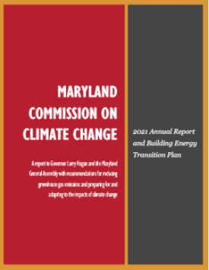
Maryland Commission on Climate Change (MCCC)
Original Climate Change Commission established through executive order in 2007 - Developed a 2008 Climate Action Plan that led to the 2009 GGRA
MCCC codified into law in 2015
Established a balanced, bipartisan Commission
  Representatives from the General Assembly, state and local government, the private sector, environmental advocacy groups, labor, the general public & more
Basic charge of the MCCC:
  Provide recommendations on how to reduce GHG emissions and adapt to the impacts of climate change
Four Working Groups:
  Mitigation
  Adaptation and Resiliency
  Scientific and Technical
  Education, Communication, and Outreach

Slide 4
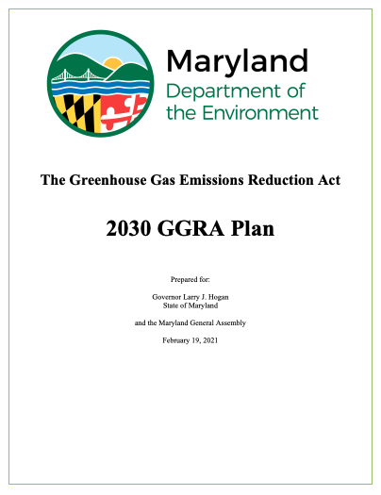
Climate Change Legislation History
Climate change effort originated in 2007 by Executive Order (2008 “Climate Action Plan”)
  Resulted in the “Greenhouse Gas Emission Reduction Act” of 2009 – MDE generated a 25% by 2020 Plan
GGRA reauthorized in 2016, adding a new goal
  40% GHG reduction by 2030
  In 2021, MDE submitted a comprehensive plan for a 40% reduction by 2030
April 2022, the Climate Solutions Now Act became law
  CNSA requires a Plan for a 60% by 2031 and Net-zero by 2045
Both the GGRA and CSNA require that the State’s GHG Plans support a healthy economy and create new jobs

Slide 5
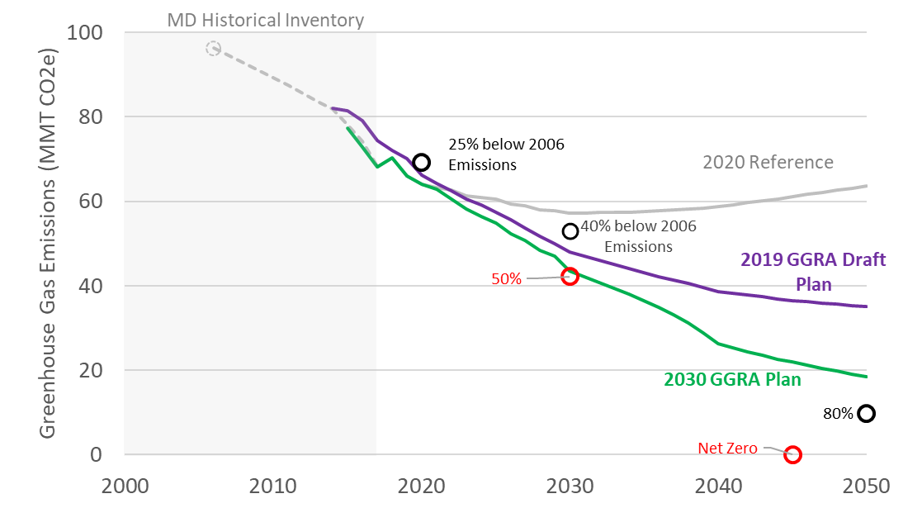
The 2030 GGRA Plan
The Climate Action Plan includes existing and new programs - across all levels of government
Maryland greenhouse gas emissions, accounting for sequestration. Projections from Draft Plan and 2030 GGRA Plan.
Notes:
The 2030 plan that we published in February includes detailed GHG emissions analysis
projections using an economy wide model developed for us by the consultant E3 the
model is referred to as the pathways model
this graph shows our GHG projections out through 2050
the Gray line is our reference case which is affected by existing policy - no new action
and you can see that we can continue to make progress in the near term but we
don't achieve our goals without additional action
the purple line represents how much lower emissions were projected to be, under our
draft GGRA plan - that we released in late 2019
and the green line shows the latest projections underour latest GGRA plan - that we
released earlier in this year
It includes existing and new programs, across all levels of government with a
focus on new state programs
Also important to note that these numbers account for sequestration

Slide 6
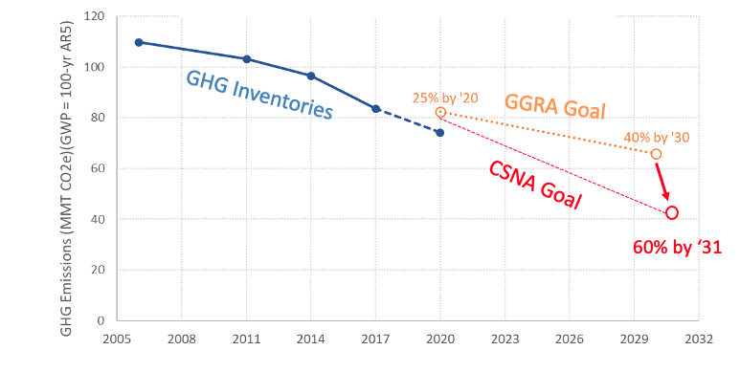
Climate Solutions Now Act of 2022
Most Ambitious Near-Term Goal in U.S.: 60-by-31
And Net Zero by 2045, consistent with other leaders

Slide 7
Overview: to Inform the Discussion
  What are MD’s renewable energy goals?
  What/who are the local drivers in MD?
  How will MD balance these goals with land use change and water quality impacts?
  What new guidance has MD issued based on what you’ve learned about large scale solar development?

Slide 8
Maryland’s Renewable Energy Goals
The Clean Energy Jobs Act (CEJA) establishes that 50% of MD’s electricity shall come from renewable energy resources by 2030
  Includes a commitment to examine ways to achieve 100% clean electricity by 2040
CEJA builds upon the renewable portfolio standard (RPS) which is the primary statutory obligation that increases electricity generation from renewables
Renewable energy generators will enter a market and supply renewable energy credits
Specifically, CEJA sets a new requirement for solar arrays to produce 14.5% of electric power by 2030, up from the current goal of 2.5% by 2020

Slide 9
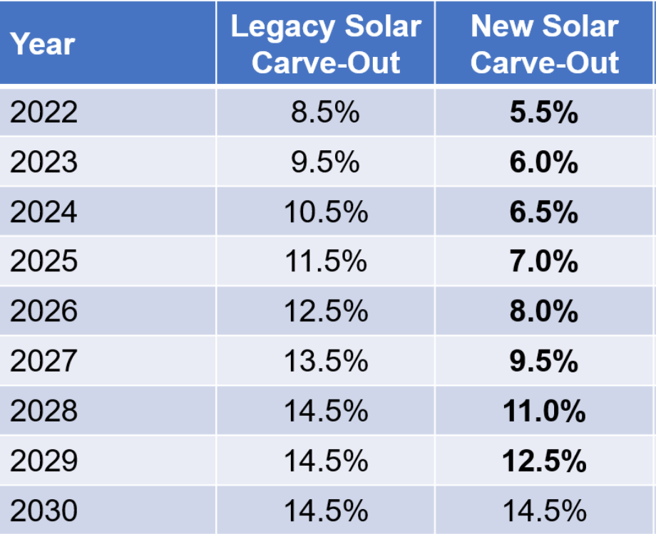
Update Renewable Portfolio Standard
The RPS requires electrical suppliers to provide a percentage of sales from Maryland-certified Tier 1 and Tier 2 renewable resources to reach 50% by 2030
In 2021, SB0065 changed Maryland’s solar carve-outs from 2022-2029
The 2030 14.5% solar carve-out remains

Slide 10
What are the local drivers of RE?
Incentives and Tax Credits
Ambitious economy-wide GHG Targets
Remove Obstacles during Project Planning/Permitting
Supportive Legislation
Expansion of the Net Energy Metering Cap

Slide 11
Smart Incentive Programs
The Maryland Energy Administration (MEA) implements several programs funded by the Strategic Energy Investment Fund to provide grants for renewable energy projects
Incentive programs enable cost effective solar development and consider land-use and land conservation
SB0860 (2022) passed into law providing a tax incentive to encourage community solar energy generating systems on:
    rooftops,
    brownfields,
    landfills and clean fills
    agrovoltaics

Slide 12
Remove Obstacles for Local Jurisdictions
Each county in Maryland has the authority to plan and regulate its own land use – but the development of new generation must be approved by PJM
PJM administers the interconnection of all regional electricity generation projects
A significant portion of Maryland’s proposed solar projects (listed in the PJM Queue) on the Eastern Shore
The solar projects in operation took an average of 3 years from entering the PJM Queue to coming on-line
Proposed solar projects on the Eastern Shore are projected to take up to 8 years

Slide 13
Increase the Cap on net-metering
The Maryland Public Service Commission issued a report in November of 2020 on the status of net energy metering in Maryland
  The Commission recommended that the General Assembly begin to explore expanding the current net metering cap or alternative replacement policies.
Expansion of the Net Energy Metering Cap
  Net energy metering has been a part of Maryland energy policy since 1997
  In 2021, the net metering cap was increased from 1,500 MW to 3,000 MW
  The doubling of the cap will encourage the adoption of distributed generation assets
  Property owners are incentivized to invest in behind-the-meter electricity generation assets like rooftop and community solar

Slide 14
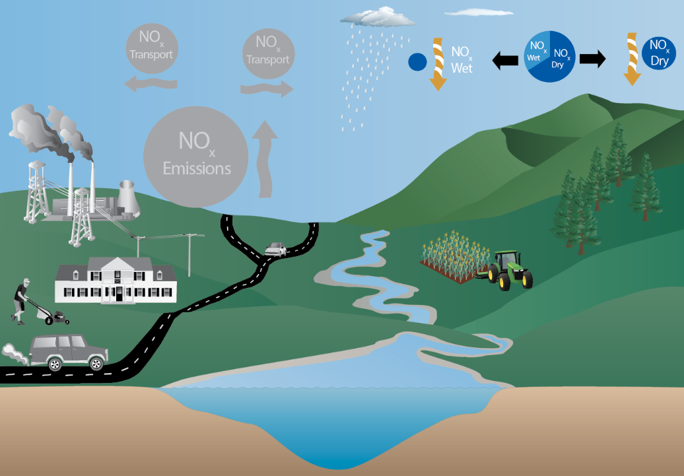
Cleaner Air from Renewable Energy
Transitioning away from fossil fuel fired electricity generation to renewable energy has a measurable impact on water quality in the Chesapeake Bay watershed
Atmospheric NOx deposits to tidal waters
Indirect deposition occurs when airborne NOx is not assimilated by the land
https://www.chesapeakebay.net/news/blog/clean_air_act_improves_water_quality_in_chesapeake_bay

Slide 15
How will MD balance these goals with land use changes and water quality impacts?
Maryland Agricultural Land and Solar Generation
For utility-scale solar developers, Maryland’s agricultural land is a convenient option
  More than 30 solar generation facilities are currently under construction or review by the state, and a vast majority will be located on agricultural lands
  From a developer’s perspective, the availability of large tracts of open land, which is more common in rural communities, is ideal as it generally does not require extensive site work (e.g., grading, or clearing), particularly if located within proximity to a power substation.
Natural and Working Lands provide critical ecological benefits such as water quality and carbon sequestration
The Maryland Public Service Commission (PSC) coordinates the CPCN* review process that requires state agencies to examine the costs and benefits of utility-scale solar (>2 MW) on agricultural land
  * Certificate of Public Convenience and Necessity (CPCN) allows someone to construct new generating station

Slide 16
Protecting Agricultural Lands
The state’s primary instrument for conserving farmland is the Maryland Agricultural Land Preservation Foundation (MALPF)
  Maryland Department of Agriculture purchases agricultural preservation easements restricting development on farmland and woodland
  Created in 1977, MALPF is one of the first of its kind and has become one of the nation's leaders in agricultural land preservation
  Its mission is to protect the best quality farms and expand on existing preservation areas to increase the size of contiguous blocks of preserved farmland

Slide 17
Maryland's Forest Conservation Act and Solar Generation
Protecting Forested Land: Maryland enacted the Forest Conservation Act (FCA) in 1991 that requires that any project that disturbs more than 40,000 square feet must comply with the county implementation statutes
  The Act established standards for land development to consider conservation in the project planning process
  County and municipal governments are responsible for making sure these standards are met but CPCN permits are dependent on FCA compliance

Slide 18
Post-Solar Restoration of Farmland
Maryland’s CPCN license conditions generally require that once the operating life of a solar facility ends (at least 30 years), the facility must be decommissioned, and land returned to its original condition
Also, CPCN license conditions require a detailed decommissioning plan and surety agreement to be filed with the PSC

Slide 19
Guidance on large scale solar development?
Governor Hogan signed an executive order in 2019 establishing a task force on renewable energy development and siting (REDS)
  The Task Force released a final report in August 2020
  The report summarized the State’s renewable energy siting issues, and in particular, siting on natural and working land

Slide 20
REDS Task Force Recommendations
Develop Additional Incentive Programs
Consider Options for Updating and Streamlining the CPCN Process
Expand Rooftop Solar and Other Preferred Applications by Increasing the Net Energy Metering Cap
Accelerate Residential Rooftop Solar Permitting
Evaluate New and Existing State and Local Government Facilities and Land for Solar Potential
Establish an Offset Requirement for Farmland Development Similar to Maryland’s Existing Forest Offset
Degraded Lands with Photovoltaic (PV) Potential

Slide 21
REDS Task Force Recommendations
Develop SmartDG+ a free online tool to site solar
Address Transmission and Distribution Constraints
Assess Environmental Justice (EJ) Siting Impacts
Develop Streamlined Standard to Review and Approve Energy Storage Projects
Expand Efforts to Develop Microgrids in Maryland by Leveraging Solar in the Built Environment
Expansion of Maryland Green Registry
Promote Complementary Practices Like Agrovoltaics and Pollinator Habitat

Slide 22

Next Steps for MDE
CSNA requires MDE to produce a 60% by 2031 Plan
  Draft Plan due June 2023.
  Final Plan due December 2023.

Slide 23
Contact
Chris Beck
christopher.beck@maryland.gov

