Slide 1
2019-2020 Bay Barometer
Citizens Advisory Committee
February 25, 2021

Slide 2
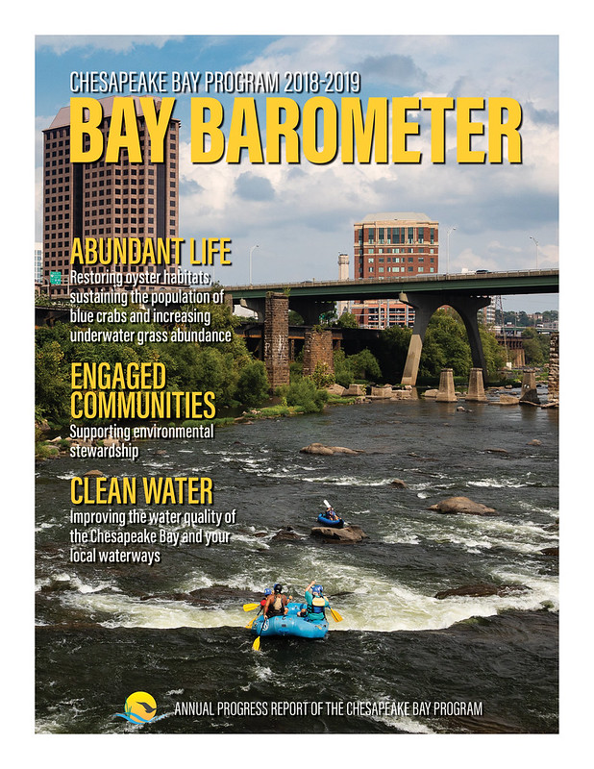
What is it?
Annual report on watershed health.
Provides a progress update on each one of the 31 outcomes in the Chesapeake Bay Watershed Agreement.
Retrospective summary of previously published indicators.
Targeted audience is typically those that are more informed than the interested public. Legislators, non-governmental organizations, academia, internal Chesapeake Bay Program partners, scientists and other researchers.

Slide 3
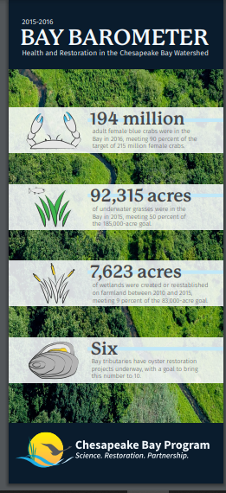
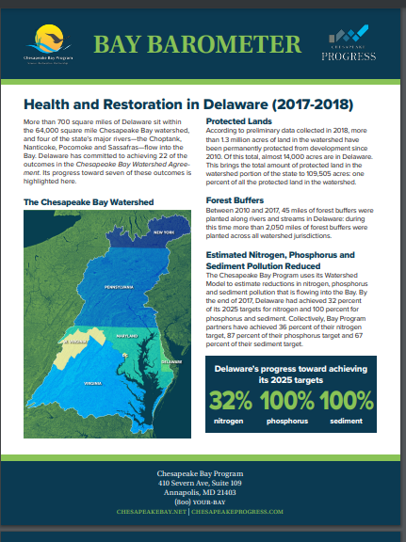
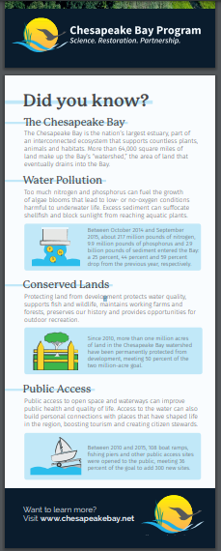
Reaching Other Audiences

Slide 4
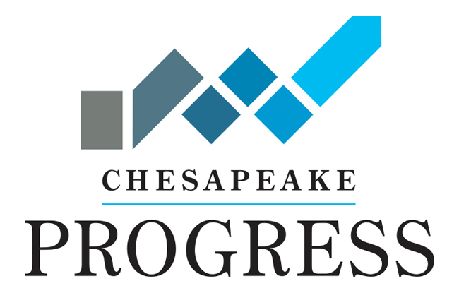
ChesapeakeProgress

Slide 5
Chesapeake Bay Watershed Agreement
5 themes.
10 goals.
31 outcomes.
19 indicators.
For 2019-20: 12 updated indicators.

Slide 6

What is this year’s Barometer telling us?

Slide 7
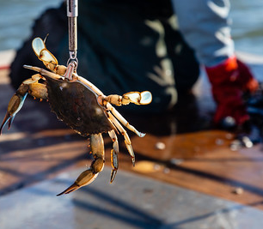
Abundant Life: Sustainable Fisheries—Blue Crab Abundance
Target: Maintain a sustainable blue crab population based on the 2012 target of 215 million adult females. Refine population targets through 2025 based on best available science.
Current progress: Between 2019 and 2020, the abundance of adult (age 1+) female blue crabs in the Chesapeake Bay decreased 26% from 191 million to 141 million. This number is above the 70 million threshold which is considered the sustainable level for female blue crabs in the Bay.
Previous progress: In 2018, there was an estimated 147 adult female blue crabs in the Bay.
Data source: The Chesapeake Bay Stock Assessment’s annual Blue Crab Advisory Report. (2020)
Notes:
For Blue Crab Abundance, this number is above the 70 million threshold which is the minimum sustainable level for female blue crabs in the Bay, but lower than the target of 215 million. For Blue Crab Management Experts have determined the blue crab stock is not depleted and is not being overfished.

Slide 8
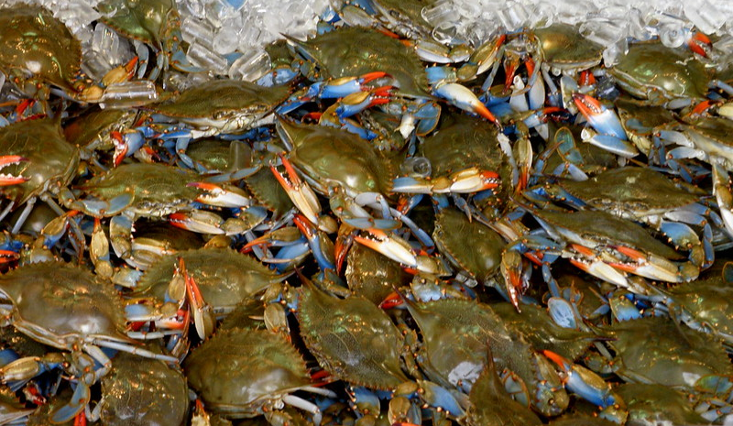
Abundant Life: Sustainable Fisheries—Blue Crab Management
Target: Manage for a stable and productive crab fishery including working with the industry, recreational crabbers and other stakeholders to improve commercial and recreational harvest accountability. By 2018, evaluate the establishment of a Bay-wide, allocation-based management framework with annual levels set by the jurisdictions for the purpose of accounting for and adjusting harvest by each jurisdiction.
Current progress: An estimated 17% of female blue crabs were harvested in 2019. For the 12th consecutive year, this number is below the 25.5% target and 34% overfishing threshold. The blue crab stock is not depleted or overfished.
Previous Progress: In 2018, an estimated 23% of female blue crabs were harvested.
Data Source: The Chesapeake Bay Stock Assessment Committee’s annual Blue Crab Advisory Report. (2020)

Slide 9
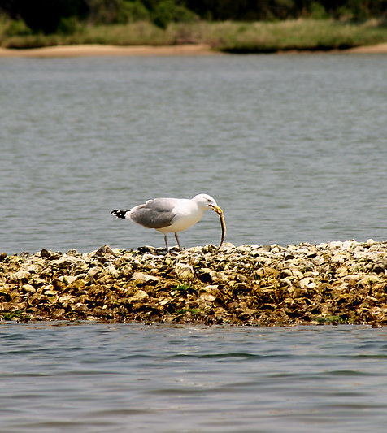
Abundant Life: Sustainable Fisheries--Oysters
Target: Continually increase finfish and shellfish habitat and water quality benefits from restored oyster populations. Restore native oyster habitat and populations in 10 tributaries by 2025 and ensure their protection.
Current progress: Ten tributaries have been selected for large-scale oyster restoration and are in various stages of progress. Maryland has completed 788 acres of oyster reefs and Virginia, 539 acres.
Previous progress: Nine tributaries had been selected for large-scale oyster restoration and were in various stages of progress. Maryland had completed 773 acres of oyster reefs, and Virginia, 510 acres.
Data source: Annual Maryland and Virginia oyster restoration updates. Current data is from 2019.
Notes:
The Manokin River was chosen by MD to be the 10th tributary in the summer of 2019.

Slide 10
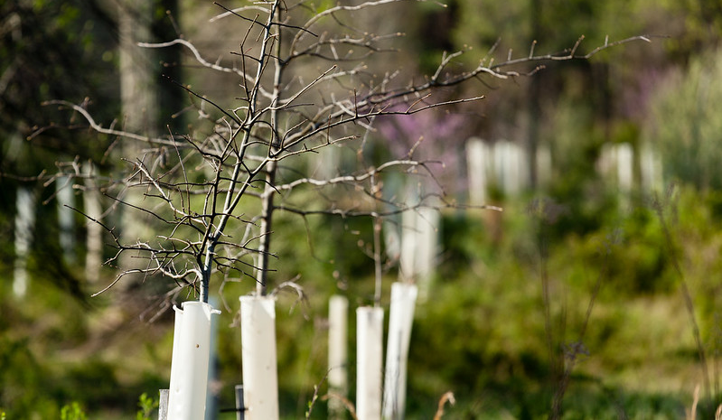
Abundant Life: Vital Habitats—Forest Buffers
Target: Continually increase the capacity of forest buffers to provide water quality and habitat benefits throughout the Chesapeake Bay watershed. Restore 900 miles of riparian forest buffers per year and conserve existing buffers until at least 70% of riparian areas in the watershed are forested.
Current progress: Between 2018 and 2019, 83 miles of buffers were planted, falling short of the annual target by 817 miles. Overall, there are 9,190 miles planted across the watershed.
Previous progress: Between 2017 and 2018, 158 miles of buffers were planted, falling short of the annual target by 742 miles. Overall, there are 9,107 miles planted across the watershed.
Data source: State agencies report on an annual basis.

Slide 11
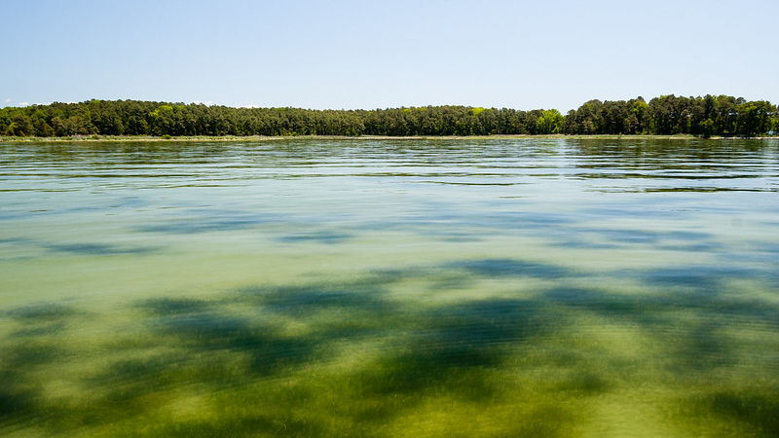
Abundant Life: Vital Habitats—Submerged Aquatic Vegetation (SAV)
Target: Sustain and increase the habitat benefits of SAV in the Chesapeake Bay. Achieve and sustain the ultimate outcome of 185,000 acres of SAV Bay-wide necessary for a restored Bay. Progress toward this ultimate outcome will be measured against a target of 90,000 acres by 2017 and 130,000 acres by 2025.
Current progress: In 2019, 66,387 acres of SAV were mapped in the Bay; achieving 51% of the target of 185,000 acres.
Previous progress: In 2018, an estimated 91,559 acres of SAV were mapped in the Bay; achieving 49% of the 185,000-acre target.
Data source: VIMS annual aerial monitoring survey, satellite imagery

Slide 12
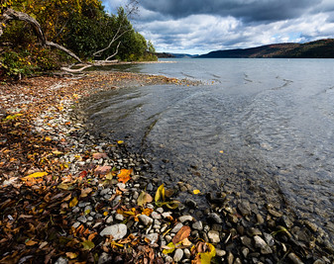
Clean Water: Water Quality—2025 Watershed Implementation Plans
Target: By 2025, have all practices and controls in place to achieve applicable water quality standards as articulated in the Chesapeake Bay Total Maximum Daily Load.
Current progress: Over the period 2009-2019, practices have been put into place to reduce 11% of nitrogen pollution, 10% of phosphorus pollution and 4% of sediment pollution entering the Bay.
Previous progress: Over the period 2009-2018, practices were put into place to reduced 10% of nitrogen pollution and13% of phosphorus loads entering the Bay.
Data sources: Jurisdiction BMP and wastewater data; watershed conditions replicated in CAST; reported every two years (2017-2019).
Notes:
Sediment was not formally tracked until 2020 when the sediment targets were approved by the PSC.
Figures above are the long-term estimated reductions over time. From the previous assessment period, 2015-2017, BMPs put into place lowered nitrogen by 39 percent, phosphorus by 49 percent and sediment by 100 percent.
Two year increments follow EPA milestones.

Slide 13
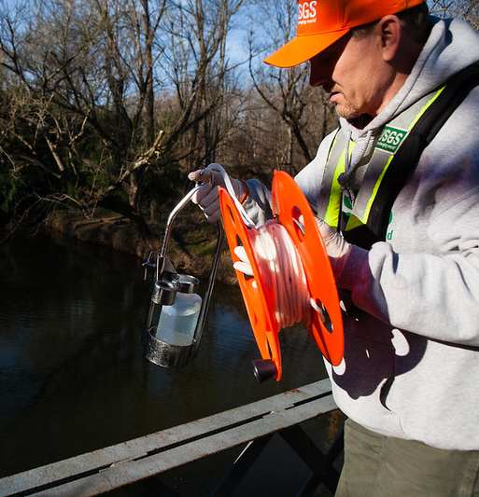
Clean Water: Water Quality—Water Quality Standards Monitoring and Attainment
Target: Continually improve the capacity to monitor and assess the effects of management actions being undertaken to implement the Chesapeake Bay Total Maximum Daily Load and improve water quality. Use the monitoring results to report annually to the public on progress made in attaining established Bay water-quality standards and trends in reducing nutrients and sediment in the watershed.
Current progress: 38% of the Bay and its tidal tributaries met water quality standards during the 2016-2018 assessment period.
Previous progress: 42% of the Bay and its tidal tributaries met water quality standards during the 2015-2017 assessment period.
Data sources: Dissolved oxygen, SAV acreage, chlorophyl-a, salinity, water temperature, Secchi depth, benthic data, river flow and load data come from MD DNR, VA DEQ, Old Dominion U, VIMS, CMC, UMCES and USGS.

Slide 14
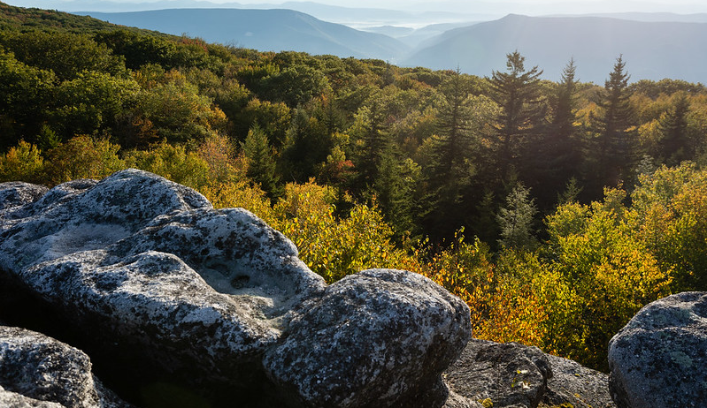
Conserved Lands: Land Conservation—Protected Lands
Target: By 2025, protect an additional two million acres of lands throughout the watershed—currently identified as high conservation priorities at the federal, state or local level—including 225,000 acres of wetlands and 695,000 acres of forest land of highest value for maintaining water quality.
Current progress: Data collected in-between 2016-2018 show that nearly 1.36 million acres of land in the Chesapeake Bay watershed have been permanently protected since 2010. This marks an achievement of 68% of the outcome achieved and brings the total amount of protected land in the watershed to 9.16 million acres.
Previous progress: Data collected in-between 2015-2017 show that a little over one million acres of land in the watershed have been permanently protected from development since 2010. This marked an achievement of 50% of the total outcome achieved.
Data sources: Reported every two years by jurisdictions.

Slide 15
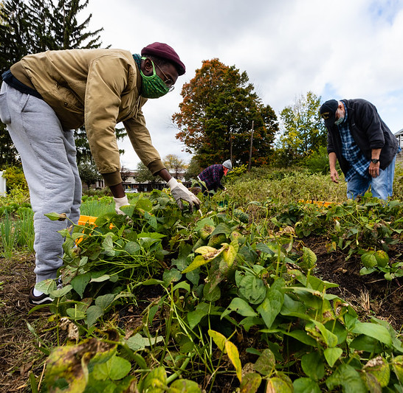
Engaged Communities: Stewardship—Diversity
Target: Identify stakeholder groups not currently represented in leadership, decision-making or implementation of current conservation and restoration activities and create meaningful opportunities and programs to recruit and engage these groups in the partnership’s efforts.
Current progress: In 2019, the most recent diversity survey indicated a slight increase (13.7% to 14.6%) in the percentage of CBP partners who self-identified as people of color. The survey results also showed an increase in the percentage of people of color in CBP leadership positions from 9.1% to 10.3%.
Previous progress: In 2016, 13.7% of CBP partners self-identified as people of color, and 9.1% self-identified as people of color in CBP leadership positions.
Data source: Survey of CBP partners every 3 years.

Slide 16
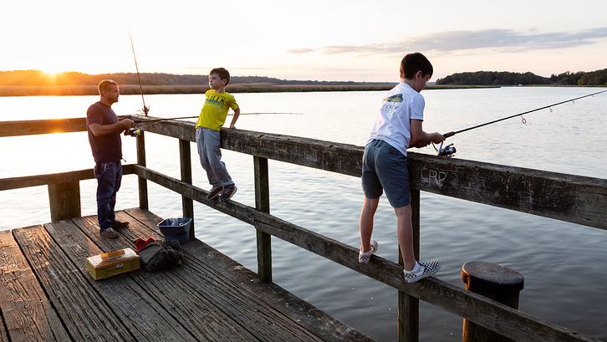
Engaged Communities: Public Access—Public Access
Target: By 2025, add 300 new public access sites, with a strong emphasis of providing opportunities for boating, swimming and fishing, where feasible.
Current progress: Between 2010 and 2019, 194 boat ramps, fishing piers and other public access sites were opened on and around the Chesapeake Bay. This marks a 65% achievement of the goal to add 300 new access sites to the watershed by 2025.
Previous progress: Between 2010 and 2018, 194 boat ramps, fishing piers and other public access sites were opened on and around the Chesapeake Bay. This marks a 65% achievement of the goal to add 300 new access sites to the watershed by 2025.
Data source: Each jurisdiction reports data on an annual basis.

Slide 17

Engaged Communities: Environmental Literacy—Environmental Literacy Planning
Target: Each participating Bay jurisdiction should develop a comprehensive and systemic approach to environmental literacy for all students in the region that includes policies, practices and voluntary metrics that support the environmental literacy Goals and Outcomes of this Agreement.
Current progress: In 2019, 27% of the local education agencies that responded to a Chesapeake Bay Program survey self-identified as “well-prepared” to deliver high-quality environmental literacy programming to their students. Of the remaining respondents, 52% identified as somewhat prepared and 22% identified as not prepared. This marks an increase in environmental literacy preparedness since the pilot Environmental Literacy Indicator Tool survey was distributed in 2015.
Previous progress: In 2017, 22% of the local education agencies that responded to a Chesapeake Bay Program survey self-identified as “well-prepared” to deliver high-quality environmental literacy programming to their students. Of the remaining respondents, 58% identified as
Data source: Environmental Literacy Indicator Tool (voluntary survey)
Notes:
However, the 2019 survey includes districts who had previously not responded so it is important to look at data from school districts who responded in both 2017 and 2019. Of those districts, 47% improved their environmental literacy indicating positive progress.

Slide 18

Engaged Communities: Environmental Literacy--Student
Target: Continually increase students’ age-appropriate understanding of the watershed through participation in teacher-supported meaningful watershed educational experiences and rigorous, inquiry-based instruction, with a target of at least one meaningful watershed educational experience in elementary, middle and high school depending on available resources.
Current progress: In 2019, 32% of the 132 local education agencies that responded to a Chesapeake Bay Program survey reported providing MWEEs to at least some of their elementary school students. At the middle school level, this number rose to 38%, and at the high school level, it rose to 43%. Data collected through the ELIT in 2019 for elementary and middle grades show the proportion of districts with system wide MWEEs have not increased, and that there has been only a slight increase in high school. However, the 2019 survey includes districts who had previously not responded, and the data suggests that these new districts are not as far along in their programming. When comparing the districts that responded in both 2017 and 2019, the number of districts with systemwide MWEEs actually increased from 45% to 52% in elementary school, 51% to 55% in middle school, and 33 to 48% in high school – indicating substantial improvement.
Previous progress :In 2017, 32% of the 132 local education agencies that responded to a Chesapeake Bay Program survey reported providing MWEEs to 29% of their elementary school students. At the middle school level, this number rose to 31%, and at the high school level, it rose to 32%.
Data source: Environmental Literacy Indicator Tool (voluntary survey)

Slide 19

Questions?
The 2019-20 Bay Barometer will hit the streets on Wednesday, March 17.

Slide 20
Thank you!
Rachel Felver
Chesapeake Bay Program Communications Director
Alliance for the Chesapeake Bay
rfelver@chesapeakebay.net

