Slide 1




Chesapeake Bay Restoration
2018 BMP Verification Assessment
Lucinda Power
EPA Chesapeake Bay Program Office
Citizens Advisory Committee Meeting
May 22, 2019

Slide 2
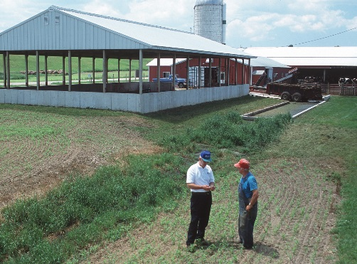
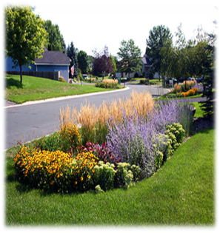
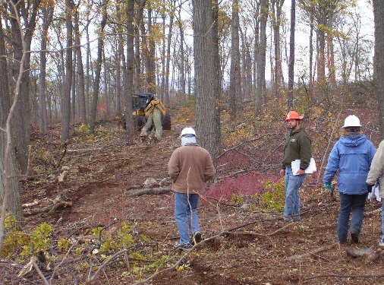
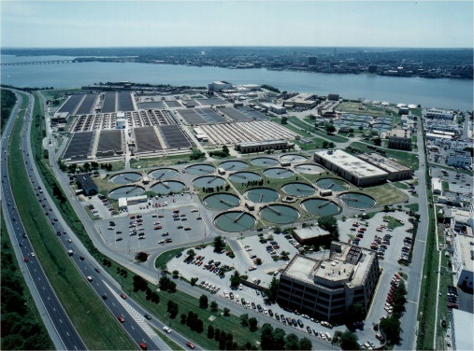

Strengthening Verification of Best Management Practices Implemented in the Chesapeake Bay Watershed: A Basinwide Framework
Report and Documentation from the Chesapeake Bay Program Water Quality Goal Implementation Team’s BMP Verification Committee
October 2014

Slide 3
BMP no longer present/functional removed from database
OR
BMP
installed,
verified, and reported by Jurisdiction
BMP verified/
upgraded with new technology
Initial Inspection
BMP gains efficiency
Data quality assurance/ validation
BMP lifespan ends – re-verify
BMP Verification
Life Cycle
BMP Performance
BMP nears end of life span
Follow-up Checks
BMP fully functional
BMP performance metrics collected

Slide 4
Practice Life Spans Translated into Credit Durations
Sector | Practice | Credit Duration
Urban Stormwater | E&S Control | 1 year
 | Stormwater Retrofits | 10 years
 | New PCSM Practices | 10 years
 | Homeowner BMPs | 5 years
 | Street Cleaning | 1 year
Agriculture | Nutrient Management BMPs | 1 year
 | Conservation Plan/SCWQ BMPs | Varies depending upon Practice (1 year to 15 years)
 | Cover Crop | 1 year
 | Conservation Tillage | 1 year
 | Manure Transport | 1 year
 | Roof Runoff Structure- NRCS 558 | 10 years
 | Barnyard Clean Water Diversion – RI-16 | 5 years

Slide 5
2018 Progress Assessment
“Only Verified Practices may be Credited After the Initial Two Year Ramp-up Period. Starting with the 2018 annual progress reporting cycle, those reported practices, treatments or technologies for which documentation of verification has not been provided through each jurisdictions’ NEIEN-based report systems may not be credited for nitrogen, phosphorus or sediment pollutant load reductions for that year.”
**Nutrient Management verification reporting begins with 2019 Progress submission, per the CBP partnership decision

Slide 6
2018 Verification Assessment
Deadline for 2018 Progress data, including verification information, was December 3, 2018. This was the first year of verification reporting
EPA CBPO conducted several runs and analyses of 2018 progress and verification data between December and March 2019
Extensive communication and collaboration between EPA CBPO and jurisdictions during this timeframe to discuss verification findings
2018 progress was finalized at the end of March 2019

Slide 7
2018 Verification Assessment
Verification Issues – Newly Reported BMPs
BMPs where there is no reported historic implementation before 2018 Progress
CBPO Comment to Jurisdiction: Please identify the sections and page numbers in your state BMP Verification Program Plan (QAPP) where there’s an explanation of the quality of the data for each of the following BMPs (compliance program, visual inspection, etc.) and why each BMP has not been previously reported. For example, does this represent new on-the-ground implementation between 7/1/17 and 6/30/18 – or a new source of data – or both?

Slide 8
2018 Verification Assessment
Verification Issues – Newly Reported BMPs

Slide 9
2018 Verification Assessment
Verification Issues – Potential Over-Reporting
BMPs where the 2017-2018 rate of implementation is more than double the 2009-2017 annual rate
CBPO Comment to Jurisdiction: For each of the BMPs below, please explain the significant increase in the rate of implementation between 7/1/17 and 6/30/18 compared to the longer-term (2009–2017) annualized implementation rate. For example, does the new implementation represent stronger programs and, if so, highlight the program – or a new source of data – or both? See the BMP charts below for each of the highlighted practices.

Slide 10
2018 Verification Assessment
Verification Issues – Potential Over-Reporting

Slide 11
2018 Verification Assessment
Verification Issues – Reported Dates
For the BMP records within the period 7/1/17 – 6/30/18, the following implementation dates and/or inspection dates are repeated a significant number of times.
CBPO Comment to Jurisdiction: Are these accurate implementation and/or inspection dates and, if not, why are dates not being tracked and reported for the associated BMPs? For example:
78% of the [7,630] BMP records over the reporting period are in 4 groups of the same date.
Where in the jurisdiction’s QAPP is this explained, e.g. what sections and page numbers?

Slide 12
2018 Verification Assessment
Remember, we are trying to asses the quality of reported data – which should be described for each BMP in each jurisdiction’s BMP Verification Program Plan – which should follow protocols developed by the WQGIT, workgroups, including BMP Verification Committee and its advisory group
Wealth of verification information at https://www.chesapeakebay.net/what/programs/bmp_introduction_to_bmp_verification

Slide 13
2018 Verification Assessment
Jurisdiction | Verification Assessment
Pennsylvania | Overall, responded adequately to CBPO verification concerns but verification issues remain with some BMPs: Nutrient Application Management Rate Nitrogen, High- and Low-Residue Tillage, Cover Crops + with Fall Nutrients, Soil and Water Conservation Plans, Manure Transport, and Urban Stream Restoration
Maryland | Responded adequately to CBPO verification concerns.
Virginia | Overall, responded adequately to CBPO verification concerns but verification issues remain with some BMPs: Nutrient Application Management Core and Supplements, Street Sweeping, Cover Crops with Fall Nutrients, and Grass Buffers
West Virginia | Responded adequately to CBPO verification concerns.
Delaware | Remaining verification issues with several BMPs, such as Conservation Tillage, High- and Low-Residue Tillage, and Poultry Mortality Composting
District of Columbia | Responded adequately to CBPO verification concerns.
New York | Responded adequately to CBPO verification concerns.

Slide 14
Potential Issues of Concern
Credit-life: BMPs are automatically dropped from the database unless reported as re-inspected and functioning or maintained, which resets the “credit” clock. Most jurisdictions do not have 1619 agreements and point locations of BMPs. This procedure came from the CBP partnership’s direction and approval.
Nutrient Application Verification: Likely contentious as compliance with plans can be difficult to discern. Verification of Nutrient Management was delayed until the 2019 Progress assessment, per the CBP partnership’s direction.

Slide 15
Next Steps
Jurisdictions are expected to address outstanding verification concerns associated with 2018 Progress by September 30, 2019, in advance of the December 2, 2019 Progress submission
The CBPO will continue working with those jurisdictions with outstanding verification concerns to ensure all issues associated with 2018 progress are addressed by September 30, 2019, in advance of the December 2, 2019 progress submission.
In addition, jurisdictions will be expected to submit detailed nutrient management verification data in the 2019 progress submission, per the CBP partnership’s direction.

Slide 16
BMP Verification Committee
WQGIT is discussing re-convening BMP verification committee to address issues identified during 2018 verification assessment, as well as to revisit the CBP partnership-approved BMP verification protocols
Management Board Chair directed the WQGIT to provide strong rationale for re-convening such a Committee, given resources involved, with specific concerns identified. Any reconvening of the BMP Verification Committee requires PSC approval (consistent with past process and decisions)

Slide 17

Lucinda Power
Implementation & Evaluation Team Leader
U.S. EPA Chesapeake Bay Program Office
410-267-5722
power.lucinda@epa.gov
www.chesapeakebay.net
www.epa.gov/chesapeakebaytmdl

