Slide 1
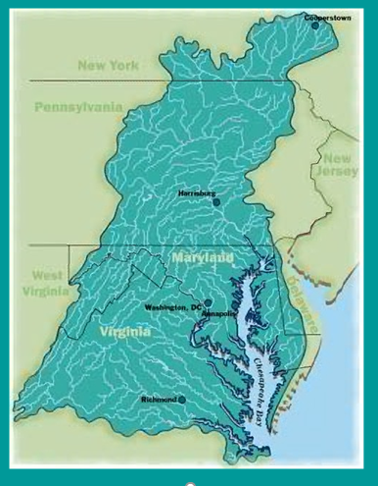
CBPO Program Update
CAC Meeting
December 5, 2021
Bill Jenkins
Acting Deputy Director, EPA/CBPO

Slide 2
OVERVIEW
Introducing Myself
Principals’ Staff Committee (PSC) Work Plan
PSC Meetings planned for March and April
Executive Council Meeting Planning
Relevant Executive Order and administration priorities

Slide 3
Bill Jenkins
Acting Deputy Director Co-Chair Habitat Goal Team Chesapeake Bay Program | Senior Advisor Laboratory Services and Applied Science Division
Phone: (215) 814-2911 jenkins.bill@epa.gov

Slide 4
Principals' Staff Committee Work Plan
    Climate Change
    Diversity, Equity, Inclusion and Justice
    Conowingo Watershed Implementation Plan and Finance Strategy
    Additional Items

Slide 5
Principals' Staff Committee Spring Meetings
March Agenda Topics
  DEIJ Implementation Plan and Community Action Board
  Chesapeake Bay Program Budget
  Executive Order on Climate Change
  Proposed Climate Change Actions for First EC Meeting of 2021
  Update on Conowingo WIP Public Outreach
  Conowingo WIP Financing Overview

Slide 6
Principals' Staff Committee Spring Meetings
April/May Draft Agenda Topics
Summer EC meeting
Draft Final Conowingo WIP
Final decision on CWIP finance strategy
DEIJ – final decision on DEIJ actions; CAB approach; funding approach
Forest Buffer update
More federal budget presentations
Report out from the biennial meeting (depending on timing)

Slide 7
Executive Council Meetings – Draft Details
September Meeting
  Early September in Norfolk, VA area
  Field experience type meeting to highlight accomplishments
  Primarily EC members
December Meeting
  Traditional style EC meeting
  DEIJ actions
  Climate change
  Plastic pollution

Slide 8
Administration Executive Orders and Priorities
Tackling the Climate Crisis at Home and Abroad
Securing Environmental Justice and Spurring Economic Opportunity
Advancing Racial Equity and Support for Underserved Communities Through the Federal Government
Executive Order on the President’s Council of Advisors on Science and Technology
Memorandum on Restoring Trust in Government Through Scientific Integrity and Evidence-Based Policymaking

