Slide 1

Final Partnership Decisions on
2025 Climate Change and
Virginia’s Approach
Chesapeake Bay Program
Science, Restoration, Partnership
Citizens Advisory Committee
February 26, 2021
James Martin, VA DEQ, WQGIT Co-Chair

Slide 2
Chesapeake Bay Program
Science, Restoration, Partnership
Key Points in Assessment of 2025 Climate Change
The efforts since December 2017 to understand the science have produced an improved model with a better understanding of the underlying processes
  Revised load estimates are focused on the deep water and deep channel designated uses
  Adjustments to the designated uses in CB6 and CB7 are being considered
  More work is needed on the shallow water simulation and understanding climate effects on BMPs
Climate Change load estimates for 2025 (1995-2025) decreased by about half from the December 2017/March 2018 estimates
However, the estimated load reduction to address climate risk for 2035 (1995-2035) is about twice that of the estimated 2025 nitrogen load reduction
The following decisions were finalized by the Principals Staff Committee on December 17, 2020

Slide 3
2025 Climate Change Load Allocation
Chesapeake Bay Program
Science, Restoration, Partnership

Slide 4
Expectations for Additional Climate Change Reductions
Chesapeake Bay Program
Science, Restoration, Partnership
Jurisdictions will be expected to account for additional nutrient and sediment pollutant loads due to 2025 climate change conditions in a Phase III WIP addendum and/or 2-year milestones beginning in 2022.
2022-2023 Milestones are due on January 15, 2022
  Programmatic Milestones
  Numeric Milestones for Key BMPs
These expectations were initially approved by the PSC in 2018

Slide 5
Document Current Understanding of 2035 Climate Effect
Chesapeake Bay Program
Science, Restoration, Partnership
Include a narrative in the 2022-2023 Milestones that describe the current understanding of 2035 climate change conditions, to the effect that:
  “Preliminary estimates for the climate impact through 2035 indicate a doubling of the 2025 load effect. The effect of climate change on our ability to meet the Bay’s water quality standards is a significant and increasing concern.”
Specific language for the narrative and a detailed one-pager are under development by the Climate Resiliency Workgroup and Communications Workgroup for WQGIT and Management Board approval.

Slide 6
Continue to Improve Understanding of the Science
Chesapeake Bay Program
Science, Restoration, Partnership
Continue efforts to improve understanding of the science and refine estimates of pollutant load changes due to 2035 climate change conditions.
  Develop a better understanding of the BMP responses, including new or other emerging BMPs, to climate change conditions.
  Compare the current 2025 climate change assumptions with measured climate conditions through 2024.
    To include: rainfall volume, intensity and distribution; air temperature, hydrology, water temperature, sea level rise, and changes in bay stratification and circulation.
  Consider the efficacy of using projections from measured trends versus downscaled global climate model data for revised 2035 estimates.
  Improve understanding and simulation of climate change impacts to open water designated use in shallow waters.
In 2025, the Partnership will consider results of updated methods, techniques, and studies and revisit existing estimated loads due to climate change to determine if any updates to those 2035 load estimates are needed.

Slide 7
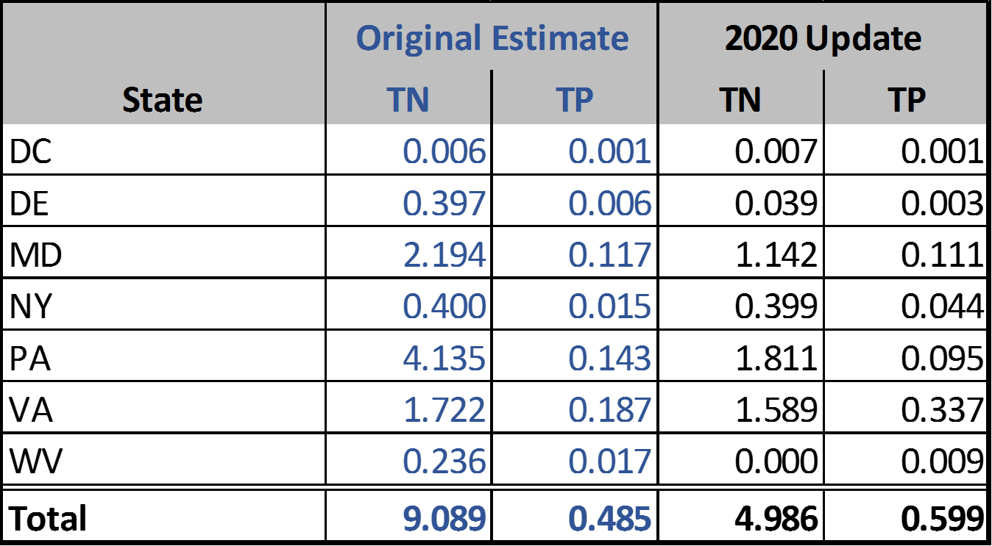
Virginia’s Approach
Virginia’s Phase 3 WIP included sufficient actions to account for the climate change estimates
Virginia’s Phase 3 WIP is sufficient to account for the 2020 updated climate change allocation

Slide 8
Virginia’s Approach
WIP included Chapter 4: Accounting for the Impacts of Climate Change
  Identified and linked to existing decision support tools such as Adapt Virginia
  Commits to reduce greenhouse gas emissions
  Commits to building resilience to climate change impacts
BMP selection and geographic targeting to maximize cost effectiveness and co-benefits
  Living Shorelines, Wetland Restoration and Oyster Restoration to improve coastal resilience
  Tillage, Cover Crops, and Soil Conservation Plans to sequester carbon in soils, increase water holding capacity and improve reliance to drought
  Forest Buffers, Afforestation and Urban Tree Canopy to increase evapotranspiration, shade streams and reduce heat island effects

Slide 9
Questions/Discussion
James Martin, VA DEQ, WQGIT Co-Chair
James.Martin@deq.virginia.gov
804-698-4298

