Slide 1
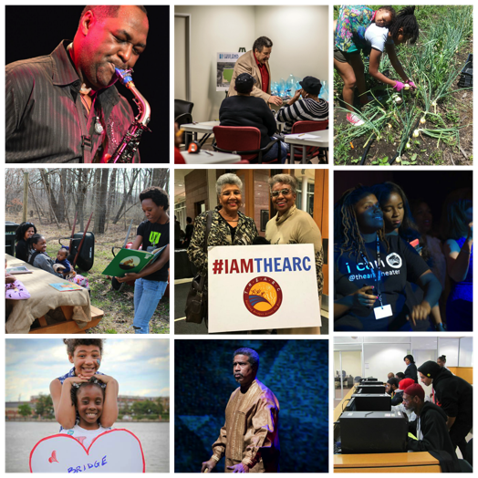
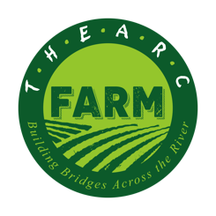
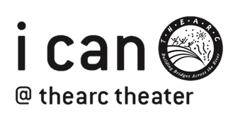
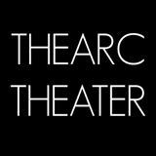
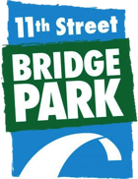
Building Bridges Across
the River is the 501©3
non-profit organization
that manages THEARC.
OUR PROGRAMS INCLUDE:

Slide 2
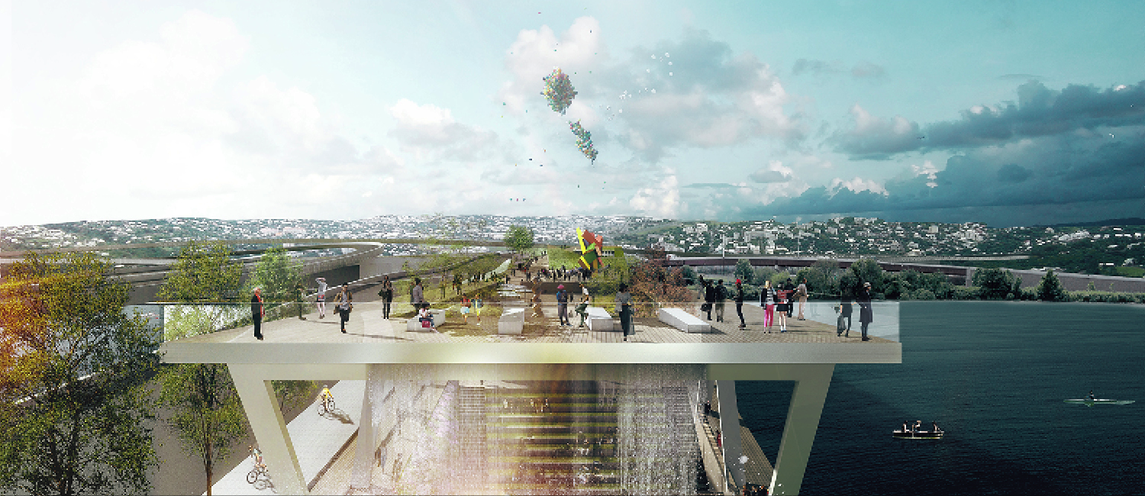

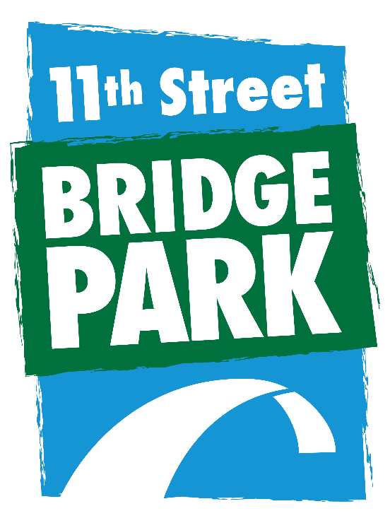



11th Street Bridge Park
A project of Building Bridges Across the River
#BridgingDC
#BridgeParkEquity
www.bridgepark.org

Slide 3

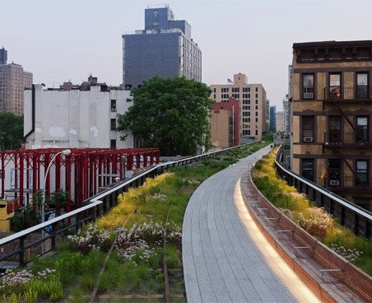
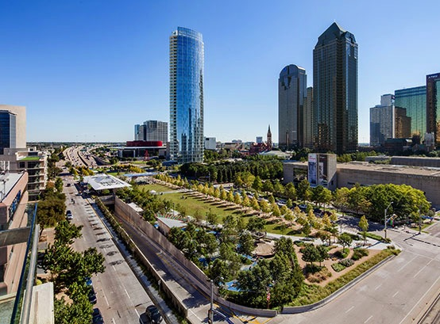
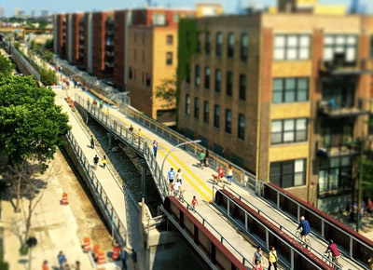
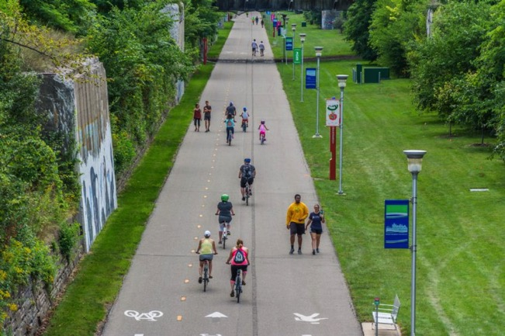
Reclaiming Space

Slide 4

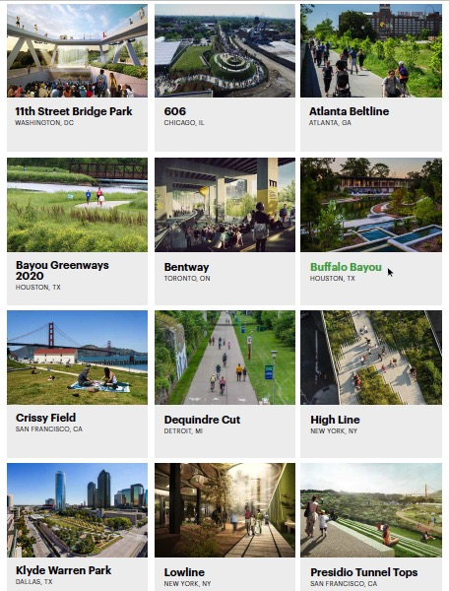
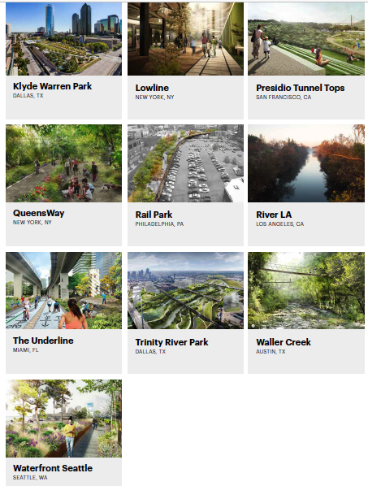

Slide 5
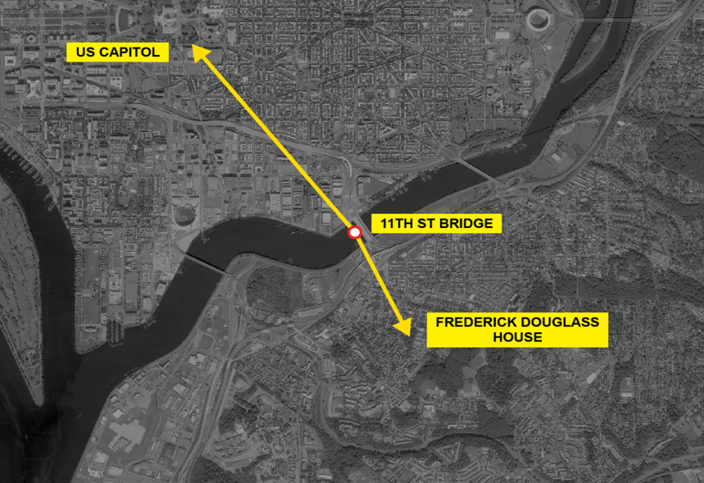
Where is the Bridge Park?

Slide 6
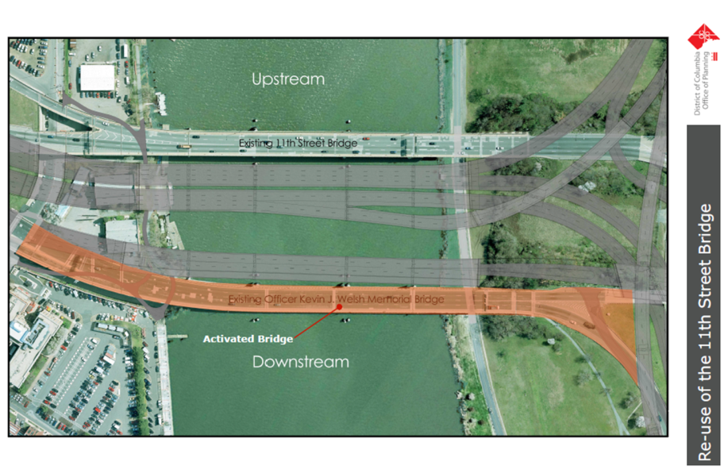
Replacing Old with the New

Slide 7
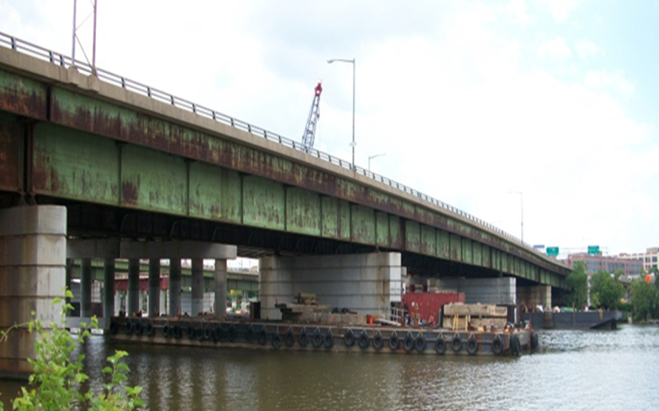
Transforming Infrastructure
Remove deck
Save piers

Slide 8
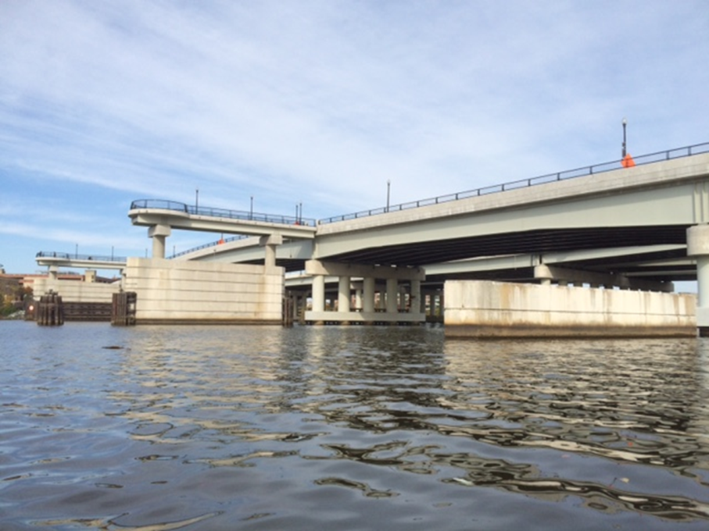

Slide 9
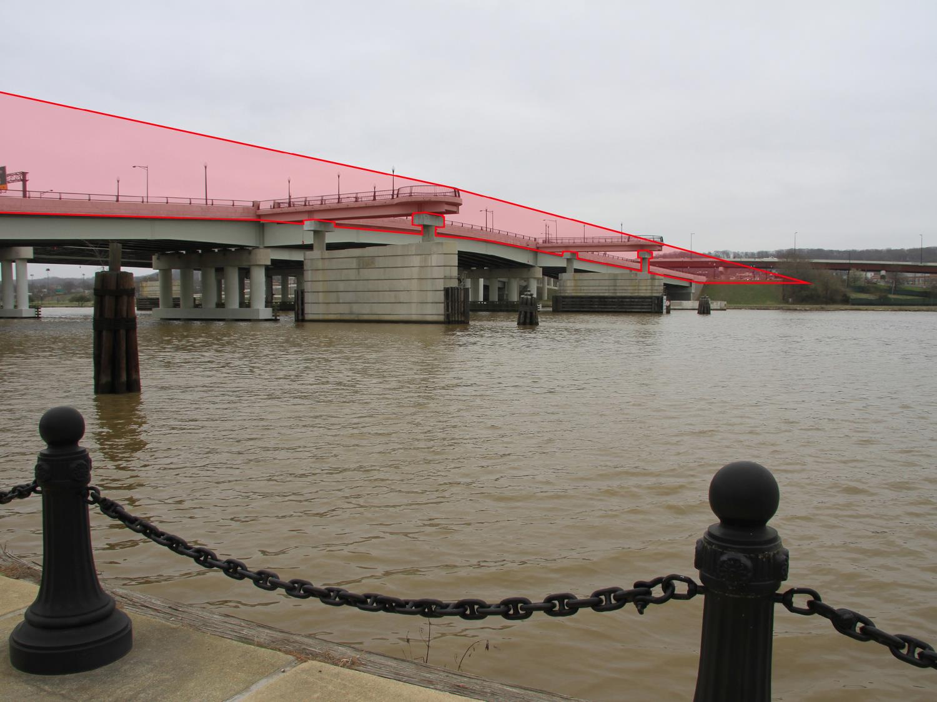

Slide 10
Our Goals
SOCIAL – reconnect communities
HEALTH – improve public health disparities
ENVIRONMENT – re-engage residents with the Anacostia River
ECONOMIC – serve as an anchor for inclusive economic opportunity

Slide 11

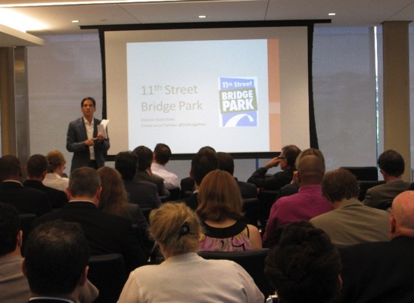
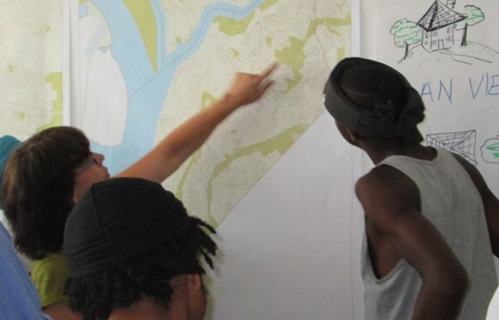
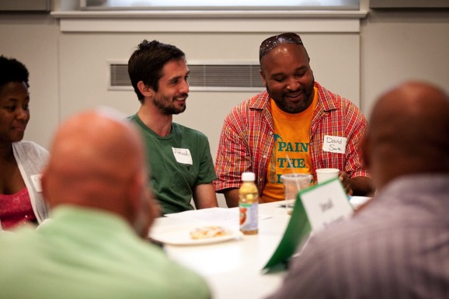
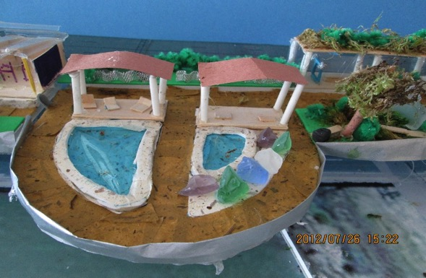
Shaped By the Community

Slide 12
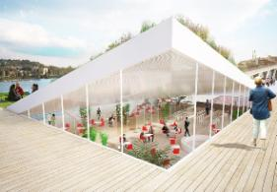
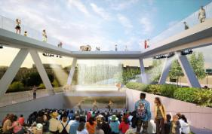
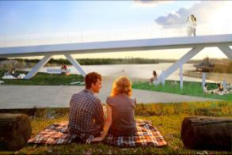
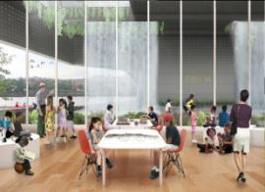
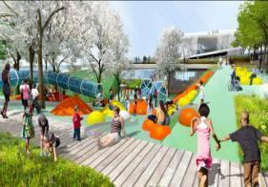
Community-Driven Programming
Urban Agriculture
Public Art
Performance Space
Environmental Education Center
Kayak & Canoe Launch
21st Century Playground
Café / Restaurant

Slide 13
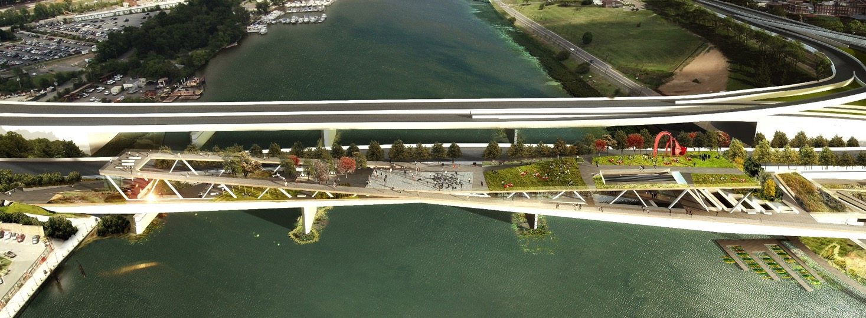
Selected Design OMA + OLIN

Slide 14
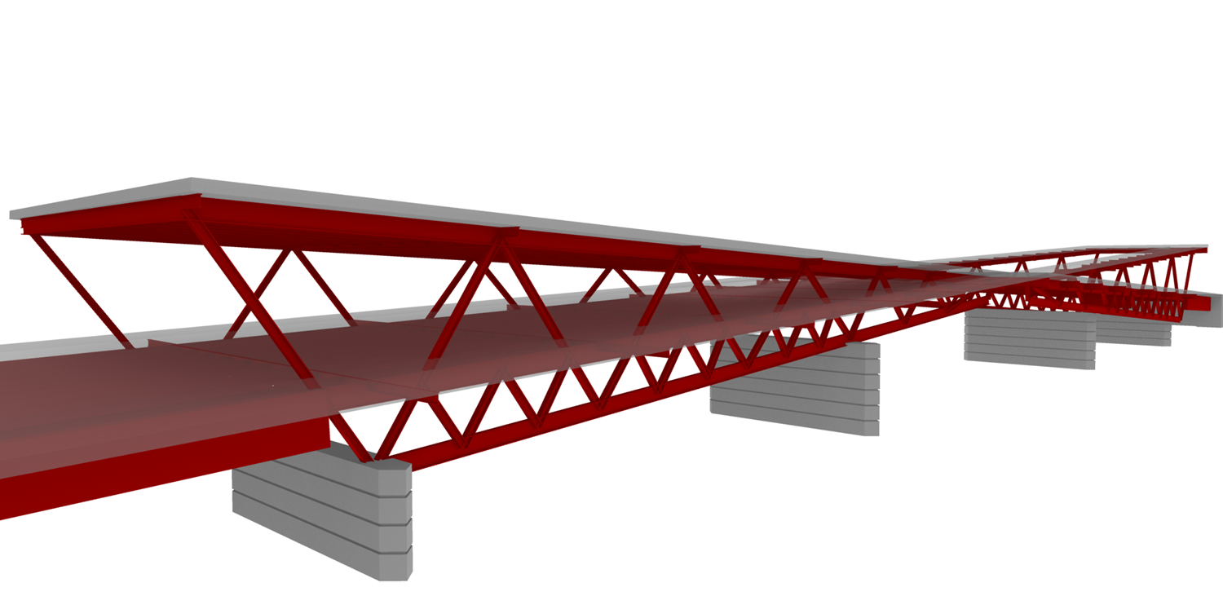

Slide 15
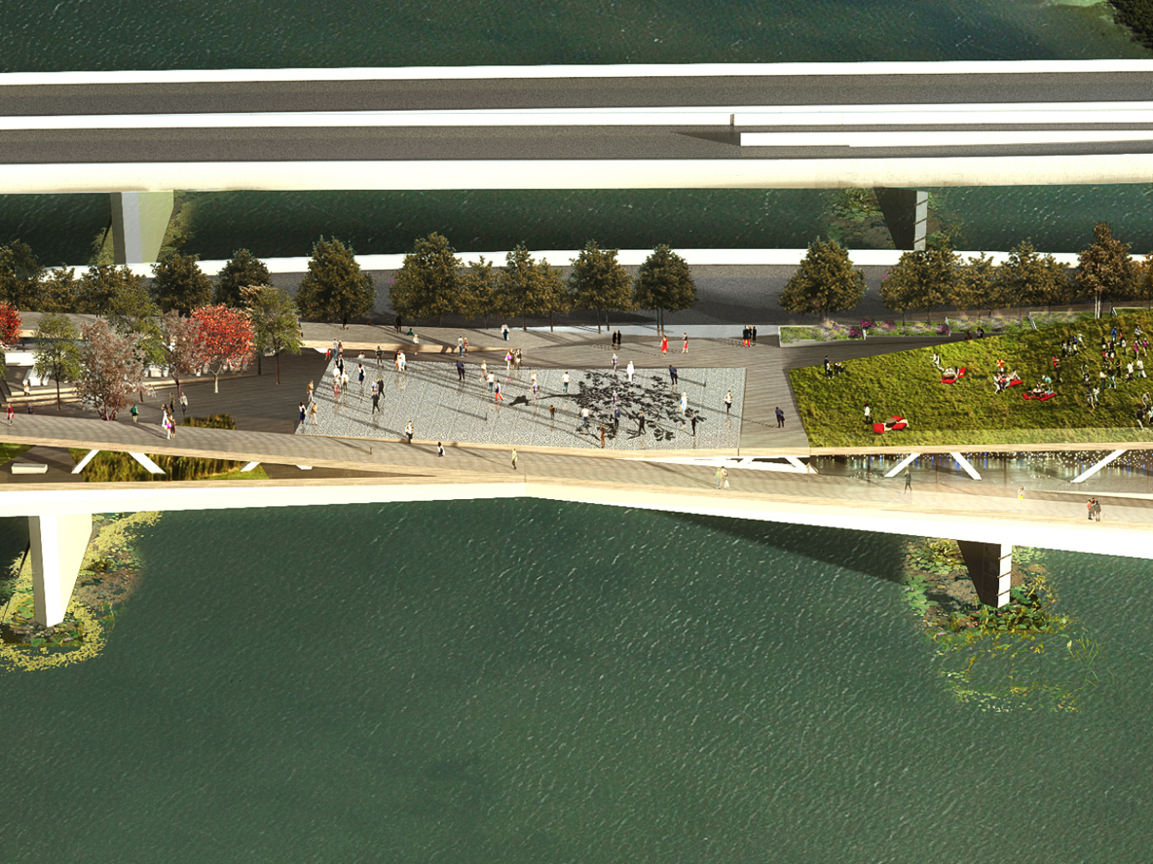
Reconnecting D.C.

Slide 16
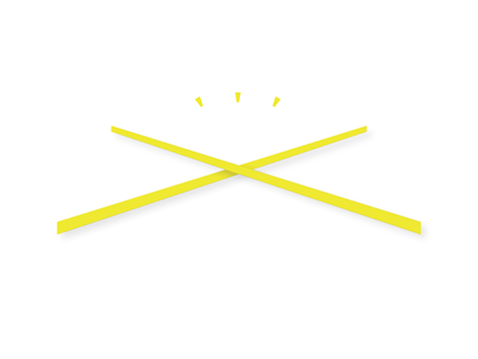

Slide 17
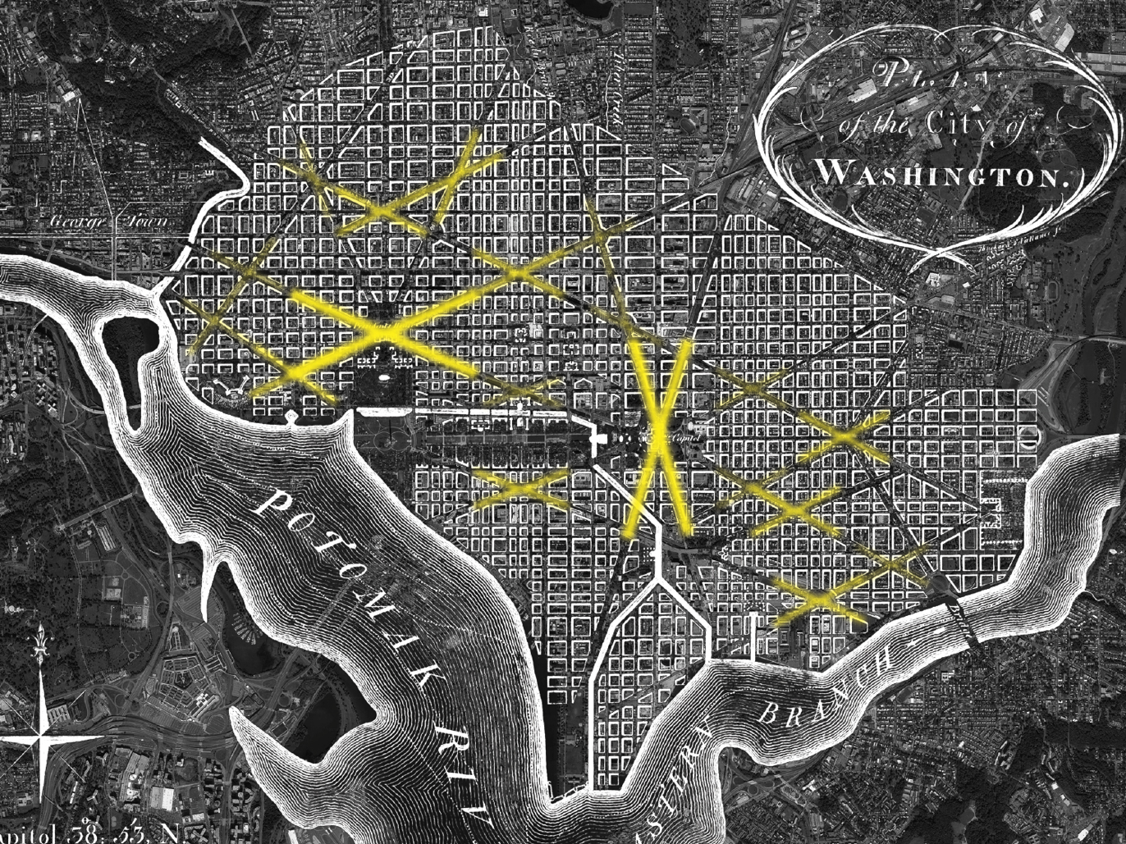

Slide 18
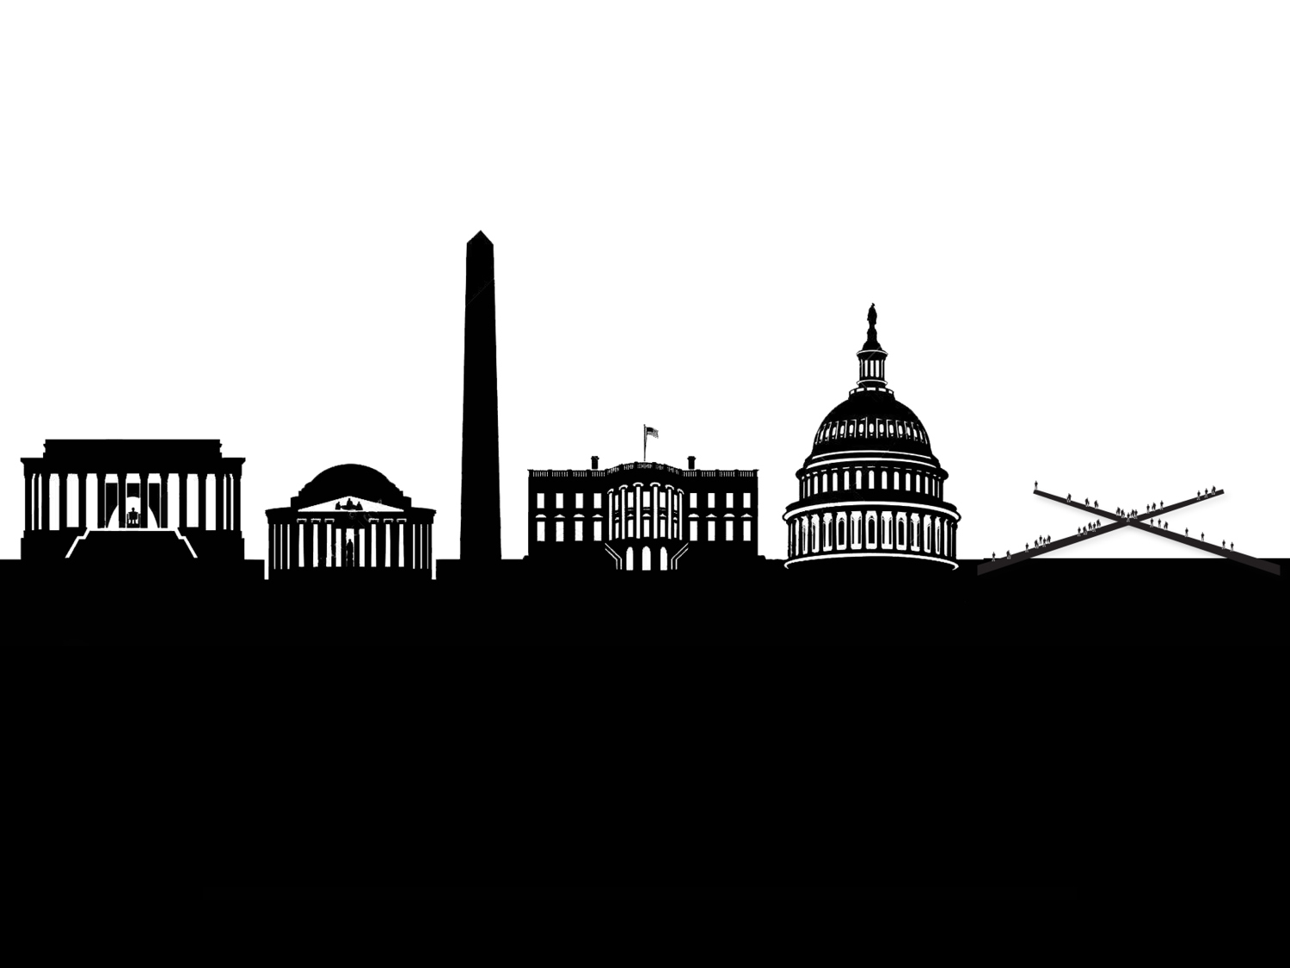

Slide 19
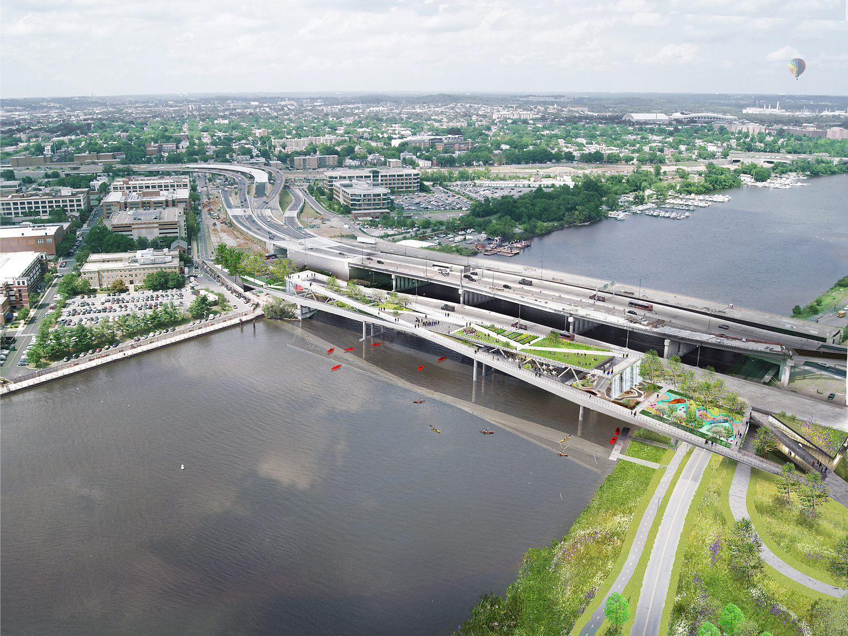

Slide 20
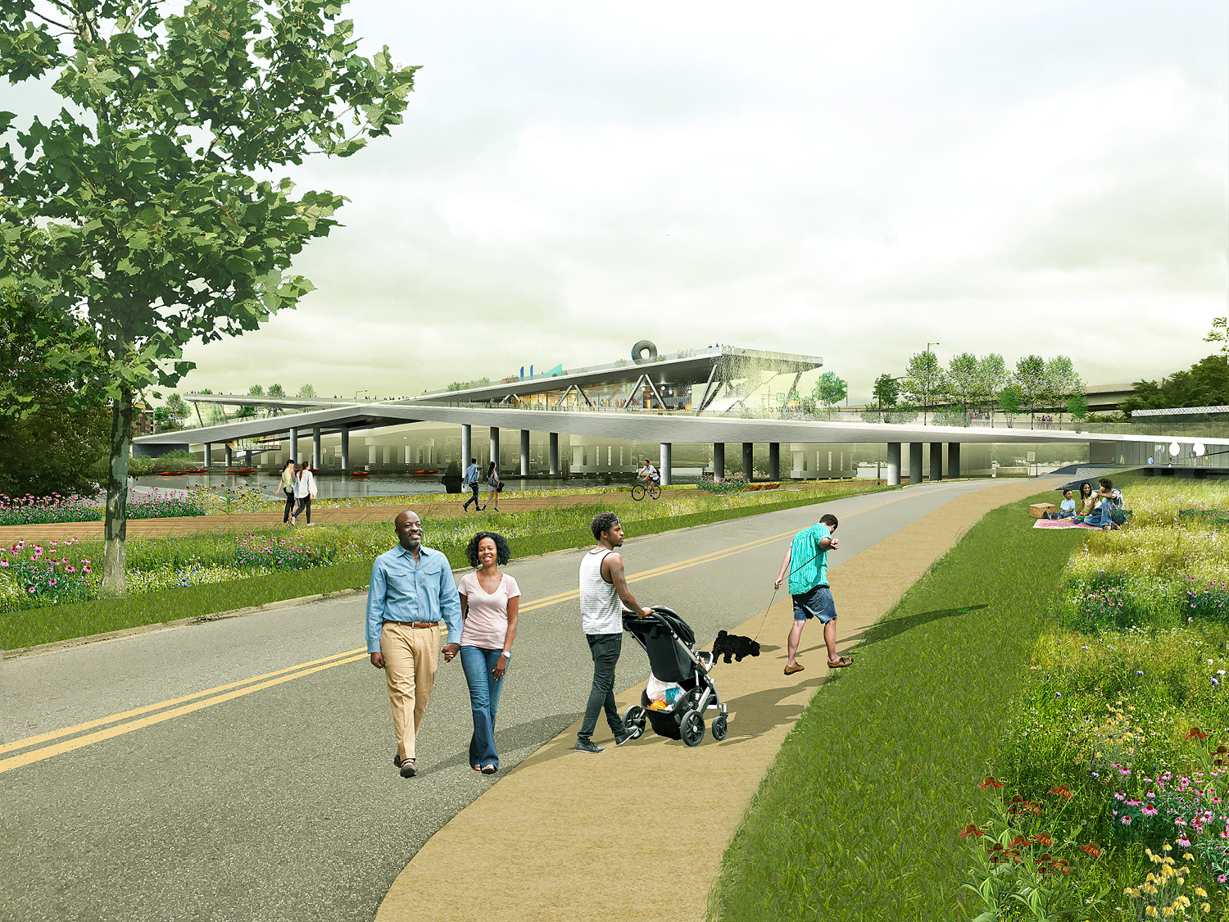

Slide 21
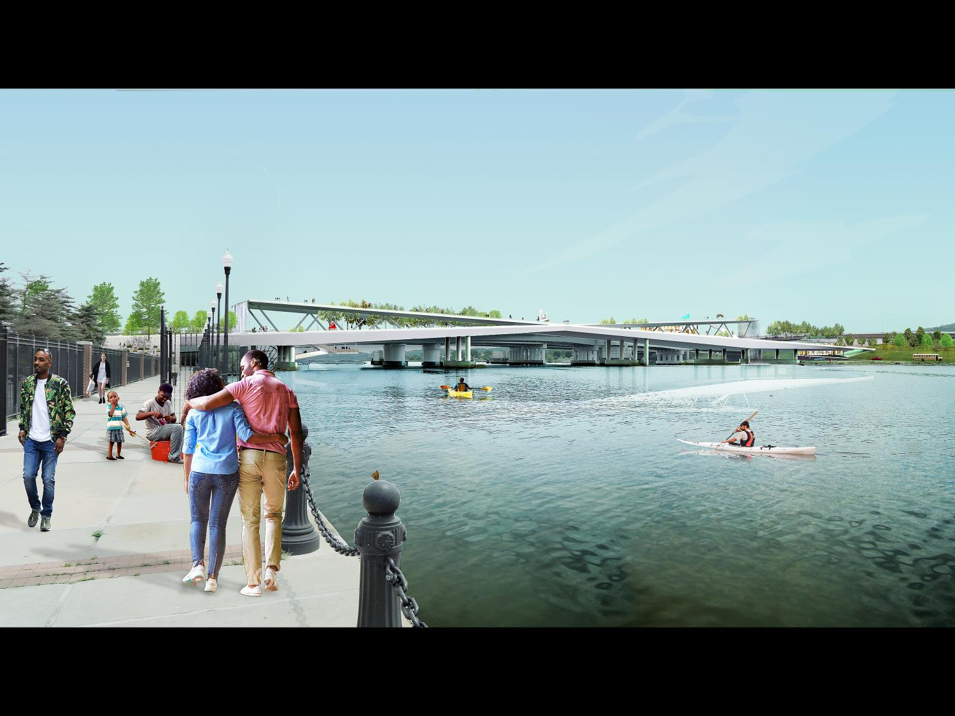

Slide 22
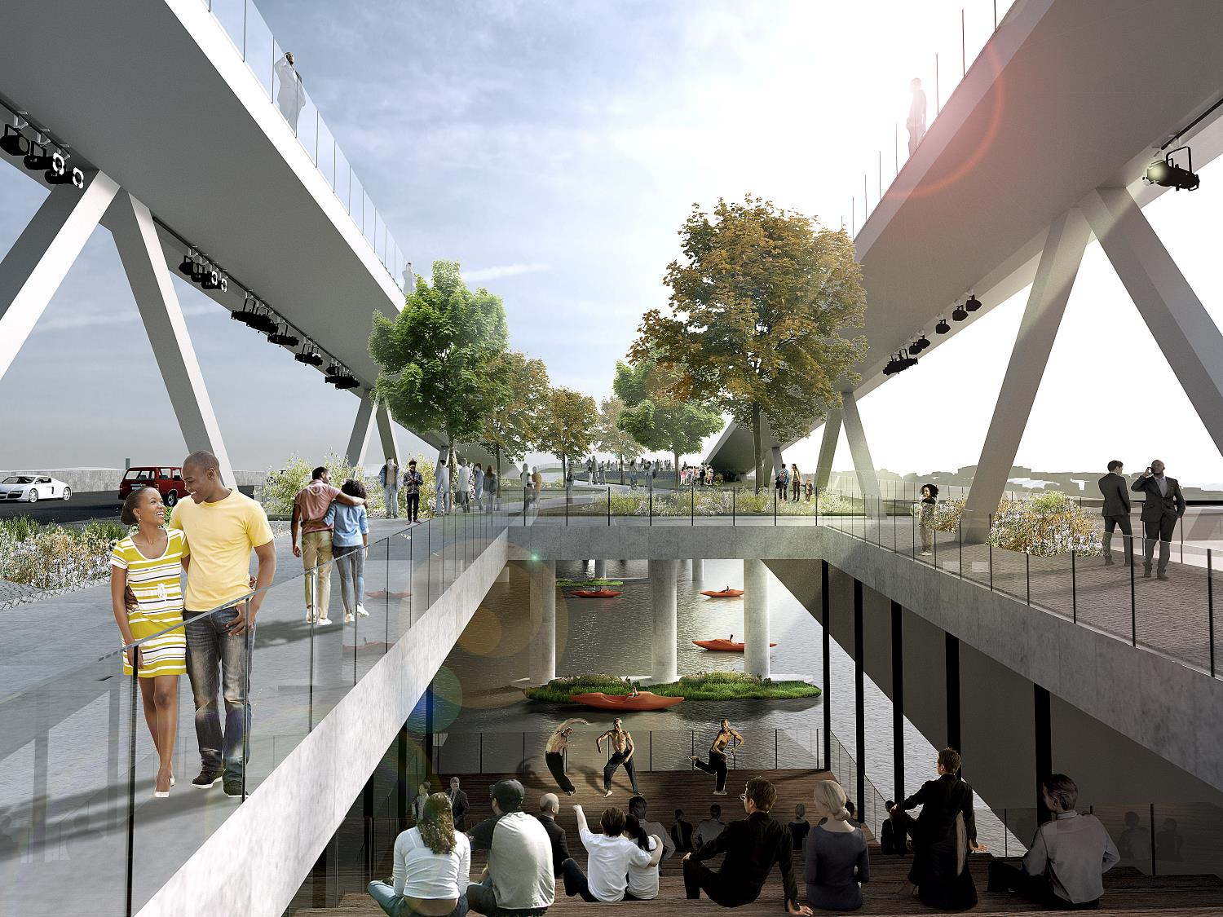

Slide 23
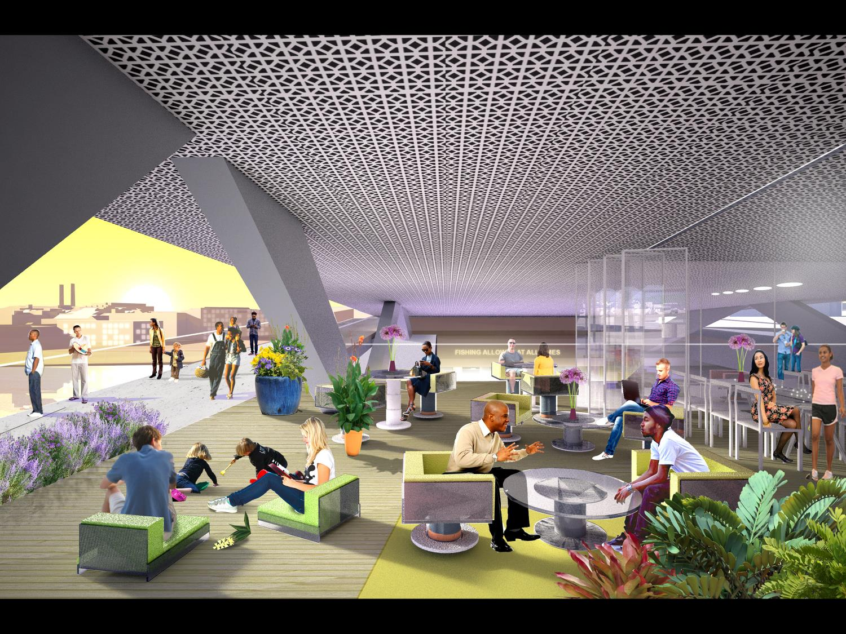
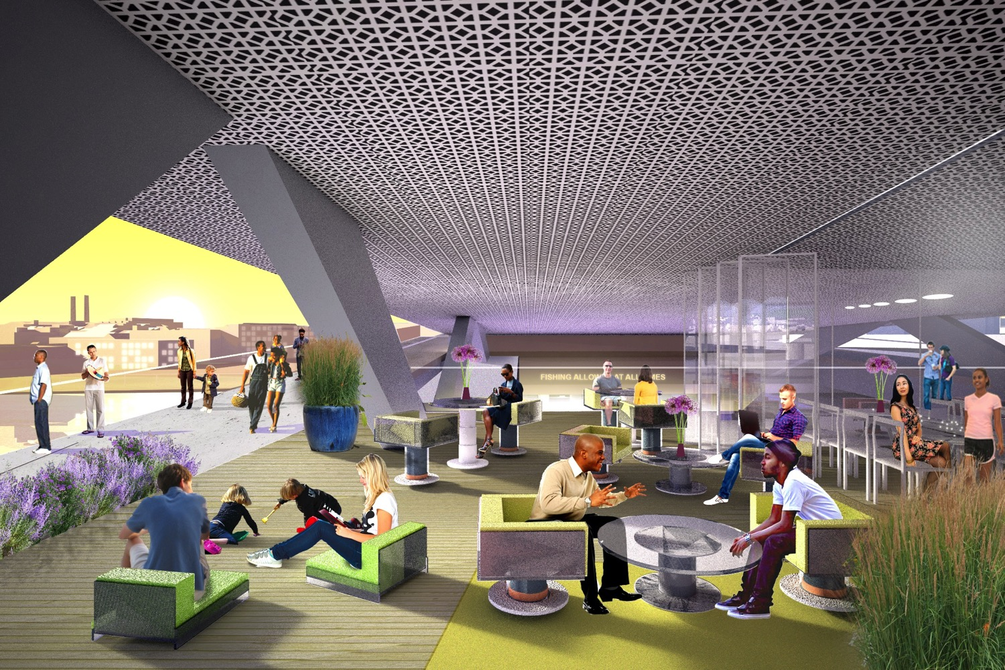

Slide 24
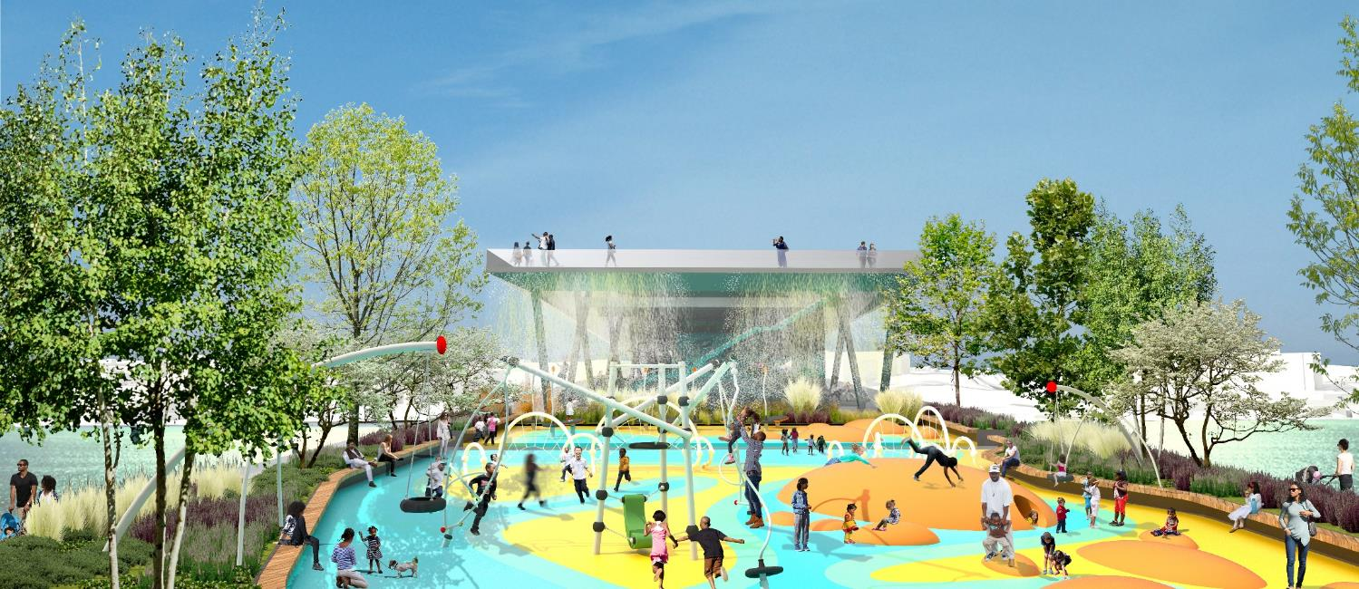

Slide 25
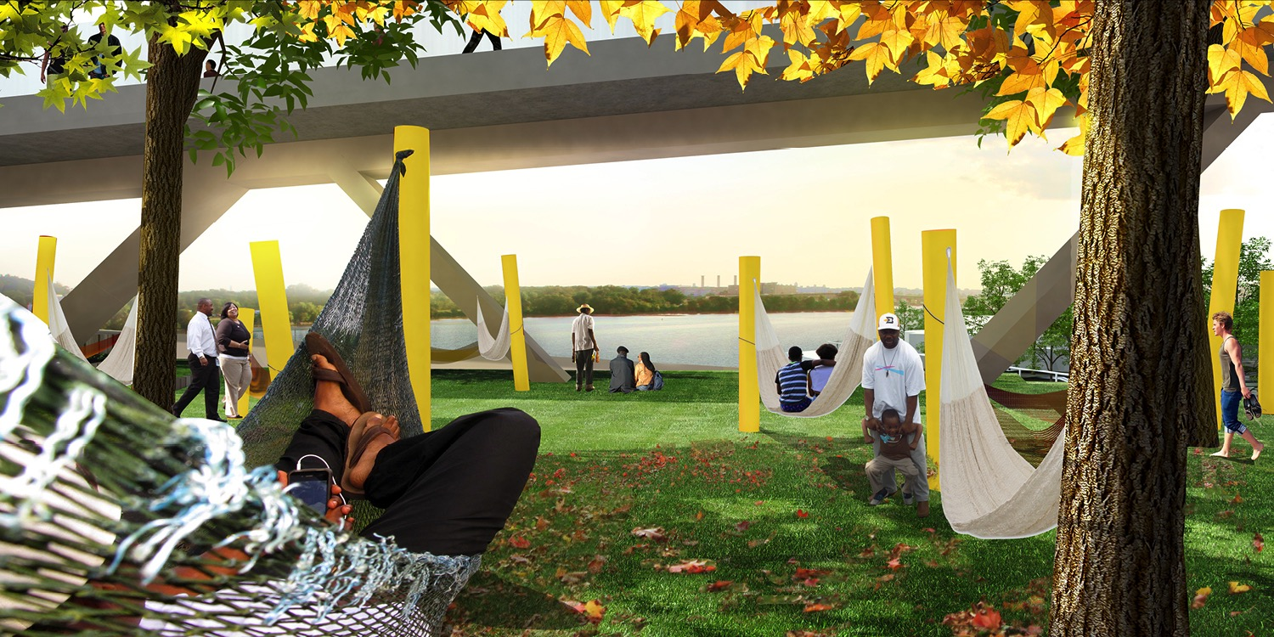

Slide 26
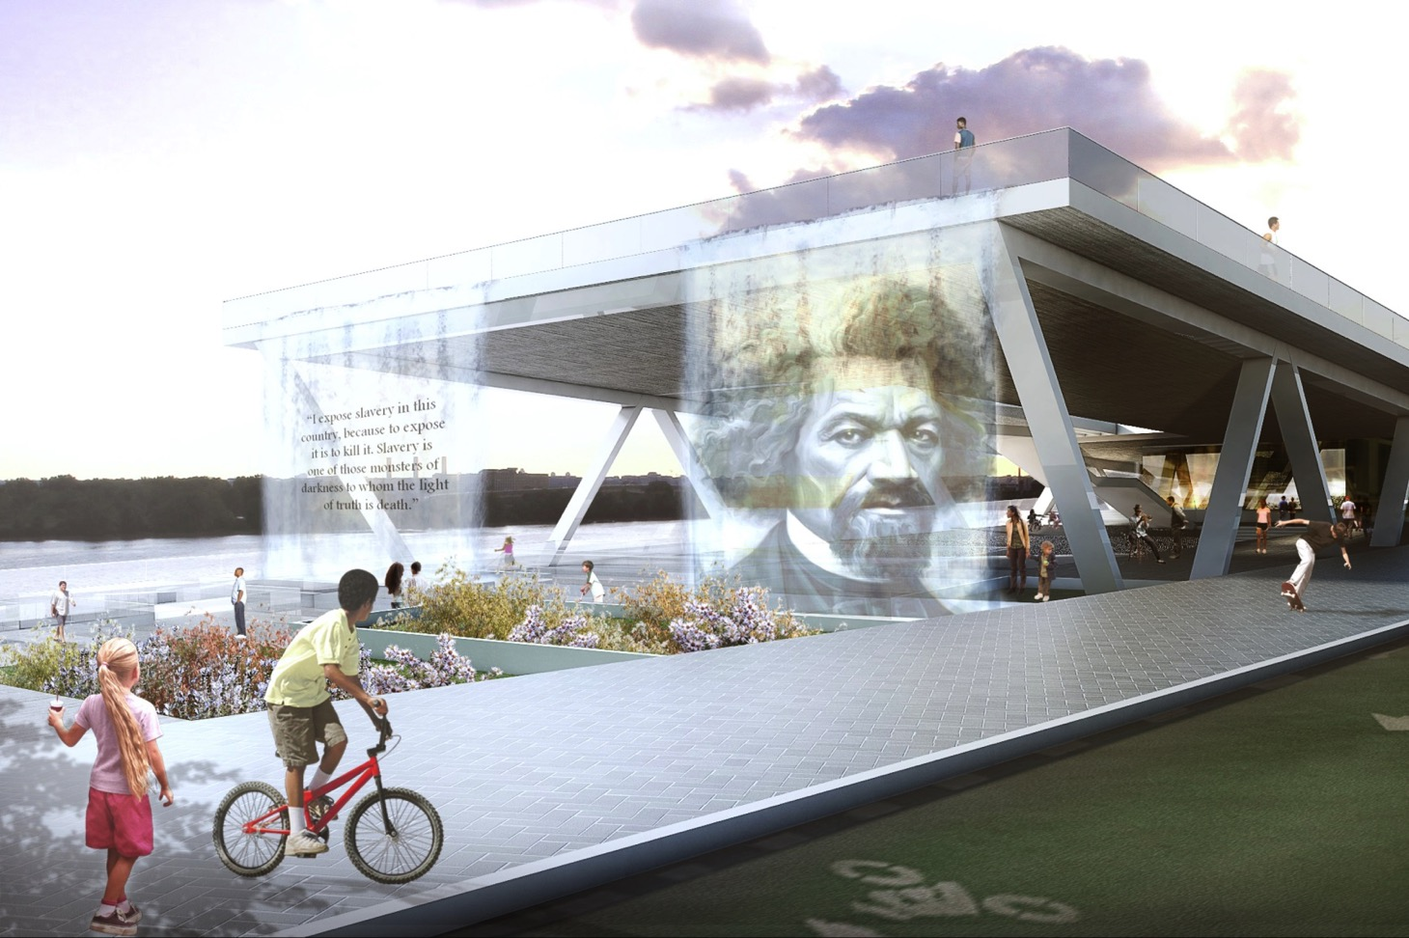

Slide 27
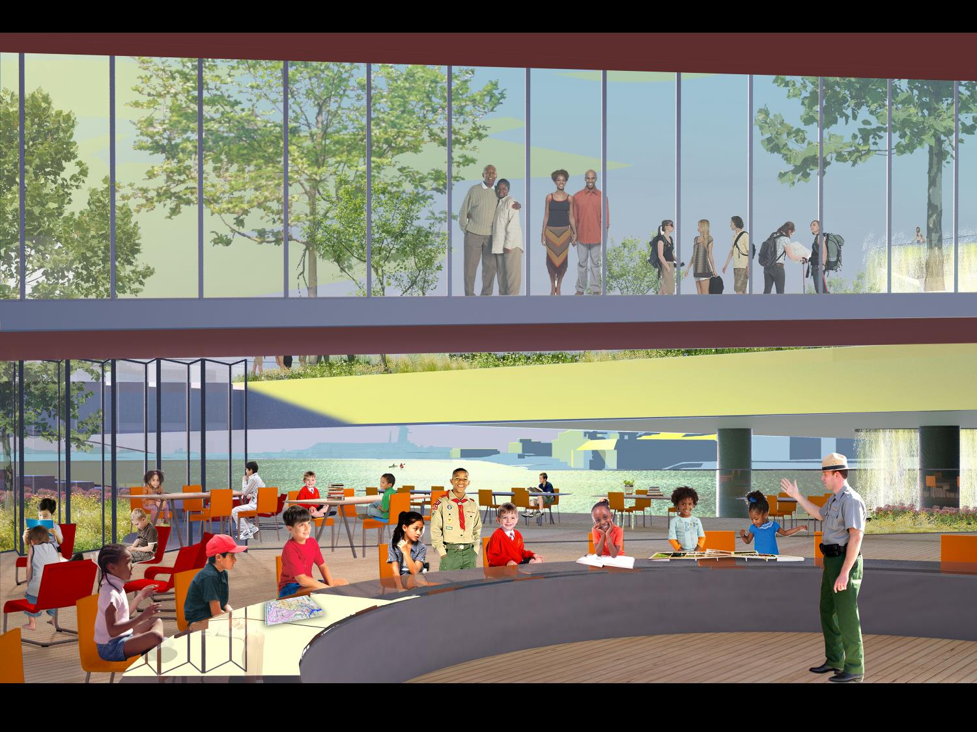

Slide 28

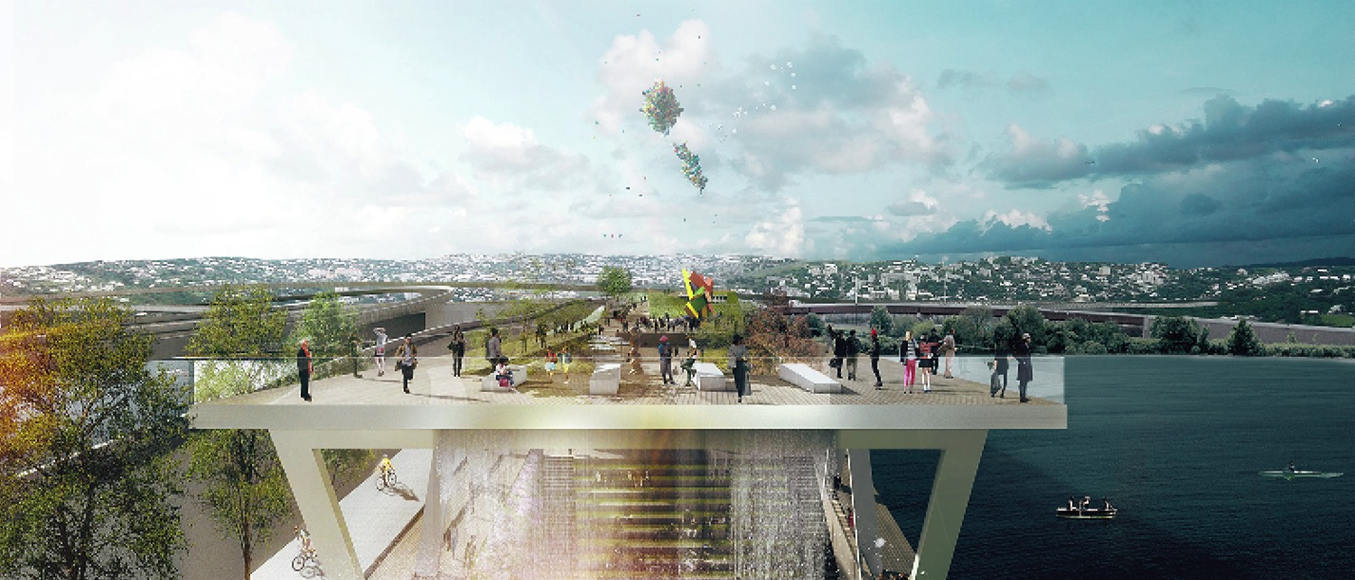

Slide 29
Project Timeline
Community Engagement
2012-2013
Design Competition
2014
Pre-Construction & Design
2016-2019
Begin Construction
2020
Expected Opening
2022 / 2023

Slide 30

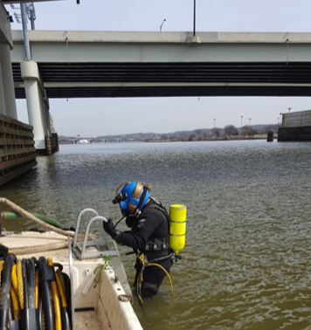
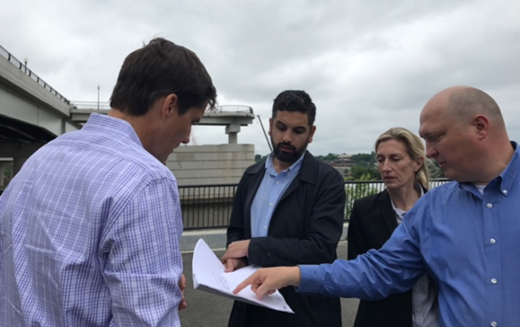
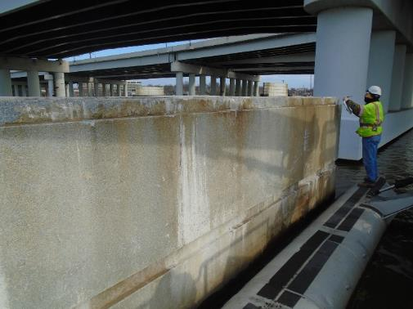
Completed Work
Above/ Underwater Pier Inspections
U.S. Commission of Fine Arts / NCPC Approval
15% Design Complete
Design Criteria Development
Structural & Geotech Analysis
ADA
Fire / EMS
MPD

Slide 31
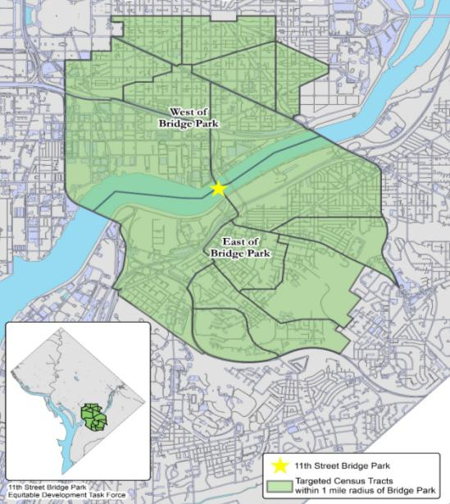
Equitable Development Plan

Slide 32
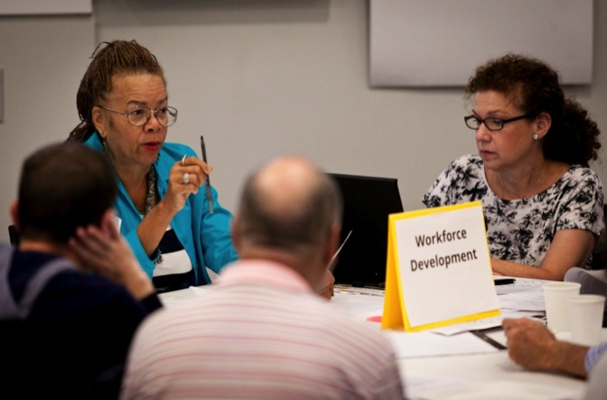
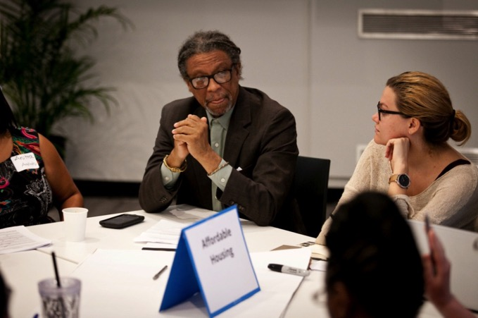



Slide 33


Slide 34






Early Wins & Implementation
70 Ward 8 Residents purchasing their own homes
13 Rental Buildings Addressing Issues of Concern
3 Down payment assistance offered
110 Children Savings Accounts

Slide 35






Elevating Equity Investments March 2017 Total Invested to Date: $11,942,126
6
1847-1849 Good Hope Road SE
Hunter Place
2255 Martin Luther King Jr Ave SE
Parkchester Apartments
Sasha Bruce Youthworks
The Commons at Stanton Square (Martha’s Table and Community of Hope)
Far Southeast Family Strengthening Collaborative - Busboys & Poets
Anacostia Coordinating Council
Bread for the City Expansion
Family Engagement Program
Anacostia River Festivals
Black L.U.V. Festival
Anacostia Playhouse
The DC Poet Project
12
14
13
10
9
1
3
2
4
2
7
11
8
www.liscdc.org/elevatingequity

Slide 36





Slide 37





Notes:
These are images from our annual Anacostia River Festival – just held on April 9 - with over 45 nonprofit partners, National Park Service and National Cherry Blossom Festival. 8,000 participants on the banks of the Anacostia River celebrating the river and community’s that line the riverbanks

Slide 38




Bridge Park Plots

Slide 39


Slide 40




Slide 41






Public Art

Slide 42




Slide 43




Slide 44




Navy Yard Art
Anacostia Riverwalk Art
Anacostia River Festival
295 Underpass Installation

Slide 45


