Slide 1

Final Enhancements to Bay Jurisdictions’ BMP Implementation Program Plans
Jim Edward
Acting Director
Chesapeake Bay Program

Slide 2
CBP BMP Verification Programs:
“Process through which agency partners ensure practices, treatments and technologies resulting in reductions of nitrogen, phosphorus and sediment pollutant loads are implemented and operating correctly.”

Slide 3
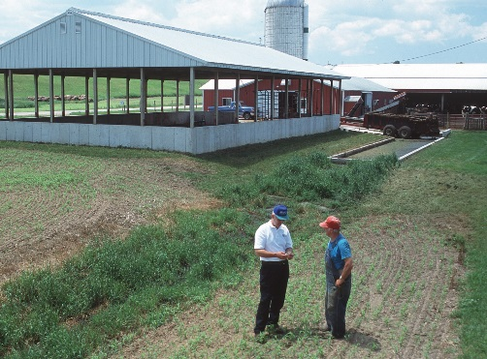
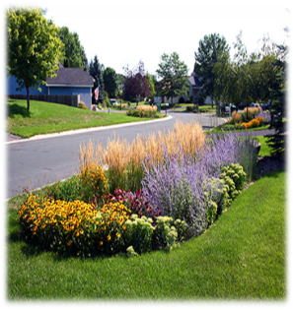
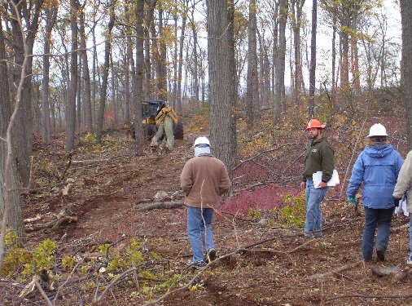
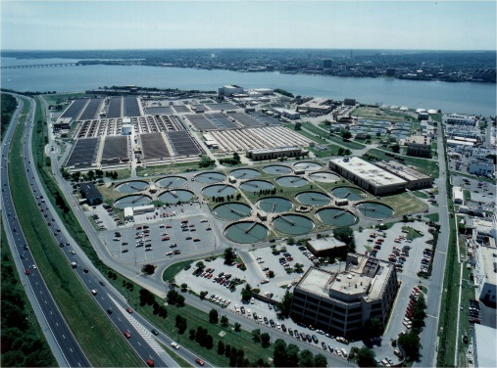
What?
Strengthening Verification of Best Management Practices Implemented in the Chesapeake Bay Watershed: A Basinwide Framework
Report and Documentation from the Chesapeake Bay Program Water Quality Goal Implementation Team’s BMP Verification Committee
October 2014

Slide 4
How?
BMP no longer present/functional removed from database
OR
BMP
installed,
verified, and reported by Jurisdiction
BMP verified/
upgraded with new technology
Initial Inspection
BMP gains efficiency
Data quality assurance/ validation
BMP Verification
Life Cycle
BMP lifespan ends – re-verify
BMP Performance
BMP nears end of life span
Follow-up Checks
BMP fully functional
BMP performance metrics collected

Slide 5
How?
Illustration of Diversity of Verification Approaches Tailored to Reflect Practices
Sector | Inspected | Frequency | Timing | Method | Inspector | Data Recorded | Scale
Stormwater | All | Statistics | <1 year | Monitoring | Independent | Water quality data | Site
 | Percentage | Targeting | 1-3 yrs | Visual | Regulator | Meets Specs | Subwatershed
 | Subsample | Law | 3-5 yrs | Aerial | Non-Regulator | Visual functioning | County
 | Targeted | Funding | >5 yrs | Phone Survey | Self | Location | State
Agriculture | All | Statistics | <1 year | Monitoring | Independent | Water quality data | Site
 | Percentage | Targeting | 1-3 yrs | Visual | Regulator | Meets Specs | Subwatershed
 | Subsample | Law | 3-5 yrs | Aerial | Non-Regulator | Visual functioning | County
 | Targeted | Funding | >5 yrs | Phone Survey | Self | Location | State
Forestry | All | Statistics | <1 year | Monitoring | Independent | Water quality data | Site
 | Percentage | Targeting | 1-3 yrs | Visual | Regulator | Meets Specs | Subwatershed
 | Subsample | Law | 3-5 yrs | Aerial | Non-Regulator | Visual functioning | County
 | Targeted | Funding | >5 yrs | Phone Survey | Self | Location | State

Slide 6
Table B-3. Jurisdictional Agriculture Verification Protocol Design Table: Visual Assessment BMPs—Single Year Chesapeake Bay Program Agriculture Workgroup
A. BMP Priority | B. Data Grouping | C. BMP Type | D. Initial Inspection |  |  |  | E. Follow-up Check |  |  | F. Lifespan/ | G. Data QA, Recording & Reporting
 |  |  | (Is the BMP there?) |  |  |  | (Is the BMP still there?) |  |  | Sunset
 |  |  | Method | Frequency | Who inspects | Documentation | Follow-up Inspection | Statistical Sub-sample | Response if Problem | (Is the BMP no longer there?)
High / Low | Visual Assessment: Single Year | Non-Cost Shared BMPs | On-Site Visual Assessment (Limited Statistical Sampling) | 100% of All Tracked & Reported BMPs | Trained and certified technical agency/NGO field staff or engineers | BMPs meet appropriate government and/or CBP practice standards | Single Year | 10% / 5% QA of All Tracked & Reported BMPs (within the year) | Bring into compliance within one year or less, or remove from reported BMPs | Single Year | Document inspections/follow-up checks, prevent double counting, and QA reported data
High / Low | Visual Assessment: Single Year | Cost-Shared Programs | On-Site Visual Assessment Only | 100% of All Tracked & Reported BMPs | Trained and certified technical agency/NGO field staff or engineers | BMPs meet appropriate government and/or CBP practice standards | Single Year | 10% / 5% QA of All Active Contractual BMPs (within the year) | Bring into compliance within one year or less, or remove from reported BMPs | Single Year | Document inspections/follow-up checks, prevent double counting, and QA reported data
High / Low | Visual Assessment: Single Year | Permit-Issuing Programs | On-Site Visual Assessment Only | 100% of All Tracked & Reported BMPs | Trained and certified technical agency field staff or engineers | BMPs meet the appropriate government and/or CBP practice standards | Single Year | 20% Annually of All Active Permits | Bring into compliance within one year or less, or remove from reported BMPs | Single Year | Document inspections/follow-up checks, prevent double counting, and QA reported data
EXAMPLE BMP | Visual Assessment: Single Year | Cost-Shared Programs: Traditional Cover Crop- Early Drilled Rye | On-Site Visual Assessment: Cover Crop Establishment | 100% of All Active Contracts | County Conservation District USDA-NRCS Certified Field Technician | Cost-Share Program BMP Certification Form | On-Site Visual Assessment: Cover Crop Termination | 10% QA of All Active Contractual BMPs | Cost-Share Program Contract Compliance Policy | Contract Year | Cost-Share Program Documentation / 10% QAQC Compliance Checks by State Agency / Tracking & Reporting Protocol

Slide 7
When?
“Only Verified Practices may be Credited After the Initial Two Year Ramp-up Period. Starting with the 2018 annual progress reporting cycle, those reported practices, treatments or technologies for which documentation of verification has not been provided through each jurisdictions’ NEIEN-based report systems may not be credited for nitrogen, phosphorus or sediment pollutant load reductions for that year.”

Slide 8
2017 CBPO Email on BMP Verification
In 2017, the CBPO Director sent an email to the CBP Management Board and Water Quality Goal Team to refocus the Partnership on BMP Verification. In that email, he indicated that each jurisdiction would be receiving a more detailed follow-up letter outlining specific actions and steps to be taken to ensure that each jurisdiction has a robust operational BMP verification program.
These actions and steps are based on EPA’s feedback provided when we approved, or conditionally approved, each jurisdiction’s respective BMP verification quality assurance plan.

Slide 9
Letters to Bay Jurisdiction on
BMP Verification Plan Enhancements
On May 18, 2018, EPA Acting CBPO Director sent letters to each of the Bay jurisdictions, asking them to continue to put into place the needed enhancements to their BMP verification programs to ensure all future practices submitted for crediting have a documented record of verification.
Attached to each letter is a bulleted listing of specific BMP verification program elements that EPA has found to be needing further attention.
A lot of work went into cleaning up the jurisdictions’ records of historic BMP implementation for the period 1985 – 2017, as submitted through the NEIEN (National Environmental Information Exchange Network).

Slide 10
Letter Clarifications
From now and into the future, all these reported practices will expire at the end of their assigned lifespan and be removed from current crediting for nutrient and sediment pollutant load reductions in our BMP accountability system unless a jurisdiction reports that BMP as having been verified as still in place and fully functioning.
If BMPs are not operating according to specifications, the responsible party’s maintenance and compliance programs should remediate the situation and report that practice for continued crediting.
As agreed to by the Partnership in our BMP Verification Framework, this is the insurance that protects private and public financial investments, habitats, and drinking water, and improves the quality of our streams and the estuary.

Slide 11
Key Dates
Starting with the 2018 progress year, EPA expects that BMPs reported as new or re-inspected implementation are accurate with respect to the amount of fully-functioning BMPs, their location and the dates of implementation and verification.
As stated in the 2018 Chesapeake Bay Program’s Grant Guidance, BMP data reported through NEIEN are to be assured for quality, submitted no later than December 1, 2018, and cover the reporting period July 1, 2017 – June 30, 2018.
All outstanding issues identified in the attachments to the letters need to be addressed in written responses to Jeff Sweeney by June 30, 2018.

Slide 12
EPA/CBPO Assistance and Funding
for BMPV Enhancements
Letter encourages the jurisdictions to seek technical assistance from the appropriate staff at the Chesapeake Bay Program Office to help in enhancing their BMP verification programs.
Also encourages them to utilize each jurisdiction’s Chesapeake Bay Regulatory and Accountability Program grant funds as well as future Watershed Implementation Plan assistance funds to support enhancement and operation of your BMP verification program.

Slide 13
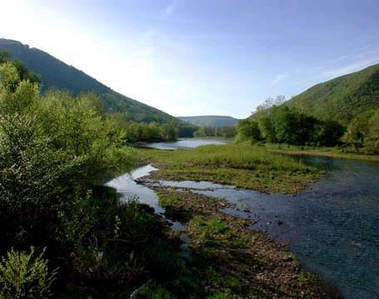




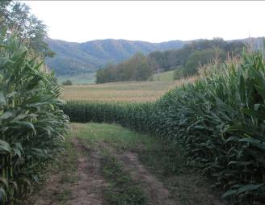



Questions?
13

