Slide 1
Chesapeake Bay Program Updates
Citizens’ Advisory Committee Meeting
February 23, 2017

Slide 2
Agenda
Transition Update
2015-16 Bay Barometer
Communications and Outreach Assistance
2017 CBP Priorities

Slide 3
Transition Update
Transition Team Briefing
Chesapeake Bay TMDL
Program Funding/Staffing
Grant/Contract Awards
Hiring Freeze
Review of Scientific Presentations/Reports

Slide 4
Transition Update
Executive Orders
Reconsider New/Existing Power Plant GHG Rules
Prohibit Use of Social Cost of Carbon Benefits Measure
Dismantle Clean Power Plants Rule
Rescinding Clean Water Act Jurisdiction Rule
2 for 1 Regulatory Reduction

Slide 5
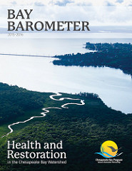
2015 – 16 Bay Barometer
Annual report on the health and restoration efforts of the Chesapeake Bay watershed.
Retrospective summary of previously published indicators
Audience is CBP partners and the interested public.
Notes:
Our 2015-16 Bay Barometer was released on February 1, 2017. It is our annual report on the health and restoration efforts of the watershed.
It is a roundup of our indicators that have been updated over the past year. The report is geared toward our Chesapeake Bay Program partners, but as we did last year, we also developed a ‘rack card’ that is more succinct, public-friendly round-up of the information to target students and teachers.
When we released the Barometer this year, we were pleased to welcome Dr. Don Boesch, President of the University of Maryland, and Wil Baker, President of the Chesapeake Bay Foundation, who joined us during our media call to voice their support that Bay restoration is best done when we are all united.

Slide 6
2015 – 16 Bay Barometer
New Indicators for 2017
Diversity
Sustainable Schools
Oysters
Notes:
We were excited to include three new indicators this year – diversity, sustainable schools and oysters.

Slide 7
2015 – 16 Bay Barometer
Positive Trends:
Nitrogen, phosphorus and sediment loads (monitored data) and reducing nitrogen, phosphorus and sediment pollution (modeled data)
Attaining water quality standards
Underwater grass abundance
Blue crab abundance, oysters
Black duck
Restoring fish passage, restoring wetlands, protecting lands and establishing public access sites
Notes:
Overall, the Barometer shows some very good news this year – we are seeing positive trends for the following indicators:
nitrogen, phosphorus and sediment loads in our monitored data; (from 2014 to 2015, there was an estimated 25 percent drop in nitrogen, 44 percent drop in phosphorus and a 59 percent drop in sediment entering the Bay)
reducing nitrogen, phosphorus and sediment pollution in our modeled data; (between 2009 and 2015, pollution practices put into place have lowered nitrogen levels entering the bay by 8 percent, phosphorus loads by 20 percent and sediment loads by 7 percent. The wastewater sector met its pollution reduction goal ten years ahead of schedule)
attaining water quality standards, (Between 2013 and 2015, an estimated 37 percent of the tidal Bay and its tributaries have met water quality standards)
underwater grass abundance; (92,315 acres in 2015; surpassed our 2017 goal two years ahead of schedule)
blue crab abundance, (between 2014 and 2015, abundance of adult female crabs increased 92 percent from 101 million to 194 million)
oysters, (six tributaries have been selected for restoration and are at various stages of progress)
black duck, (51,332 black ducks observed between 2013 and 2015, marking a 5 percent increase since the previous assessment period; at 51 percent of goal)
restoring fish passage, (817 additional miles opened up between 2012 and 2015 marking an 82 percent achievement of goal)
restoring wetlands, (between 2010 and 2015, 7,623 acres of wetlands added to agricultural lands, marking a 9 percent achievement toward goal)
protecting lands and (in-between 2015 and 2016, data shows that 1 million acres of land were permanently protected from development; 50 percent achievement of goal)
establishing public access sites. (between 2010 and 2015, 108 public access sites were added, which is 36 percent achievement of the overall goal).

Slide 8
2015 – 16 Bay Barometer
Negative Trends
Planting Forest Buffers
Notes:
We are seeing less than positive trends with our forest buffer indicator. Last year was our lowest year on record with only 64 miles planted between 2014 and 2015, which is 836 miles less than its 900 mile goal.

Slide 9
2015 – 16 Bay Barometer
News Stories
Tree canopy
Healthy watersheds
Forage fish
Fish habitat
Blue crab management
Brook trout
Toxic contaminants
Land use
Citizen stewardship
Local leadership
Climate resiliency
Notes:
The Bay Barometer also included ‘news stories’ highlighting some of our outcomes that do not yet have formal indicators.

Slide 10
Communications and Outreach
Midpoint Assessment and Phase III WIP Communications Planning
CAC Assistance
Identifying Audiences
Messaging
Notes:
The biggest priority for the Bay Program this year will be the midpoint assessment. Jurisdictions will submit their milestone evaluations in early 2018, which will allow us to evaluate where everyone stands in regard to having 60 percent of their pollution reduction practices in place. Results from the midpoint assessment, as well as several other decisions on such items as Conowingo and climate change that will be made by the Principals’ Staff Committee will help inform the next iteration of the Watershed Model. The Model, in turn, will help each jurisdiction with their Phase III Watershed Implementation Plan preparations. As we begin to focus on the best way to communicate these many changes and the progress of the jurisdictions, the Chesapeake Bay Program is working to identify the necessary audiences and develop the right messaging and products to support their needs.
I’d like to take minute to invite you all to comment on what you think you need from the Bay Program to help you communicate to your networks, or what could help you better understand the entire process. Are there certain products, such as videos or newsletters that would be helpful? Success stories? Our Communications Director, Rachel Felver, is here today, so if you think of something later that would be useful to you, please reach out to her.
This allows me to segue way into an ask I have for all of you. As we work to develop our messages or potential communications products, may we use you as a sounding board? The folks in this room are varied in where they live, what they do and who they represent. It would be useful for us to be able to gauge if the communications we are putting out there resonate with different audiences. Our goal is to reach as many people as we can – to show them that the hard work we are all doing is paying off, but we must remain committed.

Slide 11
2017 CBP Priorities
Notes:
The Chesapeake Bay Program has adopted a biennial review system, which is an adaptive-management based implementation process for us to meet our commitments under the Chesapeake Bay Watershed Agreement. It is a two year process in which the partnership will review progress on each outcome under the watershed agreement – identify what is working and what isn’t, as well as consider developments in the fiscal, policy and scientific arenas. This will allow us to adjust our workplans and management strategies as appropriate and develop the next two year workplans.
This process was kicked off two weeks ago with a two day biennial review meeting that gave us a broad review of where and why we have and have not made progress in achieving our outcomes over the past two years and an identification of recent issues and developments ini the scientific, policy and fiscal arenas that impact the achievement of these outcomes.
This process will continue in March with the first quarterly progress meeting, which will provide a more detailed look at specific outcomes and identify necessary changes. And then this process will repeat every two years.

Slide 12
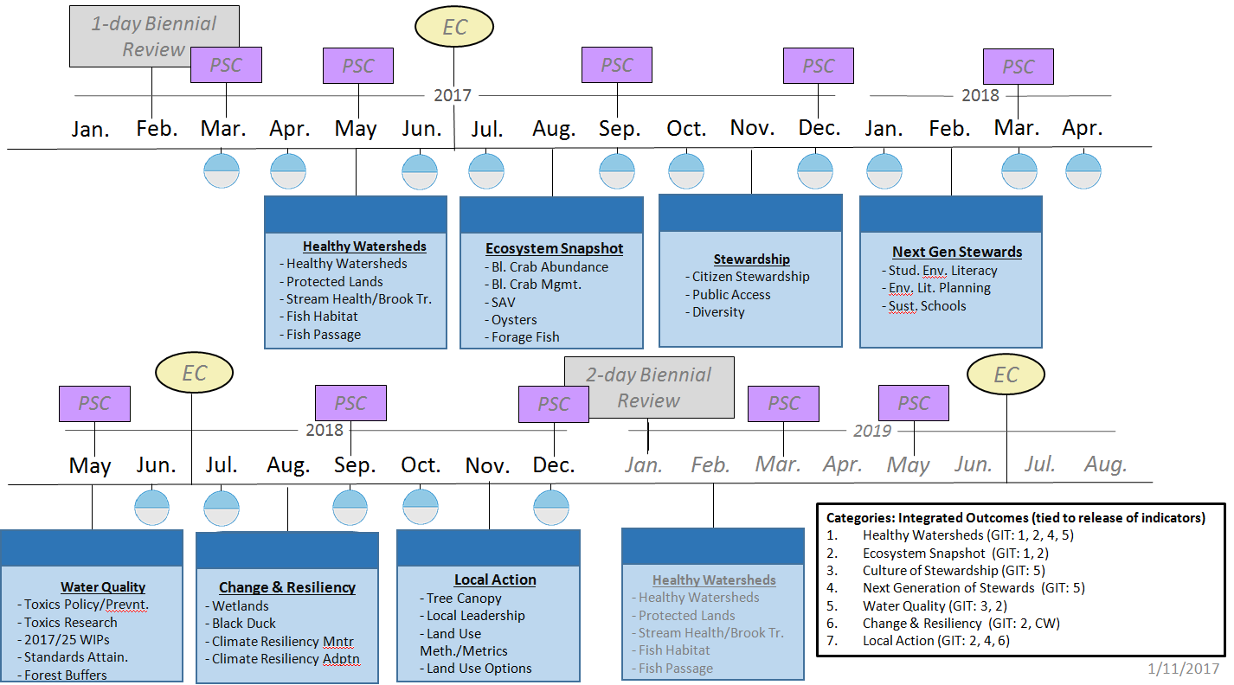
Biennial Strategy Review System Timeline

Slide 13
2017 CBP Priorities
Indicators Show….
Outcomes with Greatest Progress:
Protected Lands
Fish Passage
SAV
Outcomes with Greatest Challenges:
Forest Buffers
Wetlands
Diversity
Oysters
Outcomes with no indicators:
Citizen Stewardship
Local Leadership
Forage Fish
Healthy Watersheds
Others

Slide 14

Questions?
Nick DiPasquale
Director, Chesapeake Bay Program
dipasquale.nicholas@epa.gov

