Slide 1
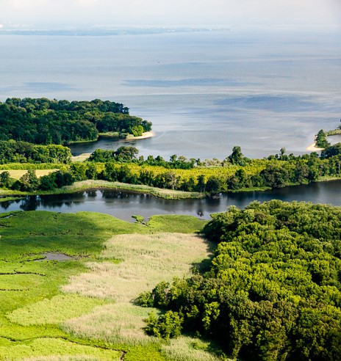

Planning for Clean Water- Stakeholder Assessment and Outreach Recommendations
Local Leadership Workgroup presentation
August 24, 2021
Photo credit: Chesapeake Bay Program

Slide 2
Objectives for This Presentation
Report on findings from the stakeholder assessment.
Share recommendations on how to proceed with training.
Obtain feedback and discussion from LLWG.
Determine next steps.

Slide 3
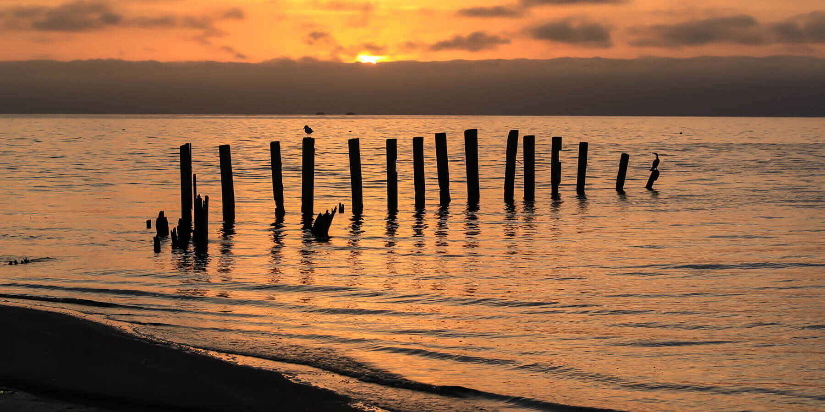
Purpose of the Assessment
Photo credit: Yvonne Navalaney/Shutterstock

Slide 4
How the Assessment was Conducted
Initial round of contacts from Steering Committee.
Second round based on recommendations from the first round.
Prompting questions used as a guide.
Drafted notes; shared notes with interviewees.
30+ interviews to date.

Slide 5
Major contacts
Local and Regional Planners
American Planning Association State Chapters in DE, NCAC, VA, PA, WVA and MD.
Association of State Floodplain Managers chapters in WVA and PA.
COGs and PDC’s in Washington, D.C.; MD, VA and WVA.
Individual planners and Planning Directors in DE, Washington, D.C., MD, VA, NY, and PA.
Organizations providing support to planners
Association of Counties, Townships, Boroughs in MD, PA, and VA.
Universities in DE and WVA.
VA Municipal League.
Upper Susquehanna Coalition.
WVA Hazard Mitigation and Disaster Recovery Working Group.
Notes:
Gaps still include the New York State APA. In general, DE, WVA and NY are not as represented.

Slide 6
Findings
Ten Major Themes
Water quality and hazard mitigation co-benefits.
Plan integration for resilience.
How Bay science might inform long-range planning.
How to leverage infrastructure funding to maximize environmental benefits.
Bay-wide recreation and open space preservation.
What do small towns need to know about the Bay program.
Planners talking points about the Bay.
Stormwater and wastewater management.
Smart Growth and the Bay.
The OneWater approach and how it benefits the Bay.

Slide 7
A Few Quotes……….
“ What’s the link between Bay crediting for stormwater management and hazard reduction? How do you fund flood mitigation and also get some crediting for water quality improvements?’
“We need to look at climate impacts and equity in the Bay watershed. There’s a need to ID vulnerable communities and be able to “bake in” how to address inequities into all planning documents.”
“So say we met the 2025 reduction goal: Now what? Comprehensive plans can go way beyond the target year. And we have more people moving here. So how do we live under the cap? “
“Continuing to grow commerce and economic development will be the chief investment concern among municipalities. How do we demonstrate the link between good water quality and economic development? How do we make the argument against sprawl?”
“Urban and town green spaces are important for reducing heat island effect. Aren’t there policies with the Bay program that encourage urban forestry?”
*

Slide 8
Recommendations (so far….)
Use existing venues
Offer CFM and AICP-CE credits
Put the local planners first in delivering content
Develop a curriculum around the major themes
Pick the key messaging
Provide “plug-and-play” rubric to develop the webinar content
Start with less controversial topics
Dove-tail a longer workshop with a scheduled conference
Just start

Slide 9
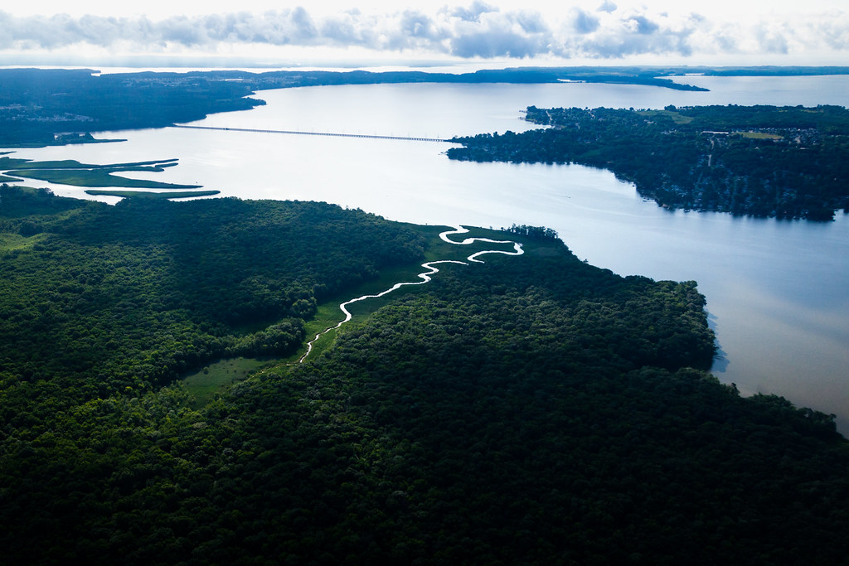
Next Steps?
Develop 3-minute orientation to the Bay
Develop Run of Show agendas
Cross-walk Bay agreement outcomes and assessment findings
Partner with the mid-Atlantic Planning Council
Partner on a half-day “deep dive” with a Chapter or Division of APA
Photo credit: Chesapeake Bay Program

