Slide 1
EPA Chesapeake Bay Program Update
Jim Edward
Deputy Director
EPA Chesapeake Bay Program Office
Citizens Advisory Committee Meeting
Cambridge, Maryland
November 16, 2016

Slide 2
EPA CBP Program Updates
2016 CBP Diversity Profile Results and Indicator
Environmental Finance Symposium Report Action Team
Joint State-Federal Strategy Ag Nutrients Strategy for Pennsylvania

Slide 3
Chesapeake Bay Program 2016 Diversity Profile: Results, Highlights and Next Steps
Chesapeake Bay Program Office and Alliance for the Chesapeake Bay

Slide 4
Diversity Management Strategy and Workplan
“Identify stakeholder groups that are not currently represented in the leadership, decision making and implementation of conservation and restoration activities, and create meaningful opportunities and programs to recruit and engage them in the partnership’s efforts.” – Diversity Outcome
“Explore the use of organizational demographic profile tools (e.g. Guidestar and D5) for the Bay Program jurisdictions, agencies, partners and other NGOs in the Bay watershed to report on diversity representation within their organizations.” – Diversity Management Strategy
“Establish a baseline of the level of diversity in the CBP (staff, boards, programs and initiatives aimed at increasing internal diversity).” – Diversity Workplan

Slide 5
Process and timeline
The Alliance for the Chesapeake Bay conducted the profiles on behalf of the Chesapeake Bay Program
The Program was sent to the Principal Staff Committee, Management Board, Advisory Committees, GITs, and workgroup members.
May: Develop simple survey monkey instrument
Mid July: Follow-up emails from CBP leadership
Fall 2016 Post results on CBP website – Press release and web story
Early June: Email from Al Todd to CBP membership
90 days to complete the profile
September 2016: Present results to Management Board
June 23, 2016
Profile Created via Survey Monkey

Slide 6

About the Diversity Profile
Generated simple online demographic profile tool
11 Simple questions
Voluntary and Anonymous
“Self-Identify” responses
Includes questions on leadership/management roles due to outcome language

Slide 7
11 Survey Questions
What type of organization do you currently work for?
Within your organization, what is your role? Please choose one.
Do you identify yourself as a member of CBP leadership? Choose one. If mulitple roles, please list in other.
How long have you been participating in the CBP organization?
What is your gender?
What is your age?
Which category(s) best describe you?
Do you identify as a member of the Lesbian, Gay, Bisexual, Transgender or Gender Nonconforming community?
Do you identify as a person who is disabled?
What Chesapeake watershed jurisdiction do you live in?
What Chesapeake watershed jurisdiction do you live in?

Slide 8
Summary and demographic responses highlights
Profile sent to approximately 750 CBP staff and partners
374 total respondents
49.8% response rate
Notes:
750 is an approximation*

Slide 9
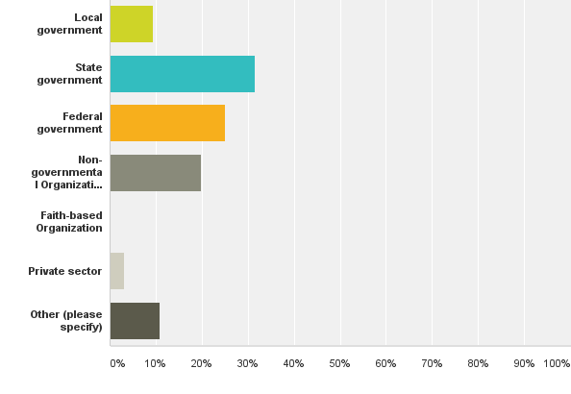
What type of organization do you currently work for?
9.4% (35)
31.5% (117)
Answered: 372 Skipped: 2
25% (93)
19.9% (74)
0.3% (1)
3.2% (12)
10.8% (40)

Slide 10
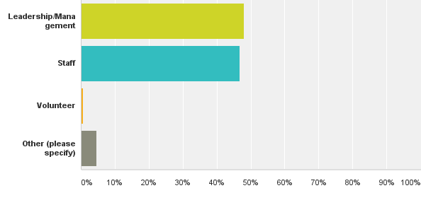
Within your organization, what is your role? Please choose one.
Answered: 366 Skipped: 8
48.1% (176)
46.7% (171)
0.6% (2)
4.6% (17)

Slide 11
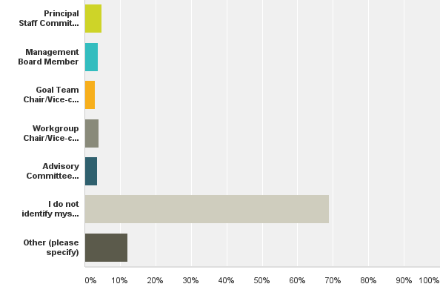
Do you identify yourself as a member of CBP leadership? Choose one. If multiple roles, please list in other.
4.8% (18)
3.8% (14)
Answered: 372 Skipped: 2
2.9% (11)
4% (15)
3.5% (13)
68.8% (256)
12.1% (45)

Slide 12
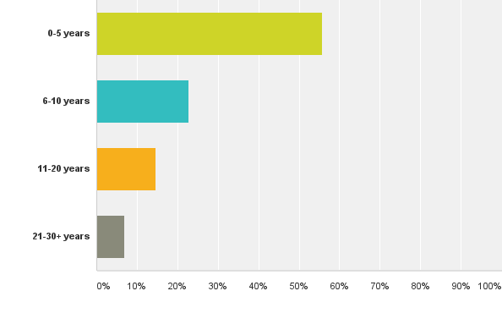
How long have you been participating in the CBP organization?
55.7% (207)
Answered: 372 Skipped: 2
22.9% (85)
14.5% (54)
7% (26)

Slide 13
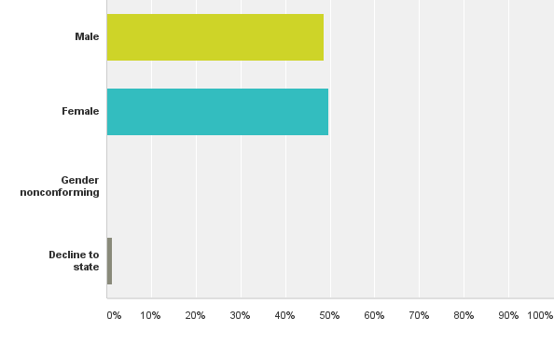
What is your gender?
48.7% (181)
Answered: 372 Skipped: 2
49.7% (185)
0.3% (1)
1.3% (5)

Slide 14
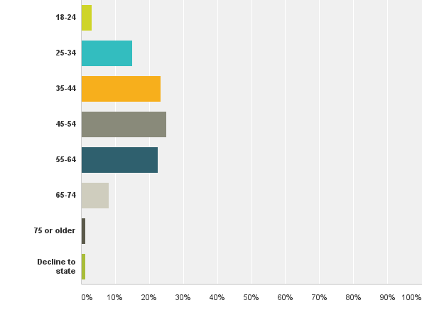
What is your age?
3% (12)
15.1% (56)
Answered: 372 Skipped: 2
23.4% (87)
25% (93)
22.6% (84)
8.1% (30)
1.3% (5)
1.3% (5)

Slide 15
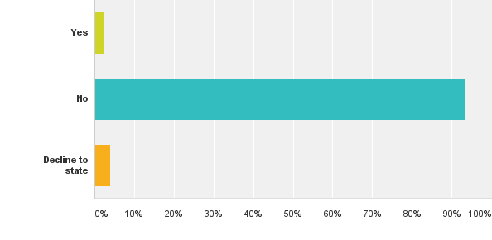
Do you identify as a member of the Lesbian, Gay, Bisexual, Transgender or Gender Nonconforming community?
Answered: 371 Skipped: 3
2.4% (9)
93.5% (347)
4% (15)

Slide 16
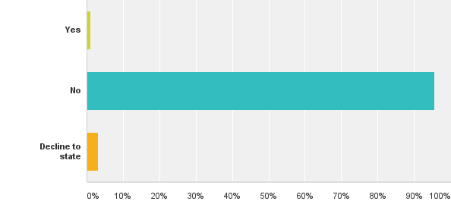
Do you identify as a person who is disabled?
Answered: 373 Skipped: 1
1.1% (4)
95.7% (357)
3.22% (12)

Slide 17
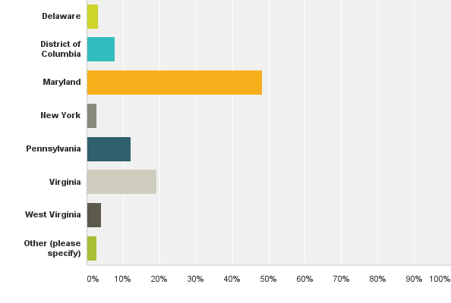
What Chesapeake watershed jurisdiction do you live in?
3.2% (12)
7.8% (29)
Answered: 373 Skipped: 1
48.3% (180)
2.7% (10)
12.1% (45)
19.3% (72)
4% (15)
2.7% (10)

Slide 18
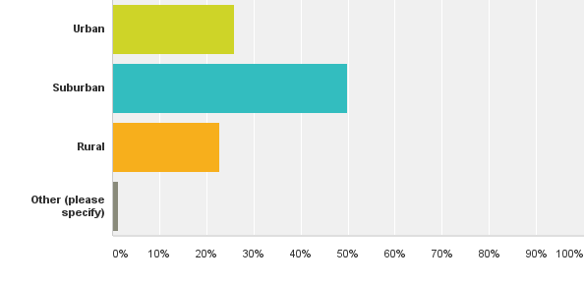
What landscape do you currently reside in?
Answered: 374 Skipped: 0
25.9% (97)
50% (187)
22.7% (85)
1.3% (5)

Slide 19
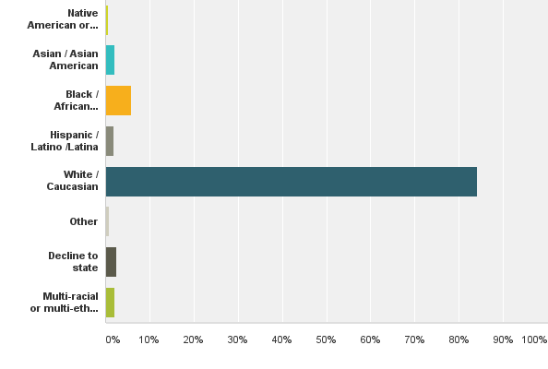
Which category(s) best describe you?
0.5% (2)
2.1% (8)
Answered: 373 Skipped: 1
5.9% (22)
1.9% (7)
84.2% (314)
0.8% (3)
2.4% (9)
2.1% (8)

Slide 20
Answer Choices | Responses (%) | Responses #
Native America or Alaskan Native | 0.54% | 2
Asian / Asian American | 2.14% | 8
Black / African American | 5.90% | 22
Hispanic / Latino / Latina | 1.88% | 7
White / Caucasian | 84.18% | 314
Other | 0.80% | 3
Decline to state | 2.41% | 9
Multi-racial or multi ethnic (please specify) | 2.14% | 8

Slide 21
Data Analysis
Initial focus on ethnic/racial diversity because from the results of the profile tool, it was identified as a major gap.
Analysis is preliminary
Will continue to consult with diversity workgroup, MB, STAR, indicators workgroup, Green 2.0, etc.
Notes:
we chose to focus on ethnic groups because Green 2.0 AND it was identified as a major gap as the result of this profile tool. Not just that we’re following what Green 2.0 is doing.

Slide 22
Approach for Data Analysis
CBP profiles revealed 50 non-caucasion respondents: 13.4%
Out of the 50 non-caucasions, only 12 held leadership positions: 3%
CBP profile further revealed 314 white/caucasion respondents: 84%
Out of the 314 white respondents, 100 identified themselves as CBP leadership: 31.8%
A preliminary analysis of the 50 non-white responses out of the 374 total responses follows
Notes:
After talking with Green 2.0, we thought it would be best to begin our focus with ethnic diversity

Slide 23
Preliminary data analysis of 50 non-white respondents
http://www.cpehr.com/blog-1/promoting-diversity-in-the-workplace

Slide 24
100 respondents: 27% of all 374 respondents, 32% of caucasion respondents

Slide 25
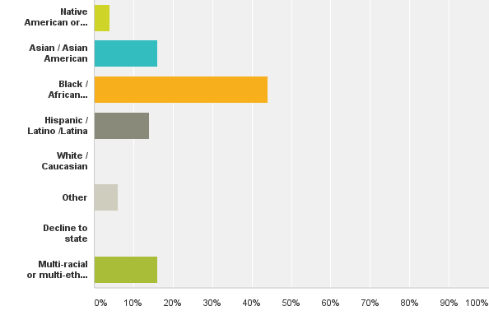
Which ethnic category(s) best describe you?
4% (2)
16% (8)
44% (22)
14% (7)
0% (0)
6% (3)
0% (0)
16% (8)

Slide 26
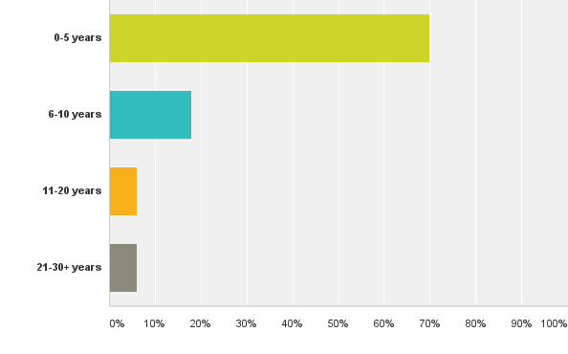
How long have you been participating in the CBP organization?
70% (35)
18% (9)
6% (3)
6% (3)

Slide 27
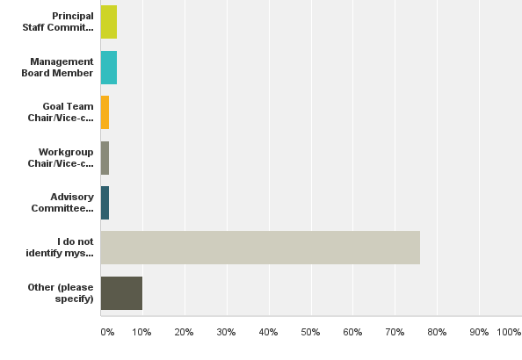
Do you identify yourself as a member of CBP leadership? Choose one. If multiple roles, please list in other.
4% (2)
4% (2)
2% (1)
2% (1)
2% (1)
76% (38)
10% (5)

Slide 28
Questions going forward
Have the terms used in the Outcome been appropriately defined? (Word to replace minority)
What pieces of information do we need to adaptively manage our work? What metric or information would be most meaningful to our workgroup?
Does the proposed indicator address the Diversity Outcome in the 2014 Chesapeake Bay Watershed Agreement?
Is the indicator long term, taking into account possible future changes? Can the Partnership show trends over time using this proposed indicator? (Retention, diversity among leadership, etc.)
Is there a threshold or reference value against which the proposed indicator can be compared, so that users can assess the significance of the values associated with it? (e.q. 36% of nationwide people of color caucus)
Once we decide on an indicator(s), do we want to set a specific Program diversity “goal” for 2025?

Slide 29
Key Challenges/Stressors in Setting an Indicator for the Diversity Outcome
Outcome: Identify stakeholder groups that are not currently represented in the leadership, decision making and implementation of conservation and restoration activities, and create meaningful opportunities and programs to recruit and engage them in the partnership’s efforts.
Key Challenges/Stressors that can impact indicator:
Inadequate communication and outreach present challenges
Lack of employment opportunities and professional engagement presents challenges
Lack of community-based organization capacity
Environmental justice issues
Lack of metrics and tracking tools

Slide 30
Potential Diversity Indicator Options
1. Set a specific 2025 goal for increasing overall diversity representation in the CBP. (currently 13.4%)
2. Set a specific 2025 goal for diversity representation in CBP leadership positions (currently 3%)
3. Track progress in achieving diversity representation compared to national and regional percentage thresholds and diversity representation in CBP leadership . (National 36%. CBW x ___%. ) (Preferred Option)
4. Set goals for both overall CBP diversity and diversity in CBP leadership.
5. Others?

Slide 31
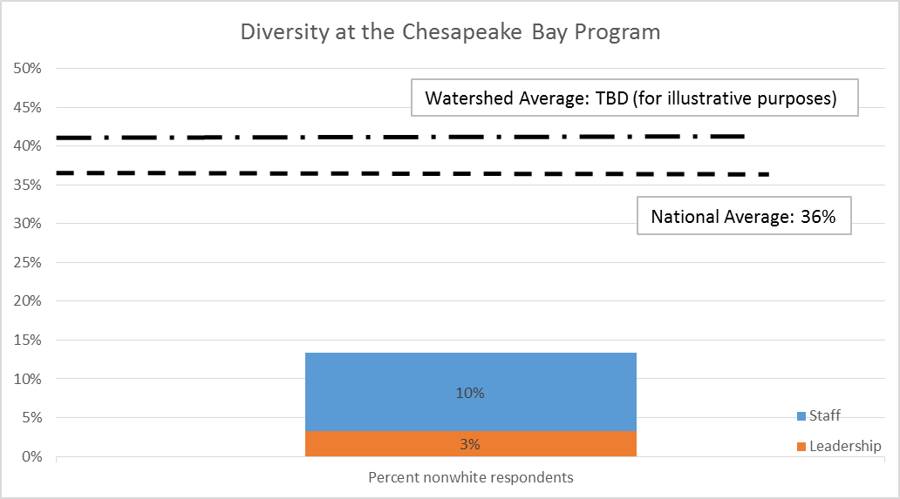

Slide 32
Next Steps
Make Diversity Profile results widely available – (December)
Establish Diversity Indicators for Bay Barometer and Chesapeake Progress (December)
Web Story on ChesapeakeBay.net (December)
Repeat Profile in 2018/2019 and every 2 years through 2025
In 2017, the diversity workgroup will reevaluate indicator and potentially propose a revised indicator with a goal target along with a 2025 goal.
Diversity workgroup may also propose additional indicators that measures diversity participation for partners outside of the Chesapeake Bay Program

Slide 33
Management Board Charge to Finance Symposium Report Action Team
The Management Board will convene an action team that will include the members of the GIT 6 Budget and Finance Workgroup and other interested partners to propose a “path forward” regarding the recommendation in the report and the issues raised at the symposium.
The action team will report to the Management Board by March 2017.
The Action Team will seek input on priorities from the PSC and consult with symposium attendees and others with financing and environmental market expertise.

Slide 34
The Action Team Charge
Draft a plan and a “path forward”/schedule for further analysis, studies, or other actions that may need to be taken by the CBP to address these recommendations over time. Present the draft plan at the March 2017 Management Board Meeting and at the Spring 2017 PSC Meeting.
Identify those recommendations that are most likely to benefit from a coordinated CBP partnership approach vs. those that may be best addressed through separate actions by individual jurisdictions, agencies or other partners.
Assess challenges of and opportunities to support selected recommendations, including, but not limited to, cost, workload, and resource implications.
Prioritize which recommendations should be acted on first so that other responses can build upon those actions as well as any that can be pursued simultaneously.

Slide 35
The Action Team Charge
5. Consider short-term vs. long term actions that may be taken to address each recommendation.
6. Identify work being done by the CBP, our partners, and in other regions of the country that may serve as models for others seeking to address recommendations.
7. Identify which Goal Team, workgroup or other partner within the CBP organization would take the lead in responding to recommendations. Also identify those actions that may require use of an external entity through use of a grant, contract or other vehicle.

Slide 36
Action Team Composition
Action Team Representatives are from:
Maryland (Chair: Jag Khuman MDE/MWQFA)
Virginia
Pennsylvania
District of Columbia
EPA
USDA
STAC
LGAC

Slide 37
A Joint State-Federal Strategy to Accelerate Nutrient Load Reductions in Pennsylvania's Chesapeake Bay Watershed
Announced @ October 2, 2016 Executive Council Meeting
See October 11, 2016 Joint Fact Sheet

Slide 38
Pennsylvania Chesapeake Bay Watershed Ag Funding Opportunities 2016 – 2017
Building Collaborative Approaches to Fund Nutrient Reduction Efforts
2016 Boost of State and Federal Funds
CEC Announcement
2016 Growing Greener 2
(Applications due 1/13/17)
FY18 RCPP
RFP Winter 2016
NFWF Chesapeake Bay
Stewardship Fund
RFP February 2017
PA*:
$4.3M priority practices
$1M to CDs for practices
$2.5M riparian forest buffers
$1.5M required plans
$2.5M ag easements
USDA*:
$8.1M priority practices & easements
$4.6M technical assistance
EPA*:
$3.2M priority practices
$1M market & ag-led efforts
Chesapeake Bay Watershed priority with additional funding above prior year.
$1M in special PA ag funding opportunity from EPA to solicit innovative market-based and ag-led efforts to reduce PA ag nutrient pollution (exploring matching contributions).*
$1M in special Chesapeake Bay TA funding from USDA.*
USDA and EPA to coordinate NFWF FY17 grant programs and NRCS Conservation Innovation Grants FY17 funding.*
* Announced at the October 4, 2016 Chesapeake Executive Council Meeting
Updated 11/14/2016

Slide 39

Questions?
Jim Edward - edward.james@epa.gov

