Slide 1


Slide 2
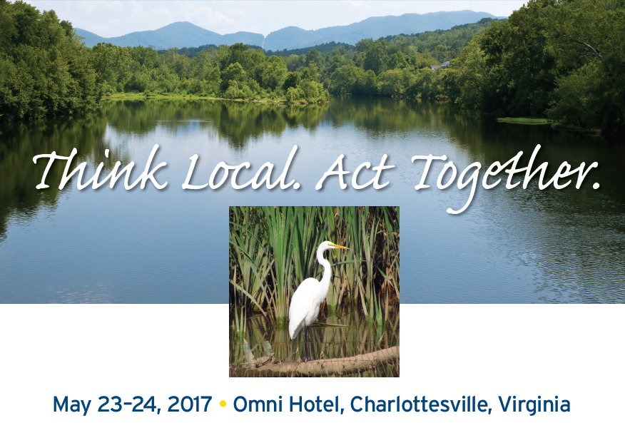

Slide 3
Conference Highlights
Chesapeake Bay Funders Network/Choose Clean Water Steering Committee Joint Meeting
Mustafa Ali – Hip Hop Caucus
Tracks: Equity, Collaboration, Communications, Agriculture, Stormwater
Plenary: TMDL/2017 Mid Point Assessment Update

Slide 4
Coalition Federal Update
FY2017 Final Funding
FY2018 Upcoming Funding
Reauthorization of the Farm Bill

Slide 5
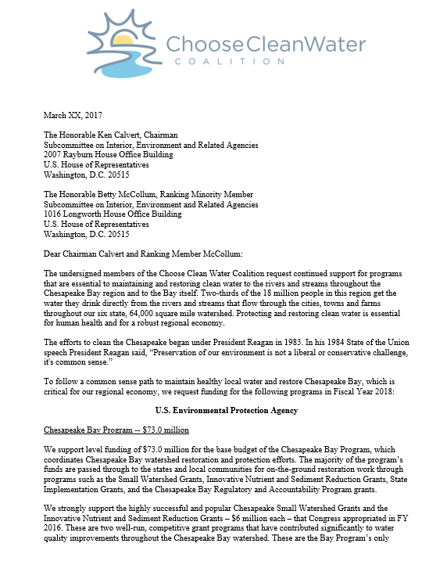
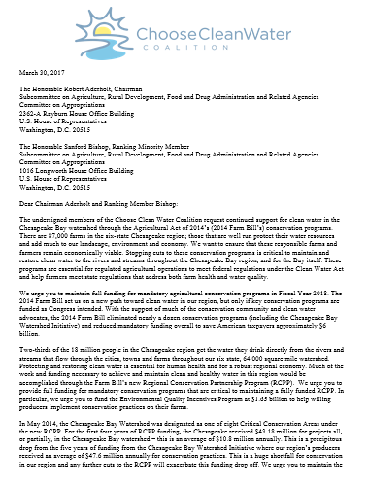
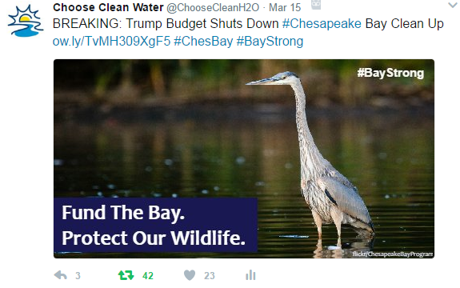
Supporting Materials
Chesapeake Bay Program Funding by State
District of Columbia | $2.8 million
Delaware | $2.9 million
Maryland | $10.8 million
New York | $2.9 million
Pennsylvania | S11.4 million
Virginia | S11.2 million
West Virginia | $3.6 million
Total | $45.6 million
Notes:
President’s Proposed Budget Response
Press release and supporting documents sent morning of
Provided suggested graphics, text and hashtag #BayStrong to Coalition
Coalition conducted six interviews on day of (one TV, two radio, three print).
Ongoing radio series with WYPR on projects in each state funded by CBP
Continuing to update communications tools for Coalition, including for Lobby Day

Slide 6
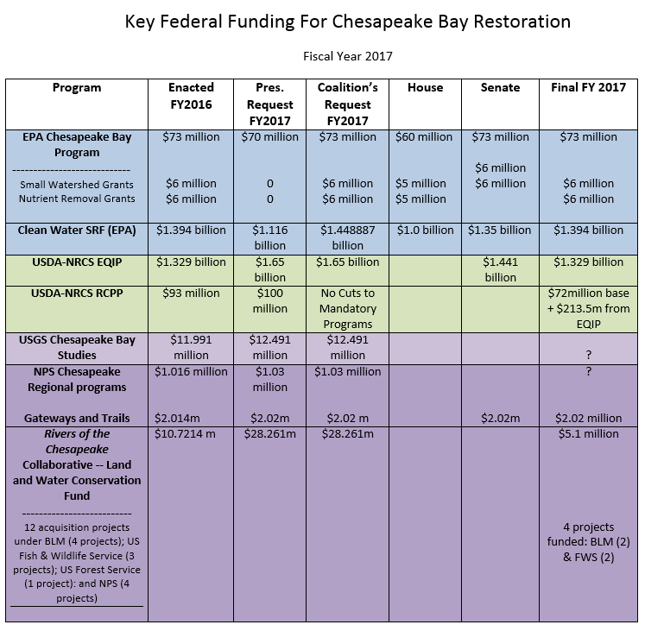

Slide 7
FY2018 Coalition Funding Strategy
Goal: to ensure level funding from FY2017
Focus on all 52 House and Senate members from the Chesapeake Bay watershed
Particular focus on ALL appropriators and members of the Interior Subcommittee

Slide 8
Who Are Our Targets?
Tier One:
House Appropriators
  Andy Harris (R-MD)
  Dutch Ruppersberger (D-MD)
  Matt Cartwright (D-PA)
  Charlie Dent (R-PA)
  Scott Taylor (R-VA)
  Evan Jenkins (R-WV)*
Senate Appropriators
  Chris Coons (D-DE)
  Chris Van Hollen (D-MD)*
  Shelley Moore Capito (R-WV)*
  Joe Manchin III (D-WV)
House “Leadership”
  Steny Hoyer (D-MD)
  Glenn “GT” Thompson (R-PA)
Senate “Leadership”
  Chuck Schumer (D-NY)
  Tom Carper (D-DE)
  Ben Cardin (D-MD)
*Members of the Interior
appropriations subcommittee

Slide 9
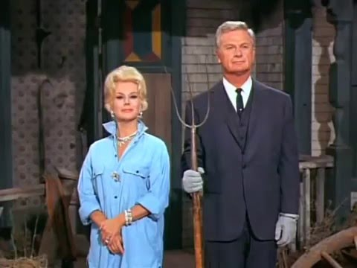
Farm Bill

Slide 10
Farm Bill Funding
Reauthorization of the Farm Bill
2008 Farm Bill – Chesapeake Bay Watershed Initiative
  $47.6 million annually for 5 years
2014 Farm Bill – Regional Conservation Partnership Program
  $10.8 million for the first 4years

Slide 11
Who are our Farm Bill targets?
Senate:
  Kirsten Gillibrand (D-NY)
  Bob Casey (D-PA)
  Chris Van Hollen (D-MD)
House:
  John Faso (R-NY)
  Glenn “GT” Thompson (R-PA)
  Lisa Blunt Rochester (D-DE)
  Bob Goodlatte (R-VA)

Slide 12
How do we do this?
Communications
  Rapid response
  Coordinated member communications
  “Our Water” Campaign
Federal Affairs
  Working with congressional allies and additional targets
  Appropriation request letters
  Year-long Hill visits
  Continuing to thank our federal officials through letters and our members
  Working with other geographic programs
Increase conservation funding from the RCPP section of the current Farm Bill ($10 million annually) to closer to 2008 Farm Bill annual amount of $47 million.

Slide 13
Upcoming
Strategic Planning
EC Meeting
Chesapeake Bay Awareness Week
2nd Annual Upper Susquehanna Watershed Forum
Diversity, Equity and Inclusion

