Slide 1
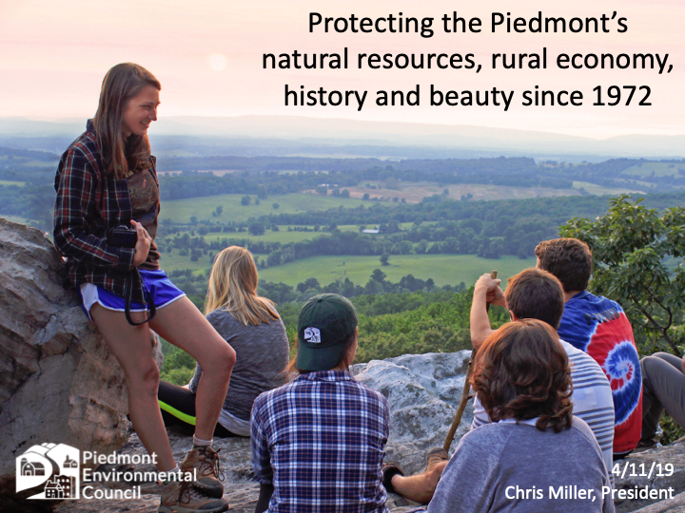

Slide 2
The PEC Service Area
9 Counties
Large
Small
Varied geography
Multiple watersheds
Varied habitat
Full range of communities:
Urban
Suburban
Exurban
Rural
Wilderness areas
Varied demographics
Loudoun
Charlottesville
Small towns and villages
Rural communities
Wide range of socio-economic conditions
  Zipcodes with high wealth
  Areas of underserved, economically disadvantaged
Politics reflects the full range of Virginia perspectives
Demographic Trends
Growth rate overall is higher than state, with Loudoun, Culpeper, Charlottesville/Albemarle experiencing high inmigration
Within region, majority of population has shifted from rural to urban/suburban; recent experience has been a surge in purchase of existing homes, new pressure for rezoning
Moving to greater diversity,

Slide 3
History and Culture
Upland areas with Monacan communities, a mixture of forest and savannah with abundant water flowing from springs, streams and rivers.
Large section of the Old Carolina Trail/Road, used by Iroquois nations for trading
Colonial settlement mostly in 18th and 19th centuries
Mix of plantation and small farms
Large percentage of population enslaved prior to Civil War
Many African American communities founded after Emancipation
Formation of the Shenandoah National Park by exercise of eminent domain impacted communities, attitudes towards conservation
Populations were largely stable from 1790 until 1950; post World War II/Cold War expansion of federal government in DMV has had profound impact, with growth rates ranging from 0.9 % annually to 3.0% since 1960.
The potential for even more dramatic growth spurred interest in growth management and conservation
In addition to the SNP. state used wildlife funds to create Thompson and Phelps Wildlife Management Area; Sky Meadow State Park donated to Virginia in 1975. Appalachian National Scenic Trail runs along Blue Ridge, including through SNP. Other publicalands have been donated to Virginia include WHitney State Forest, and the Bull Run Mountain Preserve
PEC founded in 1972 as a regional non governmental organization to coordinate community based planning and advocacy to promote and protect the communities, rural economy, natural resources, history and beauty of the Piedmont region
Focus in the 1970’s and 1980’s was on planning and policy. In 1981, Fauquier enacted rural zoning ordinance that substantially reduced by-right development potential in rural areas, focused growth and public infrastructure in Warrenton, the Plains, Marshall, and several service districts

Slide 4
Current Issues: Planning for next 20 years
Climate change impact on population migration, resiliency planning for increased precipitation/flooding
  PEC lead sponsor for Resilient Virginia Conference
  Partner with Resilient Virginia on Resiliency Assessment for Albemarle
  Developing Climate Action Plan recommendations for Albemarle
  Can we expand Albemarle pilot to other jurisdictions
Push for more equitable development policies and addressing environmental justice issues
  Access to affordable housing
  Access to land
  Access to safe drinking water, sewage treatment
  Siting issues
    Landfill
    Infrastructure
    Mines
  Focusing benefits of clean energy
Expansion of data centers and the internet economy
  Siting
  Water consumption
  Energy load
Clean energy generation and infrastructure, challenge of utility scale solar
Rural event centers, Agrotourism, Adult Beverages

Slide 5
Current Issues
Accelerating conservation and sustainable land management
  Focus areas:
    Upper Rappahannock Initiative
    Goose Creek
    Blue Ridge
    Piedmont Grasslands Bird Initiative
    Source water protection
  Expanding access to agricultural practices
    Education and outreach
    Increasing technical capacity
    Supporting federal, state, local and private funding and financing
  Layering conservation and practices
    Aggregation for stream restoration, wetland,nutrient, sediment, and carbon
    Fleetwood Farm
    Eldon Farm

Slide 6
Current Issues: Sustainable and resilient stream crossings
Reducing barriers in headwater streams
Brook Trout as indicator species
Pilots on crossing design
    Private
    VDOT
Incorporating habitat restoration
Incorporating public access
Going to scale

Slide 7
Current Issues: Sustainable food systems
Production
  Soil4Health Coalition
  Piedmont Grasslands Birds Initiative
  PEC Community Farm at Roundabout Meadows
  CASA, CCW, other regional coalitions
  ALE plans, resource management plans
Manufacturing, aggregation, distribution
  Goal: improving return on investment to local partners
  Buy Fresh Buy Local
  Gilberts Farm Market, farm market support
  Beef processing initiative
  Partner with 4PFoods
  Can we create regional brand tied to more sustainable practices?
Food security
  Farm to Food Pantry
  Support of federal, state policy to enable purchases from local producers
  PEC Community Farm, community farm network with regional food banks/food pantries

Slide 8
Current Issues: Improving public access to land and water
Pandemic surge in demand
Improving access at local, regional, and statewide scale
Local Level
  Neighborhood parks/recreation
  Tree canopy and safe streets
  Incorporating green space into community planning
  Trail planning
  Connecting water access to trails, transit
Regional/State
  Need more access generally
  Information, accommodations, and connections
  Access to rivers and streams
  Large landscape planning

Slide 9
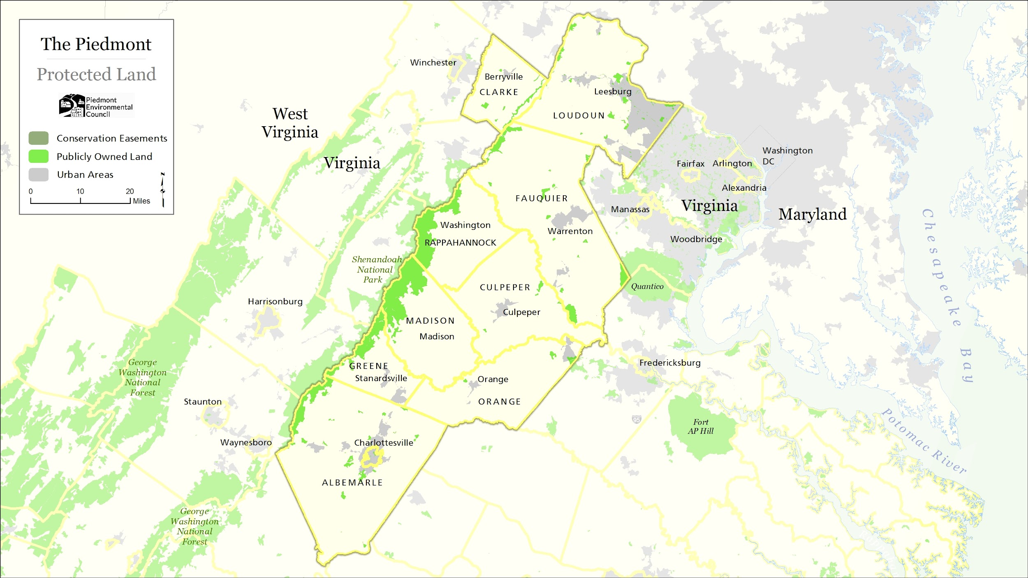
Notes:
Here is PEC’s region. Publicly owned land makes up only 6.5% of our service area of approximately 2 million acres in nine counties. This places the onus for wildlife conservation directly in the hands of private landowners.

Slide 10
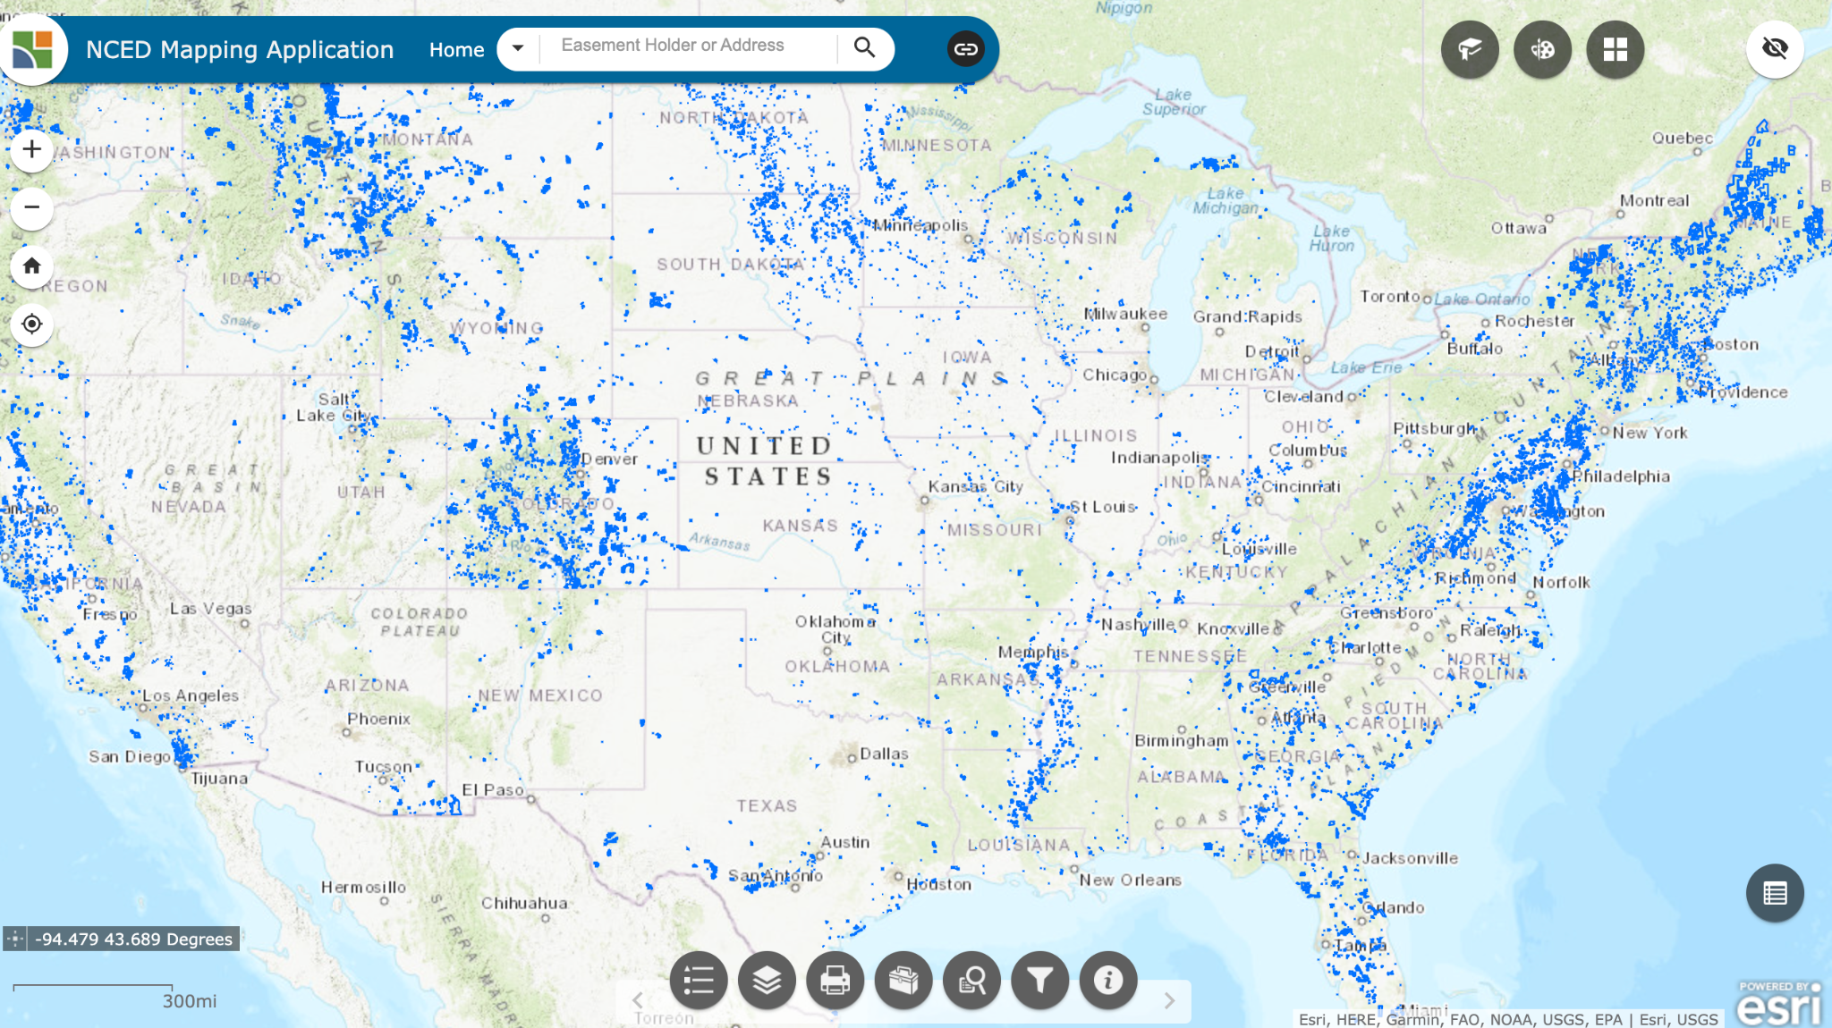
Notes:
In various places around the United States, especially east of the Mississippi, private lands conservation is very important. This map shows all conservation easements in the National Conservation Easement Database---notice the areas of concentration in Montana, Colorado, New England, but particularly in the MidAtlantic and Virginia

Slide 11
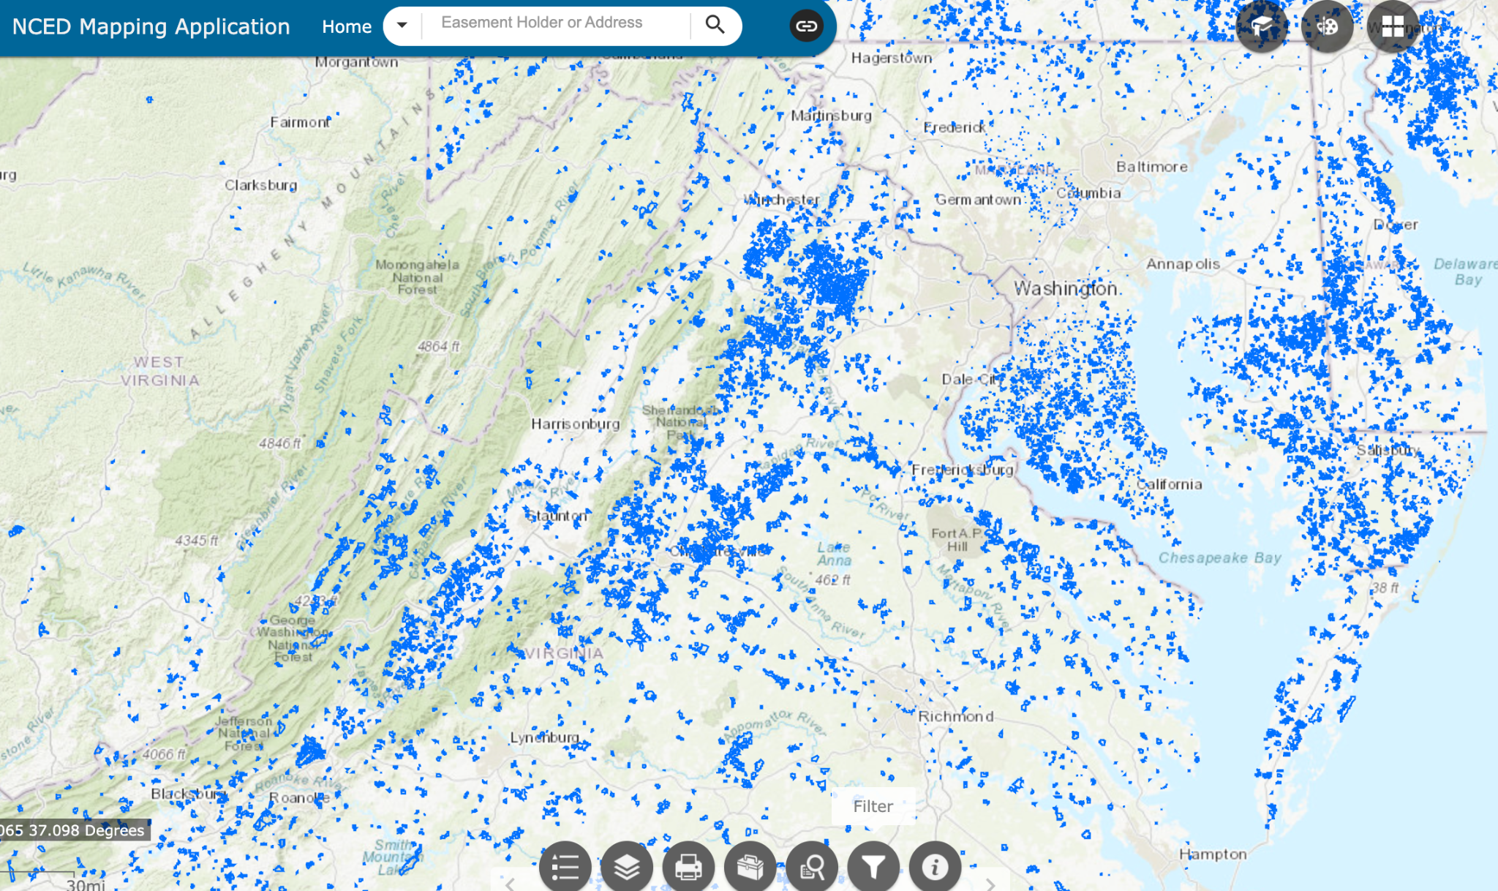
Shenandoah
National
Park
Notes:
Over the past 50 years, a broad partnership of public agencies and NGO’s such as PEC, the Shenandoah National Park Trust, and SCBI have encouraged private conservation and conservation easements. Thousands of families, including many who are watching this presentation, have donated conservation restrictions on their private land to protect pubic values and reduce future development.

Slide 12
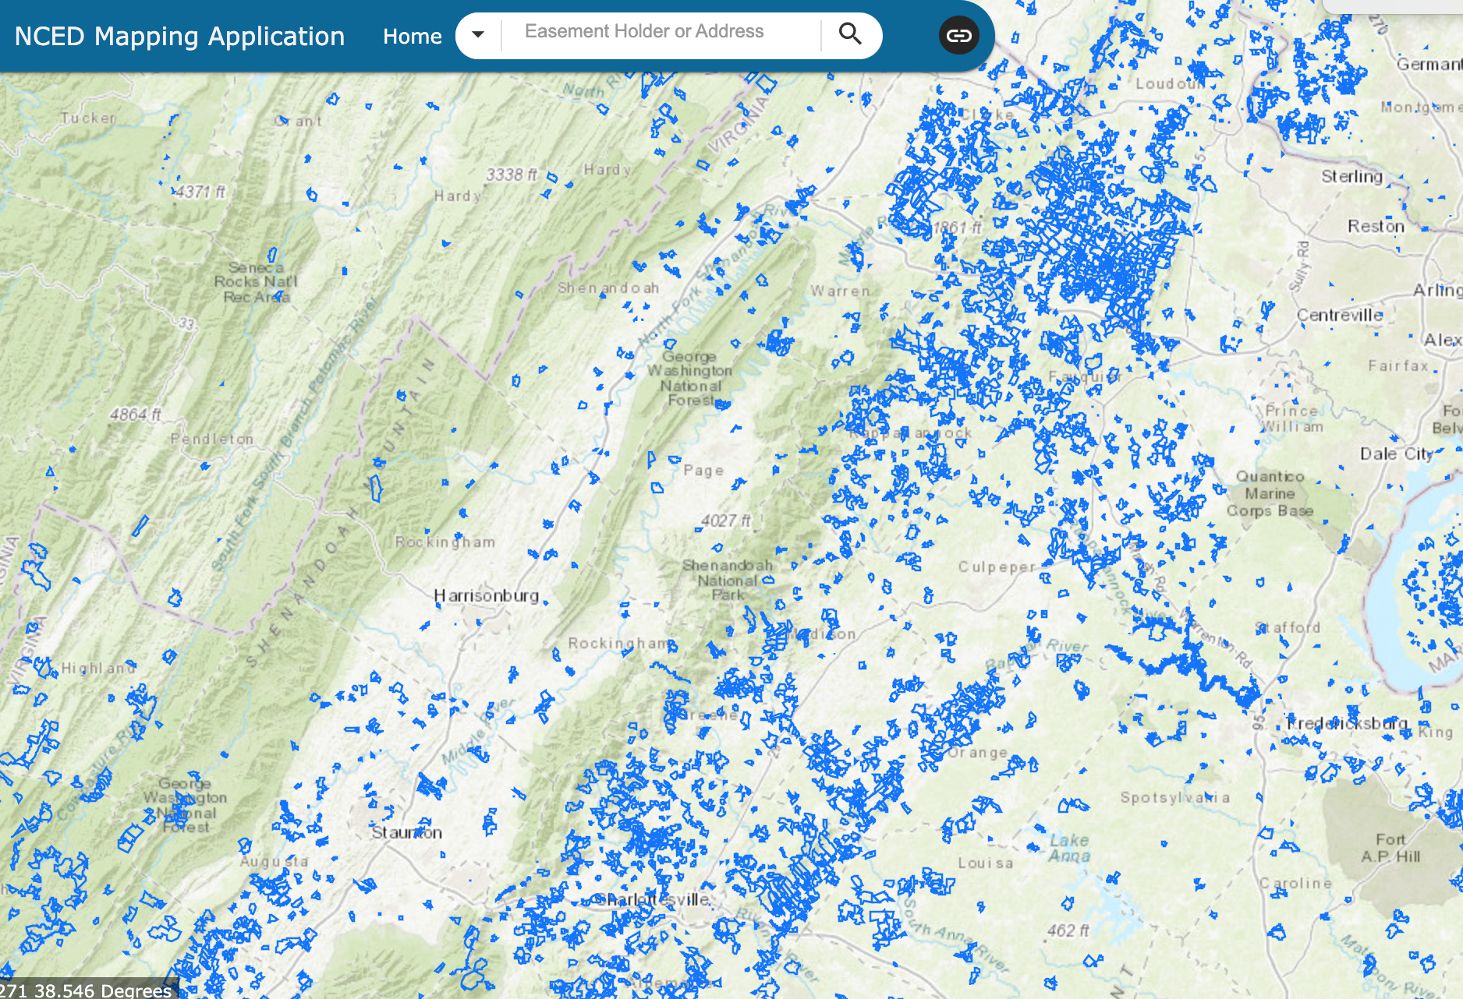
Shenandoah
National
Park
Notes:
This close up view highlights the areas of success and the areas where more effort is needed, such as in the fertile and biologically important Upper Rapphannock River watershed. What is encouraging is the connectivity of the easements and the potential to provide corridors along mountain ranges and river systems that link back to ecological cores in the Shenandoah National Park and the George Washington and Jefferson National Forests.

Slide 13
Fauquier County
Fauquier watersheds
Upper Potomac
  Goose Creek
  Bull Run
  Broad Run
  Cedar Run
Upper Rappahannock
  Thumb Run
  Carters Run
  Main stem
Fauquier County Planning and Policy
Comprehensive plan
Strong commitment to conservation of land
Policies to protect water supply, water quality needs to be strengthened

Slide 14
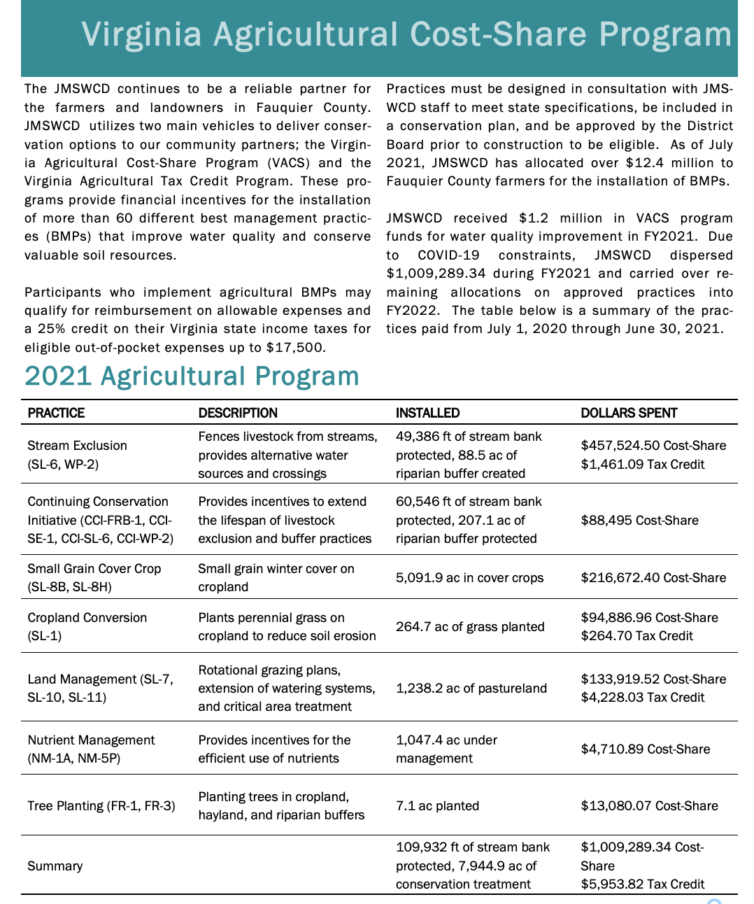
John Marshal Soil and Water Conservation District
2021 Agricultural Program

Slide 15
Cedar Run
Airlie Reservoir
260 MG storage capacity
Drainage area 3.53 square miles/ 1.14 MGD
Warrenton Reservoir
124 MG storage capacity
Drainage area 12.3 square miles/1.14 MGD

Slide 16
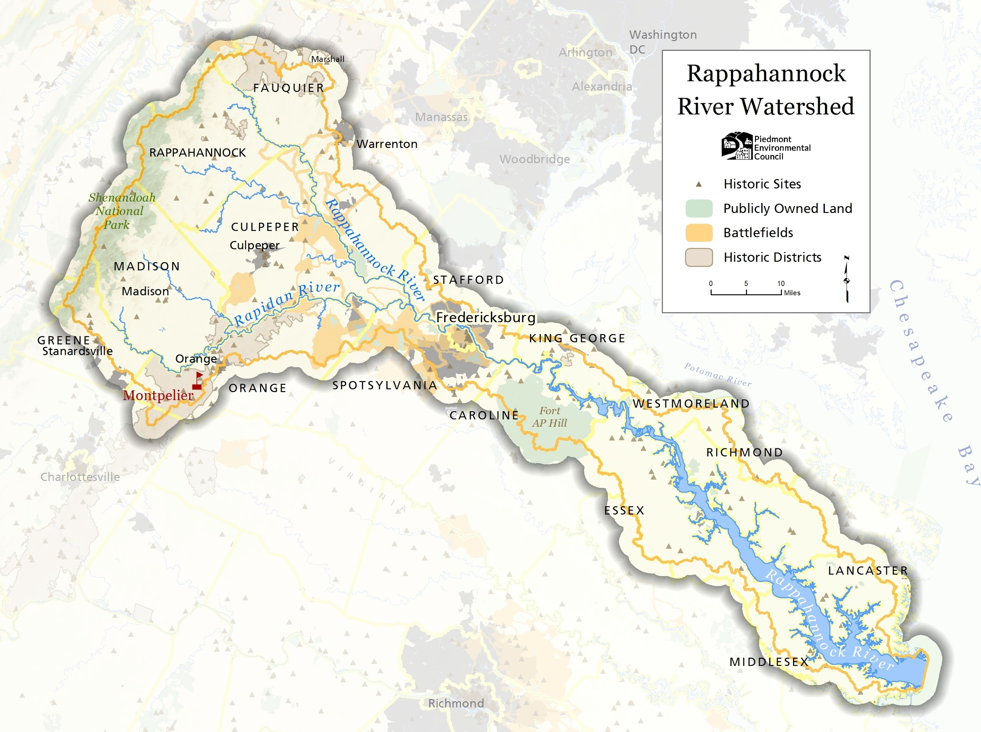
Notes:
Before we get started, I want to help frame the geography of this project. Headwaters Stream Initiative, or HSI as I’ll likely say over and over again, is located in the Upper Rappahannock River watershed. For the purposes of our project, we consider our area to include the confluence of the Rappahannock and Rapidan rivers at the tip of Culpeper County and everything upstream from there.

Slide 17
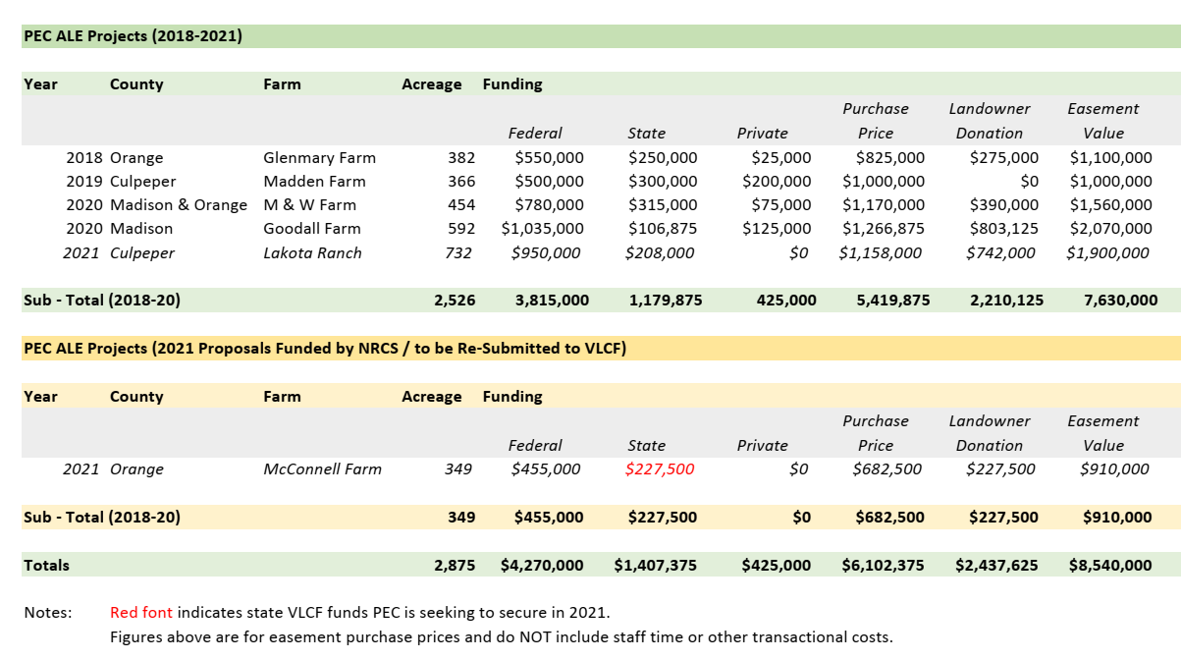
Volgenau Foundation: Leveraging Funding for Farmland Conservation in the Upper Rappahannock

Slide 18
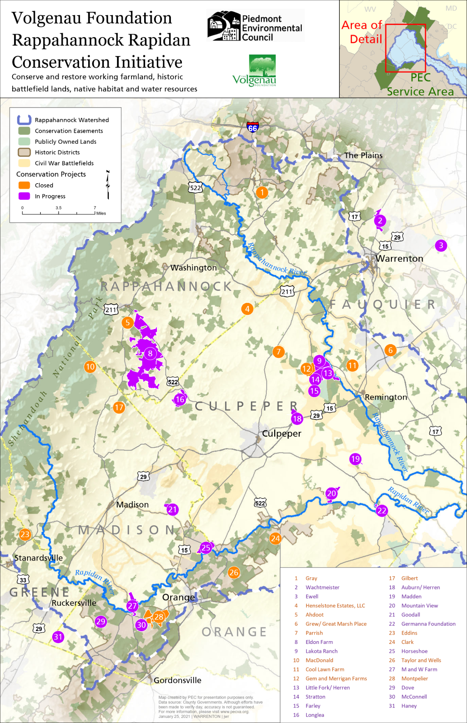
Volgenau Foundation
Rappahannock-Rapidan Conservation Initiative
The two grant objectives were:
Permanently protect 2,000 acres in the upper Rappahannock watershed with conservation easements
PEC has directly played a role in 13 conservation projects conserving over 2,800 acres in 2019-20.
Increase state and Federal conservation funding
$4.169 M during 2019-21 period

Slide 19
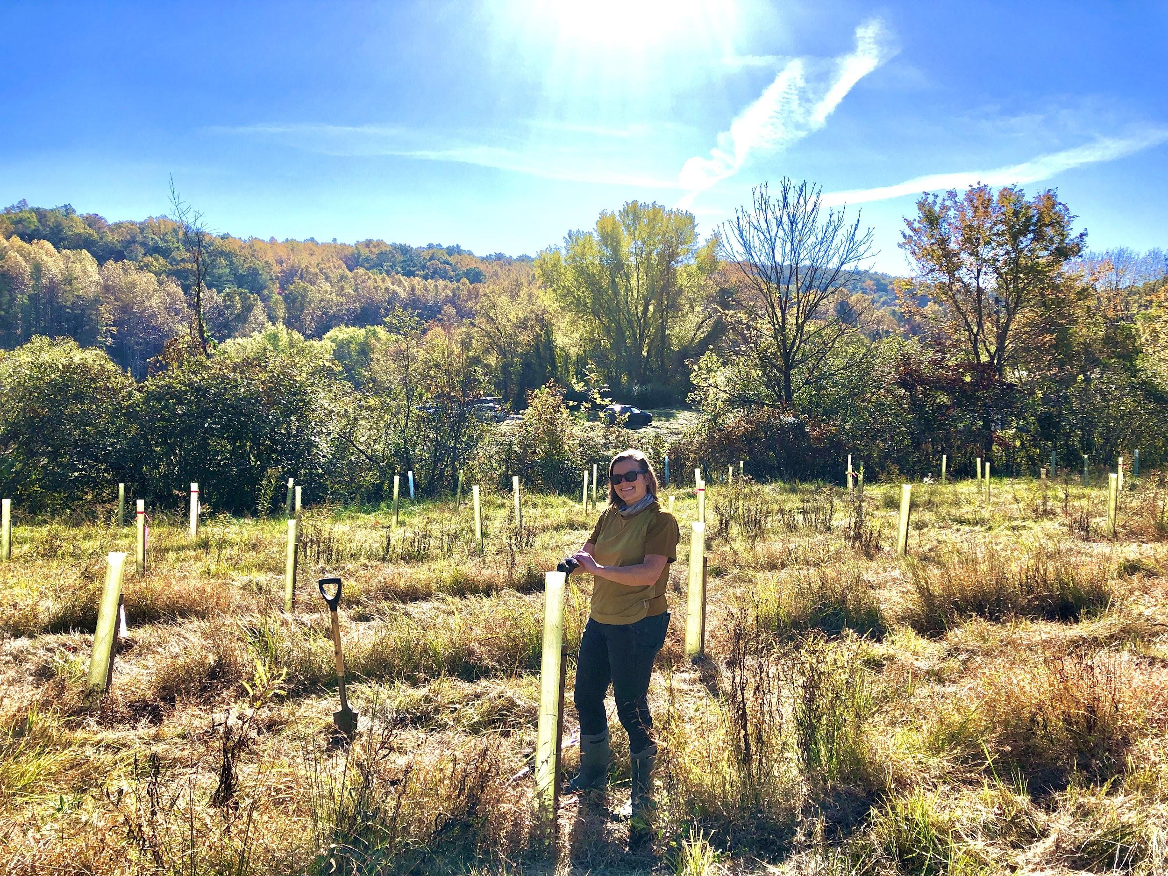
Headwaters Stream Initiative
A joint project of The Piedmont Environmental Council + Friends of the Rappahannock
Maggi Blomstrom
Rappahannock-Rapidan Conservation Initiative Coordinator
The Piedmont Environmental Council
Notes:
Hi folks - My name is Maggi Blomstrom, and I’m the Rappahannock-Rapidan Conservation Initiative Coordinator for the Piedmont Environmental Council
For the next 10 minutes, I’ll provide an overview of the Headwaters Stream Initiative, a joint project of The Piedmont Environmental Council and Friends of the Rappahannock

Slide 20
Overview
The Headwaters Stream Initiative is designed to provide FREE technical assistance, project design, materials, and labor for the planting of native trees and shrubs in riparian zones on qualifying properties in the headwater counties of the Rappahannock River Watershed including:
Rappahannock, Fauquier, Culpeper, Madison, Greene, and Orange Counties.
Notes:
The Headwaters Stream Initiative is designed to provide FREE technical assistance, project design, materials, and labor for the planting of native trees and shrubs in riparian zones on qualifying properties in the headwater counties of the Rappahannock River Watershed -- the area that I outlined on the map.

Slide 21
Overview
The Headwaters Stream Initiative is designed to provide FREE technical assistance, project design, materials, and labor for the planting of native trees and shrubs in riparian zones on qualifying properties in the headwater counties of the Rappahannock River Watershed including:
Rappahannock, Fauquier, Culpeper, Madison, Greene, and Orange Counties.
Partners who make this possible:
John Marshall Soil & Water Conservation District (SWCD) PEC’s Krebser Fund for Rappahannock County
Culpeper SWCD Foundations + donors
Loudoun SWCD Willing + interested landowners
Natural Resources Conservation Service (NRCS) Friends of the Rappahannock
Virginia Department of Forestry (DOF) The Piedmont Environmental Council
Old Rag Master Naturalists Local High Schools
Goose Creek Association Trout Unlimited
Notes:
This initiative goes far beyond PEC and FOR, and it truly is only made possible by all of the partners in our region collaborating toward a common goal of water quality improvement.
This includes multiple Soil and Water Conservation Districts, NRCS, Department of Forestry, Master Naturalists, environmental non-profits, foundations and donors, local schools, and most importantly -- willing and interested landowners.

Slide 22
Problems to solve
From a landowner’s perspective: So many programs available but they (a) don’t know where to start, (b) don’t know if/how they compliment each other, and (c) often drop off the radar.
From a land trust perspective: Encouraging enhanced stewardship through restrictive easement terms and (at the best of times) providing basic info about available cost-share but little time for hand-holding/follow-up.
1
3
2
From a technical service provider perspective: Generally speaking there are lots of funded programs but (a) it’s first come, first serve, (b) overwhelming workload leads to less availability to hand-hold, (c) not all properties qualify despite having a need.
4
From a conservation funder’s perspective: Wants to see significant increase in water quality protections through on the ground projects in a relatively short period of time but often wants to see available public $$ sources utilized first (cost-share).
Notes:
HSI started around 2015/2016 as a way to address some problems that we were encountering:
From a landowner’s perspective: There’s generally a base knowledge that programs could be available to meet their conservation need, but they don’t know where to start; don’t know that multiple organizations might be able to compliment each other with layered practices; and their time is limited and often times it drops off their radar without immediate follow-up from a technical service provider.
From the technical service provider perspective: There generally is consistent and robust funding for practices, but the workload is immense -- which doesn’t leave a lot of time for hand-holding and follow-up with interested landowners when they go dormant, and not all properties qualify despite having a need.
From a land trust perspective: We encourage enhanced stewardship through easement terms and if we’re well versed, we provide basic information about available cost-share but there’s little time for follow-up.
From a funder’s perspective: Seem to want to see shovel-ready projects that will significantly increase water quality protections that have a measurable impact to the Bay Model -- but want to see other sources of funding used first

Slide 23
Solution(s)
consistent, productive, (mostly) really fun, and unrelenting collaboration:
shared expertise, increased openness + communication, creative thinking + conservation finance and dedicated hand-holding in order to
ease the burden on a landowner to navigate the system, reduce replication,
save time + resources, and get more projects on the ground
Let’s get into some quick examples . . .
Notes:
HSI has worked to address these problems by:
consistent, productive, (mostly) really fun, and unrelenting collaboration:
shared expertise, increased openness + communication, creative thinking + conservation finance and dedicated hand-holding in order to
ease the burden on a landowner to navigate the system, reduce replication,
save time + resources, and get more projects on the ground
I want to share two examples to illustrate the variety of HSI projects. Bryan Hofmann, Deputy Director of Friends of the Rappahannock, will help kick us off on our first example.

Slide 24
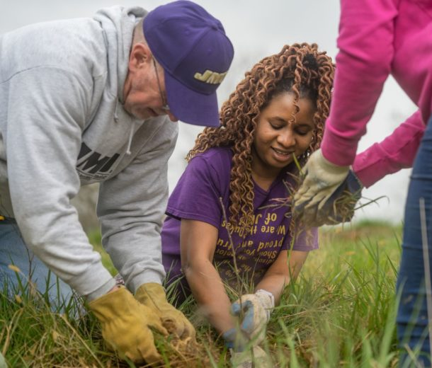
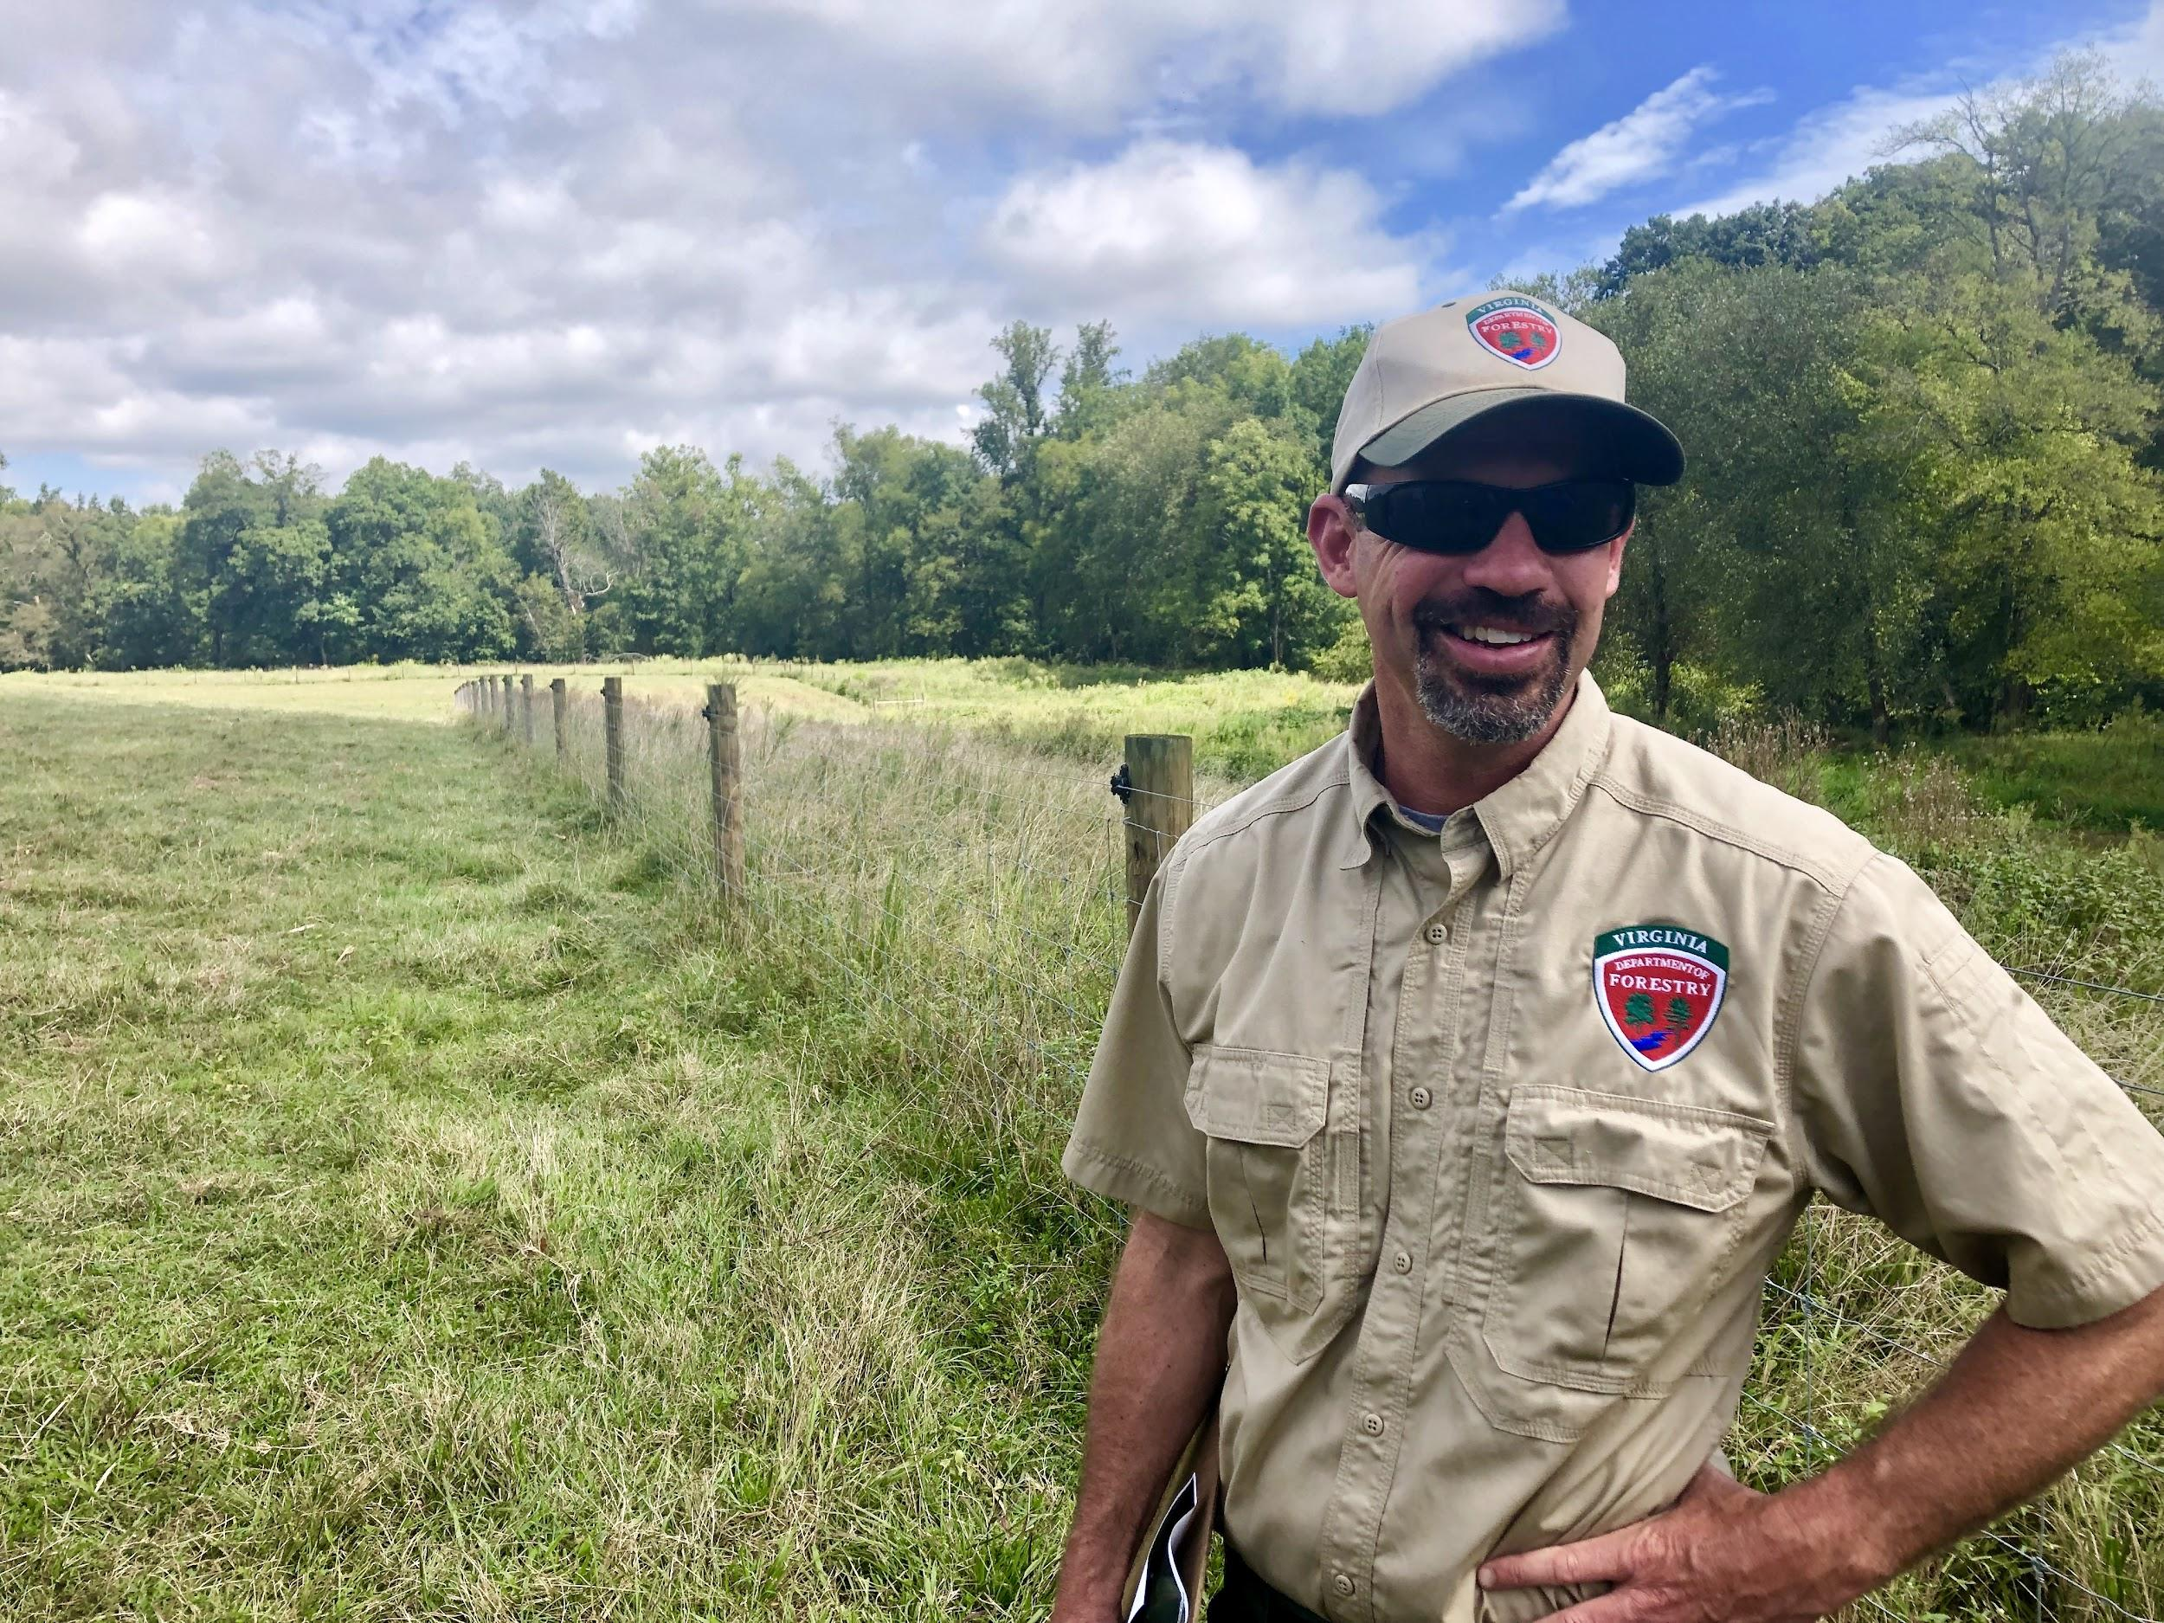
Robinson River Property
Madison County
Multiple SL-6 practices (over 25 acres of buffer protected)
Multiple FR-1 and FR-3 practices (over 21 acres planted and more planned in fall 2021)
HSI cost-share for tree plantings
DOF riparian planting plan and forest stewardship plan
NRCS Agricultural Land Easement awarded (500+ acres and 2 miles of rivers/streams protected)
EQIP application submitted for 2+ acres of wildlife habitat
0% interest agricultural bmp loan from FOR
Over 300 students from five schools helped plant trees, sample water quality, and participate in “meaningful watershed education experiences” (MWEE)
Landowner and JMU students planting trees
Jack Kauffman, DOF writing a planting plan in the new fenced out buffer

Slide 25
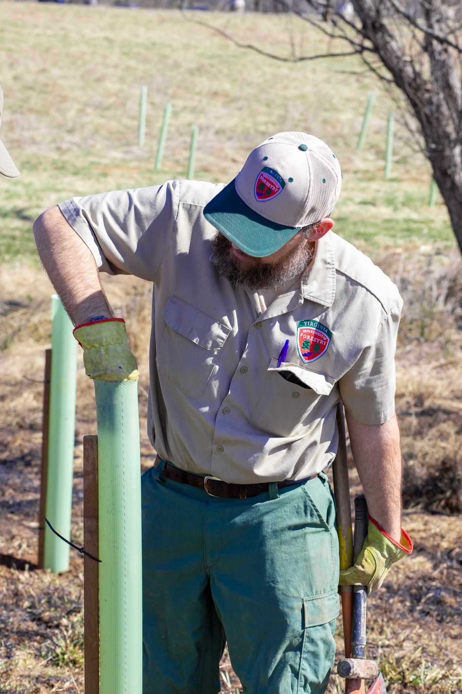
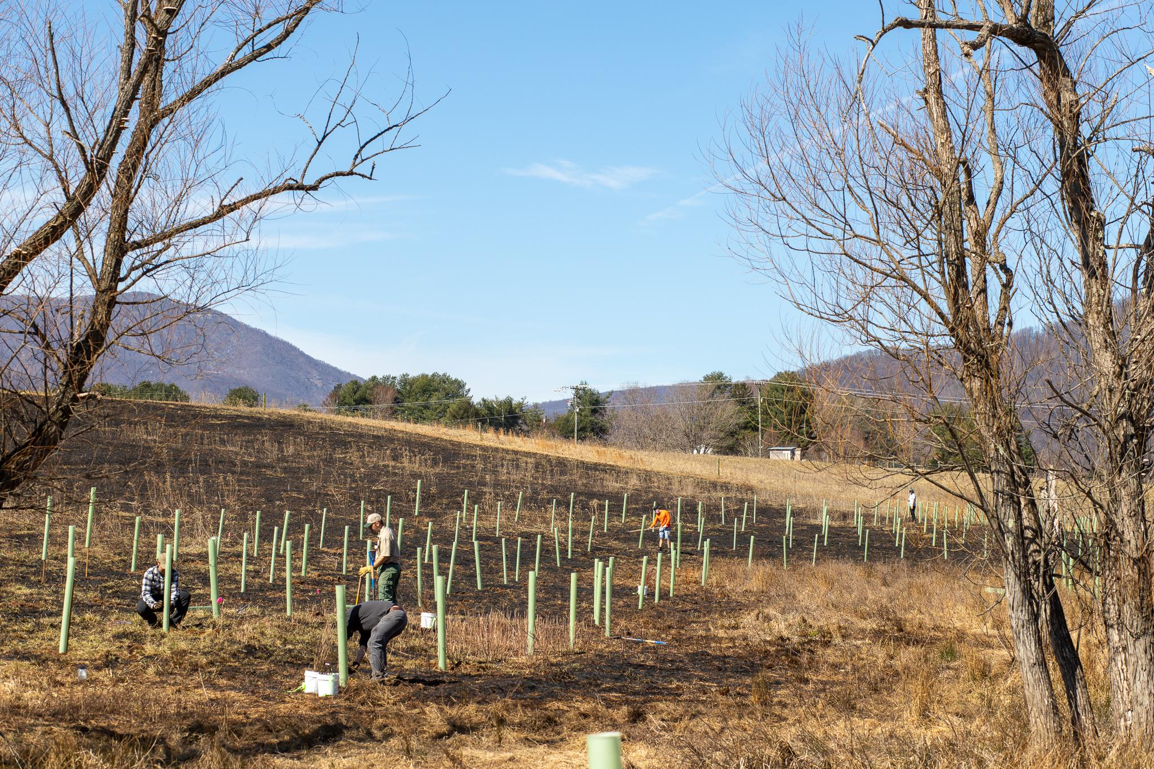
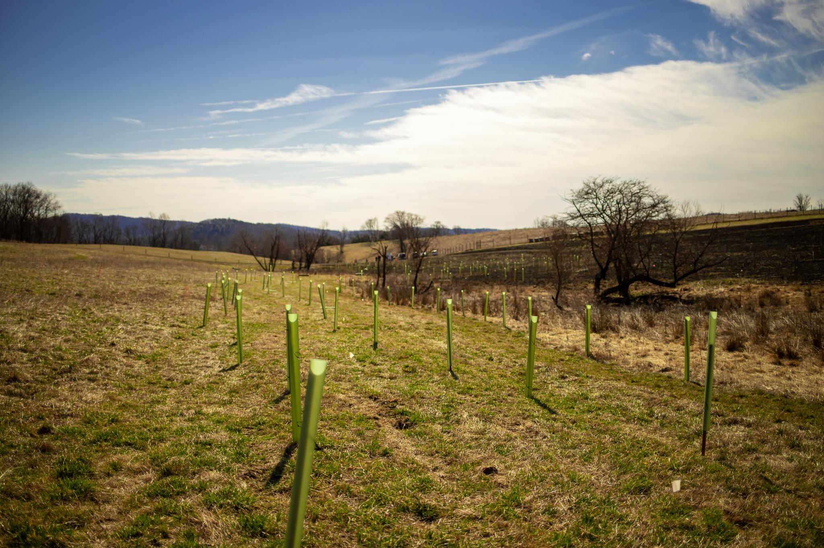
Pen Druid
Rappahannock Co.
Subwatershed: Thornton River
Project size: 2.5 acres
Cost-share: No
Trees planted: 750
Partners: Landowners, volunteers, DOF, FOR, PEC, funders
Next steps: (1) Trail extension from town of Sperryville which is open for visitors; (2) Chemical-free, native wildflower meadow where prescribed burn; (3) Markers throughout planting areas identifying natives
Joe Rosetti, DOF, helping us out!

Slide 26
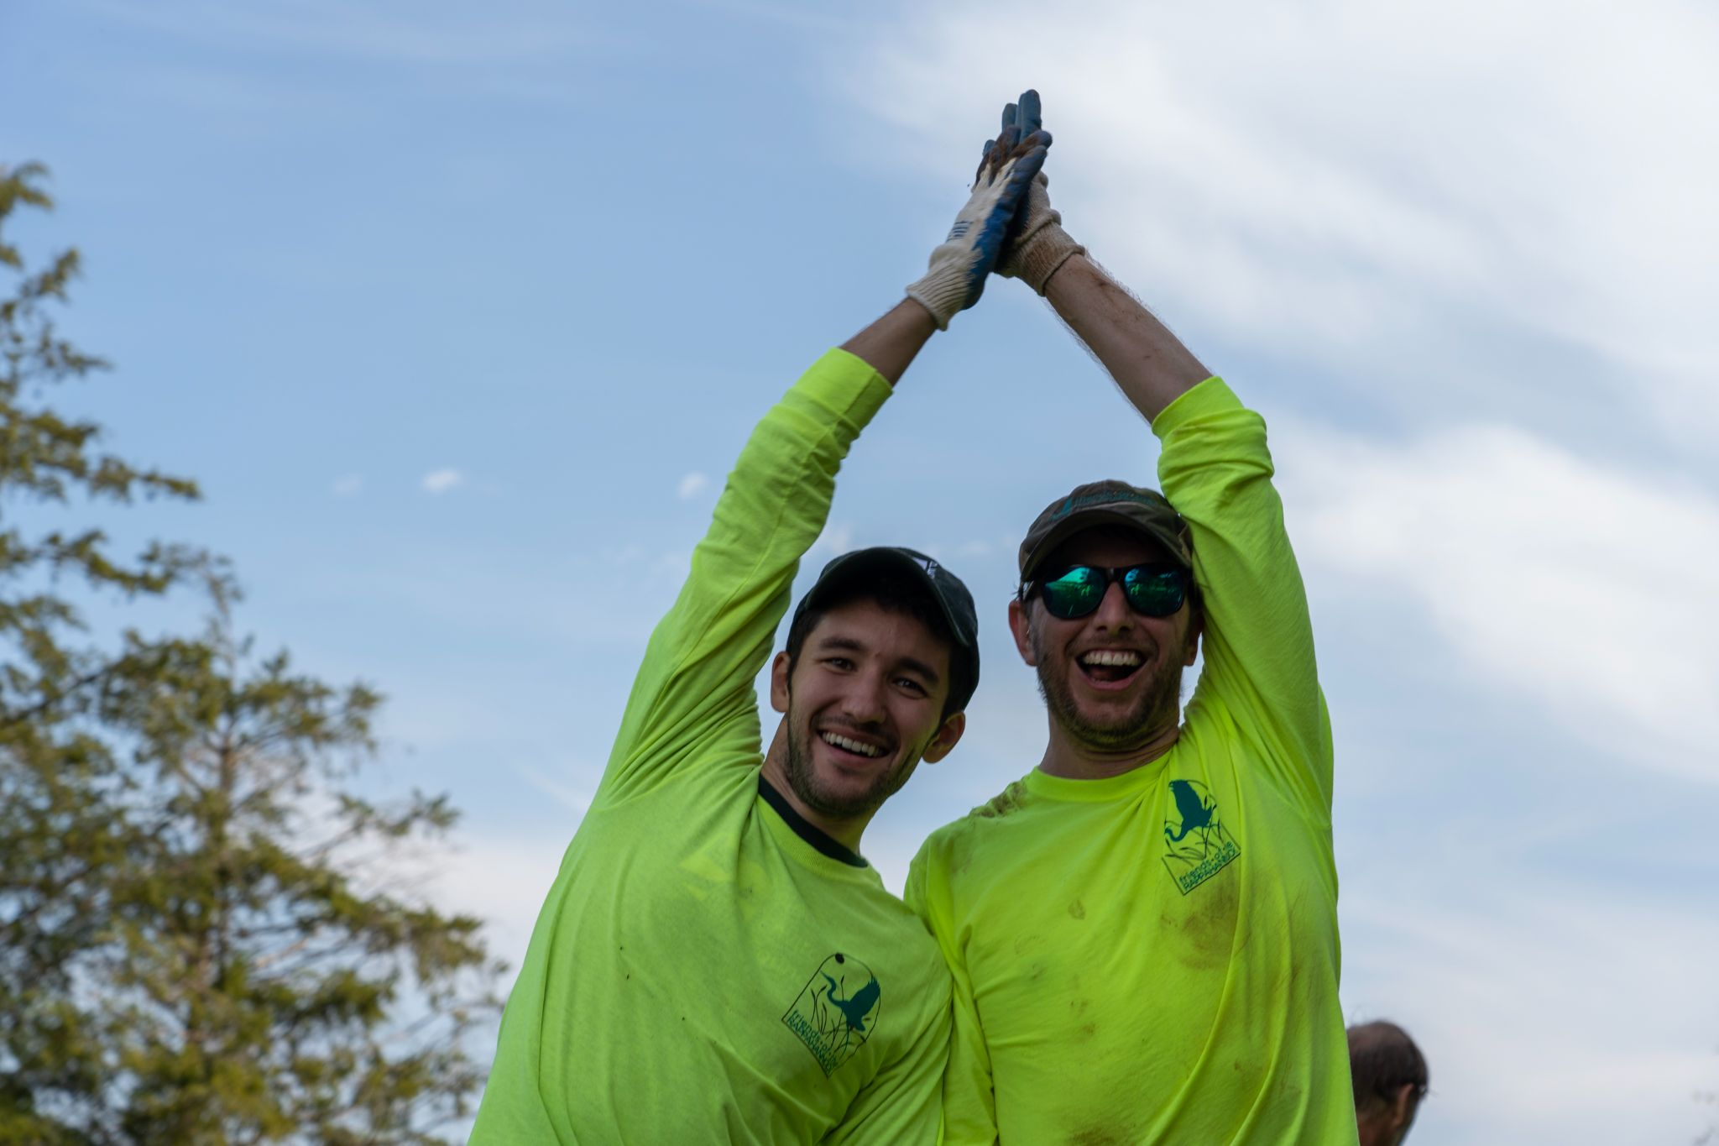
Projects by the numbers
Since 2016, over 55 projects
Year 1: 3 projects total
Year 5: 28 projects (and counting)
135+ acres with NRCS, SWCD, DOF, and private cost-share for landowners
Approximately $400,000 invested by all parties (assuming a per tree cost)
Marco Sanchez (PEC) + Bryan Hofmann (FOR) having a good ol’ time at a tree planting

Slide 27
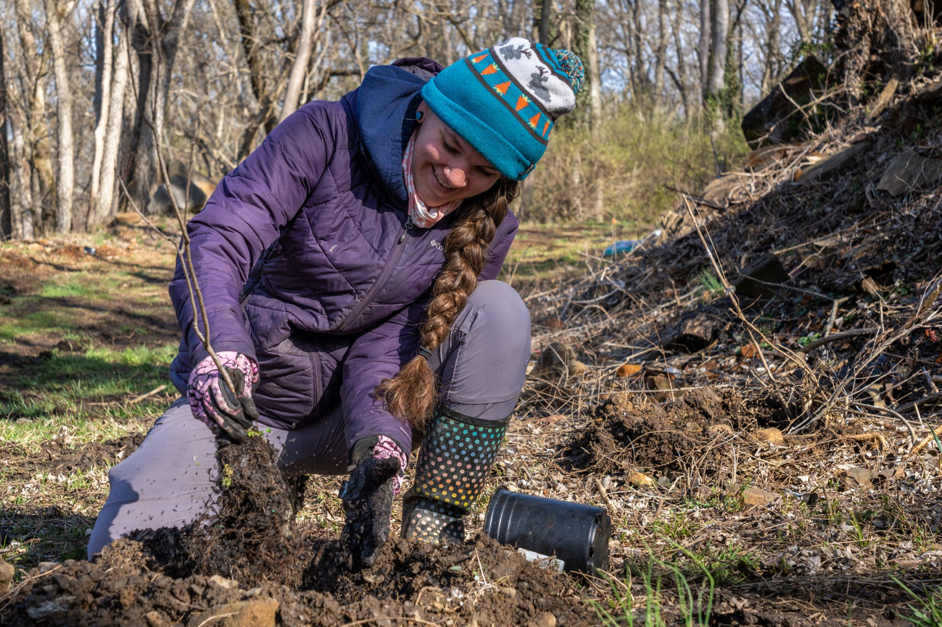
Wrap up: where are we + what’s next
Established experience and trust with landowners, technical service providers, and funders. We deliver.
Project collaboration: HSI sending shovel-ready projects to NRCS+SWCDs and they are sending projects to HSI
Increased demand: Fall 2021 planting season docket already oversubscribed
Replication of awesome projects: How to layer water quality + conservation practices year after year?
Continual listening + adaptation to needs: Incorporating landowner interests (hunting, silvopasture, grassland bird habitat); gap financing; 0% interest revolving loan programs
Consistent $upport: How to keep program funded year after year.
October Greenfield, FOR Upper Rappahannock River Steward, planting trees with partners at Rector Tract in Fauquier County -- a county park with soon-to-come canoe/kayak access to the Rappahannock River
Notes:
Established experience and trust with landowners, technical service providers, and funders. We deliver.
Project collaboration: HSI sending shovel-ready projects to NRCS+SWCDs and they are sending projects to HSI
Increased demand: Fall 2021 planting season docket already oversubscribed
Replication of awesome projects: How to layer water quality + conservation practices year after year? How to get to that “gold standard” as seen in the Robinson River project.
Continual listening + adaptation to needs: Incorporating landowner interests (hunting, silvopasture, grassland bird habitat); gap financing; 0% interest revolving loan programs
Consistent $upport: How to keep program funded year after year.
Thank you!

